Slide 1
hello

Slide 2
hello

Slide 3
hello

Slide 4
hello

Slide 5
hello

Slide 6
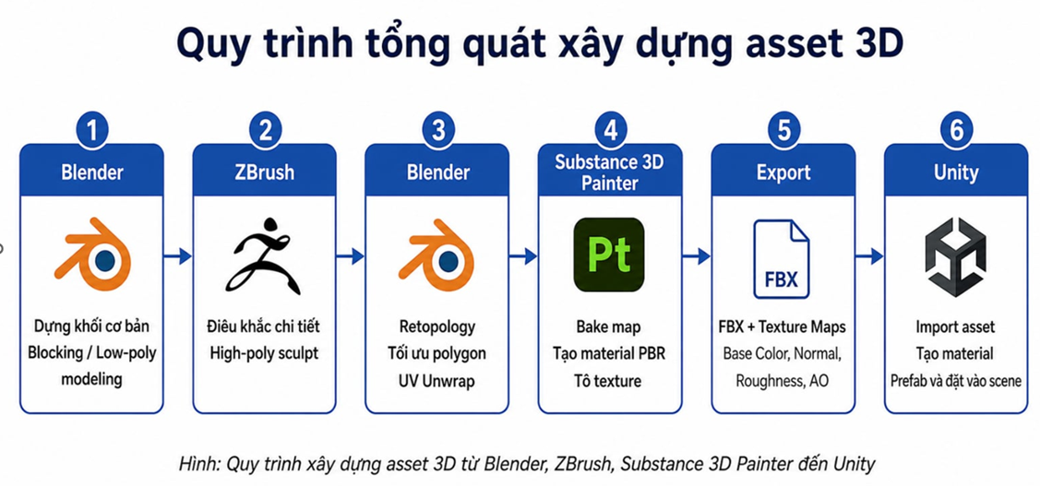
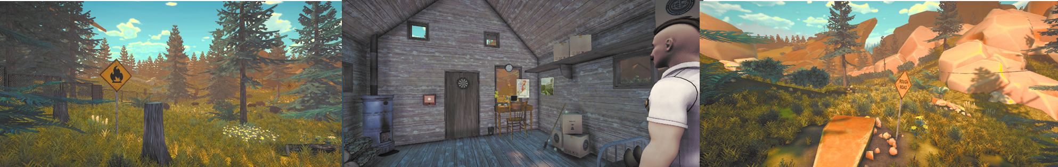
hello

Slide 7
hello

Slide 8
hello

Slide 9
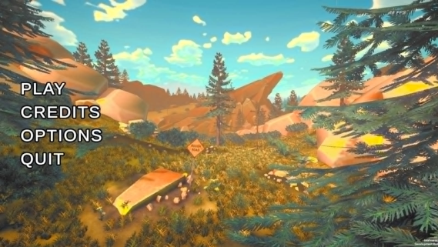
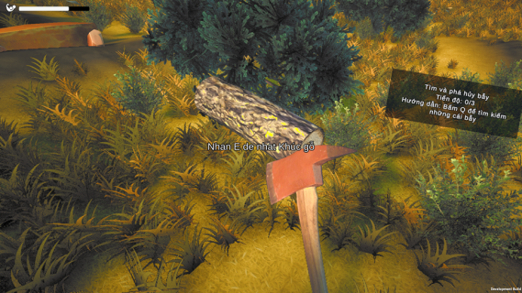
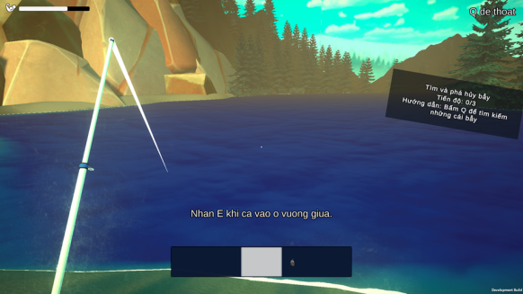
hello

Slide 10
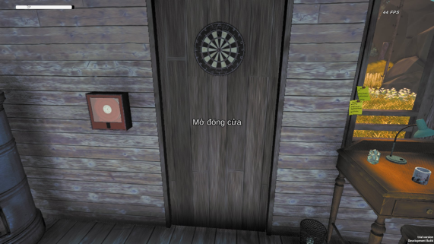
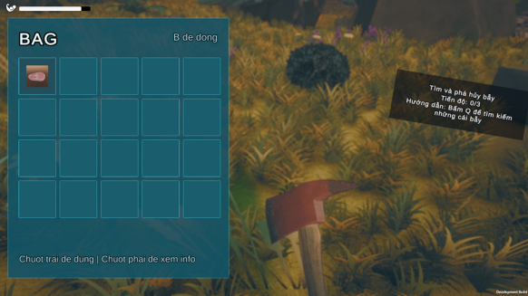
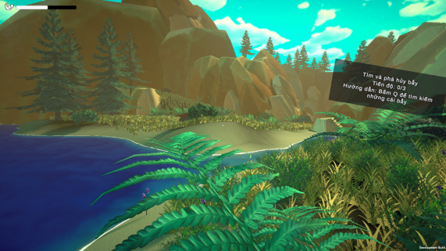
hello

Slide 11
hello

Slide 12
hello

Slide 13
hello

Slide 14
hello

Slide 15
hello

Slide 16
new

Slide 17
new

Slide 18
new

Slide 19
new

Slide 20
new

