Slide 1
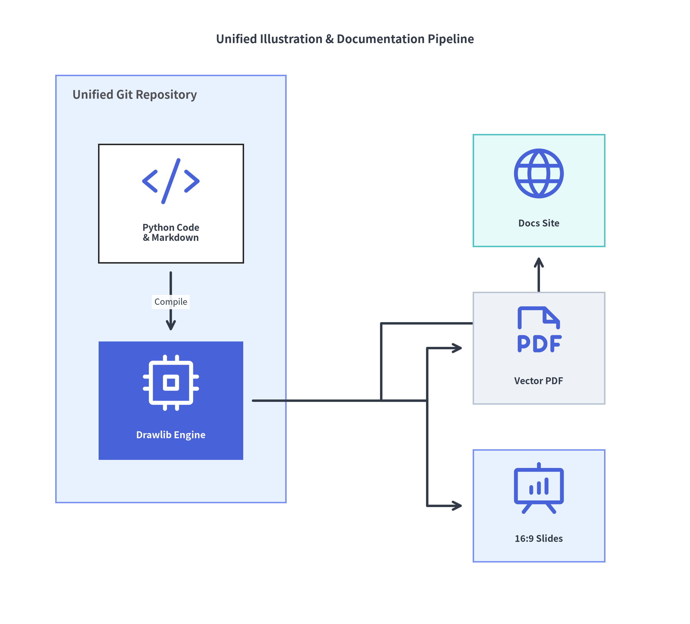

Drawlib
Illustration & Illustrated Documentation as Code
Unify declarative Python diagrams, technical documentation, vector PDFs, and 16:9 presentations inside a single version-controlled Git repository.
• Pure-Python Declarative API — Zero GUI silos, raw SVG math, or rigid text DSLs
• Single Source of Truth (SoT) — Code, architecture diagrams, and docs evolve together in PRs
• Autonomous AI Agent Ready — Built-in rules catalog & multimodal visual self-healing loop
Drawlib Official Showcase Deck
Pure Python (>=3.11) • Apache 2.0 License
Notes:
• Welcome to the official Drawlib Showcase presentation.
• Drawlib is a pure-Python library built around the philosophy of "Illustration as Code" and "Illustrated Documentation as Code."
• As shown in the architecture diagram on the right, Drawlib unifies Python code and Markdown inside your Git repository and compiles them into interactive documentation websites, vector PDFs, and 16:9 presentation slide decks—including this very presentation.

Slide 2
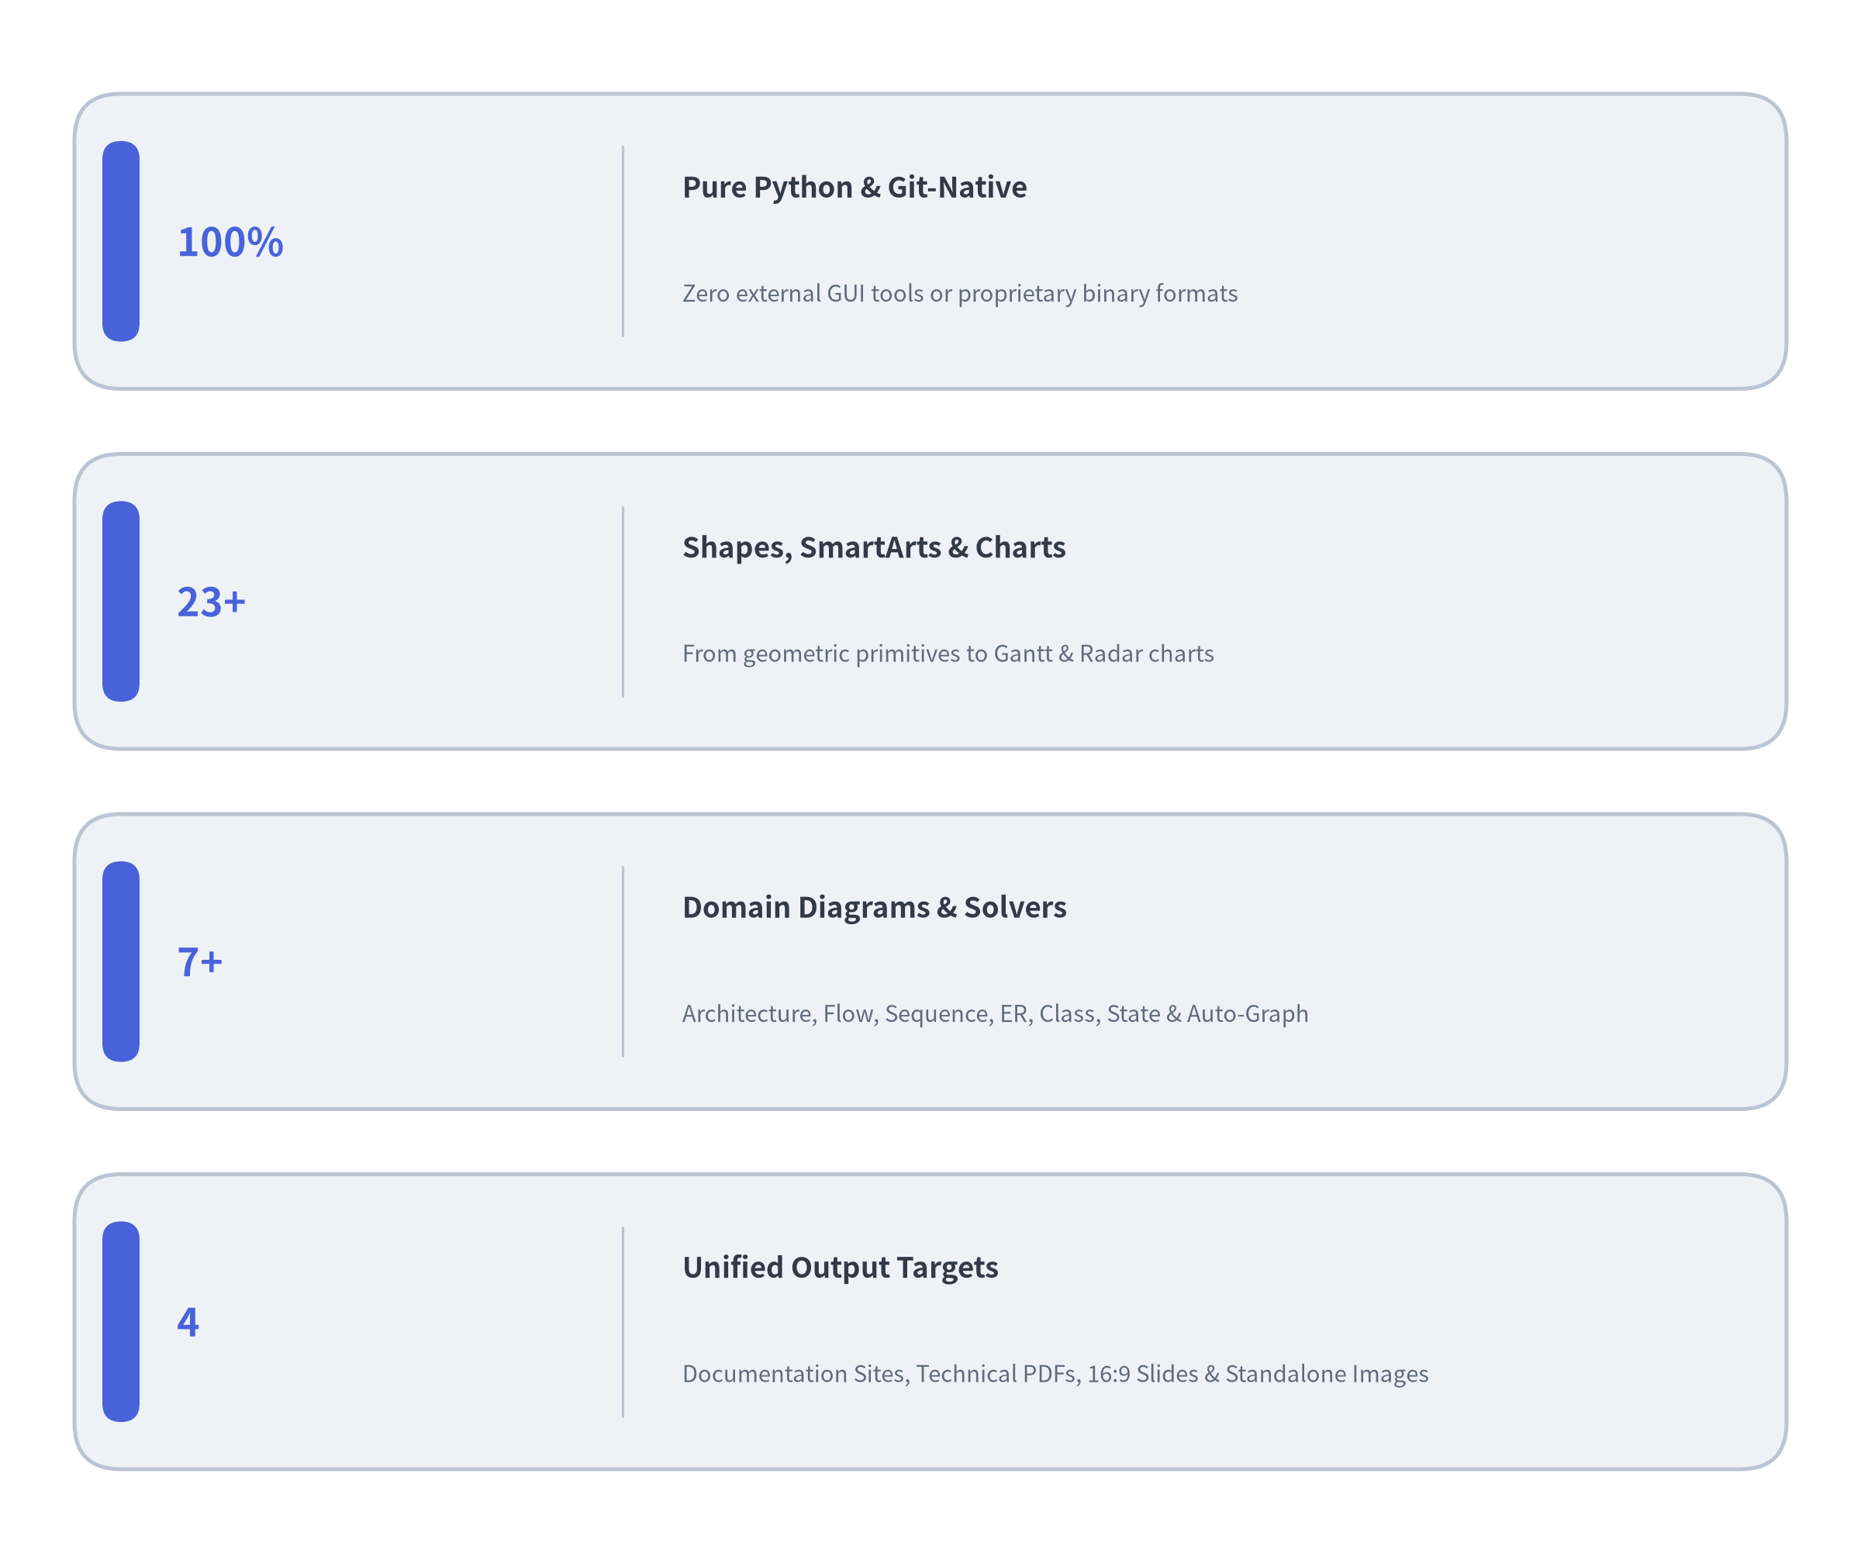

What is Drawlib?
A declarative, pure-Python graphics and documentation engine that treats architectural diagrams, quantitative charts, animations, and technical documents as first-class software artifacts.
1. Pure-Python Declarative API
• Write expressive Python (>=3.11) using variables, loops, type-checked models, and reusable project helpers (styles.py & utils.py).
• No opaque Graphviz/Java binaries, no fragile XML/SVG hand-editing, and no 200-line matplotlib patch boilerplate.
2. Four Publishing Archetypes
• Scaffold and build Multi-Page Documentation Sites (site), Linear Technical Specs & Vector PDFs (doc), 16:9 Widescreen Slide Decks (slide), and Standalone Images (image) from one unified CLI.
3. Autonomous AI Agent Ready
• Ships with an embedded On-Demand Rules Catalog (drawlib rules show) and headless coordinate-grid preview (drawlib show -g), enabling AI coding agents to write, inspect, and self-heal visual diagrams autonomously.
Notes:
• At an executive level, Drawlib rests on three core pillars: a pure-Python declarative API, four integrated publishing archetypes, and first-class ergonomics for AI coding agents.
• On the right, our KPI cards summarize the scope of the ecosystem: 100% pure Python and Git-native, 23+ geometric primitives paired with 10 SmartArts and 7 quantitative charts, 7+ domain diagram engines and auto-layout solvers, and 4 unified publishing targets.

Slide 3
Presentation Roadmap
A comprehensive 7-chapter tour from the philosophy of Illustration as Code to high-level diagrams, animations, and AI workflows.
Live Dogfooding in Action
This 60-slide presentation is 100% authored and compiled with Drawlib:
• Source of Truth: Markdown files and embedded drawlib Python blocks in docs/slide_about_drawlib_src/
• Shared Theme & Macros: Centralized palette in styles.py and reusable layout helpers in utils.py
• Inline Vector SVGs: Every static diagram renders as crisp inline <svg> with automatic @font-face bundling
• Interactive <canvas> Animations: Step-by-step animated diagrams controlled via A or Presenter View (P)
• Dual Output: Compiled into both an interactive HTML5 web deck and a 1920×1080 vector PDF
Notes:
• Here is our 7-chapter roadmap for the presentation.
• We begin in Chapter 1 with why Drawlib exists and the problems it solves, move through the core engine and primitives in Chapter 2, SmartArts and quantitative charts in Chapter 3, domain diagrams and auto-layout graphs in Chapter 4, multi-frame animations in Chapter 5, the documentation and slide engine in Chapter 6, and finally the AI agent workflow in Chapter 7.
• Notably, this entire slide deck is dogfooded directly from docs/slide_about_drawlib_src/ using the exact features we are showcasing.

Slide 4
Notes:
• In Chapter 1, we explore the fundamental motivation behind Drawlib.
• Why do engineering teams struggle to keep technical diagrams and documentation up to date?
• We will examine the three traditional pain points—GUI tool fragmentation, text DSL layout limitations, and low-level plotting boilerplate—and show how Drawlib establishes a unified Single Source of Truth for both human engineers and AI coding agents.

Slide 5
Pain Point 1: The Tool Fragmentation Problem
Why traditional technical documentation inevitably drifts out of sync with reality.
Three Disconnected Silos
1. Source Code in Git (src/)
◦ Version-controlled, peer-reviewed in Pull Requests, and continuously tested in CI/CD.
2. Diagrams in External GUI Tools (Draw.io, Visio, Figma)
◦ Drag-and-drop canvas state lives in proprietary cloud workspaces or opaque binary/XML blobs.
◦ Impossible to review meaningful diffs in Git or refactor programmatically across 30 diagrams.
3. Prose in External Wikis / Docs (Confluence, Word, Notion)
◦ Engineers manually export .png screenshots and paste them into external pages.
The Inevitable Result: Documentation Rot
• Updating a single microservice port requires opening a GUI tool, re-aligning boxes, exporting a PNG, and re-uploading to a wiki.
• Under deadline pressure, engineers skip the manual handoffs—leaving architecture diagrams months or years out of date.
Notes:
• Let's examine Pain Point 1: Tool Fragmentation.
• In most engineering organizations, source code lives in Git, architecture diagrams live in external GUI canvases like Draw.io, Visio, or Figma, and technical documentation lives in external wikis.
• Every architecture change requires manual redrawing and manual PNG exporting across tools. Over time, those manual handoffs break down, causing severe documentation rot.
• Drawlib eliminates these silos by bringing code, diagrams, and documentation into a single Git repository.

Slide 6
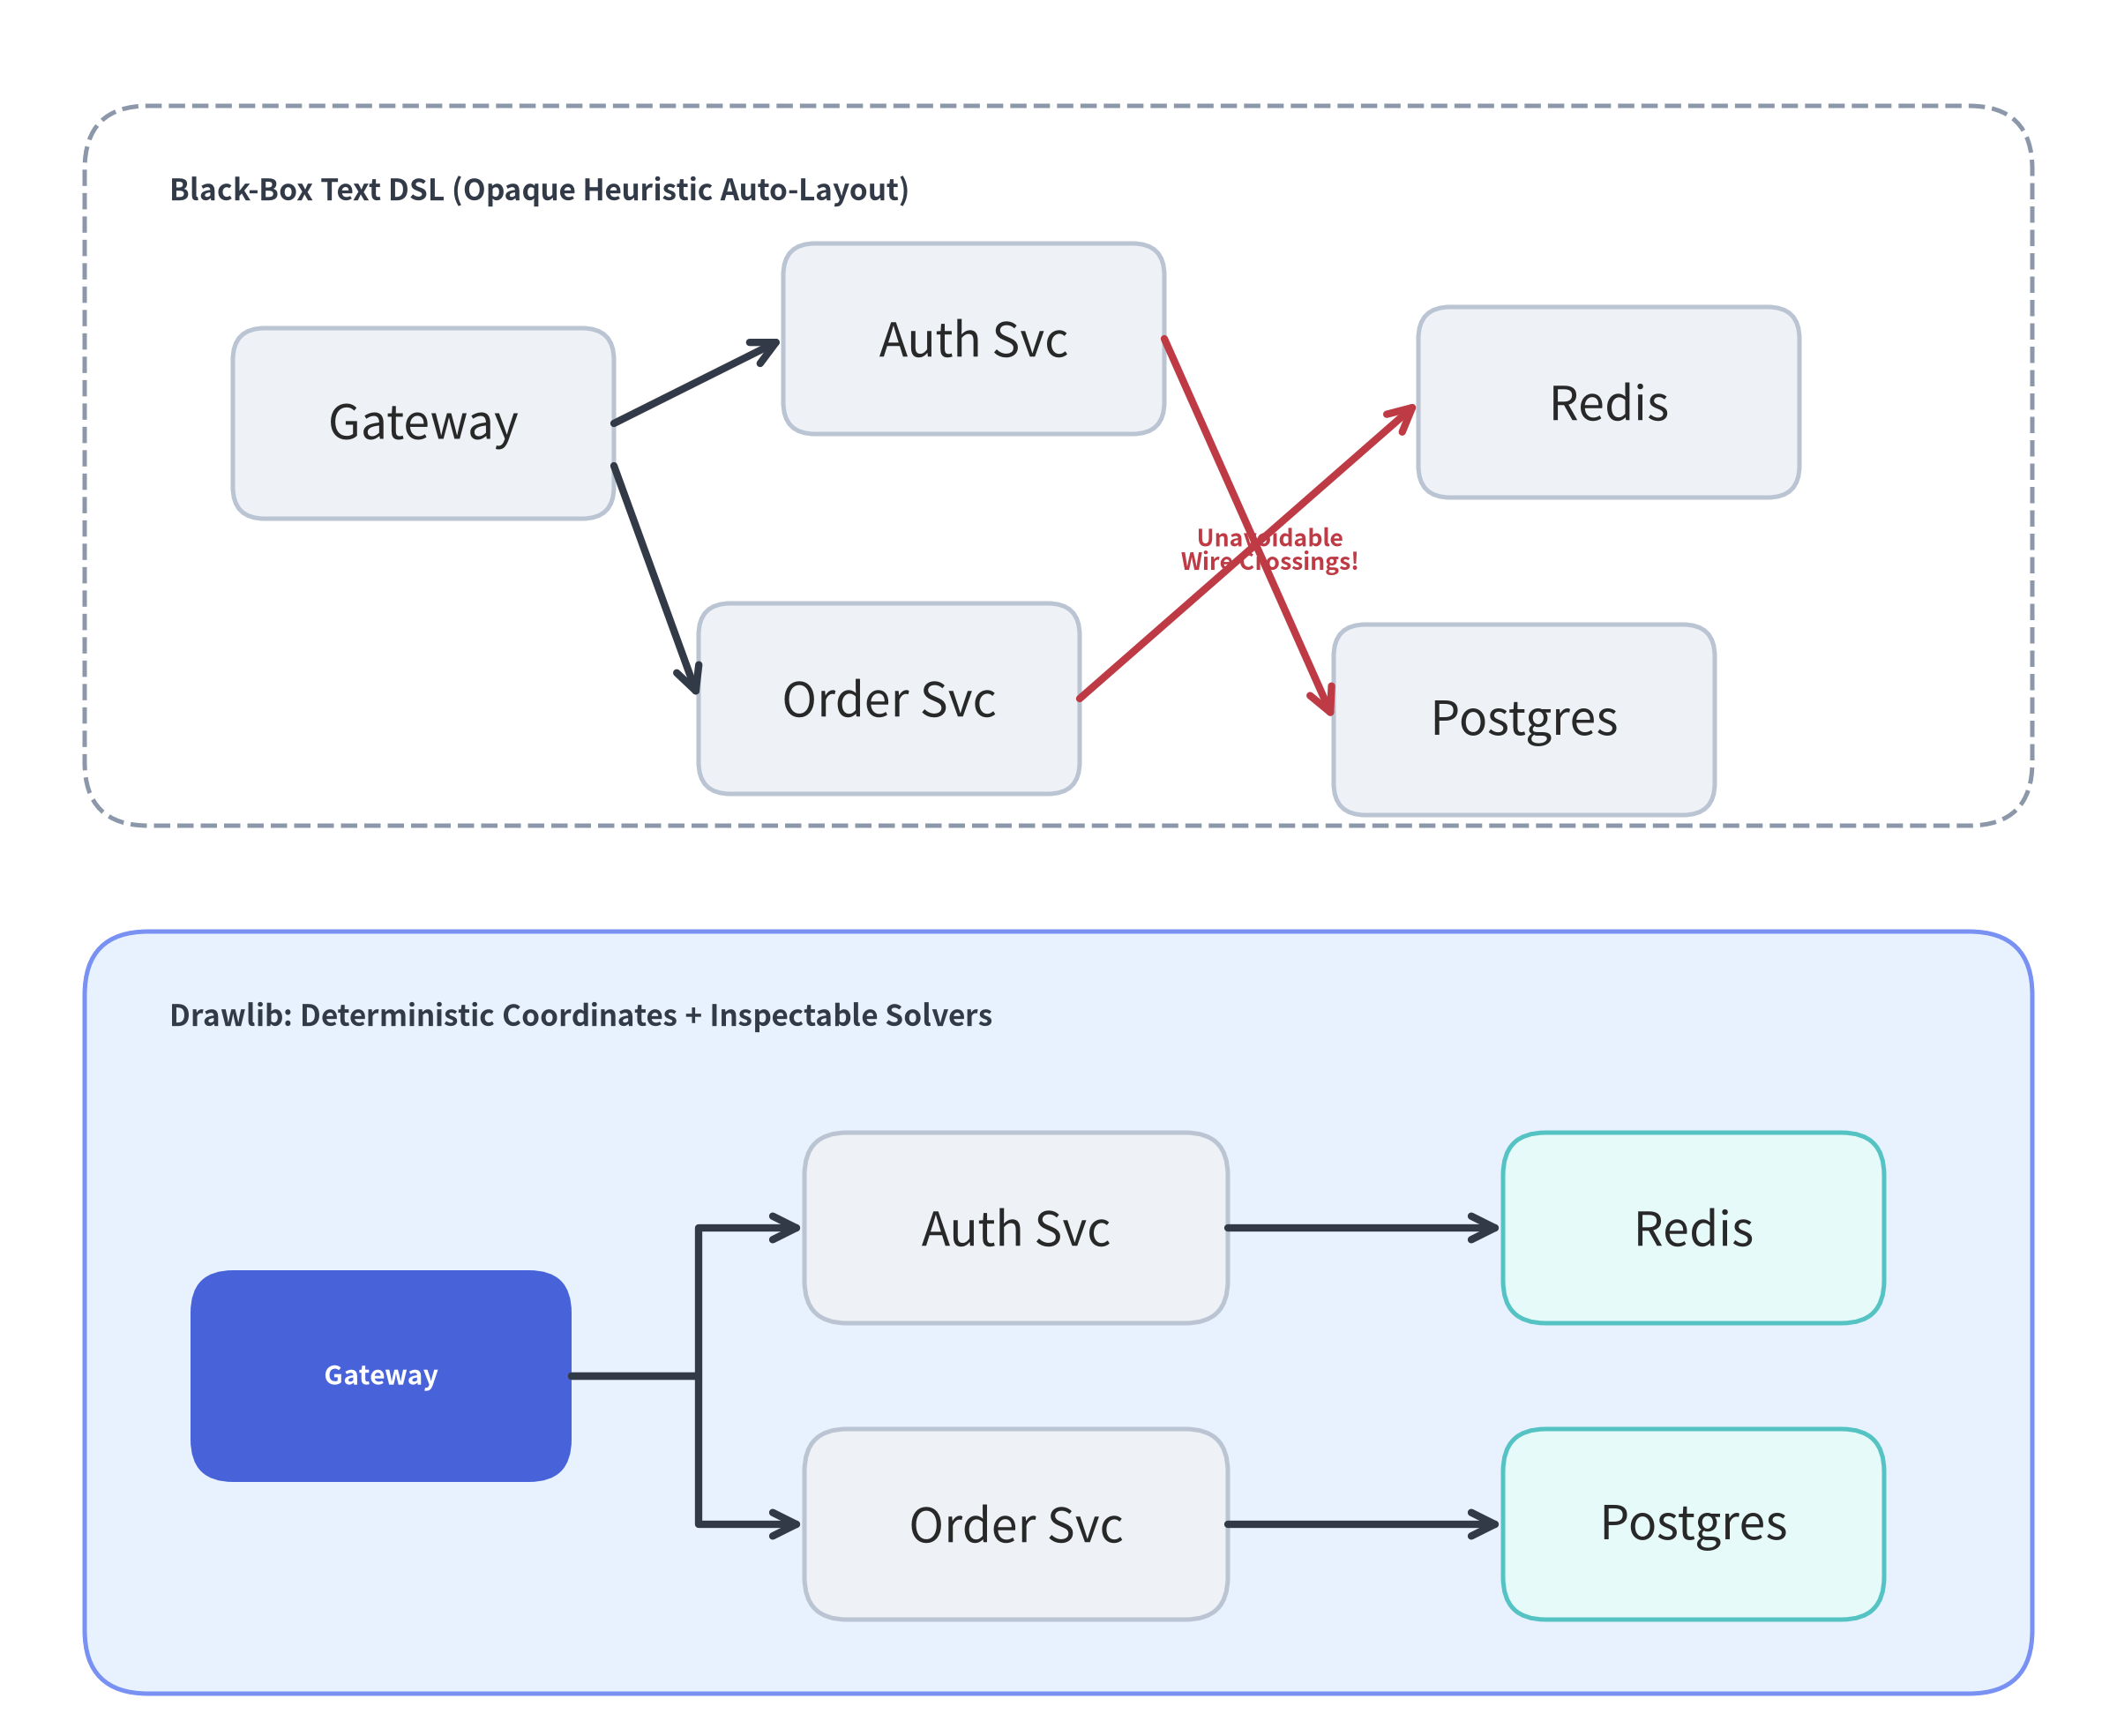

Pain Point 2: Text DSL Limitations (Mermaid / PlantUML / Graphviz)
Why black-box heuristic layout DSLs hit a wall on real-world production architectures.
Great for 5 Nodes — Frustrating for 25 Nodes
Text-to-diagram DSLs (Mermaid, PlantUML, DOT) rely on rigid, opaque layout heuristics:
• Unpredictable Layout Shifts
◦ Adding a single edge or renaming a label can cause the layout engine to reshuffle the entire diagram unpredictably.
• No Fine-Grained Coordinate Control
◦ You cannot say "align these 3 databases vertically at X=80" or "route this error path around the VPC border".
◦ Engineers resort to hacks like invisible dummy nodes (A ~~~ B) and hidden links just to nudge boxes.
• No Programming Constructs
◦ Static DSL syntax lacks variables, for loops, math expressions, conditional branches, or shared Python functions.
• Limited Visual Expressiveness
◦ Cannot combine cloud architecture topologies, statistical charts, custom vector shapes, and multi-frame animations on one canvas.
Notes:
• Pain Point 2 is the limitation of text DSLs like Mermaid, PlantUML, and Graphviz DOT.
• While text DSLs are diffable in Git, they treat layout as a black box. They work well for a 5-node toy flowchart, but as soon as you model a multi-tier cloud architecture, adding one connection can scramble node positions or create awkward wire crossings that you cannot fix.
• Drawlib gives you both worlds: 5 automatic graph layout solvers (drawlib.graph) when you want topological auto-layout, AND 100% deterministic Cartesian coordinates (drawlib.diagrams) when you want exact alignment and routing.

Slide 7
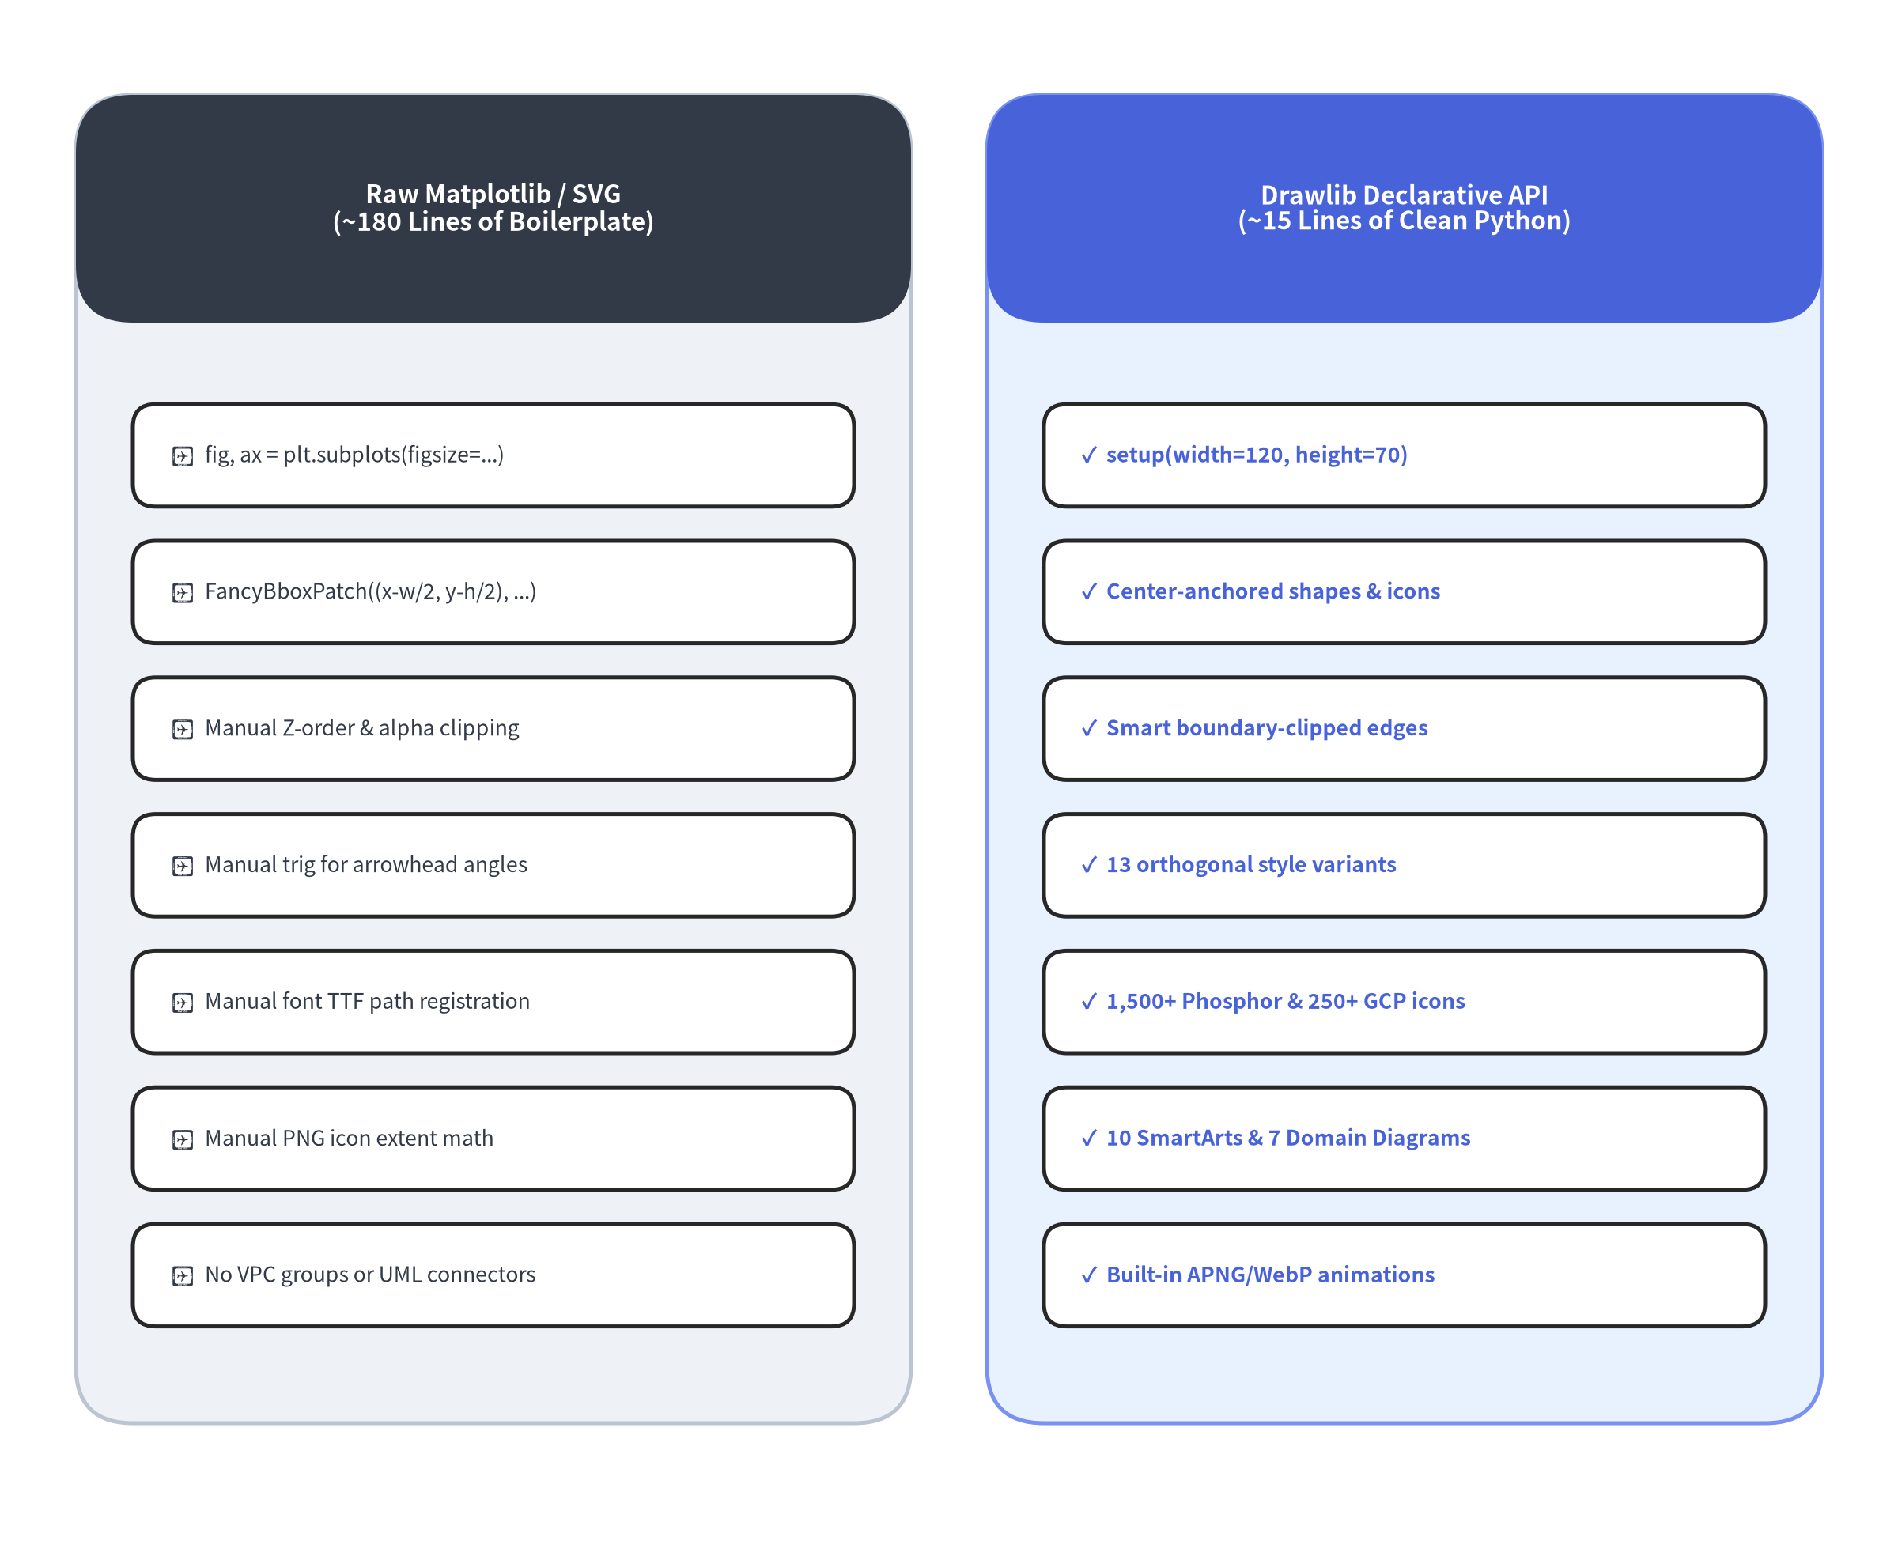

Pain Point 3: Raw SVG & Matplotlib Boilerplate
Why general-purpose plotting libraries and raw vector XML are too low-level for architecture diagrams.
The Low-Level Productivity Trap
When engineers outgrow text DSLs, they sometimes reach for raw <svg> templates or Python's matplotlib.patches:
• Verbose Patch & Bezier Boilerplate
◦ Drawing a single rounded service box with an icon, centered two-line title, and orthogonal boundary-clipped arrow in raw matplotlib requires 40–60 lines of FancyBboxPatch, ConnectionPatch, Path, and manual bounding-box math.
• Inverted or Confusing Coordinate Defaults
◦ Raw SVG uses top-left origins with manual <text dy="..."> baseline offsets and no automatic word/boundary clipping.
• No Domain Semantics
◦ Plotting libraries know about scatter plots and histograms, not VPC NodeGroups, UML Class relationships, Sequence lifelines, ER Crow's foot notation, or Phosphor/GCP icons.
Notes:
• Pain Point 3 is the opposite extreme: writing raw SVG XML or low-level matplotlib.patches code directly.
• While Matplotlib is a powerhouse for scientific plotting, building an architecture diagram or sequence diagram with raw FancyBboxPatch and ConnectionPatch objects takes nearly 200 lines of tedious coordinate math per diagram.
• Drawlib wraps the rendering engine in a clean, type-validated, domain-aware Python API where 15 lines of declarative code replace 180 lines of boilerplate.

Slide 8
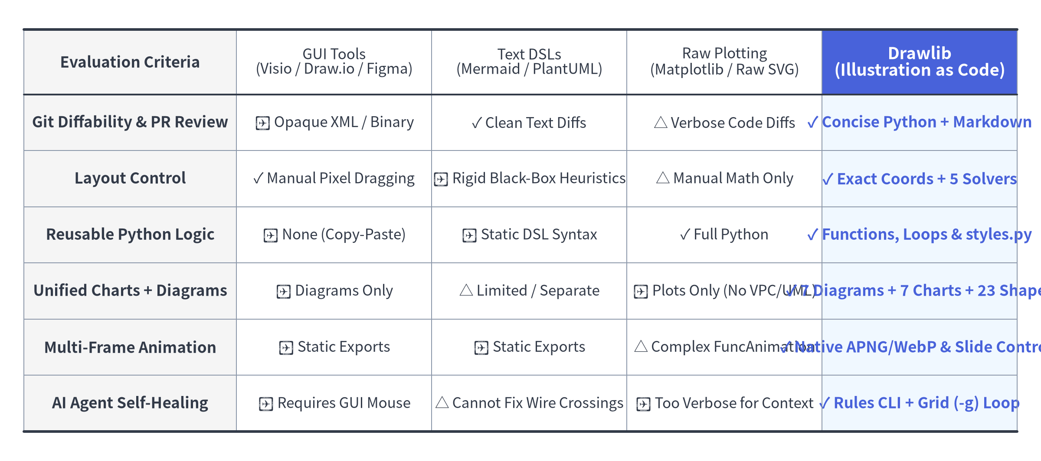

Landscape Comparison Matrix
How Drawlib bridges the gap between GUI canvases, text DSLs, and low-level plotting libraries.
Notes:
• This comparison matrix—rendered live using drawlib.smartarts.Table—summarizes how Drawlib compares against GUI tools, text DSLs, and raw plotting libraries across six key engineering criteria.
• Notice the rightmost column: Drawlib is the only solution that combines clean Git diffability, both deterministic coordinate control and automatic layout solvers, full Python programmability, unified architecture diagrams + quantitative charts, native multi-frame animations, and an AI agent self-healing workflow.

Slide 9
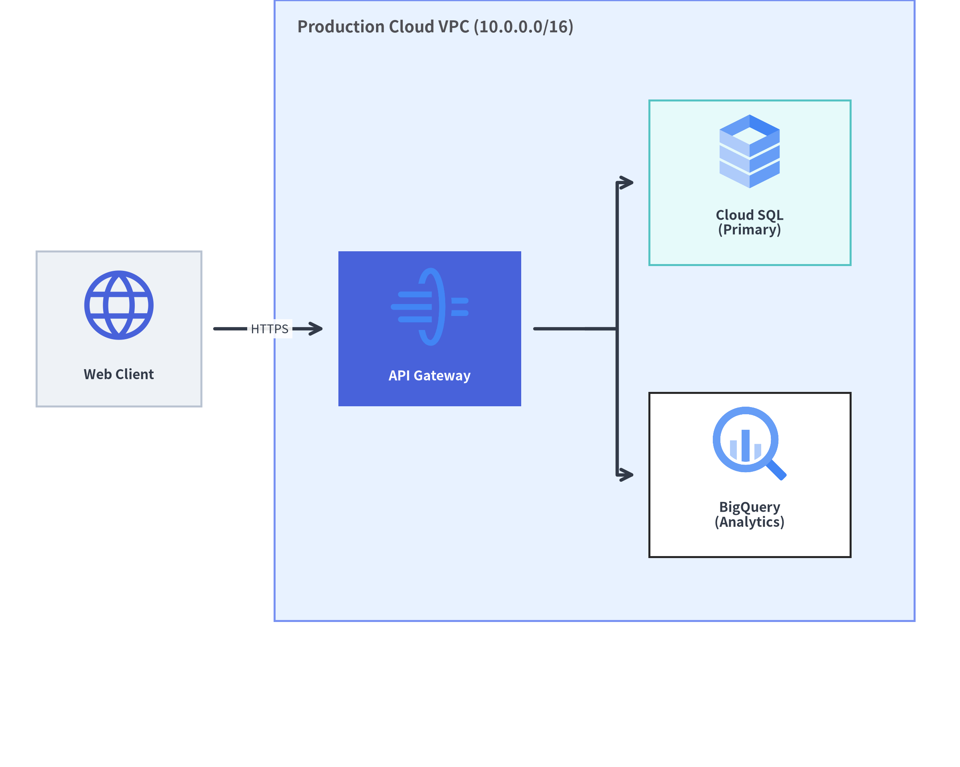

The Drawlib Solution: Declarative Python Architecture
Write clean, type-checked Python on the left—get publication-grade vector diagrams on the right.
15 Lines of Declarative Python
from drawlib.diagrams.architecture import (
ArchitectureDiagram, GcpIcon, Node, NodeGroup, PhosphorIcon,
)
from drawlib.styles import Styles
d = ArchitectureDiagram(
node_style=Styles.Primary,
node_text_style=Styles.DarkBold,
edge_style=Styles.DarkBold,
edge_text_style=Styles.Dark,
node_card_style=Styles.Neutral,
)
vpc = d.add(NodeGroup("Production Cloud VPC", padding=7), (26, 8))
client = d.add(Node("Web Client", width=18, height=16, icon=PhosphorIcon.GLOBE), (8, 42))
gw = vpc.add(
Node("API Gateway", width=20, height=16, icon=GcpIcon.CLOUD_API_GATEWAY,
card_style=Styles.PrimaryFlat, text_style=Styles.WhiteBold),
(16, 34),
)
sql = vpc.add(Node("Cloud SQL", width=20, height=16, icon=GcpIcon.CLOUD_SQL), (54, 50))
bq = vpc.add(Node("BigQuery", width=20, height=16, icon=GcpIcon.BIGQUERY), (54, 18))
d.connect(client, gw, label="HTTPS")
gw.fork([sql, bq], at_x=58, padding=1.5)
d.draw()
• Auto-Bounding Containers: NodeGroup wraps child nodes automatically.
• Smart Orthogonal Edges: .connect() and .fork() clip cleanly at node boundaries.
Notes:
• Look at how clean the Drawlib solution is in practice.
• On the left is a 15-line declarative Python snippet using ArchitectureDiagram, NodeGroup, Node, and official GcpIcon / PhosphorIcon enums.
• On the right is the exact vector SVG output compiled from that snippet: NodeGroup automatically computes its bounding box around child nodes, gw.fork([sql, bq]) routes a 1-to-2 orthogonal bus fan-out, and our 50%+ neutral baseline keeps the visual hierarchy crisp with API Gateway as the focal hero node.

Slide 10
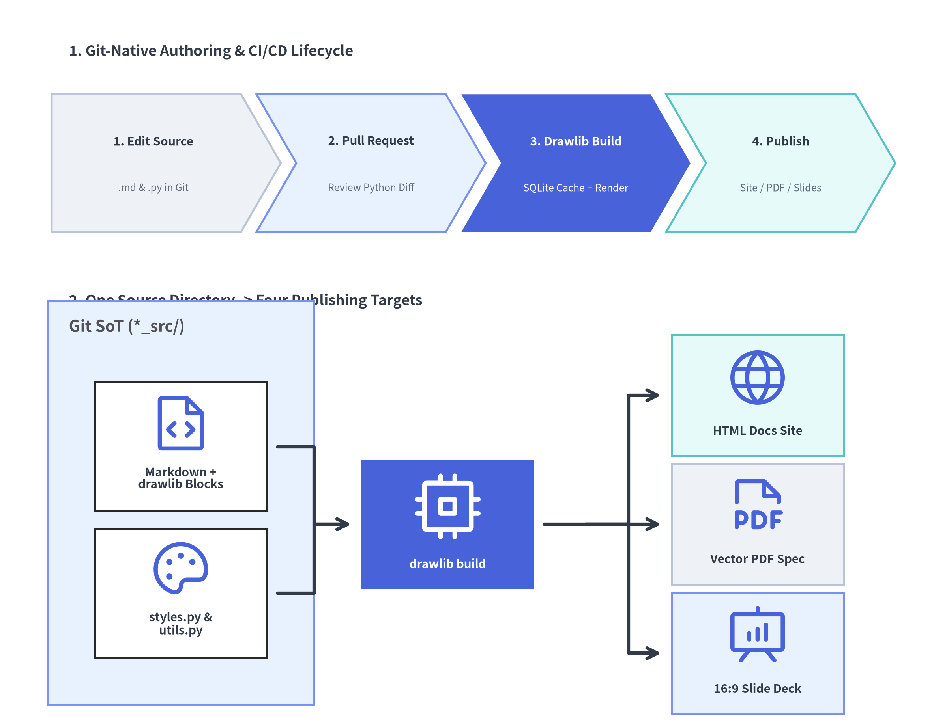

Single Source of Truth (SoT) in Git
Code, diagrams, and prose evolve together in atomic Pull Requests and compile deterministically.
Software Engineering Rigor for Documentation
1. Atomic Pull Requests
◦ When an engineer adds a new gRPC service or database table in src/, they update the drawlib diagram block in docs_src/ in the exact same commit.
2. Code Review & Static Verification
◦ Reviewers inspect clean Python diffs instead of binary .png blobs.
◦ CI validates every diagram block, checks internal hyperlinks (drawlib check), and verifies zero syntax or type errors.
3. Deterministic Multi-Target Compilation
◦ One command (drawlib build) compiles .md + .py sources into HTML documentation sites, GitHub-flavored Markdown, 1920×1080 slides, and vector PDFs.
4. Content-Addressable SQLite Caching
◦ Unchanged diagrams are restored from .drawlib/cache.db in < 1ms, making incremental rebuilds instantaneous.
Notes:
• When diagrams and documentation live in Git alongside application code, we achieve a true Single Source of Truth.
• On the right, we combine two Drawlib components on a single canvas—a ChevronProcess at the top and an ArchitectureDiagram at the bottom—to illustrate how .md files, styles.py, and utils.py flow through PR code review and drawlib build to produce HTML sites, vector PDFs, and 16:9 slide decks.

Slide 11
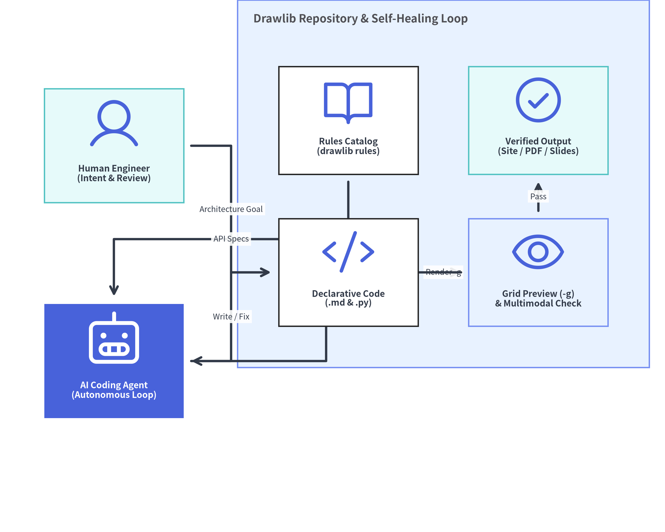

Designed for Both Humans and AI Coding Agents
Why pure Python + multimodal visual inspection unlocks autonomous documentation engineering.
Python is the Native Lingua Franca of LLMs
• Zero Proprietary Syntax Friction
◦ LLMs are pre-trained on billions of lines of Python—they naturally understand functions, loops, arithmetic coordinate layout, and Pydantic type hints.
• Self-Contained Rules Catalog (drawlib rules)
◦ Agents query uv run drawlib rules show <topic> on demand to inspect exact function signatures and style guidelines without bloating context windows.
• Autonomous Visual Self-Healing Loop
1. Author: Write or update drawlib Python code in *_src/.
2. Render with Grid: Export a preview with -g (drawlib show ... -g -o preview.png).
3. Inspect Multimodally: View the rendered image to check alignment, margins, and contrast.
4. Self-Repair: Adjust coordinates or styles until the visual output is publication-grade.
Notes:
• Crucially, Drawlib is designed from the ground up for both human engineers and AI coding agents.
• Because AI models reason natively in Python, they can query drawlib rules show, write declarative drawing code, render a preview with the coordinate grid (-g), visually inspect the output image, and autonomously self-heal any layout or overlap issues before presenting the final result to the human engineer.

Slide 12
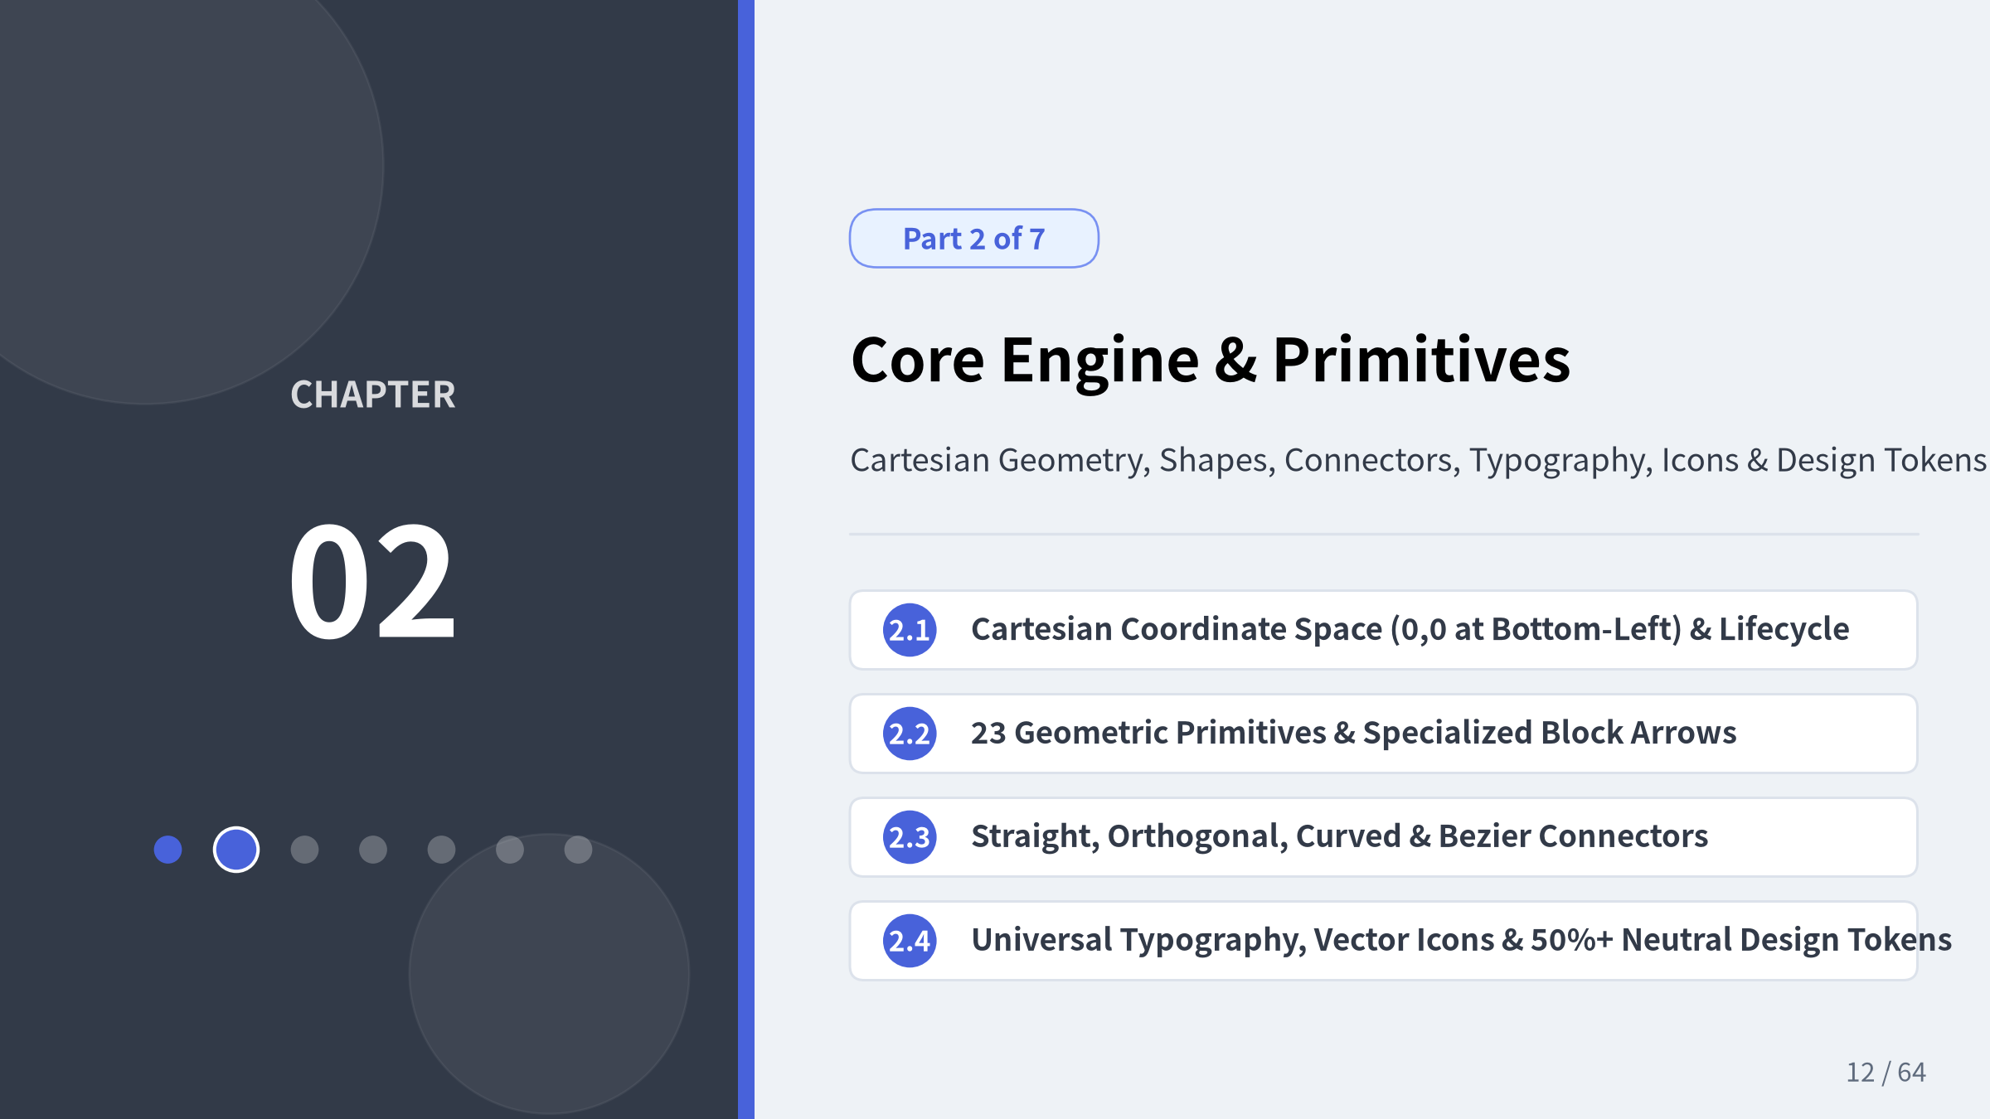
Notes:
• In Chapter 2, we dive into Drawlib's core rendering engine and foundational drawing primitives.
• We will cover the Cartesian coordinate system, visual grid debugging, all 23 geometric shapes and block arrows, straight/curved/Bezier connectors, multilingual typography, vector/cloud icons, and the 50%+ neutral design token discipline.

Slide 13
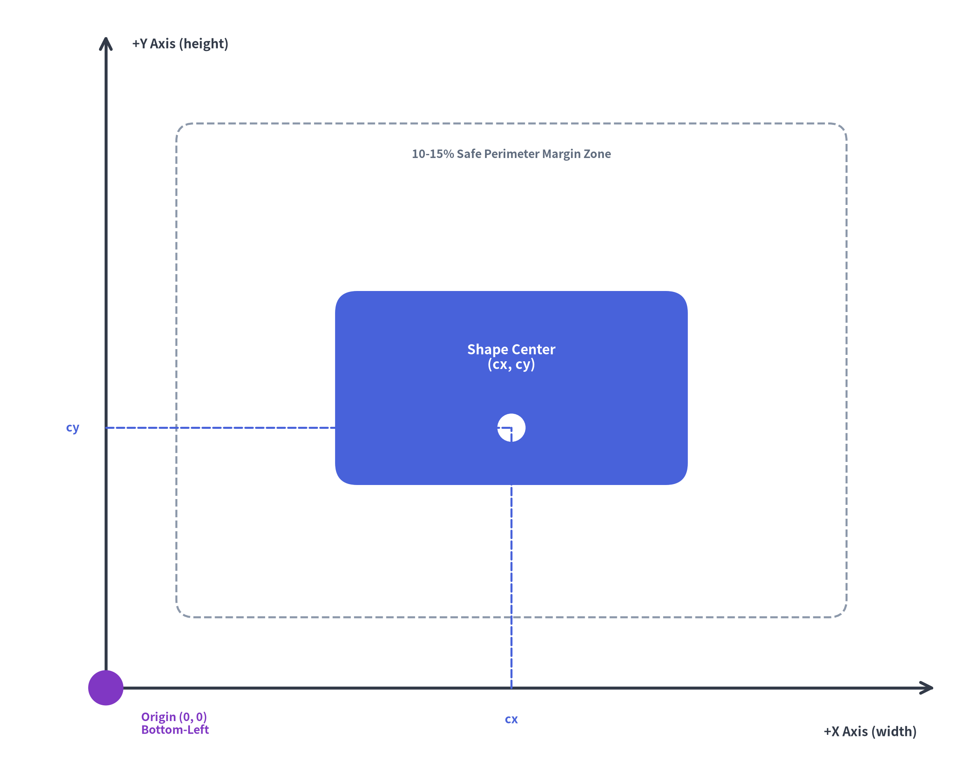

Cartesian Canvas & Coordinate System (drawlib.canvas)
An intuitive, resolution-independent 2D mathematical coordinate space with (0, 0) at the bottom-left.
1. Canvas Lifecycle
from drawlib.canvas import clear, save, setup
from drawlib.shapes import rectangle
from drawlib.styles import Styles
clear()
setup(width=100, height=70)
rectangle((50, 35), width=40, height=20,
style=Styles.PrimaryFlat,
text="Centered at (50, 35)",
text_style=Styles.WhiteBold)
save("diagram.svg")
2. Core Spatial Rules
• Bottom-Left Origin (0, 0): X increases rightward (0 → width); Y increases upward (0 → height).
• Center-Anchored Primitives (cx, cy): Shapes (rectangle, circle, cylinder, rhombus, etc.) and icons are anchored at their geometric center (cx, cy), making horizontal (cy equal) and vertical (cx equal) alignment trivial.
• Z-Order Layering Discipline: Draw background containers first, entity shapes second, connector lines third, and foreground badges/text last.
• 10–15% Safe Perimeter Margin: Keep outer margins clear so labels and arrowheads never clip.
Notes:
• Every Drawlib canvas uses a clean Cartesian coordinate system where (0, 0) is at the bottom-left corner, X grows to the right, and Y grows upward.
• Because primitives are anchored at their geometric center (cx, cy) by default, aligning three services horizontally means simply giving them the same cy coordinate—regardless of each shape's width or height.

Slide 14
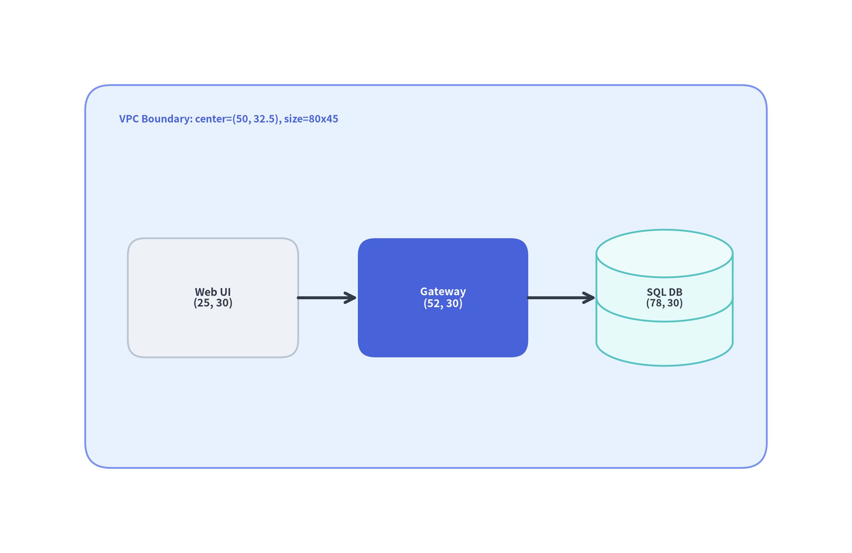

Visual Debugging with Coordinate Grid (grid=True / -g)
Inspect exact coordinates and verify margins without touching production code.
Two Ways to Enable the Coordinate Grid
1. CLI Flag (-g / --grid) — Recommended
◦ Render any Python script or embedded Markdown diagram with a temporary coordinate ruler overlay:
# Preview a standalone script with grid
uv run drawlib show arch.py -g -o preview.png
# Preview an embedded Markdown diagram with grid
uv run drawlib show docs_src/index.md arch.png -g -o preview.png
2. Programmatic setup(..., grid=True)
◦ Turn on the grid directly inside setup() during interactive layout design:
setup(width=100, height=65, grid=True, grid_xpitch=10, grid_ypitch=10)
Why the Grid Matters
• Zero Guesswork: Immediately see that Client sits at (25, 30), Gateway at (52, 30), and DB at (78, 30).
• Multimodal AI Anchor: Allows AI coding agents to read exact (x, y) coordinates directly from the rendered image.
Notes:
• When designing or debugging a diagram layout, you never have to guess coordinates blindly.
• Passing -g to drawlib show (or grid=True in setup()) overlays a crisp coordinate grid across the canvas, showing major and minor grid lines so you can verify exact alignment and outer margins at a glance.

Slide 15
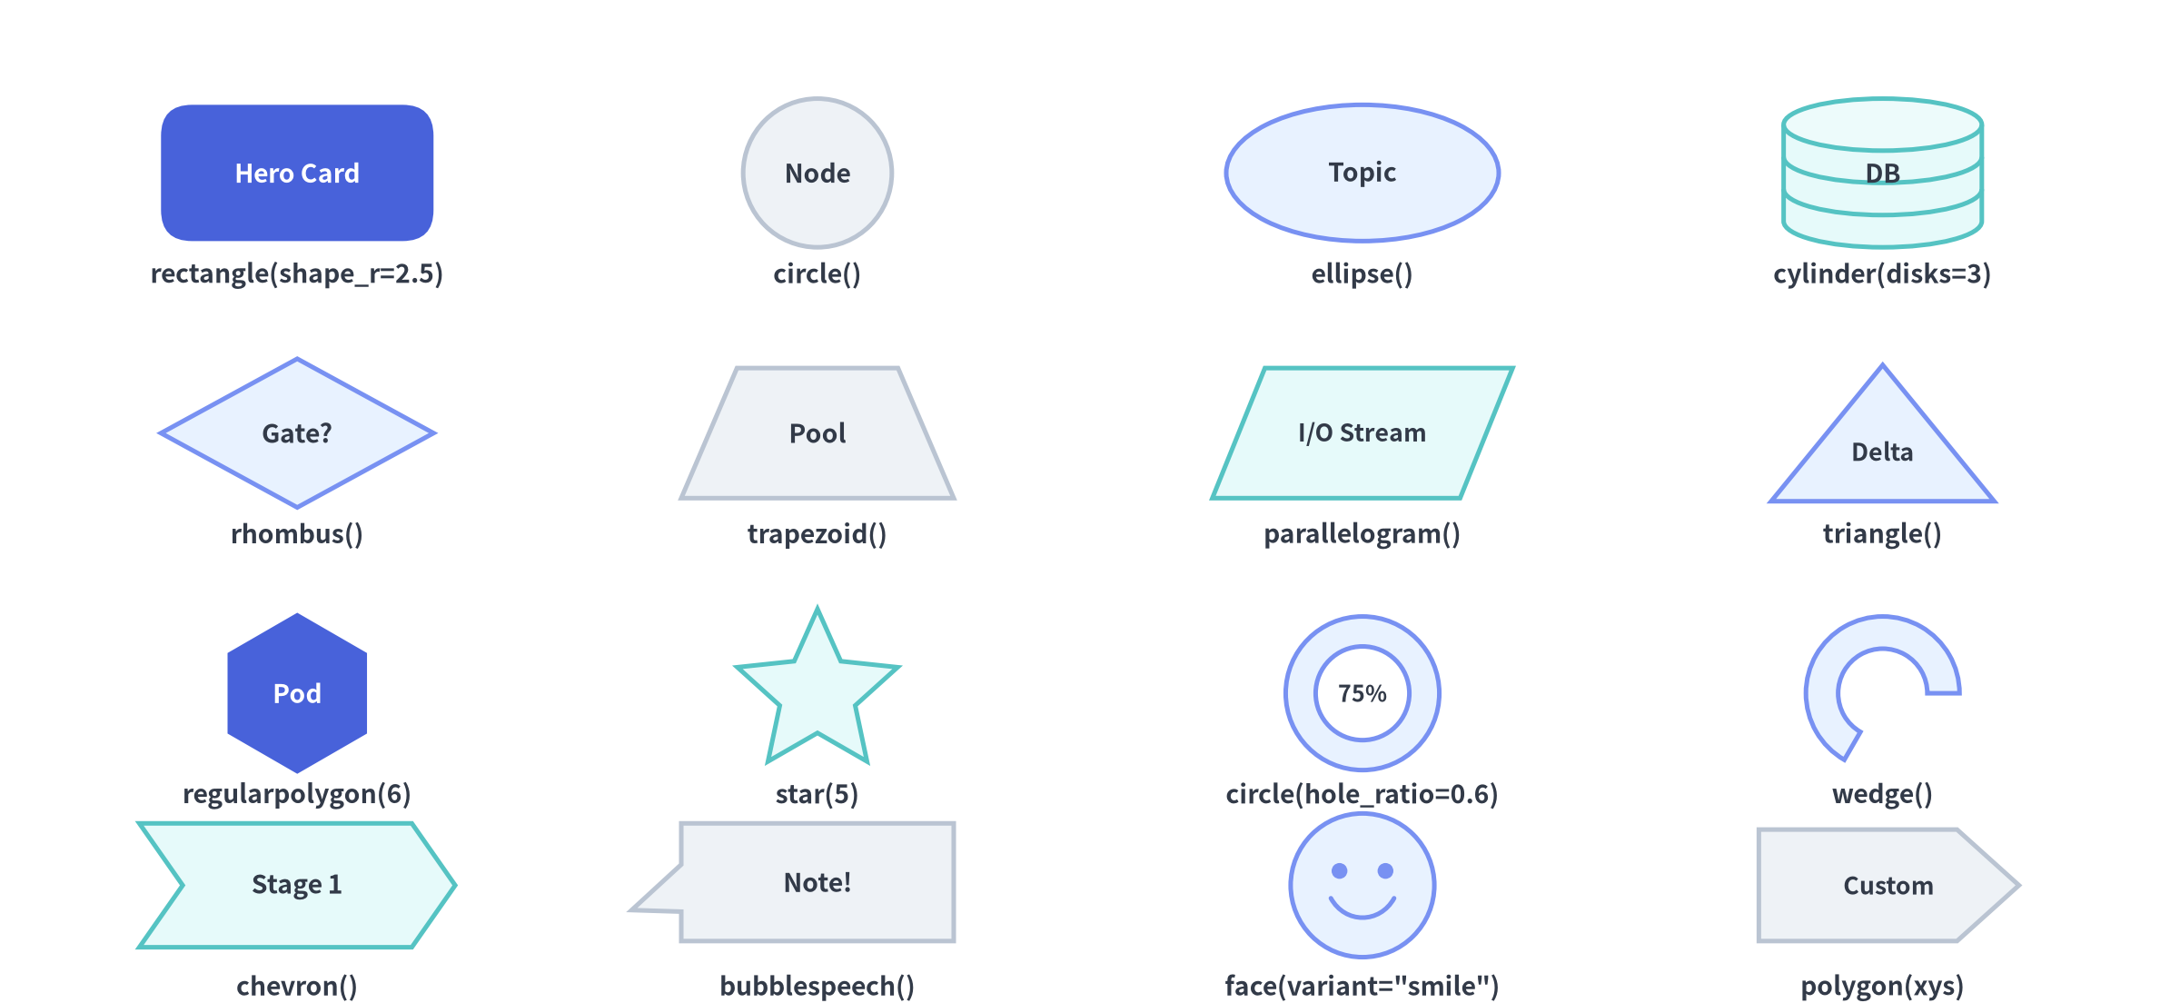

40+ Geometric Primitives (drawlib.shapes)
A rich vocabulary of vector shapes—all supporting style (including rotation style.angle), text, and text_style.
Notes:
• drawlib.shapes provides over 40 geometric primitives out of the box.
• Here is a 4x4 visual catalog of 16 core shapes: rounded rectangles, circles, ellipses, multi-disk 3D database cylinders, rhombuses, trapezoids, parallelograms, triangles, hexagons (regularpolygon), stars, hollow rings (hole_ratio), wedges, chevrons, speech bubbles, expressive user faces, and arbitrary polygons.

Slide 16
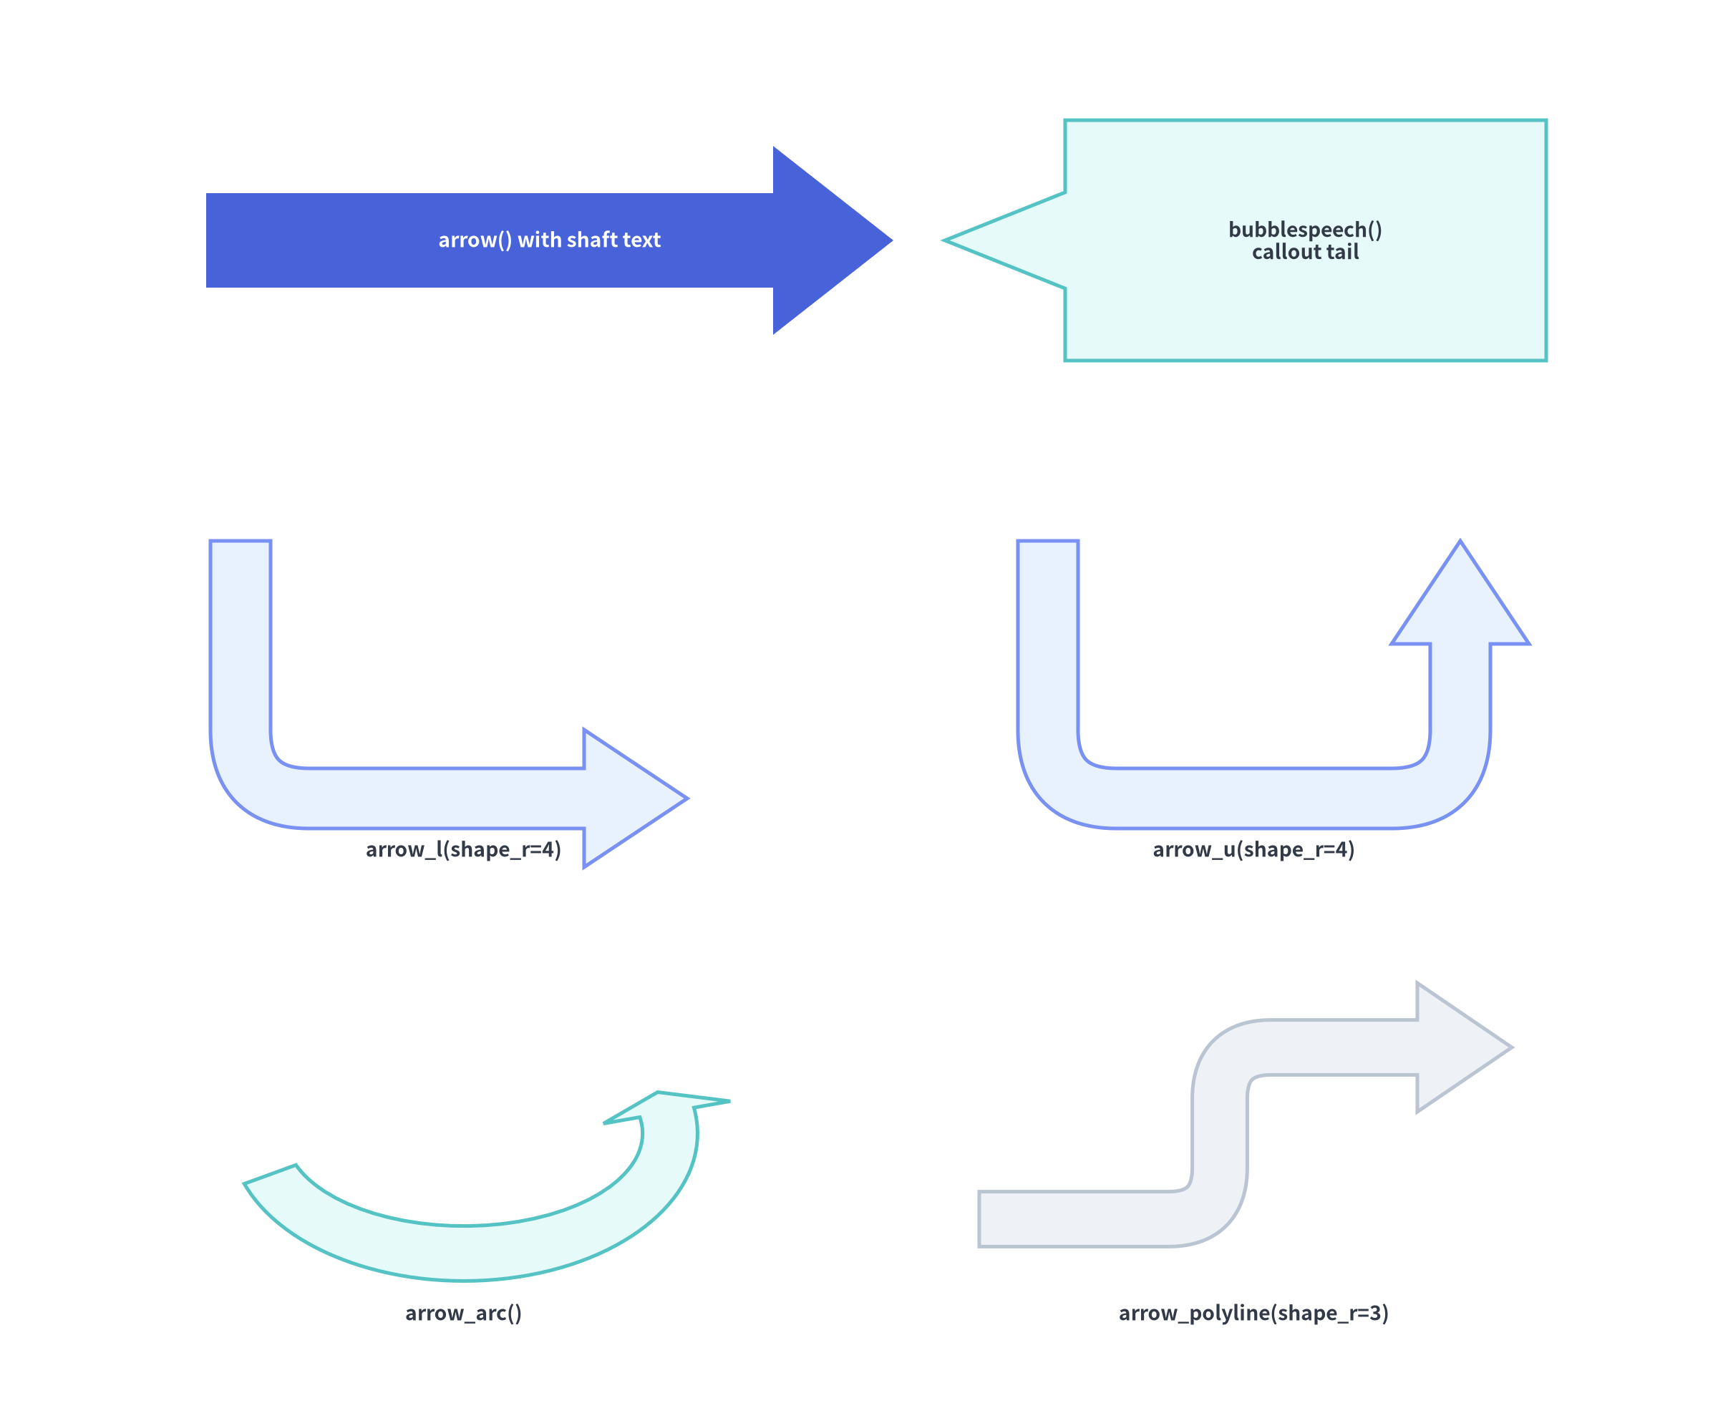

Block Arrows & Callouts (arrow, arrow_l, arrow_u, arrow_arc)
2D filled planar block arrows and speech callouts for prominent phase transitions and annotations.
5 Directed Block Arrows + Speech Callouts
from drawlib.shapes import (
arrow, arrow_arc, arrow_l, arrow_polyline, arrow_u, bubblespeech,
)
from drawlib.styles import Styles
# 1. Straight block arrow (supports embedded shaft text)
arrow((10, 66), (48, 66), tail_width=4, head_width=9,
head_length=6, style=Styles.PrimaryFlat,
text="Data Transfer", text_style=Styles.WhiteBold)
# 2. L-shaped & U-turn block arrows (with rounded elbow r)
arrow_l((25, 42), width=26, height=18, tail_width=3.5,
head_width=8, head_length=6, style=Styles.SecondaryNeutral.patch(shape_r=4))
arrow_u((68, 42), width=24, height=20, tail_width=3.5,
head_width=8, head_length=6, style=Styles.BlueNeutral.patch(shape_r=4))
# 3. Circular arc & multi-segment polyline block arrows
arrow_arc((25, 16), width=22, height=18, angle_start=180,
angle_end=20, tail_width=3, head_width=7, style=Styles.PrimaryNeutral)
arrow_polyline([(52, 10), (66, 10), (66, 22), (88, 22)],
tail_width=3, head_width=7, head_length=5, style=Styles.Neutral.patch(shape_r=3))
• Note: arrow() supports embedded text; for arrow_l, arrow_u, arrow_arc, and arrow_polyline, place external text() labels alongside the shaft.
Notes:
• Beyond standard geometric shapes, drawlib.shapes includes five specialized 2D block arrows (arrow, arrow_l, arrow_u, arrow_arc, arrow_polyline) and bubblespeech callouts.
• Notice how arrow_l, arrow_u, and arrow_polyline use style.shape_r to create smooth, rounded bends automatically.

Slide 17
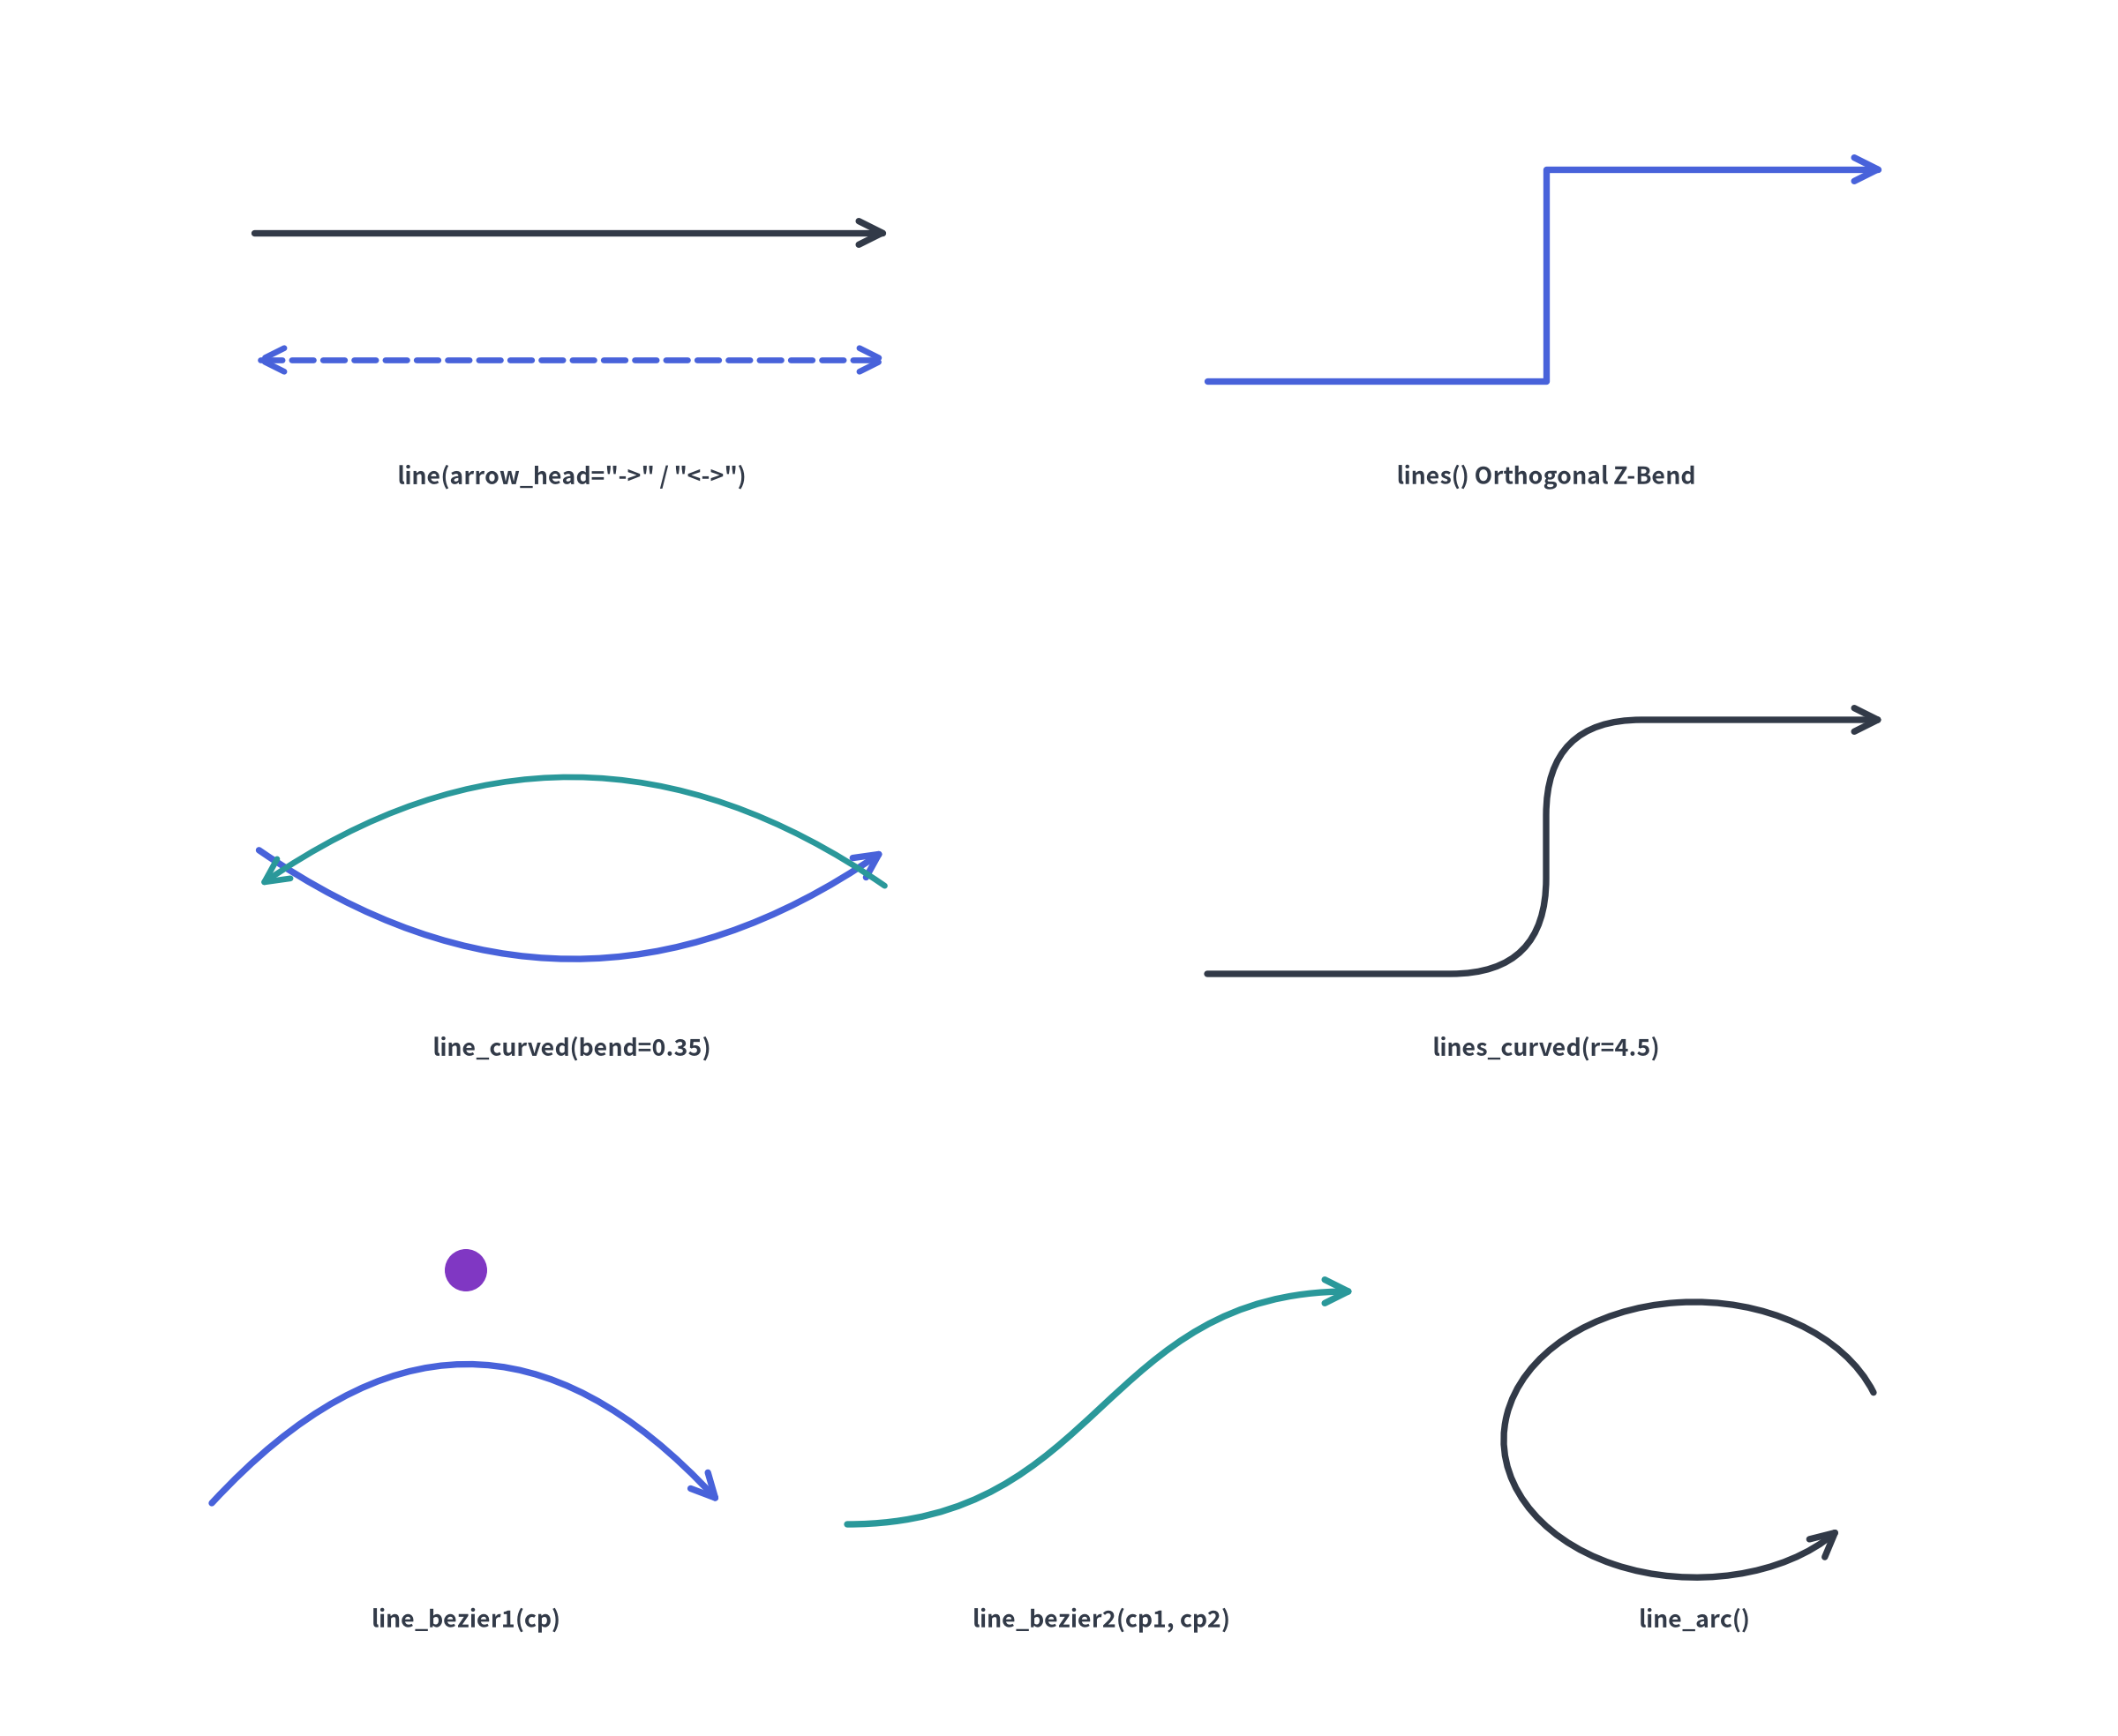

Lines, Polylines & Bezier Curves (drawlib.lines)
Precision 1D vector connectors with straight, orthogonal, filleted, arc, and polynomial Bezier routing.
7 Connector Primitives & Arrowheads
from drawlib.lines import (
line, line_arc, line_bezier1, line_bezier2,
line_curved, lines, lines_curved,
)
from drawlib.styles import Styles
# 1. Straight line & orthogonal polyline
line((10, 70), (45, 70), arrow_head="->", style=Styles.DarkBold)
lines([(55, 65), (72, 65), (72, 75), (90, 75)],
arrow_head="->", style=Styles.PrimaryBold)
# 2. Curved arc spline (bend) & filleted polyline (r)
line_curved((10, 44), (45, 44), bend=0.35,
arrow_head="<->", style=Styles.PrimaryBold)
lines_curved([(55, 38), (72, 38), (72, 52), (90, 52)],
r=4.0, arrow_head="->", style=Styles.DarkBold)
# 3. Quadratic/Cubic Beziers & Elliptical Arcs
line_bezier1((10, 16), (45, 16), cp=(27, 30),
arrow_head="->", style=Styles.SecondaryBold)
line_bezier2((55, 10), (90, 24), cp1=(72, 10), cp2=(72, 24),
arrow_head="->", style=Styles.BlueBold)
• Arrowhead Options: "" (none), "->" (forward), "<-" (reverse), "<->" (bidirectional).
• Filled vs. Stick Heads: Customize via style.patch(line_arrow_head_fill=True, line_arrow_head_scale=22).
Notes:
• drawlib.lines provides 1D vector connectors to link nodes and components.
• You can use straight line(), Manhattan orthogonal lines(), symmetric request-response arcs with line_curved(bend=...), automatically filleted polylines with lines_curved(r=...), quadratic/cubic Bezier splines (line_bezier1, line_bezier2), and circular retry loops (line_arc).

Slide 18
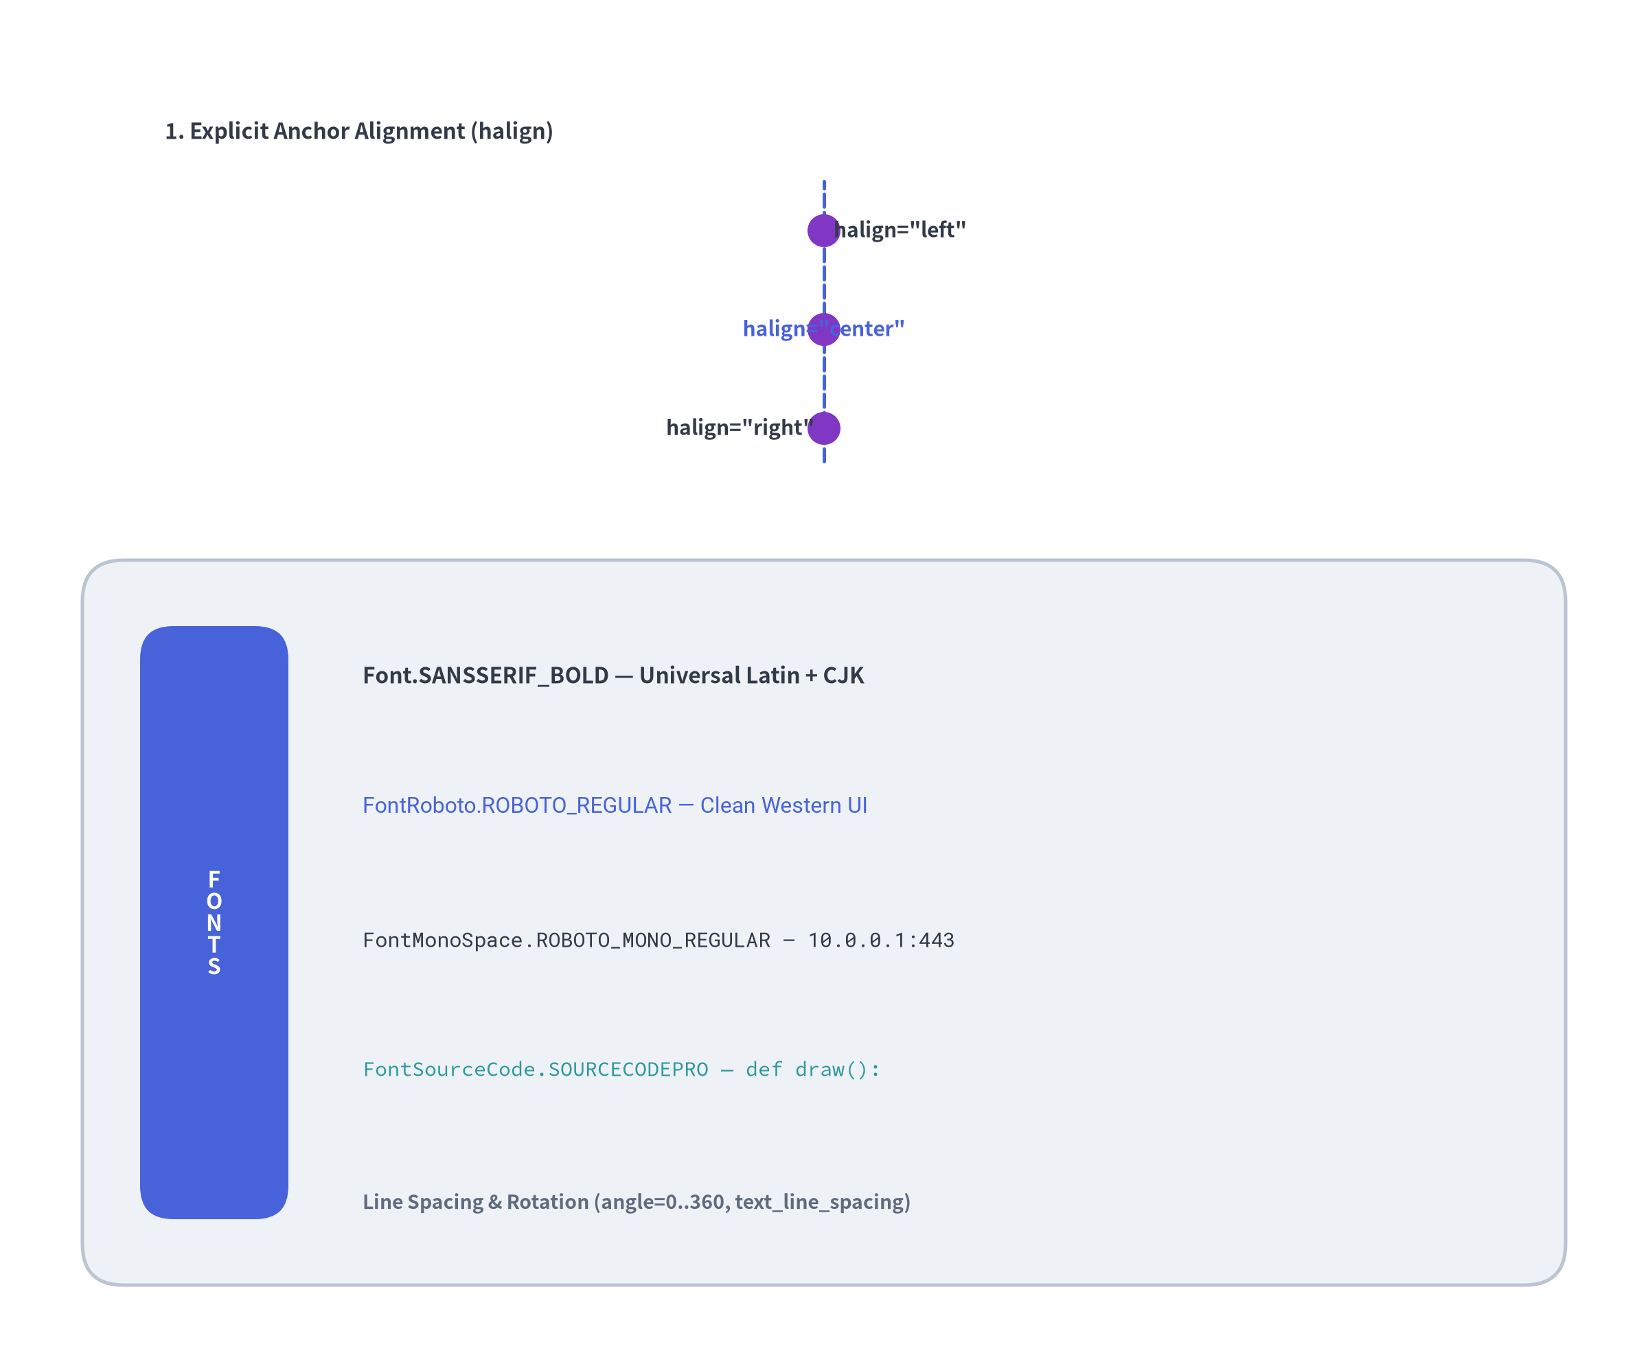

Typography, Alignments & Embedded Fonts (drawlib.text, drawlib.fonts)
Universal multilingual fonts, explicit anchor alignments, and automatic @font-face SVG bundling.
1. Horizontal & Vertical Text Primitives
from drawlib.fonts import Font, FontFile, FontMonoSpace, FontRoboto, FontSourceCode
from drawlib.styles import Styles
from drawlib.text import text, text_vertical
# Anchor alignment via halign & valign
text((20, 60), "Left Anchor",
style=Styles.DarkBold.patch(halign="left"))
text((80, 60), "Right Anchor",
style=Styles.DarkBold.patch(halign="right"))
# Built-in font families & custom TTF/OTF files
text((50, 40), "Roboto Bold",
style=Styles.PrimaryBold.patch(text_font=FontRoboto.ROBOTO_BOLD))
text((50, 25), "Custom FontFile(.ttf)",
style=Styles.AccentBold.patch(text_font=FontFile("brand.ttf")))
# Vertically stacked characters
text_vertical((12, 30), "TIER", style=Styles.MutedBold)
2. Automatic SVG @font-face Bundling
• When compiling slides or docs with .svg diagrams, Drawlib automatically copies required .ttf/.otf font files into _assets/fonts/ and injects @font-face rules so browsers and PDF exports render identically anywhere.
Notes:
• Typography in Drawlib is handled through drawlib.text and drawlib.fonts.
• text() and text_vertical() support exact horizontal (left, center, right) and vertical (bottom, center, top) anchor alignment.
• Built-in font families include Font (universal Noto Sans/Serif with CJK), FontRoboto, FontMonoSpace, FontSourceCode, regional scripts, and FontFile for custom .ttf/.otf assets—all automatically bundled into _assets/fonts/ for SVG rendering.

Slide 19
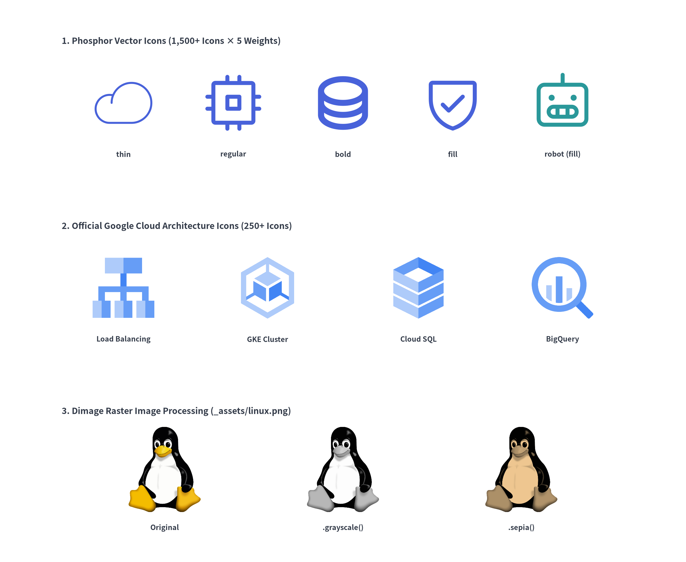

Standardized Icons & Image Processing (drawlib.icons, drawlib.images)
1,500+ Phosphor vector glyphs, 250+ official GCP cloud icons, and in-memory Dimage transformations.
1. Dual Icon Engine (phosphor & gcp)
from drawlib.icons import gcp, phosphor
from drawlib.images import Dimage, image
from drawlib.styles import Styles
# Vector Phosphor icons (5 weights: thin, light, regular, bold, fill)
phosphor.cpu((20, 65), width=12, style=Styles.PrimaryBold)
phosphor.database((45, 65), width=12, style=Styles.PrimaryFlat)
# Official Google Cloud architecture icons (multi-color PNGs)
gcp.compute_engine((20, 40), width=14, style=Styles.Neutral)
gcp.cloud_sql((45, 40), width=14, style=Styles.Neutral)
2. Bitmap Manipulation with Dimage
• Load external .png/.jpg/.webp assets or capture sub-diagrams in memory via get_dimage_from_code().
• Chain non-destructive effects: .grayscale(), .sepia(), .invert(), .brightness(), .blur(), .mosaic(), .trim(), and .make_transparent().
image((30, 15), width=16, image="_assets/linux.png")
image((65, 15), width=16, image=Dimage("_assets/linux.png").grayscale())
Notes:
• Standardized icons make technical architectures readable at a glance.
• drawlib.icons provides over 1,500 vector phosphor icons across 5 typographic weights (thin, light, regular, bold, fill) and 250+ official gcp cloud service icons.
• drawlib.images complements vector icons with image() and Dimage, allowing you to embed bitmap logos and apply transformations like .grayscale() and .sepia() directly in Python.

Slide 20
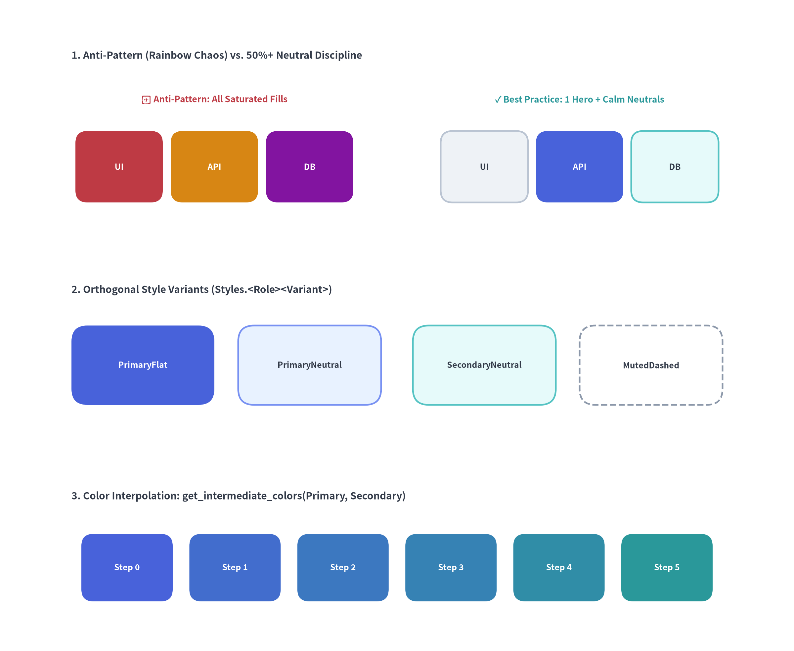

Design Token Discipline & The 50%+ Neutral Rule (drawlib.styles)
How systematic PascalCase tokens and neutral grounding prevent "rainbow chaos" in technical diagrams.
1. Systematic Styles.<Color><Variant> Matrix
from drawlib.styles import Colors, Styles, get_intermediate_colors
# Always import PascalCase Styles & Colors!
hero = Styles.PrimaryFlat # Saturated focal point
card = Styles.PrimaryNeutral # Soft tinted-neutral card
base = Styles.Neutral # Calm slate/white baseline
zone = Styles.MutedDashed # Container boundary
# Immutable overrides via .patch()
custom = Styles.PrimaryBold.patch(line_width=3.0, text_size=12)
# Smooth color interpolation for gradients & heatmaps
ramp = get_intermediate_colors(Colors.Primary, Colors.Secondary,
num=3, include_ends=True)
2. The 50%+ Neutral Baseline Rule
• Avoid Rainbow Chaos: Never fill every node with competing saturated colors (PrimaryFlat, WarningFlat, DangerFlat, PurpleFlat).
• Ground 50%+ in Calm Neutrals: Use Styles.Neutral, Styles.PrimaryNeutral, Styles.SecondaryNeutral, Styles.BlueNeutral for standard components, reserving Styles.PrimaryFlat / Styles.AccentFlat (text_style=Styles.WhiteBold) strictly for 1–2 focal hero nodes.
Notes:
• Design token discipline is what separates amateur diagrams from executive-ready architecture blueprints.
• Always import Colors and Styles in PascalCase from drawlib.styles.
• Follow the 50%+ Neutral Baseline rule: ground at least half of your shapes in calm neutrals (Styles.Neutral, Styles.PrimaryNeutral, Styles.SecondaryNeutral), and reserve saturated fills (Styles.PrimaryFlat) for 1 or 2 hero focal nodes.

Slide 21
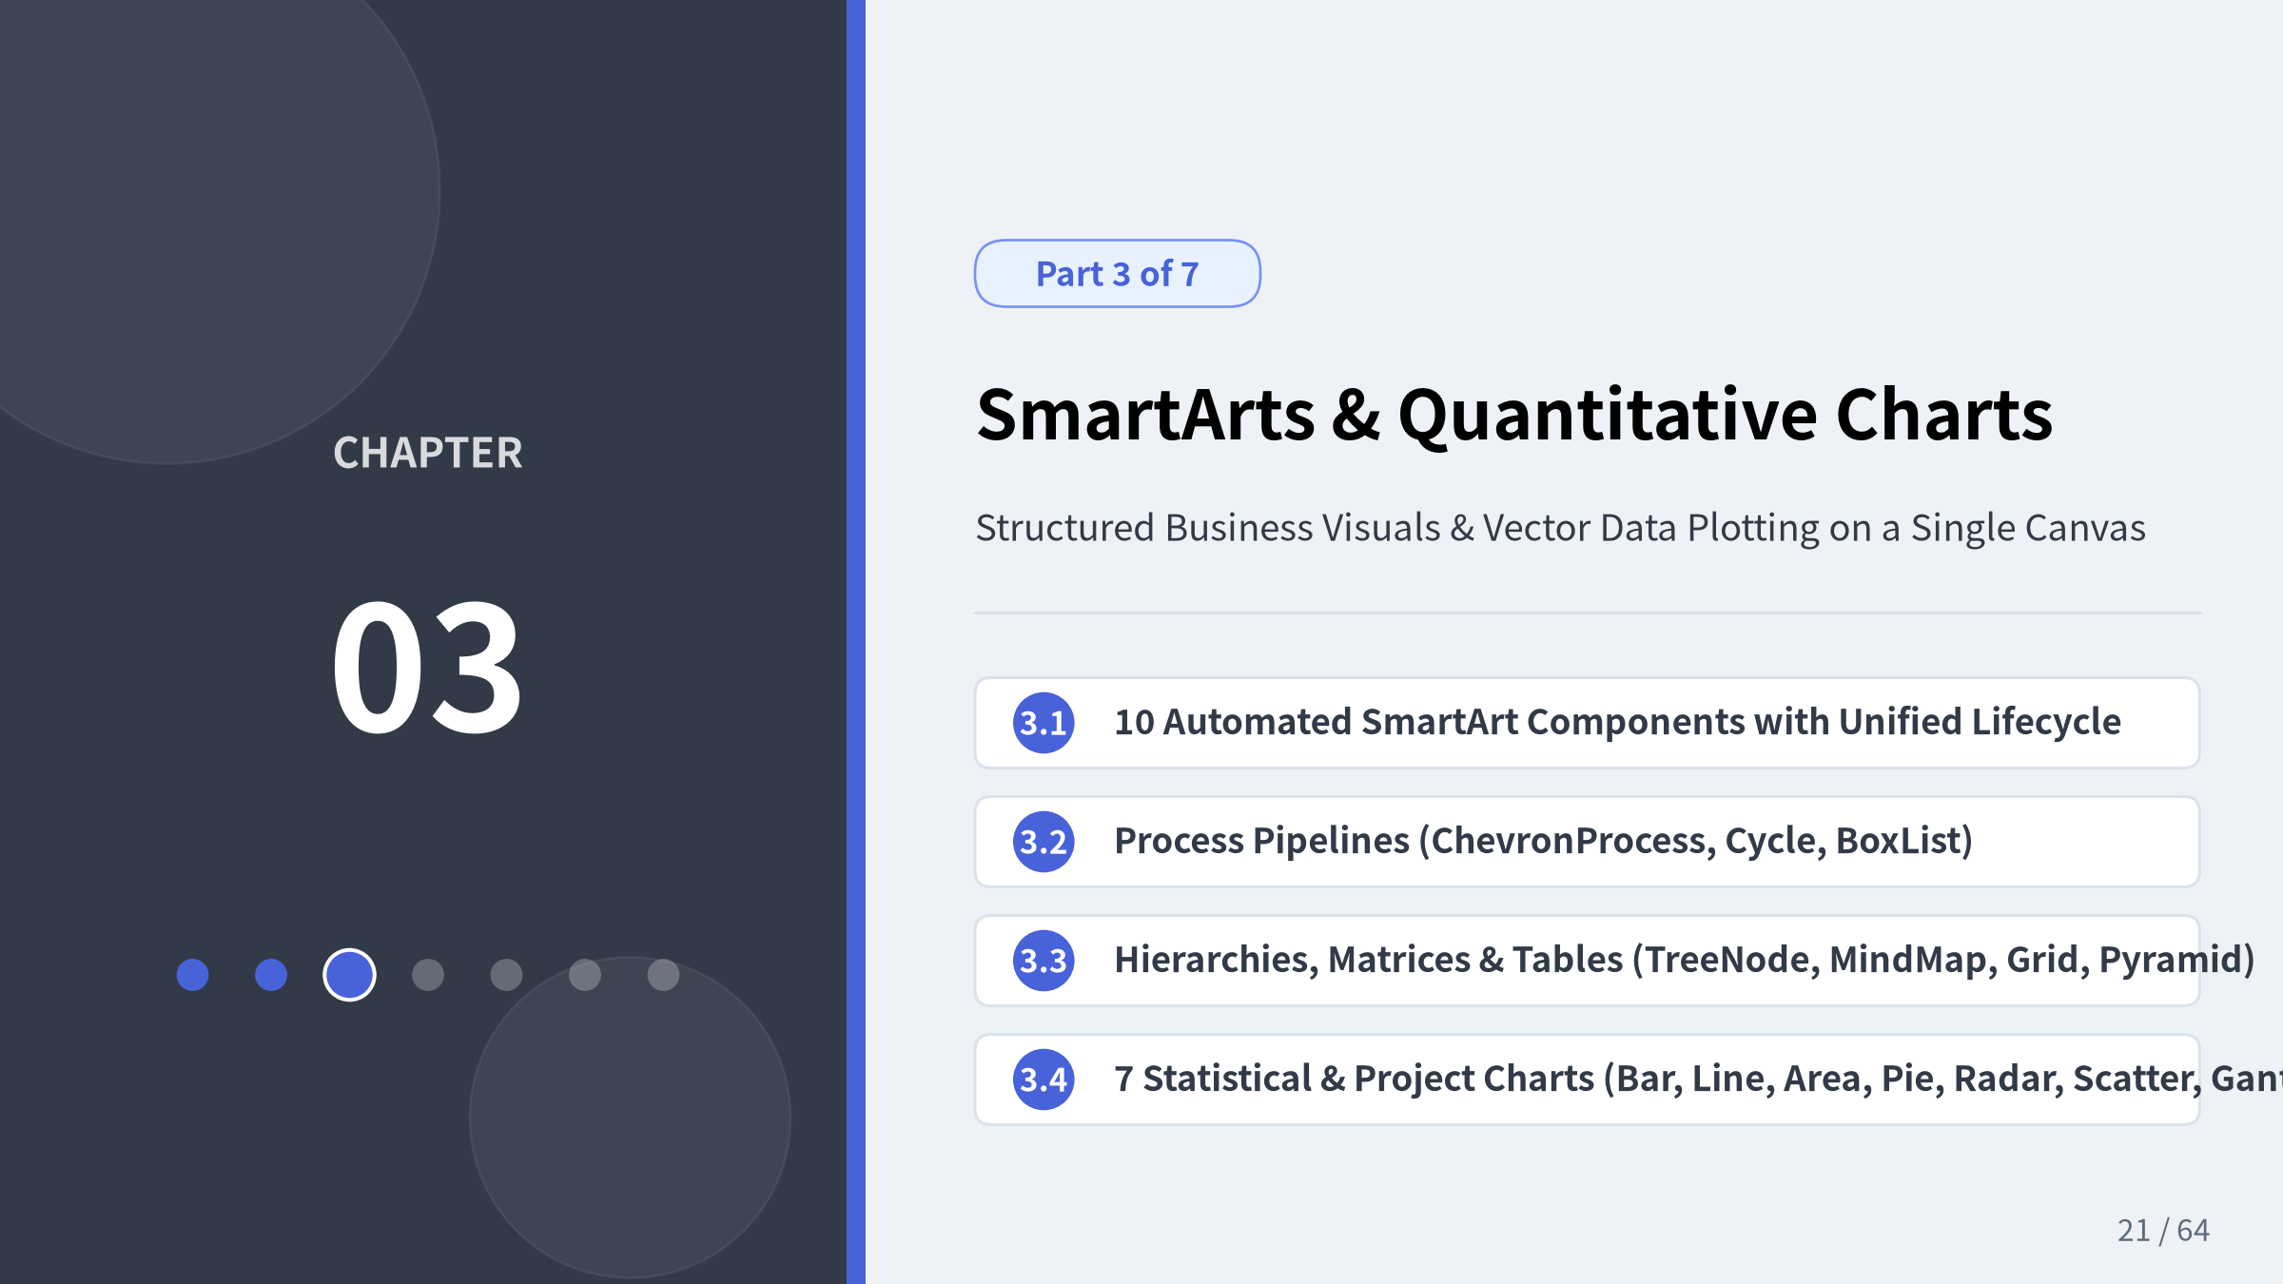
Notes:
• Welcome to Chapter 3: SmartArts & Quantitative Charts.
• Up to this point, we explored Drawlib's foundational canvas, primitives, icons, and the 7-color semantic design system.
• While primitives give you pixel-exact freedom, assembling recurring patterns like process chevrons, circular PDCA loops, directory trees, tables, or statistical charts out of raw rectangles and lines is tedious and error-prone.
• In this chapter, we introduce two high-level modules that automate complex geometric math while staying 100% native to the Drawlib vector canvas:
1. drawlib.smartarts: 10 structured business and technical visual components with a unified 4-phase lifecycle.
2. drawlib.charts: 7 statistical, relational, and project timeline charts that coexist directly alongside architecture diagrams on the same coordinate plane.

Slide 22

SmartArts Architecture & Unified Lifecycle
10 High-Level Structured Components (drawlib.smartarts)
Instead of manually calculating polygon vertices and text offsets, drawlib.smartarts automates layout geometry for 10 essential diagram patterns:
Anchor Convention | SmartArt Components | Flow Direction
Top-Left (x, y) | Table, TreeNode, BulletPoints, SourceCode | Rightward (+x) & Downward (-y)
Bottom-Left (x, y) | ChevronProcess, GridLayout, Pyramid | Rightward (+x) & Upward (+y)
Center (x, y) | MindMapNode, Cycle (default) | Radial outward from center
Directional (x, y) | BoxList ("left", "right", "bottom", "top") | Along chosen axis
Unified 4-Phase Component Lifecycle
1. Instantiate: Configure default style and text_style tokens.
2. Register (add(..., show=True)): Returns a mutable item reference.
3. Mutate in Place: Toggle item.show = False or patch item.style across animation frames without shifting layout coordinates.
4. Render (draw(xy, scale=1.0)): Uniformly scales shapes, strokes, and fonts around xy.
Notes:
• drawlib.smartarts provides 10 high-level graphical components that bridge the gap between low-level geometric primitives and full domain diagrams.
• Notice the Coordinate Anchor Table on the left:
Coordinate Anchor Table
• Components that read top-to-bottom like text (Table, TreeNode, BulletPoints, SourceCode) anchor at their Top-Left (x, y) coordinate.
• Structural blocks that stack or extend from a baseline (ChevronProcess, GridLayout, Pyramid) anchor at their Bottom-Left (x, y) coordinate.
• Radial structures (MindMapNode, Cycle) anchor at their Center (x, y).
• Every stateful SmartArt shares the 4-Phase Lifecycle shown in the top ChevronProcess:
4-Phase Lifecycle
ChevronProcess
1. Instantiate with base styles.
2. Register items via .add(..., show=True), which returns a mutable item object.
3. Mutate .show or .style between frames for step-by-step slide builds without shifting other items.
4. Call .draw(xy, scale=1.0) to render at any resolution or scale factor.

Slide 23
Pipelines & Feedback Loops (ChevronProcess & Cycle)
Linear Stages vs. Continuous Iterations
1. ChevronProcess — Phased Pipelines
• Interlocking Geometry: Automatically computes chevron tip angles (corner_angle=60.0) and uniform item widths across total width.
• Clean Entry Edge: flat_left_end=True renders the first stage as a flat-backed pentagon while subsequent stages interlock seamlessly.
• Dual-Line Labels: Each stage supports a primary text heading and a secondary description subtitle with independent style overrides.
2. Cycle — Circular & Radial Workflows
• Trigonometric Orbit: Distributes N nodes ("circle", "rectangle", or "none") evenly around orbit radius starting from start_angle=90.0 (12 o'clock).
• Curved Arc Connectors: Connects steps with circular arc arrows (arrow_type="arc") and configurable arrow_color_mode ("monochrome", "match_source", "match_target").
• Central Command Hub: Calling cycle.set_center(...) places a central hub node inside the orbit for radial governance or SRE command loops.
Notes:
• This slide showcases two of the most frequently used process components in drawlib.smartarts: ChevronProcess and Cycle.
• In the top panel, ChevronProcess renders a 5-stage CI/CD pipeline with flat_left_end=True. Notice how Stage 3 ("Security Gate") uses Styles.PrimaryFlat with Styles.WhiteBold text as the primary focal point, while the remaining 80% of stages use calm neutral and tinted-neutral styles (Styles.Neutral, Styles.PrimaryNeutral, Styles.SecondaryNeutral, Styles.TealNeutral).
• In the bottom panel, Cycle renders a 5-step SRE Incident Response loop around a central set_center("SRE", description="On-Call Hub") node. Drawlib automatically computes the 72-degree angular intervals and trims the circular arc arrows (arrow_gap) so arrowheads never collide with node borders.

Slide 24
Stacks, Matrices & Tiered Layers (BoxList, GridLayout, Pyramid)
Structured Card & Layer Components
1. BoxList — Directional Card Sequences
• Aligns sequential cards along "left", "right", "bottom", or "top" orientations.
• Ideal for status badges, KPI ribbons, and linear step stacks.
2. GridLayout — Multi-Span Architecture Matrices
• Bottom-Left Indexed: (col=0, row=0) starts at the bottom-left cell; rows increment upward (+y) and columns increment rightward (+x).
• Cell Spanning: Any item can span multiple columns and rows (position=(col, row), width=w, height=h) to model full-width ingress/platform layers alongside multi-column microservice cells.
• Outer Container: Optional outer_style (including shape_r) wraps the entire matrix in a dashed or solid boundary.
3. Pyramid — Proportional Tiered Hierarchies
• Slices a triangular pyramid into an apex triangle and progressive trapezoidal tiers.
• Supports direction="bottom" (upright) or "top" (inverted funnel) and order="vertex_to_base" or "base_to_vertex".
Notes:
• On this slide, we combine three structural SmartArt components on a single canvas: GridLayout on the left, Pyramid on the right, and BoxList along the bottom ribbon.
• Left (GridLayout): Demonstrates cell spanning in a 4x4 matrix. Remember that GridLayout is anchored at the bottom-left (x, y) and row=0 is the bottom-most row ("Multi-Zone Kubernetes Foundation"), while row=3 is the top-most row ("Edge Ingress"). Middle rows span 1 or 2 columns to represent individual microservices and data stores.
• Right (Pyramid): Models the classic Software Testing Pyramid using order="vertex_to_base": Manual exploratory testing (1%) at the apex, E2E UI tests (9%), Integration & Contract tests (20%), and Automated Unit Tests (70%) anchored at the wide foundation in Styles.PrimaryFlat.
• Bottom (BoxList): Shows a horizontal sequence of regional status cards using direction="left".

Slide 25
Hierarchies & Brainstorming (TreeNode & MindMapNode)
Two Complementary Tree Engines
1. TreeNode — Directory & Package Hierarchies
• Top-Left Anchored: Steps downward row-by-row with crisp orthogonal ├ and └ connector lines.
• Cascading Root Styles: Set text_style, line_style, and margins once on the root TreeNode; all descendants inherit them automatically.
• Custom Icon Attachments: Use TreeNode.register_drawing_item(...) and .set_drawing_item(name) to prepend or append Phosphor icons (phosphor.folder, phosphor.file_py, phosphor.file_code).
2. MindMapNode — Two-Pass Radial & Org Trees
• Pass 1 (Bottom-Up Measurement): Recursively measures exact subtree bounding heights and widths so branches never collide.
• Pass 2 (Orthogonal Routing): Routes right-angled junction lines from the center root node across all 4 directions (branch="left", "right", "top", "bottom").
• Flexible Node Shapes: Mix "ellipse", "rectangle", and borderless "none" leaf labels.
Notes:
• This slide compares Drawlib's two hierarchical SmartArt components: TreeNode and MindMapNode.
• Left (TreeNode): Designed for vertical directory and package listings. Using TreeNode.register_drawing_item, we bind Phosphor vector icons (phosphor.folder, phosphor.file_py, phosphor.file_code) that automatically align with the orthogonal tree lines.
• Right (MindMapNode): Uses a two-pass layout algorithm to measure subtree extents first and then route orthogonal connectors in all four directions (branch="left", "right", "top", "bottom") around the central "Platform Core" ellipse node.

Slide 26
Data Matrices & Embedded Code (Table & SourceCode)
Tabular Precision & Vector Syntax Highlighting
1. Table — Fine-Grained Matrix Styling
• Flexible Sizing: draw(xy, width, height, data) distributes columns evenly, while draw_flexible(xy, column_widths, row_heights, data) gives exact per-column and per-row dimensions.
• Zebra & Cell Highlighting:
◦ set_style_cell_evenodd(even_color, even_text_style, odd_color, odd_text_style) applies alternating row stripes.
◦ set_style_cell(background_color, text_style, rows=[...], columns=[...]) highlights specific SLA breaches or target cells.
• Selective Borders: set_style_border(top=..., top2=..., bottom=..., between_rows=...) controls perimeter and inner rules independently.
2. SourceCode — Vector Code Containers
• Renders Pygments-tokenized code directly onto the canvas as crisp vector glyphs and rounded containers (show_linenum=True).
• Built-in themes ("dark", "monokai", "default", "google", "monochrome") and CJK-aware monospace fonts (font_lang="en" | "ja").
Notes:
• Technical presentations frequently need to pair operational data tables with configuration snippets or code blocks right inside a diagram canvas.
• Top (Table): Demonstrates draw_flexible() with custom column widths ([26, 20, 16, 18, 12]), alternating row shading via set_style_cell_evenodd(), and targeted cell highlights via set_style_cell()—marking the 99.999% SLA cell in green and the 380 ms batch latency cell in rose.
• Bottom (SourceCode): Renders syntax-highlighted YAML directly into the vector SVG canvas with line numbers (show_linenum=True) and dark theme styling (SourceCodeStyles.get("dark")).

Slide 27
Quantitative Charts Overview (drawlib.charts)
Why Built-In Vector Charts Beat External Plotting Tools
Traditional workflows force you to plot charts in Matplotlib/Excel, export PNGs, and paste them next to architecture diagrams—resulting in mismatched fonts, blurry raster scaling, and broken visual alignment.
4 Pillars of drawlib.charts
1. First-Class Canvas Coexistence: Charts render directly onto the Drawlib canvas at any (x, y) coordinate. You can draw connector arrows directly from an architecture microservice node to a live telemetry BarChart or PieChart.
2. Deterministic Bounding Layout: Explicit width, height, and radius parameters guarantee predictable margins without layout drift.
3. Nice Numbers & Logarithmic Axes: Axis(scale="linear" | "log") automatically computes human-readable tick steps ($1, 2, 5 \times 10^k$) or base-10 powers ($10^k$) with custom formatters (format="{:.1f}M", unit="ms").
4. Animation-Ready (show & draw_ratio): Toggle series.show = False without rescaling axes, or animate draw_ratio (0.0 -> 1.0) along "bottom_to_top" or "left_to_right".
Notes:
• Why did we build a dedicated charting engine (drawlib.charts) when libraries like Matplotlib and Seaborn already exist?
• Look at the right-hand canvas: we have an architecture topology on the left (Edge Ingress -> API Gateway -> Worker Pool) and live vector BarChart and PieChart instances drawn on the exact same coordinate plane, connected by arrows directly from the API Gateway node!
• Every chart uses the exact same Styles, Colors, and bundled Font tokens as the surrounding diagram, eliminating font mismatches and raster pixelation.
• Furthermore, all 7 chart classes support series.show = False (which hides a series while locking the 100% axis scale so axes never jump during slide transitions) and draw_ratio (0.0 -> 1.0) for smooth bar/line/wedge growth animations.

Slide 28
Categorical & Trend Charts (BarChart, LineChart, AreaChart)
Cartesian Data Visualization
1. BarChart — Grouped, Stacked & Log Scales
• Supports orientation="vertical" | "horizontal" and bar_mode="group" | "stack".
• Rounded bar tip corners (bar_r=0.8), direct value labels (value_format="{:.0f}M"), and linear or logarithmic (scale="log") axes.
2. LineChart — Linear Polylines & Smooth Splines
• Set smooth=True for cubic-like spline interpolation or smooth=False for exact vertex segments.
• Per-series line_style ("solid", "dashed", "dotted"), line_width, and point_shape ("circle", "square", "none").
3. AreaChart — Cumulative & Overlapping Streams
• mode="stack" layers series cumulatively to show total volume breakdown; mode="overlap" renders semi-transparent overlapping polygons (fill_alpha=0.35).
• Shared fluent helpers across all three: configure_x_axis(...), configure_y_axis(...), and standalone draw_legend(xy, ...).
Notes:
• This slide demonstrates the three core Cartesian categorical/trend chart types: BarChart, LineChart, and AreaChart.
• Top-Left (BarChart): Compares quarterly Cloud ARR vs. Services revenue using bar_mode="group", rounded tip corners (bar_r=0.6), and direct value labels above each bar.
• Top-Right (LineChart): Plots 24-hour CPU utilization across a Primary Cluster (solid smooth spline curve with circle markers) and a Read Replica (dashed curve with square markers).
• Bottom (AreaChart): Visualizes cumulative regional network bandwidth in mode="stack" with fill_alpha=0.65, showing both individual region contributions and the aggregate global bandwidth envelope.

Slide 29
Radial & Relational Charts (PieChart, RadarChart, ScatterChart)
Proportions, Trade-Offs & Correlations
1. PieChart — Solid Pies & KPI Donuts
• Set hole_ratio=0.5 (up to 0.9) with center_text to render executive KPI donut rings.
• Supports per-slice outward emphasis (explode=2.5) and automatic label suppression on tiny wedges ($<4%$).
2. RadarChart — Multi-Axis Trade-Off Polygons
• Evaluates 3+ symmetric dimensions radiating from a central origin (grid_shape="polygon" | "circle").
• Ideal for comparing architectural trade-offs (e.g., Microservices vs. Monolith across Scalability, Latency, Reliability, Operability, and Velocity).
3. ScatterChart — XY Plots & 3D Bubbles
• Plots continuous (x, y) coordinates or 3-tuple (x, y, radius) bubbles across dual independent linear or log axes.
• Combine named add_series(...) clusters with individually labeled benchmark points via chart.add(xy, label=...).
Notes:
• This slide highlights three specialized chart types for proportional, multi-dimensional, and relational analysis:
1. PieChart (Top-Left): Configured as a Donut chart (hole_ratio=0.5) with a $4.8M Cloud center summary badge and an exploded primary slice (explode=1.2).
2. RadarChart (Top-Right): Compares Microservices vs. Monolith architectures across 5 non-functional dimensions (Scale, Reliability, Security, Velocity, Low Latency). Microservices excel at horizontal scale and team velocity, whereas the Monolith achieves lower in-process call latency.
3. ScatterChart (Bottom): Plots continuous X-Y benchmark measurements comparing an Async Rust Runtime (circle markers) against a Thread-Pool Worker (square markers), plus a standalone labeled SLO ceiling marker (chart.add(...)).

Slide 30
Engineering Roadmaps & Timelines (GanttChart)
Declarative Project Schedules as Code
Maintaining engineering roadmaps in external spreadsheet or GUI tools makes version control diffs impossible. GanttChart models schedules directly in Python:
Core Schedule Building Blocks
• add_section(name): Full-width horizontal divider bands that group tasks by workstream or team.
• add_task(name, start, end, style, progress=...):
◦ start and end accept column names ("Apr") or continuous floating-point column indices (1.5 = middle of 2nd column).
◦ progress (0.0 to 1.0) renders a two-tone completion fill bar with percentage text (progress_text_style).
• add_milestone(name, at, style): Renders a diamond milestone marker at exact timeline coordinate at.
• add_dependency(from_task, to_task): Routes orthogonal finish-to-start dependency arrows between tasks.
• add_marker(at, style, label="Today"): Draws a vertical status line across all rows.
Notes:
• Slide 10 concludes Chapter 3 with GanttChart, one of the most practical charts for software engineering teams.
• Notice how GanttChart combines all five scheduling primitives in a single declarative specification:
GanttChart
1. add_section() divides the roadmap into three clear engineering workstreams.
2. add_task() specifies start/end offsets across the four quarterly columns (0.0 to 4.0) along with completion ratios (progress=1.0, 0.85, 0.60, 0.25).
3. add_milestone() places diamond markers at v2.0 Core Freeze and GA Release v2.0.
4. add_dependency() routes orthogonal arrows linking dependent tasks (t1 -> t2 -> t3 -> t4 -> t5).
5. add_marker(at=1.85, label="Today") draws a dashed vertical line marking the current date across the entire schedule.

Slide 31
Notes:
• Welcome to Chapter 4: Domain Diagrams & Auto-Layout Graphs.
• Software architecture documentation requires standard formal notations: cloud network topologies, ISO 5807 swimlane flowcharts, chronological UML sequence lifelines, Crow's Foot database schemas, UML 2.0 class hierarchies, and finite state machines.
• In the first half of this chapter, we explore drawlib.diagrams—six purpose-built engines where you specify clean node coordinates while Drawlib handles boundary clipping, orthogonal Z-bends, row-level foreign key anchoring, and group bounding boxes.
• In the second half, we explore drawlib.graph—five pure coordinate layout solvers (ArchitectureGraph, LayerGraph, TreeGraph, RadialGraph, and GridGraph) that compute GraphLayout coordinates via get_layout() (print(layout) and layout.offset()) for seamless 2-step rendering with drawlib.diagrams and drawlib.shapes.

Slide 32
The 6 Domain Diagram Engines (drawlib.diagrams)
Purpose-Built Engines with Shared Architecture
Unlike black-box text-to-diagram tools (PlantUML, Mermaid) that scramble your layout whenever a label changes, drawlib.diagrams combines deterministic coordinate placement with intelligent boundary & wire automation:
4 Shared Architectural Guarantees
1. Center & Icon Coordinate Anchoring: Passing xy=(x, y) to d.add(...) anchors the exact geometric center of the card or icon—ensuring aligned nodes always connect with perfectly straight horizontal or vertical wires.
2. Universal Connectable Protocol: Nodes, groups, entities, classes, states, and Junction waypoints share dynamic boundary clipping, start_side/end_side port selection, and smart "orthogonal" / "direct" / curved bend routing.
3. Layout-Preserving show=True/False: Hiding any node (node.show = False) automatically hides its connected edges and dangling fork() stems while keeping NodeGroup bounds, swimlanes, and lifeline spacing 100% locked.
4. Uniform draw(xy, scale=1.0): Scales the entire diagram proportionally around bottom-left xy.
Notes:
• drawlib.diagrams provides 6 specialized domain diagram engines organized into three families:
drawlib.diagrams
1. System & Architecture: ArchitectureDiagram for cloud infrastructure, VPCs, and microservice meshes.
2. Behavior & Process: FlowDiagram (ISO 5807 flowcharts with cross-functional swimlanes), SequenceDiagram (chronological lifelines and with condition frames), and StateDiagram (UML statecharts and FSMs).
3. Structural & Data Models: ERDiagram (Crow's Foot database schemas with column-level anchoring) and ClassDiagram (UML 2.0 3-compartment class models).
• All 6 engines share the Connectable routing engine, show=True/False layout-preserving visibility for animations, and draw(xy, scale=1.0).

Slide 33
ArchitectureDiagram Fundamentals: Icons, Groups & Forks
Why ArchitectureDiagram Wires Never Kink
In naive diagramming tools, adding a 2-line label underneath an icon shifts the node's bounding center downward, causing horizontal arrows between aligned icons to develop ugly Z-bends.
3 Core Innovations
1. Card-Centric Coordinates (xy = Card Center):
◦ When you call d.add(Node("Label", width=w, height=h, icon=...), xy=(x, y)), (x, y) is strictly the center of the node card (w, h).
◦ Multi-line labels fit inside the card without shifting the card's center—so nodes sharing the same y always connect with a razor-straight horizontal line!
2. Auto-Bounding NodeGroup Containers:
◦ Calling group = d.add(NodeGroup(title="...", padding=6.0), xy=(gx, gy)) creates a relative coordinate group that automatically expands its boundary box to enclose all child nodes and nested subgroups.
3. 1-to-N Bus Fan-Out (node.fork()):
◦ lb.fork([svc1, svc2, svc3], at_x=55.0, padding=2.0) creates a clean vertical distribution bus at at_x with orthogonal taps into every target node.
Notes:
• This slide illustrates the three core design mechanics of ArchitectureDiagram:
ArchitectureDiagram
1. Card-Centric Alignment: Look at Mobile & Web Client App (which has a 3-line label) and API Gateway (which has a 1-line label). Because both are placed at y=38.0, their cards are horizontally aligned and the "Straight Y=38" arrow between them is completely flat without any vertical jog.
2. gateway.fork([w1, w2, w3], at_x=52.0): Instead of drawing three overlapping diagonal lines from the gateway, .fork() places a clean vertical bus at x=52.0 and branches orthogonally into each worker.
3. Auto-Bounding NodeGroup: The dashed container around the three workers calculates its width and height automatically from the enclosed nodes plus padding=6.5.

Slide 34
Multi-Tier Production Cloud Topology (GcpIcon & PhosphorIcon)
Official Cloud & Interface Icons Built In
drawlib.diagrams.architecture integrates directly with Drawlib's icon ecosystem:
• GcpIcon (259 Official Icons):
◦ Compute & Containers: GcpIcon.GOOGLE_KUBERNETES_ENGINE, GcpIcon.CLOUD_RUN, GcpIcon.COMPUTE_ENGINE
◦ Networking & Security: GcpIcon.CLOUD_LOAD_BALANCING, GcpIcon.CLOUD_ARMOR, GcpIcon.CLOUD_CDN
◦ Databases & Storage: GcpIcon.CLOUD_SQL, GcpIcon.CLOUD_SPANNER, GcpIcon.CLOUD_STORAGE, GcpIcon.BIGQUERY
• PhosphorIcon (1,531 Vector Icons):
◦ Clients, browsers, devices, locks, queues, and generic infrastructure symbols.
Nested Hierarchical NodeGroups
• Nest Public Subnet and Private Subnet groups inside an outer VPC Network group (vpc.add(NodeGroup(...), xy=...)).
• Child coordinates inside a NodeGroup are local to that group's origin, making subnet refactoring effortless.
Notes:
• Here we see a complete production Google Cloud VPC topology rendered with ArchitectureDiagram.
• Notice the nested NodeGroup hierarchy:
NodeGroup
• The outer VPC Network (10.0.0.0/16) group encloses two inner groups: Public Subnet (10.0.1.0/24) (styled in Styles.PrimaryNeutral) and Private Subnet (10.0.2.0/24) (styled in Styles.SecondaryNeutral).
• Official GcpIcon assets (GcpIcon.CLOUD_LOAD_BALANCING, GcpIcon.GOOGLE_KUBERNETES_ENGINE, GcpIcon.CLOUD_SQL, GcpIcon.CLOUD_STORAGE) are paired with PhosphorIcon.USER for external client traffic.
• lb.fork([gke1, gke2], at_x=48.0) cleanly splits traffic across the subnet boundary into both GKE pods.

Slide 35
Workflows & Swimlanes (FlowDiagram)
ISO 5807 Flowcharts with Cross-Lane Coordinates
FlowDiagram models operational workflows, CI/CD release gates, and approval processes across organizational or system swimlanes:
Standard Flowchart Node Classes
• Start / End: Rounded stadium/pill terminals (shape_r=5.0).
• Process: Rectangular execution step (24 x 12).
• Decision: Diamond conditional gate (22 x 14) with explicit start_side="right" | "bottom" | "left" branch routing.
• Data: Slanted parallelogram for I/O artifacts or payloads (24 x 12).
Unified Swimlane Coordinate System
• Call flow.add_lane(name, width=...) for vertical columns or set lane_orientation="horizontal" for horizontal rows.
• Global Coordinate Plane: All nodes share the exact same global (x, y) canvas space—so placing steps across different lanes at the same y coordinate guarantees horizontal alignment!
Notes:
• This slide demonstrates FlowDiagram modeling an automated canary deployment and rollback workflow across three vertical swimlanes: CI Build Pipeline, Canary Verifier, and Production Fleet.
• Notice how all five ISO 5807 symbol types (Start, Data, Process, Decision, and End) are used with semantic styling:
Start
Data
Process
Decision
End
• Deploy 5% Canary is highlighted in Styles.PrimaryFlat as the hero action.
• p99 < 50ms & Err < 0.1%? uses a Decision diamond (Styles.SecondaryNeutral) that routes left to Auto-Rollback (Styles.WarningNeutral) on failure or right to Promote 100% Global Traffic (Styles.TealNeutral) on success.
• Because rollback, slo_gate, and promote all share y=21.0, the horizontal decision branches across all three swimlanes are perfectly level.

Slide 36
API Interactions & Lifelines (SequenceDiagram)
Chronological Protocols & Python Context Managers
SequenceDiagram turns protocol specifications into clean lifeline diagrams without manual Y-coordinate bookkeeping:
Expressive Python Idioms
• Participants & Groups:
◦ d.add(Participant("Name", width=18, height=13, icon=GcpIcon.CLOUD_RUN))
◦ vpc = d.add(ParticipantGroup(title="Zero-Trust Mesh", style=Styles.MutedDashed))
• Message Verbs (autonumber=True):
◦ a.request(b, "label"): Solid synchronous call arrow (―▶).
◦ b.reply(a, "label"): Dashed return arrow (---▶).
◦ is_async=True: Open stick arrowhead (―>) for Pub/Sub or async events.
• Execution & Annotations:
◦ p.activate() / p.deactivate() for lifeline execution bars.
◦ p.note("...", pos="right") or d.note("...", over=[p1, p2]) for sticky notes.
• Python with Condition Frames:
◦ with d.alt("Token Valid"): ... with d.else_("Expired"): ...
◦ with d.loop("Retry"): ..., with d.opt(...):, with d.par(...):
Notes:
• This slide showcases SequenceDiagram modeling an OAuth2 / JWT microservice call flow with autonumber=True.
• Notice how Python's with d.loop("Up to 2 Retries on Transient Timeout"): context manager naturally scopes the retry frame around the FetchOrders request and reply!
• ParticipantGroup(title="Internal Zero-Trust Service Mesh") draws a dashed boundary enclosing API Gateway, Auth / JWKS, and Order Service, while gateway.activate() and gateway.deactivate() render the vertical execution bar along the gateway's lifeline.

Slide 37
Relational Schemas & Crow's Foot (ERDiagram)
Information Engineering (IE) Database Modeling
ERDiagram visualizes physical and logical relational database schemas with strict Crow's Foot cardinality markers and row-aligned foreign key connectors:
Entity & Column Capabilities
• Auto-Height Tables: Entity(name="users", width=28.0) automatically scales its vertical height based on registered columns.
• Constraint Badges: entity.add_column(name, type="...", pk=True, fk=False, nullable=False) renders [PK], [FK], and mandatory field indicators cleanly aligned in the right column.
• 7 Crow's Foot Cardinalities:
◦ "1:*" (One-to-Zero-or-More || ── o<)
◦ "1:1..*" (One-to-One-or-More || ── |<)
◦ "1:1", "1:0..1", "0..1:1", "0..1:*", "*:*"
• Row-Exact Foreign Key Anchoring:
◦ Passing start_column="id", end_column="user_id" attaches the relationship wire directly to the vertical Y-center of those specific table rows!
Notes:
• Slide 7 demonstrates ERDiagram for relational database modeling.
• Look closely at the horizontal connections between users -> orders and orders -> order_items:
users -> orders
orders -> order_items
• By specifying start_column="id" and end_column="user_id", the orthogonal connector starts at the exact vertical height of the id [PK] row in users, steps down cleanly, and terminates with a Crow's Foot (o<) right at the user_id [FK] row in orders.
• Different Crow's Foot cardinalities are shown on the same canvas: "1:*" (one-to-zero-or-many), "1:1..*" (mandatory child one-to-many), and "1:0..1" (optional one-to-one payment settlement).

Slide 38
UML 2.0 Object-Oriented Models (ClassDiagram)
Three-Compartment Classes & 6 UML Connectors
ClassDiagram models object-oriented domain architectures, design patterns, and SDK type hierarchies in standard UML 2.0 notation:
ClassNode Structure
• Header Compartment: Supports stereotype="interface" («interface») and is_abstract=True («abstract»).
• Attributes (add_attribute): Automatic visibility prefixes (+ public, - private) and static underlines.
• Methods (add_method): Parameter signatures, return types, and abstract method styling.
All 6 Standard UML Relationship Types
relationship_type | Line & Marker | Semantics
"inheritance" | Solid + Hollow Triangle | Subclass generalizes superclass
"realization" | Dashed + Hollow Triangle | Concrete class implements interface
"composition" | Solid + Filled Diamond | Strong lifecycle ownership (1..*)
"aggregation" | Solid + Hollow Diamond | Shared collection reference
"association" | Solid Line / Arrow | Structural field link
"dependency" | Dashed + Open Arrow | Method/parameter dependency
Notes:
• Slide 8 demonstrates ClassDiagram modeling an object-oriented Payment & Order domain.
• Notice how four core UML 2.0 relationships are rendered with exact marker geometries:
1. "inheritance": Order extends the abstract class AuditableEntity («abstract») via a solid line and hollow triangle.
2. "realization": StripeGateway implements PaymentGateway («interface») via a dashed line and hollow triangle.
3. "composition": Order owns 1..* LineItem instances via a filled diamond marker at the Order source port.
4. "dependency": Order.checkout(gw: PaymentGateway) depends on PaymentGateway via a dashed open-arrow connector.

Slide 39
Finite State Machines & Lifecycles (StateDiagram)
UML 2.0 Statecharts & Concurrent Forks
StateDiagram models finite state automata, protocol lifecycles, and distributed job orchestrators:
Rich State & Pseudo-State Palette
• State(name, shape="box", entry=..., do=..., exit=...):
◦ Supports 5 shapes ("box", "ellipse", "circle", "double_circle", "text_only") and internal action compartments (entry / ..., do / ..., exit / ...).
• UML Pseudo-States:
◦ InitialState(): Solid black entry circle.
◦ ChoiceState(name="..."): Dynamic conditional diamond branch.
◦ ForkJoinState(orientation="vertical" | "horizontal", length=...): Solid synchronization bar for concurrent splits and joins.
◦ FinalState(): Bullseye termination target.
Formal Transition Formatting (sd.connect)
• sd.connect(src, dst, event="...", guard="...", action="...", bend=0.25) automatically formats event [guard] / action labels and supports curved arcs (bend) and self-loops (side="top").
Notes:
• Slide 9 showcases StateDiagram modeling a distributed batch job execution lifecycle.
• Every major UML statechart element is represented in this single flow:
1. InitialState() transitions into Queued (a "box" state with entry / enqueue() and do / await_slot() compartments).
2. ChoiceState(name="Quota?") evaluates cluster capacity: if [throttled] / backoff(), a negative curved arc (bend=-0.38) loops back underneath to Queued.
3. If [ok], execution hits a vertical ForkJoinState bar that splits into two concurrent active states (Map Shards and Stream Checkpoints), synchronizes at a second ForkJoinState bar, and finishes at FinalState().

Slide 40
2-Step Auto-Layout Engine (drawlib.graph -> get_layout())
Pure Coordinate Solver + Rich Rendering
Manual (x, y) coordinates give total precision, while black-box tools like Graphviz lock you out of custom icons and styles. drawlib.graph bridges both worlds as a pure coordinate calculator (get_layout() only):
The 2-Step Workflow of drawlib.graph
1. Step 1 — Solve & Inspect (layout = g.get_layout()):
◦ Declare topology via .node(id, width=..., height=...), .edge(src, dst), and .cluster(id, nodes=[...]).
◦ Call layout = g.get_layout(width=..., height=..., margin=...) to compute a GraphLayout.
◦ Inspect all solved coordinates via print(layout) or fine-tune positions with layout.offset("canary", dy=-2.5).
2. Step 2 — Render with diagrams or shapes:
◦ Pass layout["id"].xy, .local_xy, .bottom_left, .local_bottom_left, or edge.points directly into ArchitectureDiagram, FlowDiagram, or drawlib.shapes / drawlib.lines.
◦ Attach custom callouts (bubblespeech) or charts to exact solved coordinates!
Notes:
• What if you want automatic graph layout without giving up ArchitectureDiagram icons, FlowDiagram shapes, or pixel-level adjustments?
• drawlib.graph achieves this by acting strictly as a pure coordinate calculator (get_layout() only) in a 2-Step Workflow:
drawlib.graph
pure coordinate calculator (get_layout() only)
2-Step Workflow
1. Step 1 — Solve & Inspect (layout = g.get_layout()): Declare nodes, clusters, and edges and compute a GraphLayout. You can run print(layout) to inspect the coordinate table or call layout.offset("canary", dy=-2.5) to nudge a node or cluster.
2. Step 2 — Render with drawlib.diagrams or drawlib.shapes: As shown in the top panel, we pass layout[id].xy directly into FlowDiagram (Start, Process, End) and use layout["canary"].x, .y to attach a bubblespeech callout right above the computed node!

Slide 41
The 5 Specialized Graph Layout Solvers
Choosing the Right Solver for Your Topology
Instead of forcing one generic algorithm onto every graph, drawlib.graph provides 5 domain-tuned layout solvers sharing the BaseGraph.get_layout() API:
1. ArchitectureGraph (Compass + Nested Packing):
◦ 2-level macro/micro packer: nests child clusters inside parent containers (parent="vpc") and positions top-level zones via compass coordinates (pos="left" | "center" | "right" | "top" | "bottom").
2. LayerGraph (Sugiyama Hierarchical DAG):
◦ Cycle removal, longest-path rank assignment, .tier() rank pinning, and barycenter edge-crossing minimization.
3. TreeGraph (Reingold-Tilford Compact Tree):
◦ Proportional subtree contour spacing via .child(parent, child) so sibling branches never overlap.
4. RadialGraph (Concentric Hub & Spoke):
◦ Places a central hub at ring=0, allocates angular sectors across concentric rings, and exposes radii via layout.ring_radii.
5. GridGraph (2D Matrix + Smart Channel Routing):
◦ Places cells at (row, col) with .cluster_row() / .cluster_column() and routes non-adjacent edges through inter-cell channels.
Notes:
• This final slide of Chapter 4 solves and renders all 5 specialized graph layout solvers side-by-side on a single 108x84 canvas using get_layout(width=..., height=...):
5 specialized graph layout solvers
get_layout(width=..., height=...)
1. ArchitectureGraph (Top-Left): Packs nested containers (Compute inside Cloud VPC) and aligns top-level compass zones (Client on the left, Cloud VPC in the center).
2. LayerGraph (Top-Right): Runs the Sugiyama hierarchical DAG pipeline (Ingest -> [Parse, Enrich] -> Index).
3. TreeGraph (Bottom-Left): Balances parent-child subtrees symmetrically using Reingold-Tilford contours.
4. RadialGraph (Bottom-Center): Places the circular "Mesh" hub at ring=0 with dashed concentric ring guides (layout.ring_radii) and evenly spaced spokes.
5. GridGraph (Bottom-Right): Maps nodes onto a 2x2 matrix (row, col) with smart channel edge routing.

Slide 42
Notes:
• Welcome to Chapter 5: Multi-Frame Animations.
• Static diagrams are great for structure, but distributed systems, network traffic, and phased rollouts are inherently temporal.
• In this chapter, we explore how Drawlib brings diagrams to life using a declarative frame context manager (Animation and with anim.frame():), layout-preserving element visibility (.show), quantitative chart growth (.draw_ratio), and interactive slide playback controls.

Slide 43
Animation Architecture (drawlib.anim.Animation)
Declarative Frame Context Manager
Drawlib compiles multi-frame APNG (.png) and Animated WebP (.webp) directly from pure Python loops—with zero external video encoders required.
from drawlib.anim import Animation
from drawlib.canvas import clear, save, setup
from drawlib.shapes import circle
from drawlib.styles import Styles
clear()
setup(width=100, height=40)
anim = Animation(fps=8.0, loop=0)
for idx, x in enumerate([20, 40, 60, 80]):
is_last = idx == 3
with anim.frame(duration=2.0 if is_last else None):
circle((x, 20), radius=6, style=Styles.PrimaryFlat)
save("motion.png") # APNG or Animated WebP
Key Architectural Guarantees
• Per-Frame Redraw (clear=True default): Each with anim.frame(): clears the canvas and captures a clean snapshot on exit.
• Per-Frame Duration Overrides: Hold the final frame (duration=2.0) so viewers can absorb the completed state before looping.
• Poster Frame Compatibility: Frame 0 serves as the static fallback for GitHub Markdown and vector PDF exports.
Chapter 5: Multi-Frame Animations — Animation Context Manager & Encoding
Notes:
• Animation(fps=8.0, loop=0) registers an animation controller with the active Drawlib canvas.
• Using with anim.frame(duration=...): automatically clears the canvas at the beginning of each iteration and captures a rasterized Dimage snapshot when the with block exits.
• Calling save("file.png") or save("file.webp") encodes all captured frames and per-frame durations into a single self-contained APNG or Animated WebP file.

Slide 44
Animating Primitives & Packet Traffic
Coordinate & Color Interpolation
By computing coordinates (x, y) or interpolating colors via get_intermediate_colors() across frames, primitive shapes illustrate live request flows, heartbeats, and state transitions.
from drawlib.anim import Animation
from drawlib.canvas import clear, save, setup
from drawlib.shapes import circle, rectangle
from drawlib.styles import Styles
clear()
setup(width=98, height=84)
anim = Animation(fps=8.0, loop=0)
# Interpolate packet X across 4 microservice hops
hops = [(16, "Client"), (38, "API Gateway"),
(60, "Worker Pool"), (82, "Database")]
for pkt_x, active_hop in packet_schedule:
with anim.frame(duration=0.14):
# Redraw static topology + active node highlight
# Draw traveling request packet at (pkt_x, 46)
circle((pkt_x, 46), radius=2.2, style=Styles.AccentFlat)
Best Practices for Motion Loops
• Hoist Invariant Coordinates: Calculate node anchors and packet waypoints before entering the frame loop.
• Highlight Active Receiver: Use Styles.PrimaryFlat on the node currently processing the request while keeping idle nodes in Styles.Neutral.
• Smooth Color Fades: Use get_intermediate_colors(c1, c2, num=3, include_ends=True) for gradual heatmaps or status transitions.
Chapter 5: Multi-Frame Animations — Animating Primitives & Packet Traffic
Notes:
• Here we see an actual 10-frame APNG animation running automatically on the slide (anim:auto).
• Notice how the request packet (REQ in Amber) travels left-to-right from the Client through the API Gateway and Worker Pool to the Primary DB, and then returns (ACK in Green) while the active node highlights in Indigo (Styles.PrimaryFlat).

Slide 45
Progressive Component Reveal (.show = False → True)
Zero Layout Jump Across Keyframes
Every element in drawlib.smartarts, drawlib.diagrams, and drawlib.graph supports a mutable .show: bool property.
# Build full topology once outside the loop
d = ArchitectureDiagram(...)
vpc = d.add(NodeGroup("Cloud VPC"), xy=(6, 8))
n1 = vpc.add(Node("1. Edge LB", width=16, height=14, ...), xy=(14, 24))
n2 = vpc.add(Node("2. App Tier", width=16, height=14, ...), xy=(42, 24), show=False)
n3 = vpc.add(Node("3. Storage", width=16, height=14, ...), xy=(70, 24), show=False)
d.connect(n1, n2, label="gRPC")
d.connect(n2, n3, label="SQL")
# Reveal progressively across frames
for step in range(3):
n2.show = (step >= 1)
n3.show = (step >= 2)
with anim.frame(duration=0.8):
d.draw()
Why .show Beats Omitting .add()
• Fixed Container Bounds: NodeGroup, ChevronProcess, GridLayout, and LayerGraph compute full bounding boxes across all registered items—even when show=False.
• Automatic Edge Hiding: Hiding a diagram node (n3.show = False) automatically hides its incoming/outgoing edges and dangling junctions.
Chapter 5: Multi-Frame Animations — Layout-Preserving Progressive Reveal
Notes:
• Click the diagram (or press A) to step through the 5 stages interactively!
• Notice two critical behaviors:
1. In the top ChevronProcess, Stage 1 already has its exact 1/5th width on Frame 0 because stages 2–5 are registered with show=False.
2. In the bottom ArchitectureDiagram, the Google Cloud Production Environment VPC boundary stays 100% locked at its full size from Frame 0, and edges appear automatically as their target nodes turn .show = True.

Slide 46
Quantitative Chart Growth (.draw_ratio & .draw_direction)
Spatial Interpolation with Locked Axes
All 7 chart types in drawlib.charts return mutable Series, Slice, or Task objects supporting .draw_ratio (0.0 → 1.0) and .draw_direction.
bar_s = bar_chart.add_series(
"Throughput", [42, 68, 95, 128],
style=Styles.PrimaryFlat,
draw_direction="bottom_to_top",
)
line_s = line_chart.add_series(
"P99 Latency", [38, 29, 19, 12],
style=Styles.AccentFlat,
draw_direction="left_to_right",
)
for ratio in [0.15, 0.3, 0.45, 0.6, 0.75, 0.9, 1.0]:
bar_s.draw_ratio = ratio
line_s.draw_ratio = ratio
with anim.frame(duration=2.0 if ratio == 1.0 else 0.12):
bar_chart.draw(xy=(8, 44))
line_chart.draw(xy=(8, 6))
Dual Direction Modes across Chart Families
• "bottom_to_top": Bars grow vertically from baseline; RadarChart polygons expand radially outward; PieChart wedges grow from inner hole to outer radius.
• "left_to_right": LineChart & AreaChart sweep continuously along arc length; GanttChart tasks extend across timeline; PieChart sweeps angularly.
Chapter 5: Multi-Frame Animations — Quantitative Chart Growth (.draw_ratio)
Notes:
• Notice how both the BarChart (0 to 150k) and LineChart (0 to 60ms) keep their Y-axis ticks, gridlines, and category labels completely stationary while .draw_ratio interpolates from 0.15 to 1.00.
• BarChart grows upward (bottom_to_top), while LineChart sweeps smoothly from left to right (left_to_right), revealing vertex markers and value labels as the curve reaches each category.

Slide 47
Interactive Slide Animation Controls (click, once, pause)
Presenter-Driven Keyframe Stepping
In slide decks, you control <canvas> animation playback directly from the ```drawlib code fence header—turning multi-frame APNGs into interactive slide builds:
<figure class="drawlib-image">
<img src="images/05_animations/06_slide_anim_controls/step_click_demo.png" alt="Illustration" class="slide-raster-graphic" style="width: 100%; height: 100%; object-fit: contain;" />
</figure>
Fence Option | Shorthand / Alias | Behavior in slide.js
anim-trigger:auto | anim:auto | Starts playing automatically when entering the slide.
anim-trigger:click | anim:click | Holds on Frame 0 (READY) until clicked or A is pressed.
anim-loop:infinite | loop:infinite | Loops continuously back to Frame 0 after the last frame.
anim-loop:once | loop:once | Stops on the final frame (ENDED badge; click to reset).
anim-pause:1,2 | pause:1,2 | Pauses at 0-based frame indices (PAUSED badge) until the next trigger.
Synchronized Dual-Window Control
Chapter 5: Multi-Frame Animations — Interactive Slide Playback Controls
• Keyboard & Click: Click the diagram, press A, or click ▶ Play / Resume Animation in Presenter View (P) to step through pause points in real time across both screens.
Notes:
• Try clicking the diagram on the right or pressing A on your keyboard!
• Because the fence specifies anim:click anim-loop:once anim-pause:1,2, the slide opens in READY state on Frame 0 (Step 1).
• Clicking once advances to Frame 1 and pauses (PAUSED). Clicking again advances to Frame 2 (PAUSED). Clicking a third time advances to Frame 3 and stops in ENDED state. One more click resets back to Frame 0!

Slide 48
Zero-Dependency Base64 Canvas Playback (file:// Ready)
Why Standard <img> APNGs Fail in Slide Decks
Browsers play <img src="anim.png"> passively with zero JavaScript API to pause, step, reset on slide entry, or synchronize with Presenter View—and fetch("anim.png") fails with CORS errors when opened via file://.
Drawlib's Offline <canvas> Architecture
1. Build-Time Base64 Embedding (_assets.py):
◦ During drawlib build, the compiled APNG/WebP binary is Base64-encoded directly into <canvas class="drawlib-anim-canvas" data-base64="..."> alongside the file in images/.
2. Zero-CORS Binary Decoding (slide.js):
◦ window.atob(base64Data) reconstructs the raw Uint8Array buffer in memory—working 100% offline via double-click (file://) without an HTTP server.
3. Dual-Engine Frame Extractor:
◦ Primary Path: Hardware-accelerated WebCodecs ImageDecoder API extracts ImageBitmap frames + microsecond durations.
◦ Fallback Path: Built-in pure-JS APNG chunk parser (acTL, fcTL, IDAT, fdAT + CRC32) composites frames onto an offscreen canvas.
Chapter 5: Multi-Frame Animations — Zero-Dependency Base64 Canvas Engine
Notes:
• This slide explains how Drawlib achieves interactive frame-accurate animation control even when you open index.html directly from disk via file://.
• By embedding the Base64 payload (data-base64) on the <canvas> element at compile time and decoding frames in memory via WebCodecs ImageDecoder (with a built-in pure-JS APNG chunk parser fallback), Drawlib avoids file:// CORS restrictions completely.

Slide 49
Notes:
• Welcome to Chapter 6: Documentation & Slide Engine.
• Drawlib is not just a diagramming library—it is a complete "Illustrated Documentation as Code" compiler.
• In this chapter, we explore the four project archetypes scaffolded by drawlib init, how multi-page sites and vector PDFs are built, and how the 16:9 widescreen slide engine powers the very presentation you are viewing right now.

Slide 50
Four Project Archetypes (drawlib init)
Zero-Config Project Scaffolding
Never assemble documentation directories or build scripts manually. drawlib init scaffolds production-ready project structures with synchronized themes (styles.py + style.css) and modular build_*.sh scripts:
# 1. Multi-page documentation website with sidebar
uv run drawlib init site -s default
# 2. Linear technical specification / RFC / whitepaper
uv run drawlib init doc -s google
# 3. 16:9 widescreen presentation slide deck
uv run drawlib init slide -s default
# 4. Standalone batch Python illustration repository
uv run drawlib init image -s monochrome
Strict Source-of-Truth Separation
• Edit Only <target>_src/: All human- and agent-authored Markdown, styles.py, and utils.py live in <target>_src/.
• Deterministic Outputs: ./<target>_src/build.sh compiles <target>_html/, <target>.pdf, <target>_markdown/, and <target>_images/.
Chapter 6: Documentation & Slide Engine — Four Project Archetypes
Notes:
• Drawlib provides four specialized project archetypes out of the box via drawlib init:
drawlib init
1. site for multi-page technical documentation websites with a navigation sidebar (navbar.md).
2. doc for single-page specifications, whitepapers, and RFCs with automatic Table of Contents and A4 vector PDF export.
3. slide for 16:9 widescreen presentation decks (1920x1080).
4. image (images) for standalone batch Python illustration scripts.

Slide 51
Multi-Page Documentation Sites (site)
Technical Portals & GitHub Mirrors
A site project (docs_src/) compiles nested Markdown folders into both a responsive HTML documentation portal (docs_html/) and a GitHub-browsable Markdown mirror (docs_markdown/).
Core site Capabilities
• Declarative Sidebar (navbar.md):
◦ # Brand Title sets the top-left header; ## Section groups links into collapsible categories; every internal .md link is validated at build time.
• Interactive Code Tabs (show-code / fold-code):
◦ Adding show-code to a ```drawlib fence renders an interactive UI card allowing readers to toggle between the Rendered Diagram and Copyable Python Source.
• Pre-Flight Link & Asset Scanner (drawlib serve --check):
◦ scan_broken_links() verifies all internal <a href> links, section anchors, and <img src> assets before launching the live preview server.
Chapter 6: Documentation & Slide Engine — Multi-Page Documentation Sites (site)
Notes:
• Drawlib's own official documentation (docs/docs_src/) uses the site archetype.
• navbar.md controls the hierarchical sidebar on the left and validates every linked Markdown file at compile time.
• With show-code, readers can inspect the rendered diagram alongside the exact Python code that produced it, and drawlib serve --check verifies that zero broken links or missing images exist across the entire site.

Slide 52
Single-Page Technical Docs & Vector PDFs (doc & pdf)
Chapter-Merged Whitepapers & RFCs
The doc archetype (doc_src/) is purpose-built for linear technical documents—such as architecture RFCs, whitepapers, and quickstart manuals:
doc_src/
├── 00_cover.md # Title, subtitle, author metadata
├── 01_introduction.md # Chapter 1
├── 02_architecture.md # Chapter 2 (with ```drawlib blocks)
└── 03_benchmarks.md # Chapter 3
Dual Publication Outputs from One Source
1. Unified Standalone Web Document (doc_html/index.html):
◦ Merges all numbered .md chapters in sorted order into a single index.html with an auto-generated Table of Contents, a centered 900px reading container, and full file:// portability.
2. Print-Ready Vector PDF (doc.pdf):
◦ drawlib build pdf --toc --page-break launches headless Playwright / Chromium (page.pdf()) to render crisp vector diagrams, web fonts, and A4 page breaks with deterministic metadata.
Chapter 6: Documentation & Slide Engine — Single-Page Technical Docs & Vector PDFs
Notes:
• In Drawlib's own repository, both the Quickstart Guide (docs/quickstart_src/) and the Dogfooding Whitepapers (docs/drawlib-dogfooding_src/) use the doc archetype.
• Authors write modular chapter files (00_cover.md, 01_overview.md, ...), and Drawlib compiles them into both a single-page index.html and a print-ready A4 vector PDF via headless Chromium.

Slide 53
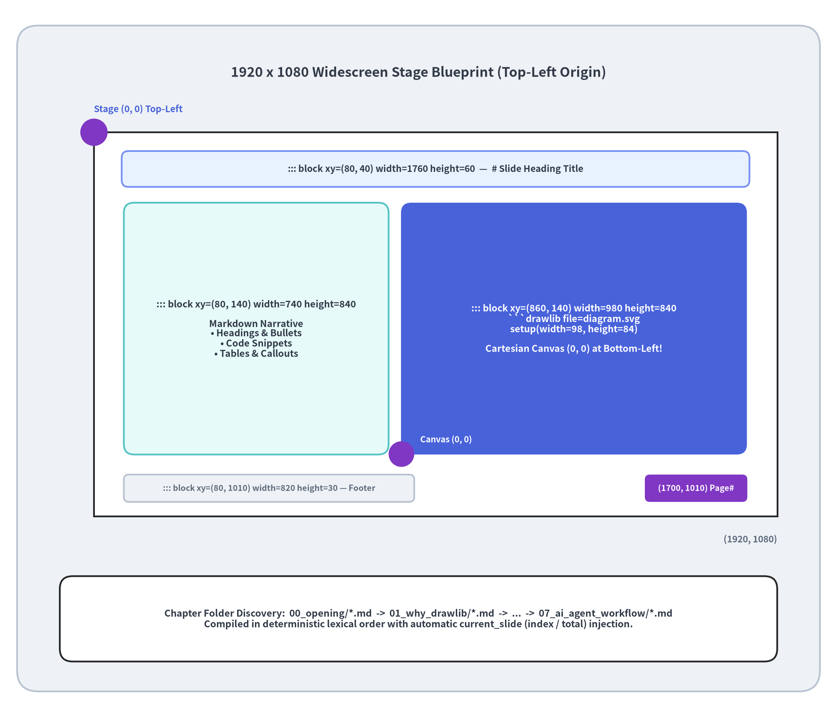
16:9 Widescreen Stage Architecture (1920x1080)
Dual Coordinate Systems Working in Harmony
Drawlib slides (drawlib init slide) combine pixel-accurate stage containers with Cartesian vector canvases:
1. Slide Stage (::: block xy=(x, y) width=W height=H) — Top-Left (0, 0):
◦ Fixed 1920 × 1080 pixel widescreen stage (automatically scaled to fit any browser window or projector).
◦ Supports hierarchical chapter folders (00_opening/, 01_why_drawlib/, ...) sorted alphabetically.
2. Drawlib Canvas (setup(width=W, height=H)) — Bottom-Left (0, 0):
◦ Inside any ```drawlib block, coordinates use standard Cartesian geometry where (0, 0) is the bottom-left corner.
Golden Aspect-Ratio Rule
Keep setup(width=W, height=H) proportional to the enclosing ::: block width and height (typically width / 10, height / 10) so inline SVGs fill their containers with zero letterboxing:
• ::: block xy=(860, 140) width=980 height=840 → setup(width=98, height=84)
• ::: block xy=(0, 0) width=1920 height=1080 → setup(width=192, height=108)
Chapter 6: Documentation & Slide Engine — 16:9 Widescreen Stage Architecture
Notes:
• Every slide in a Drawlib deck is authored on a 1920x1080 pixel stage where (0, 0) is the top-left corner, while each embedded drawlib block uses a Cartesian (0, 0) bottom-left coordinate canvas.
• Dividing the container's pixel width and height by 10 (for example, (980, 840) -> setup(width=98, height=84)) guarantees an exact 1:1 aspect ratio match.

Slide 54
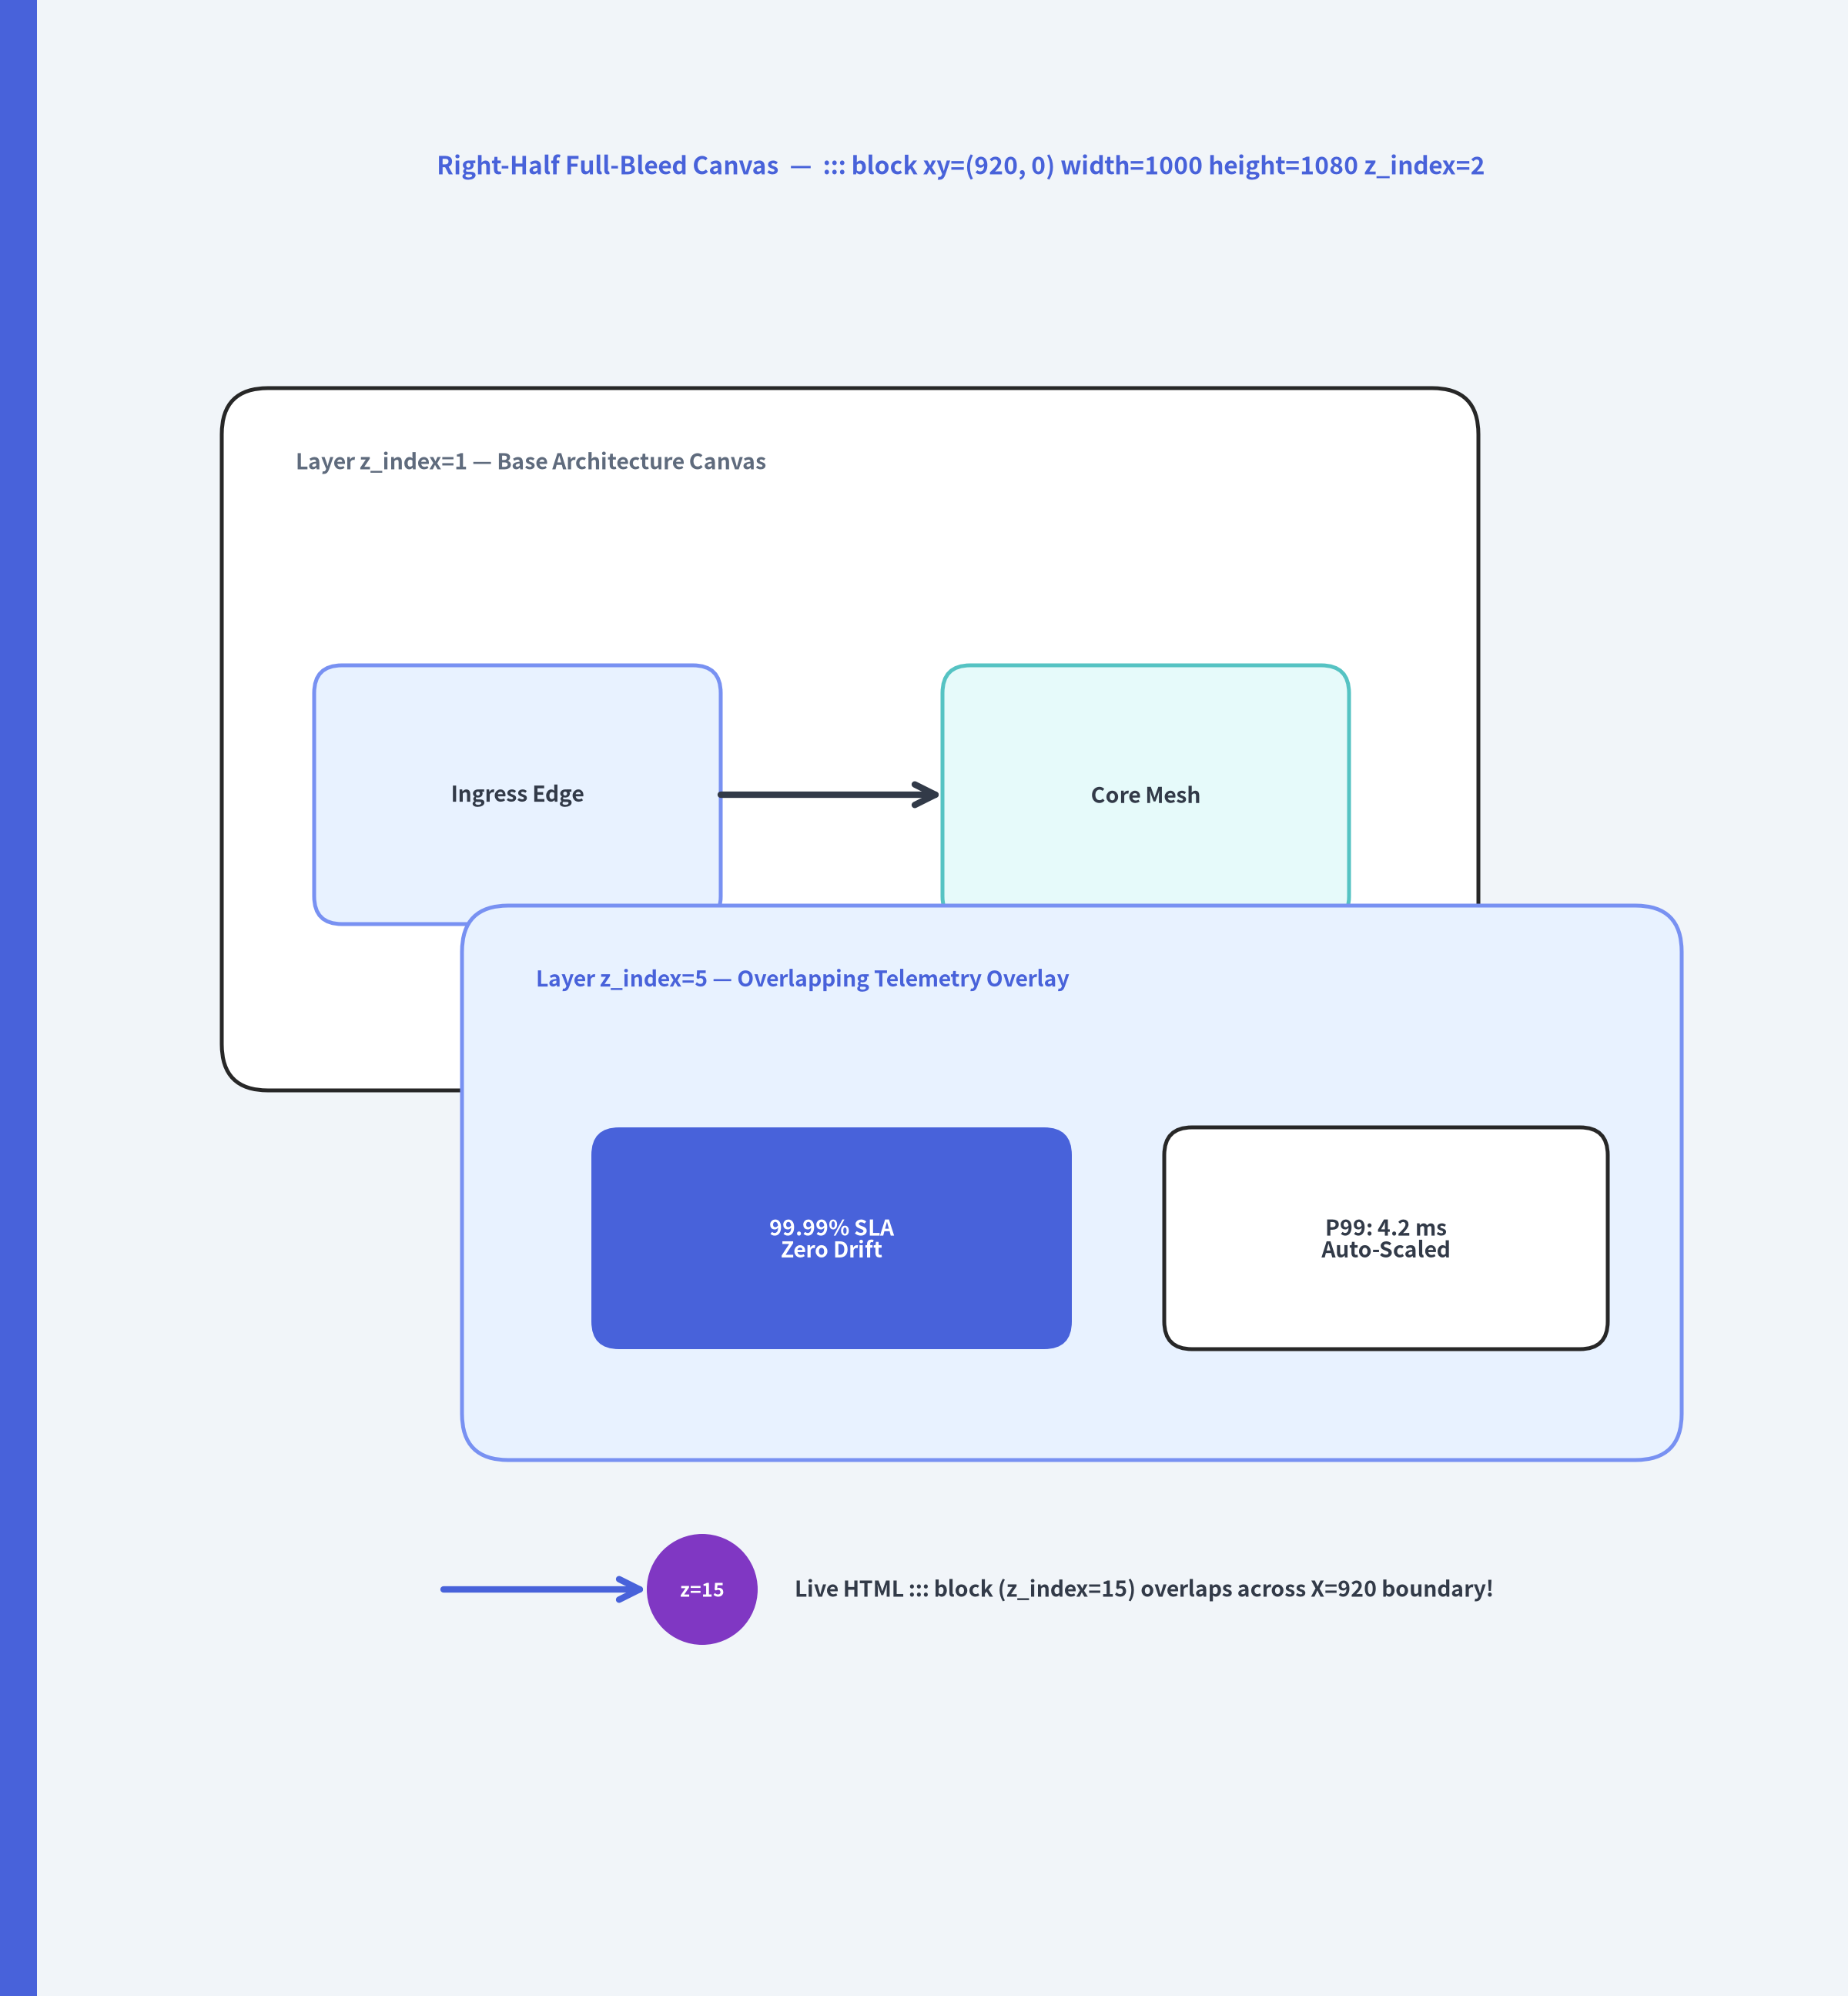

Spatial Freedom: Full-Bleed & Z-Index Layering
Breaking Free from Rigid Slide Templates
Traditional Markdown-to-slide tools lock you into centered bullet lists. Drawlib gives you absolute pixel coordinates plus z_index=<layer> stacking:
<!-- Layer 1: Right-half full-bleed diagram (Y: 0..1080) -->
Floating Callout (::: block ... z_index=15)
Live Floating Overlay (::: block xy=(760, 740) width=520 height=165 z_index=15)
• Bridges the left Markdown column (X: 80..840) and right full-bleed SVG (X: 920..1920).
• Styled with inline CSS (rgba slate background, indigo border, and drop shadow).
Chapter 6: Documentation & Slide Engine — Spatial Freedom & Z-Index Layering
Notes:
• Look at the right half of this slide: the SVG diagram (::: block xy=(920, 0) width=1000 height=1080 z_index=2) bleeds all the way from Y=0 at the top edge to Y=1080 at the bottom edge.
• And look at the dark indigo card near the bottom center: that is a real ::: block xy=(760, 740) width=520 height=165 z_index=15 HTML container floating right across the seam between the left text column and the right full-bleed SVG canvas!

Slide 55
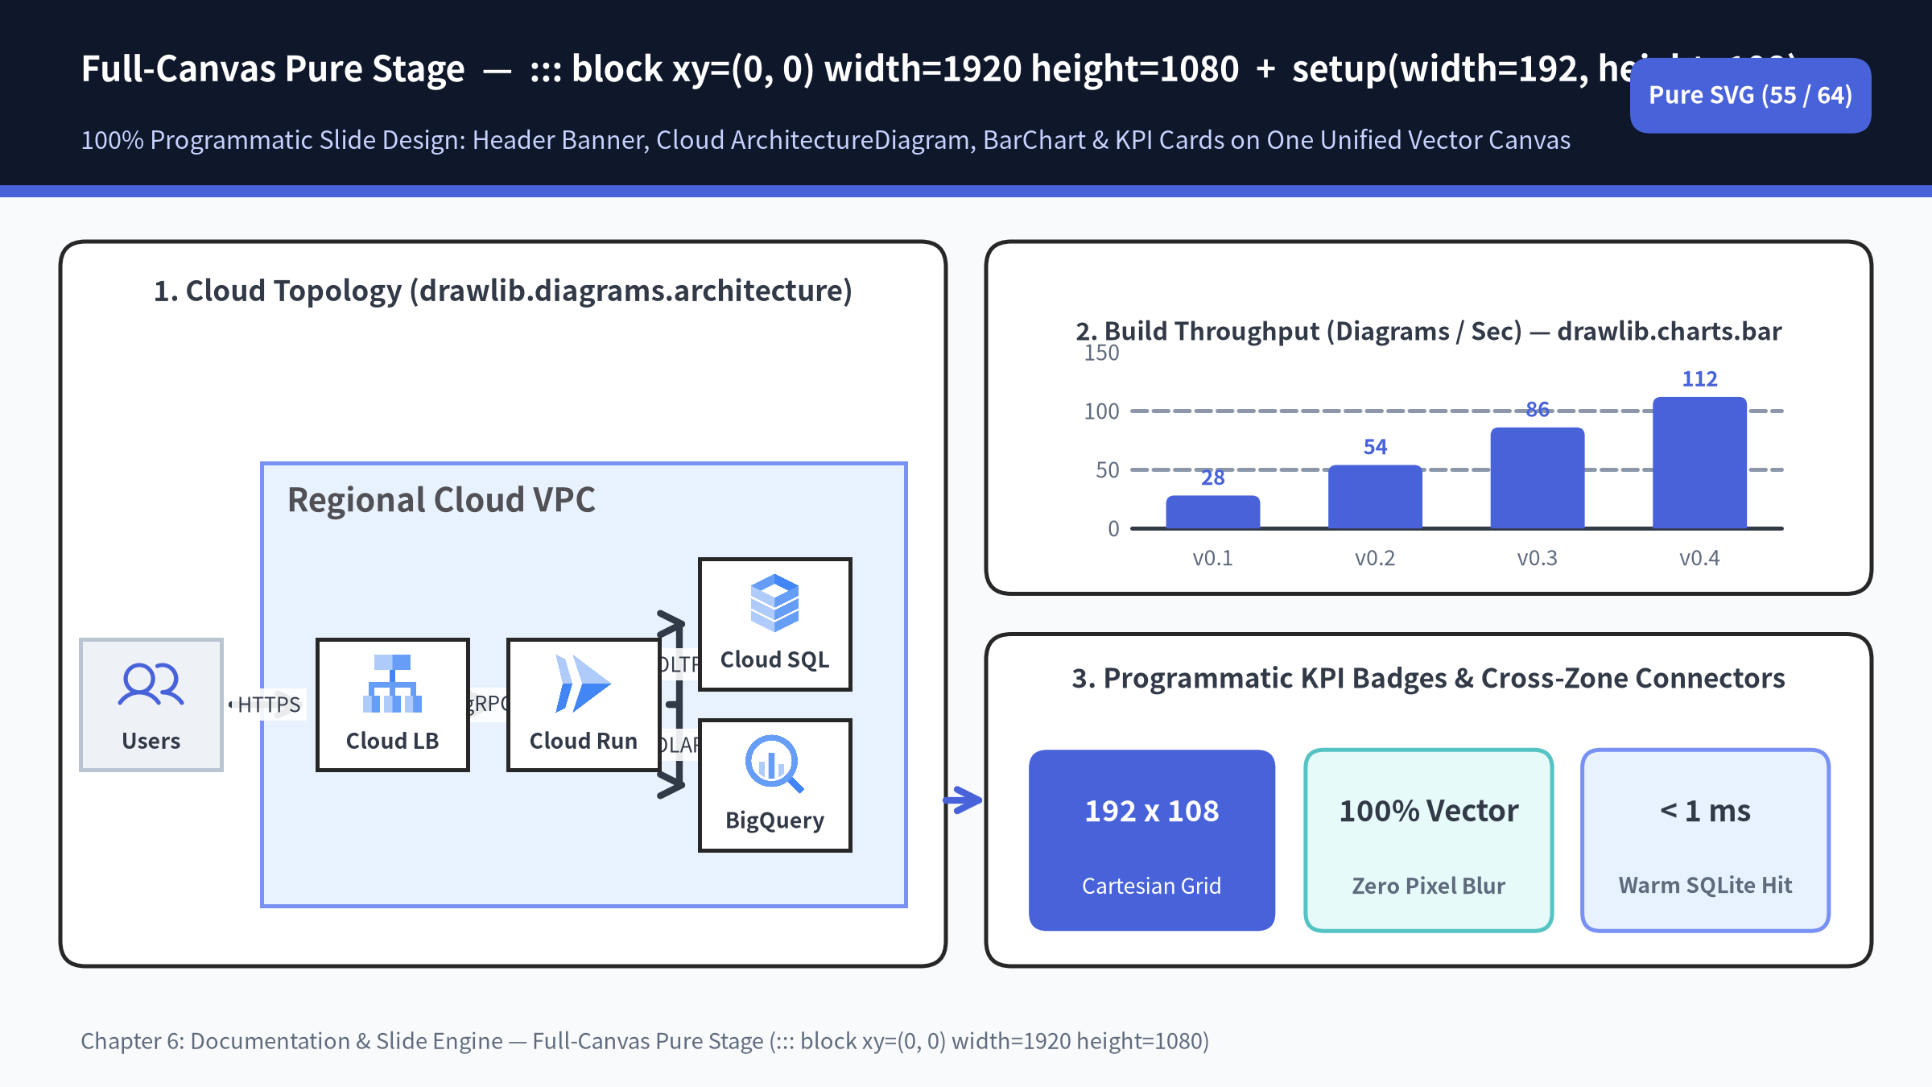

Notes:
• This entire slide is rendered from a single ::: block xy=(0, 0) width=1920 height=1080 container with setup(width=192.0, height=108.0).
• Because ArchitectureDiagram, BarChart, primitive cards, and current_slide.text all share the same Drawlib canvas, you can draw arrows directly between an architecture diagram on the left and a chart or KPI panel on the right!

Slide 56
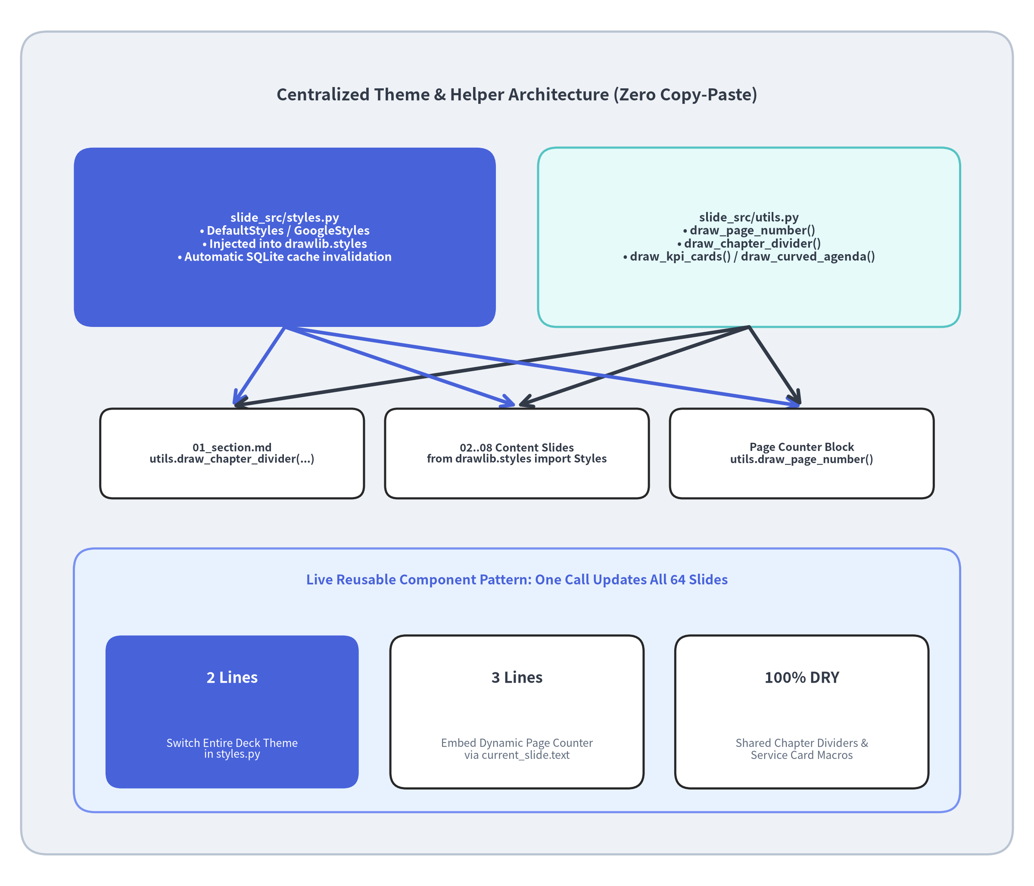

Project-Wide Consistency with styles.py & utils.py
DRY Presentation Engineering at Scale
Maintaining visual consistency across a 60+ slide deck in GUI tools is tedious and error-prone. Drawlib solves this with two shared Python modules in slide_src/:
1. styles.py — Global Design Tokens
from drawlib.preset_colors import DefaultColors
from drawlib.preset_styles import DefaultStyles
Colors = DefaultColors() # Or GoogleColors, MonochromeColors
Styles = DefaultStyles() # Or GoogleStyles, MonochromeStyles
Switching a 64-slide presentation from DefaultStyles to GoogleStyles or MonochromeStyles is a two-line change in styles.py.
2. drawlib.slide & utils.py — Reusable Slide Macros
• drawlib.slide.draw_page_number(): Renders current_slide.text ("42 / 64") on a transparent canvas (alpha=0.0).
• drawlib.slide.draw_section_header(...): Full-bleed 16:9 chapter cover (split, centered, banner, minimal) with progress dots and topic cards.
• utils.py Domain Macros: Project-specific helpers (service_card(), connect(), draw_kpi_cards()) callable in 3 lines of Python.
Chapter 6: Documentation & Slide Engine — Project-Wide Consistency (styles.py & utils.py)
Notes:
• Notice how every single slide in this 64-slide deck shares the exact same page number counter (utils.draw_page_number()) and chapter divider (utils.draw_chapter_divider()).
• Furthermore, Drawlib hashes styles.py, utils.py, and total_slides into the SQLite build cache key—so editing a helper in utils.py or changing a theme in styles.py automatically invalidates and rebuilds affected diagrams!

Slide 57
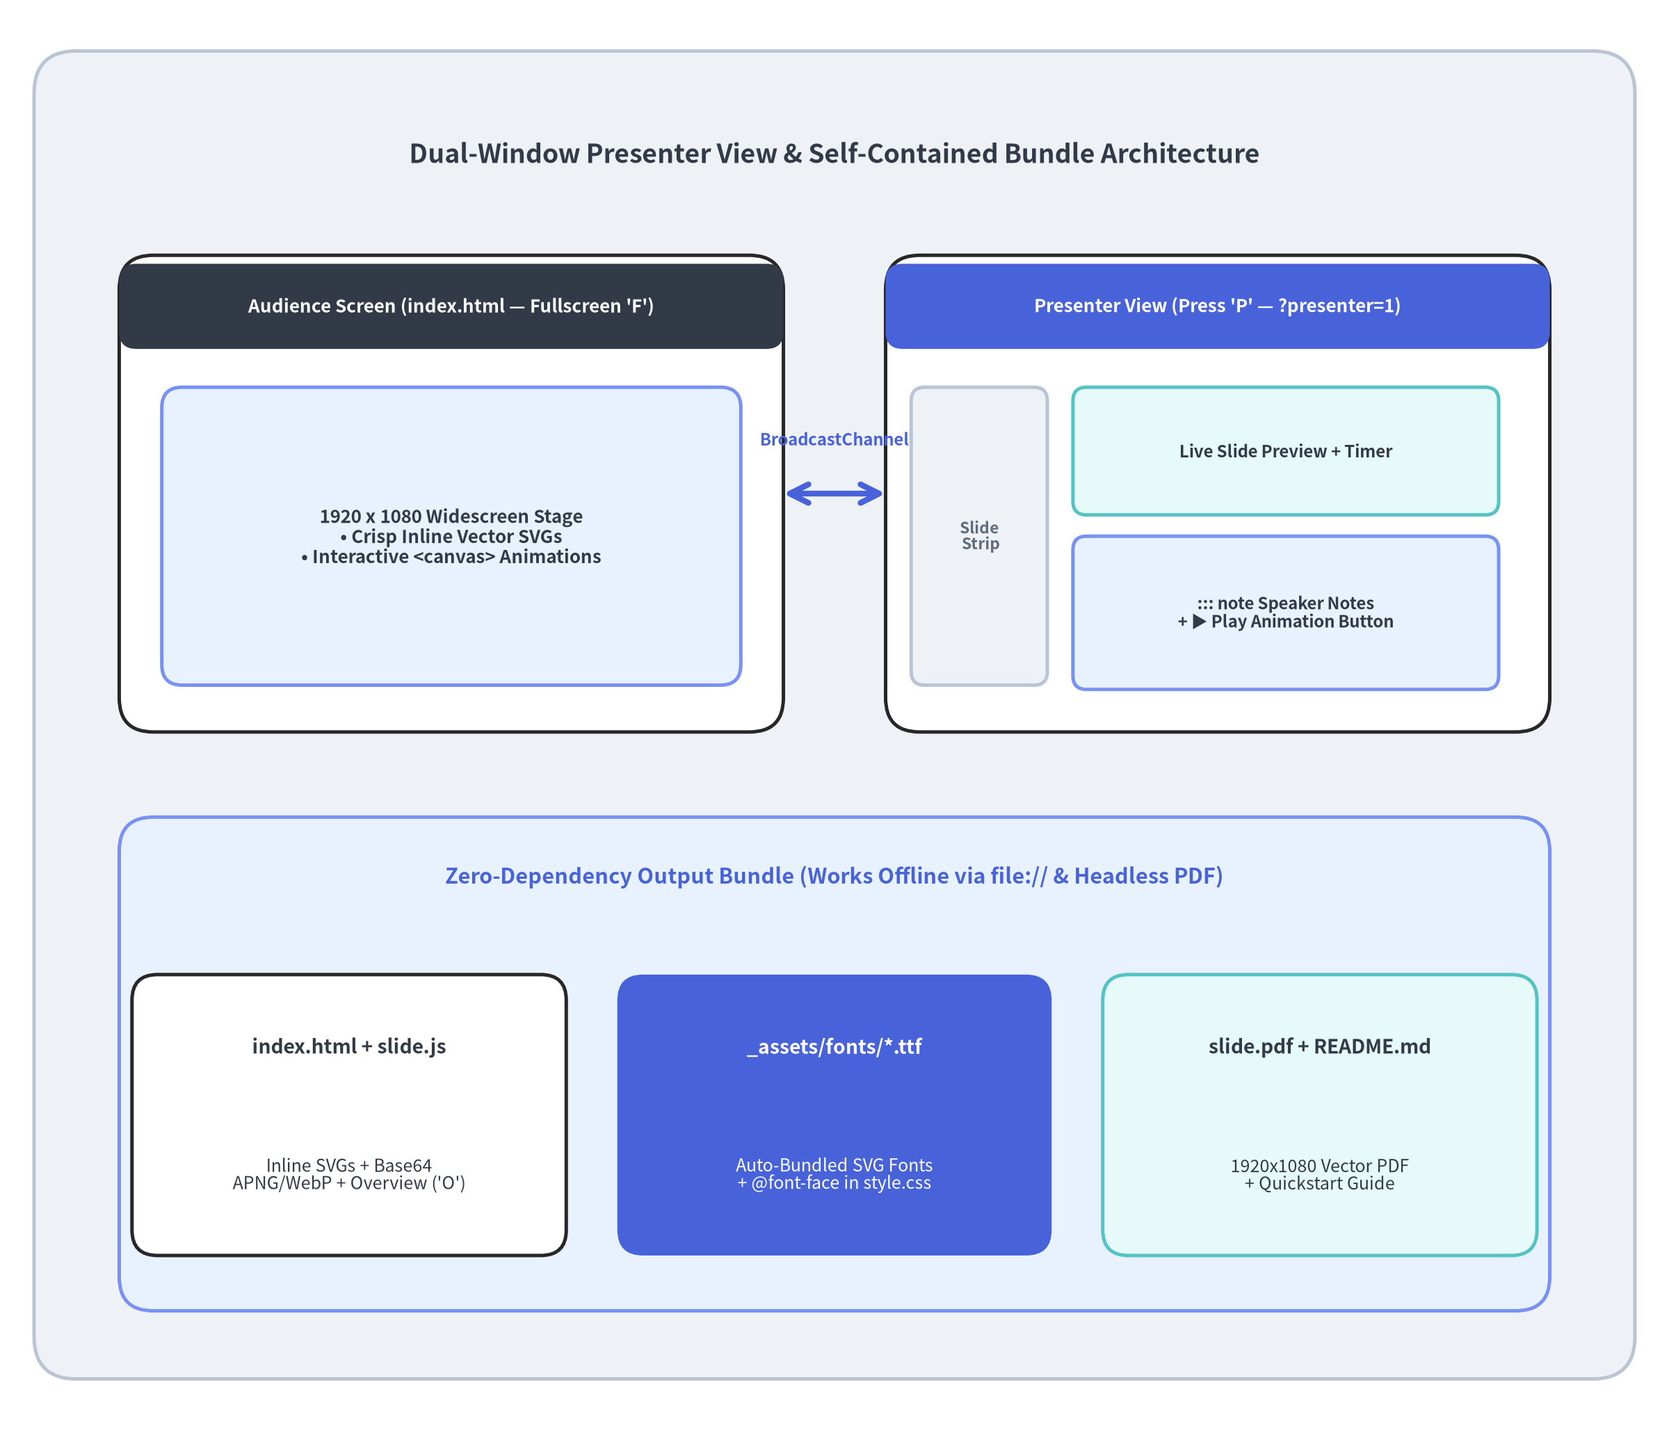

Presenter View, Overview Grid & Standalone Portability
Built for Live Stage Delivery & Offline Sharing
Compiled Drawlib slide decks (slide_html/) include a zero-dependency presentation runtime (slide.js) and self-contained assets:
Shortcut | Feature | Description
P / S | Presenter View | Opens dual-window ?presenter=1 synced via BroadcastChannel + postMessage.
O / Esc | Overview Grid | Interactive 16:9 thumbnail grid of all slides for instant navigation.
A | Animation Step | Plays, pauses, resumes, or resets <canvas> animations on the current slide.
F | Fullscreen | Toggles native widescreen browser fullscreen mode.
→ / Space | Next Slide | Advances slides (← / Home / End for navigation).
100% Standalone file:// & Vector PDF Portability
• Auto-Bundled SVG Fonts (_assets/fonts/): Copies used .ttf/.otf text & icon fonts and injects @font-face rules into style.css.
• Double-Click Ready: Zip and share the output folder—anyone can open index.html directly from disk (file://) or print to slide.pdf.
Chapter 6: Documentation & Slide Engine — Presenter View, Font Bundling & Portability
Notes:
• Press P right now to see the dual-window Presenter View in action, or press O to open the thumbnail Overview Grid!
• When drawlib build compiles a slide deck, it scans every inline SVG for font metadata (drawlib-svg-fonts), automatically copies the required .ttf / .otf files into _assets/fonts/, and injects @font-face declarations into style.css.
• That means custom typography and Phosphor/FontAwesome icons render identically on any machine—even offline via file:// or inside a headless Chromium PDF build.

Slide 58
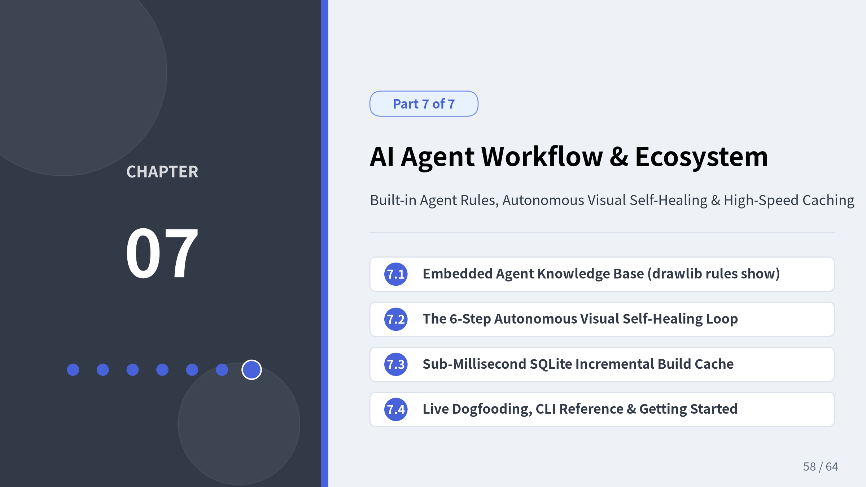
Notes:
• Welcome to our final chapter, Chapter 7: AI Agent Workflow & Ecosystem.
• Drawlib was engineered from the ground up for the era of AI pair-programming agents.
• Let's see how embedded agent rules (drawlib rules show), headless coordinate grid rendering (drawlib show -g), multimodal visual inspection, and SQLite incremental caching empower AI coding agents to author publication-grade diagrams autonomously.

Slide 59
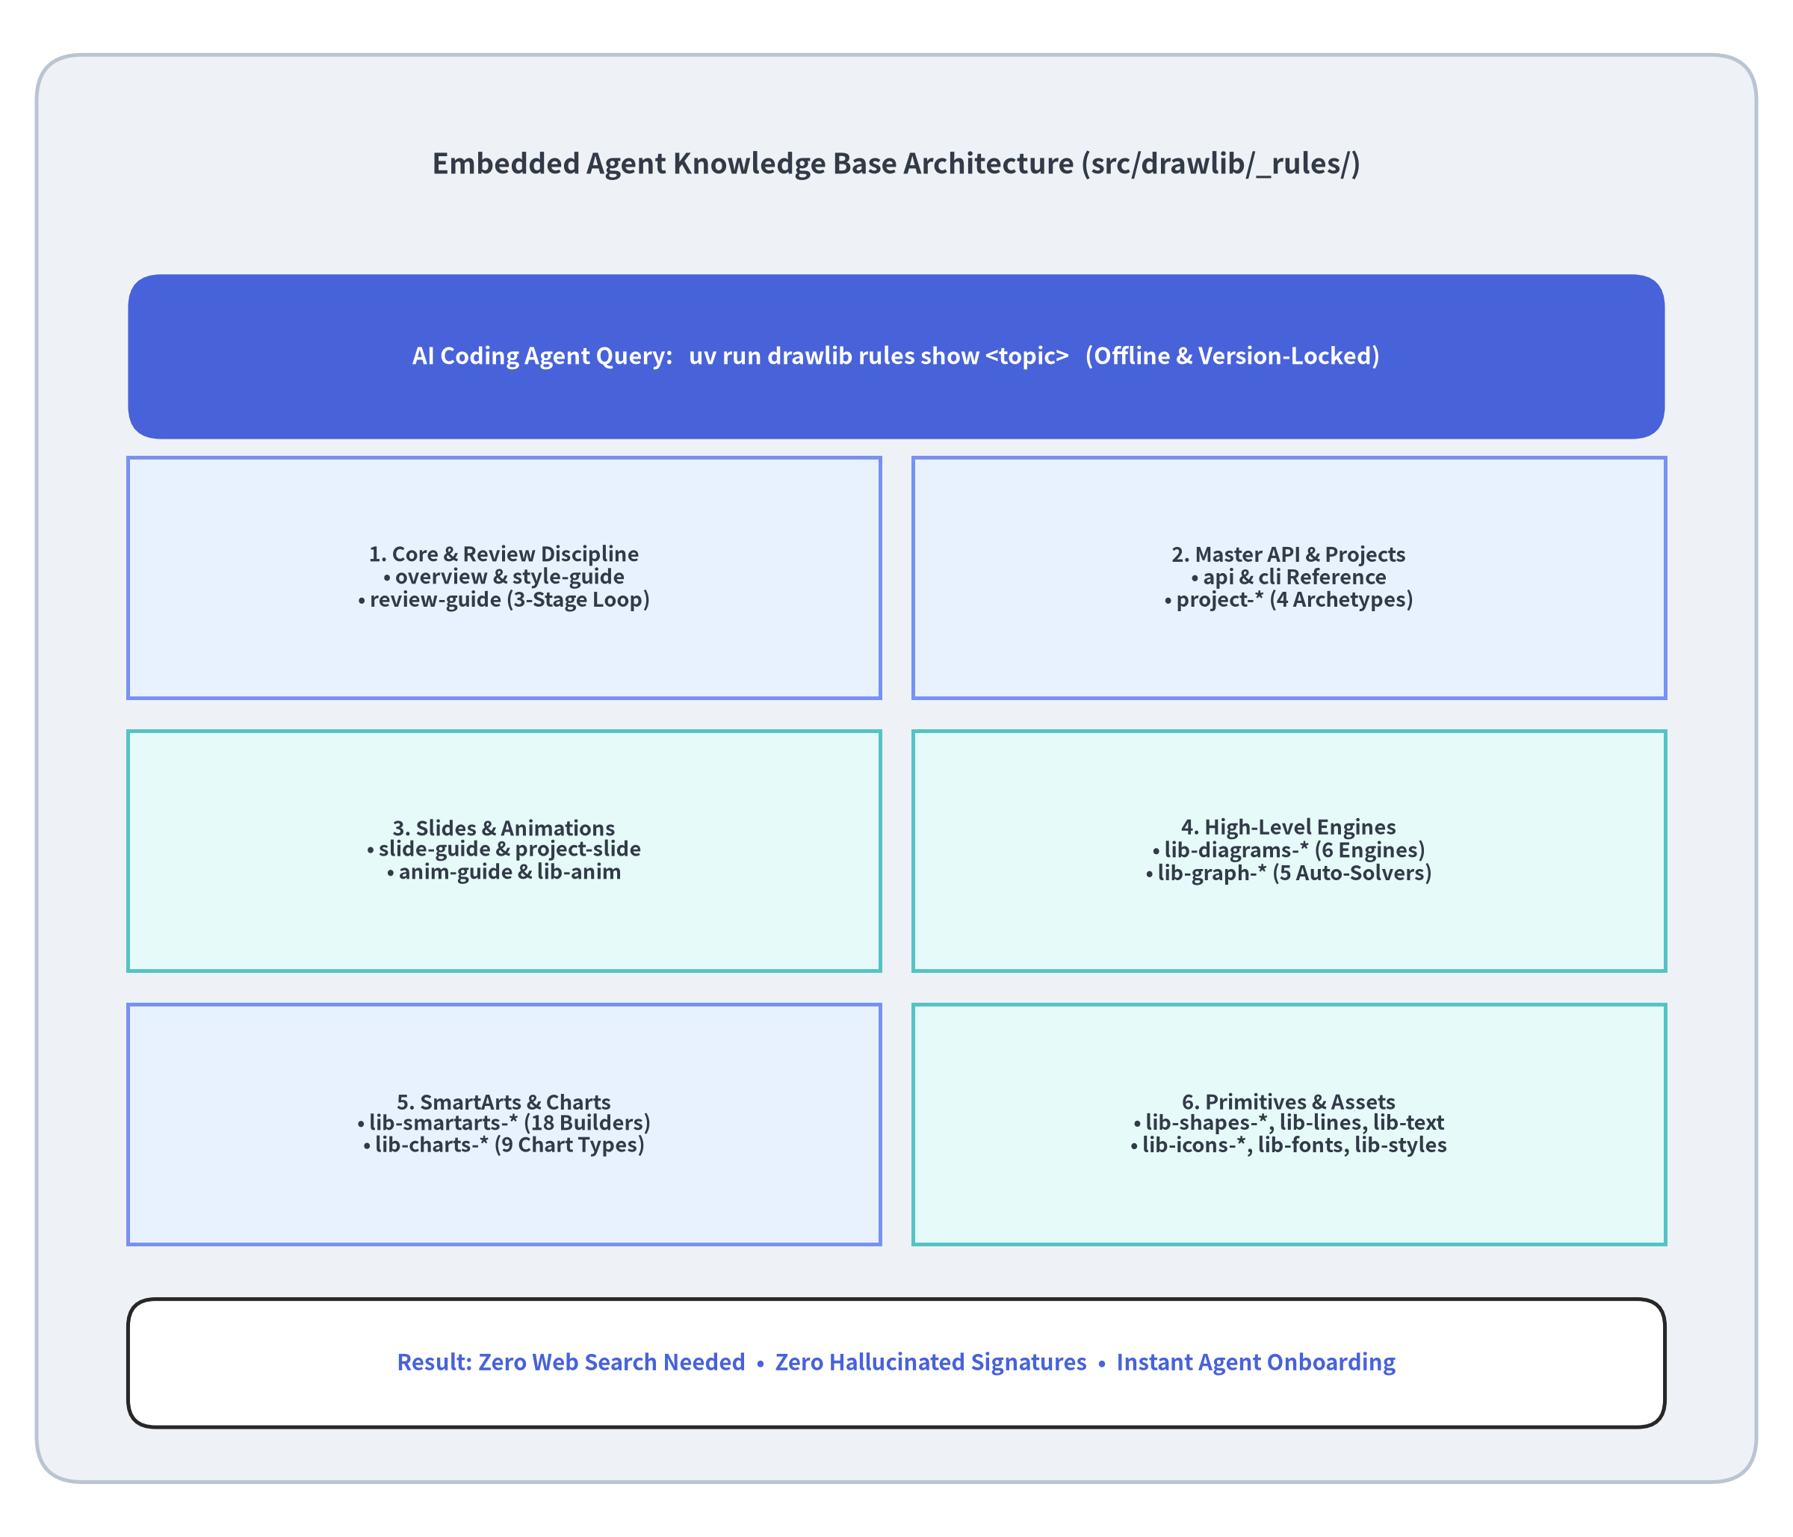

Built-in AI Agent Knowledge Base (drawlib rules)
Zero Hallucination via On-Demand Rules
Why do AI coding agents struggle with niche libraries? Because their training data is outdated or incomplete. Drawlib solves this by shipping its complete AI agent manual inside the Python package:
# 1. List all 92 embedded rule manuals
uv run drawlib rules list
# 2. Core orientation & design discipline
uv run drawlib rules show overview
uv run drawlib rules show style-guide
uv run drawlib rules show review-guide
uv run drawlib rules show api
# 3. Project archetypes & module deep-dives
uv run drawlib rules show project-overview
uv run drawlib rules show project-slide
uv run drawlib rules show anim-guide
uv run drawlib rules show lib-diagrams-overview
uv run drawlib rules show lib-charts-overview
Progressive Context Loading
• Agents start with a lightweight .agents/rules/drawlib.md bootstrap and query specific lib-<module> manuals on demand—keeping LLM context windows lean and 100% version-accurate.
Chapter 7: AI Agent Workflow & Ecosystem — Built-in AI Agent Knowledge Base
Notes:
• Because drawlib rules ships inside the drawlib wheel itself, any AI coding agent (Claude Code, Gemini CLI, Cursor, Windsurf, Copilot) can immediately query the exact API signatures and style rules for the installed version of Drawlib without needing external web access.

Slide 60
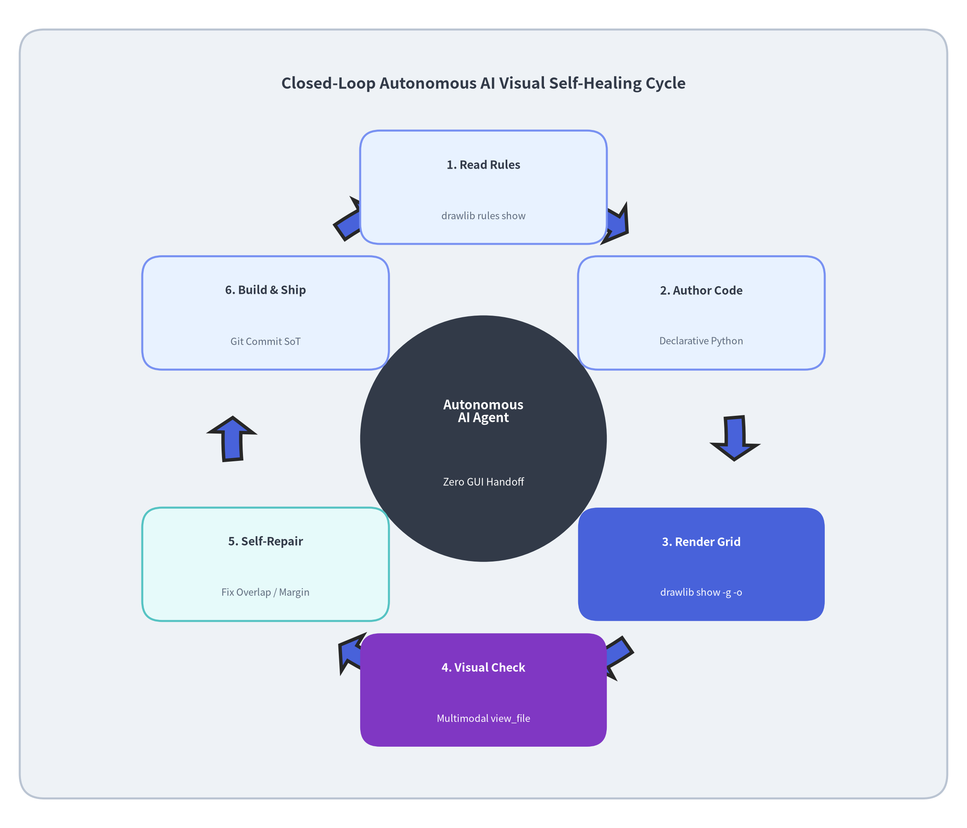

Autonomous Visual Self-Healing Loop
Closing the Loop with Multimodal Vision
Code that runs without syntax errors can still produce overlapping labels or cramped margins. Drawlib pairs headless coordinate-grid rendering (-g) with multimodal agent vision (view_file):
# Render a single diagram block with a 10x10 coordinate grid
uv run drawlib show docs_src/arch.md service_arch.png \
-g -o .drawlib/scratch/preview.png
The 6-Step Autonomous Agent Cycle
1. Read Rules (drawlib rules show): Load coordinate & style rules.
2. Author Declarative Python: Write high-level diagrams, charts, or SmartArts.
3. Render with Coordinate Grid (-g): Export headless preview image in < 1s.
4. Multimodal Inspection (view_file): Agent visually inspects the rendered PNG + coordinate grid lines.
5. Self-Repair Visual Defects: Adjust exact (x, y) coordinates, padding, or contrast if any clipping is spotted.
6. Commit Source of Truth: Check clean Markdown + Python into Git.
Chapter 7: AI Agent Workflow & Ecosystem — Autonomous Visual Self-Healing Loop
Notes:
• This 6-step loop is the secret superpower of Drawlib with multimodal AI agents.
• By running drawlib show <file> <block> -g -o preview.png, the agent gets an immediate visual coordinate ruler overlaid on the diagram. If a label is slightly off-center at x=42, the agent sees the x=50 grid line in view_file and fixes the coordinate deterministically on the very next edit!

Slide 61
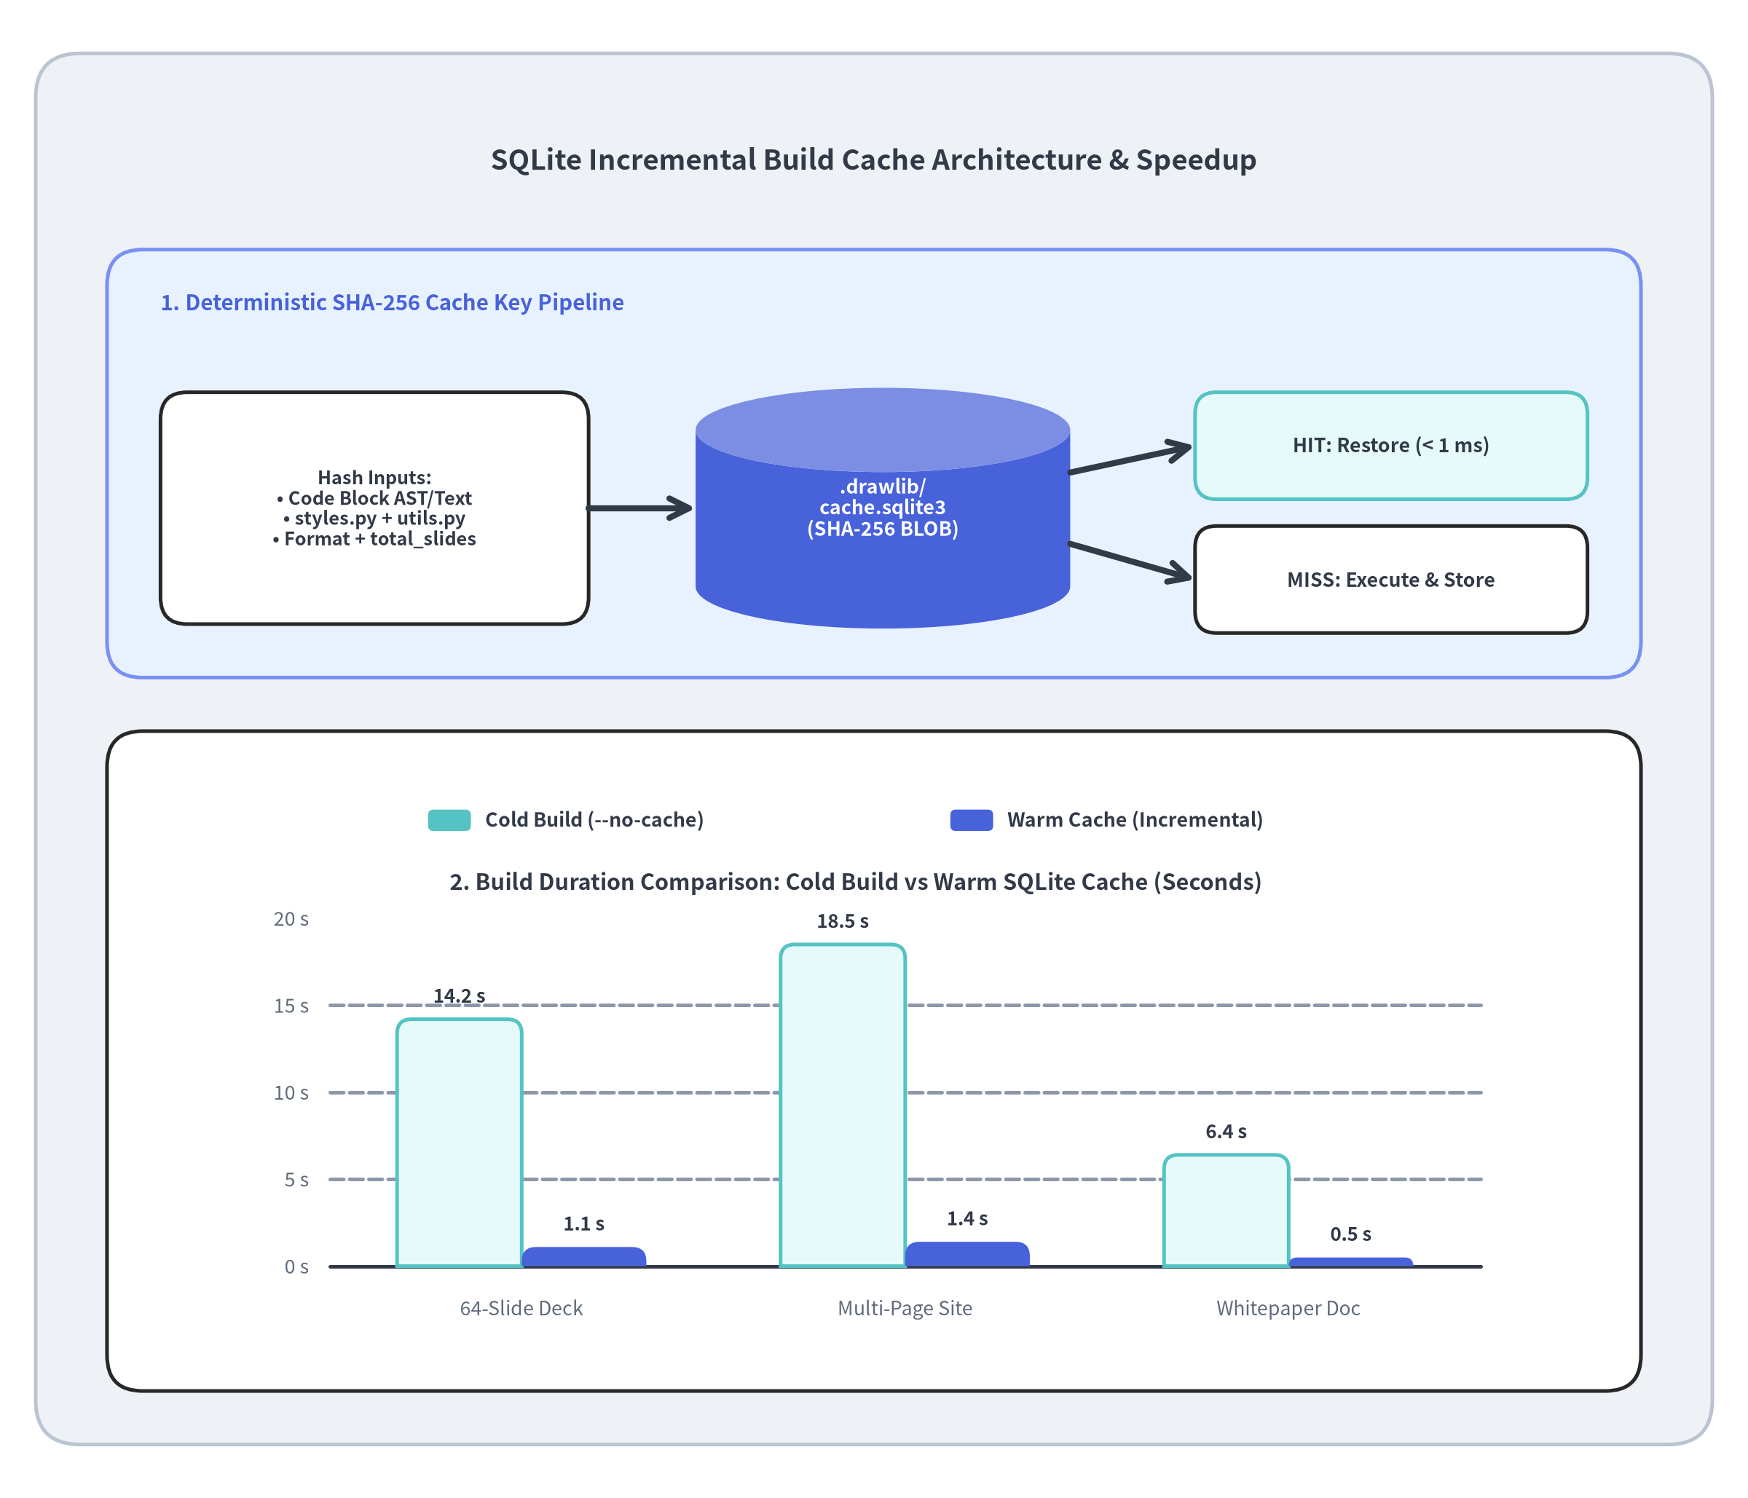

Sub-Millisecond Incremental Builds (SQLite Image Cache)
Instant Rebuilds for Large Decks & Docs
A comprehensive technical site or 64-slide presentation can contain 100+ embedded diagrams and multi-frame animations. Re-executing every Python block on every edit would slow down live authoring.
Deterministic SHA-256 Cache Key (.drawlib/cache.sqlite3)
Drawlib hashes four inputs before executing any ```drawlib block:
1. Normalized Python Code Block: Exact script source inside the fence.
2. Global styles.py & utils.py Hashes: Editing a shared helper or theme invalidates dependent diagrams automatically.
3. Target Output Format: .svg, .png (APNG), or .webp.
4. Slide Context (total_slides): Ensures current_slide.text (12 / 64) stays accurate when slides are added or removed.
Cache Hit Performance
• Cold Build (64 Slides): Renders all SVGs & APNGs from scratch (~14s).
• Warm Cache Build (1 Slide Edited): Restores 63 unchanged slides from SQLite in < 1 ms per diagram—completing the full deck build in ~1.1 seconds!
Chapter 7: AI Agent Workflow & Ecosystem — Sub-Millisecond SQLite Build Cache
Notes:
• Notice the huge speedup shown in the bottom BarChart: when editing a single slide in a 64-slide presentation, .drawlib/cache.sqlite3 restores all 63 unchanged diagrams in under a millisecond each, dropping total rebuild time from ~14 seconds to ~1.1 seconds!
• Passing --no-cache to drawlib build bypasses the SQLite cache whenever a full clean rebuild is desired.

Slide 62
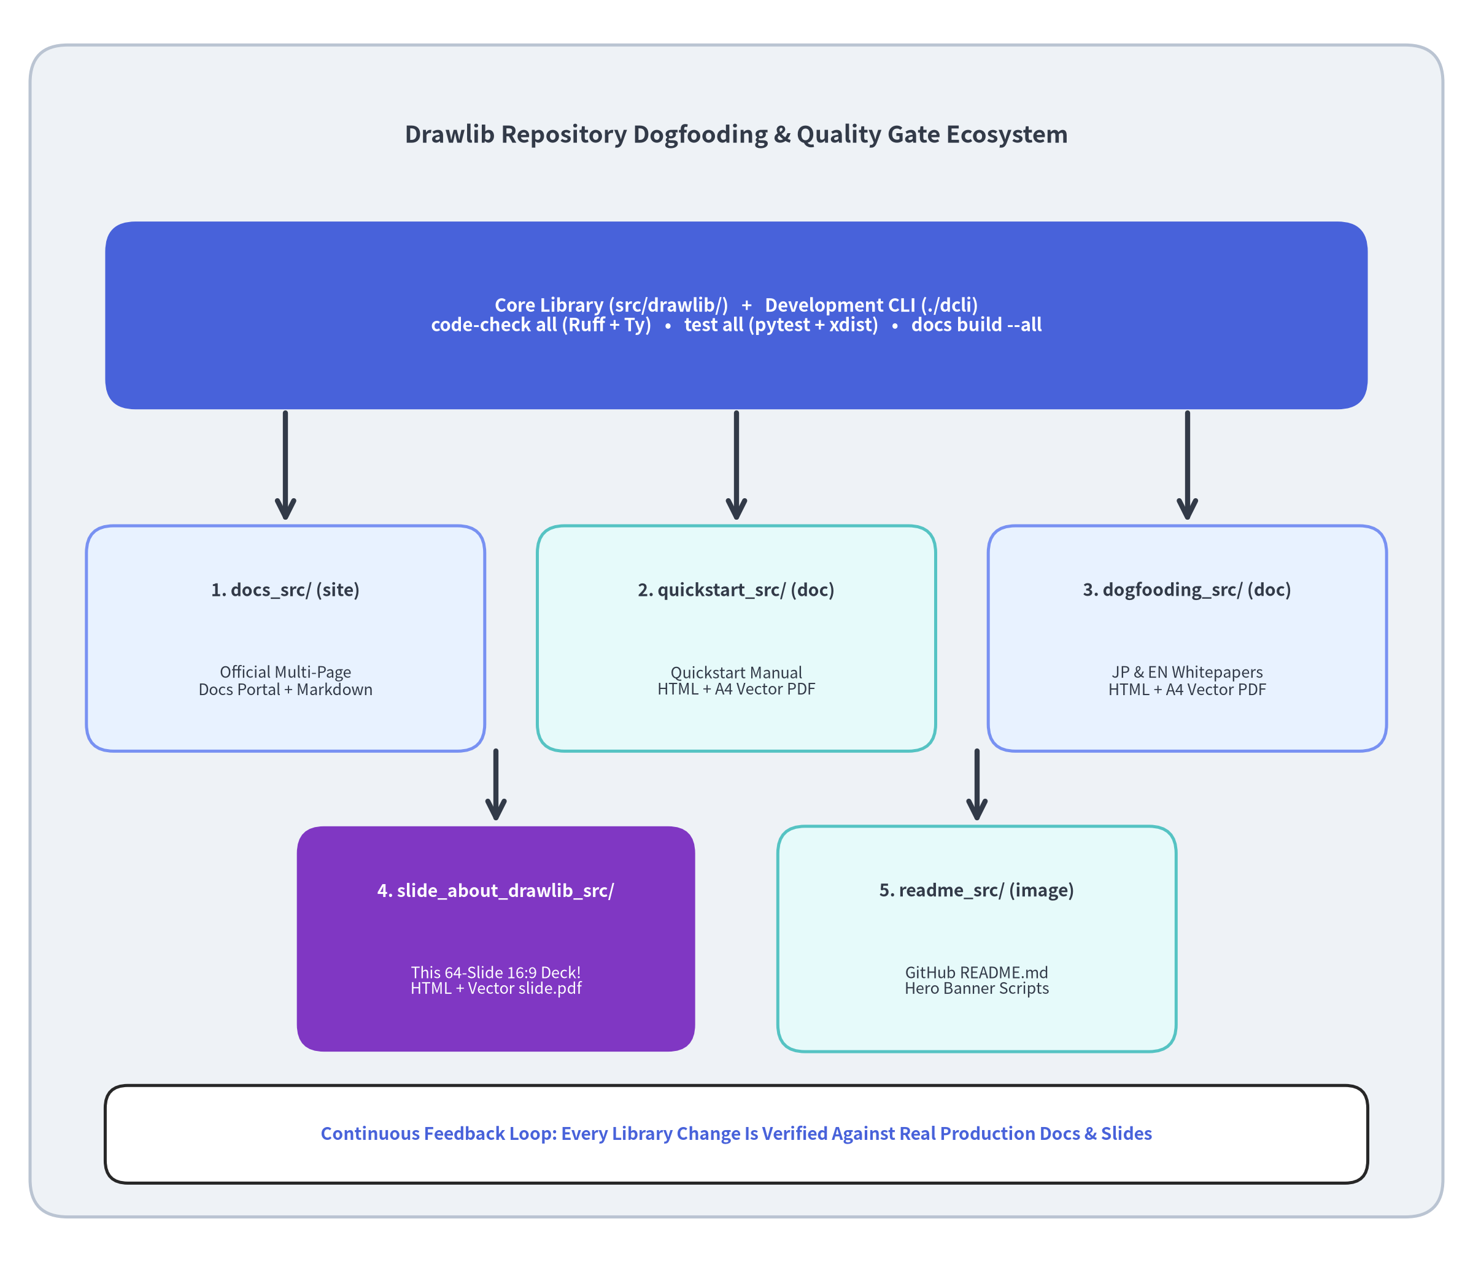

Live Dogfooding in the Drawlib Repository
Eating Our Own Cooking at 100% Scale
The drawlib repository is simultaneously the library codebase (src/drawlib/) and a live production dogfooding environment where every project archetype is continuously built and tested via ./dcli:
# 1. Static analysis (Ruff lint/format, Ty type check, docstrings)
./dcli code-check all
# 2. Parallel unit & integration test suite
./dcli test all
# 3. Build all 6 live dogfooding documentation targets
./dcli docs build --all
./dcli docs serve site --check
Six Live Dogfooding Targets in docs/
1. site (docs/docs_src/): Multi-page documentation website (docs_html/ & docs_markdown/).
2. quickstart (docs/quickstart_src/): Quickstart guide & vector PDF (doc archetype).
3. dogfooding & dogfooding-en: Japanese & English architectural whitepapers (doc + pdf).
4. slide (docs/slide_about_drawlib_src/): This 64-slide 16:9 showcase presentation deck!
5. readme (docs/readme_src/): Standalone hero illustrations for README.md.
Chapter 7: AI Agent Workflow & Ecosystem — Live Repository Dogfooding
Notes:
• Every feature you have seen in this presentation—from ArchitectureDiagram and LayerGraph to BarChart, Animation, and build_slide—is continuously dogfooded inside the Drawlib repository itself.
• Running ./dcli docs build --all compiles the multi-page documentation site, the quickstart PDF, the Japanese and English dogfooding whitepapers, the README hero images, and this entire 64-slide presentation deck!

Slide 63
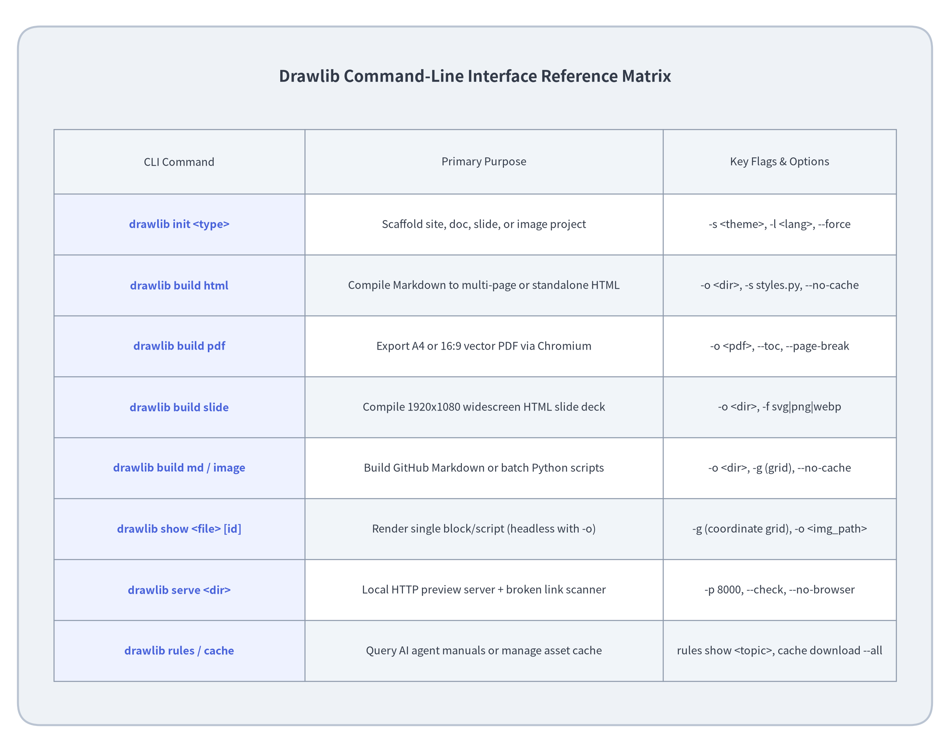

Complete CLI & Workflow Cheat Sheet
One Unified CLI (drawlib)
From initial project scaffolding to headless visual inspection and vector PDF publishing, every workflow is accessible through uv run drawlib:
1. Scaffold & Author
uv run drawlib init <site|doc|slide|image>
uv run drawlib rules show overview
uv run drawlib rules show api
2. Inspect & Verify Headlessly
# Render single block with coordinate grid
uv run drawlib show page.md arch.png \
-g -o .drawlib/scratch/preview.png
# Check links & preview in browser
uv run drawlib serve docs_html/ --check
3. Compile & Export All Targets
./docs_src/build.sh
# Or invoke subcommands directly:
uv run drawlib build html docs_src/ -o docs_html/
uv run drawlib build pdf doc_src/ -o doc.pdf --toc
uv run drawlib build slide slide_src/ -o slide/
Chapter 7: AI Agent Workflow & Ecosystem — Complete CLI Cheat Sheet
Notes:
• This Table SmartArt summarizes the entire drawlib CLI surface on a single slide.
• Whether you are scaffolding a new deck (drawlib init slide), inspecting a single diagram with a coordinate grid (drawlib show -g -o), checking for broken links (drawlib serve --check), or querying built-in agent rules (drawlib rules show), everything follows a consistent, ergonomic CLI design.

Slide 64
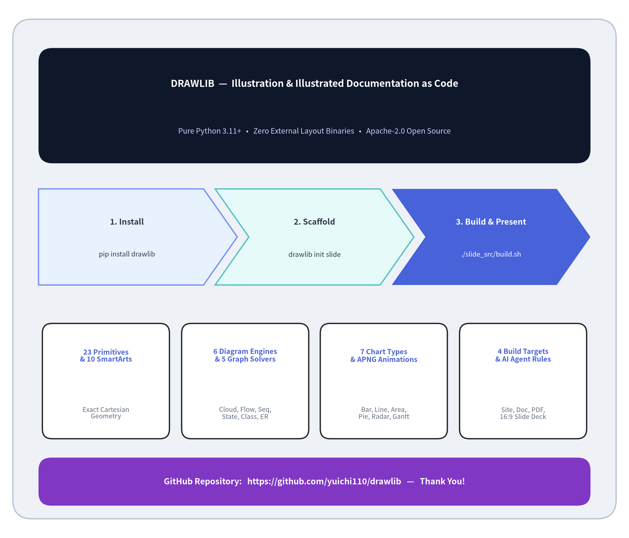

Start Drawing & Presenting as Code
Unify Your Code, Diagrams, Docs & Slides
Stop context-switching between Git, GUI drawing tools, wikis, and slide editors. Bring your entire visual communication stack into version-controlled Python and Markdown.
3-Step Quickstart
# 1. Install Drawlib (with PDF export support)
pip install "drawlib[pdf]"
# 2. Scaffold a 16:9 slide deck, doc, or site
drawlib init slide my_deck -s default
# 3. Build HTML + PDF & launch live preview
./my_deck_src/build.sh
./my_deck_src/serve.sh
Core Takeaways
• Single Source of Truth: Architecture diagrams, quantitative charts, animations, docs, and 16:9 slides live together in Git.
• AI-Native by Design: Built-in drawlib rules + headless grid rendering (drawlib show -g) enable autonomous visual self-healing.
• Explore & Contribute: https://github.com/yuichi110/drawlib
Chapter 7: AI Agent Workflow & Ecosystem — Thank You & Getting Started
Notes:
• Thank you for exploring Drawlib!
• With pip install "drawlib[pdf]" and drawlib init slide, you and your AI coding agents can start creating version-controlled architectural diagrams, multi-page documentation sites, vector PDFs, and interactive 16:9 presentations today.

