Slide 1

基礎も理解する GitHub
田中 裕一
Solutions Engineer, GitHub
2019/06/29
Notes:
Hi, I’m ______
For the next 20-30 minutes I’m going to take you through some of the market trends, how those trends are impacting businesses such as yours, and what you need to do to prepare your organization to address the resultant challenges. I’ll layout some of the major GitHub features and how they can help you transform your development organization to be more modern, more connected to open source communities and more prepared to handle whatever challenges come your way. I’ll also show you a couple of customer examples that will bring some of this to light.
Feel free to stop me and ask questions.
Sound good? Any questions before we get started, or anything that you want to make sure that we cover?
Okay, let’s get started...

Slide 2

Who am I?
田中 裕一
Solutions Engineer
yuichielectric

Slide 3
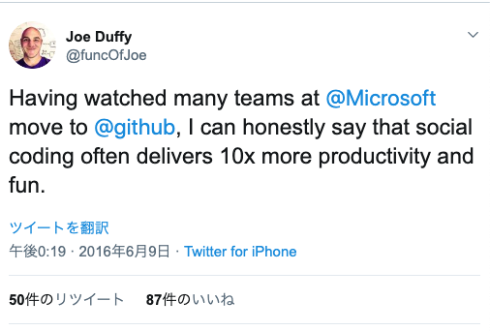
Microsoftの多くのチームがGitHubに移行 していくのを見て、正直な所ソーシャル コーディング(※ GitHubを使った開発のやり方)は時に生産性と開発者の幸福度を10倍も 高めると言って良いと思う。 Joe Duffy, Partner Director of Engineering, Microsoft

Slide 4
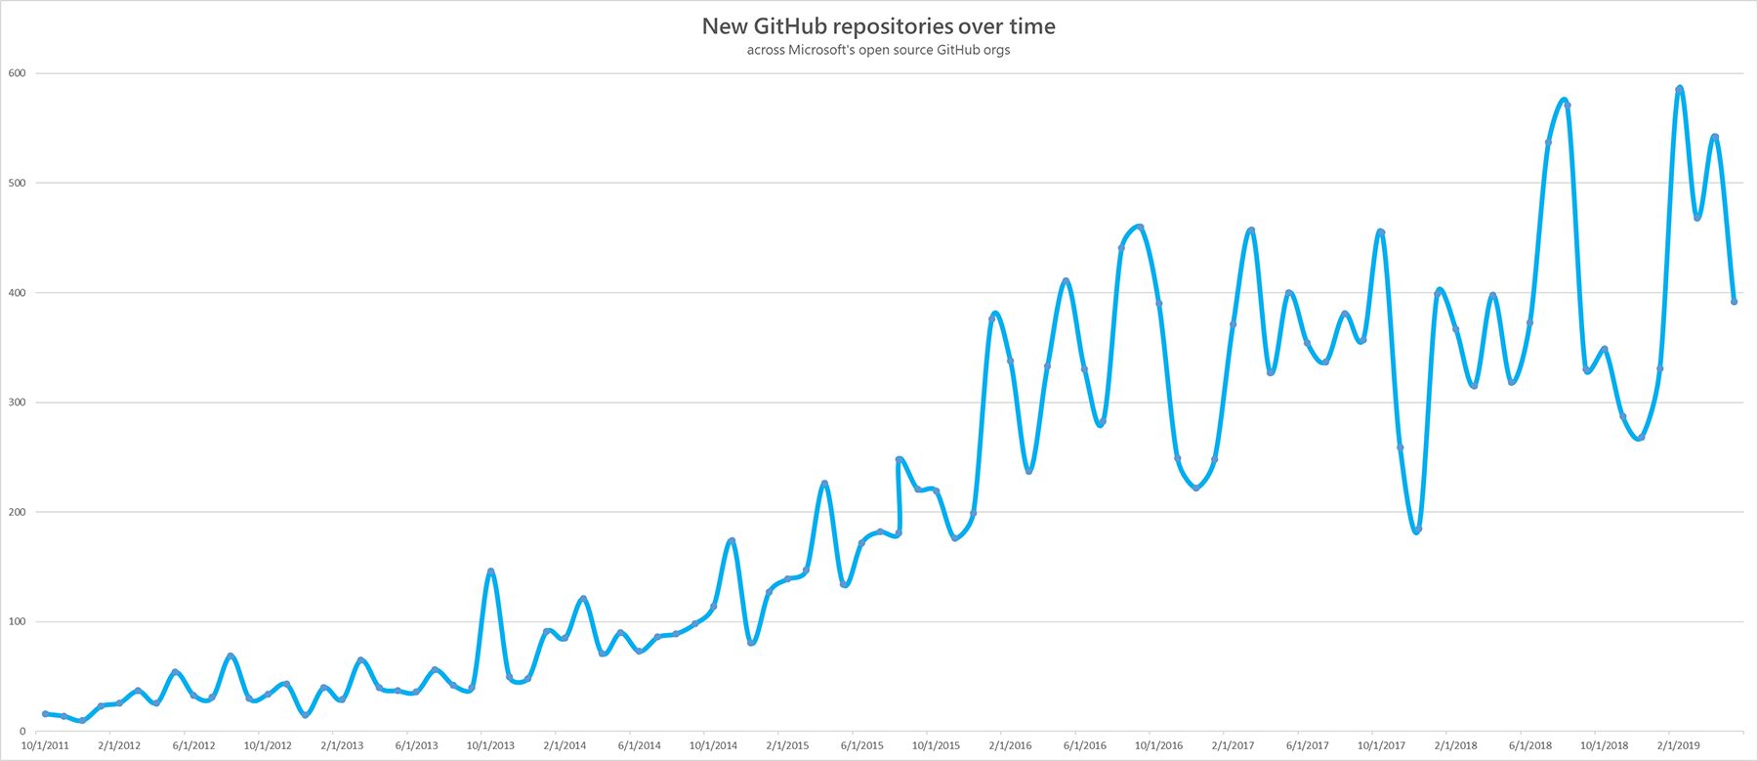
https://jeffwilcox.blog/2019/06/scaling-25k/

Slide 5
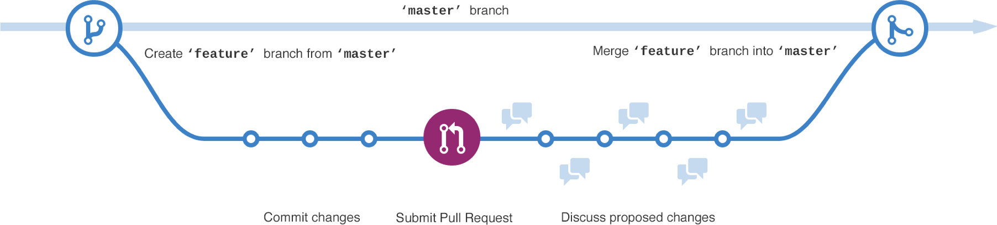
GitHub Flow & Pull Request

Slide 6
各フェーズにおけるバグの修正コスト
7倍
テスト時 vs 開発時
14倍
運用時 vs 開発時
https://agileelements.wordpress.com/2008/04/22/cost-of-software-defects/

Slide 7
GitHub Flow & Pull Request

Slide 8
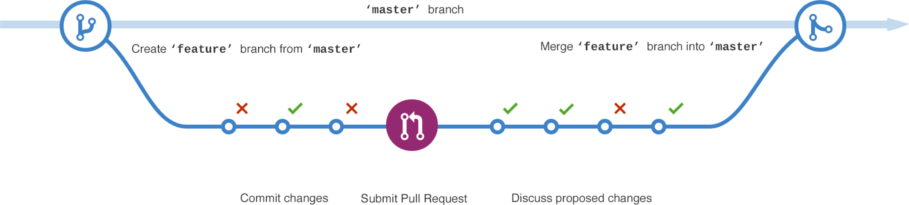
継続的インテグレーション Continuous Integration
Notes:
Automate as much as you can to ensure code quality. Run CI for every push against the feature branch and against master as if your feature was already merged. Push several times a day. Even if you do not have unit tests, which is not something I would recommend, you can use CI to at least make sure that you can build, install and run your code changes. To ensure the deployed code meets a certain quality you can set a status to deploy or merge only when CI has passed.

Slide 9
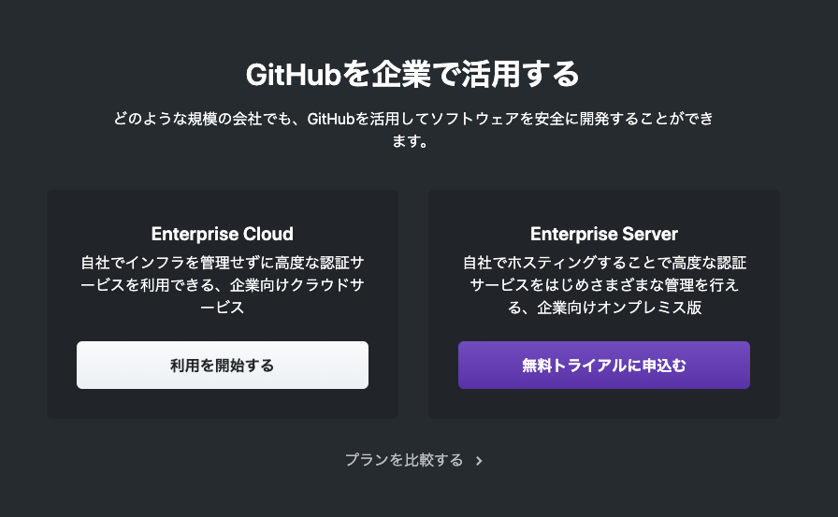
https://github.co.jp/enterprise

Slide 10


