Slide 1
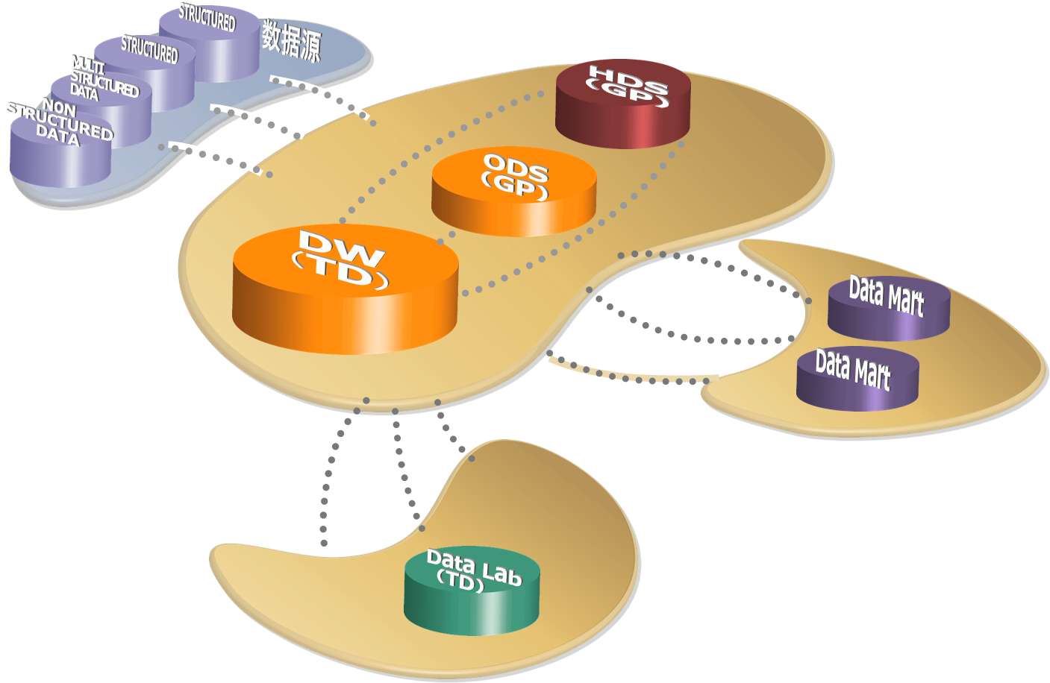
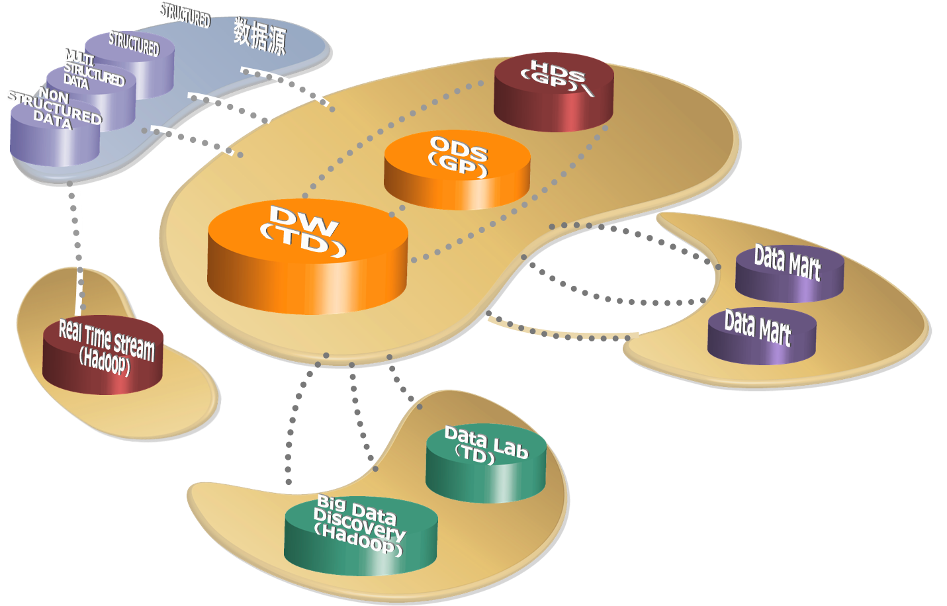
SPDB Data Architecture Roadmap Plan
現有架構
未來架構
Architecture：
EDW、ODS、HDS Co-exist, complex architecture；
Heavy workload in EDW，not so good SLA；
Most EDW workload is batch, do not support much ad-hoc and analysis.
Too long history data are stored in EDW
do not have platform to store and process big data.
Analysis Capability:
Most analysis is on SAS;
No high performance and real time analysis applications;
Big data need to be integrated and analyzed;
Architecture：
Differentiate EDW\ODS\HDS;
Optimize and expand EDW to promote SLA；
Support more analysis and ad-hoc workload in EDW；
Partition the data area to support hot/cold data, archive long history data;
Setup real time stream data processing system on adoop；
Setup big data analysis system on Hadoop；
Analysis Capbility：
Build big data analysis capability;
Support data R&D scenario on big data system;
Support data lab on EDW system;
Support high performance and real time analysis applications;

