Slide 1
Sub-Bipartite Graph Creator
Jianke Yu, Mengqi Zhang, Yangping Wu, Jingya Qian, Zheng Xu, Zifan Gao
5.28.2021

Slide 2



Bipartite Network Definition
A graph $G=(V, E)$ is called a bipartite graph if:
$V$ can be partitioned into two disjoint subsets $L$ and $R$ such that $E⊆L×R,$i.e. Every edge connects a vertex in $L$ and a vertex in $R$.
x
1
y
2
w
3
z
Partition $L$
Partition $R$
2

Slide 3









Applications of Bipartite Networks
Web Search [He et. al, ‘17]:
The set $L$ is set of users.
The set $R$ is set of web pages.
$E$ is user actions (“clicks”).
Partition $L$
Partition $R$

Slide 4
Aim of This Project
This project aims to generate datasets for bipartite graph classification research

Slide 5
Applications of Bipartite Networks Classification
User Habit Analysis
Money Laundering Detection
Common Substructures Proteins Finding[Taylor et. al, ‘20]

Slide 6
Problem Statement
Input: temporal bipartite graphs, time gap, # of min nodes, # of max nodes
Goal: To get multi-type bipartite graph dataset.
Challenges:
Few public datasets of multi type bipartite graphs
Difficult to filter and batch download
The processing is complicated
Easy to get disconnected graphs
Difficult to get information on new datasets

Slide 7
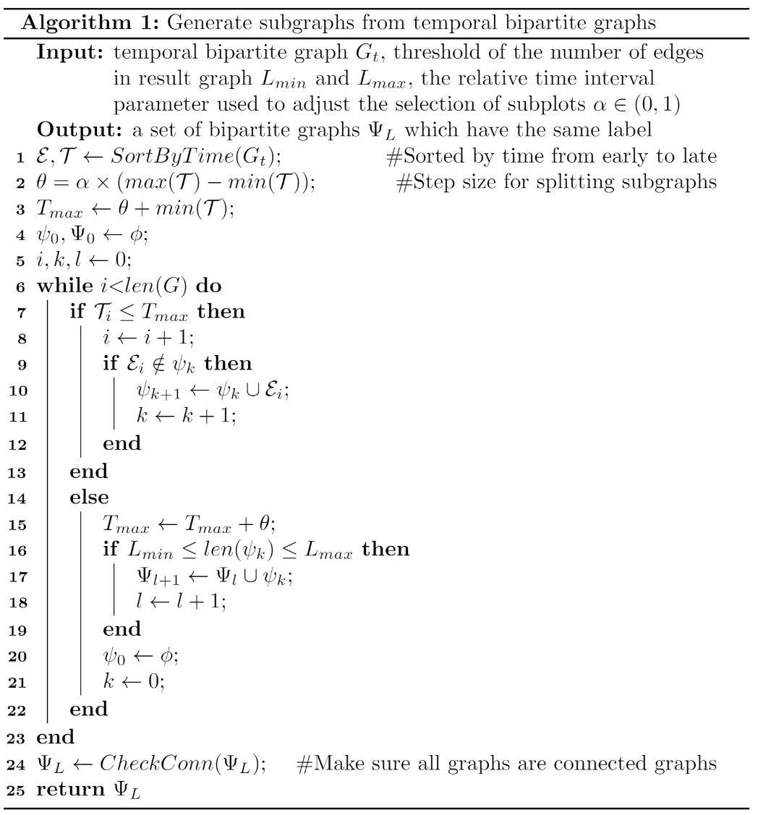
Our Generation Method

Slide 8
Sub-Bipartite Graph Creator
Program Demo
总负责人： 俞鉴珂 20020100032
需求文档： 张梦琪 20020100025
程序测试： 吴艳萍 20020100026
代码优化： 钱静雅 20020100046
主演讲人： 许 政 20020100029
幻灯片 ： 高子凡 20020100031
项目地址：https://github.com/yujianke100/Sub-Bipartite-Graph-Creator

