Slide 1
Coursera Capstone Project
Yujia Wang

Slide 2
Introduction
The City of New York has been having a significant influence on international fashion trends. New York City, especially Manhattan, is unarguably a key center for the fashion industry. The city offers a massive pool of creative talent as well as retail space in highly-trafficked locations. Our client is trying to start their own apparel store in Manhattan. As data analysts, we are engaged to answer two questions: 1) where should the new business be located and 2) what type of apparel store is preferred.

Slide 3
Data Source
For this project, we will be utilizing the Foursquare Venues Data for Manhattan. The Foursquare Venues Data for Manhattan include information like neighborhood, latitude and longitude, venue, venue name, and venue category.
The Foursquare website (see link below) has a full list of fashion-related venue categories, which include department store, clothing store, women's store, men's store, kids store, lingerie store, accessories store, shoe store, and boutique. We will use only the fashion-related venue data to make our recommendation.
https://developer.foursquare.com/docs/resources/categories

Slide 4
Methodology
For the location, we will analyze the locations of existing apparel stores. We want to locate the new business in popular shopping center where customers will gather.

Slide 5
Methodology
We grouped the dataset by neighborhood and noted that Soho has the highest number of apparel stores.

Slide 6
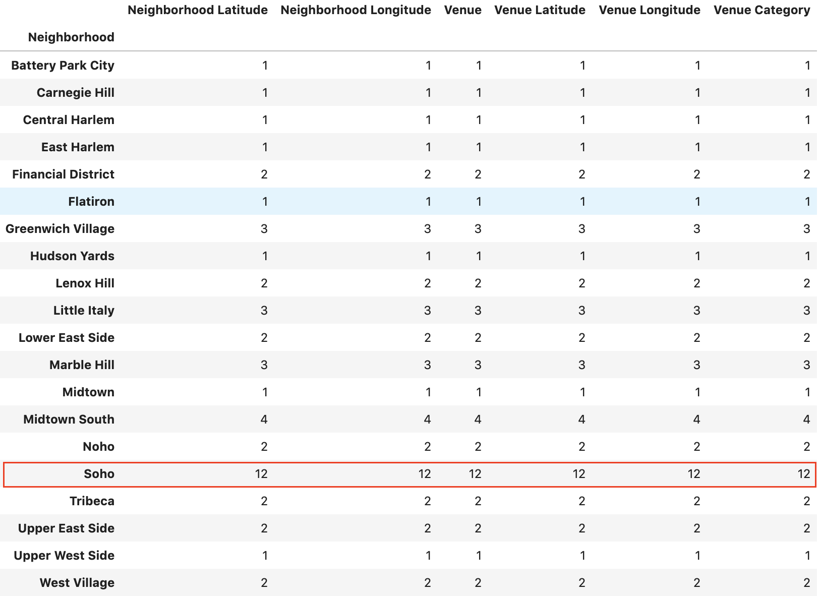
Methodology

Slide 7
Methodology
For the store type, we will analyze the venue category of existing apparel stores. We want to make the new business similar to nearby shops so that customers are more likely to be attracted.

Slide 8
Methodology
We created a dummy variable (i.e. 0 or 1) for each category and put the results into a new data frame. Next, we grouped rows by neighborhood and by taking the mean of the frequency of occurrence of each category. From here, we were able to get each neighborhood's top 3 most common venues. It is noted that the top 3 category for Soho are clothing store, women's store, and boutique.

Slide 9
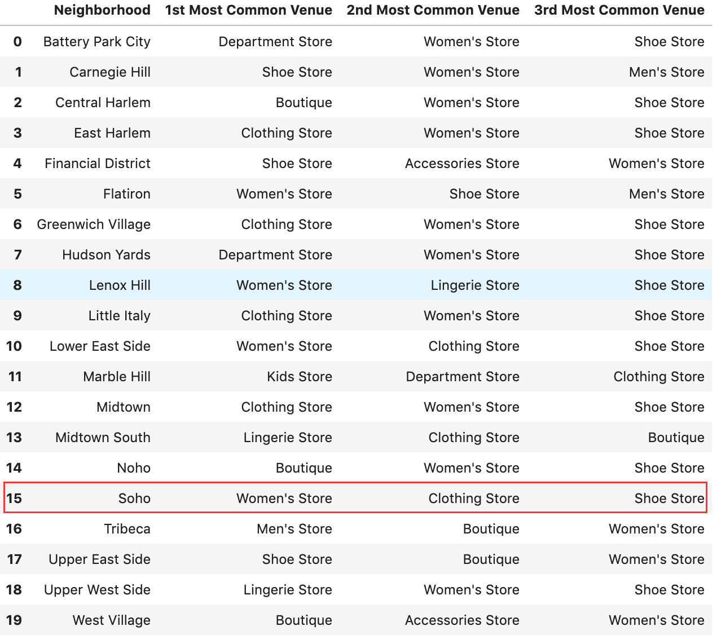
Methodology

Slide 10
Results
As a result of our analysis, we determined that Soho is the most popular shopping center within Manhattan with the most number of apparel stores out of all neighborhood. Also, we determined that within Soho, the top three apparel store categories are clothing store, women's store, and boutique store.
As a result of our analysis, our recommendation to the client is to open a new clothing store or women's store in Soho.

