Slide 1
Apply the Monte Carlo on Restaurant Waiting Process
590PR - Final Project Presentation
Team Member: Pan Zhang, Xiaoye Li,
Yun Sun, Yujia Wang

Slide 2
CONTENT
01
Motivation
02
Scenario
03
Solution
04
Results

Slide 3
Motivation
Since some restaurants are very popular among UIUC students, almost every time we have to wait a long time.
The purpose of this simulation is to examine the expected waiting time of the seats for different groups of people.
Help customer to schedule their time properly, so that enhance the customers’ service.

Slide 4
Scenario
Assumption：
The restaurant will open from 5:00pm to 9:00pm
The average number of customer groups for one night is 350
Initialize: 20 tables for 2 customers, 15 for 4 customers, 3 for 8 customers
The possibilities of customer groups going to the restaurant:
Table Size | 2 | 4 | 8
Probability | 50% | 40% | 10%
Variables:
Eating Time: normal distribution N(30, 5²)
Arrival time: triangle distribution

Slide 5
Solution
Process:
2 customers arrive at 5:10 pm
If the restaurant has available seat, they don’t need to wait
Or they will need to wait for some other customers finish their dinner
Input: Arriving Time, Table size
Output: Expected Waiting Time

Slide 6
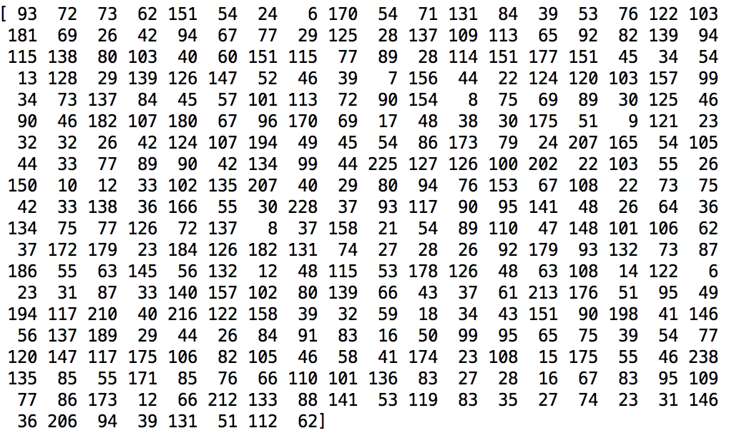
Solution
Arrive time

Slide 7
Results
Average Waiting Time
 | 5:30 | 6:00 | 6:30 | 7:00 | 7:30 | 8:00 | 8:30
2 | 0 | 10 | 16 | 16 | 10 | 2 | 0
4 | 0 | 14 | 24 | 37 | 24 | 13 | 2
8 | 0 | 16 | 23 | 27 | 26 | 17 | 9

Slide 8
Future Research
Adjusting average waiting time to be more realistic by considering the working time of restaurant.
Setting different eating time for different table size, to make our final results more convincing.
Adding some functions, like providing chances for consumers to share tables with strangers, or combining small size tables into a larger one.

Slide 9
THANKS

