Slide 1

Application of Convolutional Neural Network on Medical Image Detection and Segmentation
Shiyu Jin
Bo Yang
Yujia Wu
University of California, Berkeley
CS289A Final Project

Slide 2
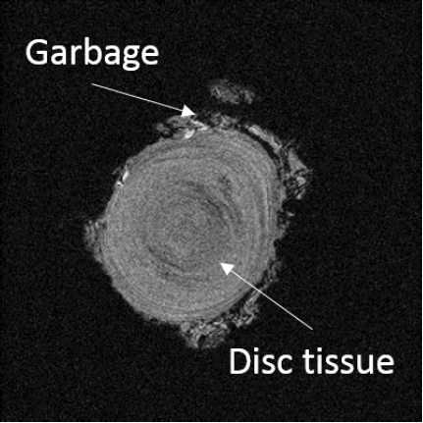
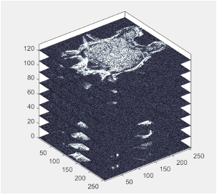
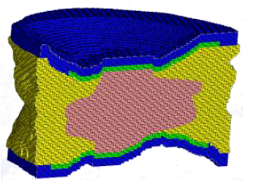
Motivation
Disc finite element model
MRI scan of bovine intervertebral disc
Stacked MRI images of disc
Notes:
Edge detection and intensity threshold method are widely used for medical image post-processing and segmentation and sometimes manual segmentation is needed. For example, MRI scan of intervertebral disc are binarized and processed to stack into 3D geometry for finite element modeling. These deterministic methods subject to many drawbacks: different scans can have different pixel brightness, threshold tuning is needed for different images, and manual work is time expensive and leads to a lot of bias.

Slide 3
Description

Slide 4
Techniques
Designed

Slide 5
Results

Slide 6
Future

