Slide 1
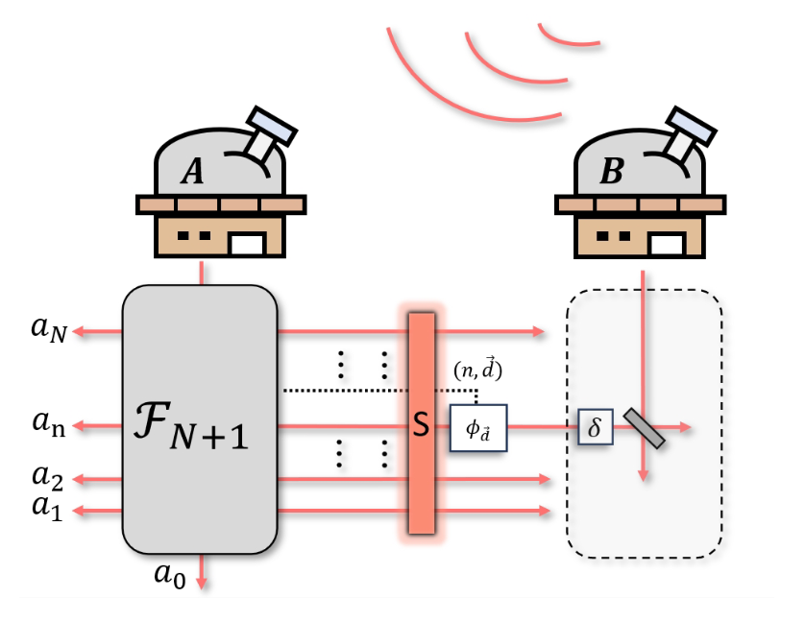

Optimal entanglement-assisted quantum telescopy
Yujie Zhang, Thomas Jennewein
arXiv:2501.16670

Slide 2

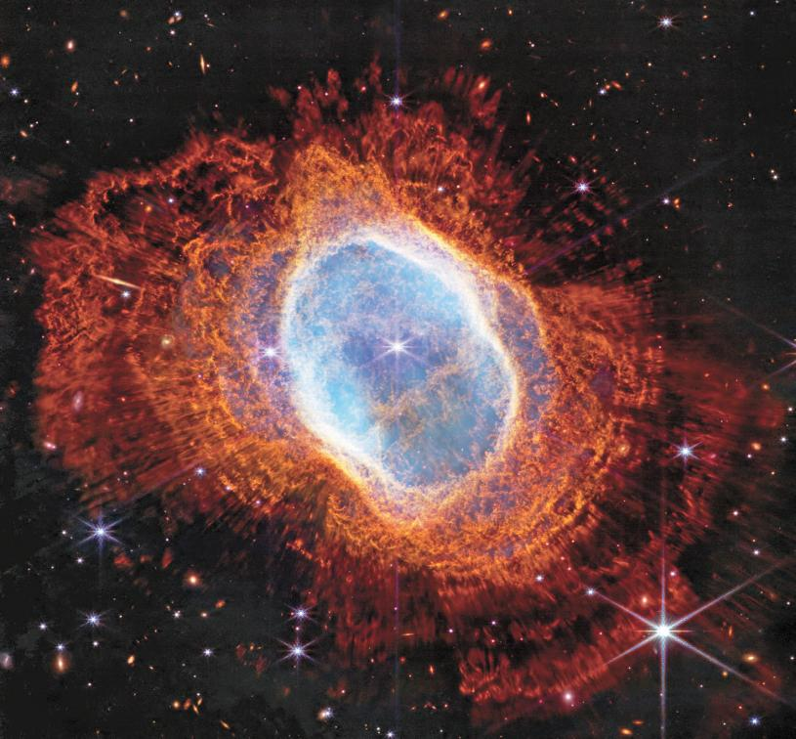
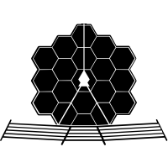



Different ways of astronomical imaging
$$D$$
$$D$$
Instead of measuring with one huge telescope (direct imaging), one can use an array of telescopes (interferometric imaging).
Single telescope:
Image NGC 3132 with the James Webb Space telescope (2022)

Slide 3

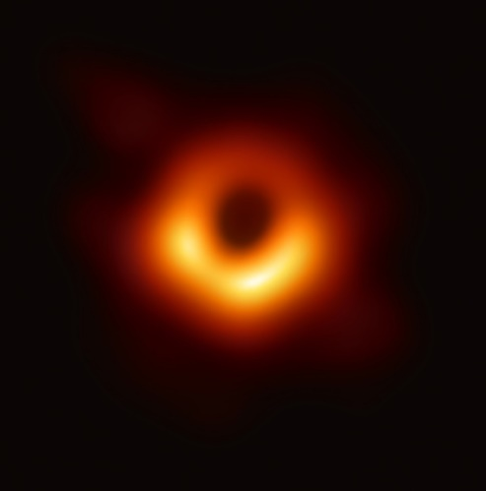
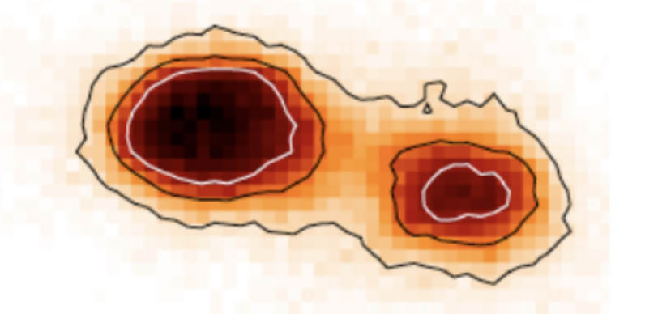













Different ways of astronomical imaging
Single telescope:
Image NGC 3132 with the James Webb Space telescope (2022)
Radio Interferometry:
Image of M87 blackhole with Event Horizon telescope arrays (2019)
Optical Interferometry:
Image of V1295 Aql with the CHARA telescope arrays (2023)
$$λ$$
$～1$um
$～1$mm
$～1$um
$$D$$
$～6.5$m
$～10000k$m
$～300$m
$$θ$$
$$～0.1arc seconds$$
$$～19 micro arc seconds$$
$$～200 micro arc seconds$$
Rayleigh limit: $θ≈\frac{λ}{D}$
sensing wavelength
‘effective’ telescope size

Slide 4
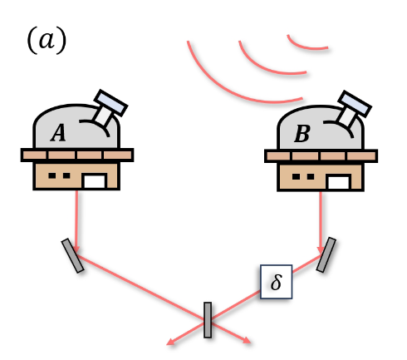
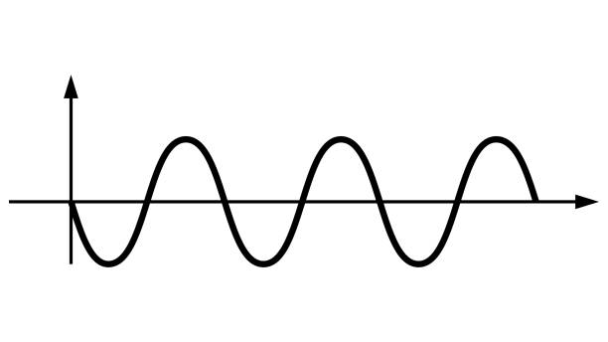
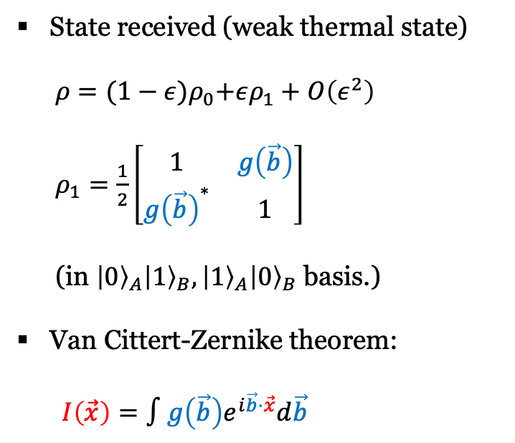



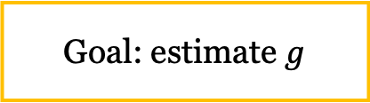
Optical Interferometry (‘Classical’ telescopy)
$I\left(\vec{x}\right)$: Intensity distribution
State received (weak thermal state)
$ρ={(1−ε)ρ}_{0}+ερ_{1}+O\left(ε^{2}\right)$
$ρ_{1}=\frac{1}{2}\left[\begin{matrix}1 & g\left(\vec{b}\right) \\ {g\left(\vec{b}\right)}^{∗} & 1\end{matrix}\right]$
(in ${\left|0\right\rangle }_{A}{\left|1\right\rangle }_{B},{\left|1\right\rangle }_{A}{\left|0\right\rangle }_{B}$ basis.)
Van Cittert-Zernike theorem:
$I\left(\vec{x}\right)=∫g\left(\vec{b}\right)e^{i\vec{b}⋅\vec{x}}d\vec{b}$
“Optical interferometers have limited baseline lengths due to the transmission loss of photons between the telescopes.”
$$\vec{b}$$
Goal: estimate $g$
$g\left(\vec{b}\right):$ complex visibility

Slide 5








Roadmap to quantum telescopy
2011-2012: The first protocol
$$(a)$$
$$(b)$$
$$A$$
$$B$$
$$A$$
$$B$$
Source
$$δ$$
$${\left|0\right\rangle }_{L}{\left|1\right\rangle }_{R}\text{+}e^{iδ}{\left|1\right\rangle }_{L}{\left|0\right\rangle }_{R}$$
Gottesman, Jennewein, Croke, PRL 109, 070503 (2012)
Tsang, PRL 107, 270402 (2011)

Slide 6
Roadmap to quantum telescopy
Since 2019: memory-based protocols
(promise to reduce the demand for entangled sources)
PRL 123, 070504 (2019), PRA 100, 023316 (2019)
PRL 129, 21052(2022)
Since 2022: new entanglement-assisted protocols
(promise better estimation in ideal and even repeater-less regions)
PRA 106,032424(2022), PRL 130,160801(2023)
PRA 109, 052434(2024), PRR 7, 023154(2025)
Light: Science & Applications 14:46 (2025)
2011-2012: The first protocol
Gottesman, Jennewein, Croke, PRL 109, 070503 (2012)
Tsang, PRL 107, 270402 (2011)
Since 2023: proof-of-concept experiments
PRL 131, 210801(2023), Frontiers in Optics, FM5B. 2 (2023)
Since 2020: super-resolution in astronomical interferometry
PRL 124, 080503(2020), PRA 104 (2), 022613 (2021)
PRA A 108 (1), 012602 (2023), arXiv 2501.15685 (2025)

Slide 7


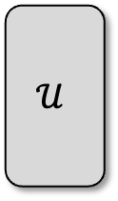



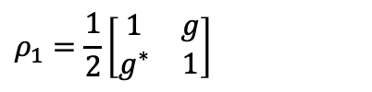
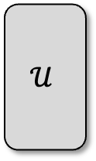






Roadmap to quantum telescopy
$$(a)$$
$$(b)$$
$$A$$
$$B$$
$$A$$
$$B$$
Astronomical state: $ρ={(1−ε)ρ}_{0}+ερ_{1}+O\left(ε^{2}\right)$
$$ρ_{1}=\frac{1}{2}\left[\begin{matrix}1 & g \\ g^{∗} & 1\end{matrix}\right]$$
$$𝒰$$
$$𝒰$$
$$⋯$$
Source
$$⋯$$
Complex visibility $g$
$$δ$$
Since 2023: proof-of-concept experiments
PRL 131, 210801(2023), Frontiers in Optics, FM5B. 2 (2023)
Since 2020: interferometric imaging and super resolution
PRL 124(8), 080503 (2020), PRA 104, 022613 (2021),
PRA 108(1), 012602 (2023), arXiv: 2501.15685(2025)
Goal: Find the most efficient way to estimate $g$ without direct detection

Slide 8




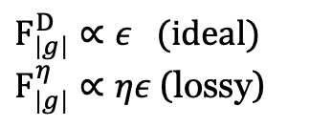
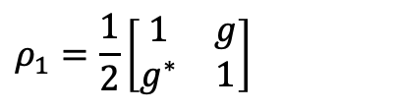





What was known
Astronomical state: $ρ={(1−ε)ρ}_{0}+ερ_{1}+O\left(ε^{2}\right)$
$$ρ_{1}=\frac{1}{2}\left[\begin{matrix}1 & g \\ g^{∗} & 1\end{matrix}\right]$$
$$(a)$$
$$(b)$$
$$(c)$$
$$A$$
$$B$$
$$A$$
$$B$$
$$A$$
$$B$$
Source
LO
LO
$$δ$$
$${\left|0\right\rangle }_{L}{\left|1\right\rangle }_{R}\text{+}e^{iδ}{\left|1\right\rangle }_{L}{\left|0\right\rangle }_{R}$$
Local oscillator
$F_{\left|g\right|}^{D}∝ε$ (ideal)
$F_{\left|g\right|}^{η}∝ηε$ (lossy)
Fisher information
$$F_{\left|g\right|}\text{=}F_{\left|g\right|}^{D}/2∝ε$$
$$F_{\left|g\right|}∝ε^{2}$$
All LOCC schemes without entanglement perform equally badly.
Tsang, PRL 107, 270402 (2011)

Slide 9






What was known
$$(a)$$
$$(b)$$
There are different ways of understanding the quantum advantages:
‘Nonlocal resources’ enable distributed measurement.
Entanglement allows ‘post-selected’ passive quantum teleportation
$$A$$
$$B$$
$$A$$
$$B$$
Source
$$δ$$
$${\left|0\right\rangle }_{L}{\left|1\right\rangle }_{R}\text{+}e^{iδ}{\left|1\right\rangle }_{L}{\left|0\right\rangle }_{R}$$
“Locality constraint limits classical telescopy, nonlocal quantum resources provide quantum enhancement”
Tsang, PRL 107, 270402 (2011)

Slide 10
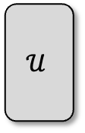
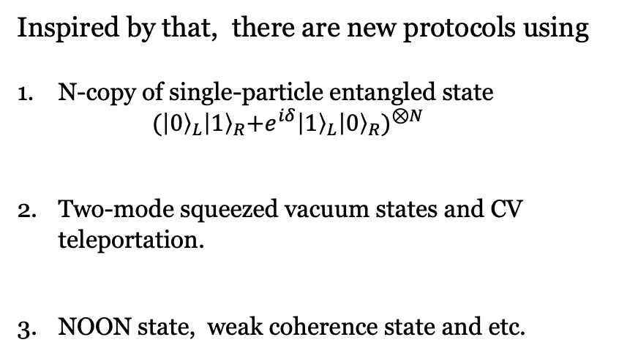


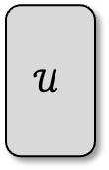
What was known
$$(a)$$
$$(b)$$
Inspired by that, there are new protocols using
N-copy of single-particle entangled state
${ (\left|0\right\rangle }_{L}{\left|1\right\rangle }_{R}\text{+}e^{iδ}{\left|1\right\rangle }_{L}{\left|0\right\rangle }_{R})^{⊗N}$
Two-mode squeezed vacuum states and CV teleportation.
NOON state, weak coherence state and etc.
$$A$$
$$B$$
$$A$$
$$B$$
PRA 106,032424(2022), PRL 130,160801(2023)
$$𝒰$$
$$𝒰$$
$$⋯$$
Source
$$⋯$$
$$δ$$
PRA 109, 052434(2024), PRR 7, 023154(2025)
However,
These studies are always case-by-case and based on Fisher information, while the quantum Fisher information is trivial.
There is no prescription for finding optimal entanglement-assisted protocols

Slide 11
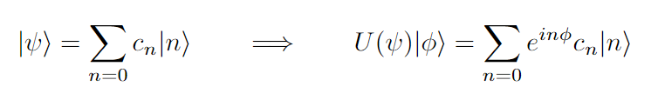
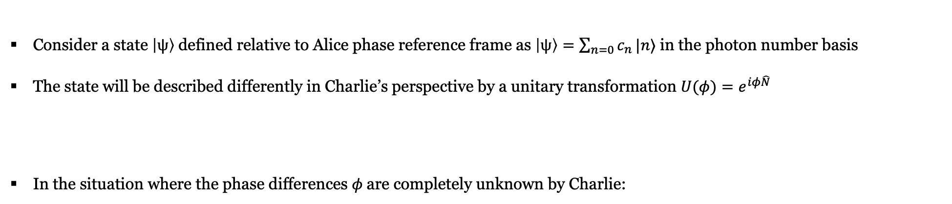
Super-selection rule:
“The resource should not only be a nonlocal resource to overcome locality,
but also, a quantum phase reference to overcome the Super-selection rule”
Consider a state $\left|ψ\right\rangle$defined relative to Alice phase reference frame as $\left|ψ\right\rangle =\sum_{n=0}{c_{n}}|n⟩$ in the photon number basis
The state will be described differently in Charlie’s perspective by a unitary transformation $U(φ)=e^{iφ\hat{N} }$
In the situation where the phase differences $φ$are completely unknown by Charlie:
This is known as particle-number ($U(1)$) super-selection rule, which erase all the phase information among number basis.

Slide 12
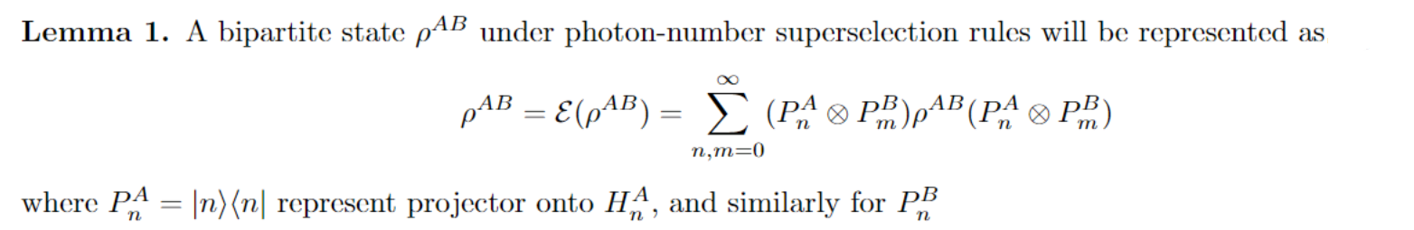

Super-selection rule constrained quantum estimation problem:
Recall the task: We want to estimate g in state: $ρ={(1−ε)ρ}_{0}+ερ_{1}+O\left(ε^{2}\right)$ with $ρ_{1}=\frac{1}{2}\left[\begin{matrix}1 & g \\ g^{∗} & 1\end{matrix}\right]$
If no super-selection rule exists (i.e., ideal direct interference): the QFI of estimating g is given as
If we consider the SSR constraint
And therefore, the achievable QFI always scales at most $ε^{2}$, which explains why the intensity interferometer (Hanbury Brown-Twiss (HBT) ) is not quite useful in astronomical imaging.

Slide 13
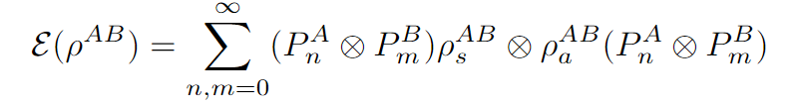
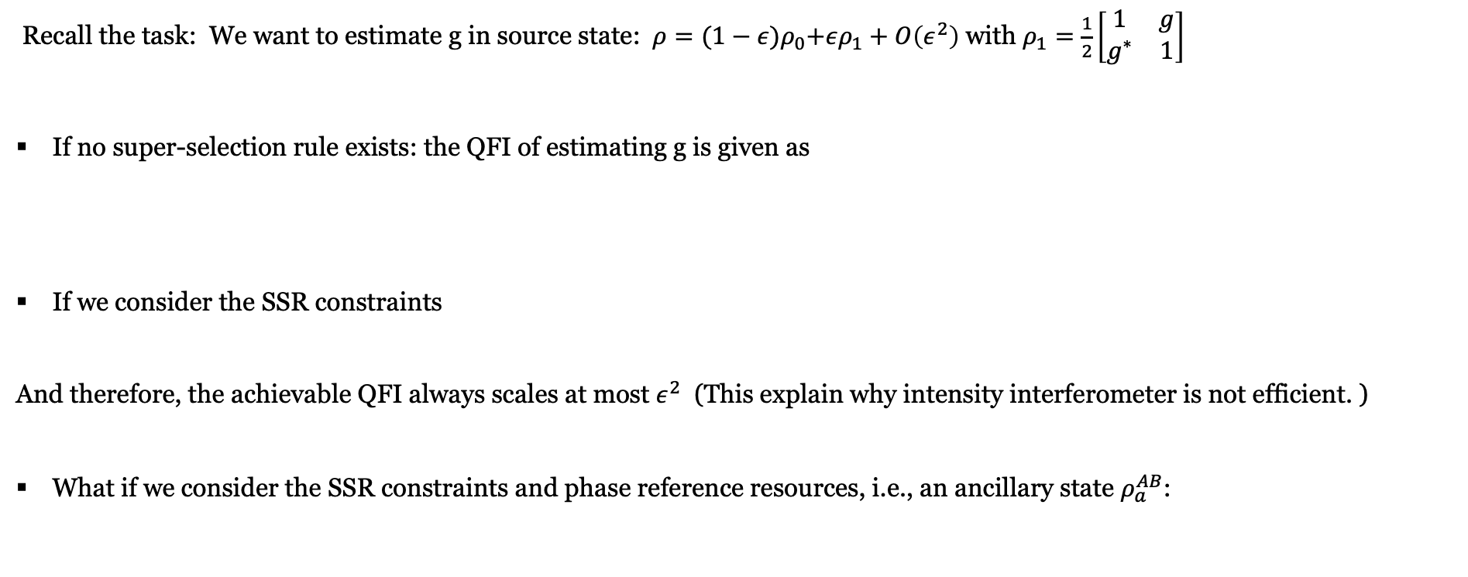
Super-selection rule constrained quantum estimation problem:
Recall the task: We want to estimate g in source state: $ρ={(1−ε)ρ}_{0}+ερ_{1}+O\left(ε^{2}\right)$ with $ρ_{1}=\frac{1}{2}\left[\begin{matrix}1 & g \\ g^{∗} & 1\end{matrix}\right]$
If no super-selection rule exists: the QFI of estimating g is given as
If we consider the SSR constraints
And therefore, the achievable QFI always scales at most $ε^{2}$ (This explain why intensity interferometer is not efficient. )
What if we consider the SSR constraints and phase reference resources, i.e., an ancillary state $ρ_{a}^{AB}$:

Slide 14
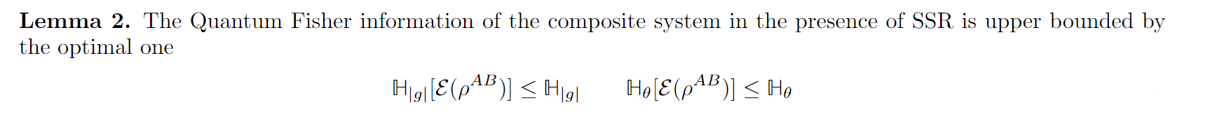
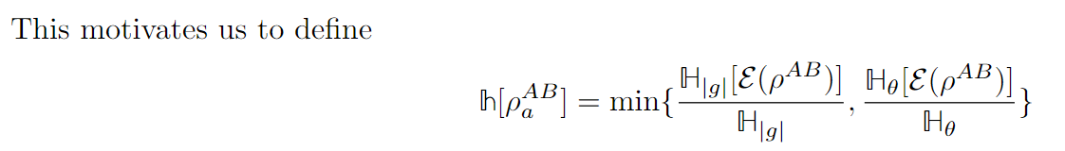
Super-selection rule constrained quantum estimation problem:
Adding ancillary state (phase reference), will not give QFI greater than the optimal one (no SSR)
QFI-ratio

Slide 15
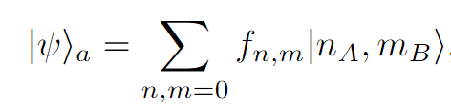
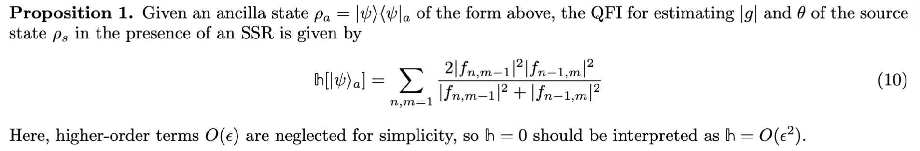
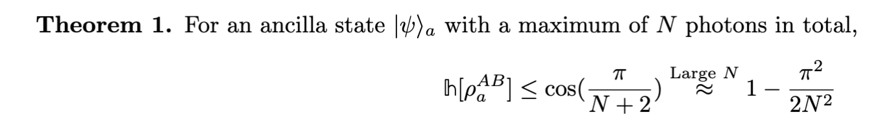
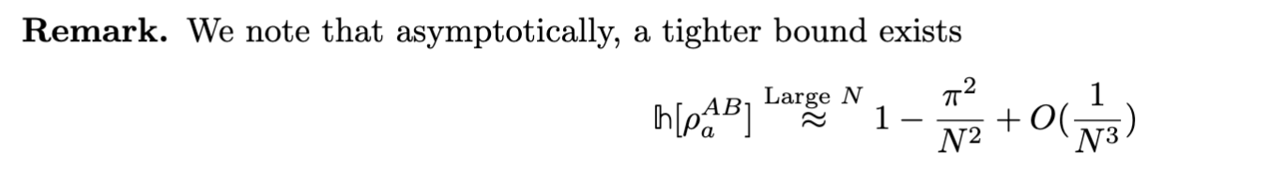
Super-selection rule constrained quantum estimation problem:
The most general form of ancillary state is of the form:
To make sense of our discussion, we consider ancilla state with bounded energy.

Slide 16
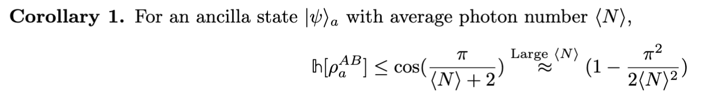
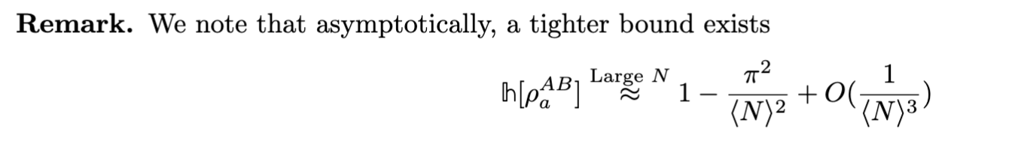
Super-selection rule constrained quantum estimation problem:
The most general form of ancillary state is of the form:
To make sense of our discussion, we consider ancilla state with bounded energy.

Slide 17
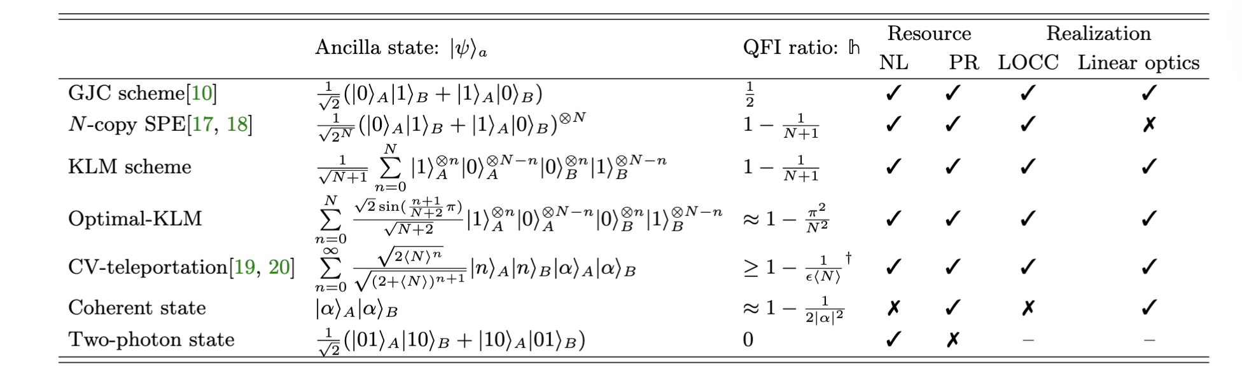
Specific protocols
Note:
The KLM state was first proposed in the study of linear optical quantum computation by Knill, Laflamme and Milburn
The optimal-KLM state saturates the upper bound asymptotically, and the state with a similar form was referred to as the Berry-Wiseman state [ PRL 85, 5098 (2020) ]

Slide 18
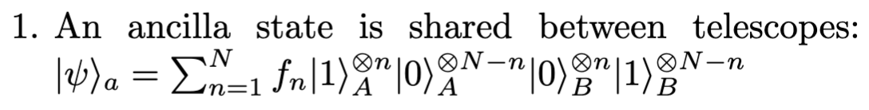
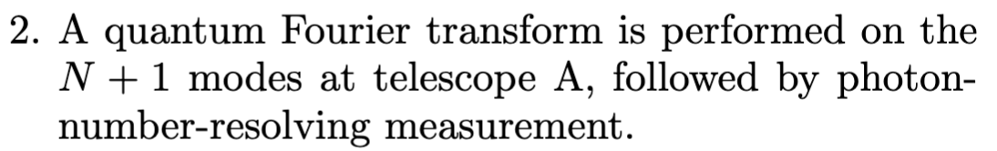
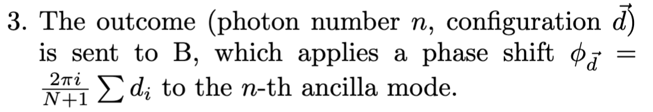
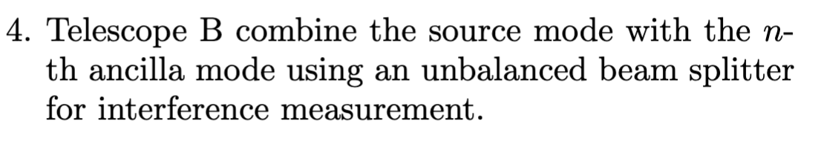
Linear optical implementation (Teleportation trick)
*Caveat: A delay line quantum memory is required for one-way classical communication.
arXiv:2501.16670

Slide 19
Conclusion (and caveats):
A resource state for quantum-enhanced quantum telescopy should both be ‘nonlocal’ and a phase reference so as to circumvent both locality and the SSR constraint.
The optimal quantum strategy reported here assumes ideal, lossless entanglement distribution, hence relies on a repeater-based quantum network.
However, our new protocols do have certain loss-robustness compared to the original GJC protocol, which utilizes only one ancilla photon, and can only offer quantum-enhancement assuming the existence of repeaters
The figures of merit discussed here are FI/QFI per mode, so the optimal protocol we proposed here does not reduce the demand for high-rate, broadband photon sources (as those memory-based protocols). Practically speaking, preparing the required highly mode-entangled states is currently infeasible, and quantum advantage under realistic noise remains marginal versus the N-copy SPE state.

