Slide 1


Defining nonclassicality for individual quantum processes -- through generalized contextuality
Yujie Zhang, David Schmid, Yìlè Yīng, and Robert Spekkens
July, 19, 2025
arXiv:2503.05884 (2025): Reassessing the boundary between classical and nonclassical for individual quantum processes
arXiv:2504.02944 (2025): Nonclassicality for measurements/set of quantum states
arXiv:2507.01122 (2025): Nonclassicality for bipartite states

Slide 2
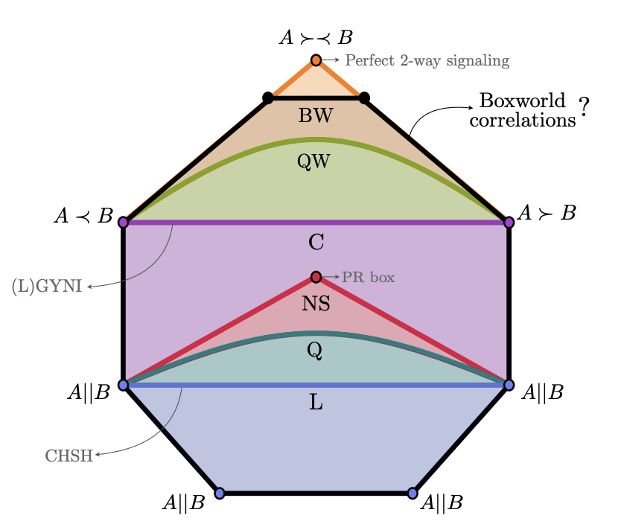
Original Question: What is nonclassical?
Over the past few days, I have learned a lot about how to become “more and more nonclassical”
Quantum contextuality → Bell test → Hardy test → Strong contextuality
Bell correlation → Non-signaling → One-way signaling → QW → BW
Jessica Bavaresco et.al.

Slide 3



New Question: What is classical ?!!
Indeed, the talk is about “where is the boundary between classical and nonclassical (for individual quantum processes)”
Classical → …….→ Quantum contextuality → Bell test → Hardy test → Strong contextuality
Classical → …… → Bell correlation → Non-signaling → One-way signaling → QW → BW
All quantum states
$$Local$$
$$Unsteerable$$
$$Separable$$
Classical
Generalized contextuality

Slide 4
Defining classicality for individual quantum processes -- through generalized noncontextuality
Yujie Zhang, David Schmid, Yìlè Yīng, and Robert Spekkens
July, 19, 2025
arXiv:2503.05884 (2025): Reassessing the boundary between classical and nonclassical for individual quantum processes
arXiv:2504.02944 (2025): Nonclassicality for measurements/set of quantum states
arXiv:2507.01122 (2025): Nonclassicality for bipartite states

Slide 5
Defining classicality: What we want?
Applicable to all quantum processes
Subject to experimental test
Constitute a resource
Invariant under different views
Connect to other notions of classicality

Slide 6
Defining classicality: What we want?
Applicable to all quantum processes
Subject to experimental test
Constitute a resource
New test for entanglement, steering, incompatibility and etc.
Invariant under different views
Connect to other notions of classicality
A clear connection among different types of processes
A clear hierarchy of classicality for the same type of processes

Slide 7








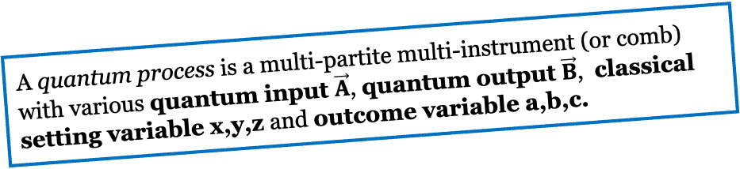






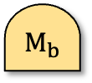



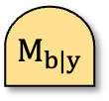








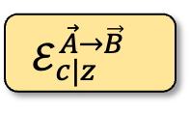




















Defining classicality: Some common views:
A quantum process is a multi-partite multi-instrument (or comb) with various quantum input $\vec{A}$, quantum output $\vec{B}$, classical setting variable x,y,z and outcome variable a,b,c.
Well-established definition(s):
$$a$$
$$A$$
$$b$$
$$A_{1}$$
$$A_{2}$$
$$B$$
$$B$$
$$c$$
$$B$$
$$⋯$$
$$ρ_{a|x}$$
$M_{b|y}$
$$ρ^{A_{1}A_{2}}$$
$${ ℰ}^{A→B}$$
$$ℰ_{z}^{A→B}$$
$$ℐ_{c}^{A→B}$$
$$x$$
$$y$$
$$A$$
$$z$$
$$A$$
$$A$$
$$A$$
Multi-Source
Multi-meter
Bipartite state
Channel
Multi-channel
Instrument
*Unsteerable
Compatible
Separable
Entanglement breaking
Compatible
Unsteerable
Local
Not well-established:
$$b$$
$$\vec{B}$$
$$A$$
$$a$$
$$A$$
$$c$$
$$⋯$$
$$ρ_{⋅|x}$$
$$ρ_{a}$$
$M_{b}$
$$B$$
$$ℰ_{c|z }^{\vec{A}→\vec{B} }$$
$$⋯$$
$$A$$
$$𝒞$$
$$x$$
$$A$$
$$z$$
$$⋯$$
$$\vec{A}$$
Multi-state
Source
Measurement
Comb
Multipartite-multi-instrument

Slide 8
Towards making the definition….
When is a set of statistics classically explainable?
When is a single process classical?

Slide 9

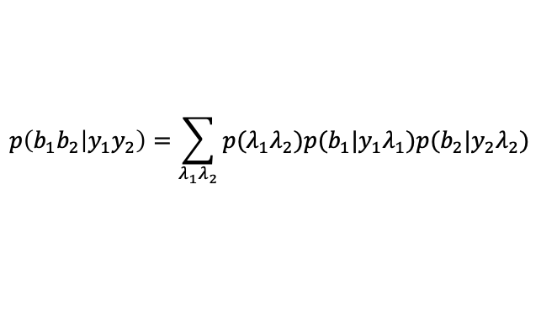




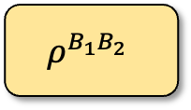





Classical-explainable statistics
(a) Bipartite Bell circuit
$$b_{1}$$
$$b_{2}$$
M
M
A quantum representation f:
$$y_{1}$$
$$y_{2}$$
$$ρ^{B_{1}B_{2}}$$
$$p\left(b_{1}b_{2} | y_{1}y_{2}\right)=Tr\left[ρM_{b_{1}|y_{1}}⊗M_{b_{2}|y_{2}}\right]$$
Ontological representation
$$p(b_{1}|{y_{1}λ}_{1})$$
$$p(b_{2}|{y_{2}λ}_{2})$$
$$p\left(b_{1}b_{2} | y_{1}y_{2}\right)=\sum_{λ_{1}λ_{2}}{p(λ_{1}λ_{2})p(b_{1}|{y_{1}λ}_{1})p(b_{2}|{y_{2}λ}_{2})}$$
$$λ_{1}$$
$$λ_{2}$$
$$p(λ_{1}λ_{2})$$
Local hidden variable model.
The quantum statistic in the bipartite scenario is classically explainable if it admits a local hidden variable model.

Slide 10

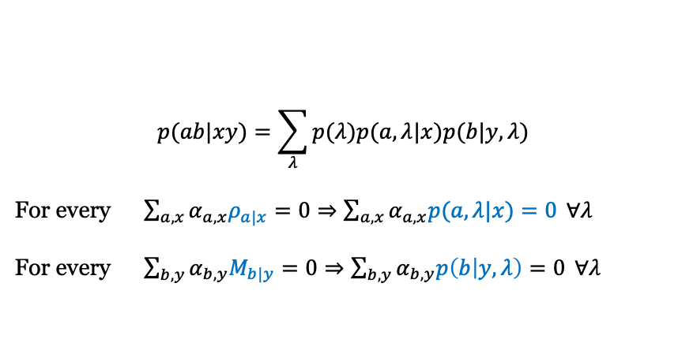








Classical-explainable statistics
(b) Prepare-and-measure circuit
$$b$$
M
A quantum representation f:
$$y$$
$$p(ab|xy)=Tr\left[ρ_{a|x}⊗M_{b|y}\right]$$
$$a$$
$ρ$
$$x$$
$$p(ab|xy)=\sum_{λ}{p(λ)p(a,λ|x)p(b|y,λ)}$$
For every $\sum_{a,x}{α_{a,x}ρ_{a|x}=0⇒\sum_{a,x}{α_{a,x}p(a,λ|x)=0 }∀λ}$
For every $\sum_{b,y}{α_{b,y}M_{b|y}=0⇒\sum_{b,y}{α_{b,y}p\left(b | y,λ\right)=0 }∀λ}$
$$p(b|yλ)$$
Ontological representation
$$λ$$
$$p(λa|x)$$
Generalized noncontextual ontological model.
The quantum statistics in the prepare-and-measure scenario is classically explainable if it admits a Generalized noncontextual ontological model.

Slide 11













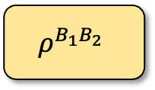




Classical-explainable statistics
(a) Bipartite Bell circuit
(b) Prepare-and-measure circuit
$$b_{1}$$
$$b_{2}$$
$$b$$
M
M
M
$$y_{1}$$
$$y_{2}$$
$$y$$
A quantum representation f:
$$ρ^{B_{1}B_{2}}$$
$$a$$
$ρ$
$$x$$
Ontological representation
$$p(b_{1}|{y_{1}λ}_{1})$$
$$p(b_{2}|{y_{2}λ}_{2})$$
$$p(b|yλ)$$
$$λ_{1}$$
$$λ_{2}$$
$$λ$$
$$p(λ_{1}λ_{2})$$
$$p(λa|x)$$
Local causal model.
(diagram-perserving)
Generalized noncontextual ontological model.
(linear)
Definition: A statistic is classically explainable if it can be mapped to an ontological representation, where the map is linear and diagram-perserving.

Slide 12
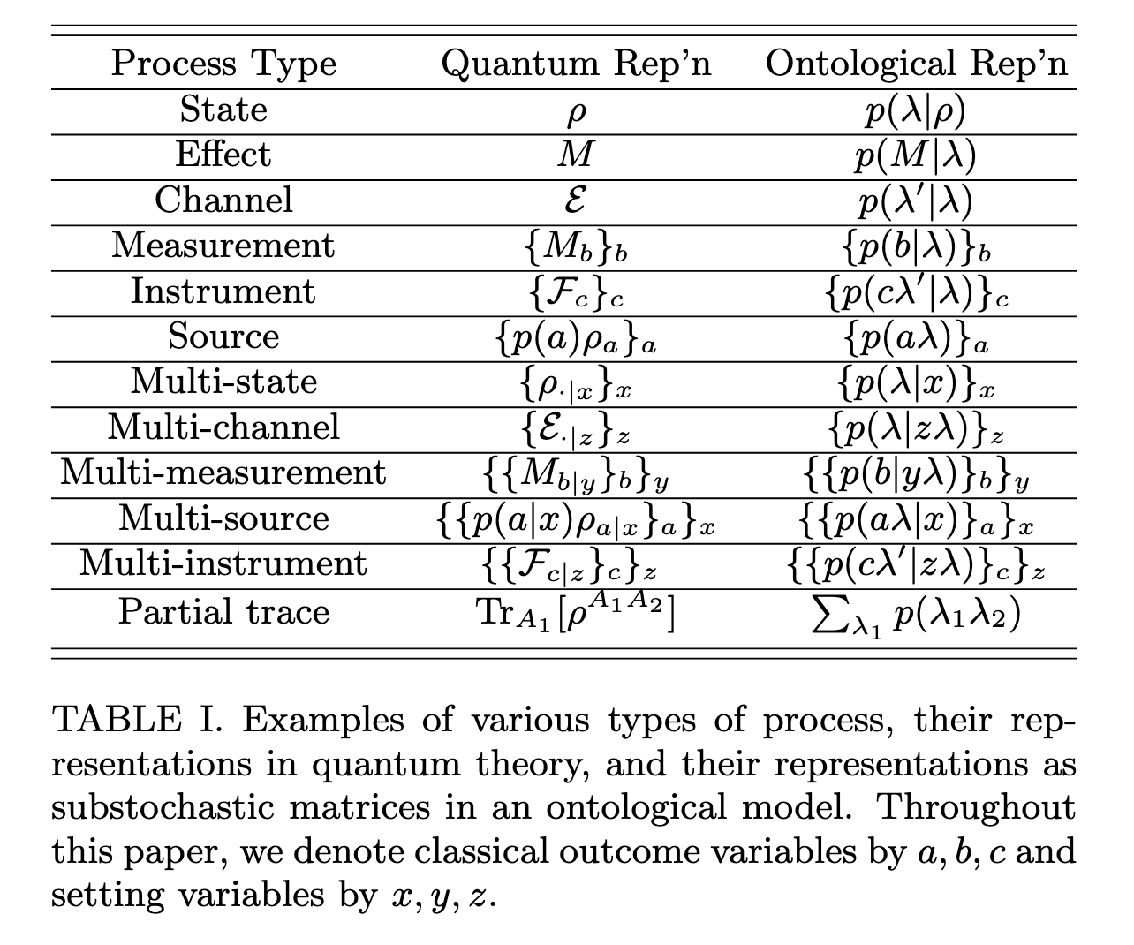
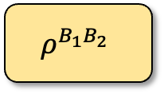





























Classical-explainable statistics
$$b$$
$$b_{1}$$
$$b_{2}$$
$$b$$
M
M
M
M
A quantum circuit f:
$$y$$
$$y_{1}$$
$$y_{2}$$
$$c$$
$$y$$
$$a$$
$$ρ^{B_{1}B_{2}}$$
$$ℰ$$
$$a$$
$$z$$
$ρ$
$ρ$
$$x$$
$$x$$
$$p(b|yλ)$$
$$p(b|yλ)$$
$$p(b_{1}|{y_{1}λ}_{1})$$
$$p(b_{2}|{y_{2}λ}_{2})$$
$$λ′$$
$$λ$$
$$λ_{1}$$
$$λ_{2}$$
$$p(cλ^{′}|zλ)$$
Ontological representation
$$p(λ_{1}λ_{2})$$
$$λ$$
$$p(λa|x)$$
$$p(aλ|x)$$
(a) PM circuit
(b) Bipartite circuit
(c) PTM circuit
Definition: A quantum circuit is classically explainable if it can be mapped to an ontological representation, where the map is linear and diagram-perserving.

Slide 13









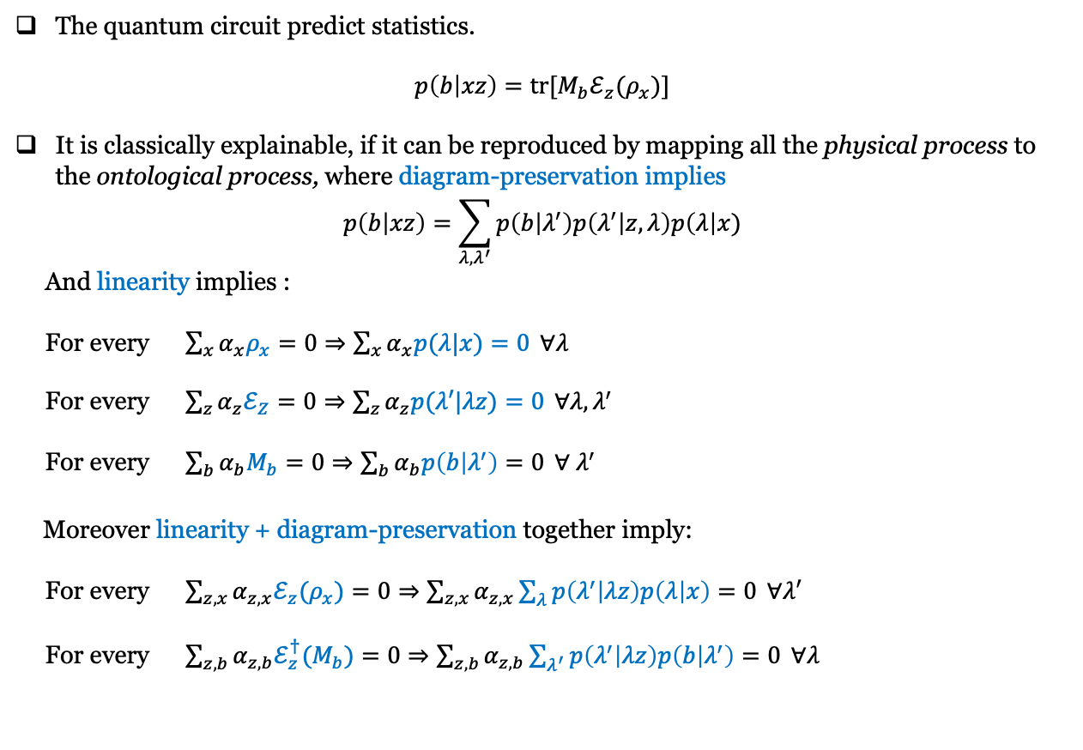



Classical-explainable statistics
The quantum circuit predict statistics.
$$p\left(b | xz\right)=tr[M_{b}ℰ_{z}(ρ_{x})]$$
It is classically explainable, if it can be reproduced by mapping all the physical process to the ontological process, where diagram-preservation implies
$$p\left(b | xz\right)=\sum_{λ, λ^{′}}{p\left(b | λ^{′}\right)p\left(λ^{′} | z,λ\right)p\left(λ\right|x)}$$
And linearity implies :
For every $\sum_{x}{α_{x}ρ_{x}=0⇒\sum_{x}{α_{x}p(λ|x)=0 }∀λ}$
For every $\sum_{z}{α_{z}ℰ_{Z}=0⇒\sum_{z}{α_{z}p(λ′|λz)=0 }∀λ,λ^{′}}$
For every $\sum_{b}{α_{b}M_{b}=0⇒\sum_{b}{α_{b}p\left(b | λ^{′}\right)=0 }∀{ λ}^{′}}$
Moreover linearity + diagram-preservation together imply:
For every $\sum_{z,x}{α_{z,x}{ℰ_{z}(ρ}_{x})=0⇒\sum_{z,x}{α_{z,x}\sum_{λ}{p\left(λ^{′} | λz\right)p\left(λ | x\right)}=0 }∀λ′}$
For every $\sum_{z,b}{α_{z,b}ℰ_{z}^{†}(M_{b})=0⇒\sum_{z,b}{α_{z,b}\sum_{λ^{′}}{p\left(λ^{′} | λz\right)p\left(b | λ^{′}\right)}=0 }∀λ}$
$$b$$
$$b$$
M
Linear
$$p(b|λ)$$
$$λ′$$
$$ℰ$$
$$p(λ^{′}|zλ)$$
$$z$$
$$λ$$
$$z$$
$$ρ$$
$$p(λ|x)$$
$$x$$
$$x$$
Quantum circuit
Ontological model

Slide 14
Towards making the definition….
When is a set of statistics classically explainable?
When is a single process classical?
Answer: If it always admits classical-explainable statistics. But…..

Slide 15
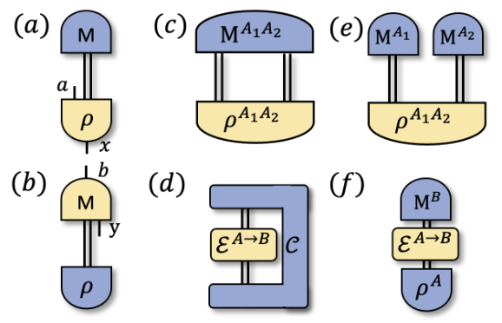


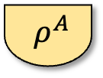
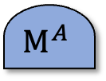

Classical quantum processes
Definition: A quantum process is classical if it always generates classically explainable statistics when
using nontrivially* in quantum circuits.
$$M^{AB}$$
Dual process
$$M^{A}$$
* No new quantum system is introduced.
$ρ^{A}$
$ρ^{B}$
$ρ^{A}$
Process to be certified
Theorem: A quantum process is nonclassical if and only if it can be used in some quantum experiment to generate a proof of the failure of noncontextuality with factorizing dual process*
* e.g., The factorizing dual of a bipartite state is a product measurement.

Slide 16

Defining classicality: What we want?
Applicable to all quantum processes
Subject to experimental test
Constitute a resource
New test for entanglement, steering, incompatibility and etc.
Invariant under different views
Connect to other notions of classicality
A clear connection among different types of processes
A clear hierarchy of classicality for the same type of processes

Slide 17
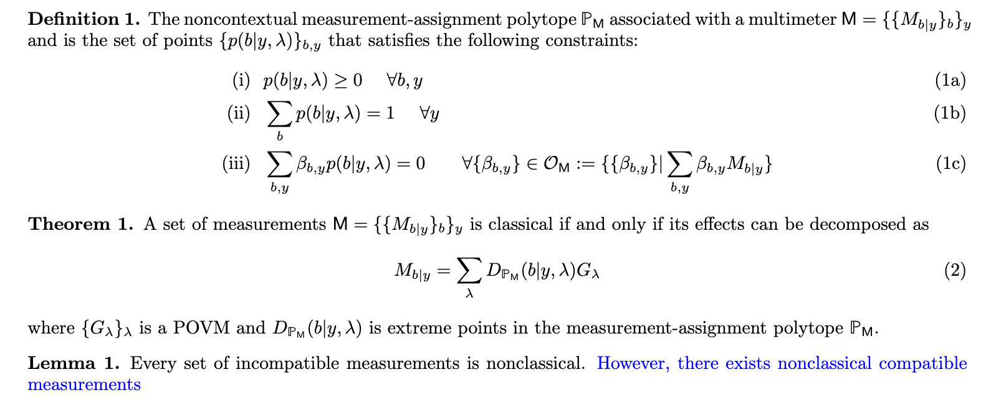






Example 1: classical measurements
arXiv:2504.02944 (2025)
$$b$$
$$b$$
M
Linear
$$p(b|yλ)$$
$$y$$
$$y$$
$$A$$
$$λ$$
$ρ$
$$p(λ|ρ)$$
Quantum circuit
Ontological model
Contextuality without incompatibility

Slide 18

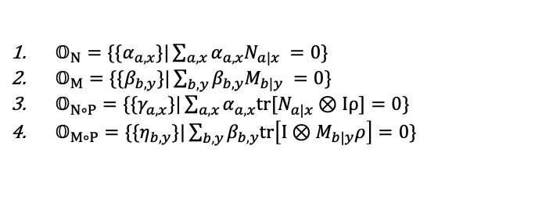



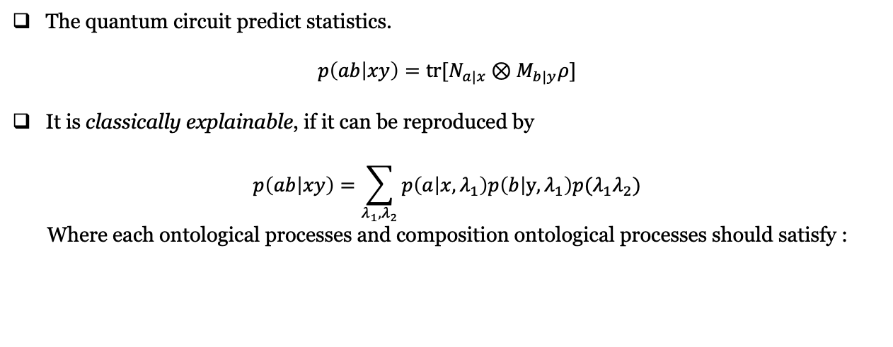





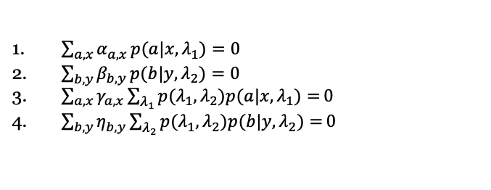
Example 2: classical bipartite state
The quantum circuit predict statistics.
$$p\left(ab | xy\right)=tr[N_{a|x}⊗M_{b|y}ρ]$$
It is classically explainable, if it can be reproduced by
$$p\left(ab | xy\right)=\sum_{λ_{1},λ_{2}}{p\left(a | x,λ_{1}\right)p\left(b | y,λ_{1}\right)p(λ_{1}λ_{2})}$$
Where each ontological processes and composition ontological processes should satisfy :
$$a$$
$$b$$
Linear
Diag. Pres
N
M
$$p(a|{x,λ}_{1})$$
$$p(b|{y,λ}_{2})$$
(diagram-preservation)
$$x$$
$$y$$
$$λ_{1}$$
$$λ_{2}$$
$$ρ$$
$$p(λ_{1}λ_{2})$$
Quantum circuit
Ontological model
$𝕆_{N}=\{\{α_{a,x}\}|\sum_{a,x}{α_{a,x}N_{a|x}} =0\}$
$𝕆_{M}=\{\{β_{b,y}\}|\sum_{b,y}{β_{b,y}M_{b|y}} =0\}$
$𝕆_{N∘P}=\{\{γ_{a,x}\}|\sum_{a,x}{α_{a,x}{tr[N}_{a|x}⊗Iρ]=0\}}$
$𝕆_{M∘P}=\{\{η_{b,y}\}|\sum_{b,y}{β_{b,y}tr\left[I⊗M_{b|y}ρ\right]=0\}}$
$\sum_{a,x}{α_{a,x}}p(a|x,λ_{1})=0$
$\sum_{b,y}{β_{b,y}}p(b|y,λ_{2})=0$
$\sum_{a,x}{γ_{a,x}}\sum_{λ_{1}}{p{(λ}_{1},λ_{2})p(a|x,λ_{1})=}0$
$\sum_{b,y}{η_{b,y}}\sum_{λ_{2}}{p{(λ}_{1},λ_{2})p(b|y,λ_{2})=}0$
(linearity)
A bipartite state is classical if it generates statistics that are classical relative to ${(𝕆}_{N},𝕆_{M},𝕆_{N∘P},𝕆_{M∘P})$
What about a bipartite state that generates statistics that are classical relative to ${𝕆⊂(𝕆}_{N},𝕆_{M},𝕆_{N∘P},𝕆_{M∘P})$?

Slide 19


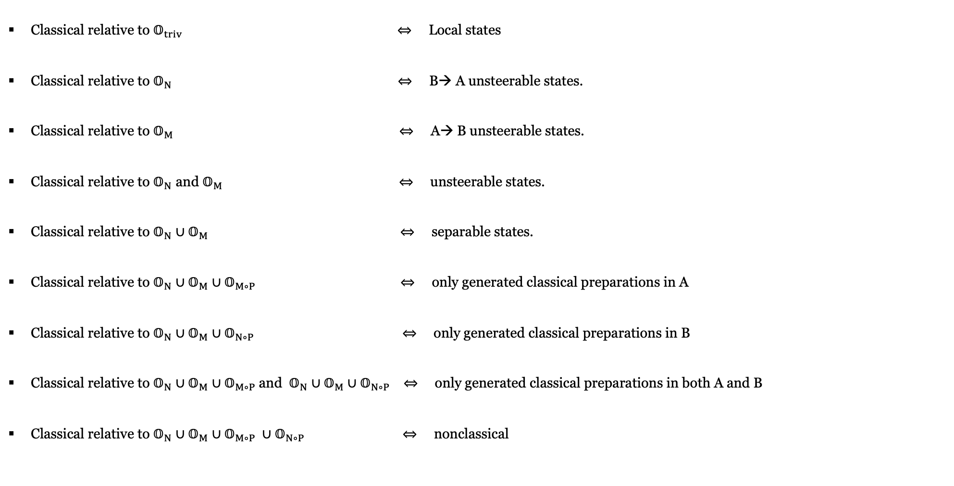








Nonclassical bipartite state
Classical relative to $𝕆_{triv}$ $⇔$ Local states
Classical relative to $𝕆_{N}$ $⇔$ B→ A unsteerable states.
Classical relative to $𝕆_{M}$ $⇔$ A→ B unsteerable states.
Classical relative to $𝕆_{N}$ and $𝕆_{M} ⇔$ unsteerable states.
Classical relative to $𝕆_{N}∪𝕆_{M} ⇔$ separable states.
Classical relative to $𝕆_{N}∪𝕆_{M}∪𝕆_{M∘P} ⇔$ only generated classical preparations in A
Classical relative to $𝕆_{N}∪𝕆_{M}∪𝕆_{N∘P} ⇔$ only generated classical preparations in B
Classical relative to $𝕆_{N}∪𝕆_{M}∪𝕆_{M∘P}$and $𝕆_{N}∪𝕆_{M}∪𝕆_{N∘P} ⇔$ only generated classical preparations in both A and B
Classical relative to $𝕆_{N}∪𝕆_{M}∪𝕆_{M∘P} ∪𝕆_{N∘P} ⇔$ nonclassical
$$a$$
$$b$$
Linear
Diag. Pres
N
M
$$p(a|{x,λ}_{1})$$
$$p(b|{y,λ}_{2})$$
$$x$$
$$y$$
$$λ_{1}$$
$$λ_{2}$$
$$ρ$$
$$p(λ_{1}λ_{2})$$
Quantum circuit
Ontological model
All quantum states
$$Local$$
$$Unsteerable$$
$$Separable$$
Classical

Slide 20
Nonclassical bipartite state
Classical relative to $𝕆_{triv}$ $⇔$ Local states
Classical relative to $𝕆_{N}$ $⇔$ B→ A unsteerable states.
Classical relative to $𝕆_{M}$ $⇔$ A→ B unsteerable states.
Classical relative to $𝕆_{N}$ and $𝕆_{M} ⇔$ unsteerable states.
Classical relative to $𝕆_{N}∪𝕆_{M} ⇔$ separable states.
Classical relative to $𝕆_{N}∪𝕆_{M}∪𝕆_{M∘P} ⇔$ only generated classical preparations in A
Classical relative to $𝕆_{N}∪𝕆_{M}∪𝕆_{N∘P} ⇔$ only generated classical preparations in B
Classical relative to $𝕆_{N}∪𝕆_{M}∪𝕆_{M∘P}$and $𝕆_{N}∪𝕆_{M}∪𝕆_{N∘P} ⇔$ only generated classical preparations in both A and B
Classical relative to $𝕆_{N}∪𝕆_{M}∪𝕆_{M∘P} ∪𝕆_{N∘P} ⇔$ nonclassical
$$a$$
$$b$$
Linear
Diag. Pres
N
M
$$p(a|{x,λ}_{1})$$
$$p(b|{y,λ}_{2})$$
$$x$$
$$y$$
$$λ_{1}$$
$$λ_{2}$$
$$ρ$$
$$p(λ_{1}λ_{2})$$
Quantum circuit
Ontological model
All quantum states
$$Local$$
$$Unsteerable$$
$$Separable$$
Classical
Measure zero

Slide 21














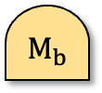




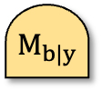




Nonclassical general process
Our unified definition
defines a strictly smaller set of classical processes for each type.
$$b$$
$$A$$
$$a$$
$$A$$
$$b$$
$$a$$
$$A$$
$$A_{1}$$
$$A_{n}$$
$$B$$
$$⋯$$
$M_{b}$
$M_{b|y}$
$$ρ^{\vec{A} }$$
$$ρ_{⋅|x}$$
$$ρ_{a}$$
$$ρ_{a|x}$$
$${ ℰ}^{A→B}$$
$$A$$
$$x$$
$$y$$
$$A$$
$$x$$
$$A$$
Classical measurement
Classical
source
Classical
multi-meter
Classical
multi-source
Classical
multipartite state
Classical channel
$$⊂$$
$$⊂$$
$$⊂$$
$$⊂$$
Compatible measurements
Unsteerable assemblage
Multipartite separable state
Entanglement-breaking
Common view of classicality

Slide 22




Nonclassical general process
Our unified definition
defines a strictly smaller set of classical processes for each type.
Reduces to ‘standard’ in a restricted scenario
$$b$$
$$A$$
$$a$$
$$A$$
$$b$$
$$a$$
$$A$$
$$A_{1}$$
$$A_{n}$$
$$B$$
$$⋯$$
$M_{b}$
$M_{b|y}$
$$ρ^{\vec{A} }$$
$$ρ_{⋅|x}$$
$$ρ_{a}$$
$$ρ_{a|x}$$
$${ ℰ}^{A→B}$$
$$A$$
$$x$$
$$y$$
$$A$$
$$x$$
$$A$$
Classical measurement
Classical
source
Classical
multi-meter
Classical
multi-source
Classical
multipartite state
Classical channel
$$=$$
$$=$$
$$=$$
$$=$$
Compatible measurements
Unsteerable assemblage
Multipartite separable state
Entanglement-breaking
Common view of classicality

Slide 23
Defining classicality: What we want?
Applicable to all quantum processes
Subject to experimental test
Constitute a resource
New test for entanglement, steering, incompatibility and etc.
Invariant under different views
Connect to other notions of classicality
A clear connection among different types of processes
A clear hierarchy of classicality for the same type of processes

Slide 24
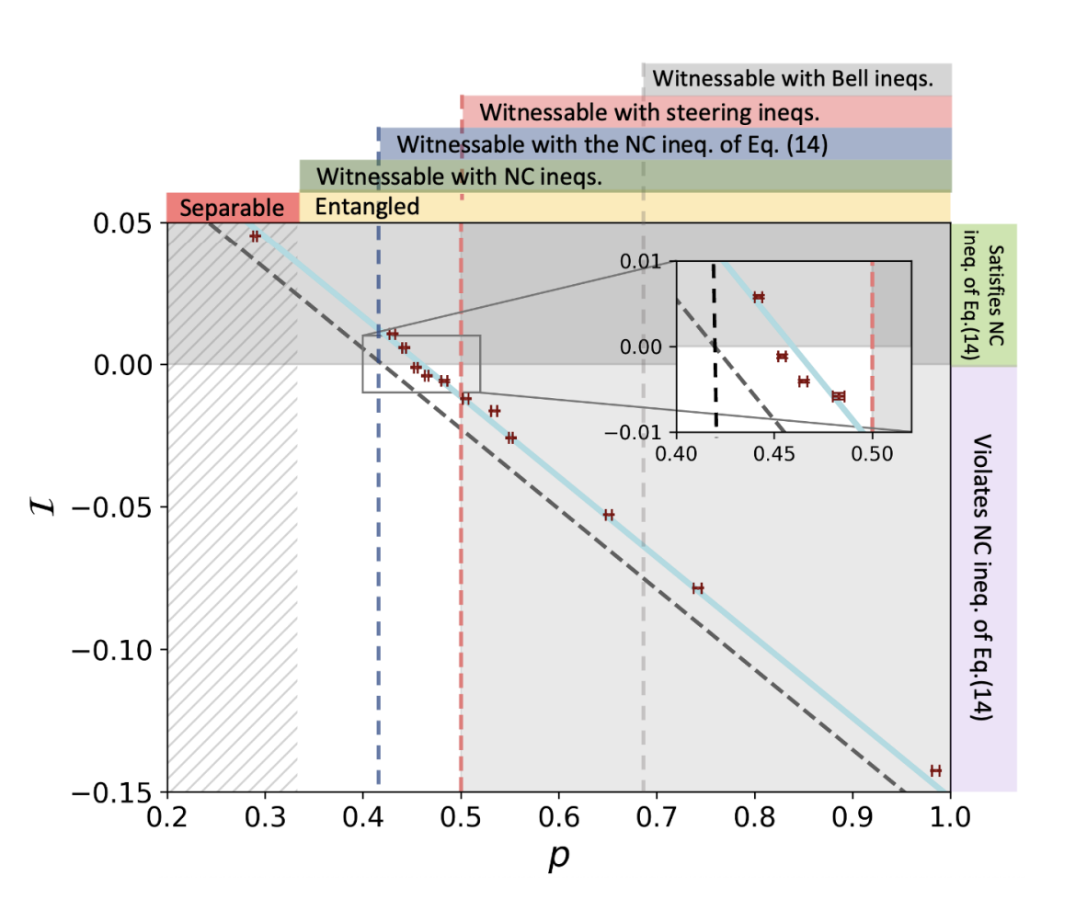
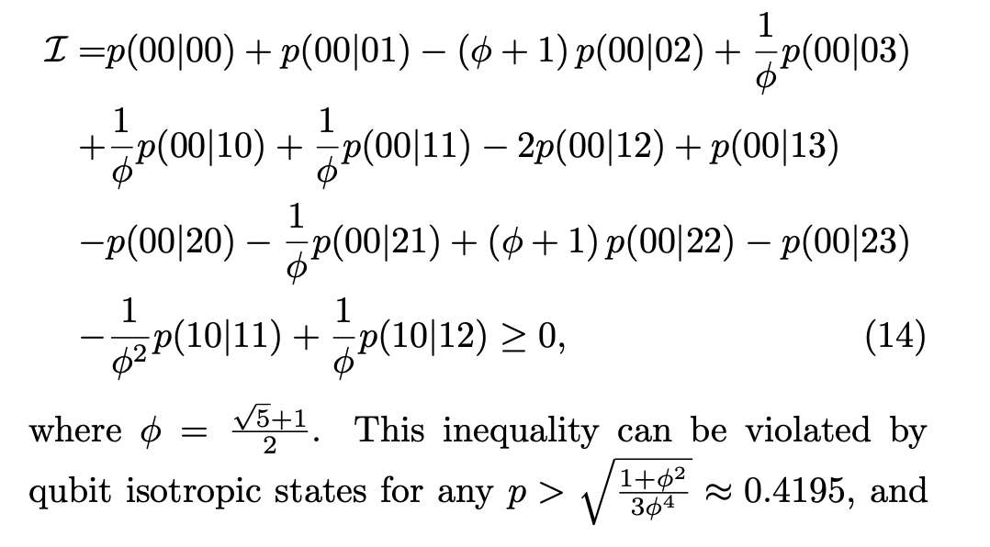
Nonclassical bipartite state
arXiv: 2507.01122

Slide 25
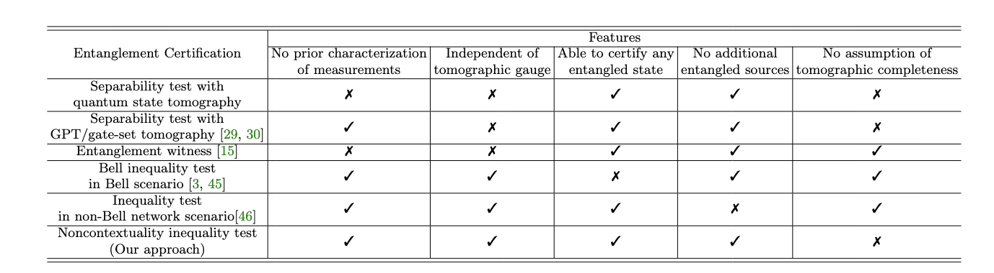
Comparing different entanglement certification

Slide 26
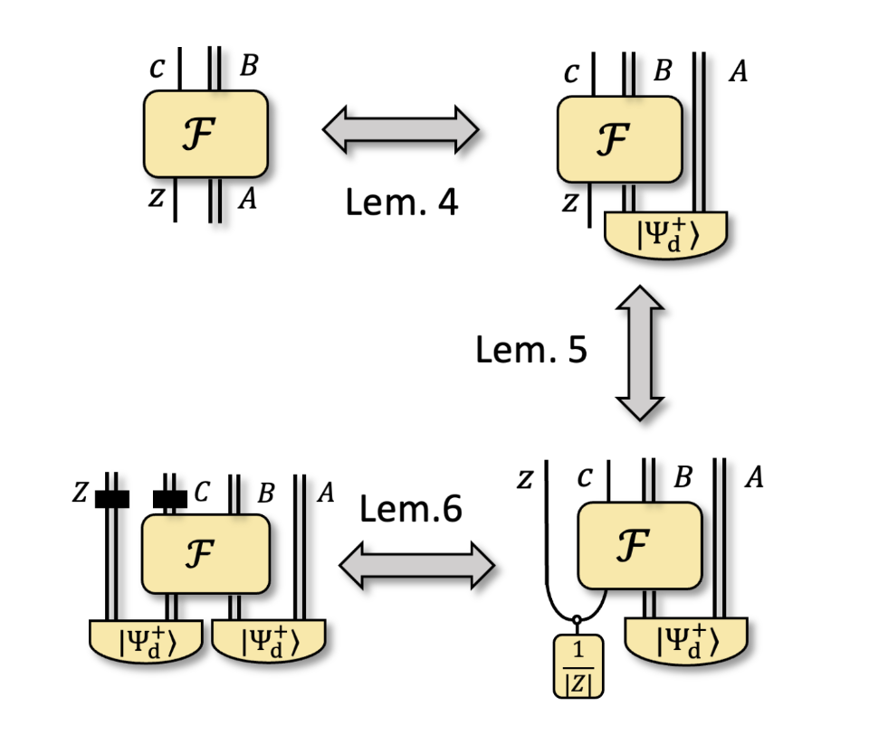
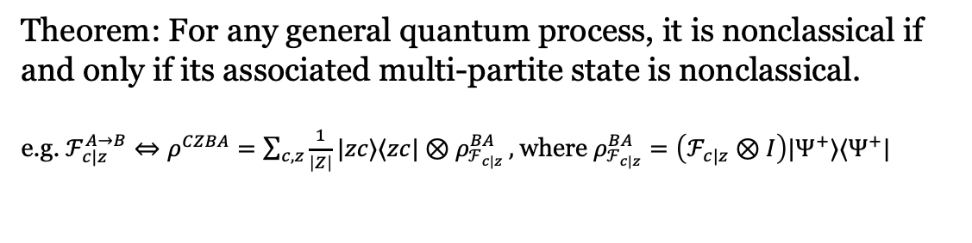
Nonclassicality for a general quantum process:
Theorem: For any general quantum process, it is nonclassical if and only if its associated multi-partite state is nonclassical.
e.g. $ℱ_{c|z}^{A→B}⇔ρ^{CZBA}=\sum_{c,z}{\frac{1}{\left|Z\right|}|zc⟩⟨zc|⊗ρ_{ℱ_{c|z}}^{BA}},$where $ρ_{ℱ_{c|z}}^{BA}=\left(ℱ_{c|z}⊗I\right)|Ψ^{+}⟩⟨Ψ^{+}|$
Lemma 4: Choi-isomorphism preserve nonclassicality
Lemma 5: Flag-convexification preserve nonclassicality
Lemma 6: Classical system can be treated as dephased quantum system.

Slide 27












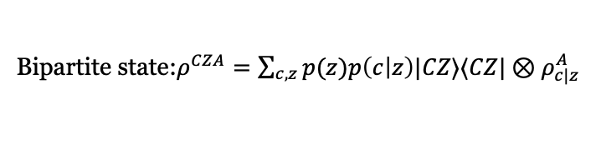





Motivation
In the common view, though different processes are “closely related” to each other, the assessments of the nonclassicality are inconsistent.
State assemblages, state ensemble, and bipartite state can all be conceptualized as the same object from different perspectives.
Flag convexification
Classical outcome as dephased quantum output
$$c$$
$$A$$
$$z$$
$$c$$
$$c,z$$
$$A$$
$$C,Z$$
$$A$$
$$ρ$$
$$ρ$$
$$ρ$$
$$ρ$$
$$z$$
$$z$$
$$p\left(z\right)$$
State assemblage: $\{\{{p(c|z)ρ}_{c|z}^{A}\}_{c}\}_{z}$
State ensemble: $\{{p(z)p(c|z)ρ}_{c|z}^{A}\}_{c,z}$
Bipartite state:$ρ^{CZA}=\sum_{c,z}{p(z)p\left(c | z\right)|CZ⟩⟨CZ|⊗ρ_{c|z}^{A}}$
Dephased basis.
State assemblage can be nonclassical.
If one randomly select the setting z and treat the result as a state ensemble, there is no notion of nonclassicality defined.
If one further treat the classical outcome as dephased quantum output, it’s always a separable state, which is classical.

Slide 28


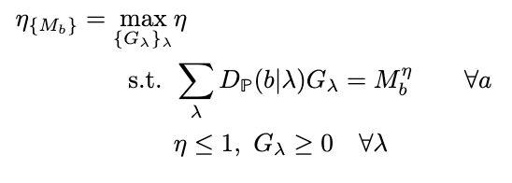
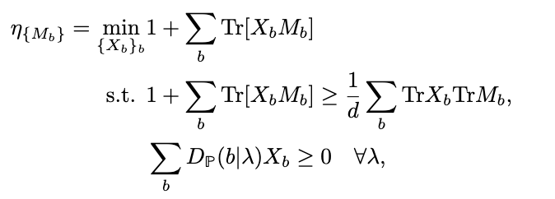
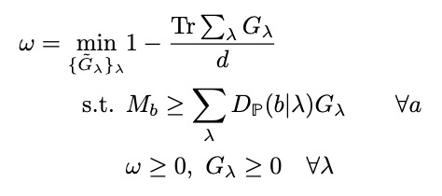
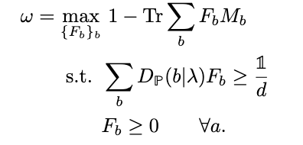
Certification and quantification
Robustness-based quantifier
Weight-based quantifier
White noise-robustness
Weight-based quantification
Primal
Dual
Primal
Dual

Slide 29
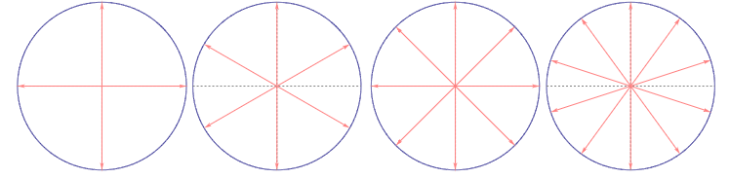
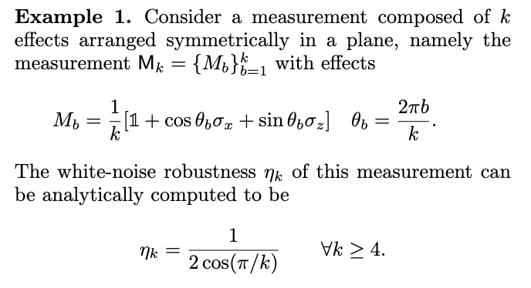
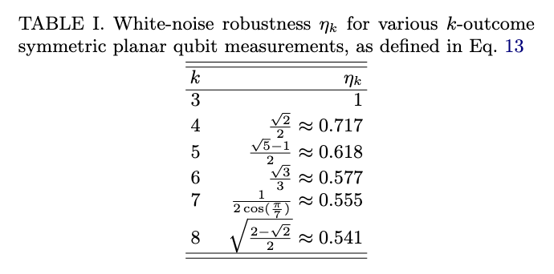
Certification and quantification
Robustness-based quantifier
White noise-robustness
Primal
Dual

Slide 30
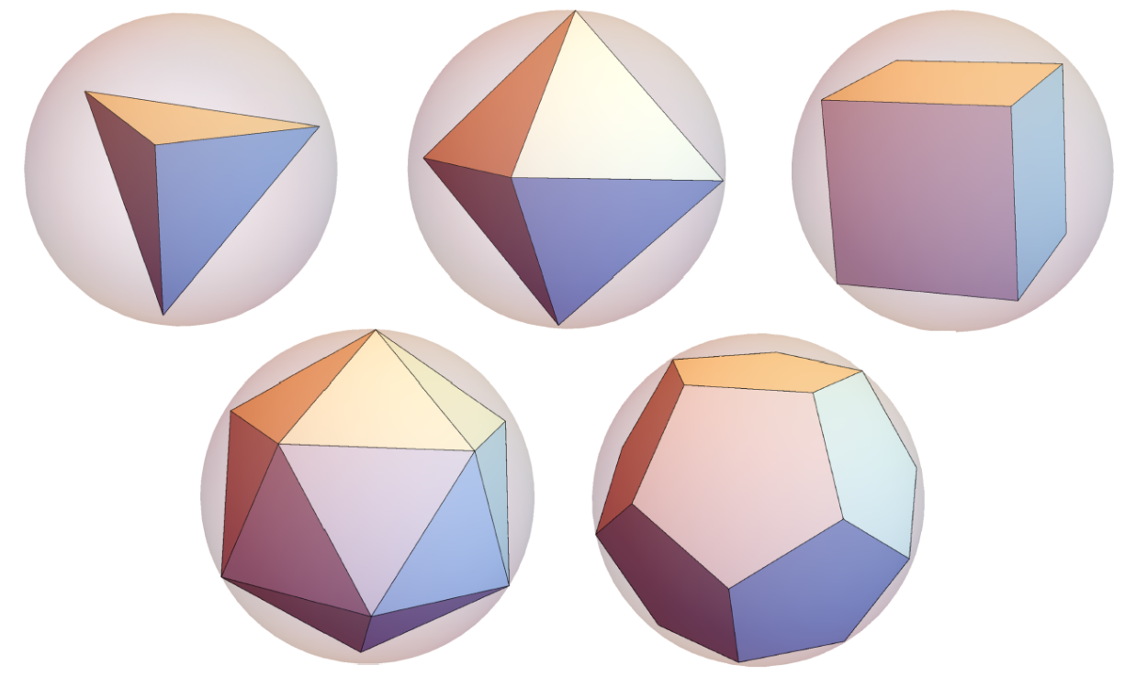
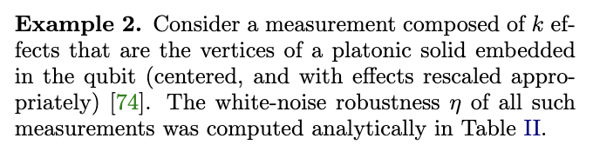
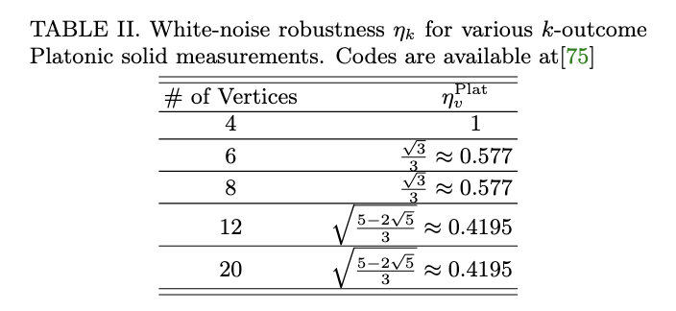
Certification and quantification
Robustness-based quantifier
White noise-robustness
Primal
Dual

Slide 31
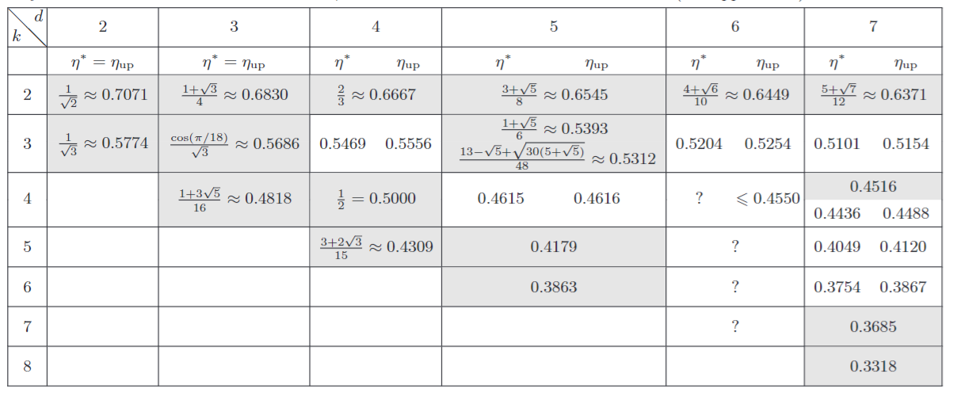
Certification and quantification
Example3: For MUB bases, its noise-robustness for generalized incompatibility equals to its noise robustness for the standard incompatibility
Robustness-based quantifier
White noise-robustness
Primal
Dual

Slide 32
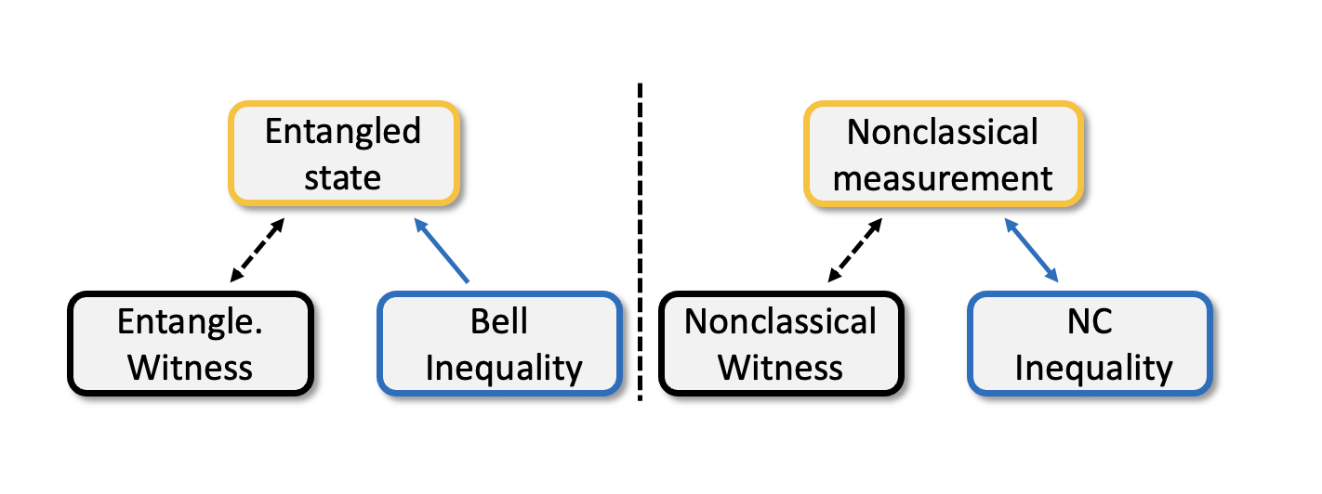
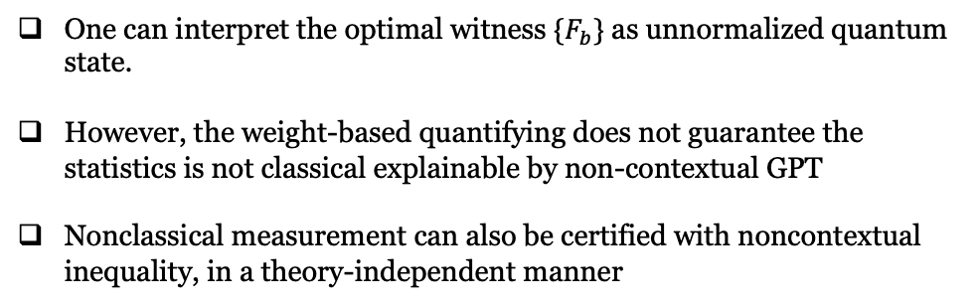
Certification and quantification
Weight-based quantifier
One can interpret the optimal witness $\{F_{b}\}$ as unnormalized quantum state.
However, the weight-based quantifying does not guarantee the statistics is not classical explainable by non-contextual GPT
Nonclassical measurement can also be certified with noncontextual inequality, in a theory-independent manner
Weight-based quantification
Primal
Dual

Slide 33
What to think next
Fundamental level:
Assumptions on diagram preservation (Can one derive it from other principles? )
Focus on operational statistics, classical explainability for all induced PM statistics, does not imply classical explainability of the whole circuit defined via diagram preservation.
Focus on nonclassical process, characterization of its single-partite marginal might be sufficient for its characterization.
There exists an even more restrictive notions of classical explainability for quantum circuit one can defined, based on its frame representation. How are they related?

Slide 34
What to think next
Fundamental level:
Assumptions on diagram preservation (Can one derive it from other principle? )
Technical level:
Bounding quantum correlation for noncontextuality inequalities.
Self-testing /Robust self-testing based on violation of noncontextuality inequalities.
This self-testing is in general less device-independent, as they need to make assumption on dimensionality
However, one might be able to test all component at the same time, as their nonclassicality is defined in a unified manner.,
e.g., the violation of a unipartite noncontextuality inequality indicates that the sum of “nonclassical fraction” for the measurement and preparation are greater than 1.

Slide 35
What to think next
Fundamental level:
Assumptions on diagram preservation (Can one derive it from other principle? )
Technical level:
Bounding quantum correlation for general noncontextuality inequality.
Self-testing /Robust self-testing based on violation of noncontextuality inequality.
Application level:
Can noncontextuality inequality help in gauge-freedom problem in gate set tomography.
Further information-theoretic tasks enabled by the new notion of nonclassical processes.

