Slide 1
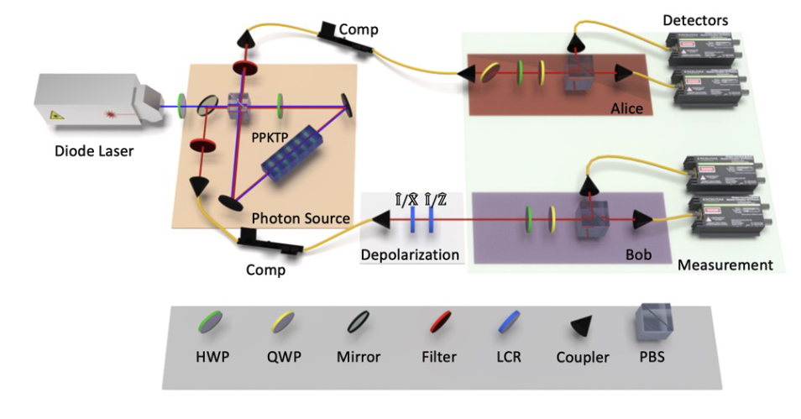
Entanglement certification: Noncontextuality inequalities and self-consistent certification
Yujie Zhang
arXiv:2503.05884 (2025)
arXiv:2504.02944 (2025)
arXiv:2507.01122 (2025)

Slide 2


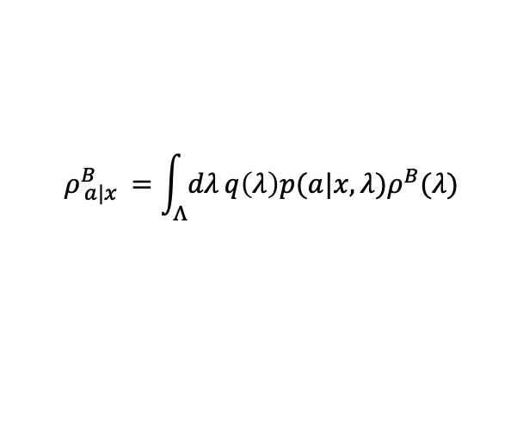

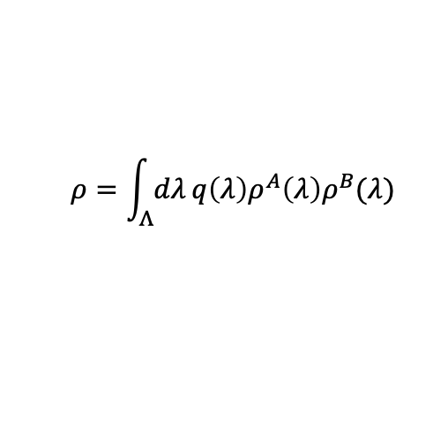




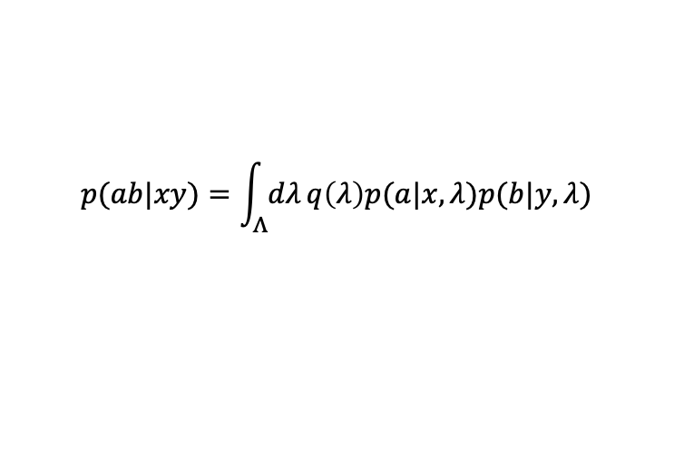
Definition of Entanglement, EPR steering and Bell nonlocality
x
x
y
$$ρ^{AB}$$
$$ρ^{AB}$$
$$ρ^{AB}$$
A
B
A
B
A
B
$$λ$$
$$λ$$
a
a
b
$$ρ=\int_{Λ}{dλ}q\left(λ\right)ρ^{A}\left(λ\right)ρ^{B}(λ)$$
$$ρ_{ a|x }^{B}=\int_{Λ}{dλ}q\left(λ\right)p(a|x,λ)ρ^{B}(λ)$$
$$p(ab|xy)=\int_{Λ}{dλ}q\left(λ\right)p(a|x,λ)p(b|y,λ)$$
$$ρ_{ a|x }^{B}={Tr}_{A}(M_{a|x }⊗I ρ)$$
$$p(ab|xy)={Tr}_{A}(M_{a|x }⊗N_{b|y }ρ)$$
(a) Entanglement/separable
(b)EPR steering/LHS model
(c)Bell nonlocality/LHV model
Characterized by the density operator.
Characterized partially by the density operator and partially by the statistics.
Characterized by the statistics.

Slide 3
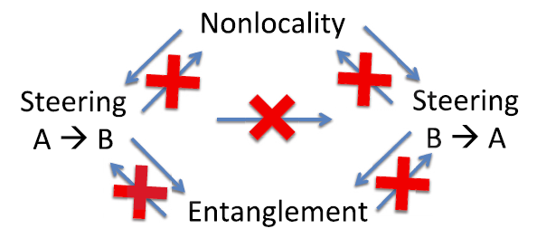
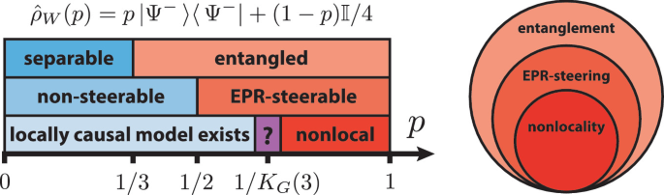
For pure state, entanglement, steering and nonlocality are equivalent concepts.
e.g. all pure entangled state violate CHSH inequality
For general mixed state, entanglement, steering and nonlocality are inequivalent.
Steerable states are strict subset of Entangled states
Nonlocal states are strict subset of steerable states.
Some entangled states are also nonlocal, so they can be certified by the statistics alone.
Can all entangled states be certified by statistics alone?

Slide 4






Assumptions: full characterization of the measurement devices+…
Detection power: all entangled states
Entanglement certification
universal
Tomography-based
$$a$$
$$b$$
N
M
Detection power
$$x$$
$$y$$
$$ρ^{AB}$$
Assumptions: Bell causal structure+ …
Detection power: all nonlocal states
(a strict subset of all entangled states)
$$DI test$$
$$(Bell test)$$
limited
strong
weak
Assumptions

Slide 5



















Assumptions: full characterization of “quantum inputs.”
Extra complexity: entangled measurement
N
M
Entanglement certification
a
$$b$$
$$a$$
$$σ_{x}^{D}$$
$$ρ^{AB}$$
$$σ_{y}^{C}$$
d
N
M
$$a$$
$$b$$
c
universal
Tomography-based
M
M
M$DI test$
DI test (Network)
$$w$$
$$y$$
$$z$$
$$x$$
$$σ^{EF}$$
$$ρ^{AB}$$
$$σ^{CD}$$
Detection power
Assumptions: more complex causal structure, source independence+…
Detection power: universal
Extra complexity:
extra (entangled) sources, entangled measurements
$$SDI test$$
$$(Steering test)$$
$$DI test$$
$$(Bell test)$$
limited
Self $testing$
strong
weak
Assumptions

Slide 6





Entanglement certification
Assumptions:
Bell causal structure
Tomographic completeness*
But no need to characterize devices
Detection power: all entangled states
universal
Tomography-based
M$DI test$
DI test (Network)
Our test
(contextuality)
Detection power
$$SDI test$$
$$(Steering test)$$
$$a$$
$$b$$
N
M
$$x$$
$$y$$
$$DI test$$
$$(Bell test)$$
$$ρ^{AB}$$
limited
Self $testing$
strong
weak
Assumptions
*: no need for state tomography

Slide 7
When is a set of statistics classically explainable?
When is a single process classical?

Slide 8












Classical-explainable statistics
(a) Bipartite Bell circuit
$$a$$
$$b$$
N
M
A quantum representation f:
$$x$$
$$y$$
$$p\left(ab | xy\right)=tr[N_{a|x}^{A}⊗M_{b|y}^{B}ρ^{AB}]$$
$$ρ^{AB}$$
$$p(a|{xλ}_{A})$$
$$p(b|{yλ}_{B})$$
Ontological representation
$$λ_{A}$$
$$λ_{B}$$
$$p\left(ab | xy\right)=\sum_{λ_{A}λ_{B}}{p(λ_{A}λ_{B})p(a|{xλ}_{A})p(b|{yλ}_{B})}$$
$$p(λ_{A}λ_{B})$$
Local hidden variable model.
Common view: The quantum statistic in the bipartite scenario is classically explainable if it admits a local hidden variable model.

Slide 9
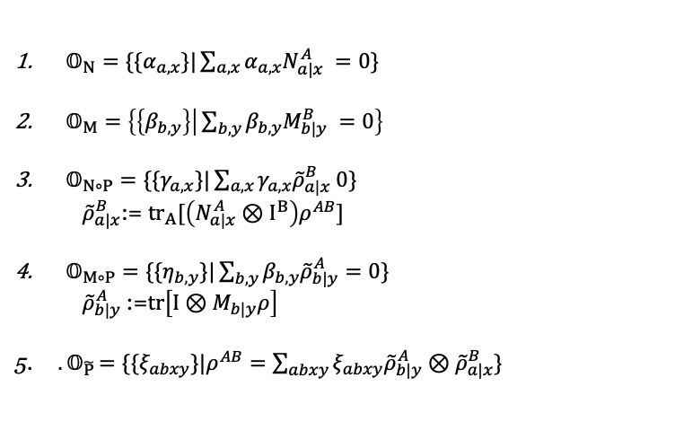






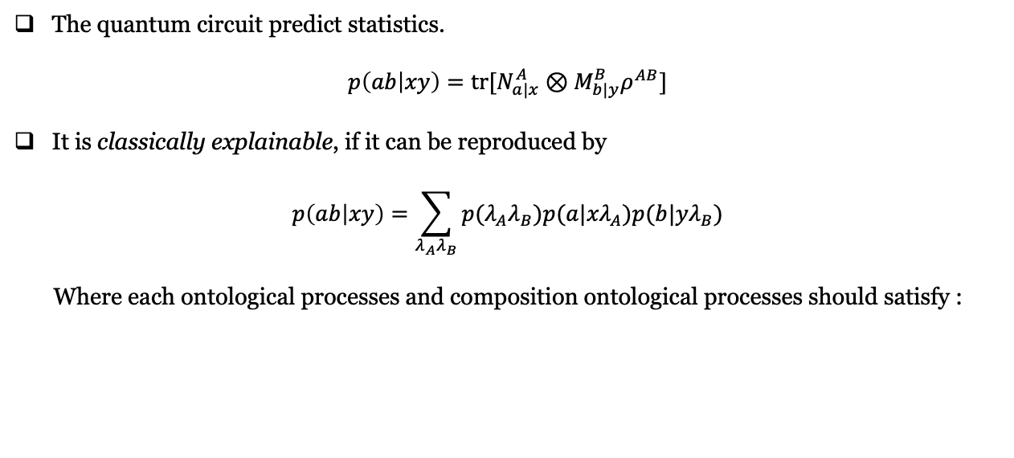







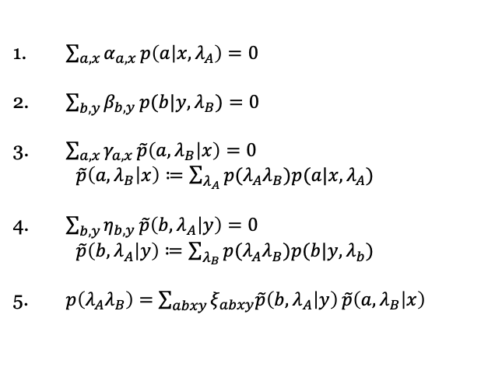

Classical bipartite state
The quantum circuit predict statistics.
$$p\left(ab | xy\right)=tr[N_{a|x}^{A}⊗M_{b|y}^{B}ρ^{AB}]$$
It is classically explainable, if it can be reproduced by
$$p\left(ab | xy\right)=\sum_{λ_{A}λ_{B}}{p(λ_{A}λ_{B})p(a|{xλ}_{A})p(b|{yλ}_{B})}$$
Where each ontological processes and composition ontological processes should satisfy :
$$a$$
$$b$$
Linear
Diag. Pres
$$a$$
$$b$$
(diagram-preservation)
N
M
$$p(a|{xλ}_{A})$$
$$p(b|{yλ}_{B})$$
$$x$$
$$y$$
$$λ_{A}$$
$$x$$
$$λ_{B}$$
$$y$$
$$ρ$$
$$p(λ_{A}λ_{B})$$
Quantum circuit
Ontological model
$𝕆_{N}=\{\{α_{a,x}\}|\sum_{a,x}{α_{a,x}N_{a|x}^{A}} =0\}$
$𝕆_{M}=\left\{\left\{β_{b,y}\right\} | \sum_{b,y}{β_{b,y}M_{b|y}^{B}} =0\right\}$
$𝕆_{N∘P}=\{\{γ_{a,x}\}|\sum_{a,x}{γ_{a,x}{\tilde{ρ}}_{a|x}^{B} 0\}}$
${\tilde{ρ}}_{a|x}^{B}$:= ${tr}_{A}[\left(N_{a|x}^{A}⊗I^{B}\right)ρ^{AB}]$
$𝕆_{M∘P}=\{\{η_{b,y}\}|\sum_{b,y}{β_{b,y}{\tilde{ρ}}_{b|y}^{A}=0\}}$
${\tilde{ρ}}_{b|y}^{A}$:=$tr\left[I⊗M_{b|y}ρ\right]$
5. ${. 𝕆}_{\tilde{P}}=\{\{ξ_{abxy}\}|ρ^{AB}=\sum_{abxy}{ξ_{abxy}{\tilde{ρ}}_{b|y}^{A}⊗{\tilde{ρ}}_{a|x}^{B}}\}$
$\sum_{a,x}{α_{a,x}}p\left(a | x,λ_{A}\right)=0$
$\sum_{b,y}{β_{b,y}}p(b|y,λ_{B})=0$
$\sum_{a,x}{γ_{a,x}}\tilde{p}\left({a,λ}_{B} | x\right)=0$
$\tilde{p}\left({a,λ}_{B} | x\right)≔\sum_{λ_{A}}{p(λ_{A}λ_{B})p(a|x,λ_{A})}$
$\sum_{b,y}{η_{b,y}}\tilde{p}\left({b,λ}_{A} | y\right)=0$
$\tilde{p}\left({b,λ}_{A} | y\right)≔\sum_{λ_{B}}{p(λ_{A}λ_{B})p(b|y,λ_{b})}$
5. $p\left(λ_{A}λ_{B}\right)=$ $\sum_{abxy}{ξ_{abxy}\tilde{p}\left({b,λ}_{A} | y\right)}\tilde{p}\left({a,λ}_{B} | x\right)$
(linearity)

Slide 10






















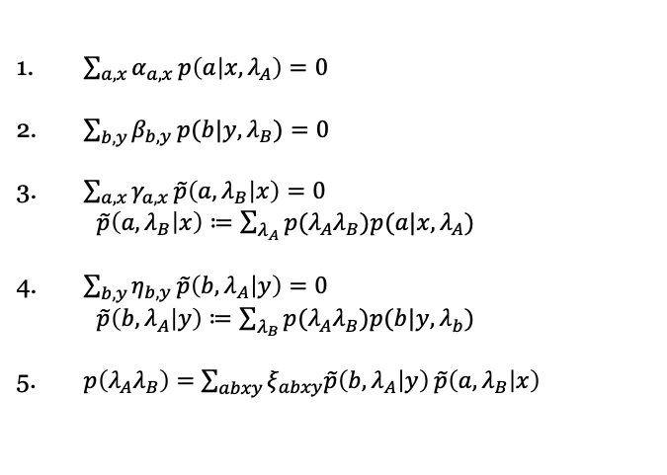






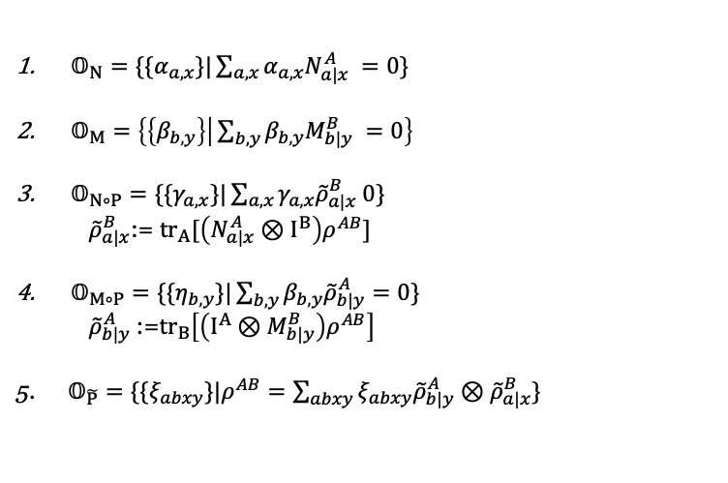
Classical bipartite state
The quantum circuit predict statistics.
$$p\left(ab | xy\right)=tr[N_{a|x}^{A}⊗M_{b|y}^{B}ρ^{AB}]$$
It is classically explainable, if it can be reproduced by
$$p\left(ab | xy\right)=\sum_{λ_{A}λ_{B}}{p(λ_{A}λ_{B})p(a|{xλ}_{A})p(b|{yλ}_{B})}$$
Where each ontological processes and composition ontological processes should satisfy :
$$a$$
$$b$$
Linear
Diag. Pres
N
M
$$p(a|{xλ}_{A})$$
$$p(b|{yλ}_{B})$$
$$x$$
$$y$$
$$λ_{A}$$
$$λ_{B}$$
$$ρ$$
$$p(λ_{A}λ_{B})$$
(diagram-preservation)
e.g.
$$b$$
$$a$$
$$a$$
M
M
$$b$$
N
$$y$$
$$x$$
M
$$x$$
$$ρ^{AB}$$
$$ρ^{AB}$$
$$y$$
$𝕆_{N}=\{\{α_{a,x}\}|\sum_{a,x}{α_{a,x}N_{a|x}^{A}} =0\}$
$𝕆_{M}=\left\{\left\{β_{b,y}\right\} | \sum_{b,y}{β_{b,y}M_{b|y}^{B}} =0\right\}$
$𝕆_{N∘P}=\{\{γ_{a,x}\}|\sum_{a,x}{γ_{a,x}{\tilde{ρ}}_{a|x}^{B} 0\}}$
${\tilde{ρ}}_{a|x}^{B}$:= ${tr}_{A}[\left(N_{a|x}^{A}⊗I^{B}\right)ρ^{AB}]$
$𝕆_{M∘P}=\{\{η_{b,y}\}|\sum_{b,y}{β_{b,y}{\tilde{ρ}}_{b|y}^{A}=0\}}$
${\tilde{ρ}}_{b|y}^{A}$:=${tr}_{B}\left[\left(I^{A}⊗M_{b|y}^{B}\right)ρ^{AB}\right]$
5. $𝕆_{\tilde{P}}=\{\{ξ_{abxy}\}|ρ^{AB}=\sum_{abxy}{ξ_{abxy}{\tilde{ρ}}_{b|y}^{A}⊗{\tilde{ρ}}_{a|x}^{B}}\}$
$\sum_{a,x}{α_{a,x}}p\left(a | x,λ_{A}\right)=0$
$\sum_{b,y}{β_{b,y}}p(b|y,λ_{B})=0$
$\sum_{a,x}{γ_{a,x}}\tilde{p}\left({a,λ}_{B} | x\right)=0$
$\tilde{p}\left({a,λ}_{B} | x\right)≔\sum_{λ_{A}}{p(λ_{A}λ_{B})p(a|x,λ_{A})}$
$\sum_{b,y}{η_{b,y}}\tilde{p}\left({b,λ}_{A} | y\right)=0$
$\tilde{p}\left({b,λ}_{A} | y\right)≔\sum_{λ_{B}}{p(λ_{A}λ_{B})p(b|y,λ_{b})}$
5. $p\left(λ_{A}λ_{B}\right)=$ $\sum_{abxy}{ξ_{abxy}\tilde{p}\left({b,λ}_{A} | y\right)}\tilde{p}\left({a,λ}_{B} | x\right)$
b
$$a$$
$$p(b|y,λ_{B})$$
$$p(a|x,λ_{A})$$
(linearity)
$$y$$
$$x$$
$$λ_{B}$$
$$λ_{A}$$
$$b$$
$$a$$
$$\tilde{p}(a,λ_{A}|x)$$
$$\tilde{p}(b{,λ}_{A}|y)$$
$$x$$
$$y$$

Slide 11
Towards making the definition….
When is a set of statistics classically explainable?
When is a single bipartite state classical?
A single bipartite state is classical if and only if the statistics it produces are always classically explainable.

Slide 12




Classical bipartite state
Classical relative to $𝕆_{triv}$ $⇔$ Local states
Classical relative to $𝕆_{N}$ $⇔$ B→ A unsteerable states.
Classical relative to $𝕆_{M}$ $⇔$ A→ B unsteerable states.
Classical relative to $𝕆_{N}$ and $𝕆_{M} ⇔$ unsteerable states.
Classical relative to $𝕆_{N}∪𝕆_{M} ⇔$ separable states.
Classical relative to $𝕆_{N}∪𝕆_{M}∪𝕆_{M∘P} ⇔$ always generating classical preparations in A
Classical relative to $𝕆_{N}∪𝕆_{M}∪𝕆_{N∘P} ⇔$ always generating preparations in B
Classical relative to $𝕆_{N}∪𝕆_{M}∪𝕆_{M∘P}$and $𝕆_{N}∪𝕆_{M}∪𝕆_{N∘P} ⇔$ always generating classical preparations in both A and B
Classical relative to $𝕆_{N}∪𝕆_{M}∪𝕆_{M∘P} ∪𝕆_{N∘P}∪𝕆_{\tilde{P}} ⇔$ (Leibniz) classical
All quantum states
$$Local$$
$$Unsteerable$$
$$Separable$$
Classical

Slide 13









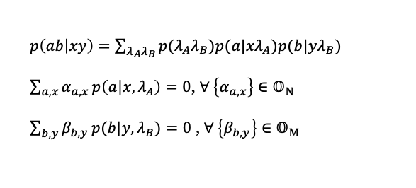



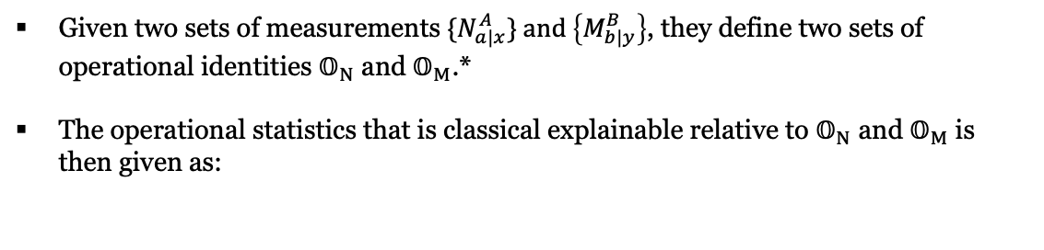
Novel test for nonclassicality
What can we benefit from this connection?
New approach to certifying entanglement
Noncontextual (NC) polytope
$$𝒩𝒞_{triv} =ℒ$$
Given two sets of measurements ${\{N}_{a|x}^{A}\} and \left\{M_{b|y}^{B}\right\}$, they define two sets of operational identities $𝕆_{N}$ and $𝕆_{M}$.*
The operational statistics that is classical explainable relative to $𝕆_{N}$ and $𝕆_{M}$ is then given as:
$$𝒩𝒞_{O_{N}}$$
$$𝒩𝒞_{O_{N}∪O_{M}}$$
$$𝒬$$
$p\left(ab | xy\right)=\sum_{λ_{A}λ_{B}}{p(λ_{A}λ_{B})p(a|{xλ}_{A})p(b|{yλ}_{B})}$
$\sum_{a,x}{α_{a,x}}p\left(a | x,λ_{A}\right)=0$, ${∀ \left\{α_{a,x}\right\}∈𝕆}_{N}$
$\sum_{b,y}{β_{b,y}}p(b|y,λ_{B})=0$ , ${∀ \left\{β_{b,y}\right\}∈𝕆}_{M}$
$$𝒩𝒞_{all}$$
$$𝒩𝒞_{O_{N}∪O_{M}}$$
$$(1)$$
$$(2)$$
$(1)$ Bell inequality
$$(3)$$
$(2)$ Steering-Witnessing NC inequality
A noncontextual local hidden variable model relative to $𝕆_{N}$ and $𝕆_{M}$
$(3)$ Entanglement-Witnessing NC inequality
*: In an experiment, one does not need to characterize the measurements to know their operational identities; instead, they can be inferred using experimental data. (see later discussion)

Slide 14
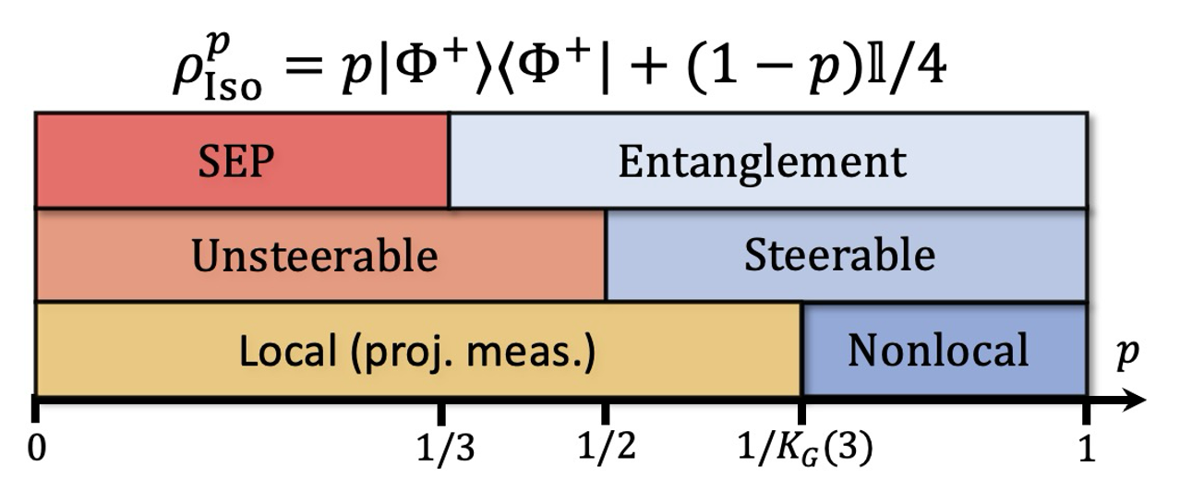









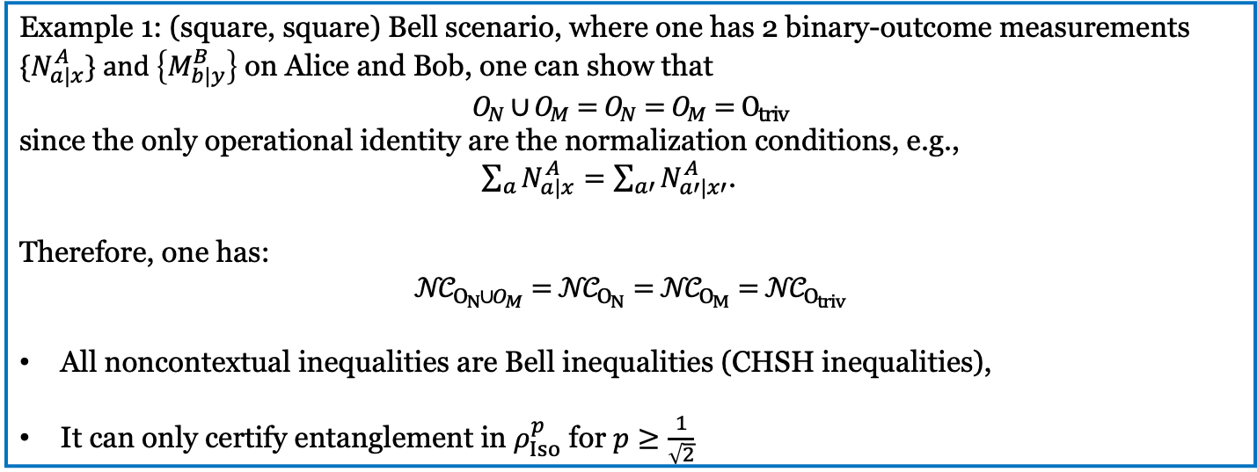
Novel test for two-qubit isotropic states
Example 1: (square, square) Bell scenario, where one has 2 binary-outcome measurements ${\{N}_{a|x}^{A}\} and \left\{M_{b|y}^{B}\right\}$ on Alice and Bob, one can show that
$$O_{N}∪O_{M}=O_{N}=O_{M}=O_{triv}$$
since the only operational identity are the normalization conditions, e.g.,
$\sum_{a}{N_{a|x}^{A}=\sum_{a′}{N_{a′|x′}^{A}}}$.
Therefore, one has:
$$𝒩𝒞_{O_{N}∪O_{M}}=𝒩𝒞_{O_{N}}=𝒩𝒞_{O_{M}}=𝒩𝒞_{O_{triv}}$$
All noncontextual inequalities are Bell inequalities (CHSH inequalities),
It can only certify entanglement in $ρ_{Iso}^{p}$ for $p≥\frac{1}{\sqrt{2}}$
$$a$$
$$b$$
Linear
Diag. Pres
$$a$$
$$b$$
N
M
$$p(a|{xλ}_{A})$$
$$p(b|{yλ}_{B})$$
$$x$$
$$y$$
$$λ_{A}$$
$$x$$
$$λ_{B}$$
$$y$$
$$ρ$$
$$p(λ_{A}λ_{B})$$
Quantum circuit
Ontological model

Slide 15
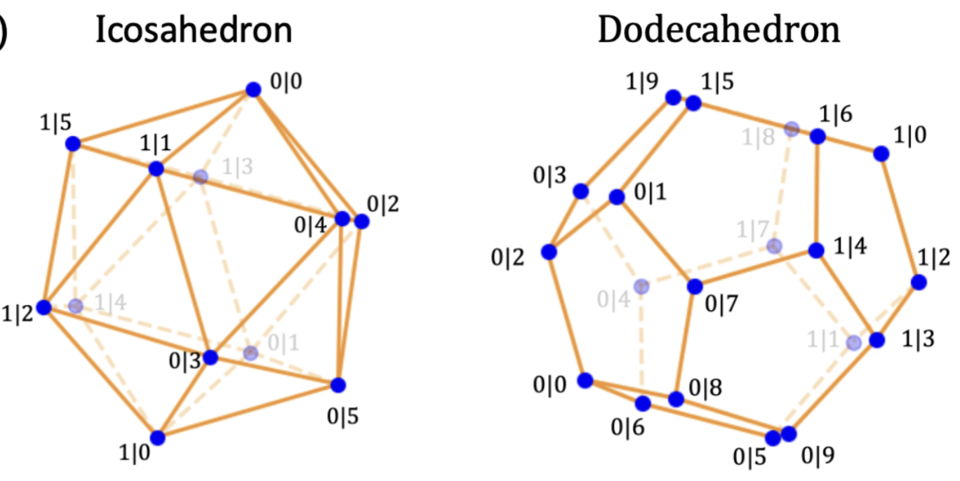
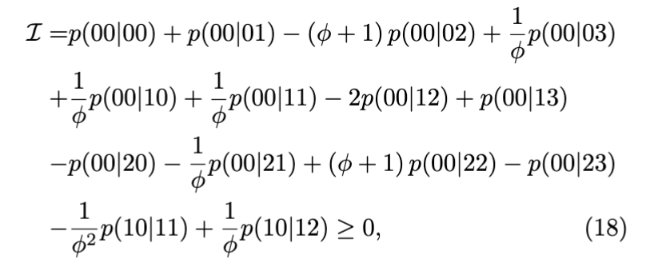
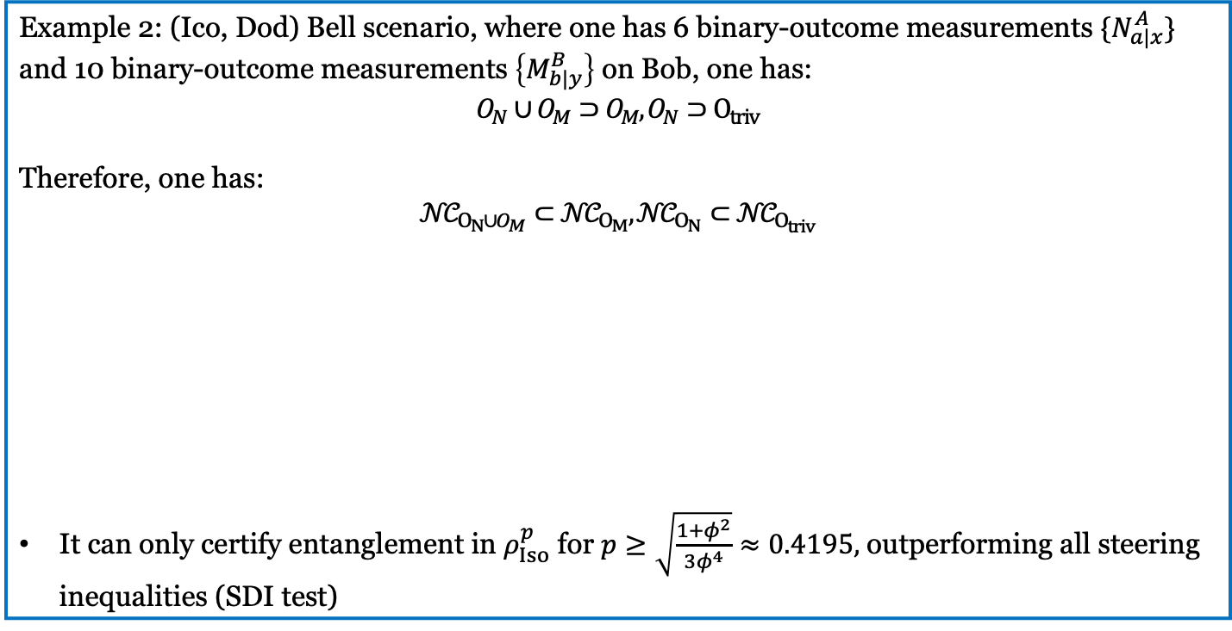
Novel test for two-qubit isotropic states
Example 2: (Ico, Dod) Bell scenario, where one has 6 binary-outcome measurements ${\{N}_{a|x}^{A}\}$ and 10 binary-outcome measurements $\left\{M_{b|y}^{B}\right\}$ on Bob, one has:
$$O_{N}∪O_{M}⊃O_{M}, O_{N}⊃O_{triv}$$
Therefore, one has:
$$𝒩𝒞_{O_{N}∪O_{M}}⊂𝒩𝒞_{O_{M}},𝒩𝒞_{O_{N}}⊂𝒩𝒞_{O_{triv}}$$
It can only certify entanglement in $ρ_{Iso}^{p}$ for $p≥\sqrt{\frac{1+φ^{2}}{3φ^{4}}}≈0.4195,$ outperforming all steering inequalities (SDI test)
$$a$$
$$b$$
Linear
Diag. Pres
$$a$$
$$b$$
N
M
$$p(a|{xλ}_{A})$$
$$p(b|{yλ}_{B})$$
$$x$$
$$y$$
$$λ_{A}$$
$$x$$
$$λ_{B}$$
$$y$$
$$ρ$$
$$p(λ_{A}λ_{B})$$
Quantum circuit
Ontological model

Slide 16
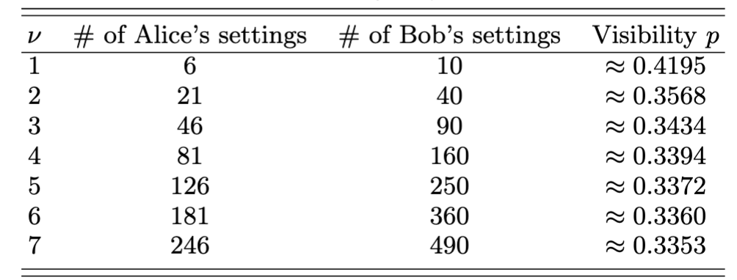
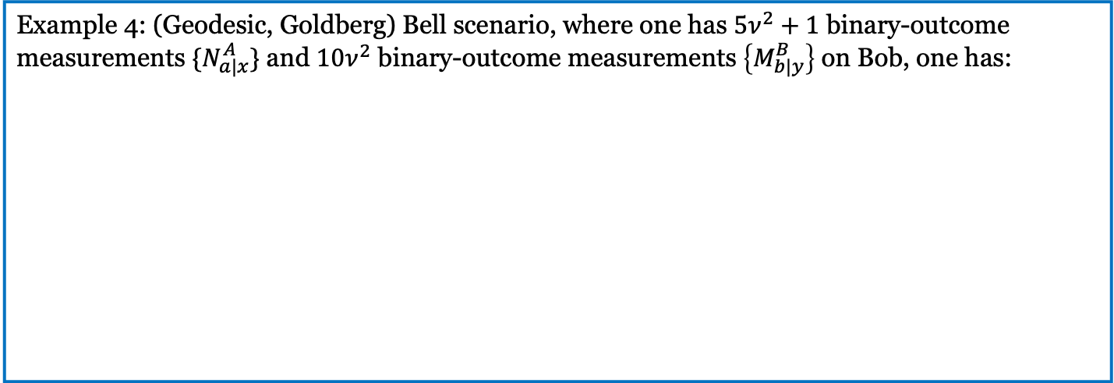
Novel test for two-qubit isotropic states
Example 4: (Geodesic, Goldberg) Bell scenario, where one has $5ν^{2}+1$ binary-outcome measurements ${\{N}_{a|x}^{A}\}$ and $10ν^{2}$ binary-outcome measurements $\left\{M_{b|y}^{B}\right\}$ on Bob, one has:
$$a$$
$$b$$
Linear
Diag. Pres
$$a$$
$$b$$
N
M
$$p(a|{xλ}_{A})$$
$$p(b|{yλ}_{B})$$
$$x$$
$$y$$
$$λ_{A}$$
$$x$$
$$λ_{B}$$
$$y$$
$$ρ$$
$$p(λ_{A}λ_{B})$$
Quantum circuit
Ontological model

Slide 17
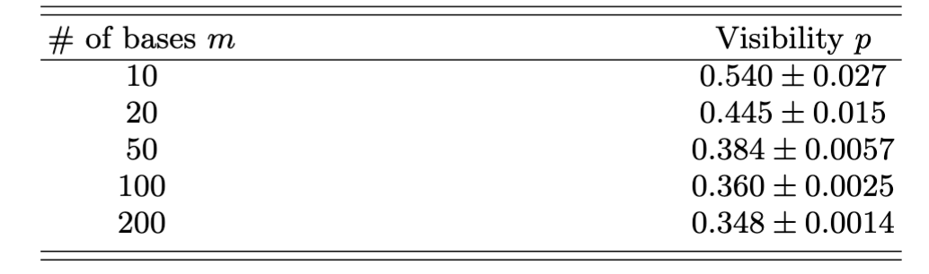








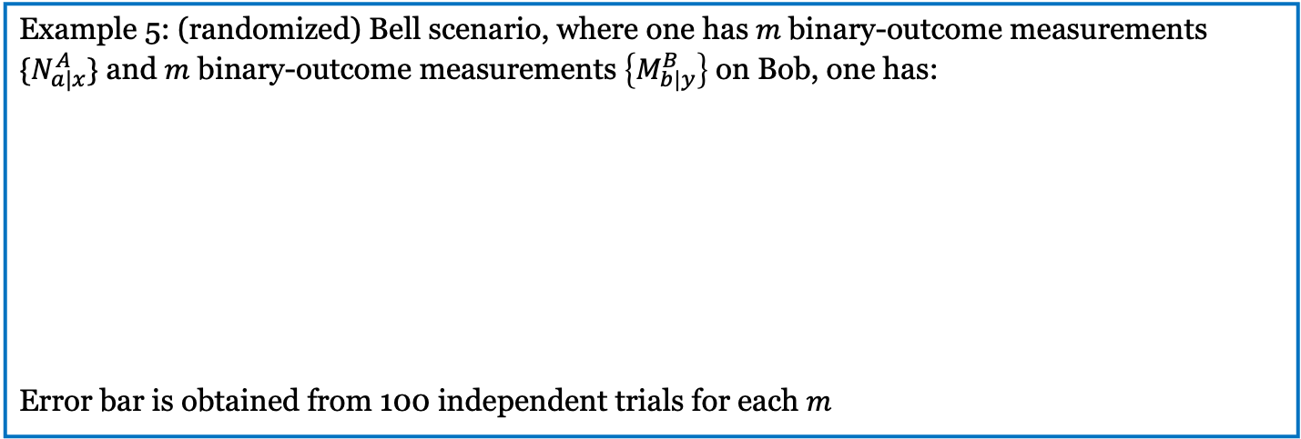




Novel test for two-qubit isotropic states
$$a$$
$$b$$
Linear
Diag. Pres
$$a$$
$$b$$
N
M
$$p(a|{xλ}_{A})$$
$$p(b|{yλ}_{B})$$
$$x$$
$$y$$
$$λ_{A}$$
$$x$$
$$λ_{B}$$
$$y$$
$$ρ$$
$$p(λ_{A}λ_{B})$$
Example 5: (randomized) Bell scenario, where one has $m$binary-outcome measurements ${\{N}_{a|x}^{A}\}$ and $m$ binary-outcome measurements $\left\{M_{b|y}^{B}\right\}$ on Bob, one has:
Error bar is obtained from 100 independent trials for each $m$
Quantum circuit
Ontological model

Slide 18
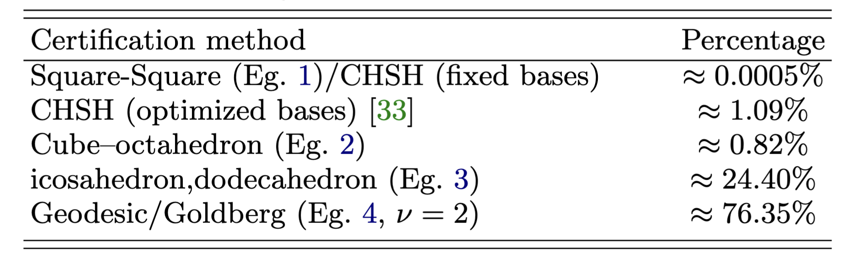








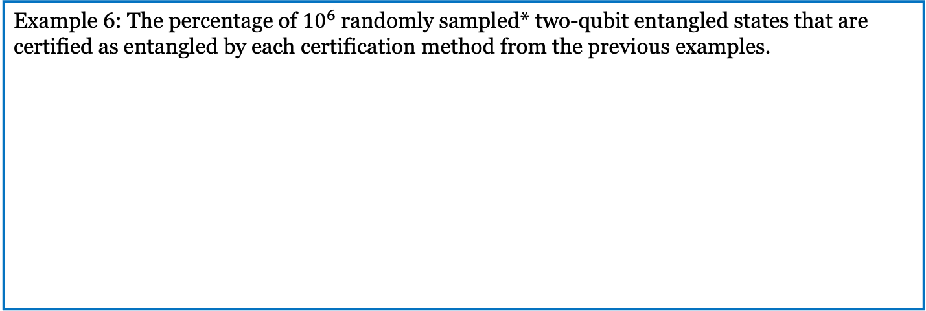



Novel test for all two-qubit entangled states
$$a$$
$$b$$
Linear
Diag. Pres
$$a$$
$$b$$
N
M
$$p(a|{xλ}_{A})$$
$$p(b|{yλ}_{B})$$
$$x$$
$$y$$
$$λ_{A}$$
$$x$$
$$λ_{B}$$
$$y$$
$$ρ$$
$$p(λ_{A}λ_{B})$$
Example 6: The percentage of ${10}^{6}$randomly sampled* two-qubit entangled states that are certified as entangled by each certification method from the previous examples.
Quantum circuit
Ontological model
$$𝒩𝒞_{triv} =ℒ$$
$$𝒩𝒞_{O_{N}}$$
$$𝒩𝒞_{O_{N}∪O_{M}}$$
$$𝒬$$
$$𝒩𝒞_{all}$$
$$(1)$$
$$(2)$$
$(1)$ Bell inequality
$$(3)$$
$(2)$ Steering-Witnessing NC inequality
$(3)$ Entanglement-Witnessing NC inequality
*: we draw mixed states from the Hilbert–Schmidt measure by generating complex matrix $A$ and define $ρ=AA^{†}/tr[AA^{†}]$

Slide 19
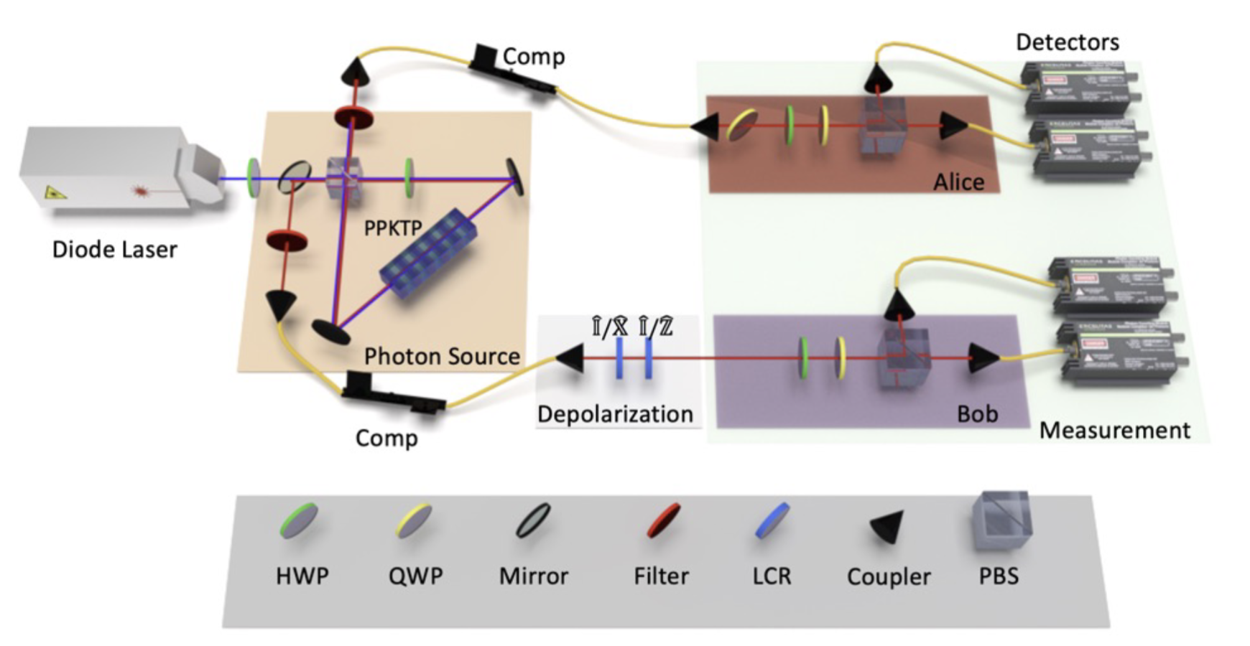
Experimental demonstration
How to test it experimentally?

Slide 20
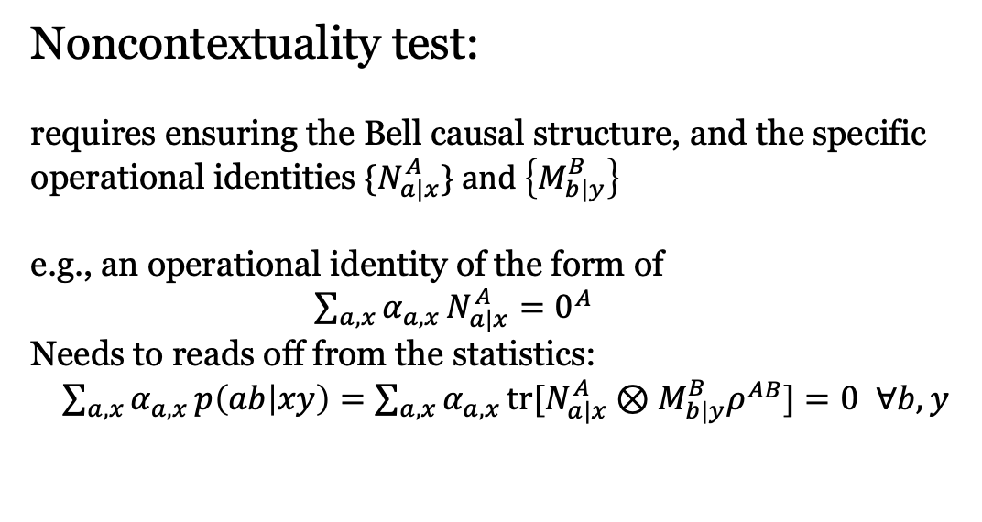
Experimental demonstration
A brief justification
Bell test:
requires ensuring the Bell causal structure, which is typically guaranteed by
The belief in special relativity.
Space-like separation, measured by your clock and ruler.
Noncontextuality test:
requires ensuring the Bell causal structure, and the specific operational identities ${\{N}_{a|x}^{A}\} and \left\{M_{b|y}^{B}\right\}$
e.g., an operational identity of the form of
$\sum_{a,x}{α_{a,x}}N_{a|x}^{A}=0^{A}$
Needs to reads off from the statistics:
$\sum_{a,x}{α_{a,x}}p\left(ab | xy\right)=\sum_{a,x}{α_{a,x}}tr[N_{a|x}^{A}⊗M_{b|y}^{B}ρ^{AB}]=0$ $∀b,y$

Slide 21
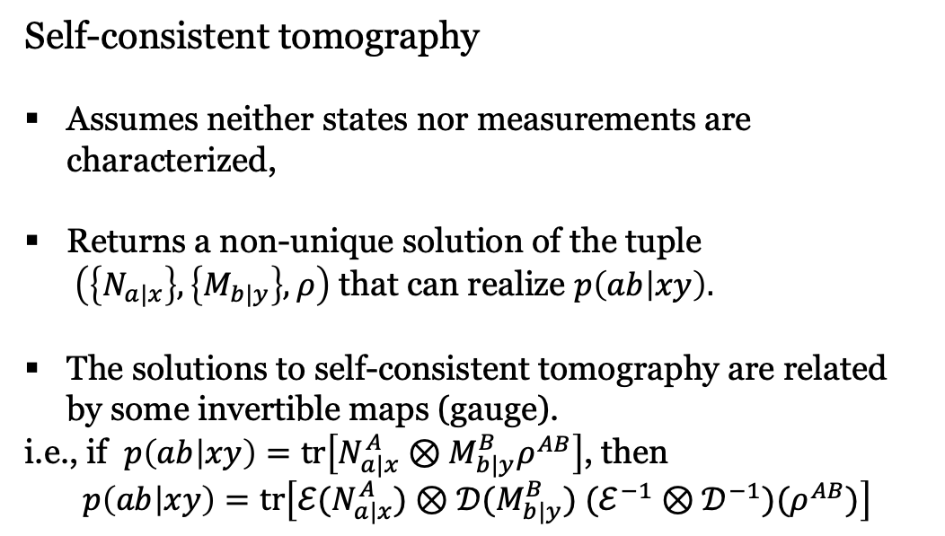
Experimental demonstration
A justification from self-consistent tomography
Self-consistent tomography
Assumes neither states nor measurements are characterized,
Returns a non-unique solution of the tuple
$\left(\left\{N_{a|x}\right\}, \left\{M_{b|y}\right\},ρ\right)$ that can realize $p\left(ab | xy\right).$
The solutions to self-consistent tomography are related by some invertible maps (gauge).
i.e., if $p\left(ab | xy\right)=tr\left[N_{a|x}^{A}⊗M_{b|y}^{B}ρ^{AB}\right]$, then
$$p\left(ab | xy\right)=tr\left[{ℰ(N}_{a|x}^{A})⊗{𝒟(M}_{b|y}^{B}) (ℰ^{−1}⊗𝒟^{−1})(ρ^{AB})\right]$$
Standard quantum state tomography
Requires the full characterization of measurement devices,
Returns a unique solution of the quantum states.
Results in a test that is completely device-dependent.
The operational identities are gauge-independent.
A noncontextuality test thus requires no measurement characterization and is gauge-independent

Slide 22
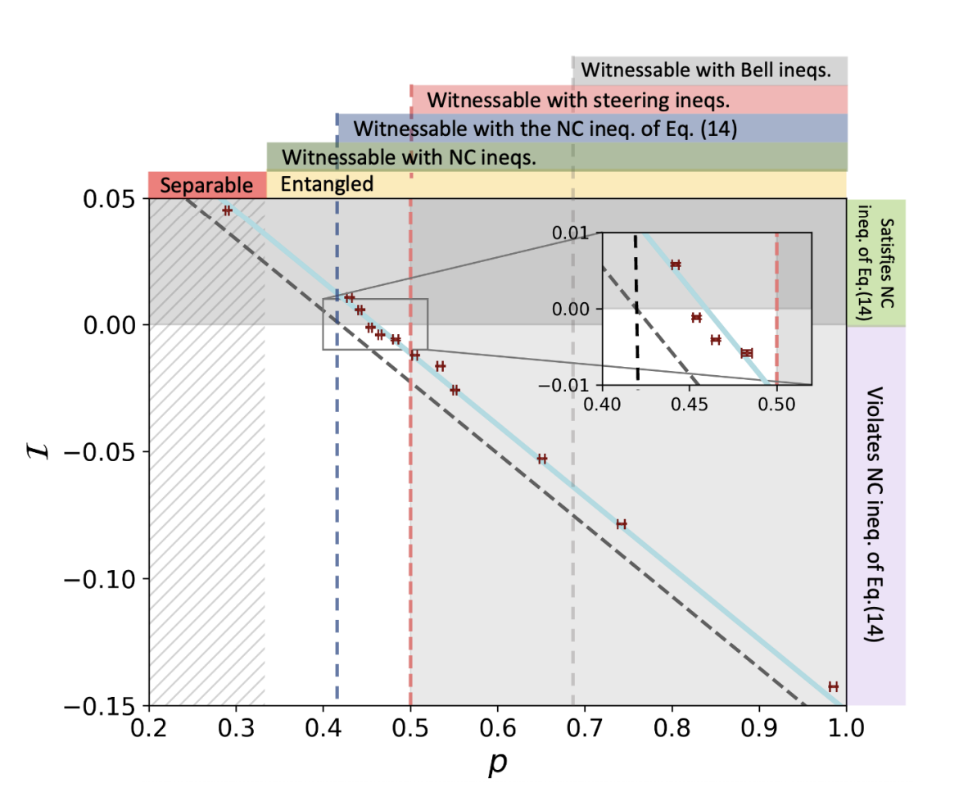
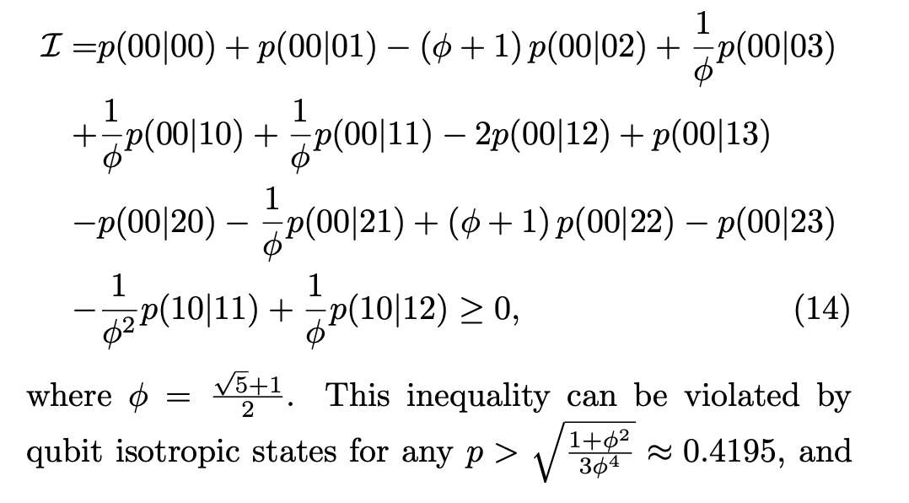
Experimental demonstration

