Slide 1



Exact Steering Bound for Two-Qubit Werner States
Yujie Zhang* and Eric Chitambar
Preprint: arxiv.2309.09960 (2023)
*Current address: IQC at University of Waterloo, Canada
Notes:
Add people’s name (with mine underlined)

Slide 2
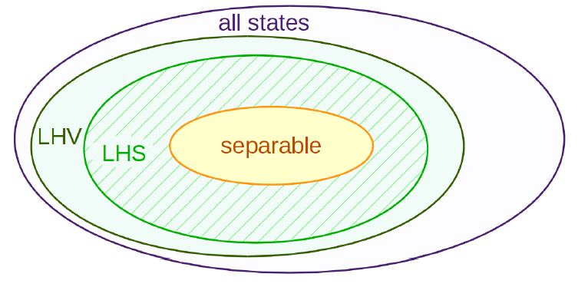
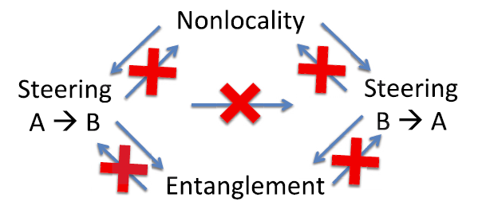

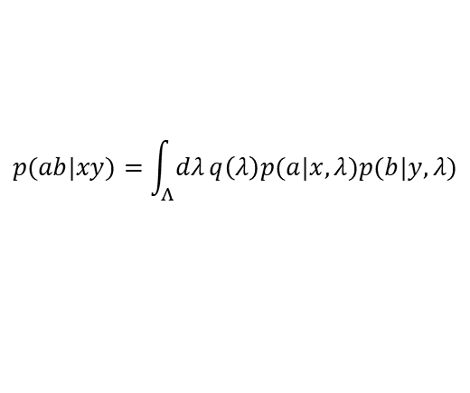

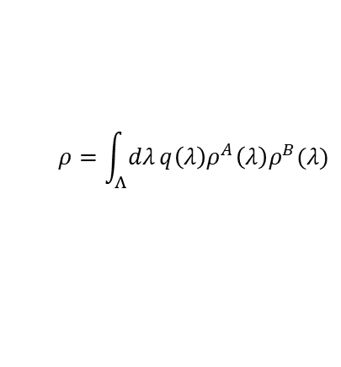



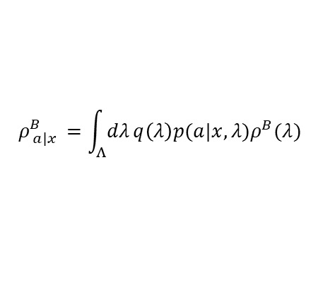


Brief introduction
Entangled
Not separable
Steerable
No LHS model
Nonlocal
No LHV model
x
x
y
$$ρ^{AB}$$
$$ρ^{AB}$$
$$ρ^{AB}$$
A
B
A
B
A
B
a
$$λ$$
a
$$λ$$
b
$$ρ=\int_{Λ}{dλ}q\left(λ\right)ρ^{A}\left(λ\right)ρ^{B}(λ)$$
$$ρ_{ a|x }^{B}={Tr}_{A}(M_{a|x }⊗I ρ)$$
$$p(ab|xy)={Tr}_{A}(M_{a|x }⊗N_{b|y }ρ)$$
$$ρ_{ a|x }^{B}=\int_{Λ}{dλ}q\left(λ\right)p(a|x,λ)ρ^{B}(λ)$$
$$p(ab|xy)=\int_{Λ}{dλ}q\left(λ\right)p(a|x,λ)p(b|y,λ)$$
(a) separable model
(b) Local hidden State (LHS) model
(c) Local hidden variable (LHV) model
Entanglement, steering and nonlocality are equivalent for pure bipartite states, but inequivalent for general mixed states.
Quantum entanglement, Rev. Mod. Phys. 81, 865 (2009)
Bell nonlocality, Rev. Mod. Phys. 86, 419 (2014)
Quantum steering, Rev. Mod. Phys. 92, 015001 (2019)

Slide 3
(a)
(b)

Slide 4
Brief introduction
Entangled
Not separable
Steerable
No LHS model
Nonlocal
No LHV model
x
x
y
$$ρ^{AB}$$
$$ρ^{AB}$$
$$ρ^{AB}$$
A
B
A
B
A
B
a
$$λ$$
a
$$λ$$
b
$$ρ=\int_{Λ}{dλ}q\left(λ\right)ρ^{A}\left(λ\right)ρ^{B}(λ)$$
$$ρ_{ a|x }^{B}={Tr}_{A}(M_{a|x }⊗I ρ)$$
$$p(ab|xy)={Tr}_{A}(M_{a|x }⊗N_{b|y }ρ)$$
$$ρ_{ a|x }^{B}=\int_{Λ}{dλ}q\left(λ\right)p(a|x,λ)ρ^{B}(λ)$$
$$p(ab|xy)=\int_{Λ}{dλ}q\left(λ\right)p(a|x,λ)p(b|y,λ)$$
(a) separable model
(b) Local hidden State (LHS) model
(c) Local hidden variable (LHV) model
Entanglement, steering and nonlocality are equivalent for pure bipartite states, but inequivalent for general mixed states.
Quantum entanglement, Rev. Mod. Phys. 81, 865 (2009)
Bell nonlocality, Rev. Mod. Phys. 86, 419 (2014)
Quantum steering, Rev. Mod. Phys. 92, 015001 (2019)

Slide 5







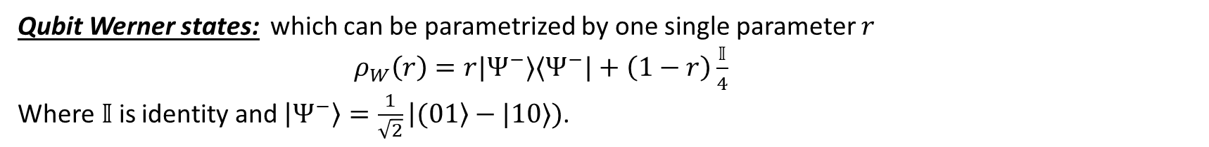

Qubit Werner States
Qubit Werner states: which can be parametrized by one single parameter $r$
$ρ_{W}\left(r\right)=r|Ψ^{−}⟩⟨Ψ^{−}|+\left(1−r\right)\frac{𝕀}{4}$
Where$𝕀$is identity and $\left|Ψ^{−}\right\rangle =\frac{1}{\sqrt{2}}\left|(01\right\rangle −|10⟩)$.
*Many other models were adapted from the original Qubit Werner state model.
PVMs LHV [Designolle 2023]: G-constant
Entangled/separable bound
Nonlocal/LHV bound
Steerable/LHS bound
Under PVMs
Under POVMs
PVMs LHS [Werner 1989]
POVMs LHS [Barrett 2002]
Steering [Wiseman 2007]
CHSH violation
Separability
$$r$$
$$\frac{1}{3}$$
$$\frac{5}{12}$$
$$\frac{1}{2}$$
$$[0.6875,0.6961]$$
$$\frac{1}{\sqrt{2}}$$
Werner’s problem
Determine the critical LHS/steering bound of (Qubit) Werner state for general measurement (POVMs)
R. F. Werner, problem 39 in https://oqp.iqoqi.oeaw.ac.at/open-quantum-problems

Slide 6
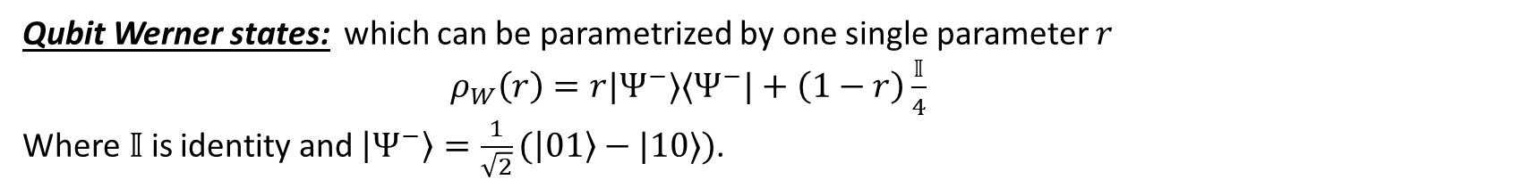
Qubit Werner States
Qubit Werner states: which can be parametrized by one single parameter $r$
$ρ_{W}\left(r\right)=r|Ψ^{−}⟩⟨Ψ^{−}|+\left(1−r\right)\frac{𝕀}{4}$
Where$𝕀$is identity and $\left|Ψ^{−}\right\rangle =\frac{1}{\sqrt{2}}(\left|01\right\rangle −|10⟩)$.
Note: Many other models were adapted from the original Qubit Werner state model.
POVMs LHS [This talk]
PVMs LHV [Designolle 2023]
Entangled/separable bound
Nonlocal/LHV bound
Steerable/LHS bound
Under PVMs
Under POVMs
PVMs LHS [Werner 1989]
POVMs LHS [Barrett 2002]
Steering [Wiseman 2007]
CHSH violation
Separability
$$r$$
$$\frac{1}{3}$$
$$\frac{5}{12}$$
$$\frac{1}{2}$$
$$[0.6875,0.6961]$$
$$\frac{1}{\sqrt{2}}$$
Werner’s problem
Determine the critical LHS/steering bound of (Qubit) Werner state for general measurement (POVMs)
R. F. Werner, problem 39 in https://oqp.iqoqi.oeaw.ac.at/open-quantum-problems

Slide 7





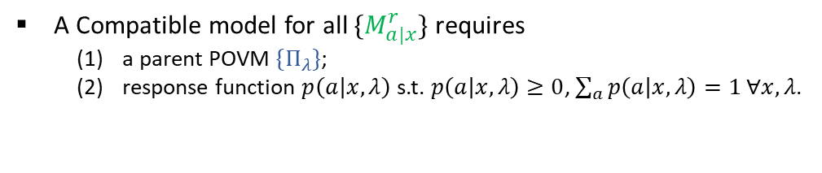


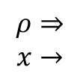


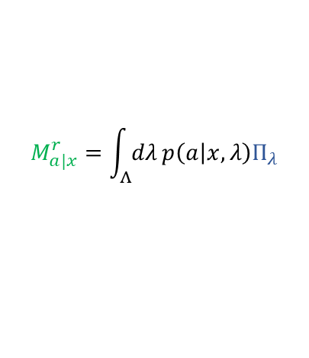




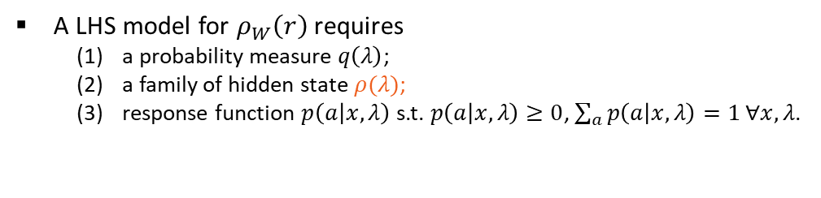




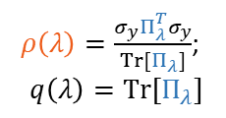
Measurement compatibility
Steerable
No LHS model
Incompatibility
No compatible model
Werner state quantum steering
“Noisy” measurement compatibility
$$x$$
$$ρ_{W}\left(r\right)=r|Ψ^{−}⟩⟨Ψ^{−}|+\left(1−r\right)\frac{𝕀}{4}$$
$$M_{a|x}^{r}=rM_{a|x }+\left(1−r\right)TrM_{a|x }\frac{𝕀}{2}$$
$$M_{a|x }$$
A
B
$$ρ⇒$$
$$Π_{λ}$$
$$→^{λ}$$
$$ρ⇒$$
$$x→$$
$$⇒$$
$$M_{a|x }^{r}$$
$$→a$$
$$P(a|x,λ)$$
$$→a$$
$$\text{Simulated} \text{by}$$
$$x→$$
$$a$$
$$λ$$
$ρ\left(λ\right)=\frac{σ_{y}Π_{λ}^{T}σ_{y}}{Tr[Π_{λ}]}$;
$$q\left(λ\right)=Tr[Π_{λ}]$$
$$ρ_{ a|x }^{r}={Tr}_{A}\left(M_{a|x }⊗Iρ_{W}\left(r\right)\right)=\int_{Λ}{dλ}q\left(λ\right)p\left(a | x,λ\right)ρ(λ)$$
$$M_{a|x}^{r}=\int_{Λ}{dλ}p\left(a | x,λ\right)Π_{λ}$$
A LHS model for $ρ_{W}\left(r\right)$ requires
a probability measure $q\left(λ\right)$;
a family of hidden state $ρ(λ)$;
response function $p\left(a | x,λ\right)$ s.t. $p\left(a | x,λ\right)≥0$, $\sum_{a}{p\left(a | x,λ\right)}=1 ∀x,λ$.
A Compatible model for all $\{M_{a|x}^{r}\}$ requires
a parent POVM ${\{Π}_{λ}\}$;
response function $p\left(a | x,λ\right)$ s.t. $p\left(a | x,λ\right)≥0$, $\sum_{a}{p\left(a | x,λ\right)}=1 ∀x,λ$.
Incompatibility’s problem
Determine the critical (in)compatibility bound for noisy all PVMs and POVMs?
LHS model of $ρ_{W}\left(r\right)$for all PVMs ${\{M}_{±|x}^{r}\}$ $⇔$ Compatible model for all noisy ” PVMs ${\{M}_{a|x}^{r}\}$

Slide 8
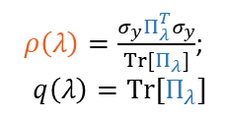
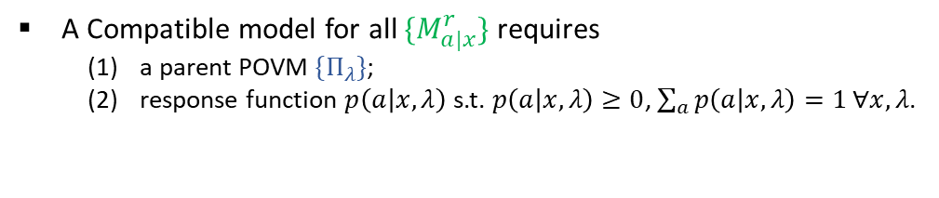
Measurement compatibility
Steerable
No LHS model
Incompatibility
No compatible model
Werner state quantum steering
“Noisy” measurement compatibility
$$x$$
$$ρ_{W}\left(r\right)=r|Ψ^{−}⟩⟨Ψ^{−}|+\left(1−r\right)\frac{𝕀}{4}$$
$$M_{a|x}^{r}=rM_{a|x }+\left(1−r\right)TrM_{a|x }\frac{𝕀}{2}$$
$$M_{a|x }$$
A
B
$$ρ⇒$$
$$Π_{λ}$$
$$→^{λ}$$
$$ρ⇒$$
$$x→$$
$$⇒$$
$$M_{a|x }^{r}$$
$$→a$$
$$P(a|x,λ)$$
$$→a$$
$$\text{Simulated} \text{by}$$
$$x→$$
$$a$$
$$λ$$
$ρ\left(λ\right)=\frac{σ_{y}Π_{λ}^{T}σ_{y}}{Tr[Π_{λ}]}$;
$$q\left(λ\right)=Tr[Π_{λ}]$$
$$ρ_{ a|x }^{r}={Tr}_{A}\left(M_{a|x }⊗Iρ_{W}\left(r\right)\right)=\int_{Λ}{dλ}q\left(λ\right)p\left(a | x,λ\right)ρ(λ)$$
$$M_{a|x}^{r}=\int_{Λ}{dλ}p\left(a | x,λ\right)Π_{λ}$$
A LHS model for $ρ_{W}\left(r\right)$ requires
a probability measure $q\left(λ\right)$;
a family of hidden state $ρ(λ)$;
response function $p\left(a | x,λ\right)$ s.t. $p\left(a | x,λ\right)≥0$, $\sum_{a}{p\left(a | x,λ\right)}=1 ∀x,λ$.
A Compatible model for all ${\{M}_{a|x}^{r}\}$ requires
a parent POVM ${\{Π}_{λ}\}$;
response function $p\left(a | x,λ\right)$ s.t. $p\left(a | x,λ\right)≥0$, $\sum_{a}{p\left(a | x,λ\right)}=1 ∀x,λ$.
Incompatibility’s problem
Determine the critical (in)compatibility bound for all noisy PVMs and POVMs?
LHS model of $ρ_{W}\left(r\right)$for all POVMs ${\{M}_{a|x}^{r}\}$ $⇔$ Compatible model for all noisy ” POVMs ${\{M}_{a|x}^{r}\}$

Slide 9
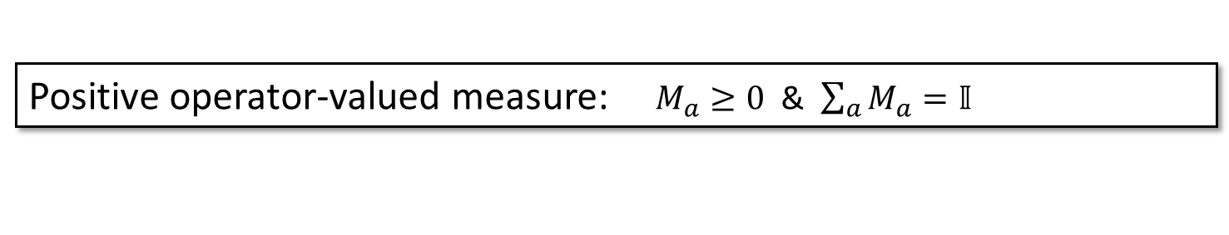
PVMs vs POVMs
Positive operator-valued measure: $M_{a}≥0$ & $\sum_{a}{M_{a}}=𝕀$
Projection valued measure: $\{M_{a}\}$ is a POVM & $M_{a}M_{a^{′}}=δ_{a,a^{′}}M_{a}$
Problem
In what tasks, nonprojective POVMs could present advantage over PVMs
*From Naimark’s theorem, POVMs can be obtained from PVMs acting on a larger space. But in a fixed dimension, there are extremal nonprojective POVMs
In quantum state tomography (Renes 2003), e.g., the use of SIC-POVM
In quantum state discrimination (Peres 1988), e.g., Unambiguous discrimination of nonorthogonal state
In quantum metrology (Zhou 2020), Randomness generation (Brask 2017), in protocols using Pretty good measurement (Ishizaka 2008, Leditzky 2022) and etc.
In achieving a larger violation in Bell scenario (Vértesi 2010).
Simulation Problem
e.g., In what quantum steering tasks, PVMs can not reveal quantumness, while POVM can?
*the classical simulation may require unbounded resource

Slide 10



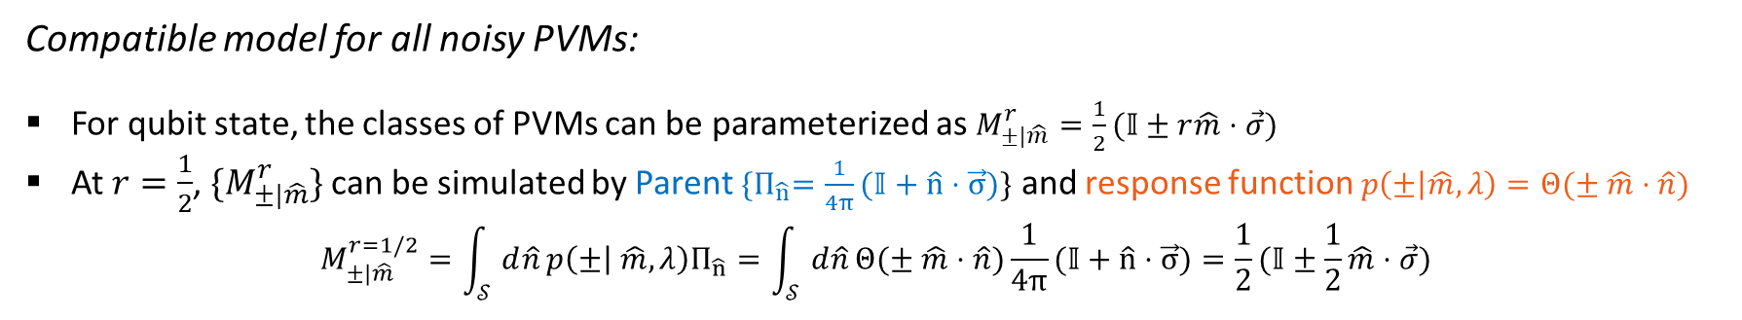
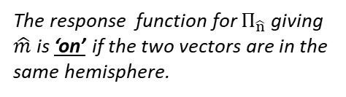
Compatible model: Werner’s model
Let start with simple example (Werner 1989):
$M_{±|\hat{m}}^{r}=\frac{1}{2}(𝕀±r\hat{m}⋅\vec{σ})$
Compatible model for all noisy PVMs:
For qubit state, the classes of PVMs can be parameterized as $M_{±|\hat{m}}^{r}=\frac{1}{2}(𝕀±r\hat{m}⋅\vec{σ})$
At $r=\frac{1}{2}$, ${\{M}_{±|\hat{m}}^{r}\}$can be simulated by Parent ${\{Π}_{\hat{n}}=\frac{1}{4π}(𝕀+\hat{n}⋅\vec{σ})\}$ and response function $p\left(± | \hat{m},λ\right)=Θ(± \hat{m}⋅\hat{n})$
$$M_{±|\hat{m}}^{r=1/2}=\int_{𝒮 }^{1}{d\hat{n}}p\left(± | \hat{m},λ\right)Π_{\hat{n}}=\int_{𝒮 }^{1}{d\hat{n}}Θ(± \hat{m}⋅\hat{n})\frac{1}{4π}(𝕀+\hat{n}⋅\vec{σ})=\frac{1}{2}(𝕀±\frac{1}{2}\hat{m}⋅\vec{σ})$$
Step function
Over the surface of Block sphere
$$\hat{m}$$
$$\hat{n}$$
The response function for $Π_{\hat{n}}$giving $\hat{m}$ is ‘on’ if the two vectors are in the same hemisphere.

Slide 11


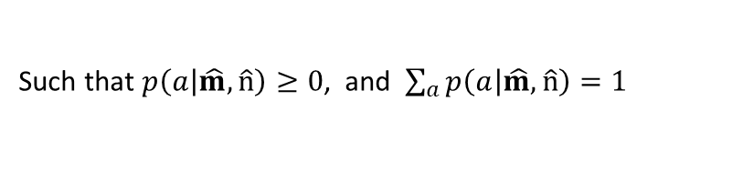
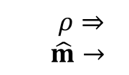




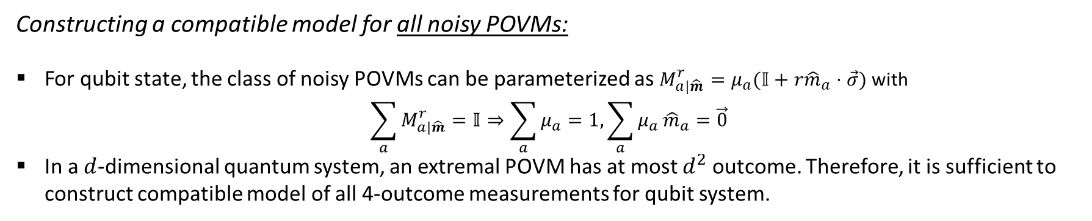




Main result
Setting up the problem
$M_{±|\hat{m}}^{r}=\frac{1}{2}(𝕀±r\hat{m}⋅\vec{σ})$
Constructing a compatible model for all noisy POVMs:
For qubit state, the class of noisy POVMs can be parameterized as $M_{a|\hat{m}}^{r}=μ_{a}(𝕀+r{\hat{m}}_{a}⋅\vec{σ})$ with
$$\sum_{a}{M_{a|\hat{m}}^{r}}=𝕀⇒\sum_{a}{μ_{a}}=1,\sum_{a}{μ_{a}}{\hat{m}}_{a}=\vec{0}$$
In a $d$-dimensional quantum system, an extremal POVM has at most $d^{2}$ outcome. Therefore, it is sufficient to construct compatible model of all 4-outcome measurements for qubit system.
Main result
Any noisy 4-outcome POVM $\{M_{a|x}^{r=1/2}\}$ can be simulated by the parent POVM ${\{Π}_{\hat{n}}=\frac{1}{4π}(𝕀+\hat{n}⋅\vec{σ})\}$, where the response function $p\left(a | \hat{m},\hat{n}\right)$ can be constructed explicitly (not uniquely)
$ρ⇒$
$\hat{m}→$
$$\text{Simulated} \text{by}$$
$$ρ⇒$$
$$Π_{\hat{n}}$$
$$→^{\hat{n}}$$
$$M_{a|\hat{m}}^{r}$$
$$→a$$
$$⇒$$
$$→a$$
$$x→$$
$$P(a|\hat{m},\hat{n})$$
Such that $p\left(a | \hat{m},\hat{n}\right)≥0$, and $\sum_{a}{p\left(a | \hat{m},\hat{n}\right)}=1$

Slide 12


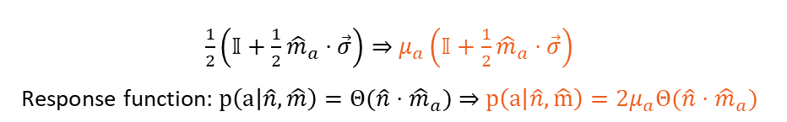



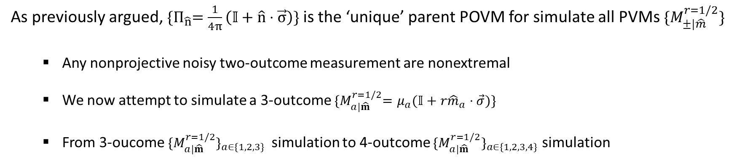
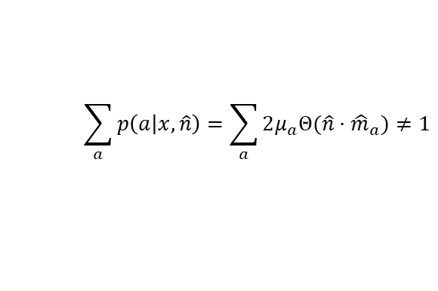



Proof idea
$M_{±|\hat{m}}^{r}=\frac{1}{2}(𝕀±r\hat{m}⋅\vec{σ})$
As previously argued, ${\{Π}_{\hat{n}}=\frac{1}{4π}\left(𝕀+\hat{n}⋅\vec{σ}\right)\}$ is the ‘unique’ parent POVM for simulate all PVMs $\{M_{±|\hat{m}}^{r=1/2}\}$
Any nonprojective noisy two-outcome measurement are nonextremal
We now attempt to simulate a 3-outcome ${\{M}_{a|\hat{m}}^{r=1/2}=μ_{a}(𝕀+r{\hat{m}}_{a}⋅\vec{σ})\}$
From 3-oucome ${\{M}_{a|\hat{m}}^{r=1/2}\}_{a∈\{1,2,3\}}$simulation to 4-outcome ${\{M}_{a|\hat{m}}^{r=1/2}\}_{a∈\{1,2,3,4\}}$ simulation
Each effect ${M_{a|\hat{m}}^{r=1/2}=μ}_{a}\left(𝕀+\frac{1}{2}{\hat{m}}_{a}⋅\vec{σ}\right)$ can be simulated
Normalization condition fails when combining
$${\hat{m}}_{1}$$
$${\hat{m}}_{1}$$
$${\hat{m}}_{1}$$
$${\hat{m}}_{2}$$
$${\hat{m}}_{3}$$
$${\hat{m}}_{3}$$
$${\hat{m}}_{2}$$
$\frac{1}{2}\left(𝕀+\frac{1}{2}{\hat{m}}_{a}⋅\vec{σ}\right)⇒$ $μ_{a}\left(𝕀+\frac{1}{2}{\hat{m}}_{a}⋅\vec{σ}\right)$
$\text{R}\text{esponse} \text{function}\text{:} p\left(a | \hat{n},\hat{m}\right)=Θ(\hat{n}⋅{\hat{m}}_{a})⇒$ $p\left(a | \hat{n},\hat{m}\right)=2μ_{a}Θ(\hat{n}⋅{\hat{m}}_{a})$
$$\sum_{a}{p\left(a | x,\hat{n}\right)=\sum_{a}{2μ_{a}Θ(\hat{n}⋅{\hat{m}}_{a})}≠1}$$

Slide 13




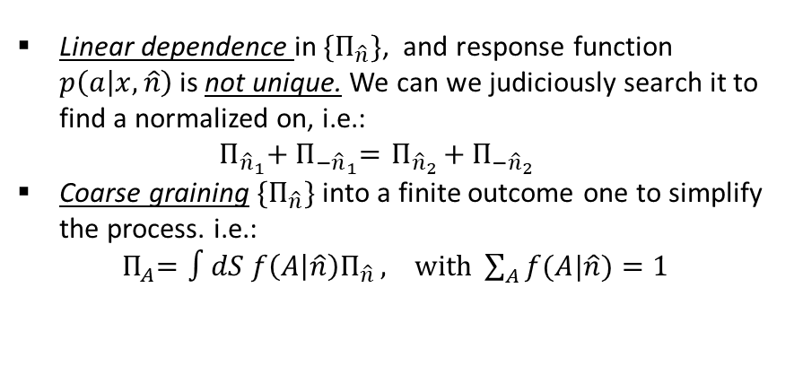

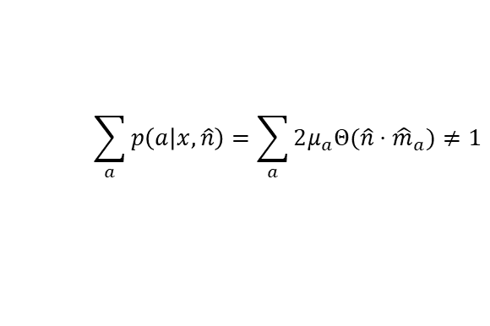


Proof idea:
$M_{±|\hat{m}}^{r}=\frac{1}{2}(𝕀±r\hat{m}⋅\vec{σ})$
As previously argued, ${\{Π}_{\hat{n}}=\frac{1}{4π}\left(𝕀+\hat{n}⋅\vec{σ}\right)\}$ is the ‘unique’ parent POVM for simulate all PVMs $\{M_{±|\hat{m}}^{r=1/2}\}$
Any nonprojective noisy two-outcome measurement are nonextremal
We now attempt to simulate a 3-outcome ${\{M}_{a|\hat{m}}^{r=1/2}=μ_{a}(𝕀+r{\hat{m}}_{a}⋅\vec{σ})\}$
From 3-oucome ${\{M}_{a|\hat{m}}^{r=1/2}\}_{a∈\{1,2,3\}}$simulation to 4-outcome ${\{M}_{a|\hat{m}}^{r=1/2}\}_{a∈\{1,2,3,4\}}$ simulation
Normalization condition fails when combining
Main intuition
Linear dependence in ${\{Π}_{\hat{n}}\}$, and response function $p\left(a | x,\hat{n}\right)$is not unique. We can we judiciously search it to find a normalized on, i.e.:
${ Π}_{{\hat{n}}_{1}}+{ Π}_{−{\hat{n}}_{1}}={ Π}_{{\hat{n}}_{2}}+{ Π}_{−{\hat{n}}_{2}}$
Coarse graining ${\{Π}_{\hat{n}}\}$ into a finite outcome one to simplify the process. i.e.:
${ Π}_{A}=∫dS f\left(A | \hat{n}\right)Π_{\hat{n} }, with \sum_{A}{f(A|\hat{n})}=1$
$${\hat{m}}_{1}$$
$${\hat{m}}_{1}$$
$${\hat{m}}_{2}$$
$${\hat{m}}_{3}$$
$${\hat{m}}_{3}$$
$${\hat{m}}_{2}$$
$$\sum_{a}{p\left(a | x,\hat{n}\right)=\sum_{a}{2μ_{a}Θ(\hat{n}⋅{\hat{m}}_{a})}≠1}$$

Slide 14
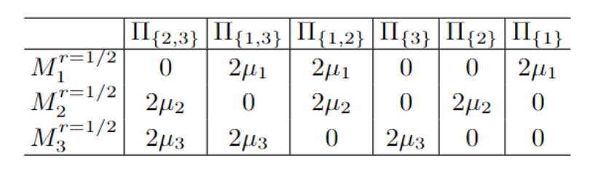

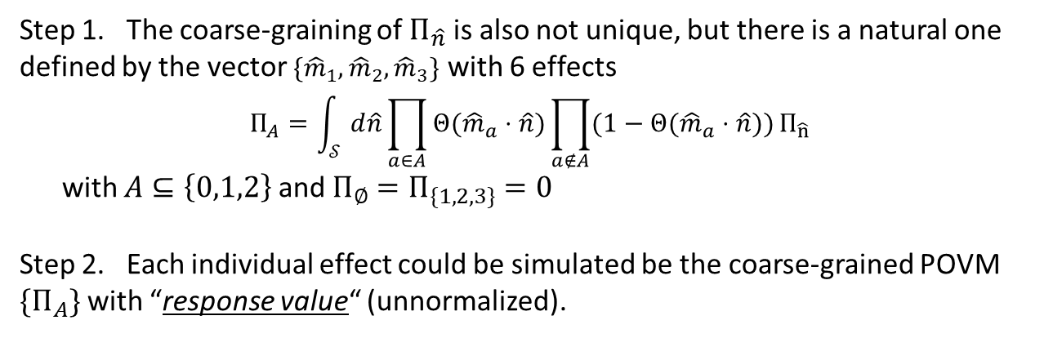
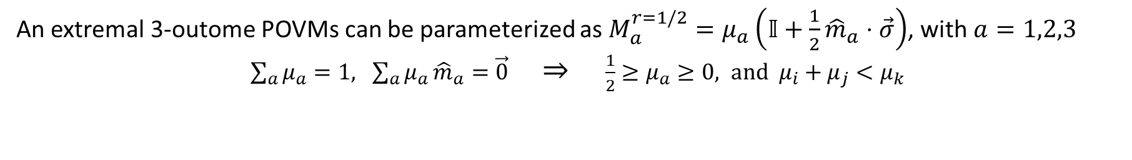

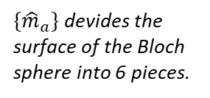








Proof idea: 3-outcome POVMs
An extremal 3-outome POVMs can be parameterized as $M_{a}^{r=1/2}=μ_{a}\left(𝕀+\frac{1}{2}{\hat{m}}_{a}⋅\vec{σ}\right)$, with $a=1,2,3$
${\sum_{a}{μ_{a}}=1, \sum_{a}{μ_{a}}{\hat{m}}_{a}=\vec{0} ⇒ \frac{1}{2}≥μ}_{a}≥0, and μ_{i}+μ_{j}<μ_{k}$
$${\hat{m}}_{1}$$
Step 1. The coarse-graining of $Π_{\hat{n}}$ is also not unique, but there is a natural one defined by the vector ${\{\hat{m}}_{1},{\hat{m}}_{2},{\hat{m}}_{3}\}$ with 6 effects
$$Π_{A}=\int_{𝒮 }^{1}{d\hat{n}}\prod_{a∈A}{Θ({\hat{m}}_{a}⋅\hat{n})\prod_{a∉A}{(1−Θ({\hat{m}}_{a}⋅\hat{n})})}Π_{\hat{n}}$$
with $A⊆\left\{0,1,2\right\}$ and $Π_{∅}=Π_{\{1,2,3\}}=0$
Step 2. Each individual effect could be simulated be the coarse-grained POVM ${\{Π}_{A}\}$ with “response value“ (unnormalized).
${\{\hat{m}}_{a}\}$ devides the surface of the Bloch sphere into 6 pieces.
$${\hat{m}}_{3}$$
$${\hat{m}}_{2}$$
$$Π_{\{1\}}$$
$$Π_{\{1,3\}}$$
$$Π_{\{1,2\}}$$
With response function
$$p\left(a | \hat{n},\hat{m}\right)=2μ_{a}Θ(\hat{n}⋅{\hat{m}}_{a})$$
$$Π_{\{2\}}$$
$$Π_{\{3\}}$$
$$Π_{\{2,3\}}$$
Table I: Simulation ${\{M}_{a}^{r=1/2}\}$ with coarse-grained parent POVM ${\{Π}_{A}\}$

Slide 15
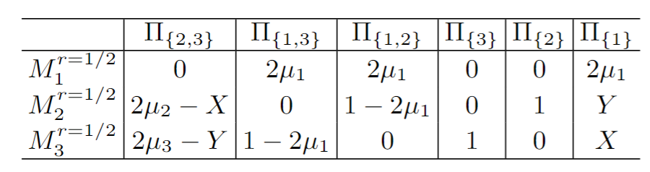
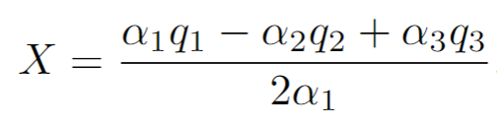
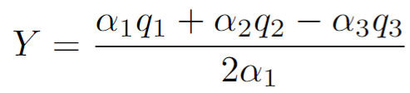
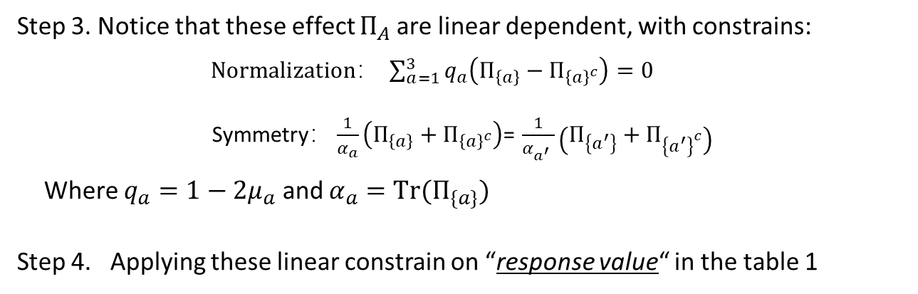
Proof idea: 3-outcome POVMs
An extremal 3-outome POVMs can be parameterized as $M_{a}^{r=1/2}=μ_{a}\left(𝕀+\frac{1}{2}{\hat{m}}_{a}⋅\vec{σ}\right)$, with $a=1,2,3$
${\sum_{a}{μ_{a}}=1, \sum_{a}{μ_{a}}{\hat{m}}_{a}=\vec{0} ⇒ \frac{1}{2}≥μ}_{a}≥0, and μ_{i}+μ_{j}<μ_{k}$
$${\hat{m}}_{1}$$
Step 3. Notice that these effect $Π_{A}$ are linear dependent, with constrains:
$Normalization： \sum_{a=1}^{3}{q_{a}\left(Π_{\left\{a\right\}}−Π_{{\left\{a\right\}}^{c}}\right)=0}$
Symmetry$：\frac{1}{α_{a}}\left(Π_{\left\{a\right\}}+Π_{{\left\{a\right\}}^{c}}\right)$= $\frac{1}{α_{a^{′}} }\left(Π_{\left\{a^{′}\right\}}+Π_{{\left\{a^{′}\right\}}^{c}}\right)$
Where $q_{a}=1−2μ_{a}$ and $α_{a}=Tr(Π_{\{a\}})$
Step 4. Applying these linear constrain on “response value“ in the table 1
${\{\hat{m}}_{a}\}$ devides the surface of the Bloch sphere into 6 pieces.
$${\hat{m}}_{3}$$
$${\hat{m}}_{2}$$
$$Π_{\{1\}}$$
$$Π_{\{1,3\}}$$
$$Π_{\{1,2\}}$$
$$Π_{\{2\}}$$
$$Π_{\{3\}}$$
$$Π_{\{2,3\}}$$
Table I: Unnormalized response value
Table II: Normalized response function
Note: Positivity after applying linear constrain need to be verified.

Slide 16







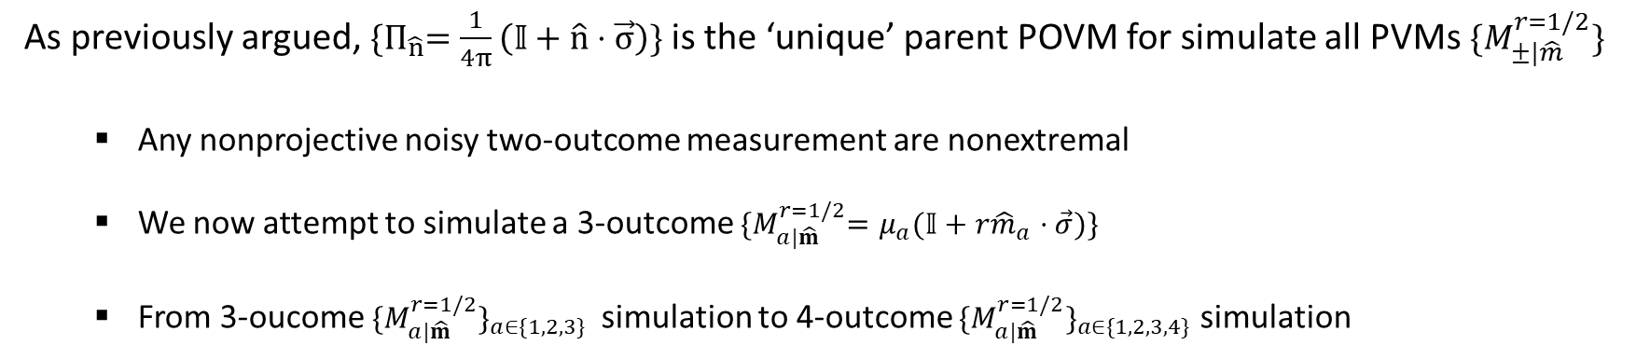




Proof idea: 4-outcome POVMs
$M_{±|\hat{m}}^{r}=\frac{1}{2}(𝕀±r\hat{m}⋅\vec{σ})$
As previously argued, ${\{Π}_{\hat{n}}=\frac{1}{4π}\left(𝕀+\hat{n}⋅\vec{σ}\right)\}$ is the ‘unique’ parent POVM for simulate all PVMs $\{M_{±|\hat{m}}^{r=1/2}\}$
Any nonprojective noisy two-outcome measurement are nonextremal
We now attempt to simulate a 3-outcome ${\{M}_{a|\hat{m}}^{r=1/2}=μ_{a}(𝕀+r{\hat{m}}_{a}⋅\vec{σ})\}$
From 3-oucome ${\{M}_{a|\hat{m}}^{r=1/2}\}_{a∈\{1,2,3\}}$simulation to 4-outcome ${\{M}_{a|\hat{m}}^{r=1/2}\}_{a∈\{1,2,3,4\}}$ simulation
$${μ_{4}\hat{m}}_{4}$$
$${μ_{5}\hat{m}}_{5^{+}}$$
$${μ_{4}\hat{m}}_{4}$$
$${μ_{1}\hat{m}}_{1}$$
$${μ_{3}\hat{m}}_{3}$$
$${μ_{3}\hat{m}}_{3}$$
$${μ_{1}\hat{m}}_{1}$$
$${μ_{2}\hat{m}}_{2}$$
$${μ_{5}\hat{m}}_{5^{−}}$$
$${μ_{2}\hat{m}}_{2}$$
Step 1: Construct compatible model for 3-outcome POVMs
Step 2: Obtain compatible model for 4-outcome POVMs

Slide 17
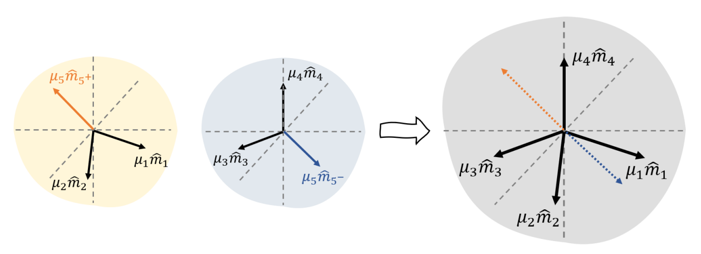
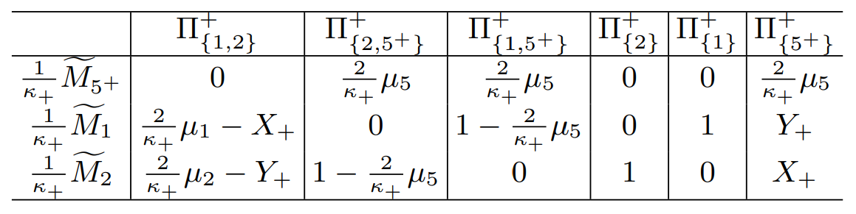
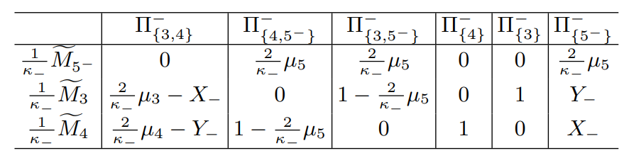
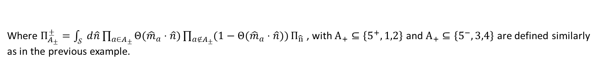
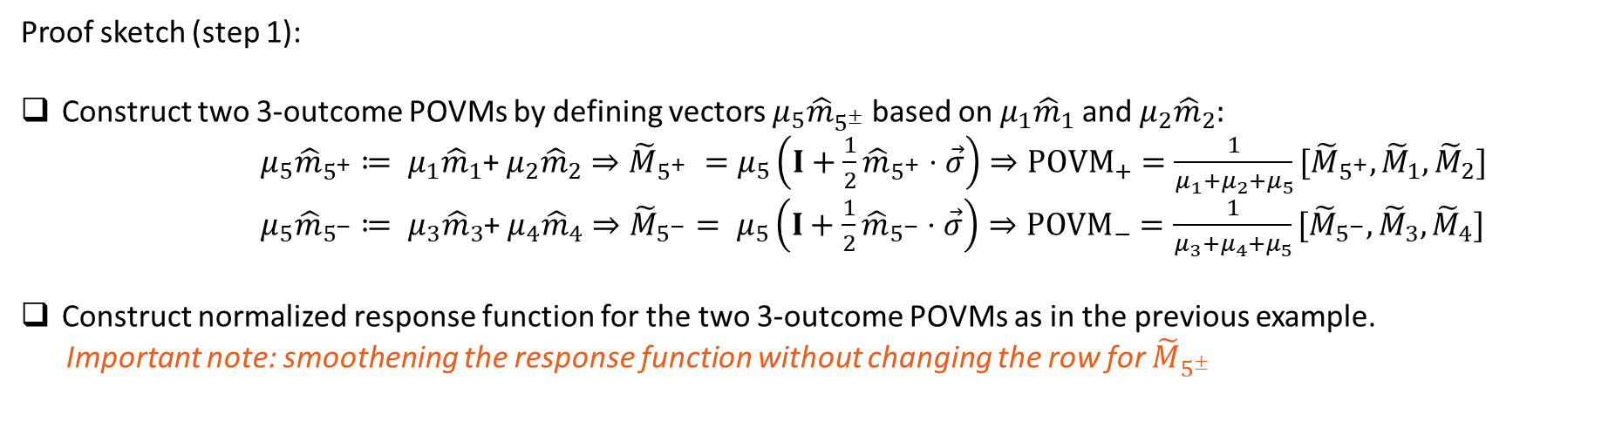
Proof idea: 4-outcome POVMs
Proof sketch (step 1):
Construct two 3-outcome POVMs by defining vectors ${μ_{5}\hat{m}}_{5^{±}}$ based on ${μ_{1}\hat{m}}_{1}$ and ${μ_{2}\hat{m}}_{2}:$
${μ_{5}\hat{m}}_{5^{+}}≔ {μ_{1}\hat{m}}_{1}$+ ${μ_{2}\hat{m}}_{2}⇒{\tilde{M}}_{5^{+}} =μ_{5}\left(I+\frac{1}{2}{\hat{m}}_{5^{+}}⋅\vec{σ}\right)⇒POVM_{+}=\frac{1}{μ_{1}+μ_{2}+μ_{5}}[{\tilde{M}}_{5^{+}},{\tilde{M}}_{1},{\tilde{M}}_{2}]$
${μ_{5}\hat{m}}_{5^{−}}≔ {μ_{3}\hat{m}}_{3}$+ ${μ_{4}\hat{m}}_{4}⇒{\tilde{M}}_{5^{−}}= μ_{5}\left(I+\frac{1}{2}{\hat{m}}_{5^{−}}⋅\vec{σ}\right)⇒POVM_{−}=\frac{1}{μ_{3}+μ_{4}+μ_{5}}[{\tilde{M}}_{5^{−}},{\tilde{M}}_{3},{\tilde{M}}_{4}]$
Construct normalized response function for the two 3-outcome POVMs as in the previous example.
Important note: smoothening the response function without changing the row for ${\tilde{M}}_{5^{±}}$
Table IIIA: Normalized response function for simulating $POVM_{+}$
Table IIIB: Normalized response function for simulating $POVM_{−}$
Where $Π_{A_{±}}^{±}=\int_{𝒮 }^{1}{d\hat{n}}\prod_{a∈A_{±}}{Θ({\hat{m}}_{a}⋅\hat{n})\prod_{a∉A_{±}}{(1−Θ({\hat{m}}_{a}⋅\hat{n})})}Π_{\hat{n}}$ , with $A_{+}⊆\left\{5^{+},1,2\right\}$ and $A_{+}⊆\left\{5^{−},3,4\right\}$ are defined similarly as in the previous example.

Slide 18
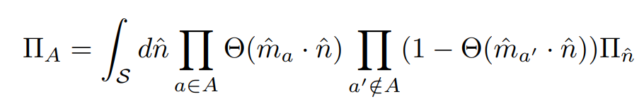


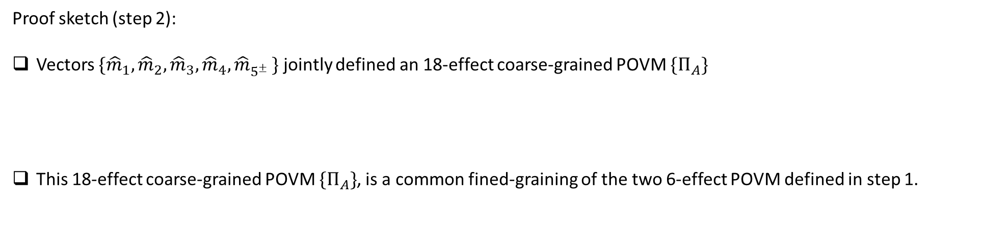
Proof idea: 4-outcome POVMs
Proof sketch (step 2):
Vectors $\{{\hat{m}}_{1},{\hat{m}}_{2},{\hat{m}}_{3},{\hat{m}}_{4}{,\hat{m}}_{5^{±}}\}$ jointly defined an 18-effect coarse-grained POVM ${\{Π}_{A}\}$
This 18-effect coarse-grained POVM ${\{Π}_{A}\}$, is a common fined-graining of the two 6-effect POVM defined in step 1.
Table IV: Normalized response function for simulating any 4-outcome POVM
Where $κ_{+}=μ_{1}+μ_{2}+μ_{5};$and $κ_{−}=μ_{3}+μ_{4}+μ_{5}$. $X_{±}$ and $Y_{±}$ are defined by $POVM_{±}$ correspondingly.

Slide 19
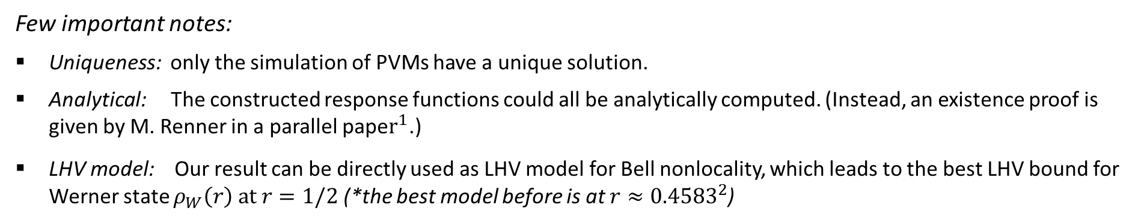
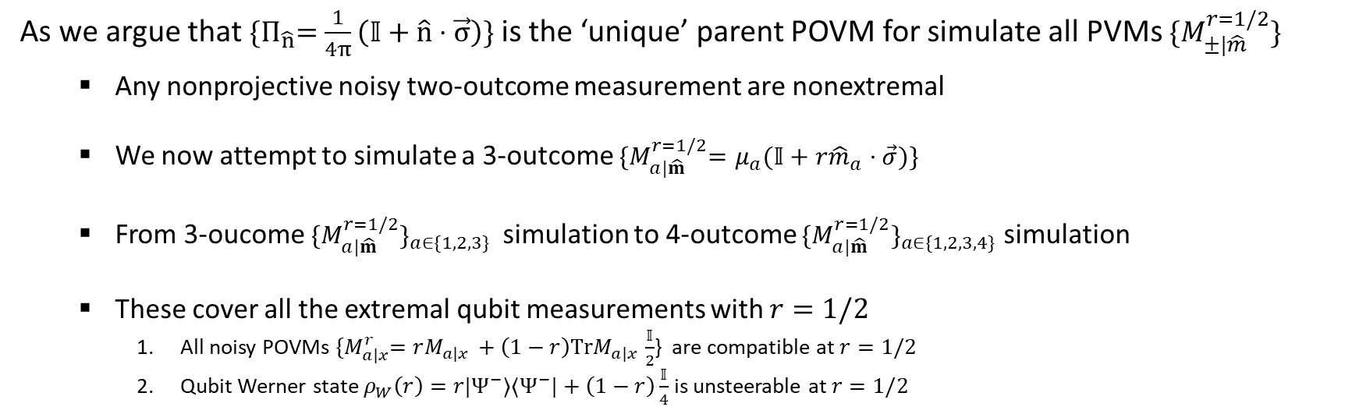

arXiv:2309.12290
Conclusion
arXiv:2309.12290
$M_{±|\hat{m}}^{r}=\frac{1}{2}(𝕀±r\hat{m}⋅\vec{σ})$
As we argue that ${\{Π}_{\hat{n}}=\frac{1}{4π}\left(𝕀+\hat{n}⋅\vec{σ}\right)\}$ is the ‘unique’ parent POVM for simulate all PVMs $\{M_{±|\hat{m}}^{r=1/2}\}$
Any nonprojective noisy two-outcome measurement are nonextremal
We now attempt to simulate a 3-outcome ${\{M}_{a|\hat{m}}^{r=1/2}=μ_{a}(𝕀+r{\hat{m}}_{a}⋅\vec{σ})\}$
From 3-oucome ${\{M}_{a|\hat{m}}^{r=1/2}\}_{a∈\{1,2,3\}}$simulation to 4-outcome ${\{M}_{a|\hat{m}}^{r=1/2}\}_{a∈\{1,2,3,4\}}$ simulation
These cover all the extremal qubit measurements with $r=1/2$
All noisy POVMs ${\{M}_{a|x}^{r}=rM_{a|x }+\left(1−r\right)TrM_{a|x }\frac{𝕀}{2}$} are compatible at $r=1/2$
Qubit Werner state $ρ_{W}\left(r\right)=r|Ψ^{−}⟩⟨Ψ^{−}|+\left(1−r\right)\frac{𝕀}{4}$ is unsteerable at $r=1/2$
Few important notes:
Uniqueness: only the simulation of PVMs have a unique solution.
Analytical: The constructed response functions could all be analytically computed. (Instead, an existence proof is given by M. Renner in a parallel pape$r^{1}$.)
LHV model: Our result can be directly used as LHV model for Bell nonlocality, which leads to the best LHV bound for Werner state $ρ_{W}\left(r\right) at r=1/2$ (*the best model before is at $r≈{0.4583}^{2}$)
M Renner, arXiv:2309.12290 (2023)
S Designolle PRR 5, 043059

Slide 20

Outlook
The exact steering bound for qubit Werner state is given, showing that POVMs provide no advantage in steering.
An improved LHV bound for qubit Werner state under POVM is provided .
For $ρ_{W}\left(r\right)=r|Ψ^{−}⟩⟨Ψ^{−}|+\left(1−r\right)\frac{𝕀}{4}$
LHS model
For arbitrary qubit-qubit state with POVMs.
Special state: e.g., T state
General state: not even analytically known for PVMs
For higher dimensional Werner state with POVMs.
Geometric picture is missing.
Coarse-graining cannot be easily generalized.
Better LHV bound for Werner state and other qubit-qubit state.
Constructing LHV/LHS model using finite amount of shared randomness.
POVMs and PVMs became inequivalent when restricted with finite amount of share randomness
How much pricier: simulating all POVMs comparing to the simulation of all PVMs (Poster 462)
LHV model
Finite model

Slide 21
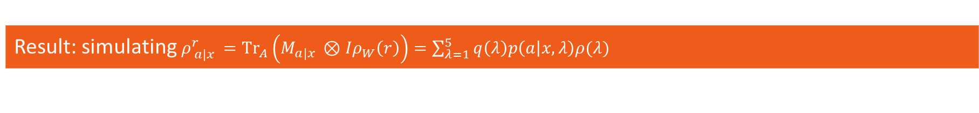
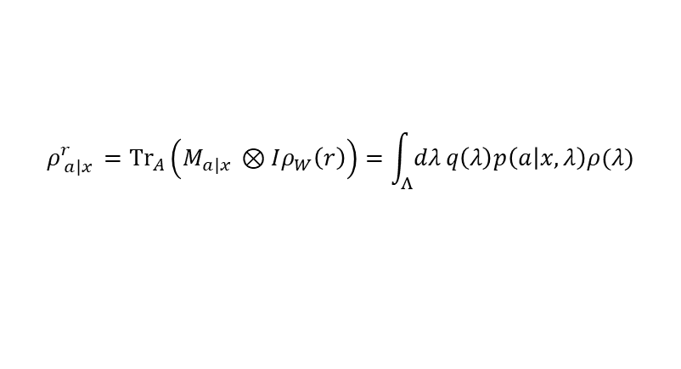
Back up: Finite share randomness
Revised Problem
Is there any task that PVMs can be simulated classically, while POVM can not?
$$ρ_{ a|x }^{r}={Tr}_{A}\left(M_{a|x }⊗Iρ_{W}\left(r\right)\right)=\int_{Λ}{dλ}q\left(λ\right)p\left(a | x,λ\right)ρ(λ)$$
PVMs and POVMs are equivalent in steering, assuming unbounded classical share randomness;
POVMs provide advantage in a restricted scenario steering, assuming finite shared randomness.
Result: simulating $ρ_{ a|x }^{r}={Tr}_{A}\left(M_{a|x }⊗Iρ_{W}\left(r\right)\right)=\sum_{λ=1}^{5}{q\left(λ\right)p\left(a | x,λ\right)ρ(λ)}$
We show that all $ρ_{ a|x }^{r}$ can be simulated when PVMs are applied with $r≤{0.3714}^{1}$
There exists a class of 3-outcome POVMs where no simulation exists with $r≥≈0.3220$
21
Y Zhang et al, arXiv:2302.09060 2023 (Poster 462)

Slide 22
The full story
With no restriction: A quantum system could be simulated by a classical system, but might require exponentially large computational complexity (unbounded)
e.g., for a small quantum system, the preparation→ density matrix, transformation→ CPTP maps, measurements→ POVMs
With restriction: There exists quantum system that can never be classically simulated.
e.g., Systems that violate Bell inequality, or steering inequality can not be simulated by two labs with locality constrain.
Noisy quantum steering could be simulated classically, independent of whether PVMs or POVMs are utilized.
e.g., In LHS model of noisy Werner state, assuming unbounded classical share randomness.
Classical simulation of a noisy quantum system with POVMs could be more expensive (more complex)
e.g., In LHS model of noisy Werner state, assuming bounded classical share randomness.

