Slide 1

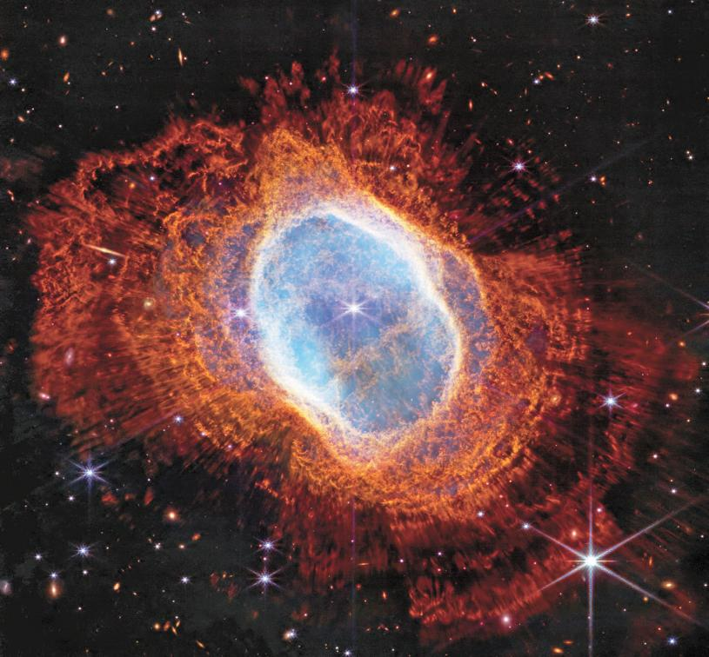

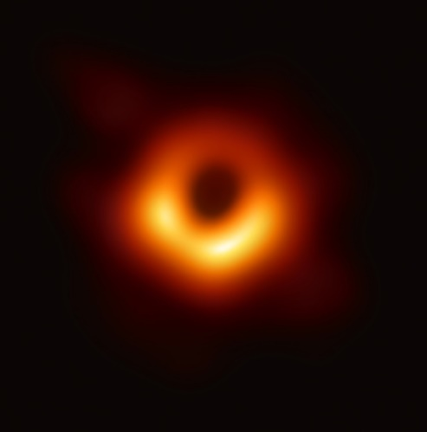

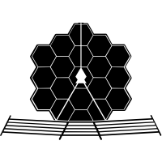



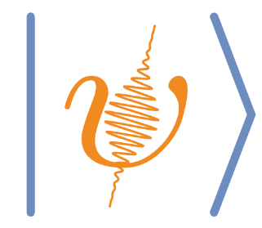
Quantum interferometric imaging
Yujie Zhang, Yunkai Wang, David Diaz, Paul Kwiat, Virginia Lorenz
University of Illinois Urbana-Champaign
Single telescope: Image NGC 3132
with James Webb Space telescope (2022)
Radio Interferometry: Image of M87 blackhole with the EHT(2019)
Quantum-enhanced Optical Interferometry: towards next generation? (20xx)
Lorenz group
Notes:
Add people’s name (with mine underlined)

Slide 2
Outline
Table-top demonstration of quantum-enhanced telescope
Comparison between classical local oscillator and ‘quantum’ local oscillator
Source simulation and closure phase reconstruction
Protocols for enhanced interferometric imaging
Quantum telescope using continuous-variable quantum teleportation
Super-resolution of two incoherent strong thermal source
Interferometric-based imaging
Measurement

Slide 3

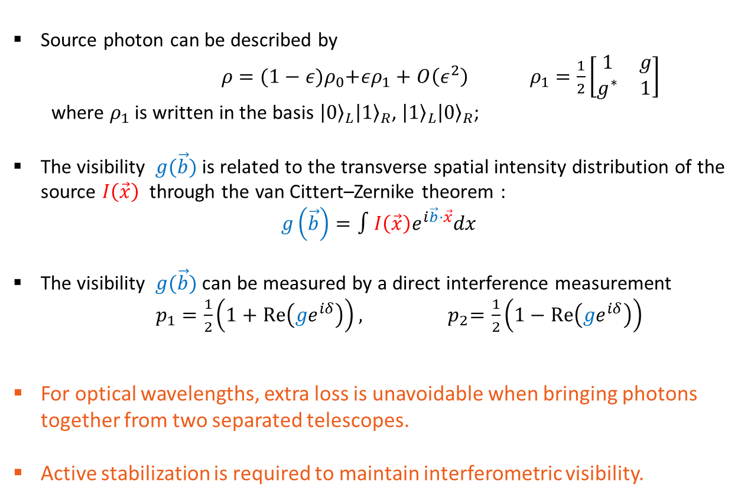



Classical telescope: Direct detection
Source photon can be described by
$ρ={(1−ε)ρ}_{0}+ερ_{1}+O\left(ε^{2}\right) ρ_{1}=\frac{1}{2}\left[\begin{matrix}1 & g \\ g^{∗} & 1\end{matrix}\right]$
where $ρ_{1}$ is written in the basis ${\left|0\right\rangle }_{L}{\left|1\right\rangle }_{R}$, ${\left|1\right\rangle }_{L}{\left|0\right\rangle }_{R}$;
The visibility $g(\vec{b})$ is related to the transverse spatial intensity distribution of the source $I\left(\vec{x}\right)$ through the van Cittert–Zernike theorem :
$$g\left(\vec{b}\right)=∫I\left(\vec{x}\right)e^{i\vec{b}⋅\vec{x}}dx$$
The visibility $g(\vec{b})$ can be measured by a direct interference measurement
$p_{1}=\frac{1}{2}\left(1+Re\left({ge}^{iδ}\right)\right),{ p}_{2}=\frac{1}{2}\left(1−Re\left({ge}^{iδ}\right)\right)$
For optical wavelengths, extra loss is unavoidable when bringing photons together from two separated telescopes.
Active stabilization is required to maintain interferometric visibility.
Source coordinates $\vec{x}$
Astronomical
source $ρ$
Telescope
L
Telescope
R
baseline $\vec{b}$
$$δ$$
Delay
D1
D2
Questions: Is there a way to perform the measurement locally.
Notes:
Change animation, caption.

Slide 4


Classical telescope: local measurement
Classical telescope: Heterodyne interferometry
Using heterodyne interferometry with synchronized Local oscillator
Extra noise will be introduced, which will overwhelm the information about the source, especially when the source is weak.
Telescope
L
Telescope
R
$$⊗$$
LO
LO
$$⊗$$
D1
synchronized
D2
Notes:
Replacing it with brief summary.

Slide 5
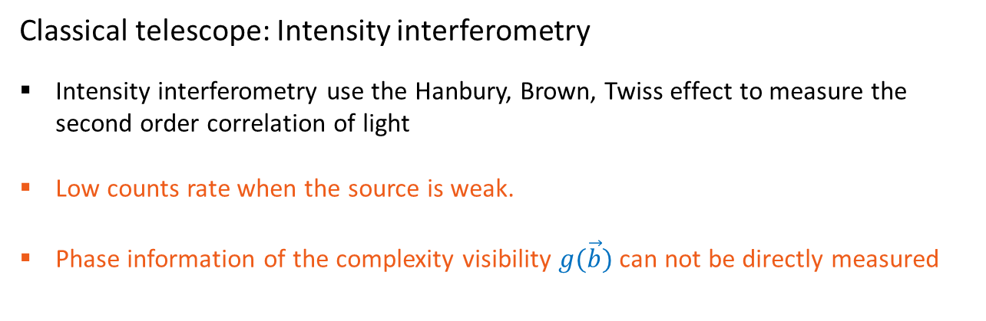
Classical telescope: local measurement
Classical telescope: Heterodyne interferometry
Using heterodyne interferometry with synchronized Local oscillator
Extra noise will be introduced, which will overwhelm the information about the source, especially when the source is weak.
Telescope
L
Telescope
R
Classical telescope: Intensity interferometry
Intensity interferometry use the Hanbury, Brown, Twiss effect to measure the second order correlation of light
Low counts rate when the source is weak.
Phase information of the complexity visibility $g(\vec{b})$ can not be directly measured
D1
D2
Notes:
Replace it with a brief summary.

Slide 6
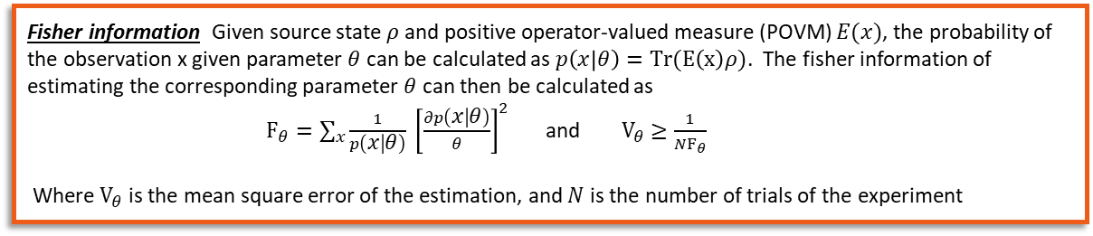





Classical interferometric telescope
Source state with $ε≪1$: $ρ={(1−ε)ρ}_{0}+ερ_{1}+O\left(ε^{2}\right)$
$$δ$$
$$⊗$$
LO
LO
$$⊗$$
$${\left|0\right\rangle }_{L}{\left|1\right\rangle }_{R}\text{+}e^{iδ}{\left|1\right\rangle }_{L}{\left|0\right\rangle }_{R}$$
Direct detection
Heterodyne interferometry
Intensity interferometry
Quantum telescope
Fisher information: $F_{\left|g\right|}$ with the above measurement
$F_{\left|g\right|}∝ε$ (no loss) | $$F_{\left|g\right|}∝ε^{2}$$ | $F_{\left|g\right|}∝ε^{2}{\left|g\right|}^{2}$
$$F_{\left|g\right|}\text{=}F_{\left|g\right|}^{D}/2∝ε$$
Note: As proved by Tsang¹, information of all ‘local’ measurement schemes are upper bounded by $ε^{2}.$
Fisher information: Given source state $ρ$ and positive operator-valued measure (POVM) $E(x)$, the probability of the observation x given parameter $θ$ can be calculated as $p\left(x | θ\right)=Tr(E\left(x\right)ρ)$. The fisher information of estimating the corresponding parameter $θ$ can then be calculated as
$F_{θ}=\sum_{x}{\frac{1}{p\left(x | θ\right)}} {\left[\frac{∂p\left(x | θ\right)}{θ}\right]}^{2}$ and $V_{θ}≥\frac{1}{NF_{θ}}$
Where $V_{θ}$ is the mean square error of the estimation, and $N$ is the number of trials of the experiment
Question: Can this be implemented experimentally already?
Mankei Tsang Phys. Rev. Lett. 107, 270402
Daniel Gottesman, Thomas Jennewein, and Sarah Croke Phys. Rev. Lett. 109, 070503
Notes:
Don’t be too strong to say anything won’t work

Slide 7





Quantum telescope: shared path entanglement
We need a high-rate true single-photon source which puts out exactly one photon per field mode to produce the entangled states.
-- Gottesman, Jennewein, Croke
Astronomical
source
To make it actually works, what is required?
A repeater network (Otherwise, loss will be applied to the ‘lab’ photon)
A source having high rate, and output exactly one photon per mode
Telescope
L
Telescope
R
$$D_{R1}$$
$$D_{L1}$$
Different temporal modes
$$D_{L2}$$
Shared entanglement
0 photon
$${\left|0\right\rangle }_{L}{\left|1\right\rangle }_{R}\text{+}e^{iδ}{\left|1\right\rangle }_{L}{\left|0\right\rangle }_{R}$$
$$D_{R2}$$
photon occupation
Quantum telescope
1 photon
>1 photon

Slide 8




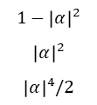



Classical interferometric telescope
Source state with $ε≪1$: $ρ={(1−ε)ρ}_{0}+ερ_{1}+O\left(ε^{2}\right)$
Weak coherent state
$$δ$$
$$⊗$$
$$|α⟩$$
$$|α⟩$$
$$⊗$$
$${\left|0\right\rangle }_{L}{\left|1\right\rangle }_{R}\text{+}e^{iδ}{\left|1\right\rangle }_{L}{\left|0\right\rangle }_{R}$$
Direct detection
‘homedyne’ interferometry
Intensity interferometry
Quantum telescope
Source
Source
Source
Source
0
$1−ε$
$ε$
$$ε^{2}$$
0
$1−ε$
$ε$
$$ε^{2}$$
0
$1−ε$
$ε$
$$ε^{2}$$
0
$1−ε$
$ε$
$$ε^{2}$$
1
1
1
1
2
2
2
2
Lab
Lab
$$1$$
0
$$1−{\left|α\right|}^{2}$$
$${\left|α\right|}^{2}$$
$${\left|α\right|}^{4}/2$$
1
1
2
$F_{\left|g\right|}∝ε+o\left(ε^{2}\right)$(no loss) | $$F_{\left|g\right|}∝\frac{ε^{2}{\left|α\right|}^{4}}{{\left|α\right|}^{4}+{\left|α\right|}^{2}ε+ε^{2}}$$ | $F_{\left|g\right|}∝ε^{2}{\left|g\right|}^{2}$
$$F_{\left|g\right|}\text{=}F_{\left|g\right|}^{D}/2∝ε$$
Notes:
Align the source photon
Have a better animation on the arrow

Slide 9






Classical interferometric telescope
SPDC
Source state with $ε≪1$: $ρ={(1−ε)ρ}_{0}+ερ_{1}+O\left(ε^{2}\right)$
$${\left|0\right\rangle }_{L}{\left|1\right\rangle }_{R}\text{+}e^{iδ}{\left|1\right\rangle }_{L}{\left|0\right\rangle }_{R}$$
$${\left|0\right\rangle }_{L}{\left|1\right\rangle }_{R}\text{+}e^{iδ}{\left|1\right\rangle }_{L}{\left|0\right\rangle }_{R}$$
$${\left|0\right\rangle }_{L}{\left|1\right\rangle }_{R}\text{+}e^{iδ}{\left|1\right\rangle }_{L}{\left|0\right\rangle }_{R}$$
Conceptual quantum telescope
Source with non-unit rate per mode
Quantum telescope
Source
Source
Source
0
$1−ε$
$ε$
$$ε^{2}$$
0
$1−ε$
$ε$
$$ε^{2}$$
0
$1−ε$
$ε$
$$ε^{2}$$
1
1
1
Strongly correlated
2
2
2
Lab
Lab
0
$1−ε$
$ε$
$$ε^{2}$$
$$1−p$$
Lab
$$1$$
0
$$p$$
1
1
1
2
Temporal mode
$$F_{\left|g\right|}∝ε$$
$$F_{\left|g\right|}∝\frac{ε^{2}p^{2}}{{εp+ε}^{2}}$$
$$F_{\left|g\right|}\text{=}F_{\left|g\right|}^{D}/2∝ε$$
Notes:
Putting d,e,f in parallel

Slide 10
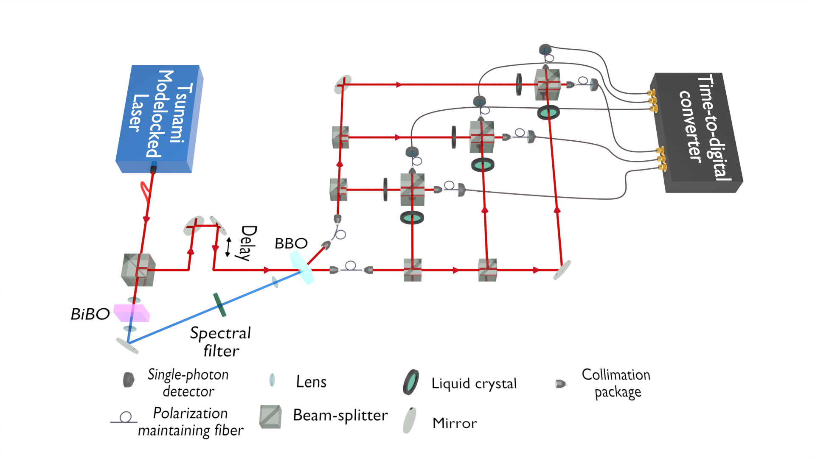
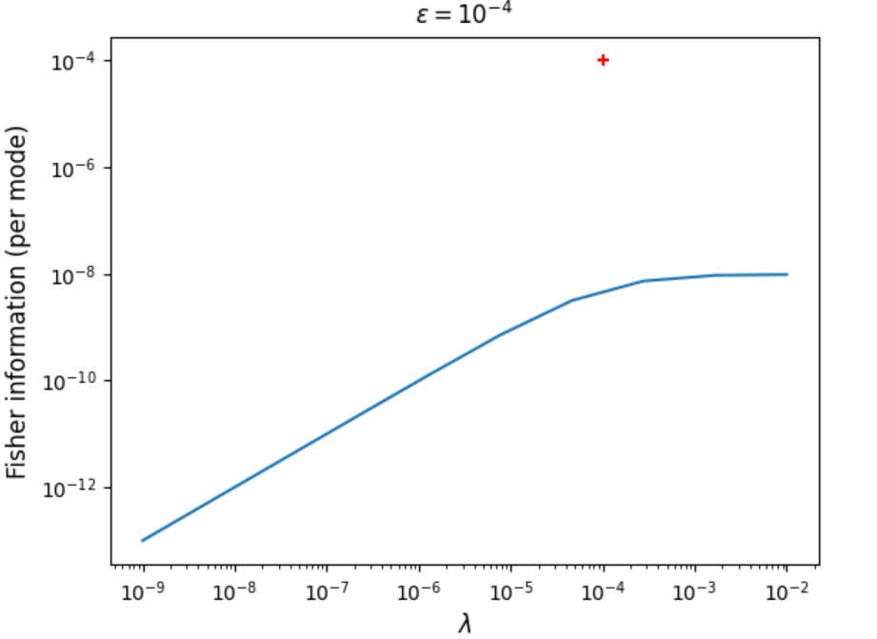


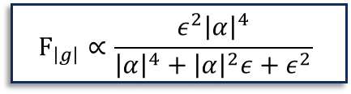




Quantum interferometric telescope
SPDC
Weak coherent state
$$F_{\left|g\right|}∝\frac{ε^{2}{\left|α\right|}^{4}}{{\left|α\right|}^{4}+{\left|α\right|}^{2}ε+ε^{2}}$$
$$⊗$$
$$|α⟩$$
$$|α⟩$$
$$⊗$$
$$F_{\left|g\right|}∝ε$$
$${\left|0\right\rangle }_{L}{\left|1\right\rangle }_{R}\text{+}e^{iδ}{\left|1\right\rangle }_{L}{\left|0\right\rangle }_{R}$$
Weak Coherent state LO
Conceptual quantum telescope
Quantum telescope
Heterodyne Interferometry
Coherent state LO
Intensity of Local oscillator${\left|α\right|}^{2}$
Notes:
Axis with words mentioning it is with three telesopes

Slide 11










Source simulation and closure phase reconstruction
Source coordinates $\vec{x}$
$$φ_{1}$$
$$φ_{2}$$
baseline $\vec{b}$
Standard scheme
$$φ_{1}$$
$$φ_{2}$$
$$φ_{3}$$
See more in David’s presentation later.
${\vec{b}}_{12}$
${\vec{b}}_{13}$
${\vec{b}}_{23}$
Closure phase scheme
Notes:
Replace it with a brief summarization

Slide 12






Quantum-enhanced interferometric imaging
Protocols for enhanced interferometric imaging
Quantum telescope using continuous-variable quantum teleportation
Super-resolution of two incoherent strong thermal source
$$Δx$$
Homodyne measurement
$$x_{L1},p_{L2 }$$
$$δ$$
$${\hat{D}}_{x_{L1},p_{L2 }}$$
$$TMSV$$
CV quantum telescope
Super-resolution of two-point strong thermal source

Slide 13


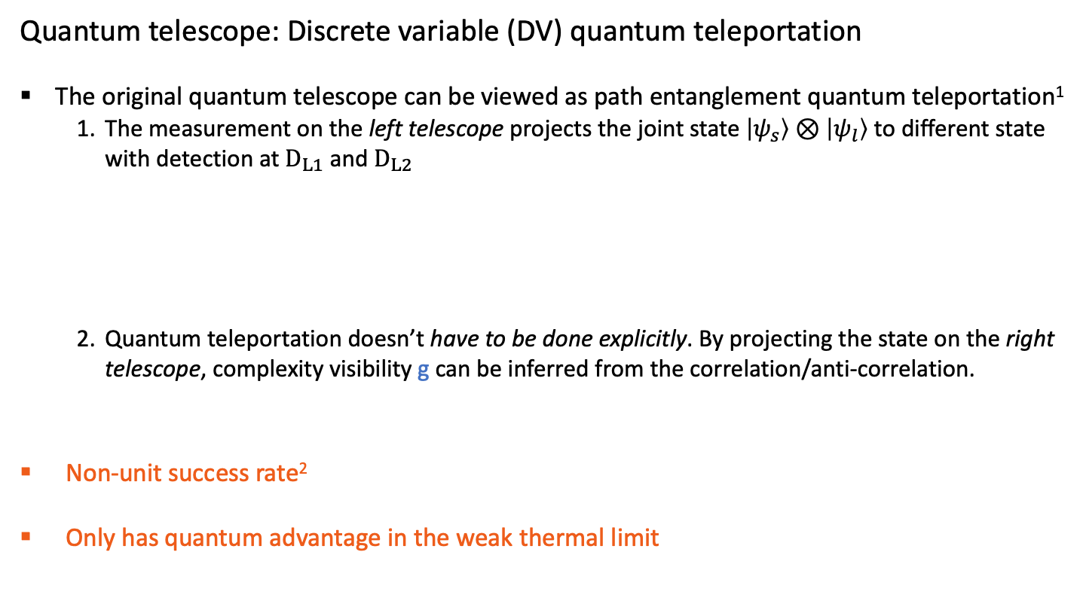





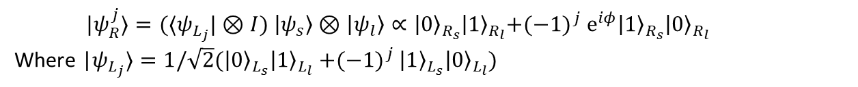

Quantum telescope with CV quantum teleportation
Quantum telescope: Discrete variable (DV) quantum teleportation
The original quantum telescope can be viewed as path entanglement quantum teleportation¹
The measurement on the left telescope projects the joint state $\left|ψ_{s}\right\rangle ⊗\left|ψ_{l}\right\rangle$ to different state with detection at $D_{L1}$ and $D_{L2}$
Quantum teleportation doesn’t have to be done explicitly. By projecting the state on the right telescope, complexity visibility g can be inferred from the correlation/anti-correlation.
Non-unit success rate²
Only has quantum advantage in the weak thermal limit
$$\left|ψ_{s}\right\rangle ={\left|0\right\rangle }_{L_{s}}{\left|1\right\rangle }_{R_{s}}{\text{+}\text{e}}^{iφ}{\left|1\right\rangle }_{L_{s}}{\left|0\right\rangle }_{R_{s}}$$
$|ψ_{R}^{j}⟩=(⟨ψ_{L_{j}}|⊗I) \left|ψ_{s}\right\rangle ⊗\left|ψ_{l}\right\rangle ∝{\left|0\right\rangle }_{R_{s}}{\left|1\right\rangle }_{R_{l}}{{\text{+(−1)}}^{j} \text{e}}^{iφ}{\left|1\right\rangle }_{R_{s}}{\left|0\right\rangle }_{R_{l}}$
Where |$ψ_{L_{j}}⟩=1/\sqrt{2}({\left|0\right\rangle }_{L_{s}}{\left|1\right\rangle }_{L_{l}}{\text{+(−1)}}^{j}{\left|1\right\rangle }_{L_{s}}{\left|0\right\rangle }_{L_{l}})$
$$D_{L1}$$
$${⟨ψ}_{L_{j}}|$$
$$\left|ψ_{s}\right\rangle ⊗ \left|ψ_{l}\right\rangle$$
|$ψ_{R_{j}}⟩$
$$δ$$
$$D_{L2}$$
$$\left|ψ_{l}\right\rangle ={\left|0\right\rangle }_{L_{l}}{\left|1\right\rangle }_{R_{l}}\text{+}{\left|1\right\rangle }_{L_{l}}{\left|0\right\rangle }_{R_{l}}$$
Quantum telescope (DV)
D. Fattal, E. Diamanti, K. Inoue, and Y. Yamamoto Phys. Rev. Lett. 92, 037904
Robert Czupryniak, Eric Chitambar, John Steinmetz, and Andrew N. Jordan Phys. Rev. A 106, 032424

Slide 14
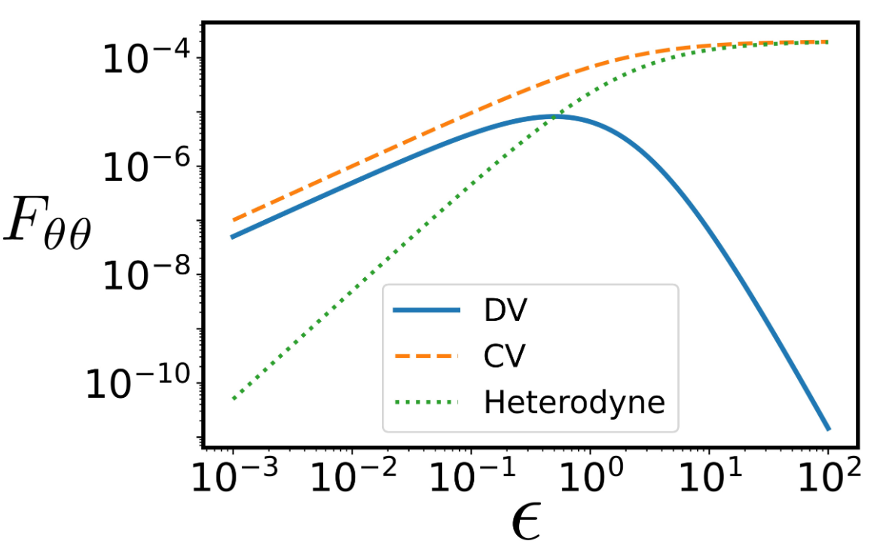


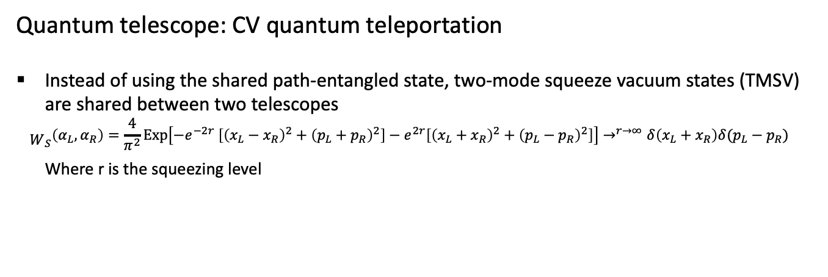



Quantum telescope with CV quantum teleportation
Quantum telescope: CV quantum teleportation
Instead of using the shared path-entangled state, two-mode squeeze vacuum states (TMSV) are shared between two telescopes
$${\begin{aligned} \\ W\end{aligned}}_{S}\left(α_{L},α_{R}\right)=\frac{4}{π^{2}}Exp\left[−e^{−2r} \left[{\left(x_{L}−x_{R}\right)}^{2}+{\left(p_{L}+p_{R}\right)}^{2}\right]−e^{2r}\left[{\left(x_{L}+x_{R}\right)}^{2}+{\left(p_{L}−p_{R}\right)}^{2}\right]\right]→^{r→∞}δ\left(x_{L}+x_{R}\right)δ(p_{L}−p_{R})$$
Where r is the squeezing level
Homodyne measurement
$$D_{L1}$$
$$x_{L1},p_{L2 }$$
$$D_{L2}$$
CV scheme is comparable to DV scheme in the weak limit
CV scheme is comparable to Heterodyne scheme in the weak limit
$${\hat{D}}_{x_{L1},p_{L2 }}$$
$$TMSV$$
Quantum telescope (CV)
Mix TMSV with source light at telescope L
Perform quadrature measurement (homodyne) at the two output ports $D_{L1}/D_{L2}$
Correct the teleported state by displacement operation with local communication.
Make direct interference measurement at telescope R
Fisher information
Fisher information given different source intensity

Slide 15
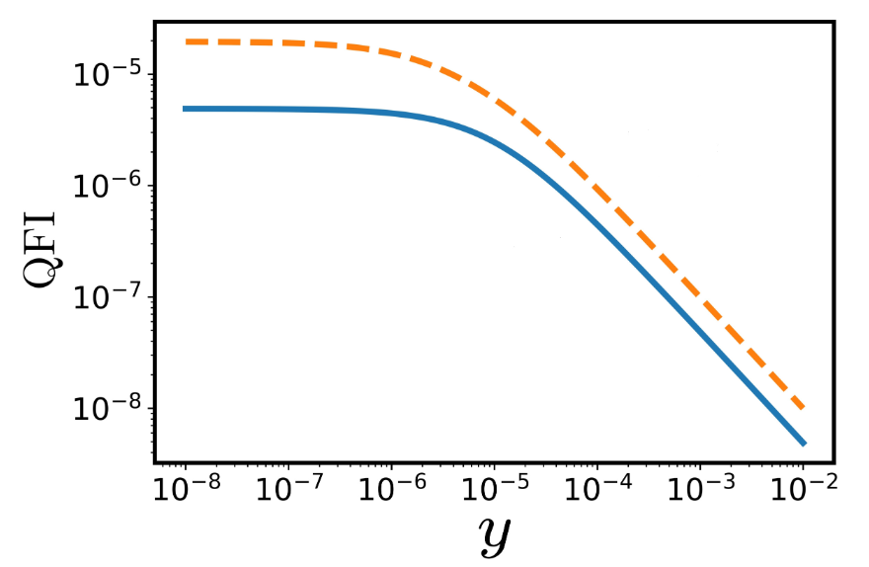
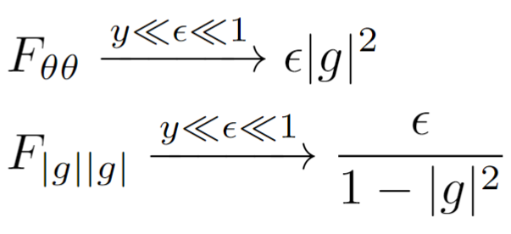
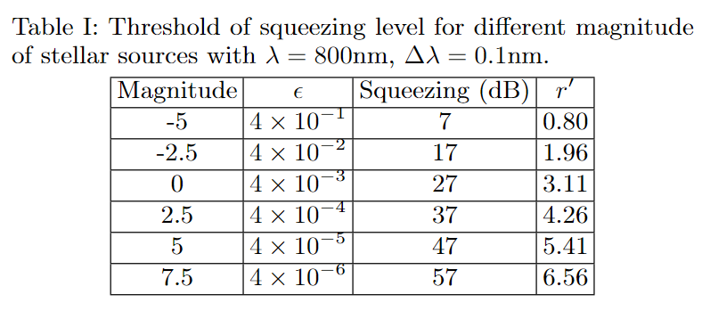






Quantum telescope with CV quantum teleportation
Quantum telescope: CV quantum teleportation
In the non-ideal case, the estimating of visibility $g$ and the corresponding optimal measurement can be computed via Guassian state quantum metrology
To achieve nearly optimal QFI, the squeezing parameter $y$ need to be made comparable to the source intensity.
Homodyne measurement
$$ε={10}^{−5}$$
$$D_{L1}$$
Fig: Quantum Fisher information given different squeezing parameter $y=2e^{−2r}$, which can be saturated direct interference
$$F_{θθ}$$
$$x_{L1},p_{L2 }$$
$$F_{gg}$$
$$D_{L2}$$
$${\hat{D}}_{x_{L1},p_{L2 }}$$
$$TMSV$$
Quantum telescope (CV)
Mix TMSV with source light at telescope L
Perform quadrature measurement (homodyne) at the two output ports $D_{L1}/D_{L2}$
Correct the teleported state by displacement operation with local communication.
Make direct interference measurement at telescope R
Note: For CV-quantum teleportation, loss is more will also degrade the quality of two-mode squeeze state, and thus we define:
$e^{−2r^{′}}=1−T^{2}+e^{−2r }T^{2}$
Where $r$ is the original squeezing level, and $T$ is the overall transmission coefficient. Which can be mitigated by using CV quantum repeaters
Notes:
Label axis with words.

Slide 16
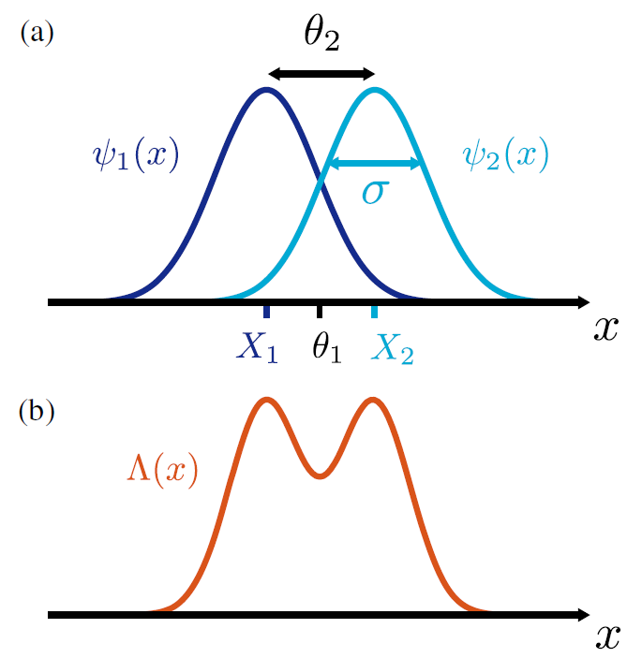



Quantum-enhanced imaging: Super-resolution
Quantum-enhanced imaging: Super-resolution
Rayleigh’s curse has played a central role in limiting the performance of astronomical imaging
Super-resolution with direct imaging¹ has been discussed in various different cases
Similar discussion can be applied to interferometric imaging² and has been discussed in the weak thermal limit.
Here we show a complementary super-resolution results in strong-thermal source using Gaussian state quantum metrology.
$$Δx$$
$$δ$$
Super-resolution of two-point strong thermal source
Measuring with one telescope (Direct imaging) with an arrays of telescopes ( interferometric imaging)
1. Mankei Tsang, Ranjith Nair, and Xiao-Ming Lu Phys. Rev. X 6, 031033
2. Cosmo Lupo, Zixin Huang, and Pieter Kok Phys. Rev. Lett. 124, 080503

Slide 17
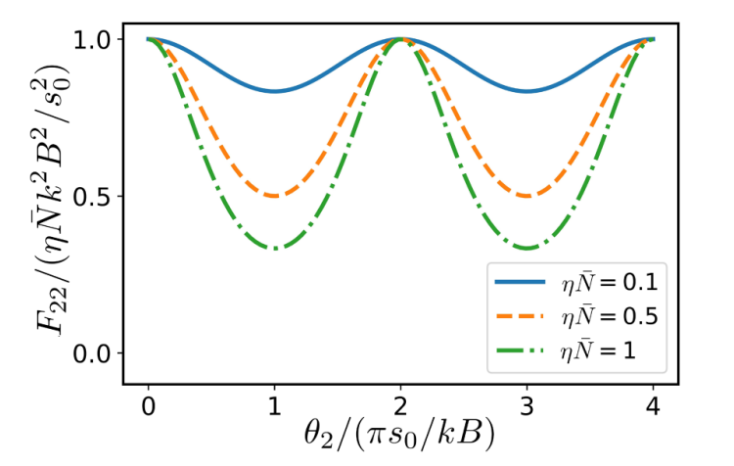
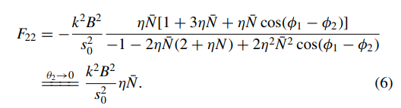


Quantum-enhanced imaging: Super-resolution
Quantum-enhanced imaging: Super-resolution of strong thermal source
The Balanced, two-point, incoherent, strong-thermal source is a two-mode gaussian state
The information carries about the separation can be computed by the quantum fisher information¹:
$$Δx$$
$$δ$$
$$F_{22}$$
Super-resolution of two-point strong thermal source
$$θ_{2}(πs_{o}/kB)$$
Quantum fisher information of estimating the separation of a balanced two-point source given different source intensity
1. Yunkai Wang, Yujie Zhang, and Virginia O. Lorenz Phys. Rev. A 104, 022613

Slide 18
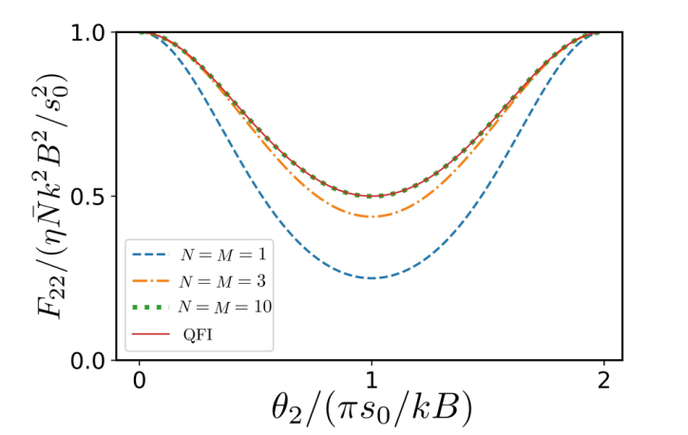
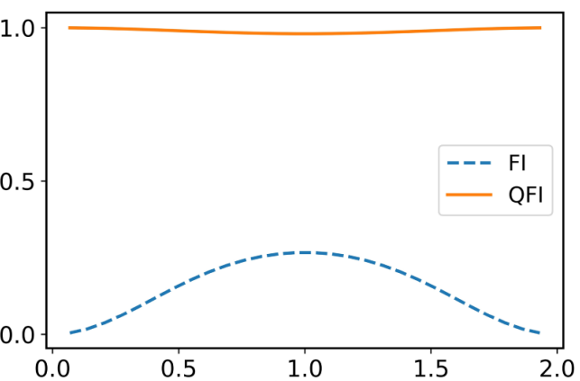







Quantum-enhanced imaging: Super-resolution
Quantum-enhanced imaging: Super-resolution of strong thermal source
To saturate the fisher information, the optimal measurement is an ultimate photon-number resolving detector with phase delay $δ$ carefully chosen based on the centroid information:
Comparison to the conventional scheme (where the phase delay $δ$ is set randomly)
$$Δx$$
$$ηN=1$$
Fisher information for photon number detection that only distinguishes the Fock state up to $|NM⟩$
$$F_{22}$$
$$δ$$
$$θ_{2}(πs_{o}/kB)$$
Super-resolution of two-point strong thermal source
$$ηN=0.1$$
$$F_{22}$$
Comparison between Quantum-enhanced interferometric imaging and conventional imaging.
1. Yunkai Wang, Yujie Zhang, and Virginia O. Lorenz Phys. Rev. A 104, 022613
$$θ_{2}(πs_{o}/kB)$$

Slide 19
Conclusion
Table-top demonstration of quantum-enhanced telescope
Comparison between classical Local oscillator and ‘quantum’ Local oscillator (More data will be collected lately)
Source simulation and closure phase reconstruction (David will present this part of experimental result)
Protocols for enhanced interferometric imaging
Quantum telescope using continuous-variable quantum teleportation (To be submitted)
Super-resolution of two incoherent strong thermal source (Phys. Rev. A 104, 022613)
Quantum telescope based on generalized intensity interferometer (To be resubmitted)
Enhanced interferometric imaging with bandwidth extrapolation (Accepted in PRA )
Notes:
Included all the other works we have done with references.

Slide 20
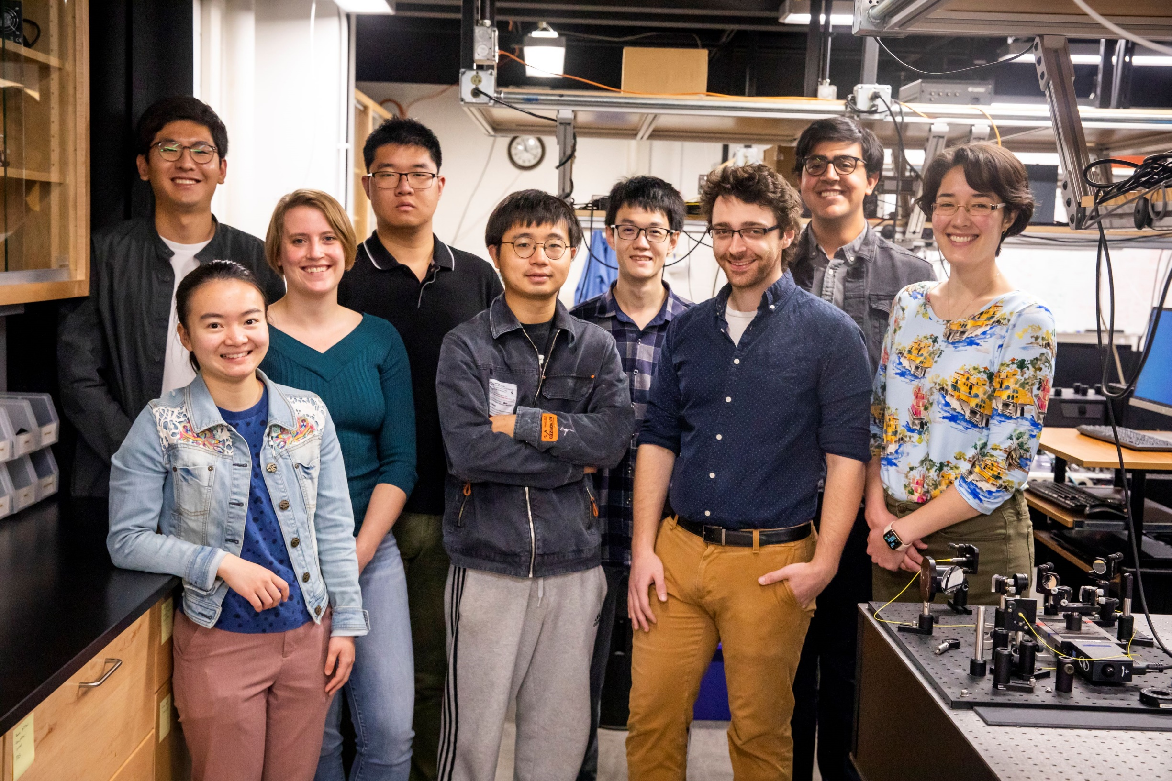

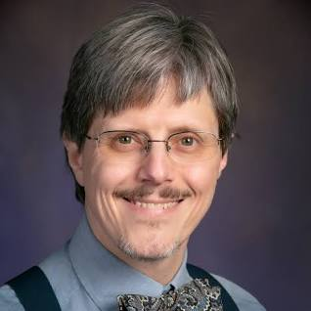
Thanks
Yujie Zhang
Yunkai wang
Prof. Virginia Lorenz
David Diaz
Prof. Paul Kwiat
Oregon: Matthew Brown, Prof. Brian Smith, Prof Michael Raymer; Michigan: Prof. John Monnier; UIUC: Prof. Eric Chitamber
Notes:
Add all collaborators.

Slide 21
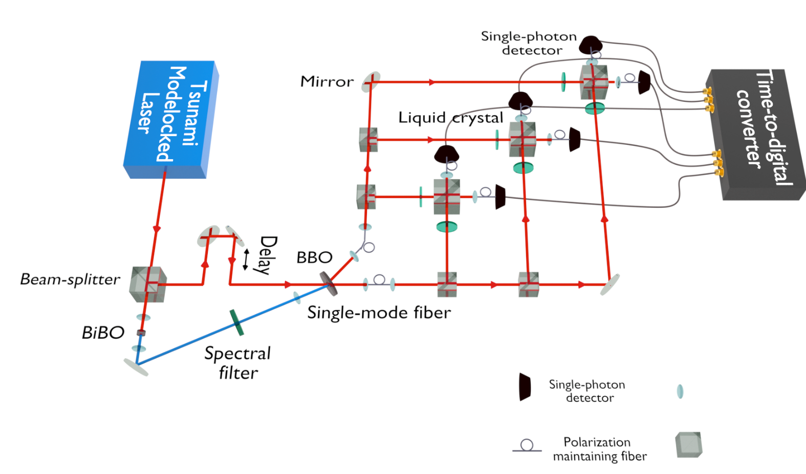




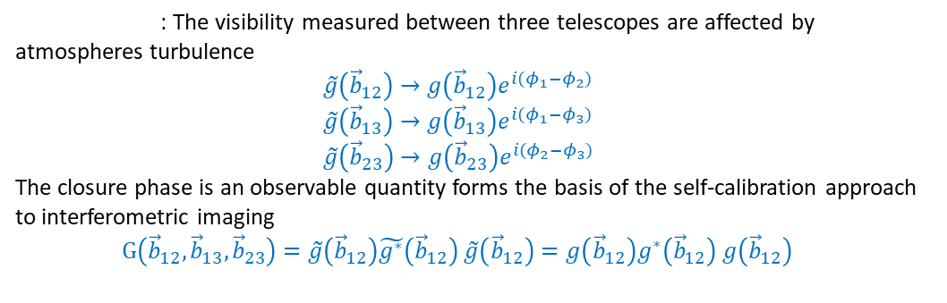
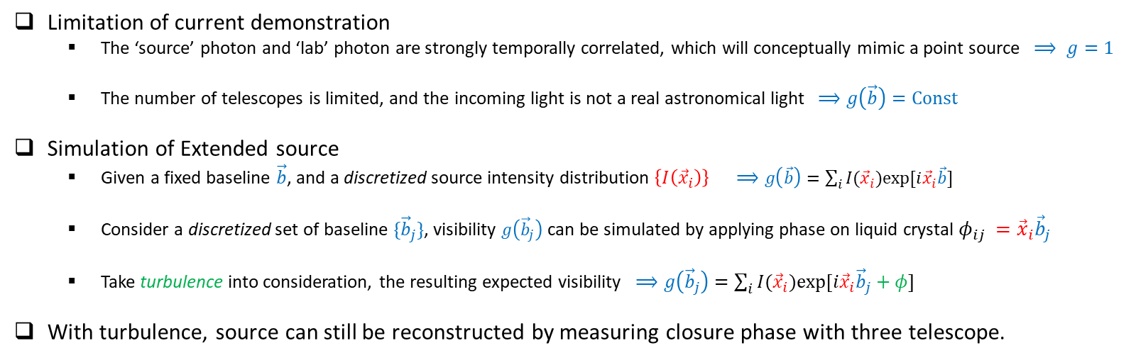
Source simulation and closure phase reconstruction
Limitation of current demonstration
The ‘source’ photon and ‘lab’ photon are strongly temporally correlated, which will conceptually mimic a point source $⟹ g=1$
The number of telescopes is limited, and the incoming light is not a real astronomical light $⟹g\left(\vec{b}\right)=Const$
Simulation of Extended source
Given a fixed baseline $\vec{b}$, and a discretized source intensity distribution $\left\{I\left({\vec{x}}_{i}\right)\right\} ⟹g\left(\vec{b}\right)=\sum_{i}{I({\vec{x}}_{i})exp⁡[i{\vec{x}}_{i}\vec{b}] }$
Consider a discretized set of baseline $\{{\vec{b}}_{j}\}$, visibility $g\left({\vec{b}}_{j}\right)$ can be simulated by applying phase on liquid crystal ${φ_{ij }=\vec{x}}_{i}{\vec{b}}_{j}$
Take turbulence into consideration, the resulting expected visibility $⟹g\left({\vec{b}}_{j}\right)=\sum_{i}{I({\vec{x}}_{i})exp⁡[i{\vec{x}}_{i}{\vec{b}}_{j}+φ] }$
With turbulence, source can still be reconstructed by measuring closure phase with three telescope.
$$φ_{1}$$
$$φ_{2}$$
$$φ_{3}$$
${\vec{b}}_{12}$
${\vec{b}}_{13}$
${\vec{b}}_{23}$
4. Interferometric imaging with three telescope and closure phase
Closure phase : The visibility measured between three telescopes are affected by atmospheres turbulence
$\tilde{g}\left({\vec{b}}_{12}\right)→g\left({\vec{b}}_{12}\right)e^{i{(φ}_{1}−φ_{2})}$
$\tilde{g}\left({\vec{b}}_{13}\right)→g\left({\vec{b}}_{13}\right)e^{i{(φ}_{1}−φ_{3})}$
$\tilde{g}\left({\vec{b}}_{23}\right)→g\left({\vec{b}}_{23}\right)e^{i{(φ}_{2}−φ_{3})}$
The closure phase is an observable quantity forms the basis of the self-calibration approach to interferometric imaging
$G\left({\vec{b}}_{12},{\vec{b}}_{13},{\vec{b}}_{23}\right)=\tilde{g}\left({\vec{b}}_{12}\right)\tilde{g^{∗}}\left({\vec{b}}_{12}\right)$ $\tilde{g}\left({\vec{b}}_{12}\right)=g\left({\vec{b}}_{12}\right)g^{∗}\left({\vec{b}}_{12}\right) g\left({\vec{b}}_{12}\right)$

Slide 22

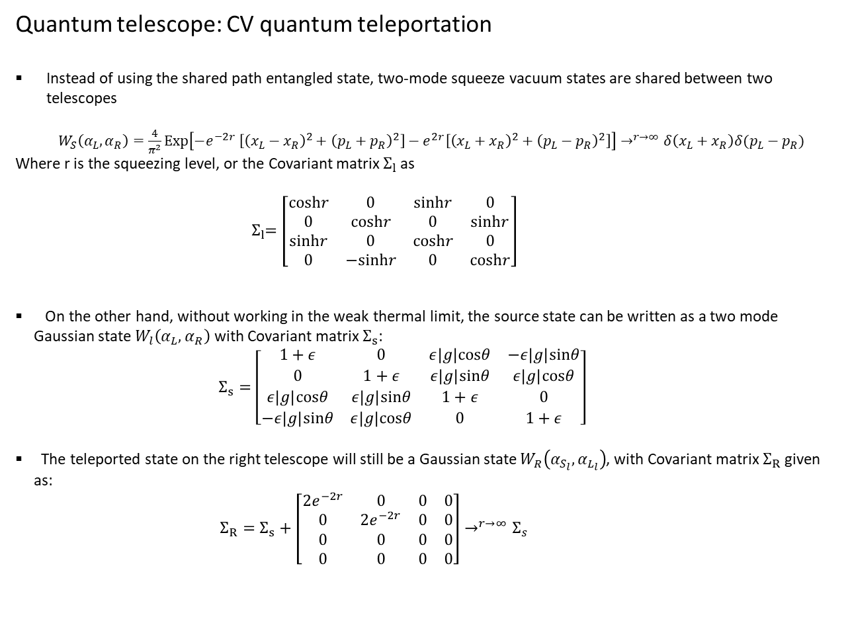

Quantum telescope with CV quantum teleportation
Quantum telescope: CV quantum teleportation
Instead of using the shared path entangled state, two-mode squeeze vacuum states are shared between two telescopes
${ W}_{S}\left(α_{L},α_{R}\right)=\frac{4}{π^{2}}Exp\left[−e^{−2r} \left[{\left(x_{L}−x_{R}\right)}^{2}+{\left(p_{L}+p_{R}\right)}^{2}\right]−e^{2r}\left[{\left(x_{L}+x_{R}\right)}^{2}+{\left(p_{L}−p_{R}\right)}^{2}\right]\right]→^{r→∞}δ\left(x_{L}+x_{R}\right)δ(p_{L}−p_{R})$ Where r is the squeezing level, or the Covariant matrix $Σ_{l}$as
${ Σ}_{l}=\left[\begin{matrix}coshr & 0 & sinhr & 0 \\ 0 & coshr & 0 & sinhr \\ sinhr & 0 & coshr & 0 \\ 0 & −sinhr & 0 & coshr\end{matrix}\right]$
On the other hand, without working in the weak thermal limit, the source state can be written as a two mode Gaussian state $W_{l}\left(α_{L},α_{R}\right)$ with Covariant matrix $Σ_{s}$:
$$Σ_{s}=\left[\begin{matrix}1+ε & 0 & ε\left|g\right|cosθ & −ε\left|g\right|sinθ \\ 0 & 1+ε & ε\left|g\right|sinθ & ε\left|g\right|cosθ \\ ε\left|g\right|cosθ & ε\left|g\right|sinθ & 1+ε & 0 \\ −ε\left|g\right|sinθ & ε\left|g\right|cosθ & 0 & 1+ε\end{matrix}\right]$$
The teleported state on the right telescope will still be a Gaussian state $W_{R}\left(α_{S_{l}},α_{L_{l}}\right)$, with Covariant matrix $Σ_{R}$ given as:
$Σ_{R}=Σ_{s}+$ $\left[\begin{matrix}2e^{−2r} & 0 & 0 & 0 \\ 0 & 2e^{−2r} & 0 & 0 \\ 0 & 0 & 0 & 0 \\ 0 & 0 & 0 & 0\end{matrix}\right]→^{r→∞}Σ_{s}$
Homodyne measurement
$$D_{L1}$$
$$x_{L1},p_{L2 }$$
$$D_{L2}$$
$${\hat{D}}_{x_{L1},p_{L2 }}$$
$$TMSV$$
Fig 5. Quantum telescope using continuous-variable quantum teleportation
CV quantum teleportation
Mixing TWSV with source light at telescope L
Performing quadrature measurement (homodyne) at the two output ports $D_{L1}/D_{L2}$
Correcting the teleported state by displacement operation with local communication.
Direct inference measurement at telescope R

