Slide 1
ReDance
Sensor-driven neurorehabilitation
Simon Appoltshauser, Emily Joyce, Eraraya Morenzo Muten, Maysa Ouaja, and Yujie Yang

Slide 2

Patient Case
Demographics
• 74 years old
• Mother of 2 Children
• Married
Background
• Dedicated Housewife
• Very involved family
Likes
Music, Rhythm, dancing
Cleanliness and Tidiness
Gymnastics
Hiking
Dislikes
Singing
Crumpled Shirts
Dirt / Stains
Exhausting exercise

Slide 3
Clinical movements anchor the routine
Item | Score | Training Movement
9. Pick up object from ground from a standing position | 3 | Trunk Flexion
10. Turning to look behind over left and right shoulders while standing | 2 | Trunk Rotation
12. Alternate placing of feet on stair, while standing unsupported | 2.5 | Hip Flexion

Slide 4
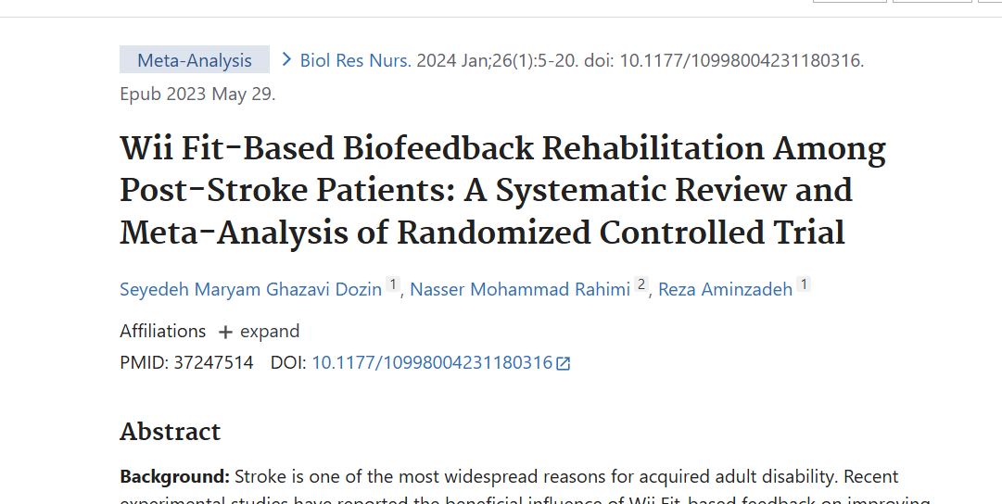
Why gamification?
Repetition becomes engaging and motivating

Slide 5
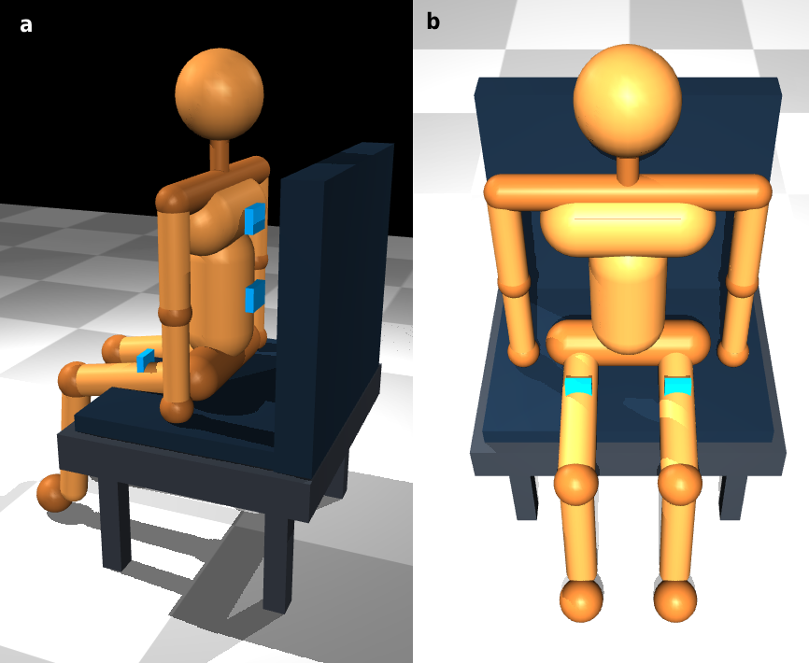
System
Overview

Slide 6
Safety
Harness

Slide 7
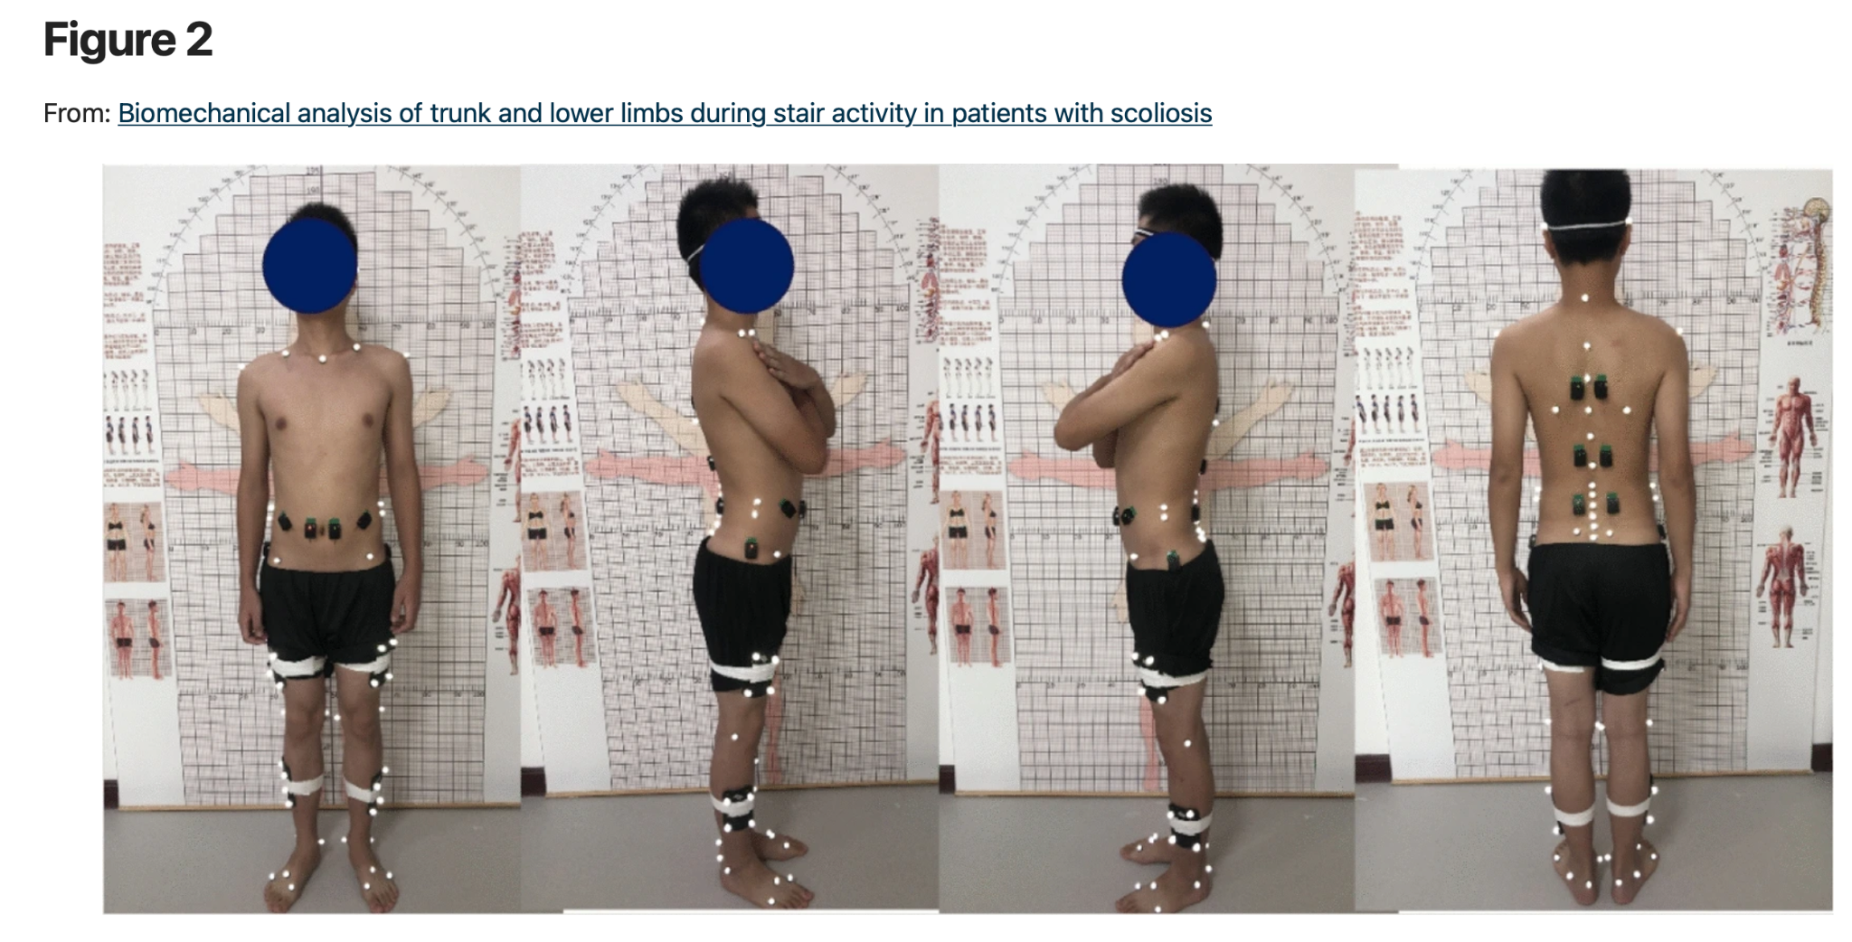
Five IMUs capture the movement chain

Slide 8
IMU data becomes movement feedback
1. Acquire & calibrate
Five IMUs stream motion
Neutral posture sets zero
Signals are synchronized
2. Derive movement
Compare sensor angles
Trunk flexion and rotation
Left and right hip flexion
3. Classify & log
Drive live feedback
Save sessions for replay
Notes:
1. Pelvic and Hip Shifting (The Most Common Cheat)
Mechanism: The subject slides one knee forward or lifts one hip off the seat, rotating the pelvis in the transverse plane.
2. Shoulder Protraction and Retraction ("Girdle Cheating")
Mechanism: If the bar across the shoulders is not locked down, or if arms are extended, the subject will reach forward with the contralateral shoulder (protraction) and pull back with the ipsilateral shoulder (retraction).
Detection: The thoracic spine remains static, while the shoulder girdle moves independently. This is caught by tracking the T1 sensor relative to the acromion markers.
3. Lateral Spine Flexion (Coronal Plane Coupling)
Mechanism: Instead of rotating purely along the vertical axis, the subject combines a partial rotation with a lateral tilt (side-bend) to the opposite side. This exploits the 3D coupling characteristics of the lumbar spine to squeeze out a few extra degrees.
Detection: The tracking system will show a sudden deviation in the coronal plane ($Y$-axis angular velocity or roll).

Slide 9
One interface, two rehabilitation modes
1. Shared interface
One movement model
One avatar and routine
One session record
2. Live patient mode
Sensors control the game
Simple cues and rewards
Immediate correction
3. Recorded physio mode
Replay saved sessions
Inspect angles and compensation
Notes:
1. Pelvic and Hip Shifting (The Most Common Cheat)
Mechanism: The subject slides one knee forward or lifts one hip off the seat, rotating the pelvis in the transverse plane.
2. Shoulder Protraction and Retraction ("Girdle Cheating")
Mechanism: If the bar across the shoulders is not locked down, or if arms are extended, the subject will reach forward with the contralateral shoulder (protraction) and pull back with the ipsilateral shoulder (retraction).
Detection: The thoracic spine remains static, while the shoulder girdle moves independently. This is caught by tracking the T1 sensor relative to the acromion markers.
3. Lateral Spine Flexion (Coronal Plane Coupling)
Mechanism: Instead of rotating purely along the vertical axis, the subject combines a partial rotation with a lateral tilt (side-bend) to the opposite side. This exploits the 3D coupling characteristics of the lumbar spine to squeeze out a few extra degrees.
Detection: The tracking system will show a sudden deviation in the coronal plane ($Y$-axis angular velocity or roll).

Slide 10
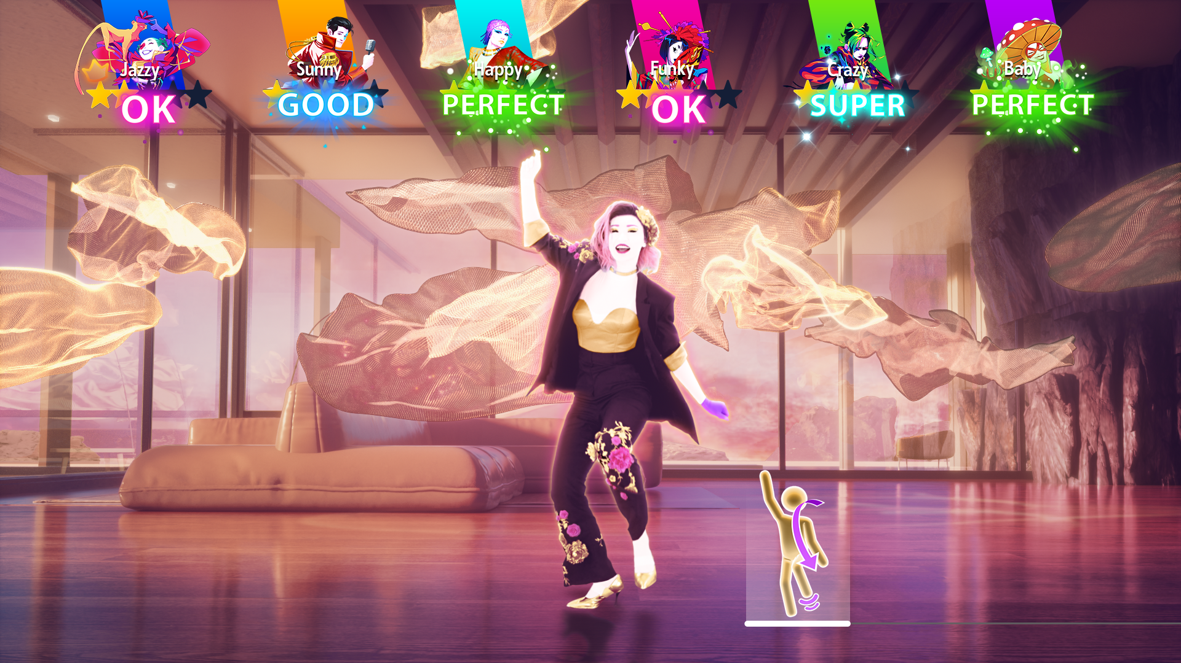
Patient mode: live, simple, motivating
Live patient mode
IMUs control the routine in real time.
Patient-facing feedback
Current exercise, instruction video, score and progress.
Movement bars show when thresholds are reached.
Rewards reinforce correct repetitions.

Slide 11
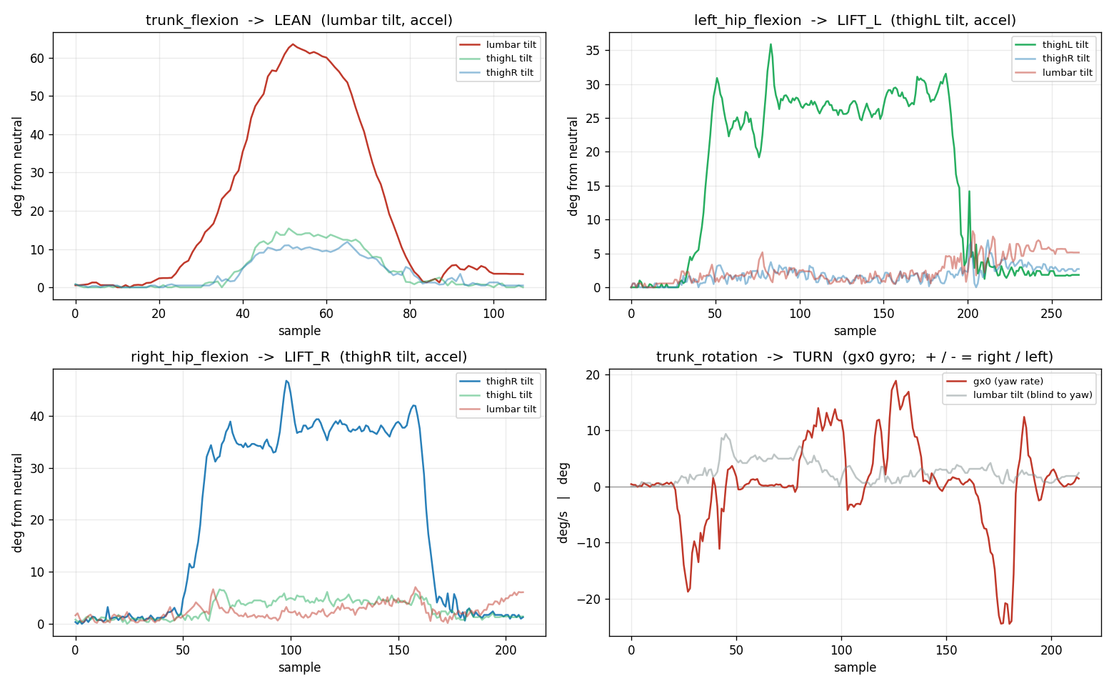
Physio mode: recorded replay • detailed IMU angle traces

Slide 12
Usability Assessment (SUS)
Solid Foundational Prototype
The score sits just below the industry average of 68.0, placing the system in the "Marginal" to "Average" category.
Represents a stable starting point.
Identifies clear, actionable improvement areas.
Requires refinement to exceed standard usability benchmarks.
67.5
Overall SUS Score

Slide 13
Workload & Friction Analysis
The "Frustration Gap"
While the zero temporal demand indicates a comfortable pace, the maximum levels of effort and frustration suggest significant mechanical friction.

Slide 14
Next improvements
Simplify the interaction flow, reduce mechanical friction, and surface clear clinician metrics. These changes turn the prototype into a more reliable rehabilitation tool.

Slide 15


The team behind ReDance
Simon Appoltshauser Emily Joyce Eraraya Morenzo Muten Maysa Ouaja Yujie Yang
Hardware • sensing • movement logic • patient and physio interfaces

Slide 16
Live demo
Simon Appoltshauser Emily Joyce Eraraya Morenzo Muten Maysa Ouaja Yujie Yang
From calibration to movement feedback and session replay

Slide 17
Questions?
Simon Appoltshauser Emily Joyce Eraraya Morenzo Muten Maysa Ouaja Yujie Yang
Additional movement metrics and plots follow in the appendix

Slide 18
Appendix
Measurement details

Slide 19
Trunk Flexion
1. Difficulty Levels
Sitting on chair
Sitting on high chair
Standing without support
2. Range of Movements
Reach knees
Reach ankles
Reach floor
3. Movement variations
Unilateral
Bilateral
Notes:
1. Pelvic and Hip Shifting (The Most Common Cheat)
Mechanism: The subject slides one knee forward or lifts one hip off the seat, rotating the pelvis in the transverse plane.
2. Shoulder Protraction and Retraction ("Girdle Cheating")
Mechanism: If the bar across the shoulders is not locked down, or if arms are extended, the subject will reach forward with the contralateral shoulder (protraction) and pull back with the ipsilateral shoulder (retraction).
Detection: The thoracic spine remains static, while the shoulder girdle moves independently. This is caught by tracking the T1 sensor relative to the acromion markers.
3. Lateral Spine Flexion (Coronal Plane Coupling)
Mechanism: Instead of rotating purely along the vertical axis, the subject combines a partial rotation with a lateral tilt (side-bend) to the opposite side. This exploits the 3D coupling characteristics of the lumbar spine to squeeze out a few extra degrees.
Detection: The tracking system will show a sudden deviation in the coronal plane ($Y$-axis angular velocity or roll).

Slide 20
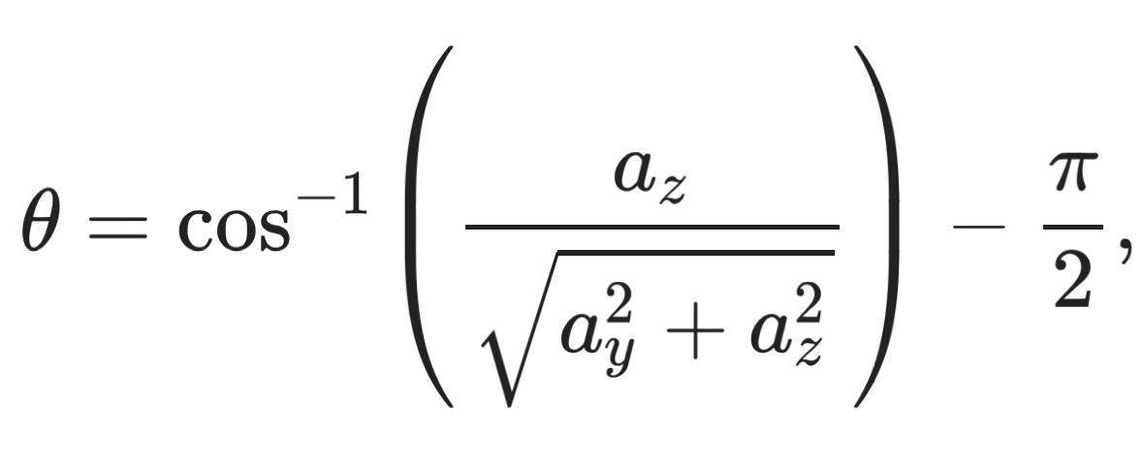
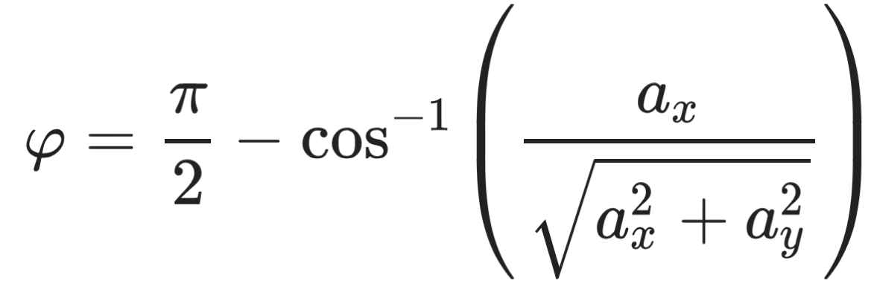
Trunk Flexion:
How to Measure
1. Sensors processing
Individual sensor angles
Sensors angle differences
2. Individual sensor angles
Tilt Lateral
3. Dynamic angle
Track angle change through time
Detect cheating and compensation
Give real-time corrective feedback
Notes:
1. Pelvic and Hip Shifting (The Most Common Cheat)
Mechanism: The subject slides one knee forward or lifts one hip off the seat, rotating the pelvis in the transverse plane.
2. Shoulder Protraction and Retraction ("Girdle Cheating")
Mechanism: If the bar across the shoulders is not locked down, or if arms are extended, the subject will reach forward with the contralateral shoulder (protraction) and pull back with the ipsilateral shoulder (retraction).
Detection: The thoracic spine remains static, while the shoulder girdle moves independently. This is caught by tracking the T1 sensor relative to the acromion markers.
3. Lateral Spine Flexion (Coronal Plane Coupling)
Mechanism: Instead of rotating purely along the vertical axis, the subject combines a partial rotation with a lateral tilt (side-bend) to the opposite side. This exploits the 3D coupling characteristics of the lumbar spine to squeeze out a few extra degrees.
Detection: The tracking system will show a sudden deviation in the coronal plane ($Y$-axis angular velocity or roll).

Slide 21
Trunk Flexion:
Possible Compensation and Cheating
1. Lateral leaning
Lateral trunk flexion/rotation
Compare sensors lateral angle
Train weaker side with unilateral movement
2. Wall leaning
Not standing unsupported
Pelvis IMU not static
Safety sofa
3. Sensor manipulation
More than one sensors
Unreachable sensor placement
Dynamic angle tracking
Notes:
1. Pelvic and Hip Shifting (The Most Common Cheat)
Mechanism: The subject slides one knee forward or lifts one hip off the seat, rotating the pelvis in the transverse plane.
2. Shoulder Protraction and Retraction ("Girdle Cheating")
Mechanism: If the bar across the shoulders is not locked down, or if arms are extended, the subject will reach forward with the contralateral shoulder (protraction) and pull back with the ipsilateral shoulder (retraction).
Detection: The thoracic spine remains static, while the shoulder girdle moves independently. This is caught by tracking the T1 sensor relative to the acromion markers.
3. Lateral Spine Flexion (Coronal Plane Coupling)
Mechanism: Instead of rotating purely along the vertical axis, the subject combines a partial rotation with a lateral tilt (side-bend) to the opposite side. This exploits the 3D coupling characteristics of the lumbar spine to squeeze out a few extra degrees.
Detection: The tracking system will show a sudden deviation in the coronal plane ($Y$-axis angular velocity or roll).

Slide 22
Trunk Rotation
Primary Drivers
Trunk rotation is a composite movement primarily driven by:
Thoracic spine
Lumbar spine
Seated Active Range of Motion (ROM)
40° to 45°
Per direction (relative to neutral sagittal plane)
Total Transverse Arc:
80° to 90° of total rotational capacity.
Asymmetry Threshold:
A difference > 10% to 15% between left and right rotation.
Clinical Significance
Indicates clinically significant mobility deficits or unilateral core muscle weakness when threshold is exceeded.
Notes:
Trunk rotation is a composite movement primarily driven by the thoracic spine (accounting for approximately 65-70% of the movement) and the lumbar spine (which only allows minimal rotation due to the sagittal orientation of its facet joints).

Slide 23
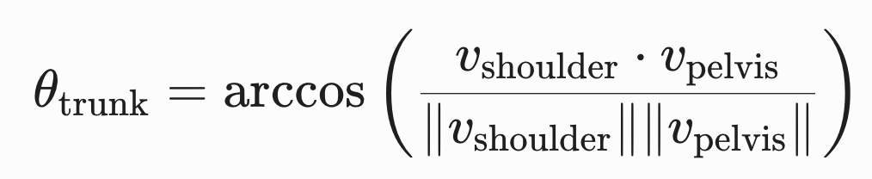
How to Measure Trunk Rotation
Test Configuration
Positioning: The participant sits upright on a backless chair or bench, feet flat on the floor, with knees and hips flexed at 90°.
Math: If using IMUs, the rotation angle θ_trunk is computed by establishing a vector connecting the two acromion processes (v_shoulder) relative to a fixed pelvic vector (v_pelvis) across the anterior superior iliac spines (ASIS). The angle in the transverse plane is given by:
Setup
IMUs:
Two IMUs at the clavicle (left and right)
One IMU at the pelvis

Slide 24
Trunk Rotation:
Possible Compensation and Cheating Mechanisms
1. Pelvic and Hip Shifting
Mechanism: Subject slides knee forward or lifts hip, rotating pelvis in transverse plane.
Detection: Detection over Thigh IMUs
2. Shoulder Cheating
Mechanism: Independent shoulder movement (protraction/retraction) when arms/shoulders aren't locked.
Detection: Thoracic spine is static; track T1 sensor relative to acromion markers.
3. Lateral Spine Flexion
Mechanism: Combines rotation with lateral tilt (side-bend) via lumbar coupling.
Detection: Look for sudden deviation in coronal plane (Y-axis roll/velocity).
Notes:
1. Pelvic and Hip Shifting (The Most Common Cheat)
Mechanism: The subject slides one knee forward or lifts one hip off the seat, rotating the pelvis in the transverse plane.
2. Shoulder Protraction and Retraction ("Girdle Cheating")
Mechanism: If the bar across the shoulders is not locked down, or if arms are extended, the subject will reach forward with the contralateral shoulder (protraction) and pull back with the ipsilateral shoulder (retraction).
Detection: The thoracic spine remains static, while the shoulder girdle moves independently. This is caught by tracking the T1 sensor relative to the acromion markers.
3. Lateral Spine Flexion (Coronal Plane Coupling)
Mechanism: Instead of rotating purely along the vertical axis, the subject combines a partial rotation with a lateral tilt (side-bend) to the opposite side. This exploits the 3D coupling characteristics of the lumbar spine to squeeze out a few extra degrees.
Detection: The tracking system will show a sudden deviation in the coronal plane ($Y$-axis angular velocity or roll).

Slide 25
Hip Flexion
Possible Compensation and Cheating Mechanisms
Beginner Cheating Proof
Ask patient to lift knees as high as possible to measure hip flexion and torso engagement.
Difficulty Levels (Example: 45° Max Engagement)
Easy (30 - 43°): Practice the movement rather than achieving max engagement.
Medium (44 - 59°): Working on gaining more hip mobility and engagement.
Hard (60 - 65°): Solely focused on engaging torso and hips after proper practice.
Compensation & Feedback
Measure thorax/pelvic concavity. Reduce via negative feedback if limits are exceeded.

Slide 26
[1]
Y. Castillo-Escario, H. Kumru, J. Valls-Solé, L. García-Alen, J. Vidal, and R. Jané, ‘Assessment of trunk flexion in arm reaching tasks with electromyography and smartphone accelerometry in healthy human subjects’, Sci Rep, vol. 11, no. 1, p. 5363, Mar. 2021, doi: 10.1038/s41598-021-84789-3.
[2]
S. Liu et al., ‘Effectiveness, Feasibility, Acceptability, and Safety of Digital Interventions in Post-Stroke Rehabilitation: A Systematic Review and Meta-analysis of Randomized Controlled Trials’, Archives of Physical Medicine and Rehabilitation, vol. 106, no. 12, pp. 1912–1932, Dec. 2025, doi: 10.1016/j.apmr.2025.07.004.
[3]
GBD 2016 Neurology Collaborators, ‘Global, regional, and national burden of neurological disorders, 1990-2016: a systematic analysis for the Global Burden of Disease Study 2016’, Lancet Neurol, vol. 18, no. 5, pp. 459–480, May 2019, doi: 10.1016/S1474-4422(18)30499-X.
[4]
J. F. Shaw, S. Pilon, M. Vierula, and D. I. McIsaac, ‘Predictors of adherence to prescribed exercise programs for older adults with medical or surgical indications for exercise: a systematic review’, Syst Rev, vol. 11, no. 1, p. 80, Apr. 2022, doi: 10.1186/s13643-022-01966-9.
[5]
J. A. Kleim and T. A. Jones, ‘Principles of experience-dependent neural plasticity: implications for rehabilitation after brain damage’, J Speech Lang Hear Res, vol. 51, no. 1, pp. S225-239, Feb. 2008, doi: 10.1044/1092-4388(2008/018).
[6]
J. Iruthayarajah, A. McIntyre, A. Cotoi, S. Macaluso, and R. Teasell, ‘The use of virtual reality for balance among individuals with chronic stroke: a systematic review and meta-analysis’, Topics in Stroke Rehabilitation, vol. 24, no. 1, pp. 68–79, Jan. 2017, doi: 10.1080/10749357.2016.1192361.
References
Notes:
https://pmc.ncbi.nlm.nih.gov/articles/PMC4567248/#S3

