Slide 1
Software
From IMU streams to live feedback and recorded review
Notes:
Software connects the sensing hardware to two users: the patient during training and the physiotherapist after the session.

Slide 2
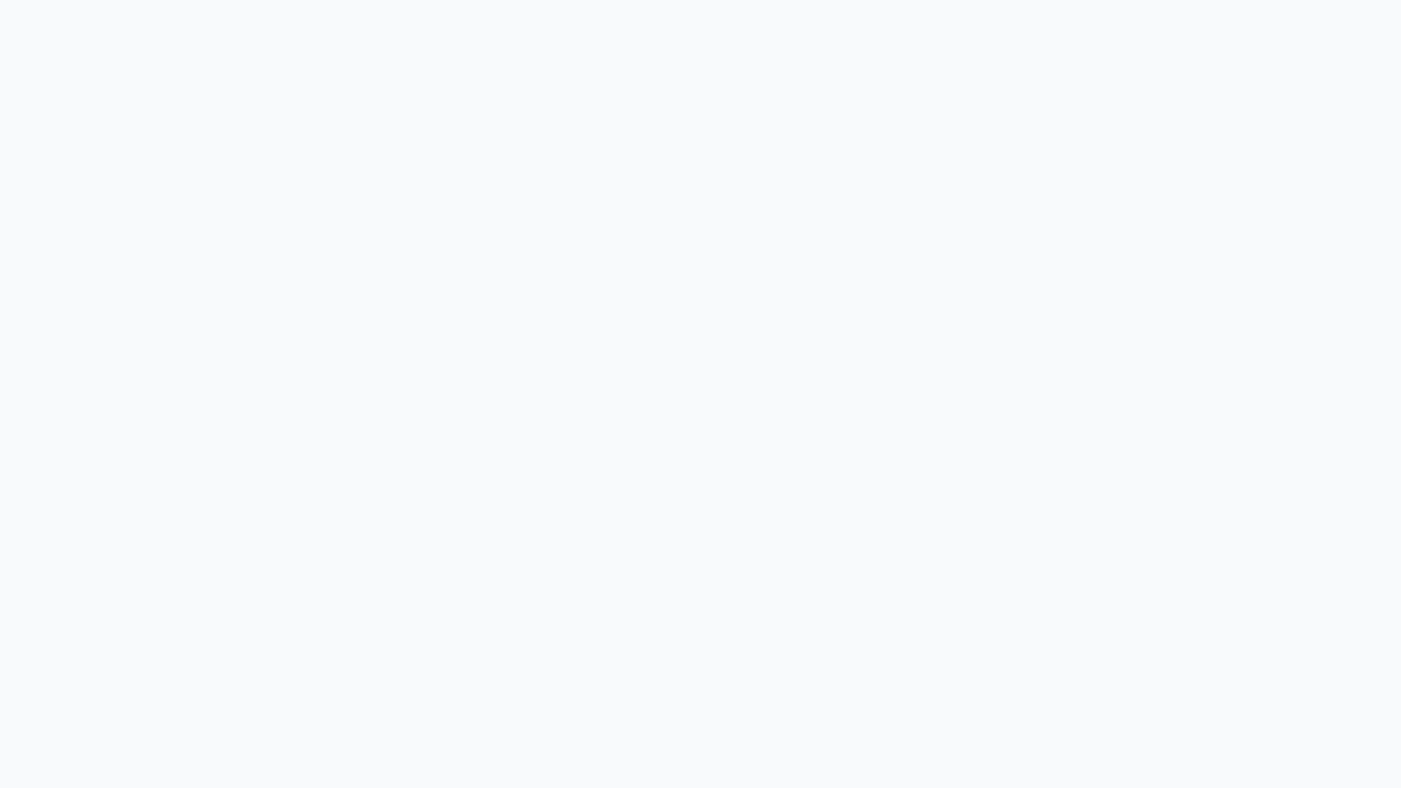
Software:
One pipeline, two interfaces
1. Acquire & calibrate
4 IMUs used by software
Median neutral baseline
2. Map & classify
Lean · Lift L/R · Turn
Dominant action + debounce
3. Use & record
Live patient feedback
samples.csv + events.csv
Recorded physio replay
Notes:
The same processing core supports both modes. Four required IMUs are validated and calibrated. The baseline is the component-wise median vector, not the mean. The mapped movements then drive live feedback and are saved for replay.

Slide 3
Data processing:
robust before feedback
1. Validate & calibrate
Reject incomplete samples
Component-wise median baseline
2. Derive motion
EMA smoothing + hysteresis
Normalized lean · lift · turn
3. Classify & log
One dominant action
Debounce stabilizes output
Raw + derived session data
Notes:
Incomplete samples are rejected first. Calibration uses _median_vector to reduce the influence of brief motion or spikes. EMA smoothing and hysteresis stabilize lean, leg lift and turn features. The classifier selects one dominant action and applies debounce before logging raw and derived data.

Slide 4
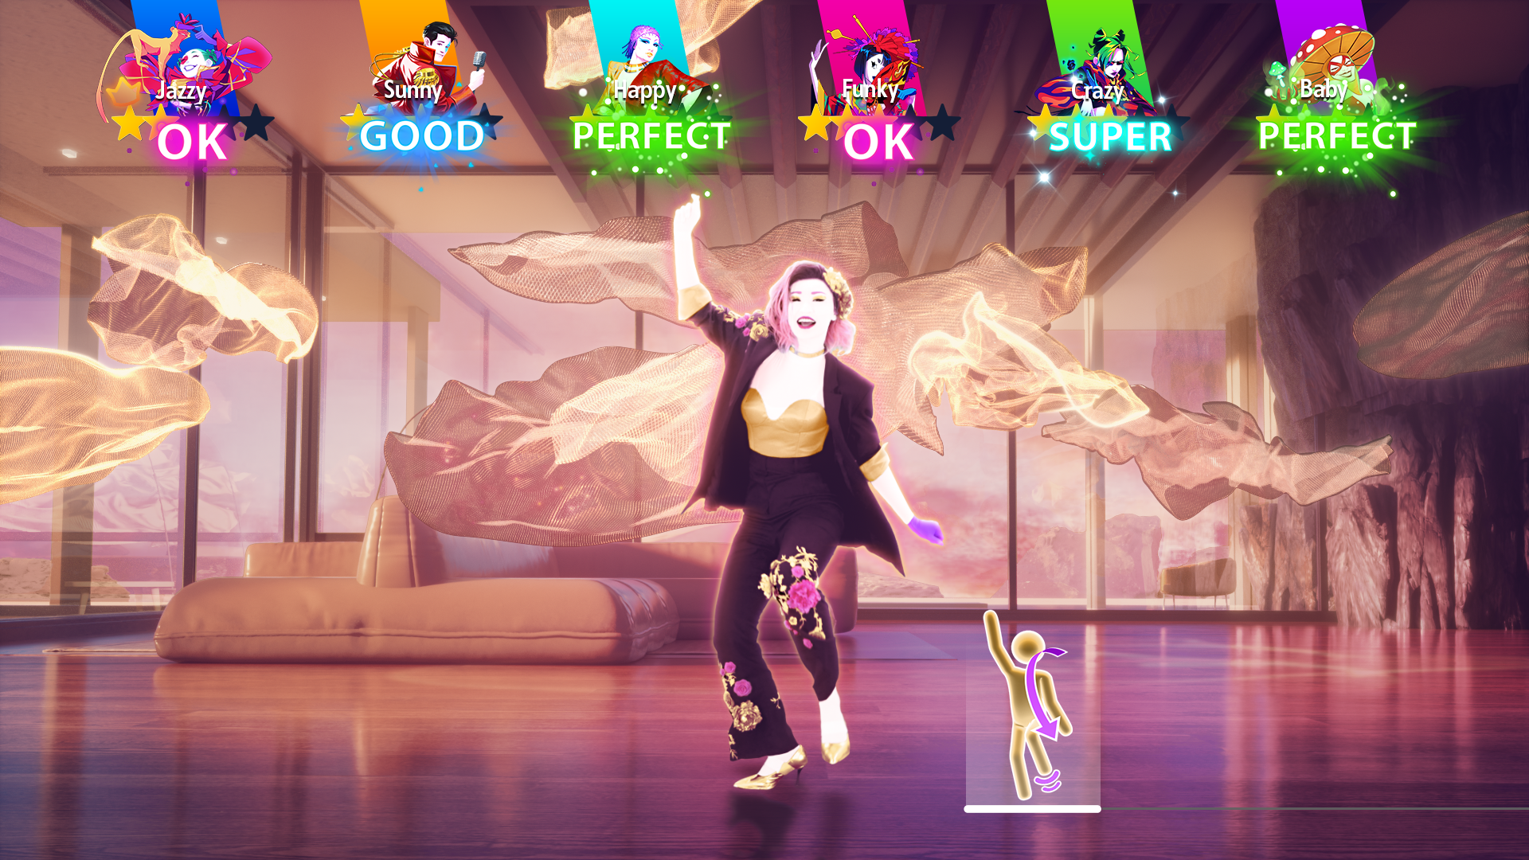
Live patient UI
Real-time sensor control
Recognized actions advance the routine immediately.
Patient-facing feedback
Instruction video and current exercise.
Movement thresholds, score and progress.
Rewards reinforce correct repetitions.
Notes:
In live mode, the patient controls the routine with the sensors. The interface keeps feedback simple: current exercise, instruction video, thresholds, score, progress and reward feedback. Recalibration is available when the neutral posture changes.

Slide 5
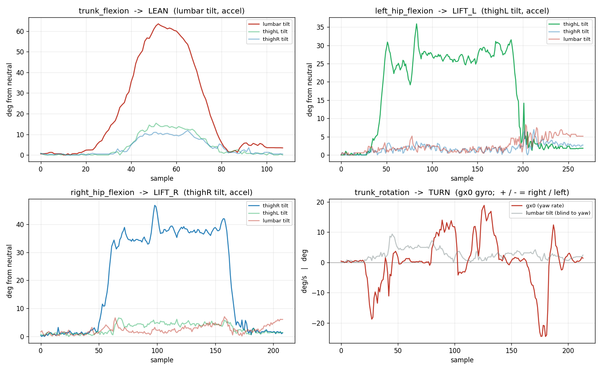
Recorded
physio replay
Notes:
The recorded session can be replayed for the physiotherapist. The current implementation already provides samples.csv, events.csv and detailed IMU-derived plots. This supports a richer offline interface, but the complete clinical replay UI is future integration work.

