Slide 1
DS 104 Final Project Proposal Presentation 20.02.2021
Yuh Jiin
20/2/2021
Notes:
ID=d924773e-9a16-4d6d-9803-8cb819e99682 Recipe=text_billboard Type=TextOnly Variant=0 FamilyID=AccentBoxWalbaum_Zero

Slide 2

So you think you want to be famous and have million views?
Data Analysis of No 1 YouTuber in Singapore
20/2/2021

Slide 3
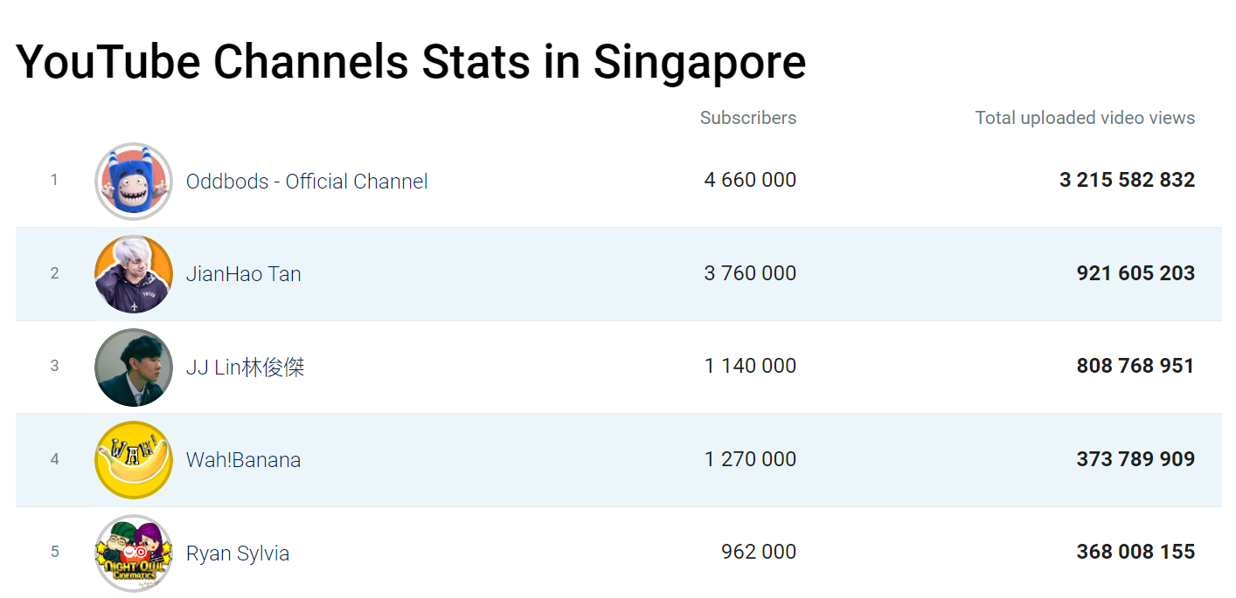
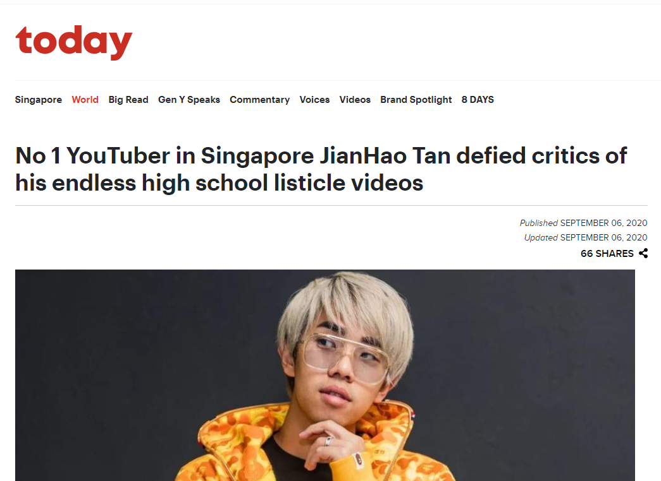
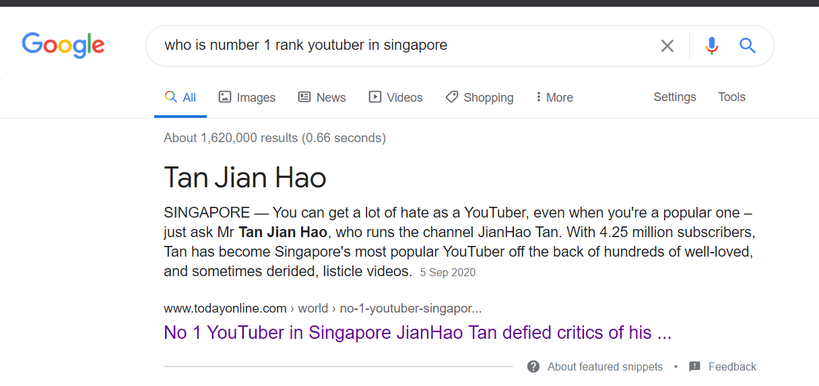
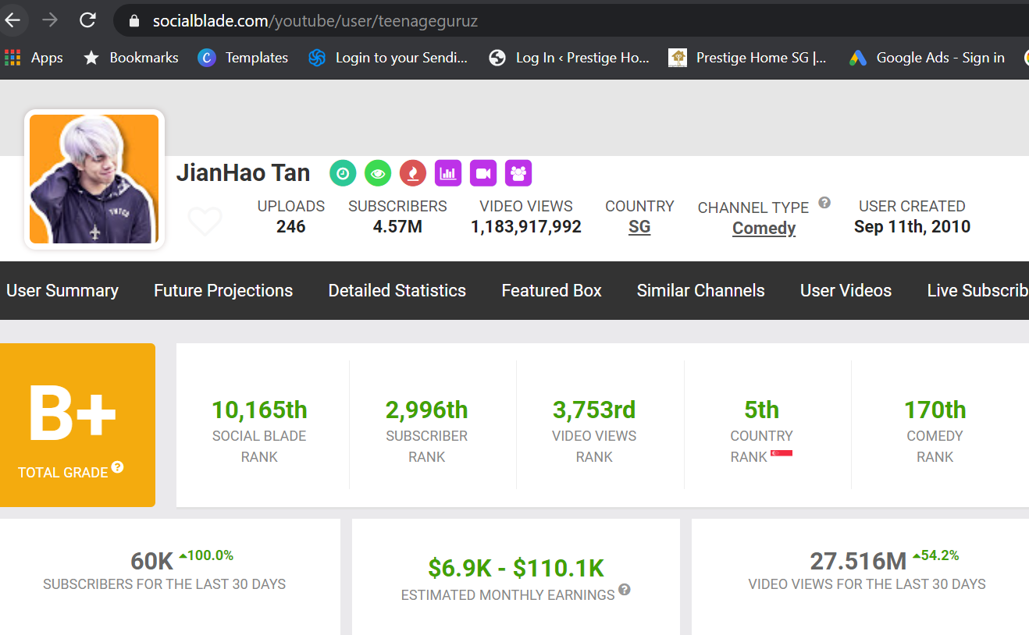
Inspiration
Sentiment analysis and Data Visualization will be use in this project.
Analysing what factors affect the increase numbers of subscriber and viewers.
Which topic/category had the most views, likes, comments and dislikes.
Whether there’s a relationship between the views, comments and likes ?
Most common keywords used in video and channel titles.
To find out whether to become a popular youtuber video is dependent on its content or the cultural background of viewers or other factor, to promote personal/product branding.
20/2/2021

Slide 4
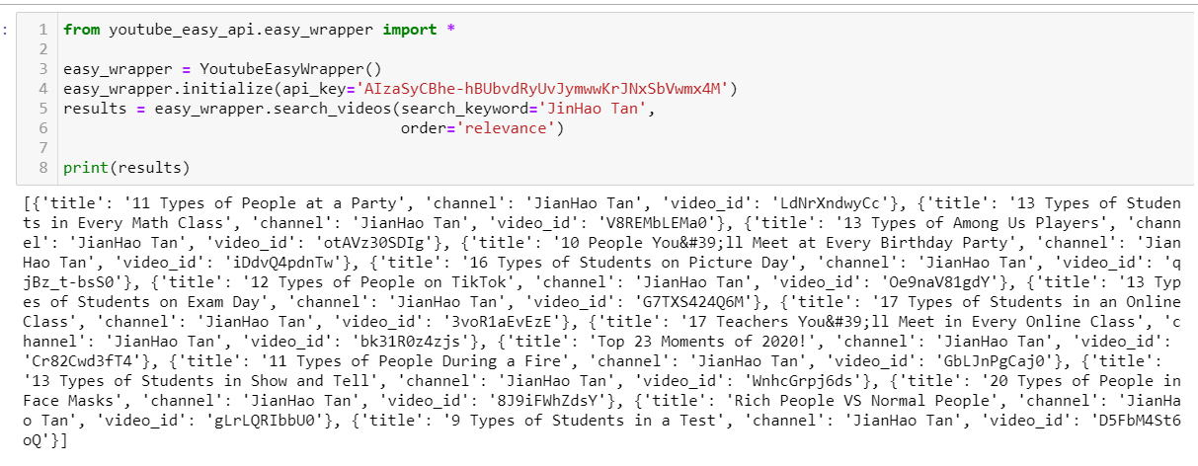
Dataset Used
Extract & Analyze YouTube Data
using YouTube API
Data was converted from JSON to Dataframe and from JSON to CSV
20/2/2021

Slide 5
Dataset
contain 50++ rows and 11 columns, total 246 videos
Important information in rows which help the analysis:
1) Time of video published
2) Duration of the video
3) Viewed Count
4) Liked Count
5) Disliked Count
6) Comments count
7) Title of the video
20/2/2021

Slide 6
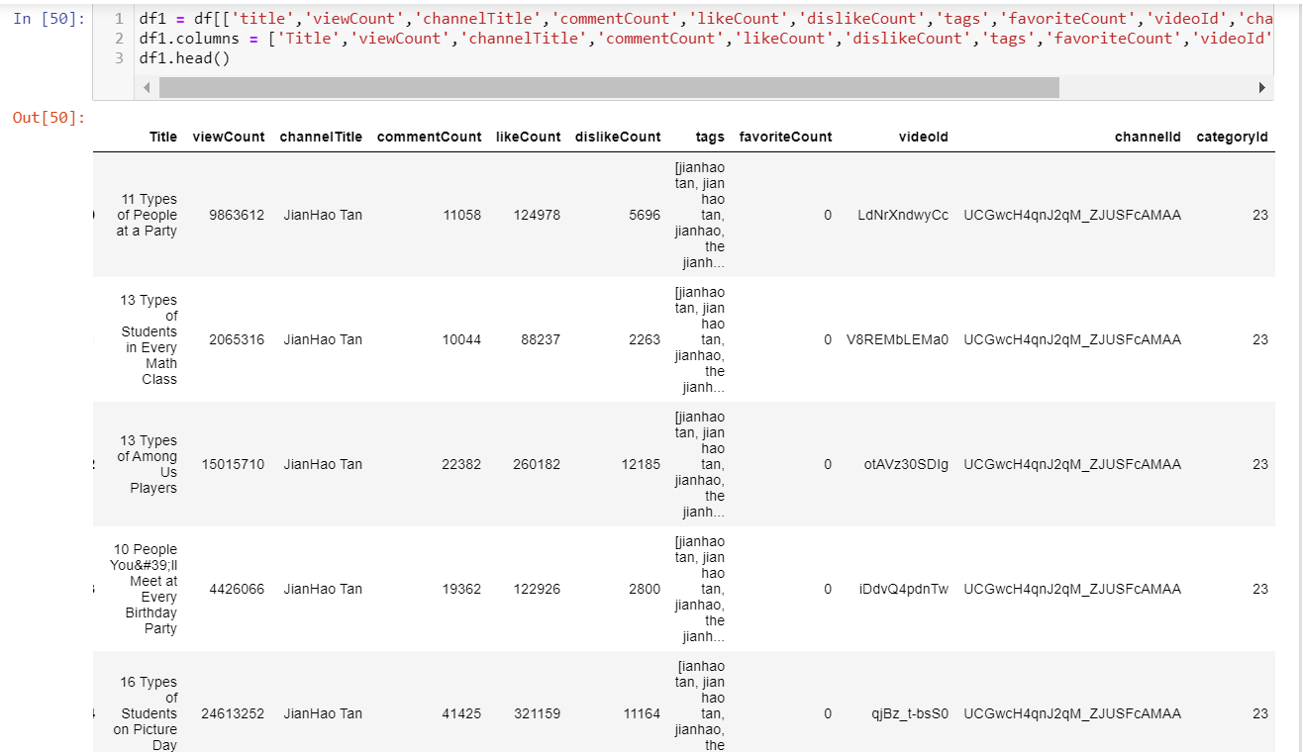
20/2/2021

Slide 7
Goal
The main goal of the analysis is to find out some interesting facts and patterns on how a “normal” person like us can become a popular youtuber by exploring the data and by using effective visualizations and NLP.
What's his strategy and target audience and keywords used in video and channel titles
Which video had the most trending videos, likes, comments and dislikes
Which video had the most views , likes ,comments and dislikes?
By anaylize the comments, we are able to categorize the charateristic of the audience and whether there’s a relationship between the views , comments and likes ?
20/2/2021

Slide 8
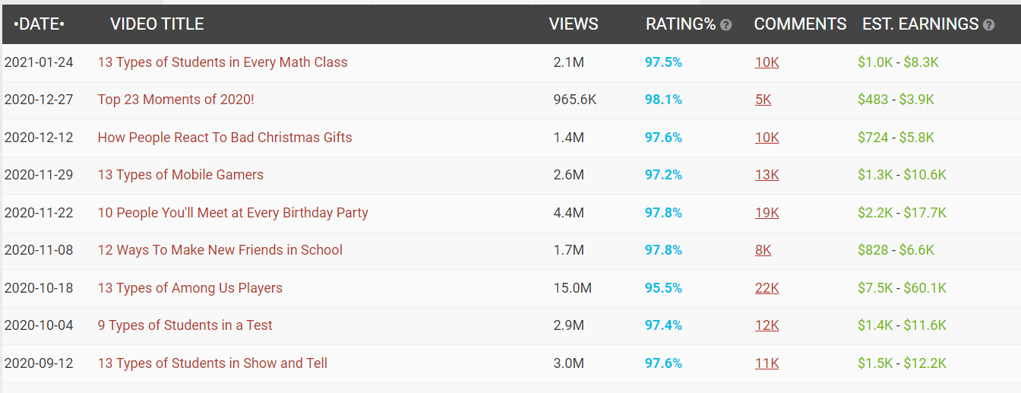
Goal
Note that most of his videos title start with numbers or ranking. We are to find out this a title attracted the most views?
Data source from https://socialblade.com/youtube/user/teenageguruz/videos
20/2/2021

Slide 9
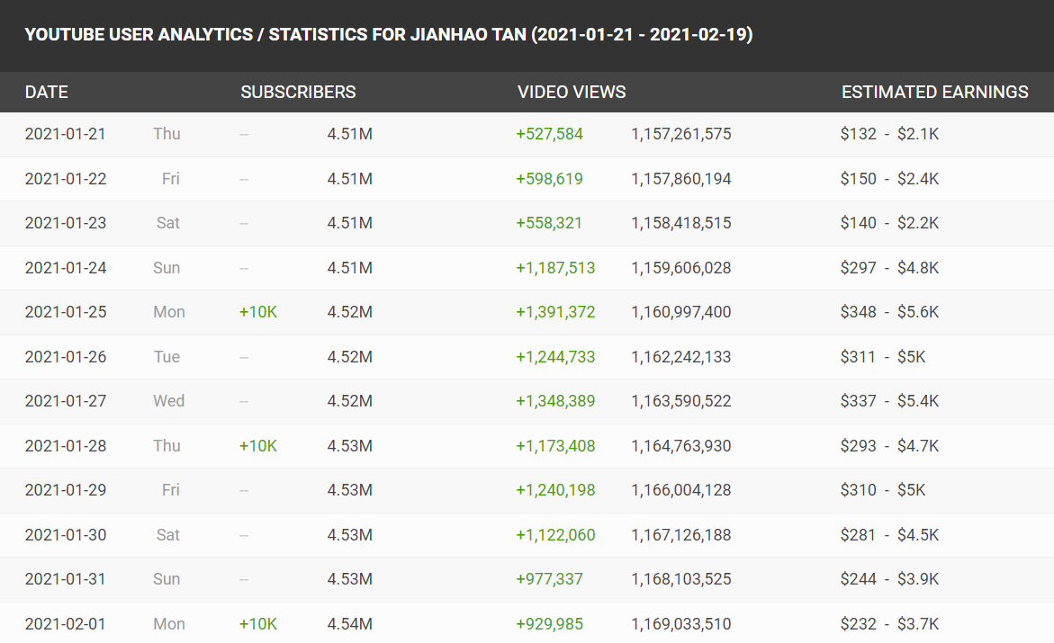
Goal
Some data showed that on specific day, the subscriber will increase 10K, to find out if the video upload related to the content.
Data source from https://socialblade.com/youtube/user/teenageguruz/videos
20/2/2021

Slide 10
Challenges
Need to specify and read each video to get the best insight
Manually input data in CSV file extract from different source

Slide 11



Thank you
yuhjiin@gmail.com
Yuh Jiin
20/2/2021

