Slide 1

WINE ANALYSIS
Yu(Louise) Jin yj465@cornell.edu
Heru(Helena) Wang hw743@cornell.edu
Jinyuan(Jack) Yu jy478@cornell.edu

Slide 2
Contents
Project Purpose
Explorative Data Analysis
Methodology
Results

Slide 3
Project Purpose
Improving the wine production process to enhance wine quality
Supporting oenologist wine tasting evaluation
Stratifying wines for premium brands and pricing
Making better marketing decisions to attract potential customers

Slide 4
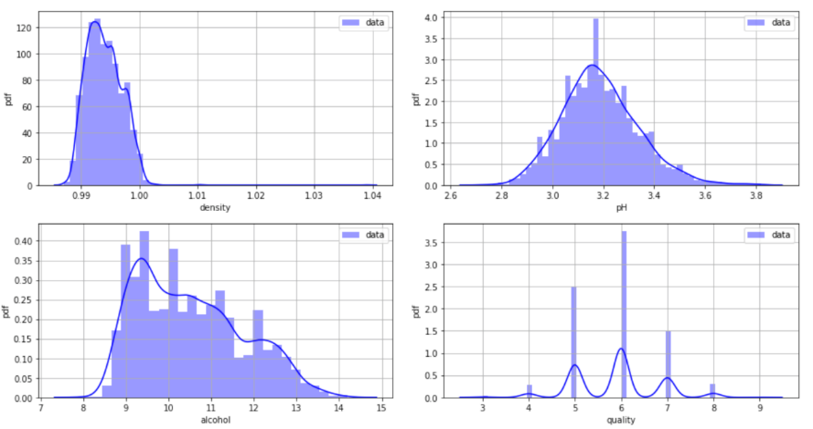
Explorative Data Analysis
Histograms of some typical variables: density, pH and alcohol, along with the output variable
https://archive.ics.uci.edu/ml/datasets/wine

Slide 5
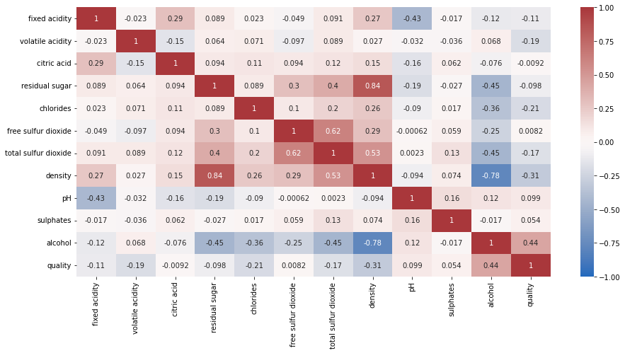
Explorative Data Analysis
Most of features are approximately independent, some of them are highly correlated.

Slide 6
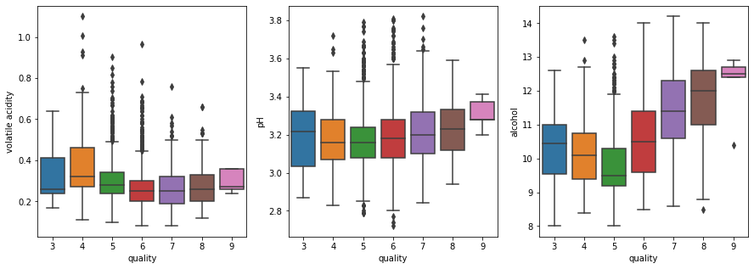
Explorative Data Analysis
Statistical graphics show that high quality wine tends to have higher pH and more alcohol.

Slide 7
Methodology
Family | Model | Description
Linear | Least Squares | Standard linear model (with least-squares estimators)
 | Polynomial | Linear model with 2nd degree polynomials of features
 | Lasso | Linear model with L¹-norm penalty function
 | Ridge | Linear model with L²-norm penalty function
 | Huber | Linear model with Huber loss function
 | Linear SVM | Support Vector Regressor with linear kernel
Trees | Decision Tree | Single decision tree with CART algorithm
 | Bagging | Bootstrap samples to grow a group of trees for prediction
 | Random Forest | Bagging model with features selected at random
 | GBDT | Gradient Boosting Decision Tree
 | AdaBoost | Adaptive Boosting Decision Tree
Others | K-Nearest Neighbors | Mean of the responses of k nearest neighbors in the train set
 | Gaussian SVM | Support Vector Regressor with radial basis function kernel
Train-test Separation
Error Metrics
Hyperparameter
Tuning
Overfitting Avoidance
Fairness and Limits

Slide 8
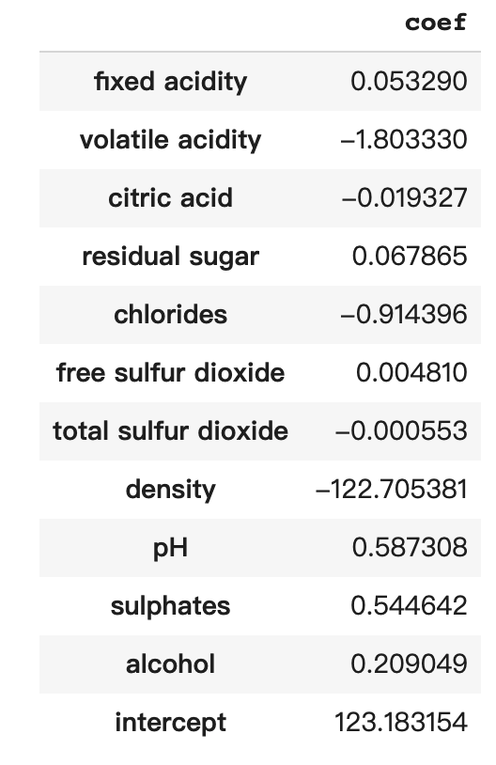
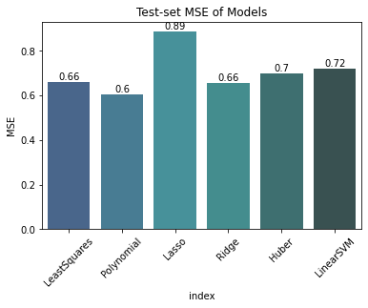
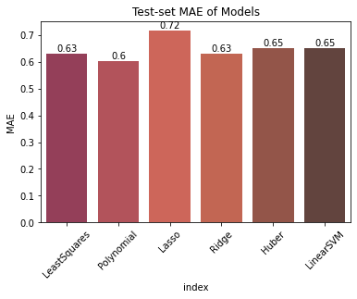
Results
Linear Models:
Linear models generally underfit the test set data. Polynomial features can generate a better result.
Fixed acidity, residual sugar, free sulfur dioxide, pH, sulphates and alcohol have positive effects on wine quality.

Slide 9
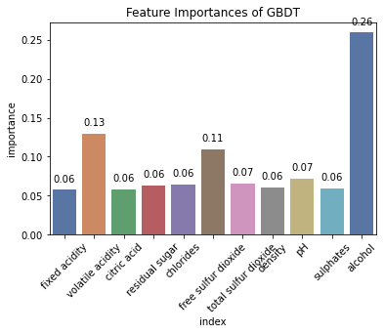
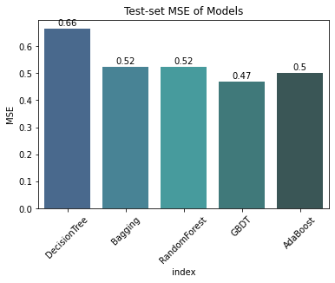
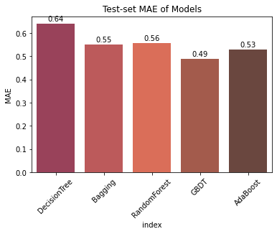
Results
Tree Models:
Among all the tree models, gradient boosting performs the best.
Based on the result of GBDT, alcohol content is the most significant feature in predicting wine quality. Volatile acidity, free sulfur dioxide and pH are also important factors.

Slide 10
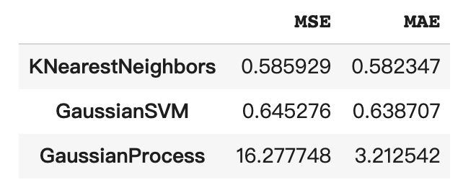
Results
Other Models: The test errors of other models like K Nearest Neighbors and Gaussian SVM are higher than those of ensemble models with decision trees.
Conclusion:
Gradient Boosting is the best one on the test set.
Most of linear models tended to be underfitted while ensemble methods worked quite well.
Features like alcohol and volatile acidity may have a stronger effect on wine quality.

Slide 11
Thanks for watching!

