Slide 1
Project2-1
2023.1.18.

Slide 2
Experiment
Before the experiment
Charging the devices (bioplux hub and eeg)
Setting the 3 software and python code for recording simultaneously
During the experiment
Taking a survey and attach the sensors, put the devices to subject
Monitoring the bio plux sensors.(If the signal looks strange, we should re-attache the seonsor.)
After the experiment
Charging the devices for next experimenter (bioplux hub and eeg)
And convert eyetracking data and daq data
Uploading dataset on the one-drive
number of participant > 1. sim > S1.hd5, S2.hd5, S3.hd5
number of participant > 2. bio > eeg/ eye/ bio> S1, S2, S3
number of participant > survey
number of participant > Timeframe.csv

Slide 3
Setting software and python code

Slide 4
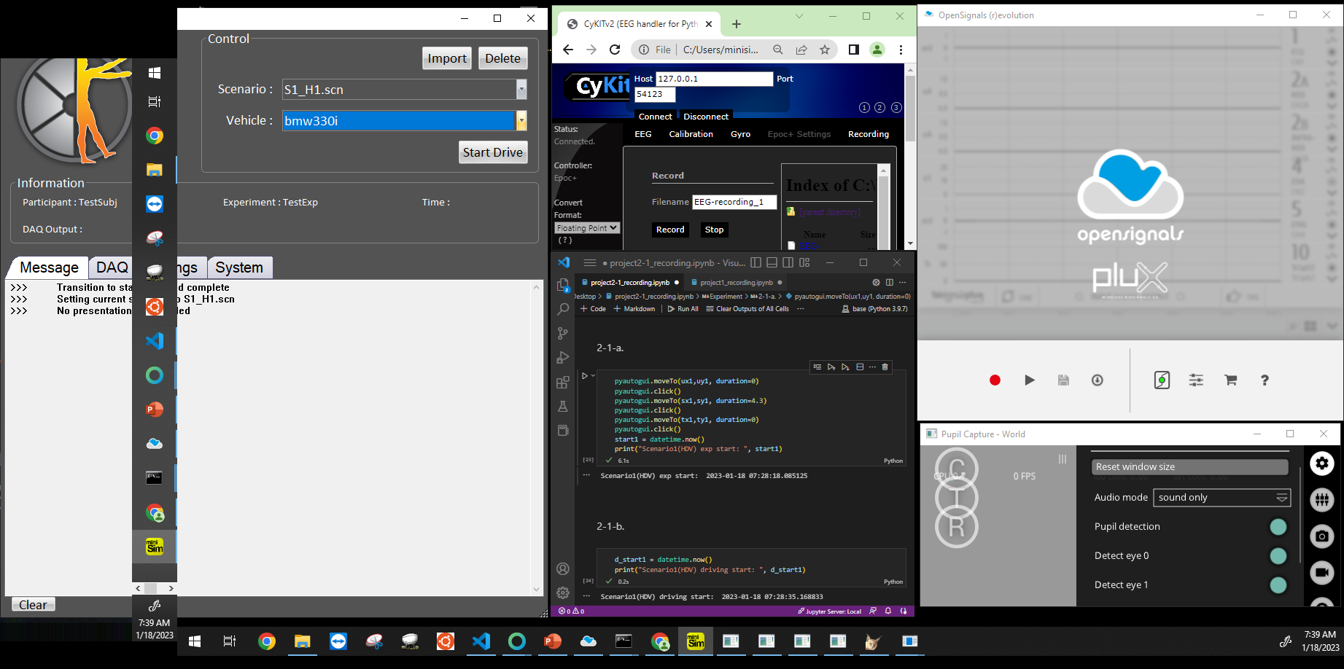
Setting software and python code
Setting the software windows and open the python file “ Project2-1_recording.ipythnb” on the desktop
Getting mouse position for automatic click
Runt the codes '1. Extracting the coordinates of recording buttons’
One by one, locate the mouse cursor on the recording and stop buttons.

Slide 5
Attaching devices

Slide 6
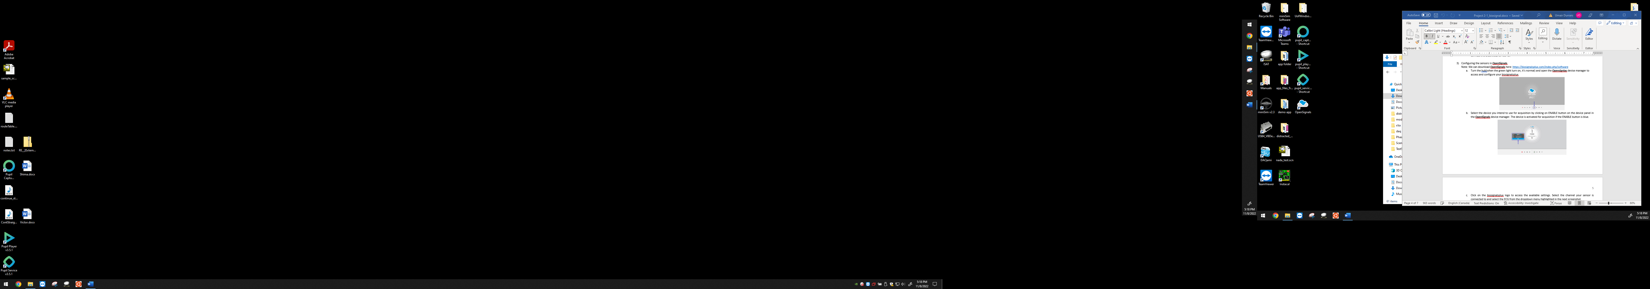
Bioplux
Attaching the sensors :
ECG(port#1): Place the red sleeve(+) on LA, black sleeve(-) on RA, and white sleeve(reference) on the bone of left elbow, with adhesives
Spo2(port#2): : Place the sleeve on the left temple with paper tape
EDA(port#3) : Place the sleeves on the back of neck with adhesives
EMG(port#4): : Place the sleeves on the above of the right eyebrow with adhesives
EMG reference(reference port): Place the sleeves for the reference on the bone of right elbow
BVP(port#5): : Place(the side with the red light should go in the direction of the fingerprint) the sensor at the thumb of non-dominant hand(to reduce the measurement noise) and then connect the electrodes to port #5 of hurb.
Configuring the sensors
Open the open signals
Turn the hub and insert the usb to the usb port
Select the device you intend to use for acquisition by clicking on ENABLE button on the device panel
And set the HZ to 400 Hz, and check the box “converted”

Slide 7
Eyetracker
Connect the wire to usb-c port put the glasses(eyetracker) on the participant.
Open the pupil capture
Adjust lenses and ask the participant roll their eyes, then the blue circle will be smaller in the screen.
Click the button “C” (Participant needs to follow the red dot for Calibration, and the participant should not move her or his body as much as possible).

Slide 8
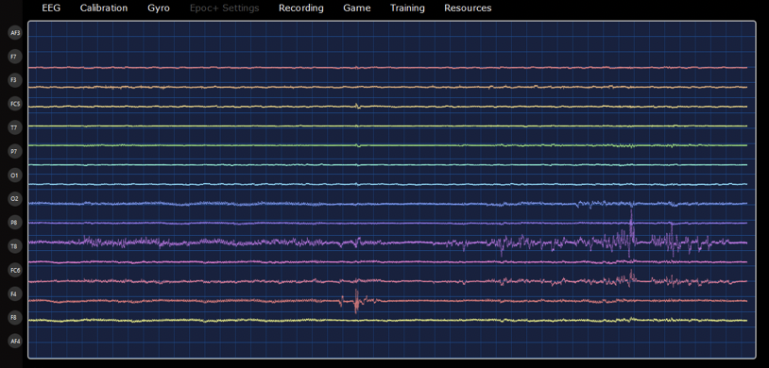
EEG
Pair the device(turn on the EEG device first and insert usb to usb port).
Open the cmd and enter the below codes
cd CyKIT-Master\py3
CyKIT.py 127.0.0.1 54123 6 eegmode
3) Open the Cykit (file path: C:\Users\minisim\CyKIT-Master\Web\CyKIT.html) and press the connect button.
4) Verify the number of channer is 14 on the screen.
5) Put the device on the participants and adjust the two back sensor to touch with the mastoid bone.

Slide 9
Recording

Slide 10
Recording
First, run the code 2-1-a’for recording the biometric signals simultaneously and recording start time
Press the start drive button in minisim
Running the code ‘2-1-b’ when the scenario starts for recording the start time
…
Press the stop drive button in minisim
Run the code ‘2-1-c’ when the scenario ends for recording the end time
Run the code 2-1-d’for saving the biometric signals simultaneously
...(repeat this process for scenario 2, 3..)...
Press the run button '3' to save timeline as csv.

Slide 11
Saving and uploading

Slide 12
Saving
Convert the eyetracking data:
Open the pupil_play
Drop the files to the window (C:\Users\minisim\recodings\date(ex.11/7)\#of recording (ex.000, 001,…))
Convert the daq data to hd5f 5 format
File path…
Eye tracking : C:\Users\minisim\recordings
EEG : C:\Users\minisim\CyKit-master\Py3\EEG-Logs
Bioplux : C:\Users\minisim\Documents\OpenSignals (r)evolution\files
Timeframe: c:\\Users\minisim\Desktop\AV-HDV
Notes:
https://kaen2891.tistory.com/38
https://rfriend.tistory.com/508
https://wikidocs.net/14611
파이썬 코드:https://rfriend.tistory.com/682
Matlab:https://kr.mathworks.com/help/ident/ug/transforming-between-time-and-frequency-domain.html

Slide 13
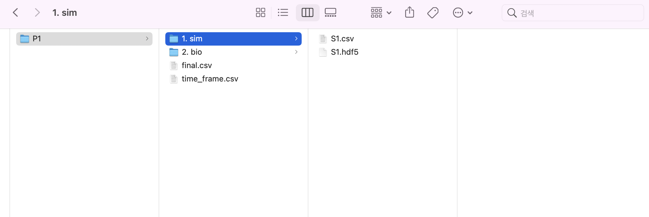
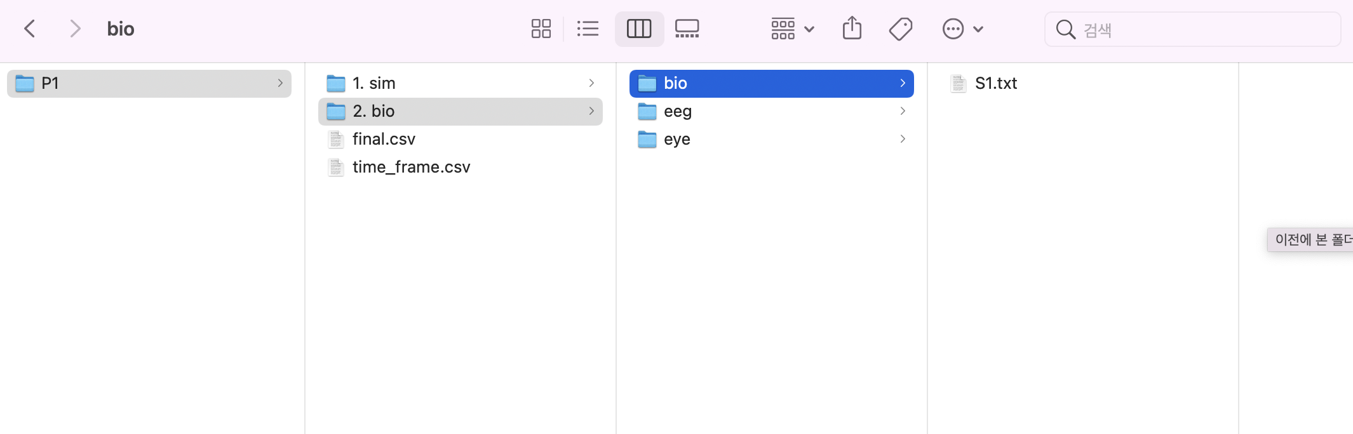
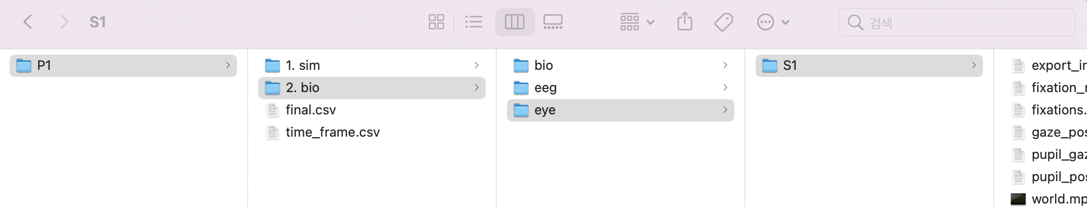
Saving
4. Uploading to one-drive
number of participant (ex.P1, P2, P3,…) > 1. sim > S1.hd5, S2.hd5, S3.hd5
number of participant > 2. bio > eeg/ eye/ bio> S1, S2, S3
number of participant > survey
number of participant > Timeframe.csv
Notes:
https://kaen2891.tistory.com/38
https://rfriend.tistory.com/508
https://wikidocs.net/14611
파이썬 코드:https://rfriend.tistory.com/682
Matlab:https://kr.mathworks.com/help/ident/ug/transforming-between-time-and-frequency-domain.html

Slide 14
Synchronizing

Slide 15
Synchronizing
Frequency:
Simulator: 60Hz
Eeg:128Hz
Eyetracker: 256Hz
Bioplux: 400Hz
Time frame
3 biometric sensors data
Simulator data
Unify these to 60 Hz through resampling
Delete front and rear data according to simulator data by using time frames
Notes:
https://kaen2891.tistory.com/38
https://rfriend.tistory.com/508
https://wikidocs.net/14611
파이썬 코드:https://rfriend.tistory.com/682
Matlab:https://kr.mathworks.com/help/ident/ug/transforming-between-time-and-frequency-domain.html

