Slide 1
WLAN Block Ack Graph Diagnostic Cases
Real captures • WQCPC-13082 / PCIE-12186

Slide 2
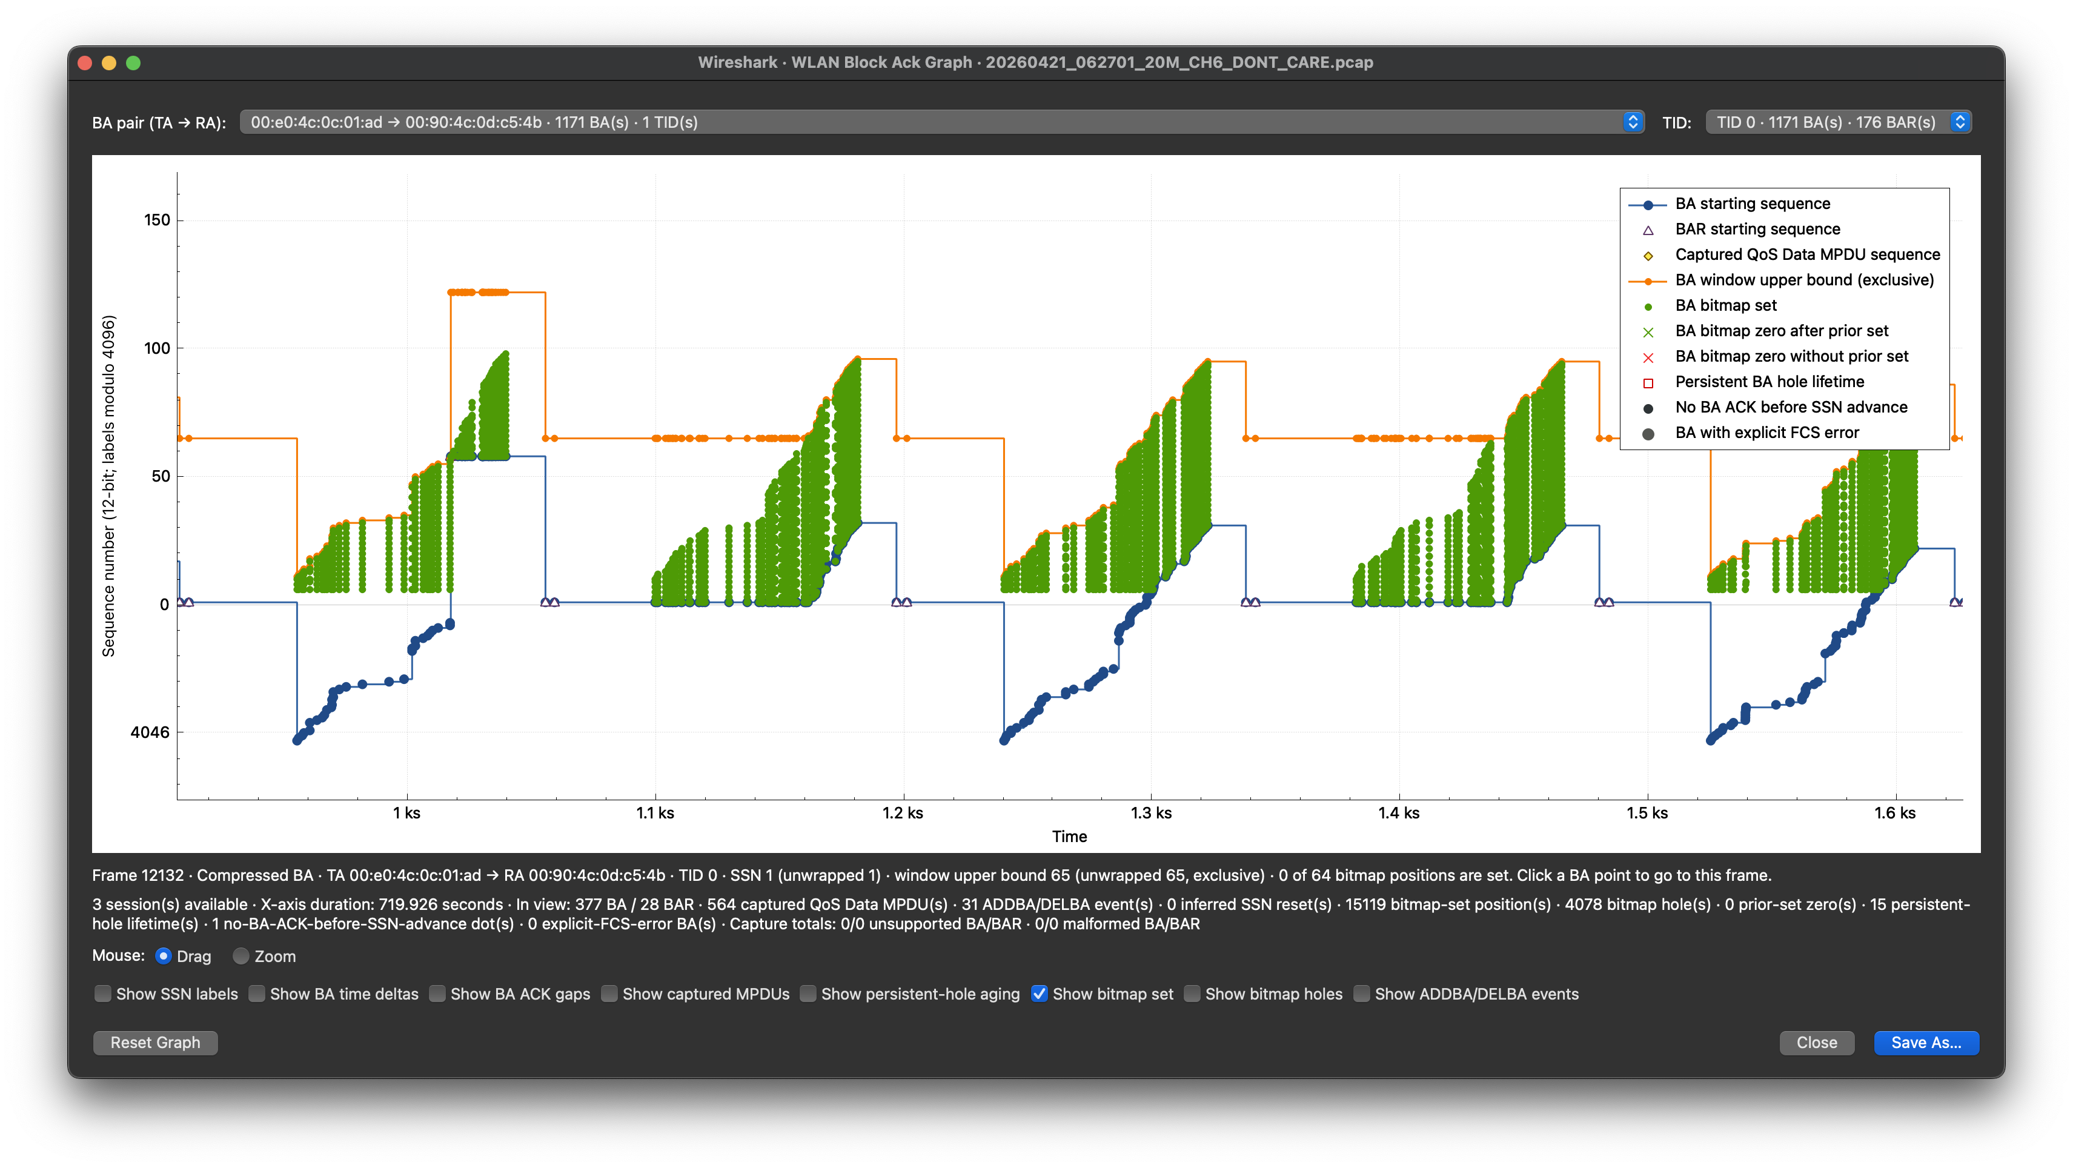
A bitmap is evidence—not a loss verdict
Exclusive upper bound
Observed bitmap set
BA starting sequence (SSN)
SSN (lower bound)
Counts for the visible plotting window

Slide 3
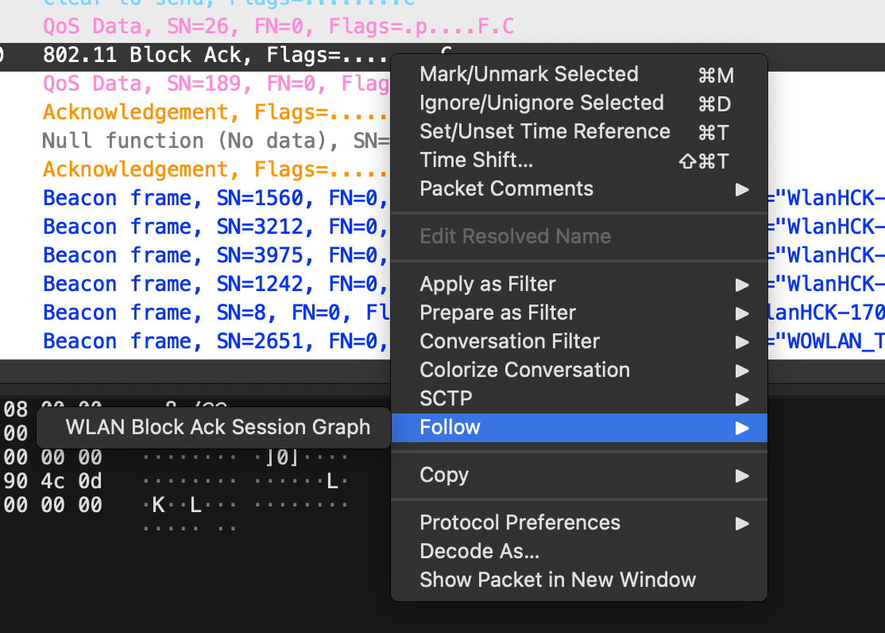
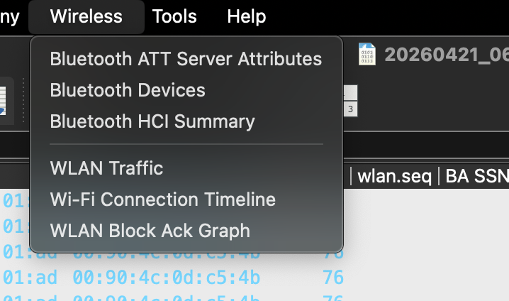
Open the session that owns the BA
1 Follow a selected BA
2 Open the full BA graph

Slide 4
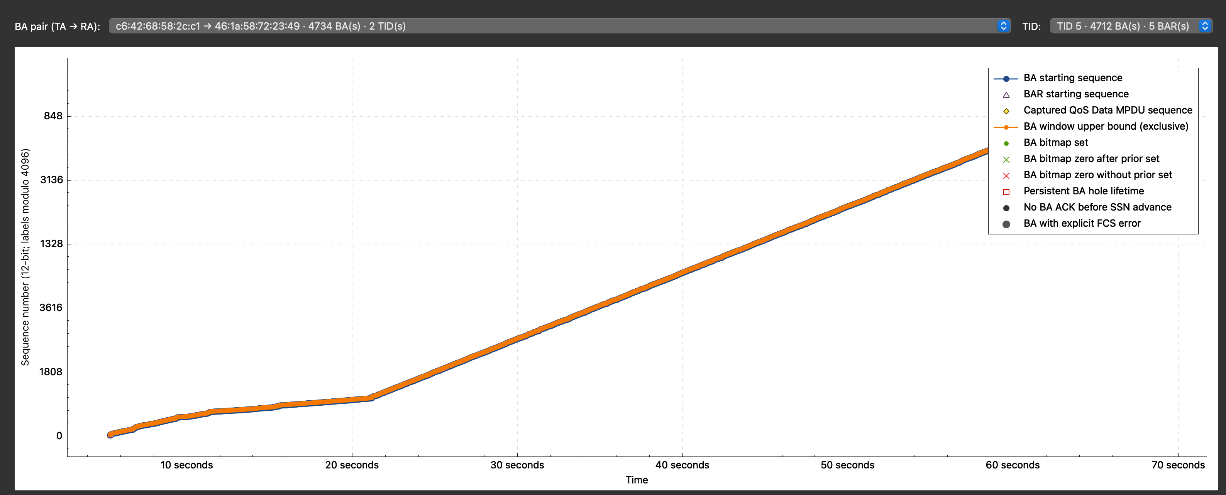
Confirm pair and TID

Slide 5
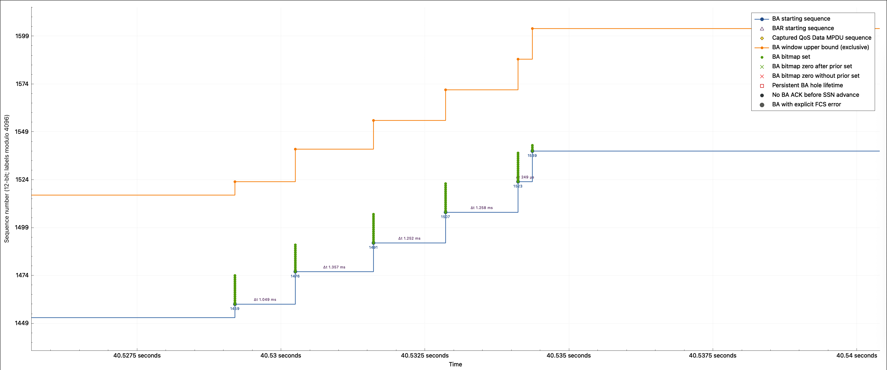
BA window = [SSN, SSN + bitmap size)
Bits explicitly set in the BA
BA point and starting SSN

Slide 6
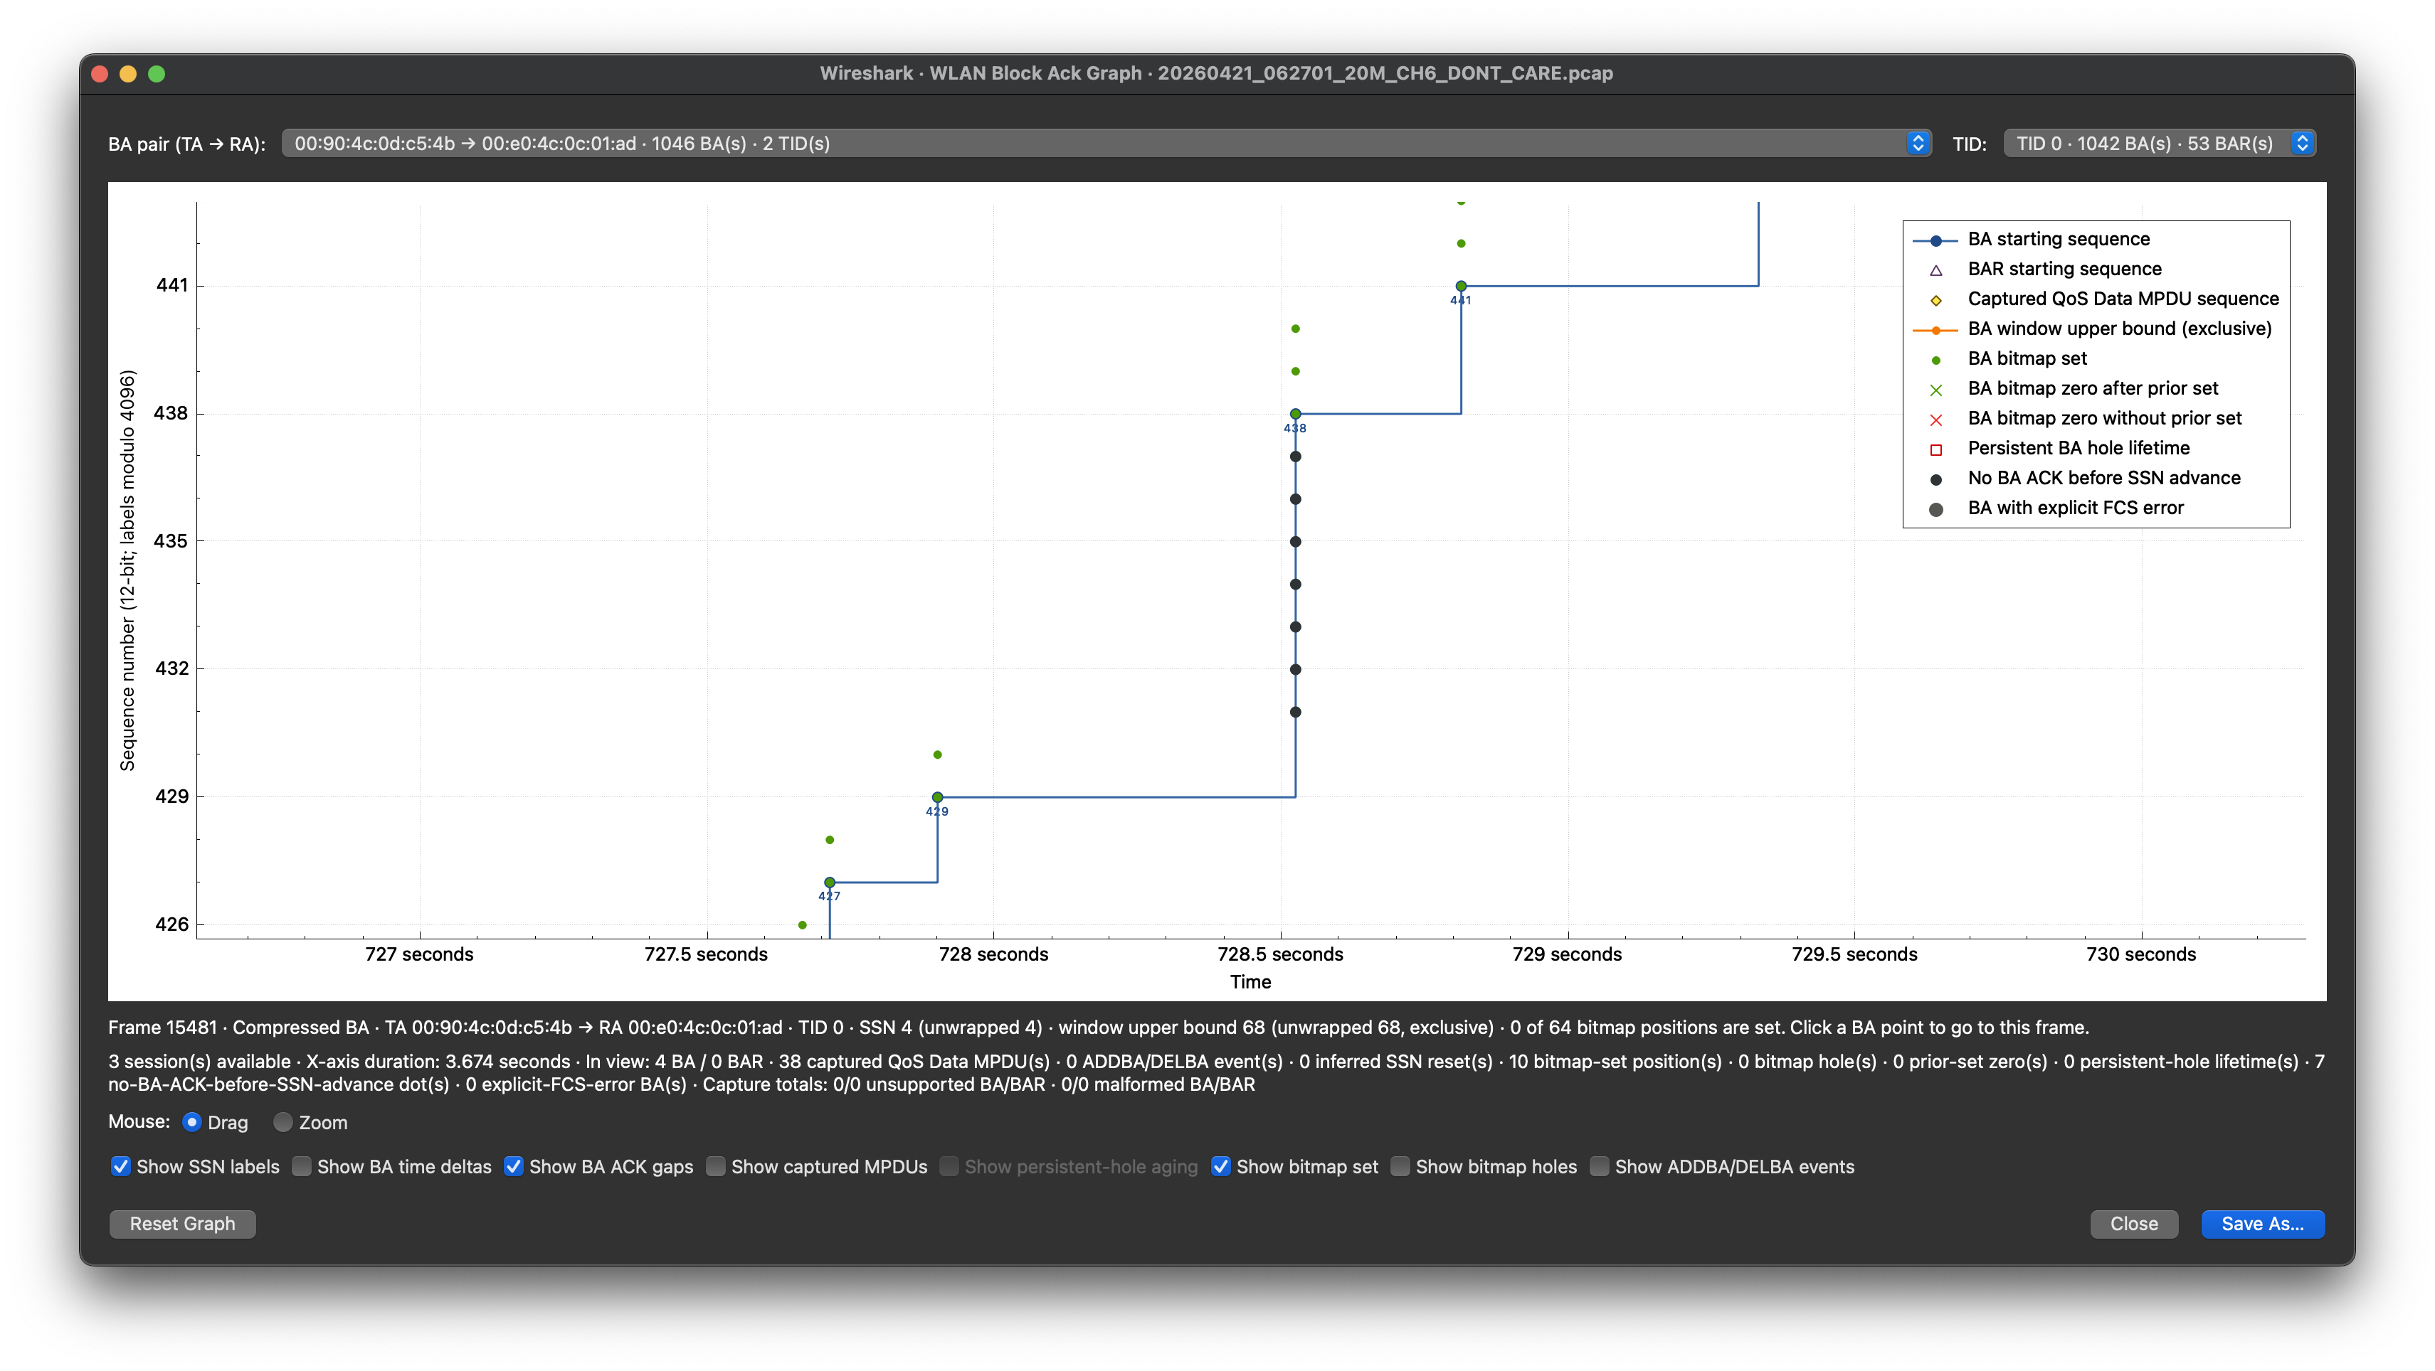
ACK gaps mark missing BA evidence
A later BA SSN passed these sequences without an observed ACK

Slide 7

Captured MPDUs confirm local visibility

Slide 8
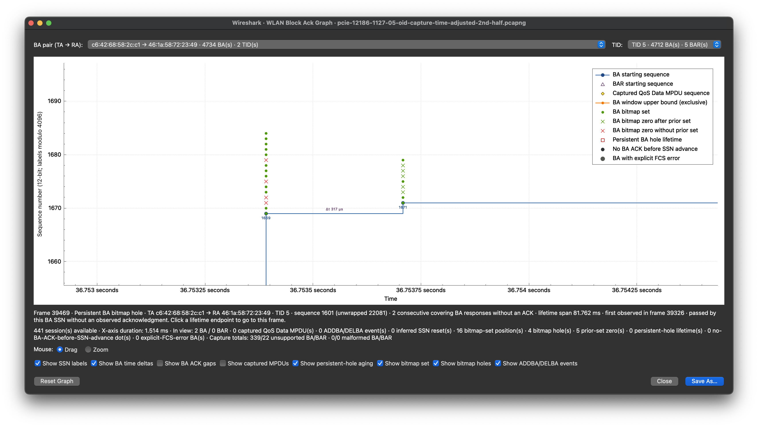
Green vs red crosses: prior-set or unseen
Green: prior set in agreement; zero now
Red: zero now
No prior set in agreement

Slide 9
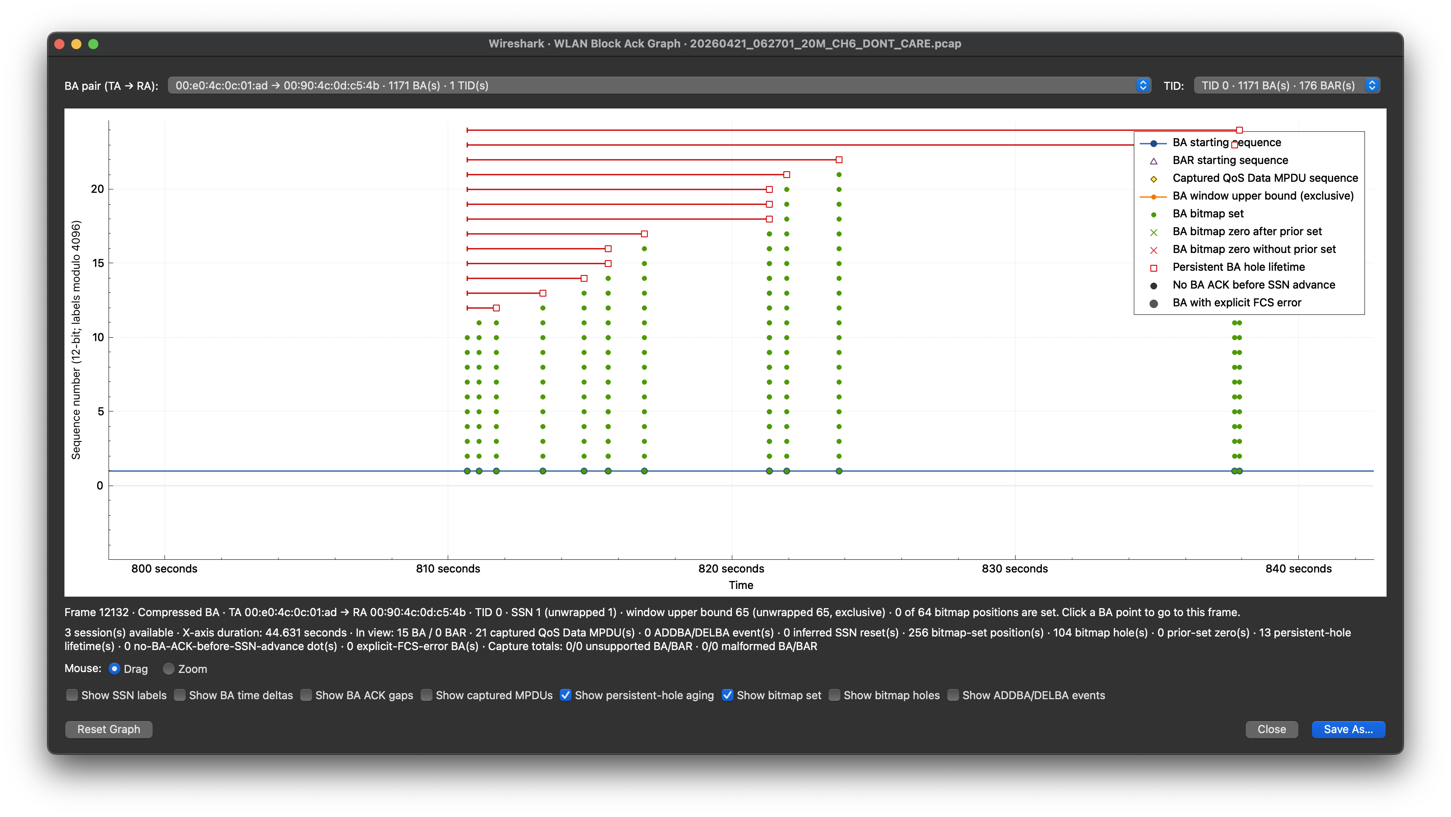
Click a span endpoint for lifetime details

Slide 10
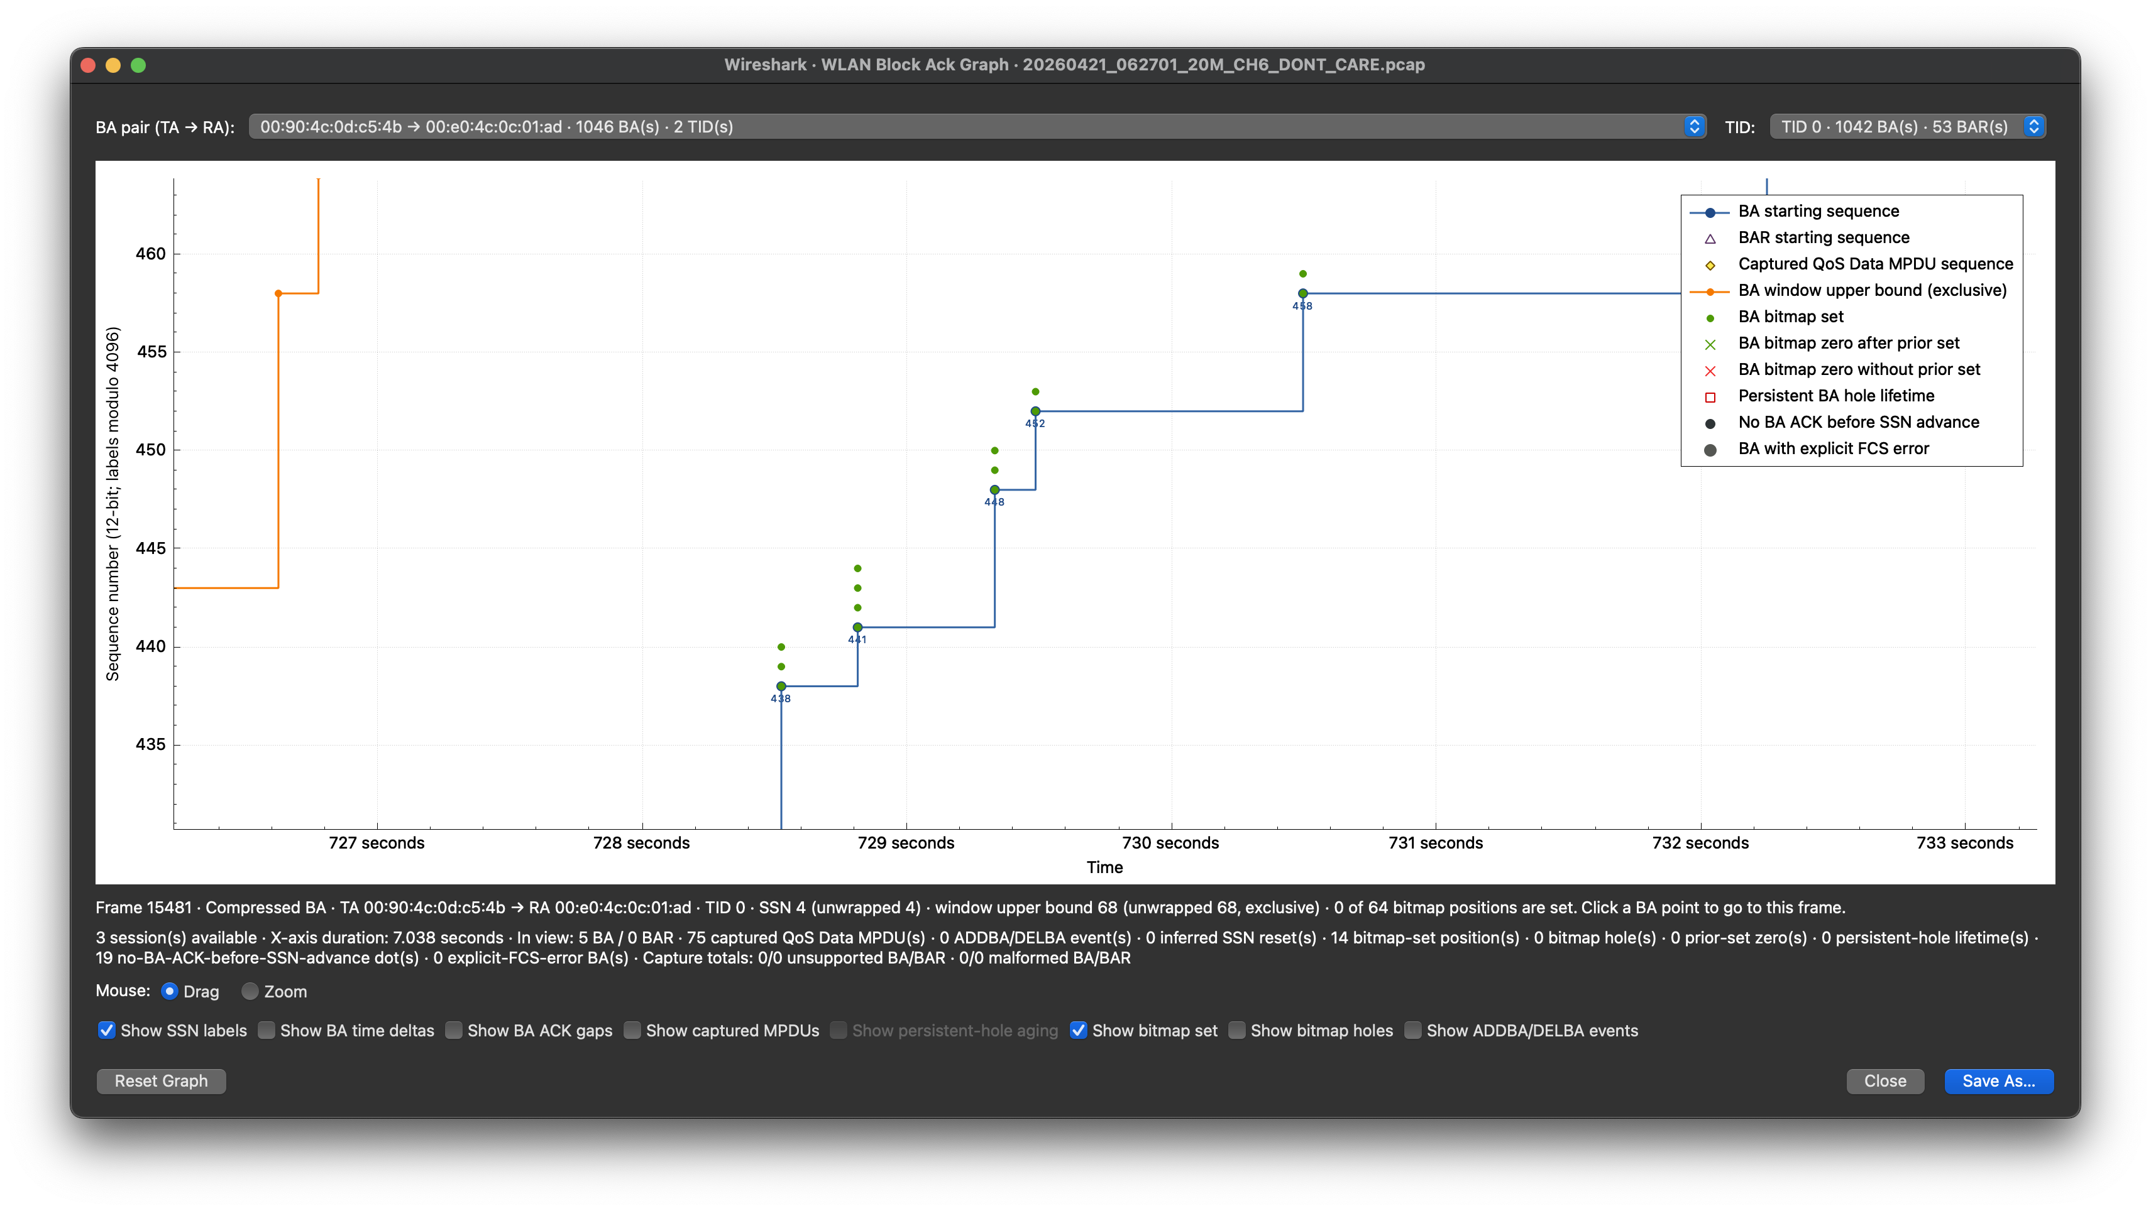
SSN labels expose sequence jumps

Slide 11

Measure BA update spacing

Slide 12
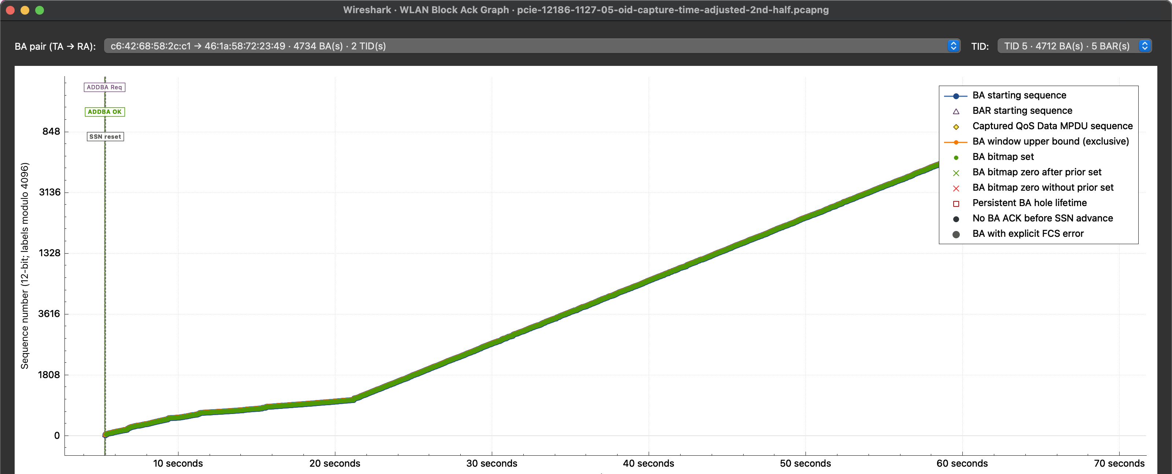
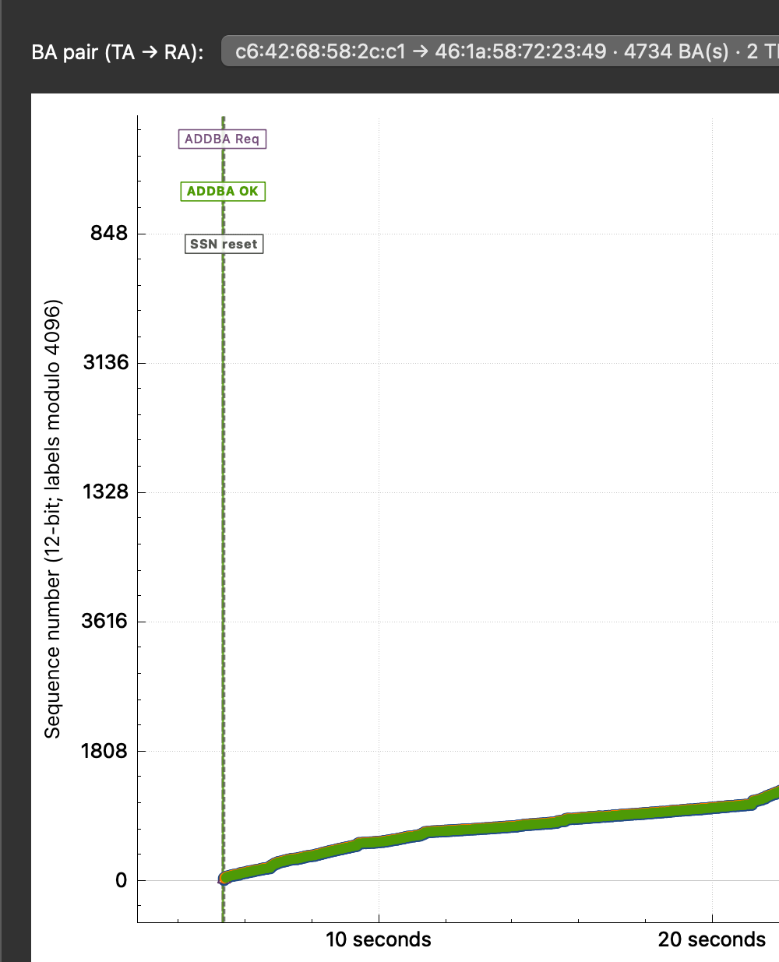
ADDBA explains the SSN reset
FULL SESSION
RESET DETAIL
ADDBA Req → ADDBA OK → SSN reset
The session setup explains the restart before the subsequent BA ramp.

Slide 13
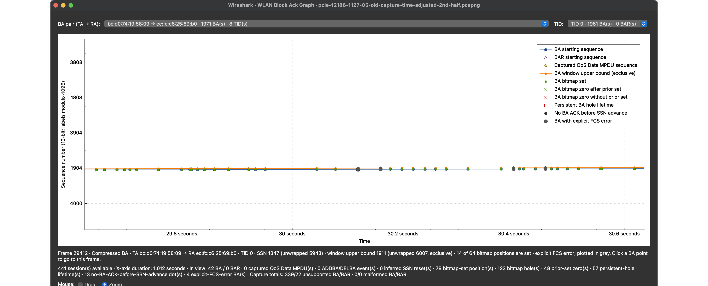
Gray markers identify explicit FCS errors

Slide 14
Graph first. Frames decide.
Use the graph to isolate the interval—then validate the source packets.

