Slide 1
WLAN BA Graph — Diagnostic Examples
Real Wireshark examples from ~/code/debug/WQCPC-13082 and ~/code/debug/PCIE-12186

Slide 2
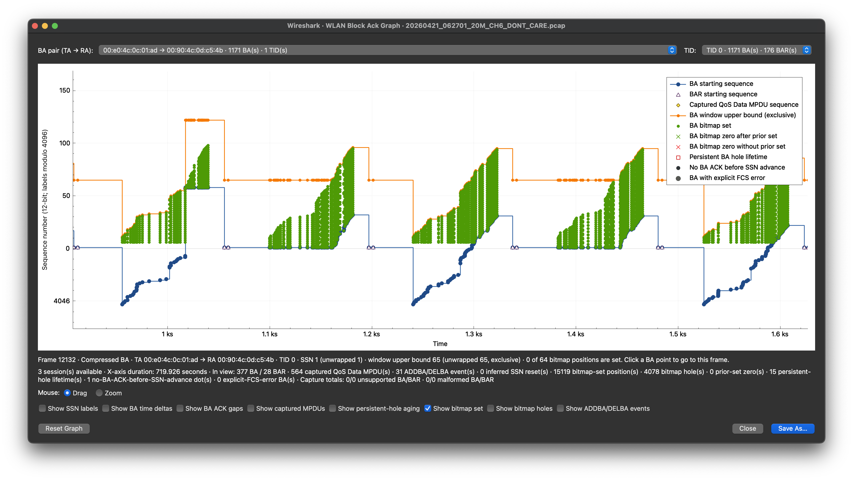
A bitmap is evidence—not a loss verdict
Exclusive upper bound
Observed bitmap set
BA starting sequence (SSN)
SSN (lower bound)
Counts for the visible plotting window

Slide 3
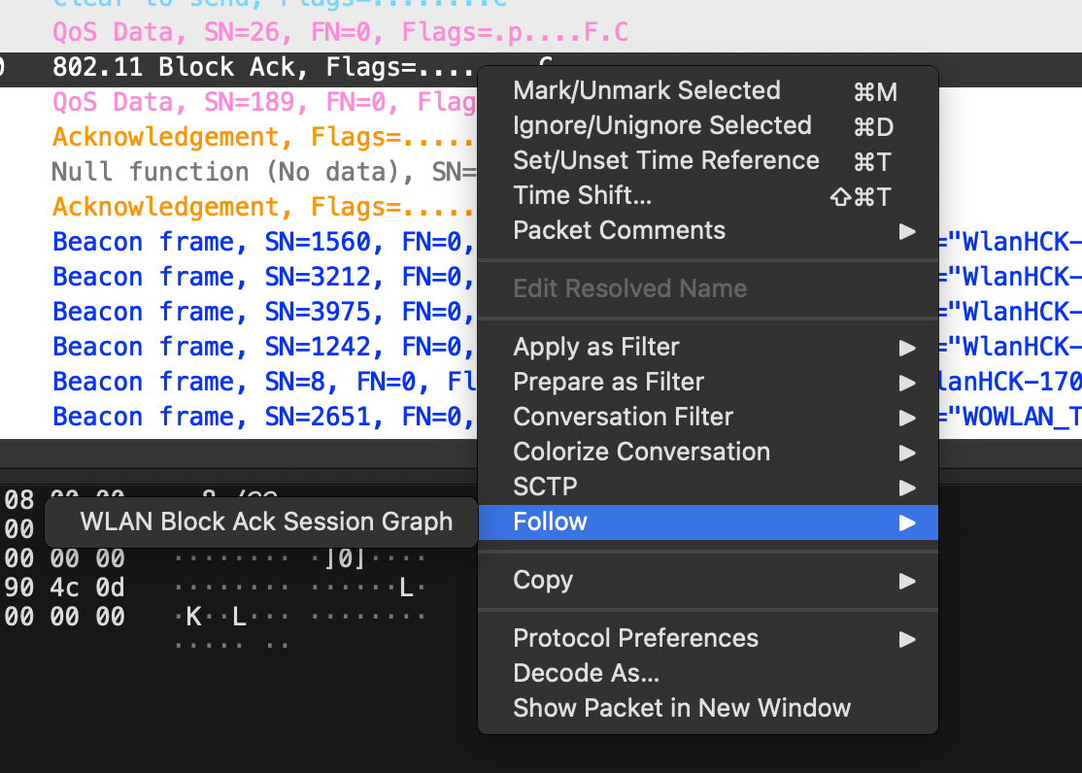
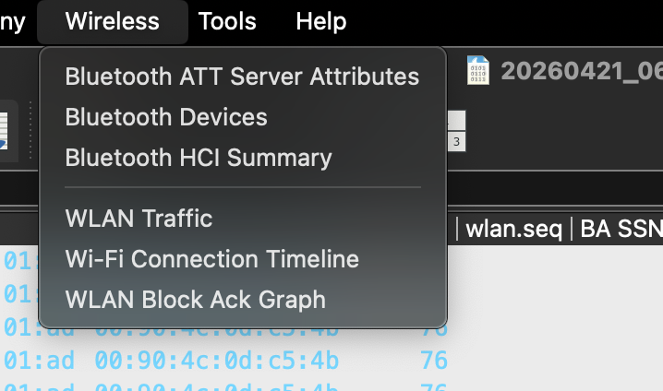
Open the session that owns the BA
Wireless → WLAN Block Ack Graph
Right-click the selected BA, then Follow

Slide 4
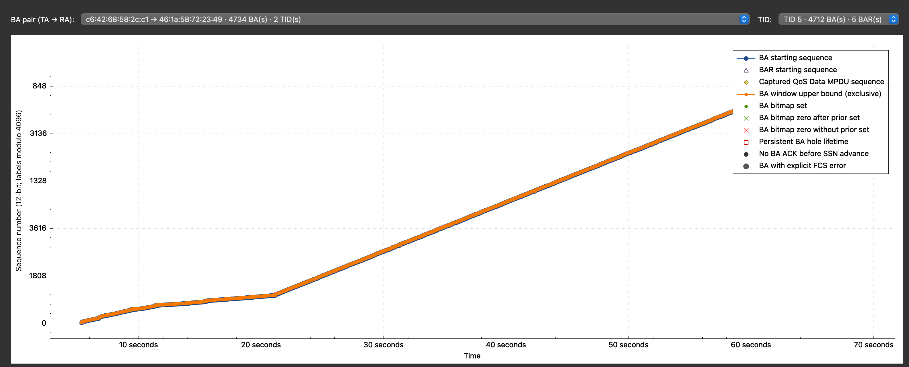
Confirm pair and TID

Slide 5
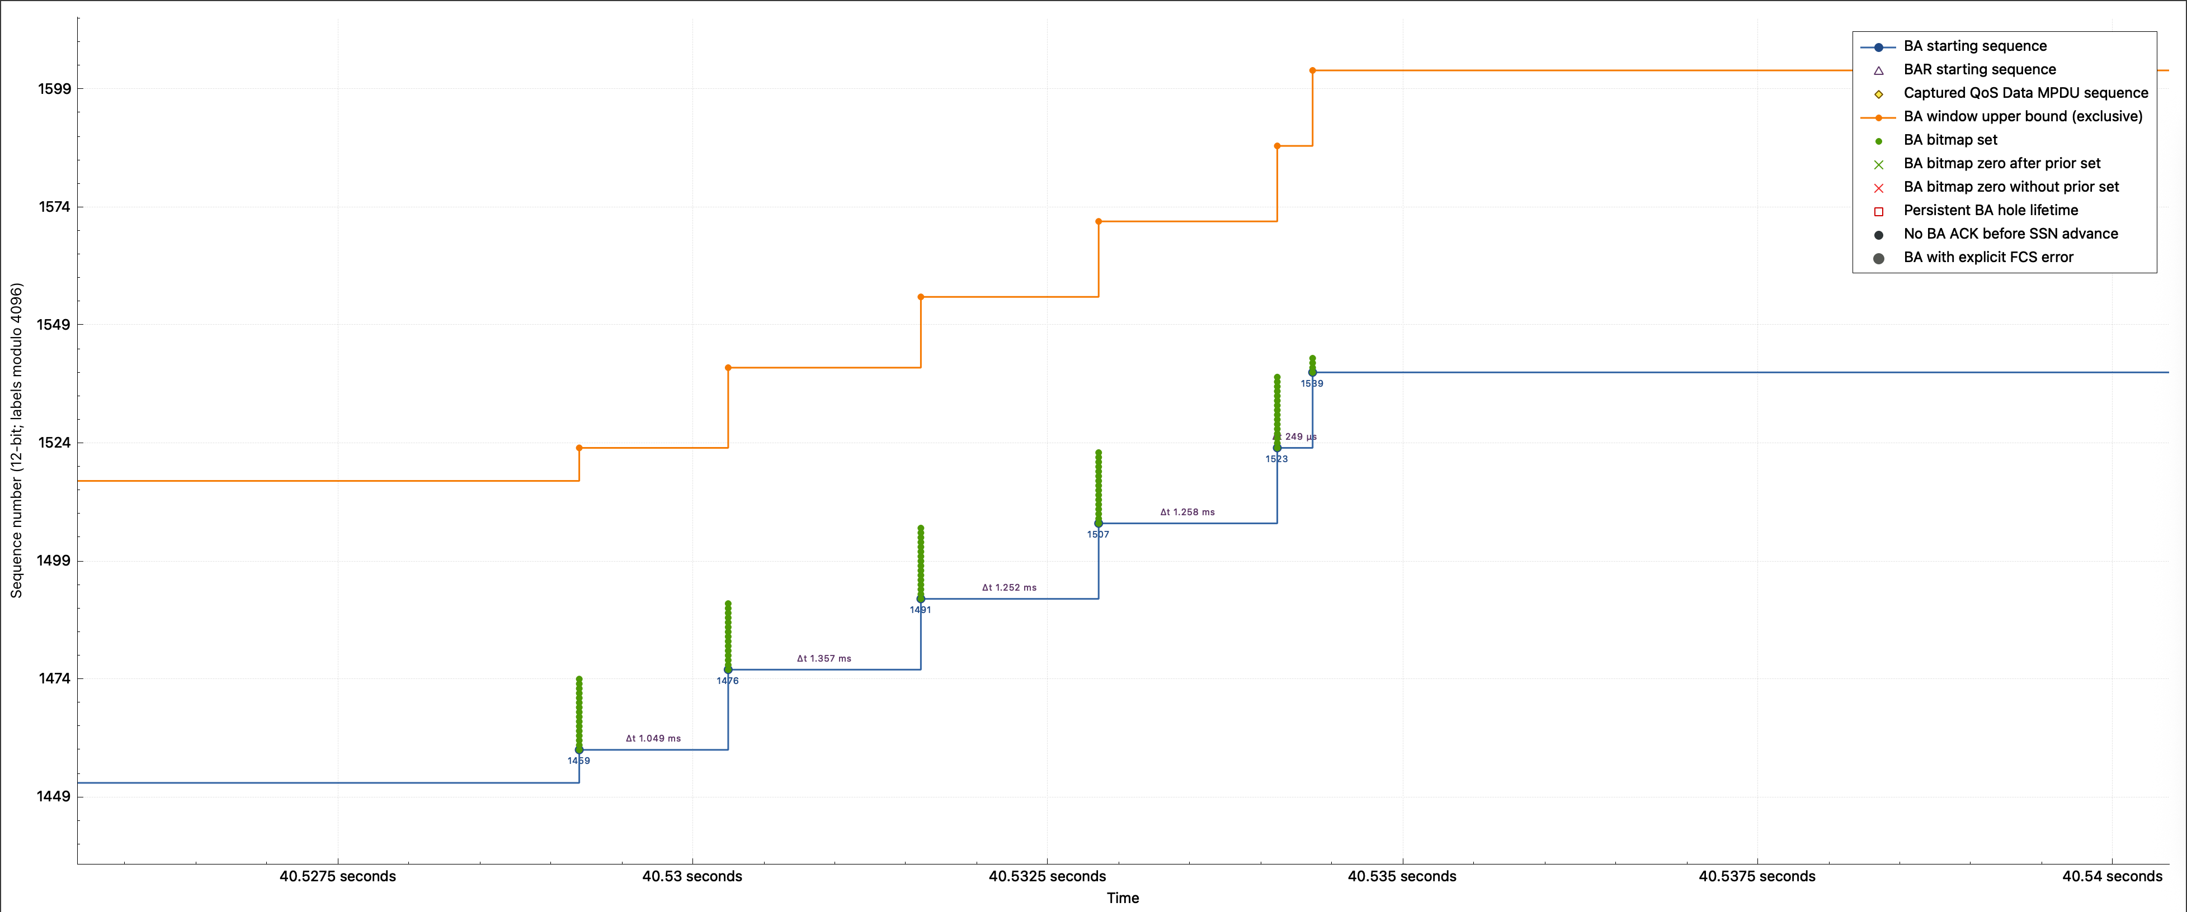
BA window = [SSN, SSN + bitmap size)
Bits explicitly set in the BA
BA point and starting SSN

Slide 6
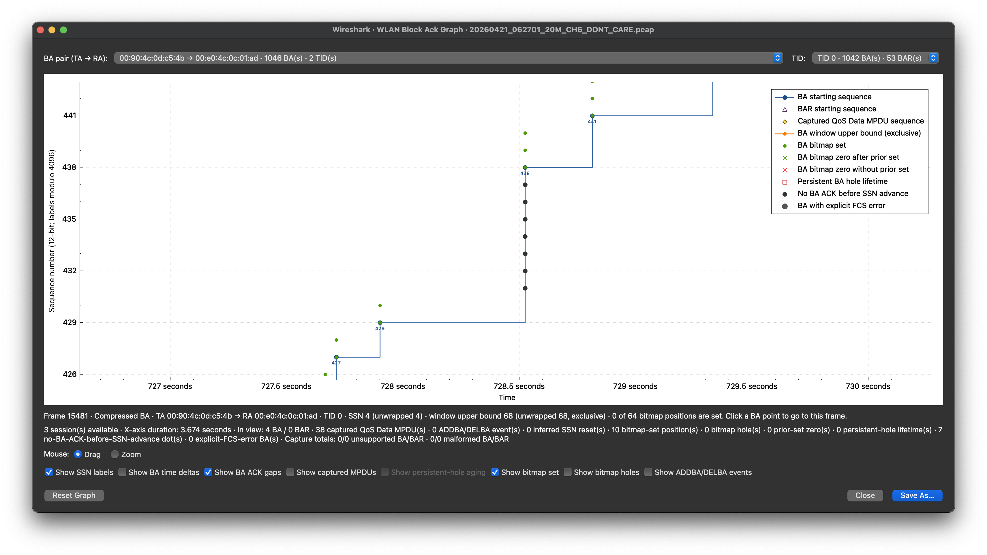
ACK gaps mark missing BA evidence
A later BA SSN passed these sequences without an observed ACK

Slide 7

Captured MPDUs confirm local visibility

Slide 8
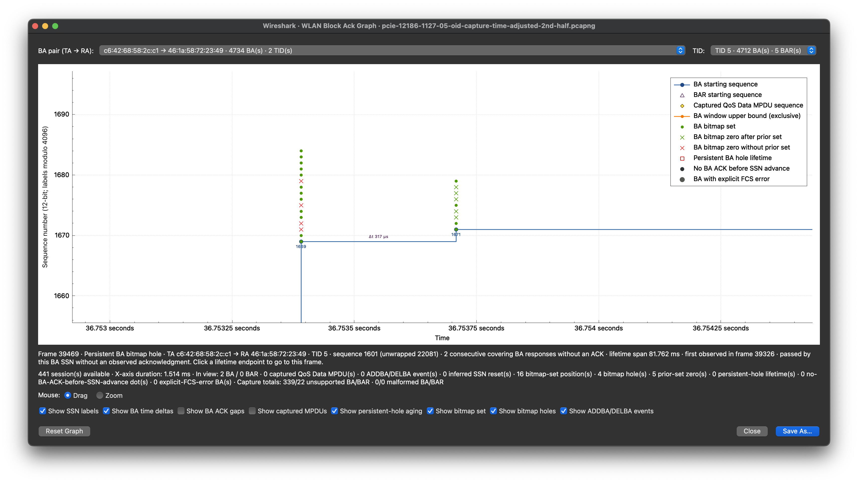
Green vs red crosses: prior-set or unseen
Green: prior set in agreement; zero now
Red: zero now
No prior set in agreement

Slide 9
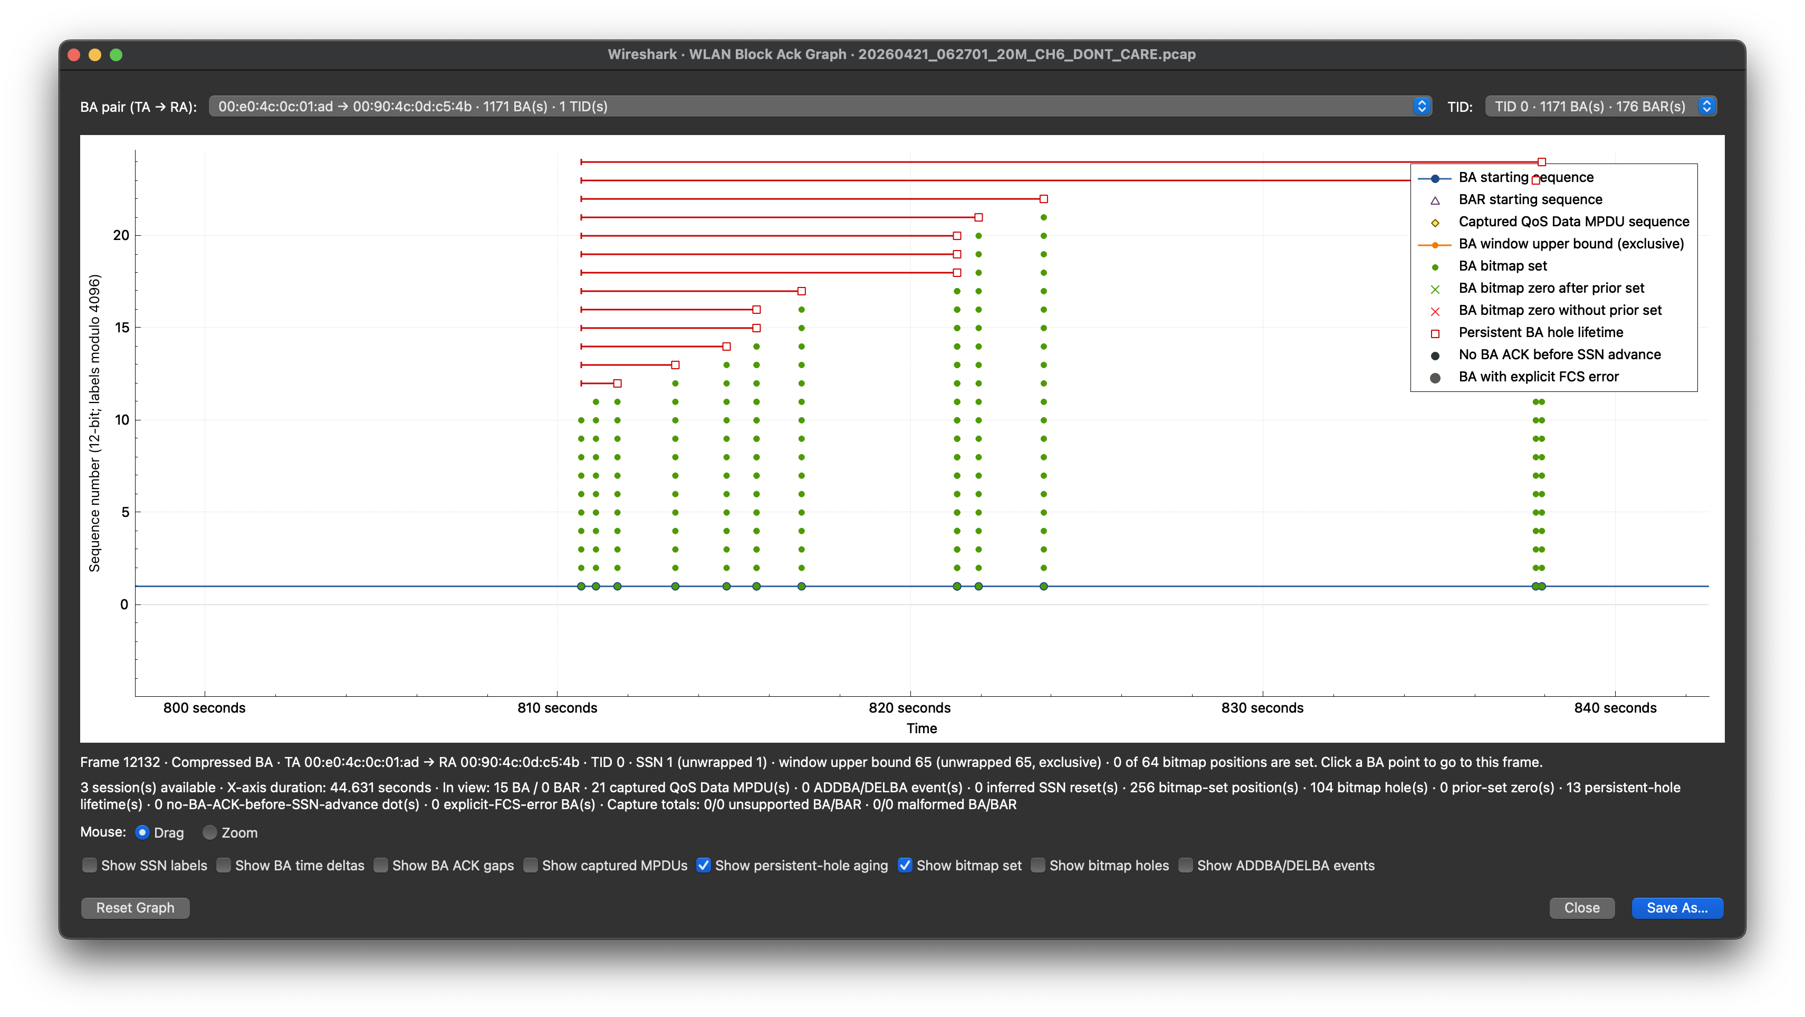
Click a span endpoint for lifetime details

Slide 10
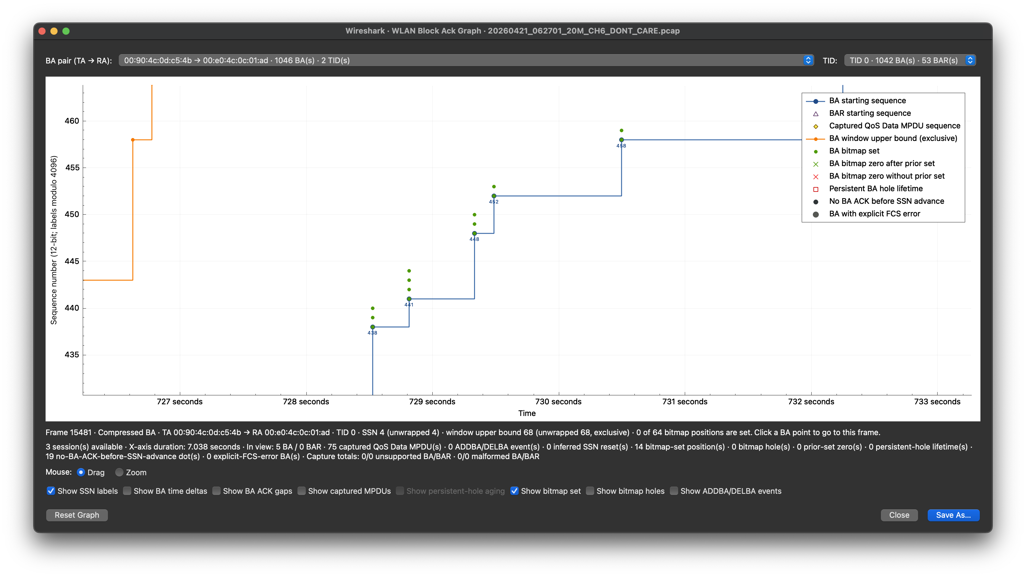
SSN labels expose sequence jumps

Slide 11

Measure BA update spacing

Slide 12
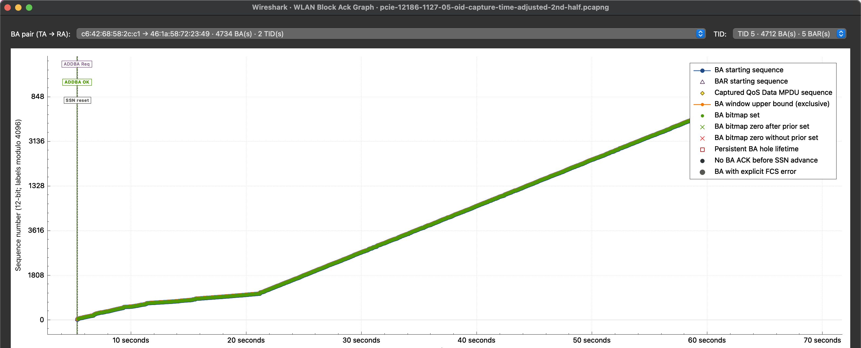
ADDBA markers explain this SSN reset

Slide 13
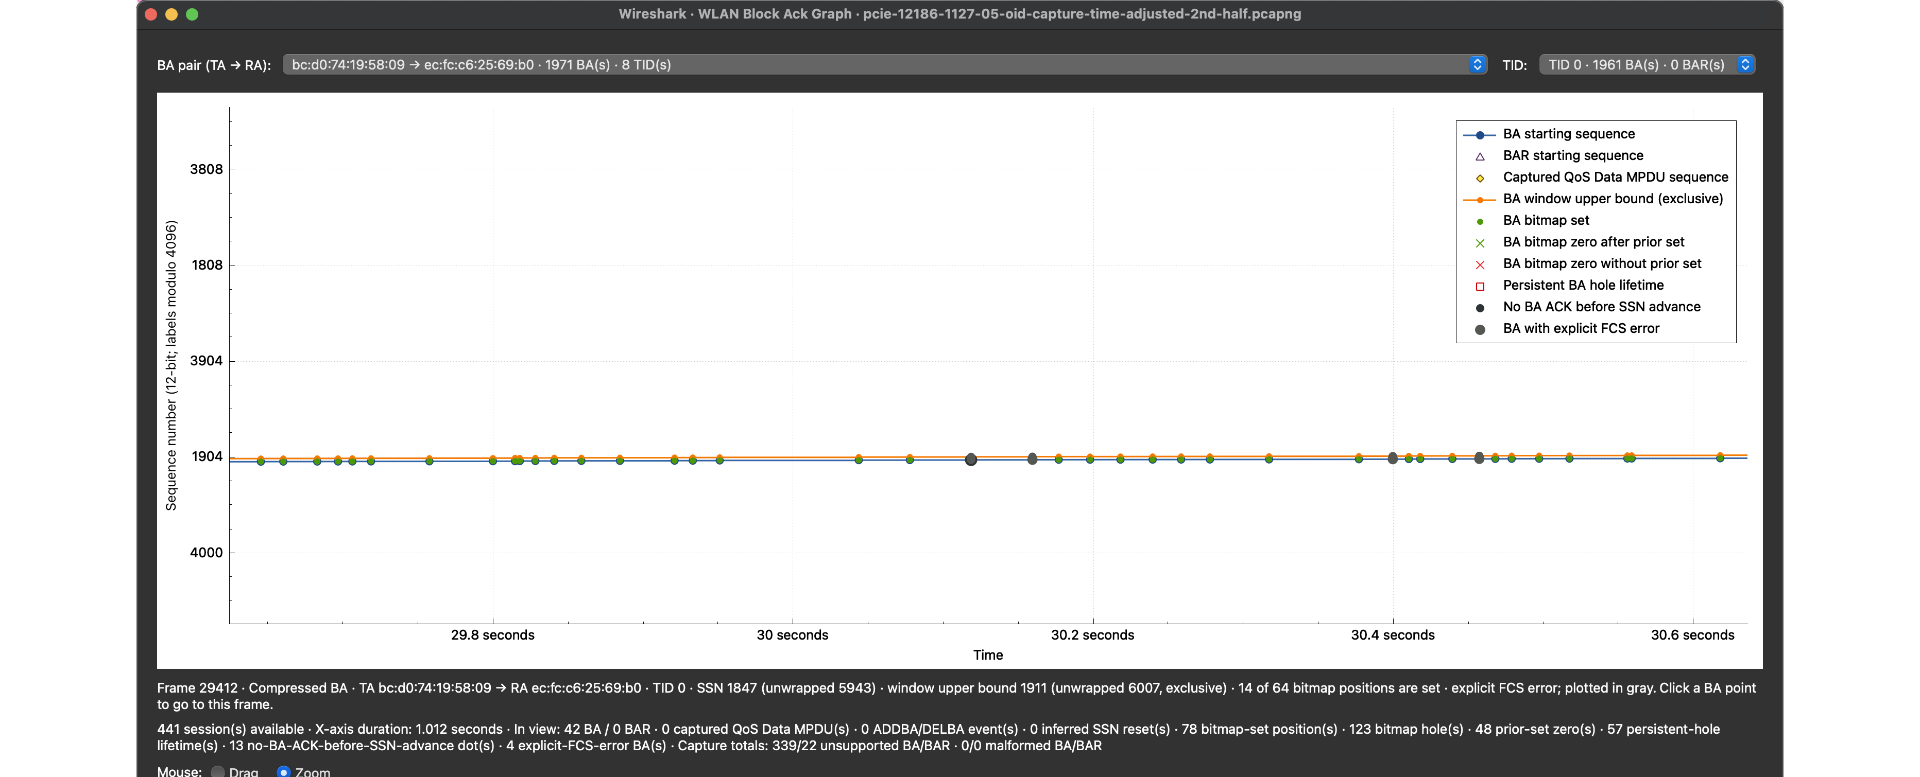
Explicit-FCS-error BAs are gray

Slide 14
Investigate the session. Validate the frames.
Use graph evidence to find the interval, then return to the source packets before declaring loss.

