Slide 1
WLAN BA Graph — Quick Start
Real Wireshark examples from ~/code/debug/WQCPC-13082 and ~/code/debug/PCIE-12186

Slide 2
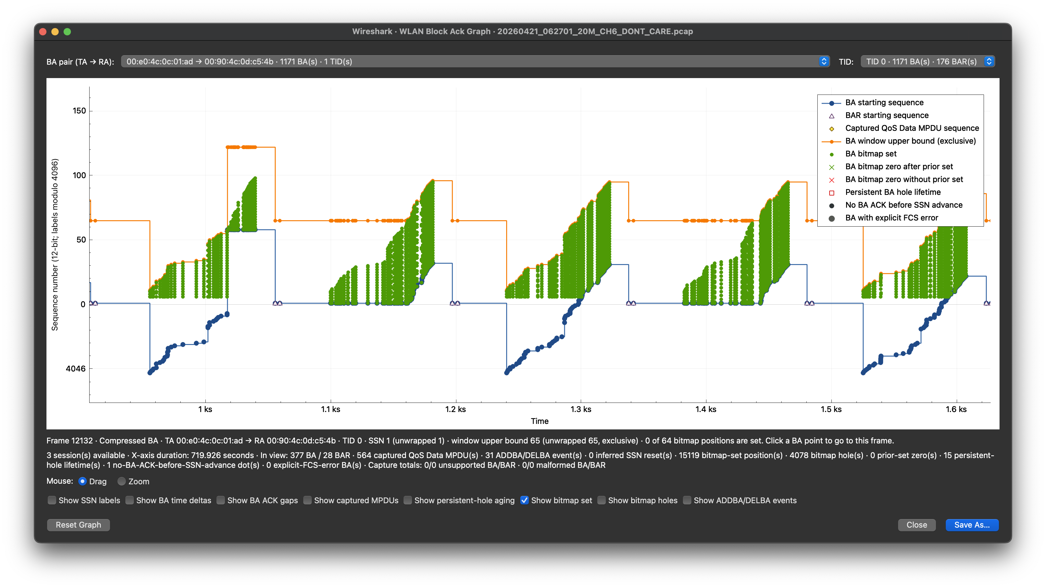
Read the BA window first
Exclusive upper bound
Green dots = bitmap set (toggle below)
BA starting sequence (SSN)
SSN (lower bound)
Counts and timing for the visible plotting window

Slide 3
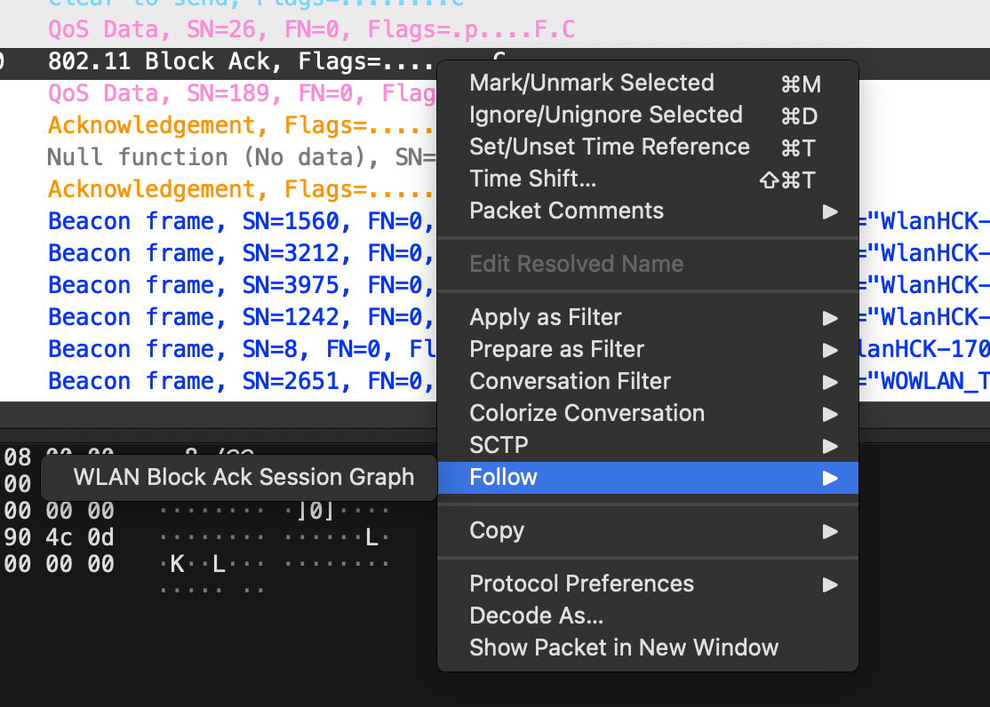
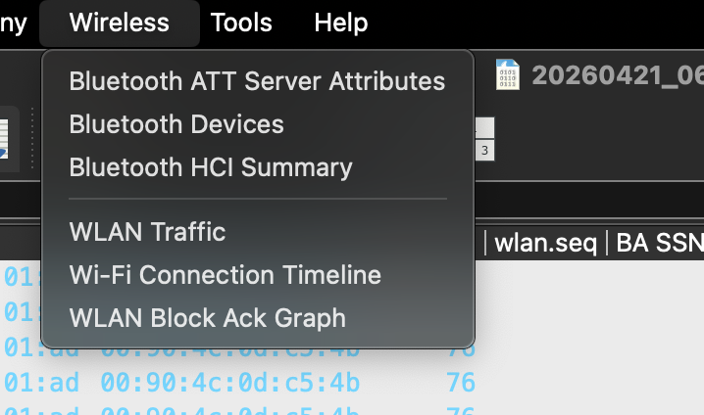
Open all sessions—or follow one BA
Wireless → WLAN Block Ack Graph
Right-click a BA, then choose Follow

Slide 4
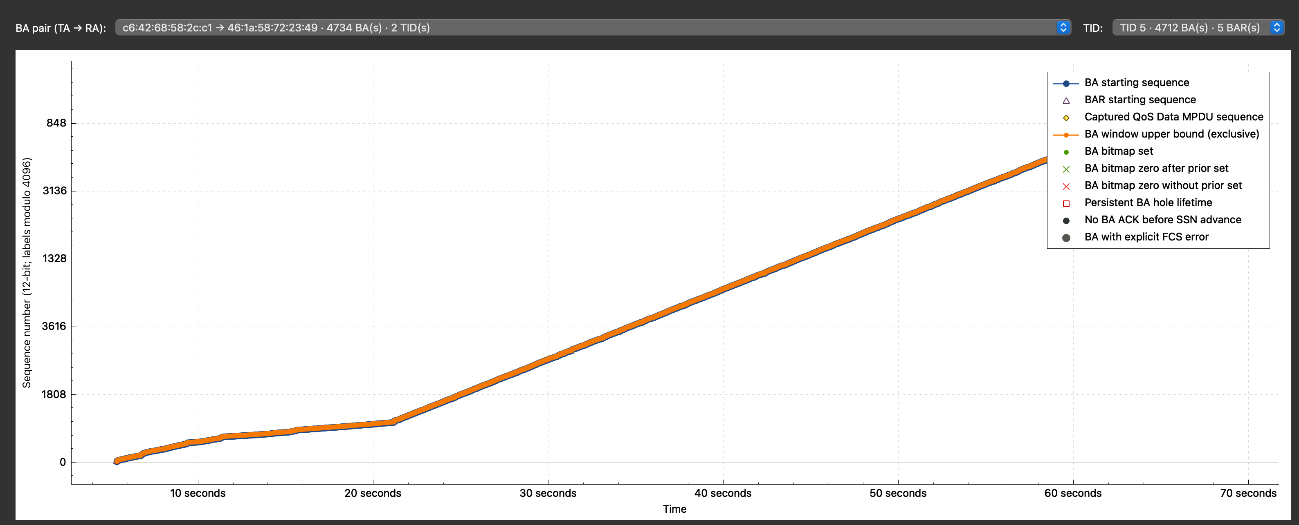
Pair totals span TIDs; lists sort by count

Slide 5
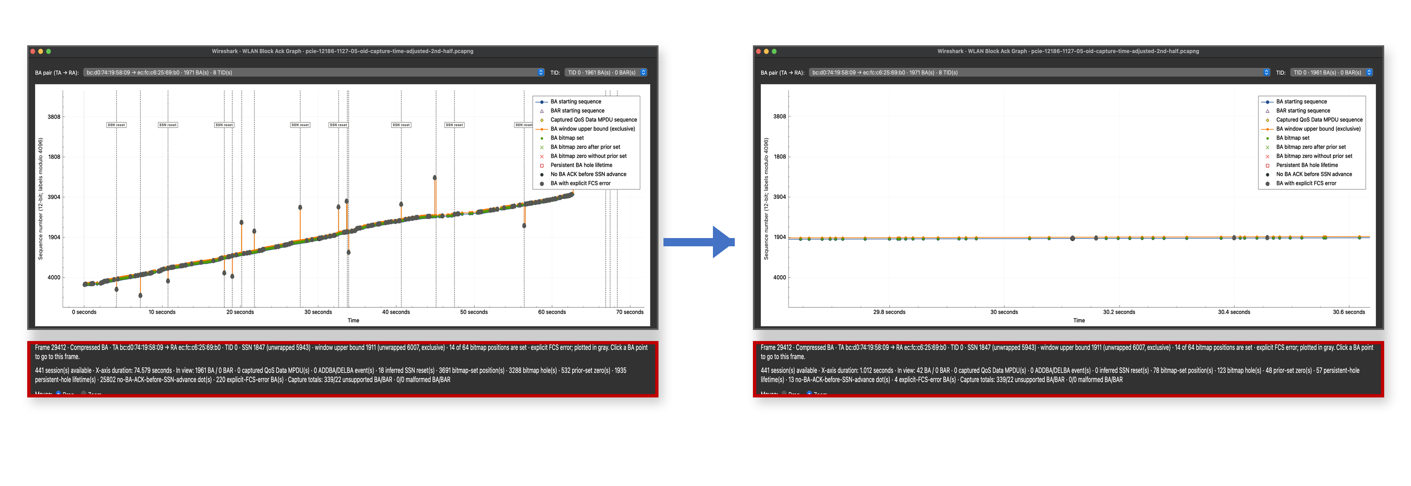
Zoom updates duration and counts

Slide 6
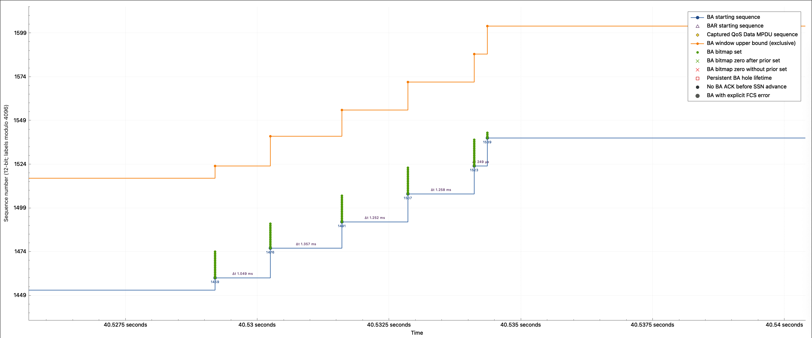
BA window = [SSN, SSN + bitmap size)
Bits explicitly set in the BA
BA point and starting SSN

Slide 7
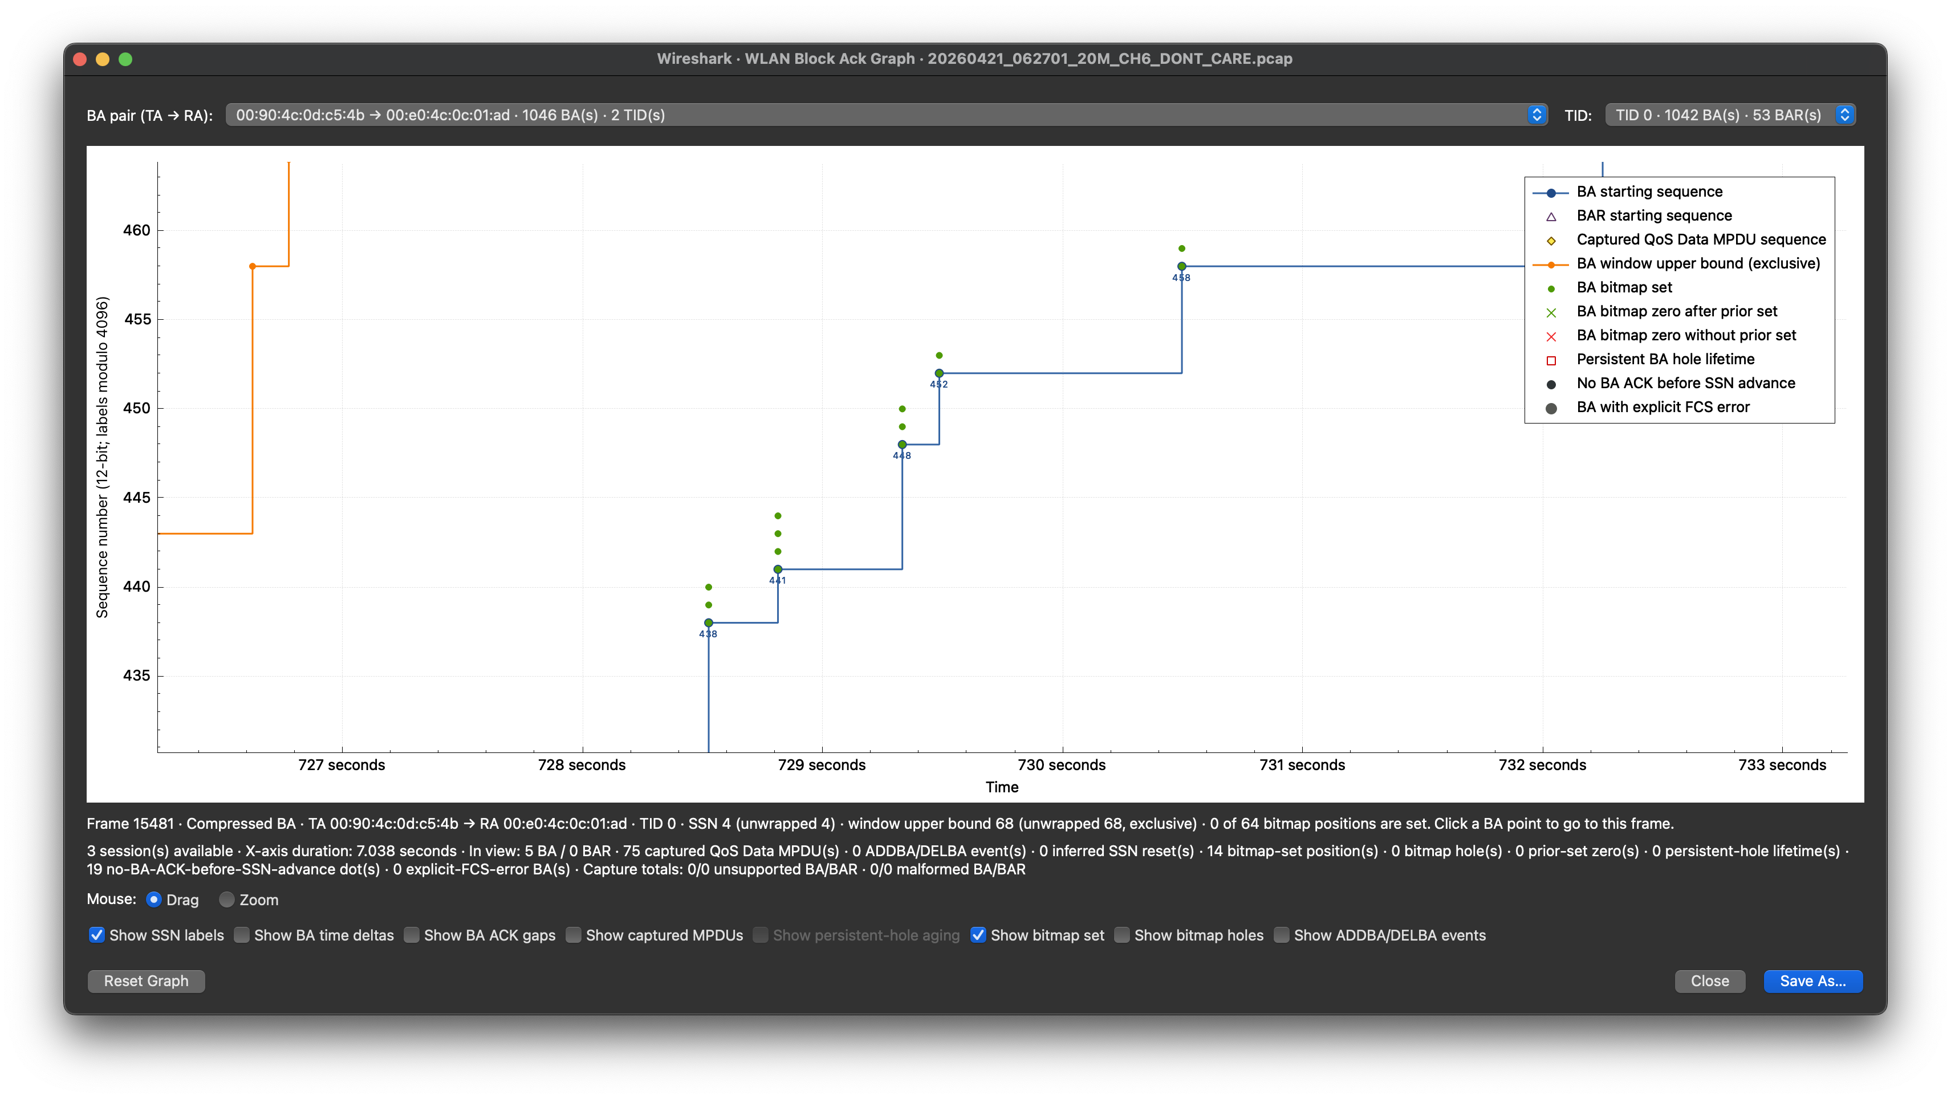
SSN labels identify each BA start

Slide 8

BA time deltas expose update spacing

Slide 9
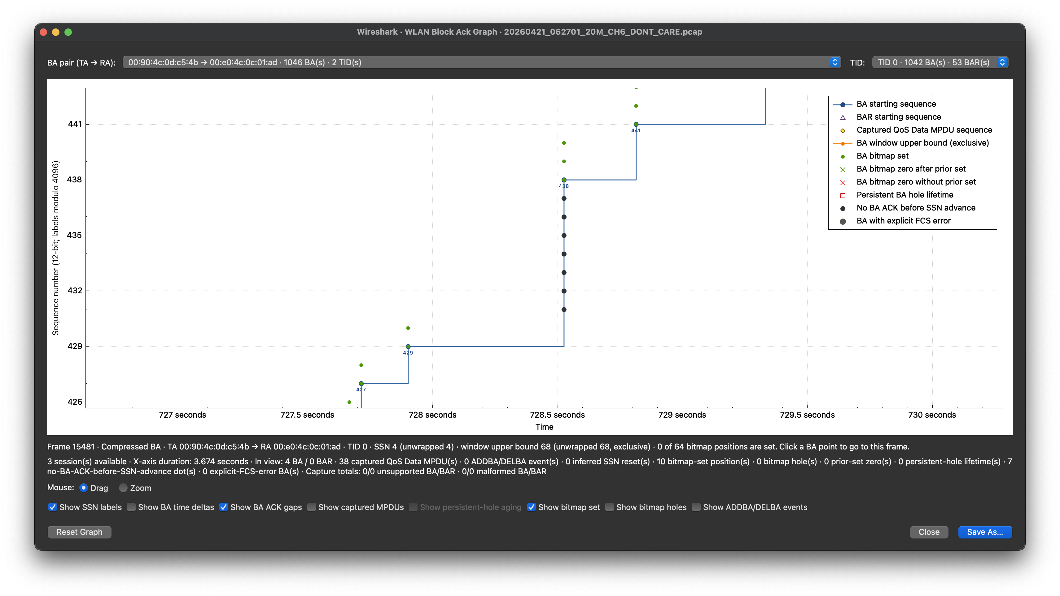
ACK gaps appear when SSN advances
A later BA SSN passed these sequences without an observed ACK

Slide 10

Gold diamonds mark reverse MPDUs

Slide 11
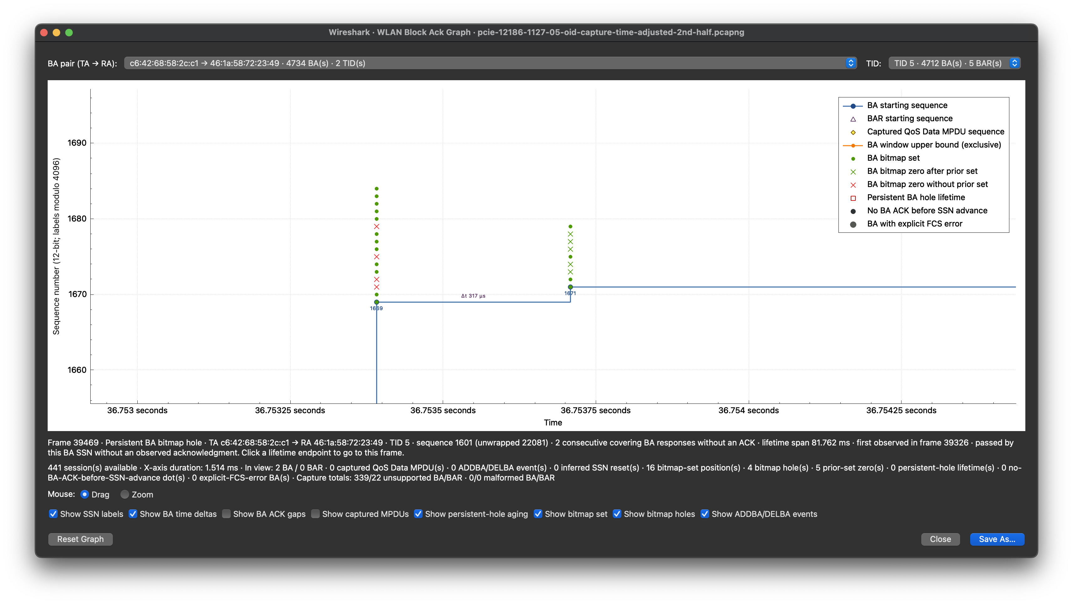
Green vs red crosses: prior-set or unseen
Green: prior set in agreement; zero now
Red: zero now
No prior set in agreement

Slide 12
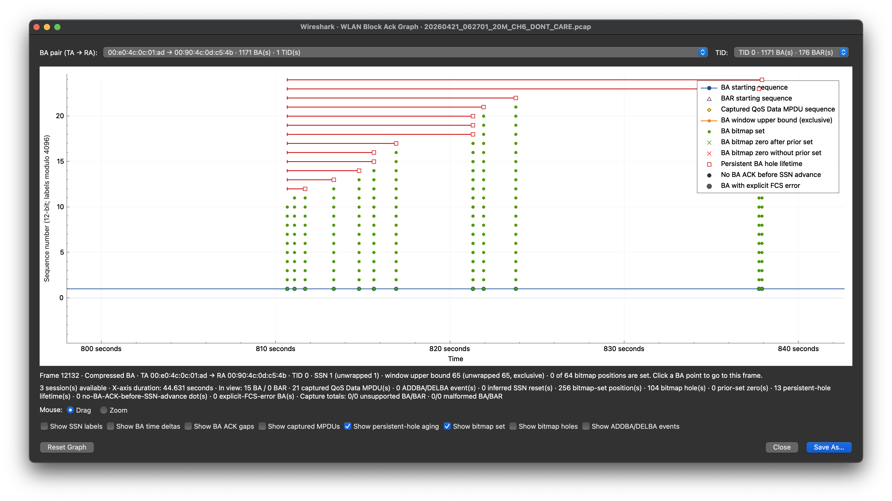
Click a span endpoint for lifetime details

