Slide 1
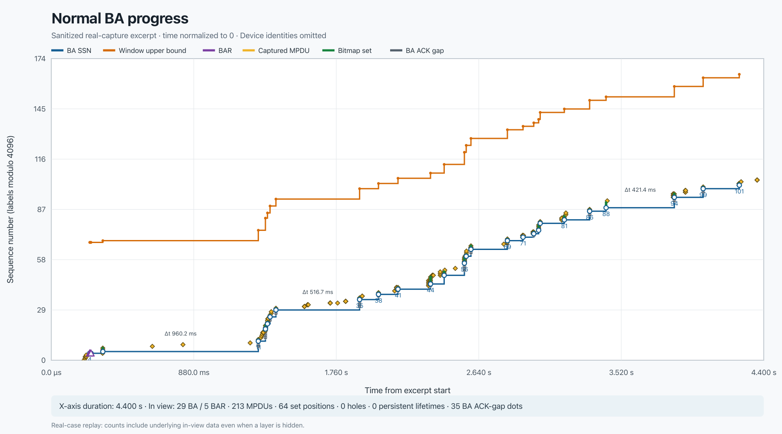
WIRESHARK WLAN
Read Block Ack behavior at a glance
A screenshot-led guide to sessions, bitmap evidence, agreement boundaries, and capture limits.
Real-world captures · current v0.0.3 behavior

Slide 2
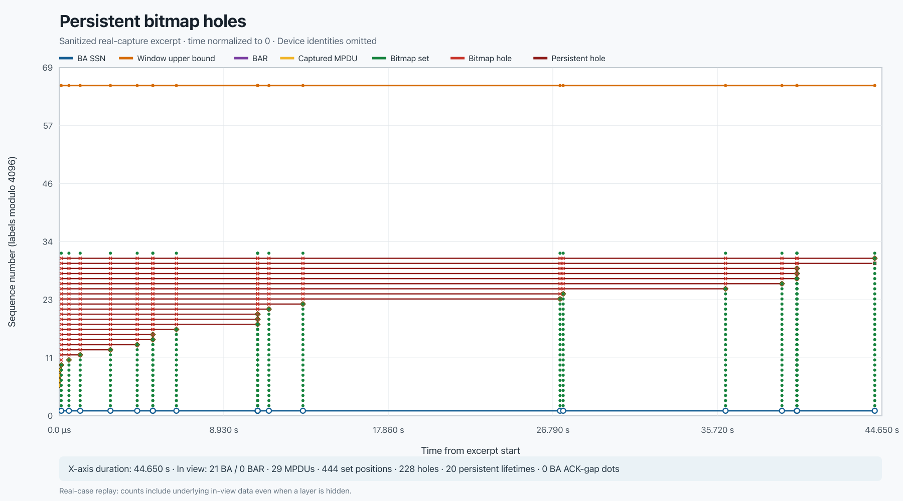
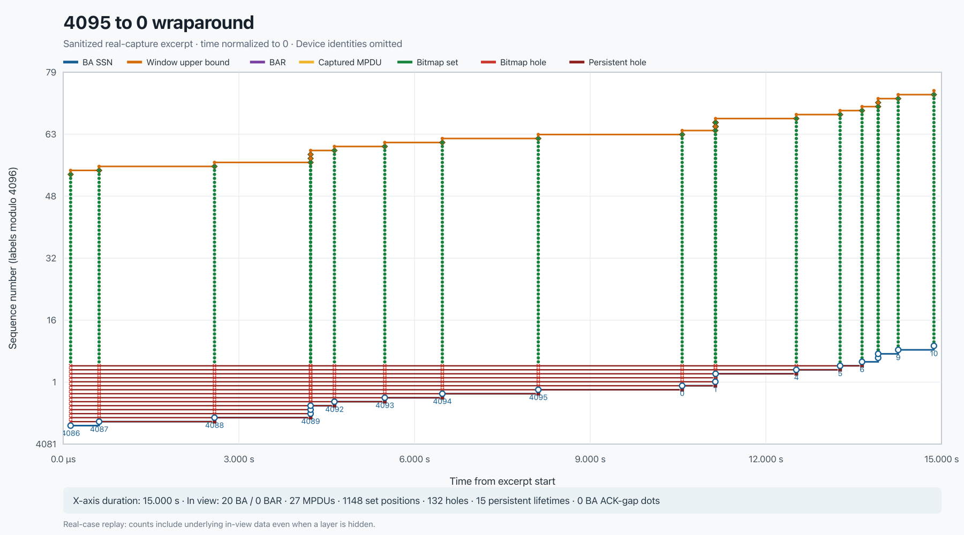
ORIENTATION
Real captures drive every example
Normal progress 29 BA · 5 BAR · 4.4 s
Persistent holes 21 BA · 20 lifetimes
Sequence wrap 4086 … 4095, 0 … 10
Primary source: /Users/yujuiwu/code/debug/WQCPC-13082/20260421_062701_20M_CH6_DONT_CARE.pcap
Static and interactive views are derived from local 802.11/radiotap captures.
02

Slide 3
ORIENTATION
A bitmap is evidence—not a loss verdict
A bitmap zero means “no ACK observed here.”
A captured MPDU means “the sniffer saw it.”
Correlate both before drawing a conclusion.
Real capture: WQCPC-13082/20260421_062701_20M_CH6_DONT_CARE.pcap
03

Slide 4
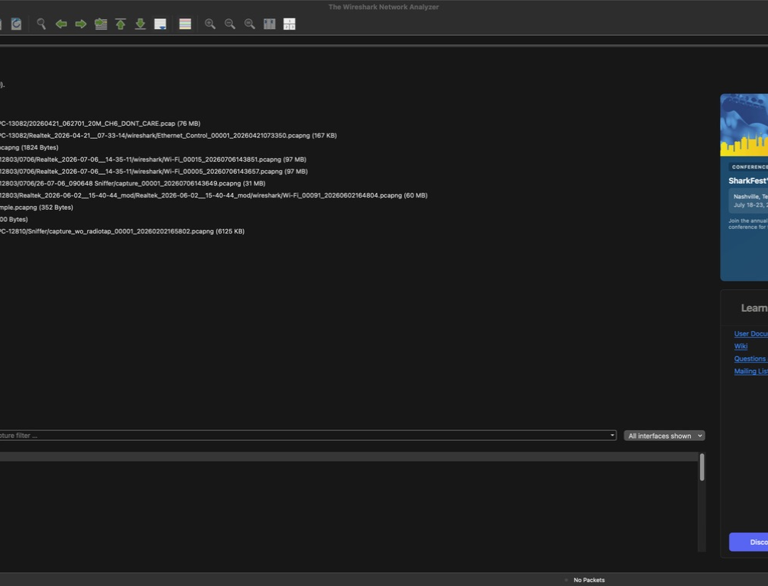
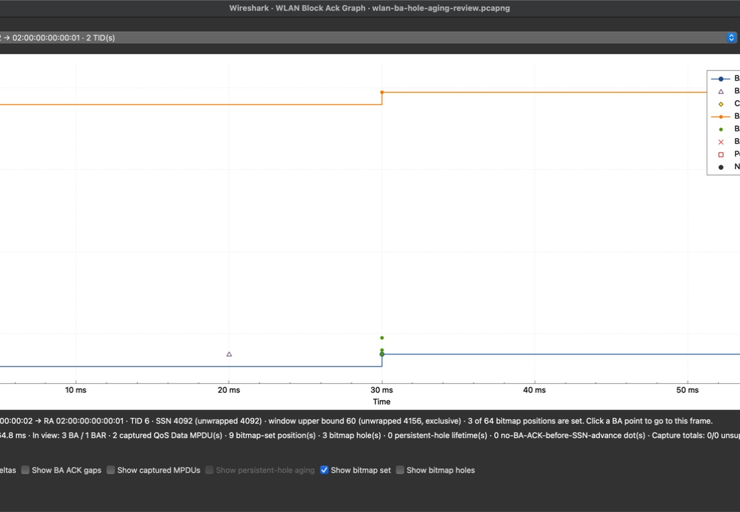
GETTING STARTED
Open all sessions—or follow one BA
Wireless → WLAN Block Ack Graph
Analyze → Follow → WLAN Block Ack Session Graph
Actual local Wireshark development build; UI-only example.
04

Slide 5
GETTING STARTED
Choose the BA pair, then the TID
BA pair (TA → RA) Sorted by total BA count across all TIDs.
TID Sorted by BA count; each item shows BA and BAR totals.
Direction follows the BA response. BARs and matching QoS Data are normalized into that session.
UI controls shown with a local review capture; interpretation examples use real captures.
05

Slide 6
READ THE NORMAL CASE
Read time first, then sequence
Y · sequence number labels modulo 4096
X · capture-relative time
Real capture: WQCPC-13082/20260421_062701_20M_CH6_DONT_CARE.pcap · normal 4.4 s excerpt
06

Slide 7
READ THE NORMAL CASE
Blue starts the window; orange ends it
●
BA starting sequence (SSN)
●
Window upper bound
Upper bound = SSN + number of bitmap sequence positions
Real capture: WQCPC-13082/20260421_062701_20M_CH6_DONT_CARE.pcap · normal excerpt
07

Slide 8
READ THE NORMAL CASE
Shape separates BARs from captured MPDUs
△
BAR starting sequence
◆
Captured QoS Data MPDU
Gold proves capture presence—not receiver delivery.
Real capture: WQCPC-13082/20260421_062701_20M_CH6_DONT_CARE.pcap · normal excerpt
08

Slide 9
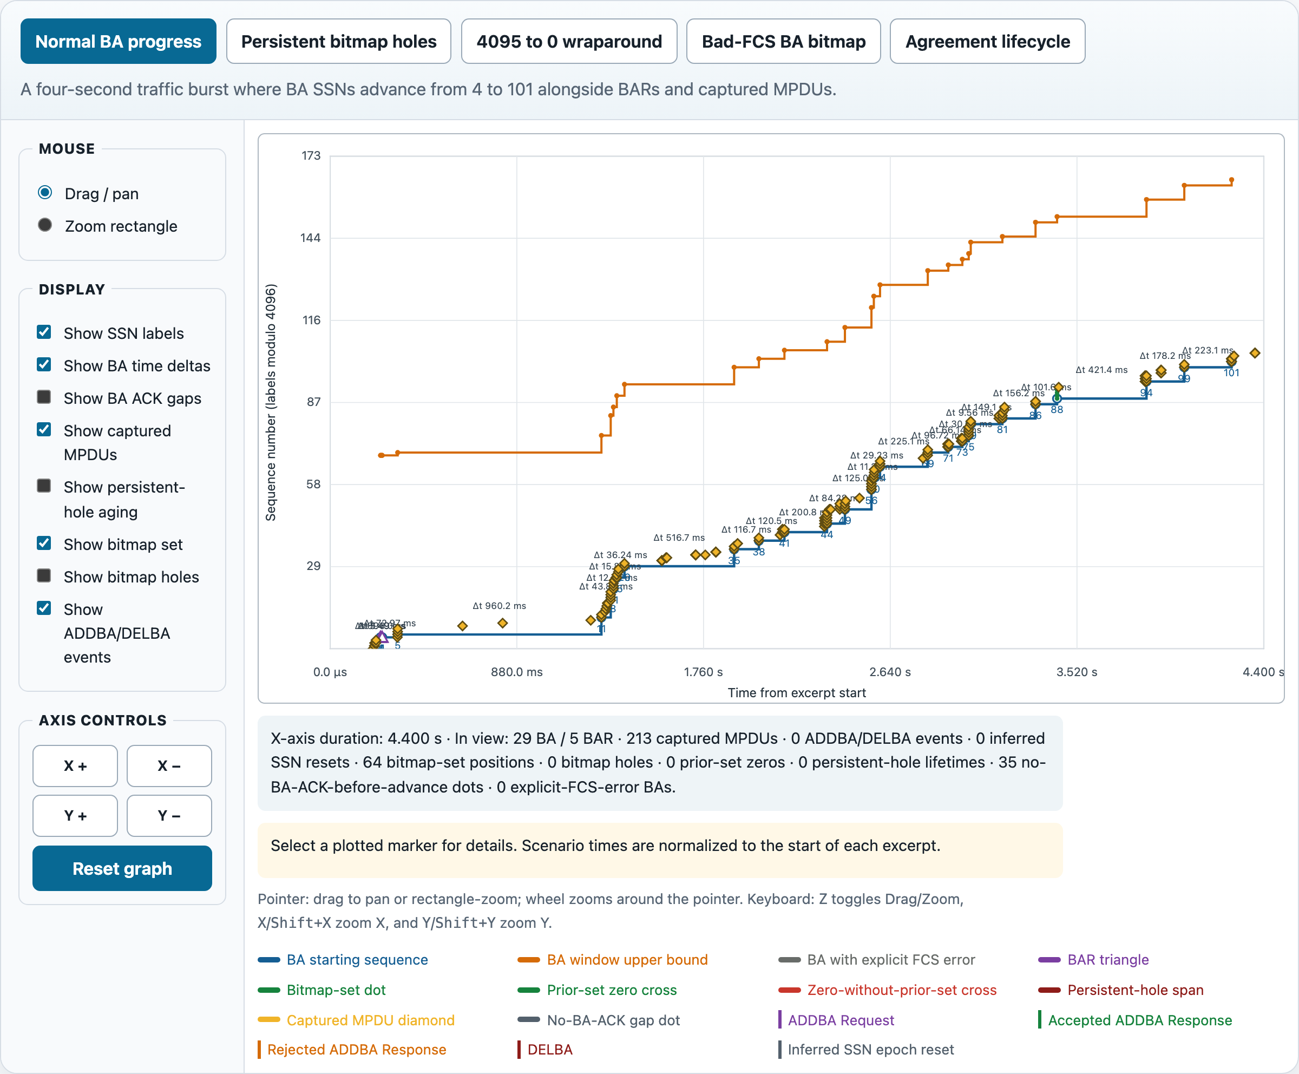
READ THE NORMAL CASE
Green dots are the BA bitmap’s set positions
Clear “Show bitmap set” when dense green evidence hides the core traces.
Real capture: WQCPC-13082/20260421_062701_20M_CH6_DONT_CARE.pcap · interactive normal replay
09

Slide 10
READ THE NORMAL CASE
A healthy session climbs like a staircase
SSN 4 → 101 in 4.4 seconds
Real capture: WQCPC-13082/20260421_062701_20M_CH6_DONT_CARE.pcap · 29 BA · 5 BAR · 213 matching MPDUs
10

Slide 11
USE THE CONTROLS
Labels show SSN; deltas show BA spacing
SSN labels wrapped 12-bit values
BA time deltas 960.2 ms · 516.7 ms · 421.4 ms
Real capture: WQCPC-13082/20260421_062701_20M_CH6_DONT_CARE.pcap · normal excerpt
11

Slide 12

USE THE CONTROLS
Click a marker to jump to its packet
The detail line reports: • frame • wrapped + unwrapped sequence • bitmap or lifetime facts
Wireshark moves the packet list to the source frame.
Actual local Wireshark graph UI; click behavior is packet-linked.
12

Slide 13
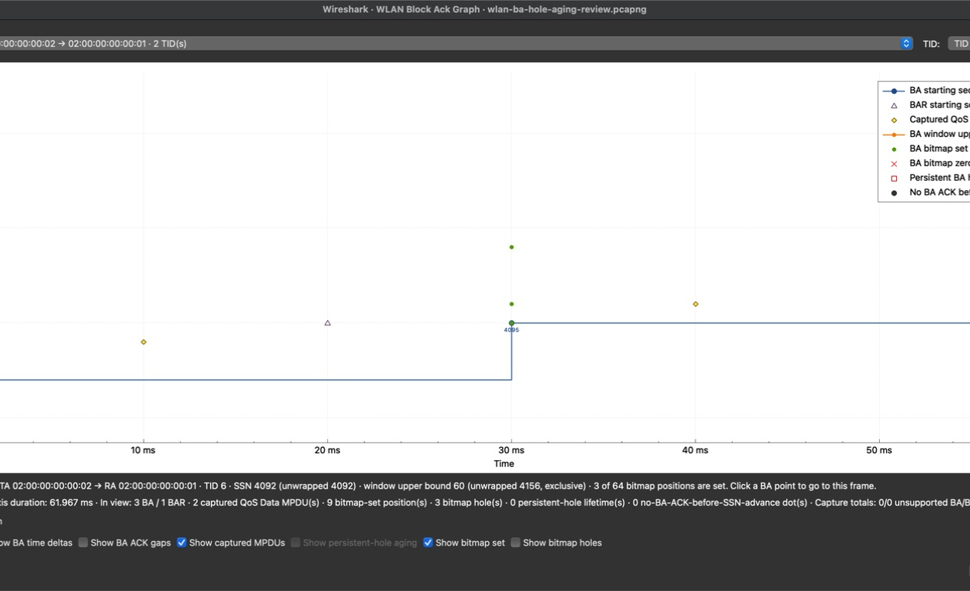
USE THE CONTROLS
Zoom selects; Drag preserves context
Zoom Drag a rectangle across the plot.
Drag Pan the current viewport.
Wheel scales · Reset Graph refits the session
Actual local Wireshark graph UI; the real-data examples use the same controls.
13

Slide 14
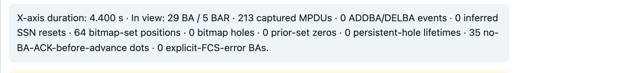
USE THE CONTROLS
The summary follows the visible range
DISPLAYED SPAN
EVENTS CURRENTLY IN VIEW
Real capture: WQCPC-13082/20260421_062701_20M_CH6_DONT_CARE.pcap · interactive normal replay
14

Slide 15
DIAGNOSE EVIDENCE
Gray dots mark SSN advances without BA ACK
●
No BA ACK before SSN advance
It is missing BA evidence. It is not proof that the MPDU was transmitted or lost.
Real capture: WQCPC-13082/20260421_062701_20M_CH6_DONT_CARE.pcap · normal excerpt · 35 gap positions
15

Slide 16
DIAGNOSE EVIDENCE
A hole is a zero before the highest set bit
Trailing zeros are not plotted.
Real capture: WQCPC-13082/20260421_062701_20M_CH6_DONT_CARE.pcap · persistent-hole excerpt · 228 holes
16

Slide 17
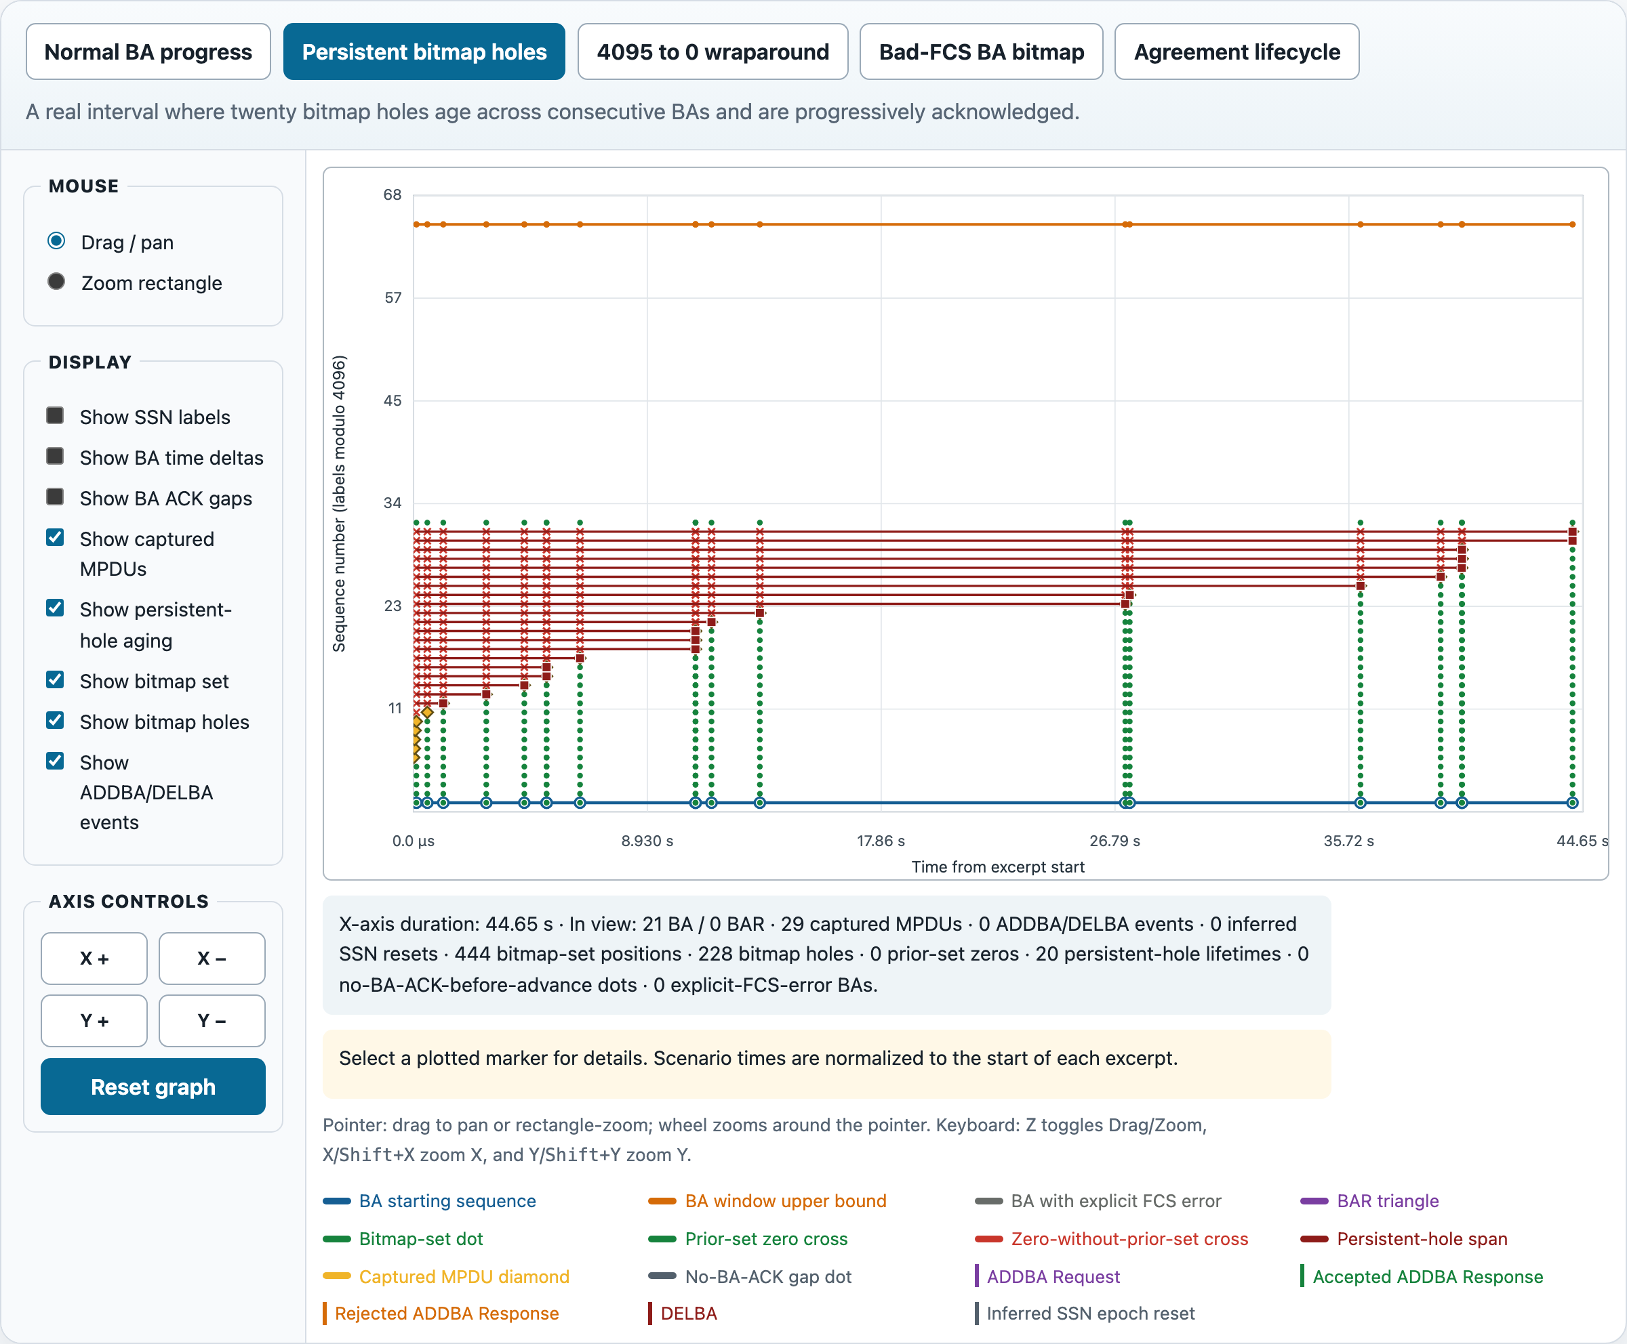
DIAGNOSE EVIDENCE
Persistent-hole spans expose aging
20 lifetimes across consecutive covering BAs
Select a square endpoint to see whether the hole was later ACKed, passed by SSN, interrupted, or still active.
Real capture: WQCPC-13082/20260421_062701_20M_CH6_DONT_CARE.pcap · 21 BA over 44.65 s
17

Slide 18
DIAGNOSE EVIDENCE
Green and red crosses mean different evidence
× Green cross An earlier BA in this agreement explicitly set the sequence.
× Red cross No earlier observed set-bit evidence exists in this agreement.
Neither color, by itself, proves transmission or loss.
Real capture: WQCPC-13082/20260421_062701_20M_CH6_DONT_CARE.pcap · classification is scoped to one agreement epoch
18

Slide 19
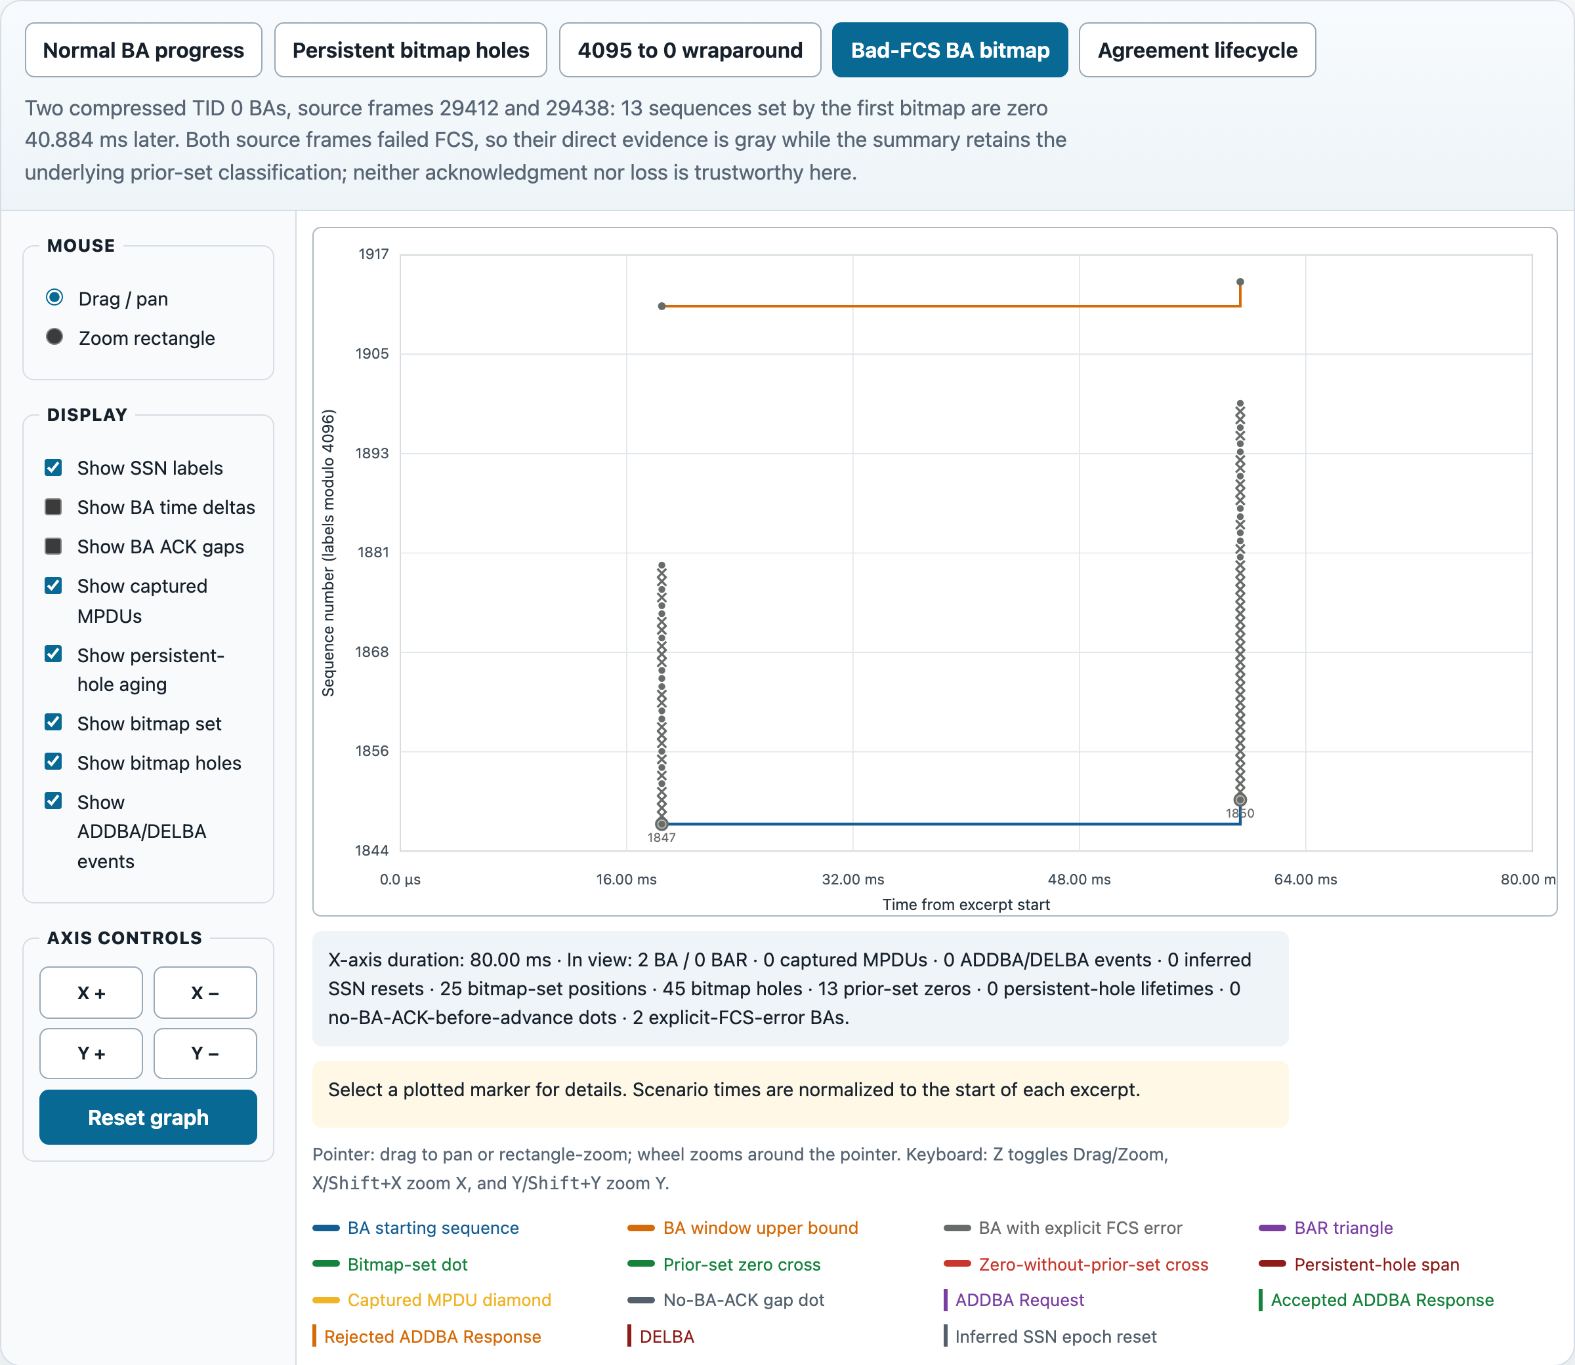
DIAGNOSE EVIDENCE
Gray marks an explicit BA FCS error
2 bad-FCS BAs 40.884 ms apart
Keep the sample for chronology—but treat its bitmap, holes, and labels as untrusted evidence.
Real capture: WQCPC-13082/20260421_062701_20M_CH6_DONT_CARE.pcap · bad-FCS frames 29412 and 29438
19

Slide 20
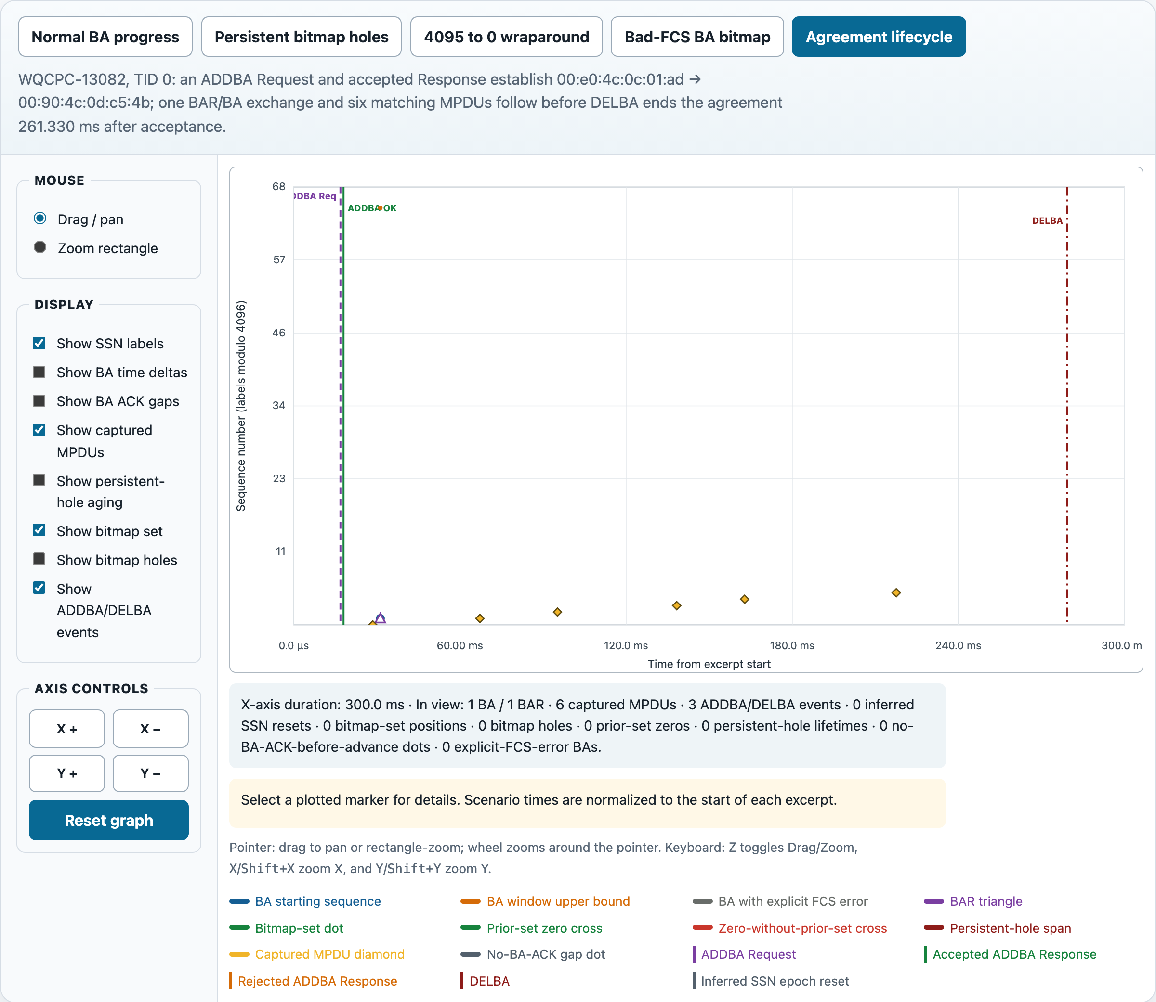
DIAGNOSE EVIDENCE
ADDBA and DELBA bound the agreement
ADDBA OK starts a new agreement and clears prior history
DELBA ends the agreement and clears history
Request and rejected response are context only.
Real capture: WQCPC-13082/20260421_062701_20M_CH6_DONT_CARE.pcap · frames 12118, 12120, and 12192 · TID 0
20

Slide 21
DIAGNOSE EVIDENCE
4095 → 0 is wraparound—not a reset
Internal progression stays continuous: 4095, 4096, 4097 …
A backward sample that cannot extend the ACK frontier starts an inferred epoch only when wrap logic cannot explain it.
Real capture: WQCPC-13082/20260421_062701_20M_CH6_DONT_CARE.pcap · 20 BA · SSN 4086 … 4095, 0 … 10
21

Slide 22
TROUBLESHOOT
Why a valid WLAN frame may not appear
Wrong BA response direction
Different TID or session epoch
Not a supported BA/BAR format
Malformed or incomplete dissection
No usable bitmap / address / TID fields
Use the packet fields and capture-total counters before assuming a plotting defect.
22

Slide 23
TROUBLESHOOT
The 32-bit BA-looking record is corrupt
Field
Observed value
Do not treat this as a valid 32-bit BA session.
Frame / time
44354 / 40.298502 s
Decoded type
Multi-STA Block Ack response
TA → RA
e1:24:a9:9c:d3:30 → 11:12:b4:5f:eb:56
Current graph excludes Multi-STA BA. The implausible addresses and explicit radio errors support that decision.
Entry
AID 0x722 · TID 2 · SSN 680
Bitmap
e6084730 · 4 bytes / 32 bits
Trust
Radiotap Bad FCS + Bad PLCP
Matching reverse-direction BARs: 0
Real capture audit: pcie-12186-1127-05-oid-capture-time-adjusted-2nd-half.pcapng
23

Slide 24
REFERENCE
Which BA formats the graph accepts
Format
Graph treatment
Real-case status
Basic BA
Supported
Code-checked
Compressed BA
Supported
2,217 BA verified
Extended Compressed
Supported
Code-checked
Multi-TID
Supported
Code-checked
Multi-STA / GCR
Excluded
Unsupported counter
The BA window upper bound reflects the number of sequence positions represented—not simply the byte count.
Current code path; primary WQCPC capture verifies Compressed BA only.
24

Slide 25
WORKFLOW
Turn a long capture into one interval
→
1 · choose pair + TID 2 · enable only the needed layers 3 · rectangle-zoom
4 · read the live summary 5 · click markers back to frames 6 · check FCS and capture visibility
Real capture: WQCPC-13082/20260421_062701_20M_CH6_DONT_CARE.pcap · normal replay used as the focused interval
25

Slide 26
WORKFLOW
Use the same six questions every time
1 · Pair + TID
2 · Agreement epoch
3 · SSN + BAR
4 · Bitmap history
5 · MPDU + retry evidence
6 · FCS + capture quality
A repeatable interpretation sequence reduces false loss conclusions.
26

Slide 27
LIMITATIONS
Capture quality sets the confidence ceiling
Explicit bad FCS Decoded, but untrusted
Bitmap zero No ACK observed—not proven loss
Examples are capture evidence; receiver-internal delivery state is not directly observed.
27

Slide 28
APPENDIX
Verified cases behind these examples
Case
Verified result
Capture inventory
310,253 packets · radiotap IEEE 802.11 · 3,700.708032 s
BA / BAR extraction
2,217 compressed BA · 234 compressed BAR
Normal replay
29 BA · 5 BAR · 213 MPDU · 35 ACK gaps
Persistent replay
21 BA · 444 set · 228 holes · 20 lifetimes
Wrap replay
4086 … 4095, 0 … 10 stays continuous
Bad-FCS classification
Frames 29412, 29438, 29771, 29815
Agreement lifecycle
Frames 12118 request · 12120 OK · 12192 DELBA
No dedicated automated GUI interaction test is claimed; visual behavior was inspected from the generated deck and source-backed captures.
Local capture extraction, renderer replay, and current source inspection.
28

Slide 29
APPENDIX
Capture index and control reference
Use
Capture / asset
Primary behavior
…/WQCPC-13082/20260421_062701_20M_CH6_DONT_CARE.pcap
32-bit audit
…/PCIE-12186/1127/05-oid-capture/pcie-…-2nd-half.pcapng
Static views
doc/wsug_src/images/ws-wlan-ba-real-{normal,holes,wrap}.png
Interactive replay
doc/wlan_block_ack_graph.html
Mouse Drag · Zoom · wheel · axis drag
Keyboard Z · X/Shift+X · Y/Shift+Y
Output Reset Graph · Save As PDF/PNG/BMP/JPEG
Full source paths are retained for local reproduction.
29

Slide 30
WLAN BLOCK ACK GRAPH
Start with the session. End with the evidence.
Pair + TID → agreement epoch → SSN/BAR → bitmap history → MPDU/retry evidence → FCS quality
A zero is evidence to investigate—not a verdict.

