Slide 1

Malware Detection
Static Analysis & Model Ensemble
資管三 106306062 郭宇雋

Slide 2
Part1. Introduction

Slide 3
Malware Detection
- Static Analysis :
- PE Section Headers
- PE Imports
- PE as Image
- Dynamic Analysis
- API Call

Slide 4
Malware Detection
- Static Analysis :
- PE Section Headers
- PE Imports
- PE as Image
- Dynamic Analysis
- API Call

Slide 5
Malware Detection
- Static Analysis :
- PE Section Headers -> Yes/No
- PE Imports -> Yes/No
- PE as Image -> Yes/No
- Dynamic Analysis
- API Call

Slide 6
Malware Detection
- Static Analysis :
- PE Section Headers -> Yes/No
- PE Imports -> Yes/No
- PE as Image -> Yes/No
- Dynamic Analysis
- API Call
Final Result (Yes/No)

Slide 7
Model Ensemble
FC Layer
Program
Concatenate
Header Data
DNN Model
0/1
Import Data
DNN Model
0/1
0/1
Image Data
CNN Model
0/1

Slide 8
Will Model Ensemble
perform better than
Individual Model?

Slide 9
Part2. Literature Review

Slide 10

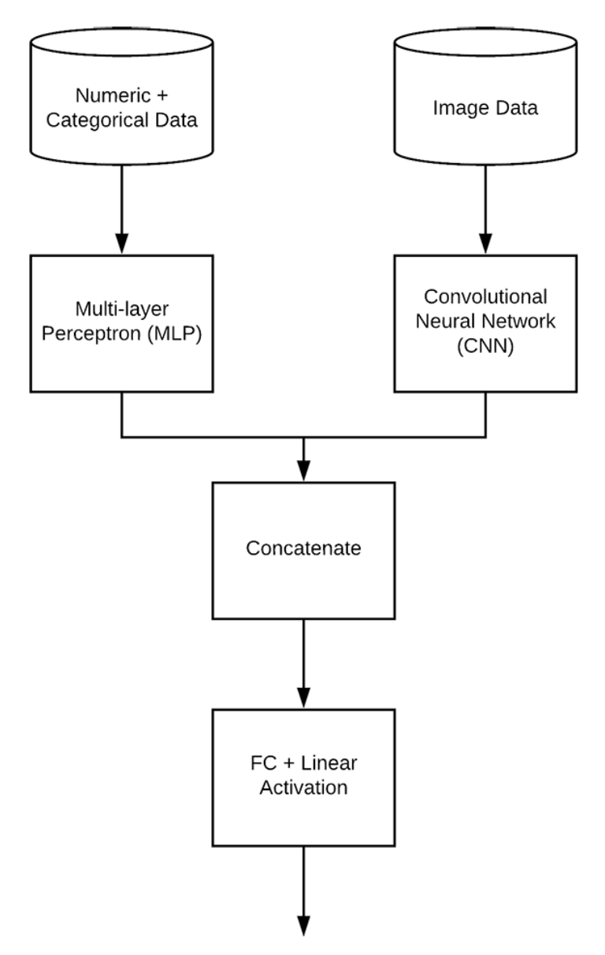
Keras: Multiple Inputs and Mixed Data
Ref: https://www.pyimagesearch.com/2019/02/04/keras-multiple-inputs-and-mixed-data/
- Two Different Inputs
- Two Different Models
- Concatenate Layer
- Fully Connected Layer

Slide 11
Keras: Multiple Inputs and Mixed Data
Ref: https://www.pyimagesearch.com/2019/02/04/keras-multiple-inputs-and-mixed-data/
MAPE
- MLP (DNN): 22.71%
- CNN: 56.91%
- Ensemble: 27.52%

Slide 12
Part3. Datasets

Slide 13
Total 3 Datasets:
Malware Analysis Datasets:
PE Section Headers
Malware Analysis Datasets:
Top-1000 PE Imports
Malware Analysis Datasets:
Raw PE as Image

Slide 14
1) Malware Analysis Datasets:
PE Section Headers
.text Section Header Data
- hash
- size_of_data
- virtual_address
- entropy
- virtual_size
- malware (0: Benign / 1: Malware)

Slide 15
2) Malware Analysis Datasets:
Top-1000 PE Imports
Total 1000 columns
- Binary Variable (0: not import / 1: import)
- malware (0: Benign / 1: Malware)

Slide 16
3) Malware Analysis Datasets:
Raw PE as Image
32*32 Grayscale Images
Total 1024 columns
- Each pixel [0, 255] -> Each column [0, 255]
- malware (0: Benign / 1: Malware)

Slide 17
Part4. Data Preprocessing

Slide 18
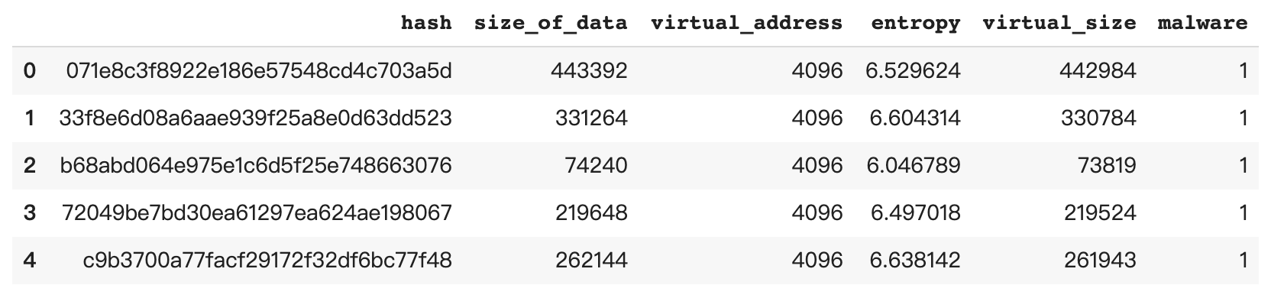
PE Section Headers Dataframe

Slide 19
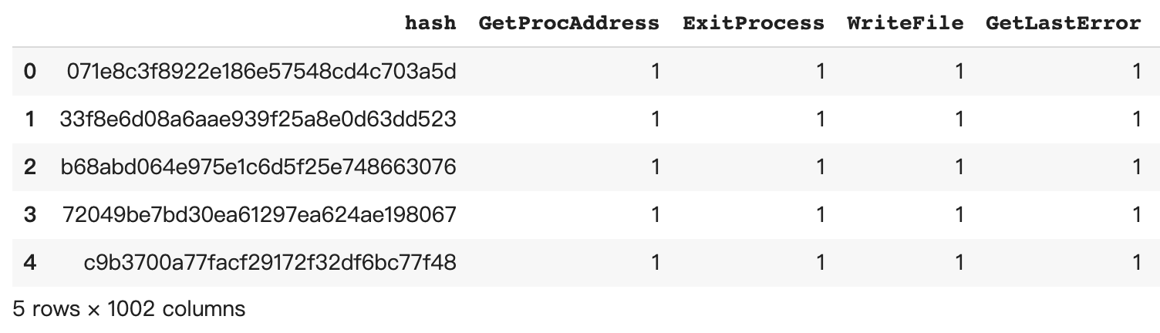
Top-1000 PE Imports Dataframe

Slide 20
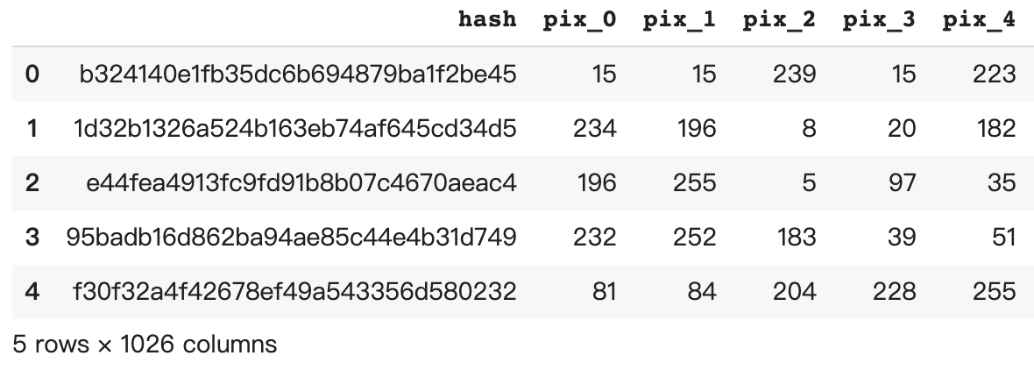
Raw PE as Image Dataframe

Slide 21
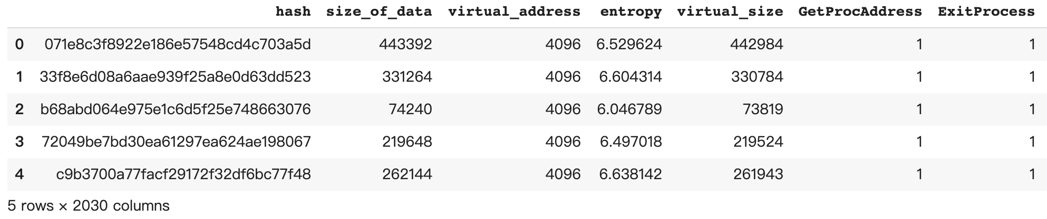
Merged Dataframe
- Merge by hash
- Drop all duplicated observations

Slide 22
Feature Engineering
- Add new column called “disk_memory_ratio”
- Calculated from ”size_of_data / virtual_size”
- The ratio of section size
In the disk vs. In the memory

Slide 23
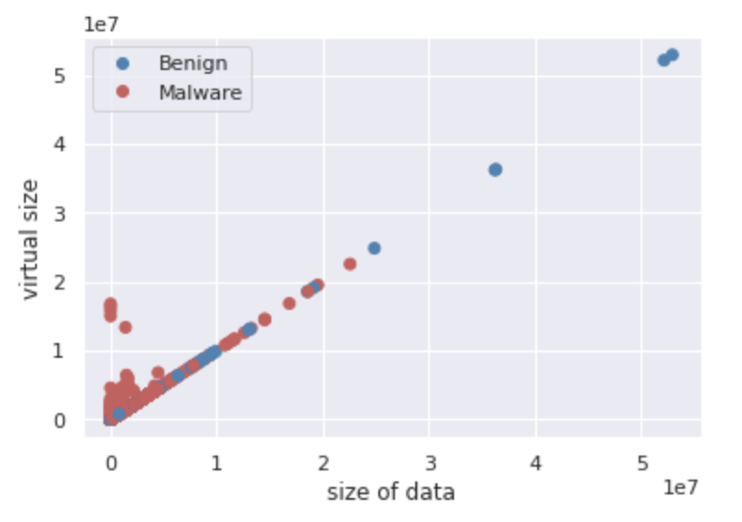
EDA
- Size_of_data and Virtual_size Distribution

Slide 24
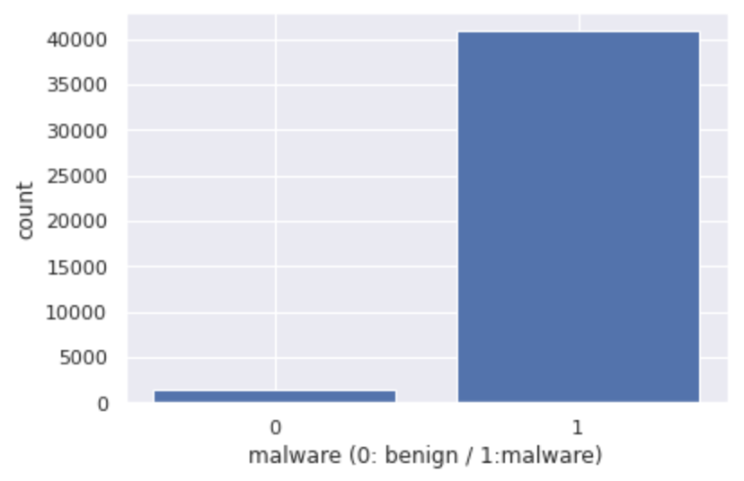
EDA
- Malware vs. Benign Distribution

Slide 25
We need Resampling!!
- Use ADASYN Oversampling

Slide 26
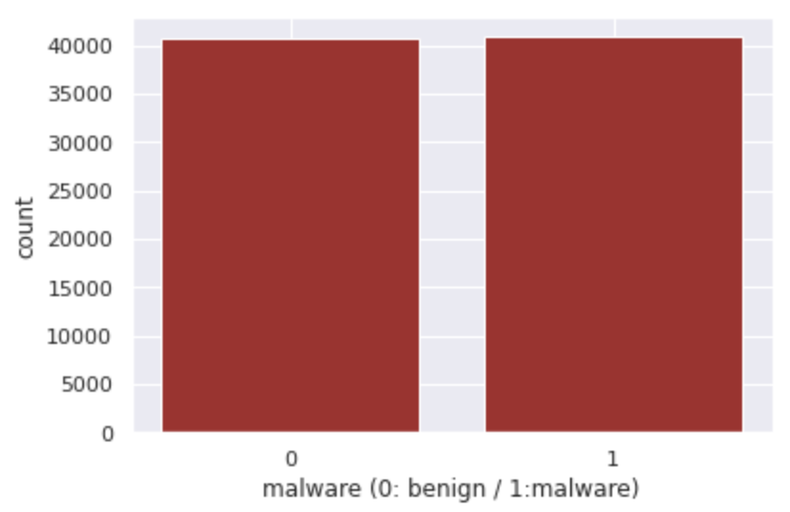
After ADASYN Oversampling
- Malware vs. Benign Distribution

Slide 27
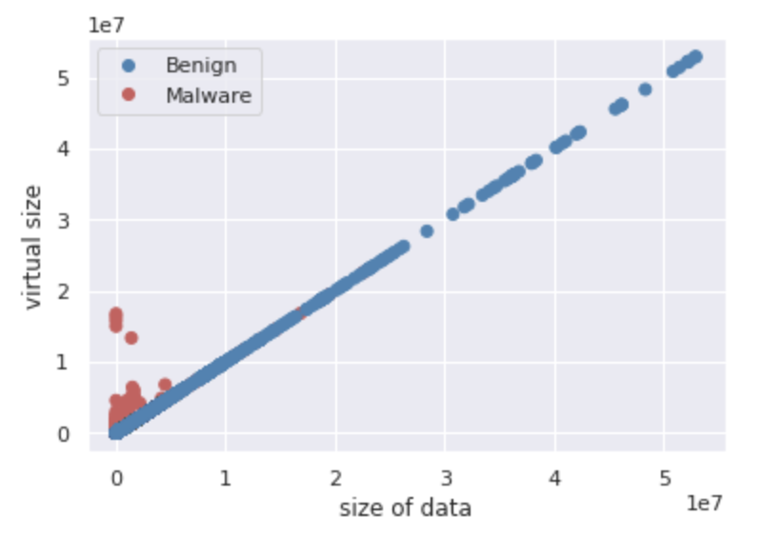
After ADASYN Oversampling
- Size_of_data and Virtual_size Distribution

Slide 28
Part5. Individual Models

Slide 29
First Model: PE Section Headers
- Standardization (Z-Score)
- Build DNN model
- Dense(32) + Dense(32) + Dense(64) + Dropout(0.2) + Dense(1)
- Adam (lr= 0.0003) and Early stopping

Slide 30
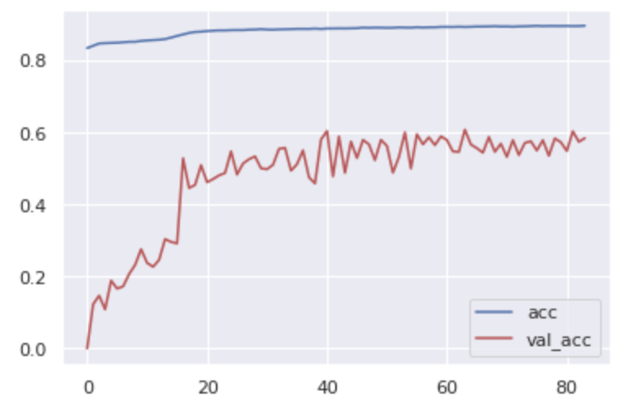
First Model: PE Section Headers
Result :
-Training Accuracy: 89.71%
-Validation Accuracy: 58.46%

Slide 31
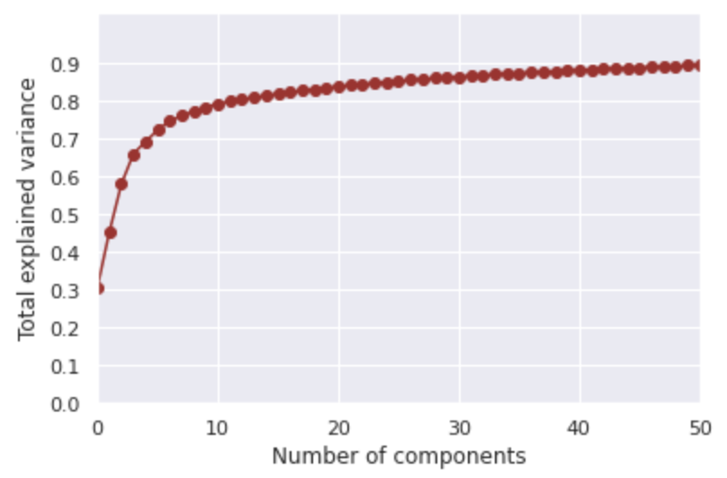
Second Model: Top-1000 PE Imports
- PCA
- Choose 60 PCs
- Total explained Variance = 90%
- Build DNN model
- Dense(64) + Dense(64) + Dropout(0.4) + Dense(32)
+ Dense(32) + Dropout(0.2) + Dense(1)
- Adam (lr= 0.0001) and Early stopping

Slide 32
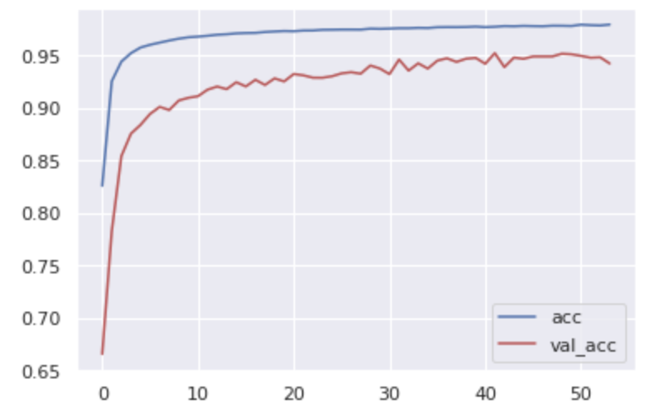
Second Model: Top-1000 PE Imports
Result :
-Training Accuracy: 97.97%
-Validation Accuracy: 94.26%

Slide 33
Third Model: Raw PE as Image
- Min-Max Normalization
- From [0, 255] to [0, 1]
- Reshape to (32, 32, 1)
- Build CNN model
- Input + Conv2D(32, 4*4) + Conv2D(64, 4*4) +
MaxPooling2D(2*2) + Conv2D(128, 4*4) + Conv2D(128, 4*4) +
MaxPooling2D(2*2) + Flatten + Dense(256) + Dropout(0.4) + Dense(1)
- Adam (lr= 0.000003) and Early stopping

Slide 34
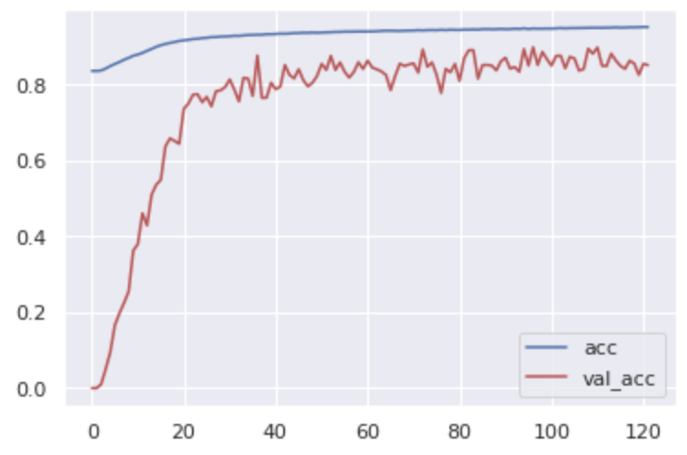
Third Model: Raw PE as Image
Result :
-Training Accuracy: 95.11%
-Validation Accuracy: 85.1%

Slide 35
Part6. Model Ensemble

Slide 36
Model Ensemble
FC Layer
Program
Concatenate
Header Data
DNN Model
0/1
Import Data
DNN Model
0/1
0/1
Image Data
CNN Model
0/1

Slide 37
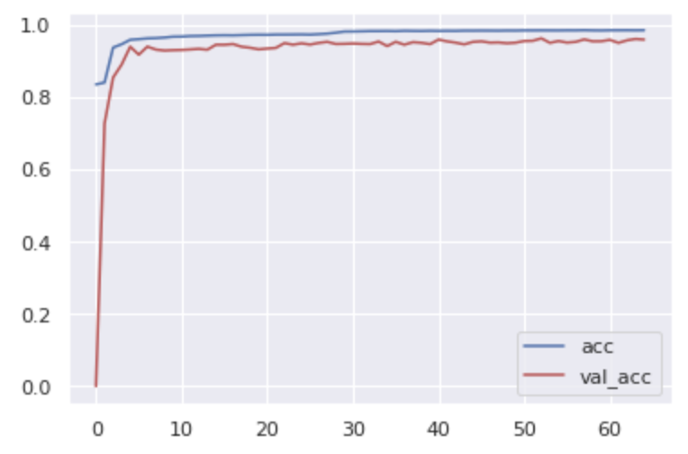
Model Ensemble
Result :
-Training Accuracy: 98.58%
-Validation Accuracy: 95.99%

Slide 38
Model Ensemble vs. Individual Model
 | Training Accuracy | Validation Accuracy
PE Section Headers with DNN | 89.71% | 58.46%
Top-1000 PE Imports with DNN | 97.97% | 94.26%
Raw PE as Image with CNN | 95.11% | 85.1%
Ensemble Model | 98.58% | 95.99%

Slide 39
Part7. Conclusion

Slide 40
Base on these datasets and the final result,
when used in Malware Detection,
Model Ensemble will perform better than Individual Model.
Moreover, instead of Average Layer,
FC Layer would be a good choice to make the NN learn the proper weights of each model’s output.

Slide 41
Datasets Reference:
[1] Angelo Oliveira, "Malware Analysis Datasets: PE Section Headers",
IEEE Dataport, 2019.
[Online]. Available: http://dx.doi.org/10.21227/2czh-es14.
Accessed: Jun. 13, 2020.
[2] Angelo Oliveira, "Malware Analysis Datasets: Top-1000 PE Imports",
IEEE Dataport, 2019.
[Online]. Available: http://dx.doi.org/10.21227/004e-v304.
Accessed: Jun. 13, 2020.
[3] Angelo Oliveira, "Malware Analysis Datasets: Raw PE as Image",
IEEE Dataport, 2019.
[Online]. Available: http://dx.doi.org/10.21227/8brp-j220.
Accessed: Jun. 13, 2020.

