Slide 1

AIDEA 醫病資料去識別化
106306040 資管四 洪忻柔
106306048 資管四 江岳憫
106306062 資管四 郭宇雋

Slide 2
Data

Slide 3
Structure
Input data
Model output
Final output
Model
Rule-Based

Slide 4
Model
Part1. LSTM

Slide 5
Part1. LSTM
2-Layer
Bi-LSTM
BERT
Embedding
LSTM
Prediction

Slide 6
Part1. LSTM
Preprocessing
Bi-LSTM (2-Layer)
Input Sentences
512 Characters
Get BERT Embedding (and Padding)
Class Weight
Train LSTM to predict NER Label
units = 128
Dropout = 0.2
Optimizer = Adam
Learning rate = 0.0006
Epochs = 25

Slide 7
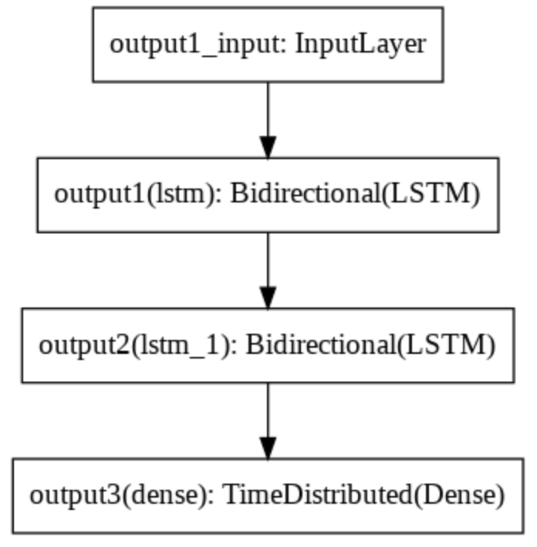
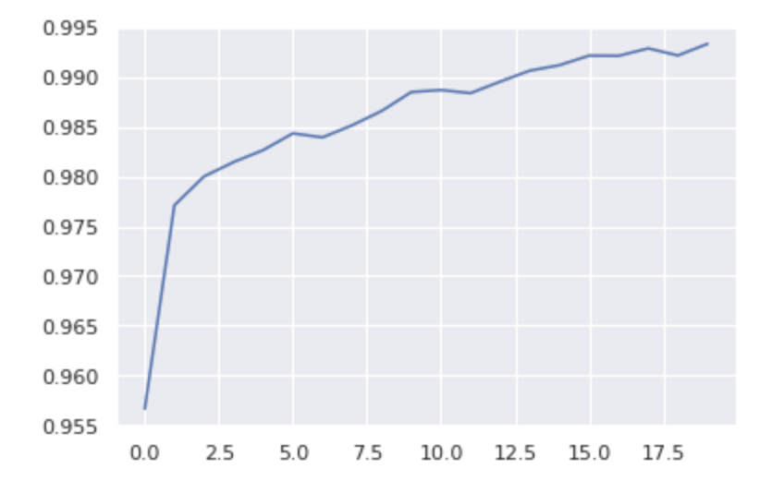
Part1. LSTM

Slide 8
Model
Part2. CRF

Slide 9
Part2. CRF
CRF
Model
LSTM Prediction
N-gram Character
Model
Prediction

Slide 10
Part2. CRF
Unigram (1-gram)
Bigram (2-gram)
Trigram (3-gram)

Slide 11
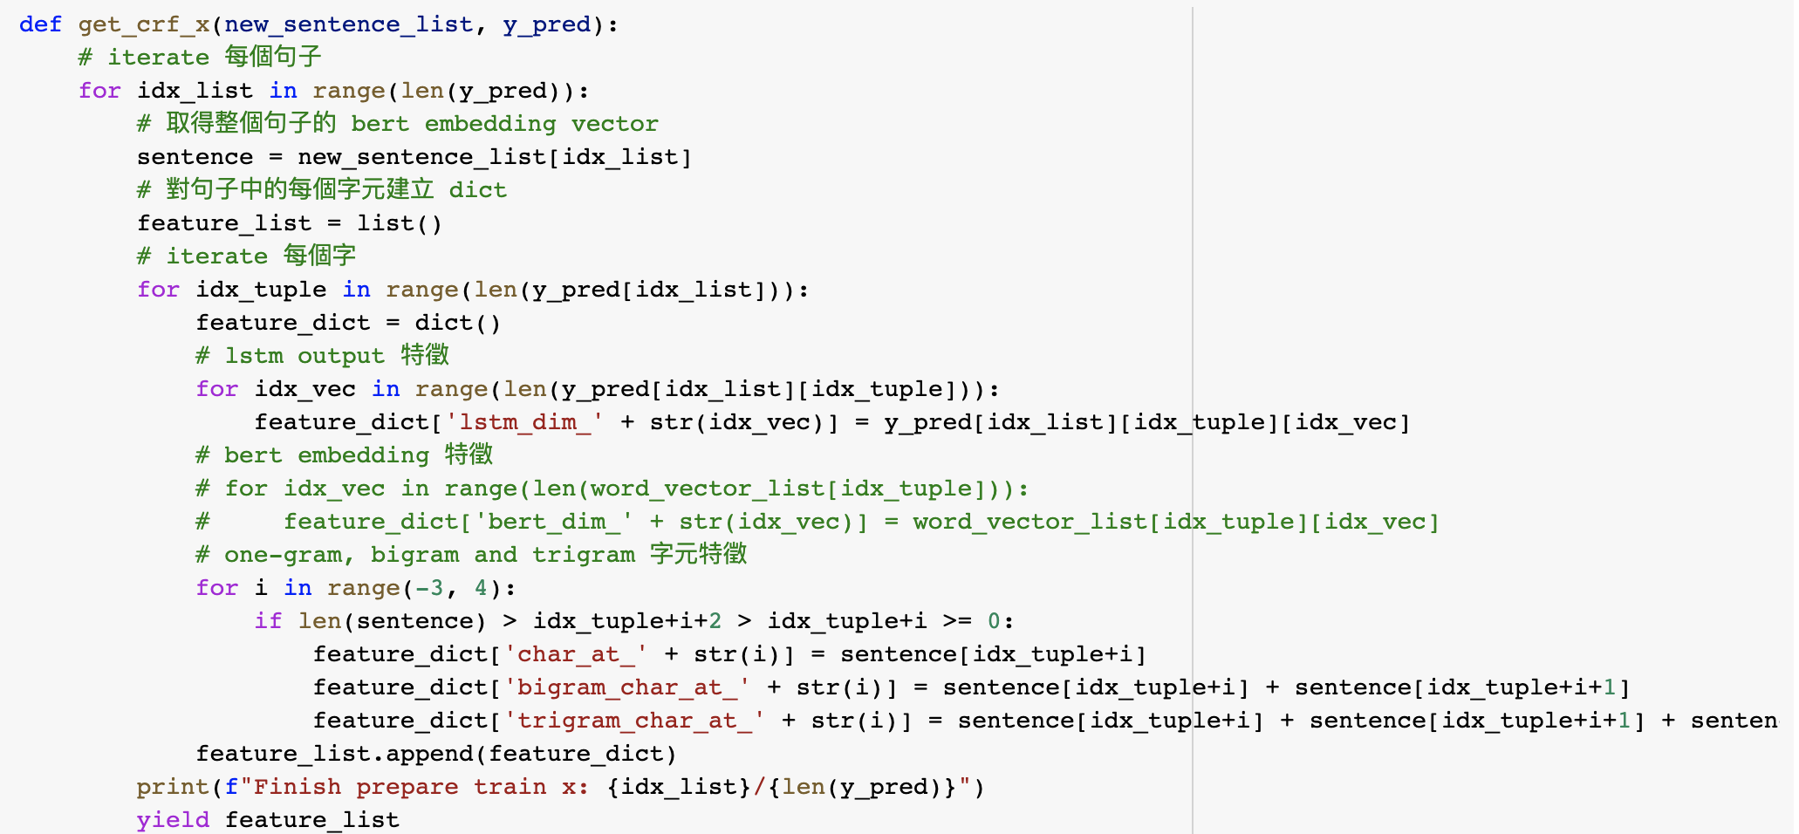
Part2. CRF
LSTM
N-gram

Slide 12
Model
Part3. Prediction

Slide 13
Part3. Prediction
2-Layer
Bi-LSTM
BERT
Embedding
LSTM
Prediction
+
CRF
Model
N-gram
Character
Model
Prediction

Slide 14
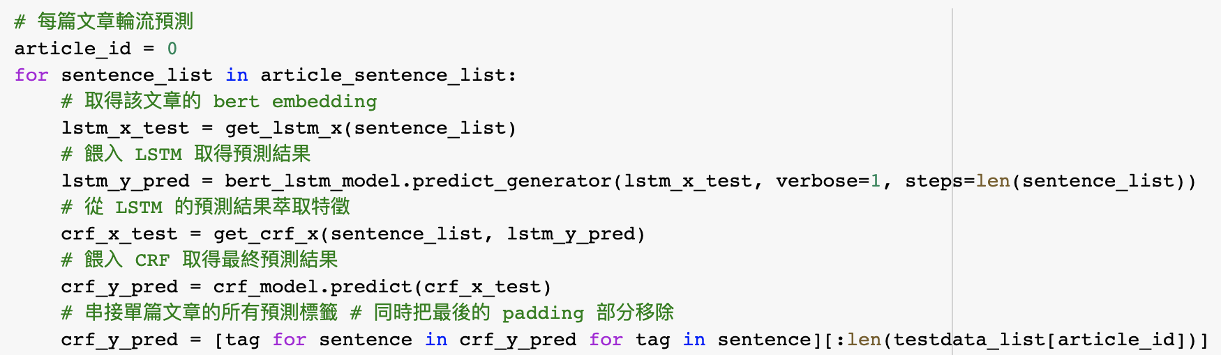
Part3. Prediction

Slide 15
Other Strategies
Rule Based

Slide 16
Structure --- Rule Based
Model output
time
contact/id
family
education
location
name
profession
clinical event
Rule-Based
Final output

Slide 17
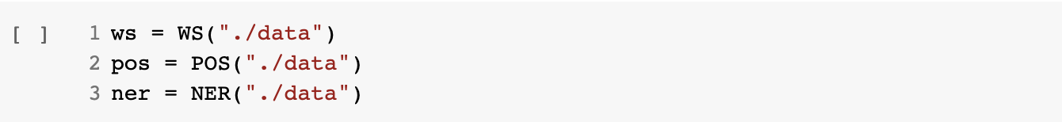
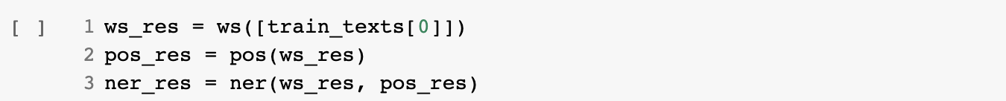
CkipTagger

Slide 18
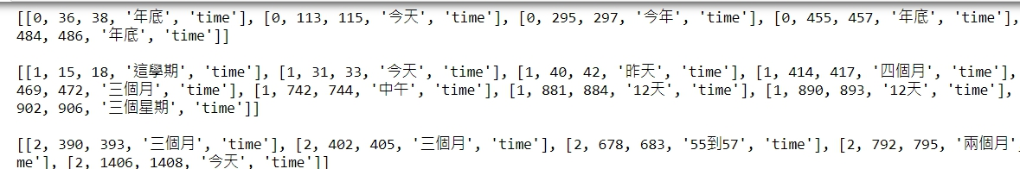
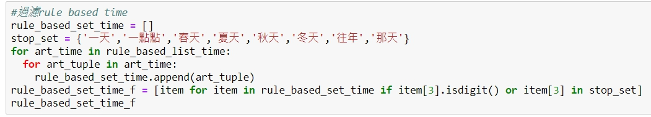
Time
OUTPUT:

Slide 19
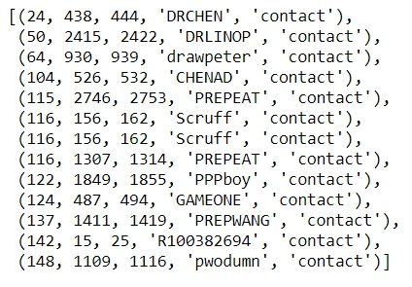
Line ID
找到文章中有line後面的英文數字組成
OUTPUT:

Slide 20
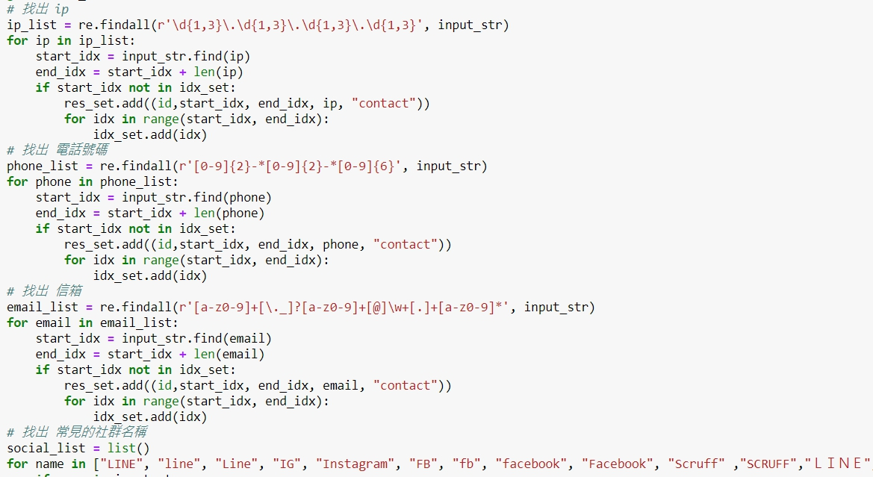
Contact
電話號碼 、信箱、常見社群名稱

Slide 21
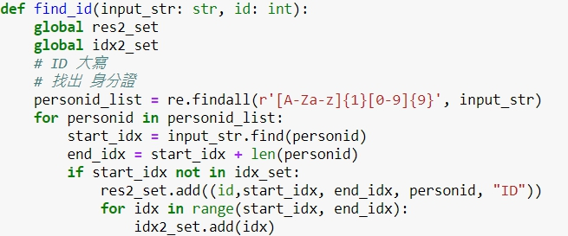
ID
個人有關編號, ex:身分證號碼

Slide 22
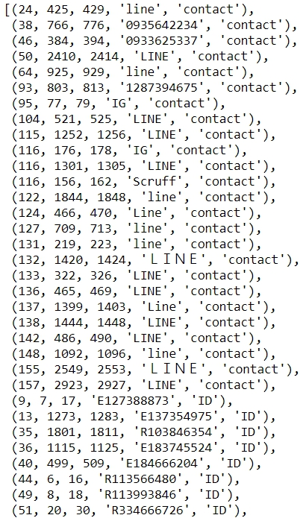
連絡方式與ID
OUTPUT:

Slide 23
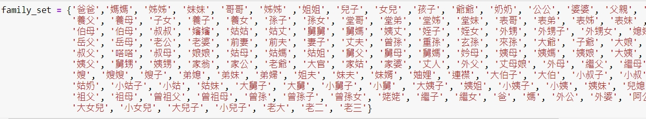
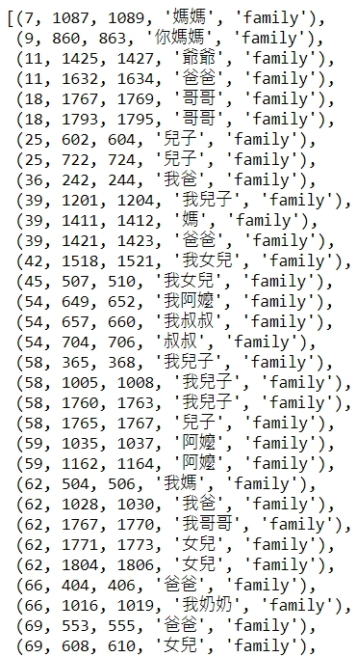
Family
OUTPUT:

Slide 24
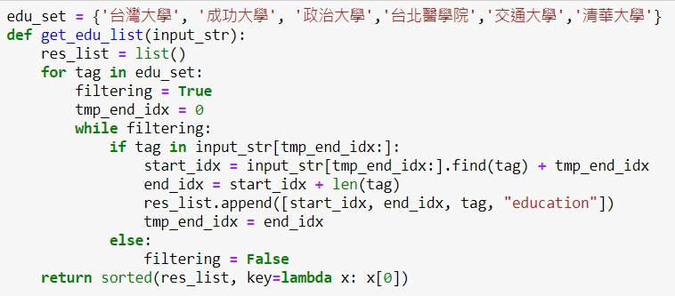
Education

Slide 25
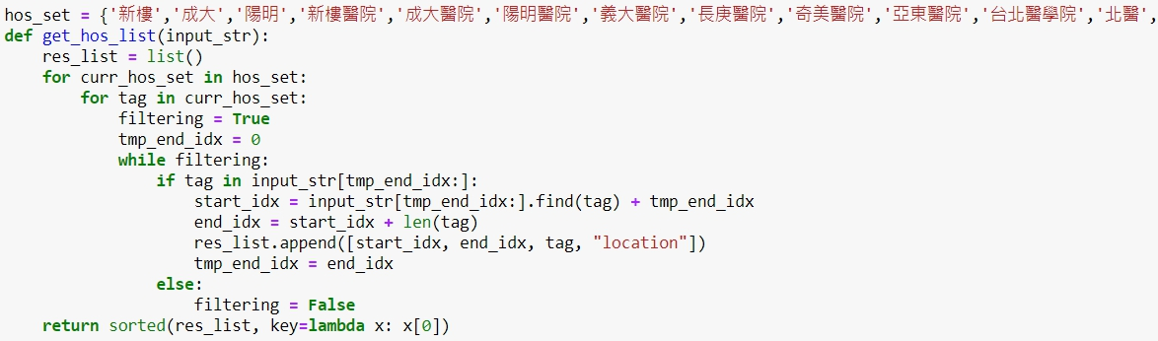
Location --- Hospital

Slide 26
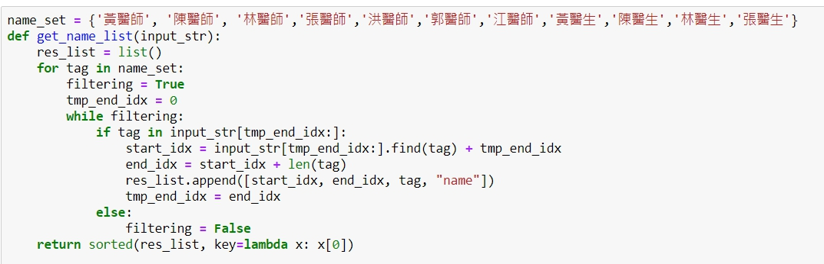
Name --- Doctors

Slide 27
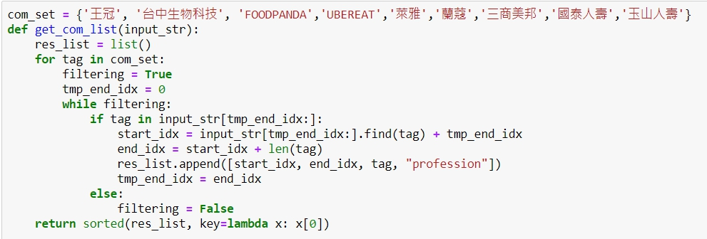
Profession

Slide 28
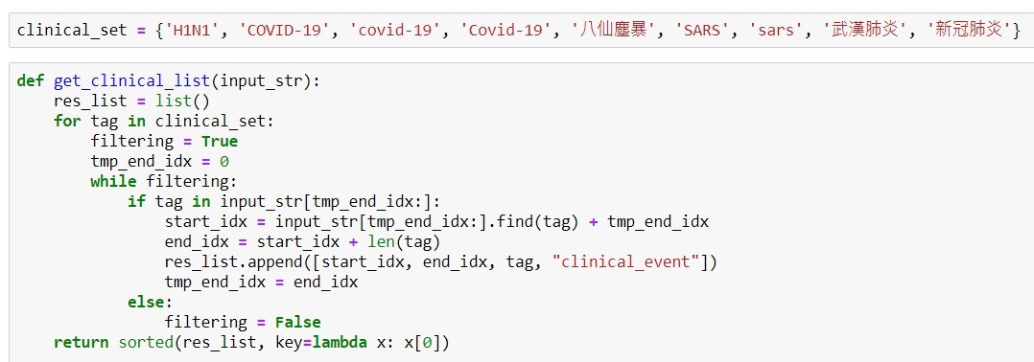
Clinical Event

Slide 29
Other Strategies
若有重複範圍
time : 以model output為主
其他rule based 皆取代model

Slide 30

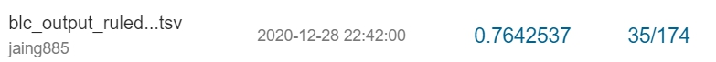
Score
Public
Private

Slide 31
Findings

