Slide 1
SchoolBell.chat
Coding Challenge
Yutaka Kawakami & Harry Lo

Slide 2


solution architecture
Model
EmployeeModel
DepartmentModel
Route to URL
View
Employee/Create
Database
Employee/Update
Controller
Employee/Index
Employee/Detail
MySQL
Department/Create
EmployeeController
Department/Update
Employee
DepartmentController
Department/Index
Department
Department/Detail

Slide 3
Entity Relationship Diagram
Manage
Employee
PK:
Id: INT
FirstName: VARCHAR
LastName: VARCHAR
Age: INT
Gender: INT
DepartmentId: INT
ManagerId: INT
Salary: INT
JoiningData DATETIME
Department
PK:
Id: INT
DepartmentName: VARCHAR
FK:

Slide 4
Package Diagram
Models
Controllers
DepartmentModel.cs
EmployeeModel.cs
EmployeeSearchViewModel.cs
ErrorViewModel.cs
DepartmentController.cs
EmployeeController.cs
Database
Views
Department
Employee
Department
Employee

Slide 5
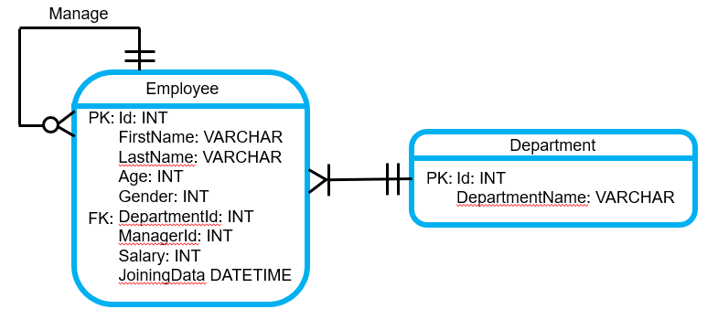
Class diagram
Department
*
- Id: int
- DepartmentName: string
0..
*
0..
<<Employee/Create.cshtml >>
<< Employee/Update.cshtml >>
<< Employee/Index.cshtml >>
<< Employee/Delete.cshtml>>
<<Department/Create.cshtml >>
<< Department/Update.cshtml >>
<< Department/Index.cshtml >>
<< Department/Delete.cshtml>>
+get()
+set()
View
1
0..
*
Employee
Database
- Id: int
- FirstName: string
- LastName: string
- Age: int
- Gender: int
- DepartmentId: int
- ManagerId: int
- Salary: int
- JoiningData DateTime
0..
*
1
0..
*
*
0..
+get()
+set()
1
1
1
EmployeeController
1
- _context: MyContext
DepartmentController
+List(): View()
+Index(string name, string ageStart, string ageEnd, string managerId, string departmentId): View()
+Create(): View()
+Detail(int id): View
+Update(int id):View()
+ Delete(int id): bool
+CreateEmployee(Employee employee): ActionResult
+UpdateEmployee(Employee employee): ActionResult
- _context: MyContext
+List(): View()
+Index(): View()
+Create(): View()
+Update(int id): View()
+Delete(int id):bool
+CreateDepartment(Department department):ActionResult
+UpdateDepartment(Department department):ActionResult

Slide 6
sequence diagram
for amending employee details
EmployeeController
Employee
Databasse
View
client requests data amendment
get employee
amend local data
updated
Return update
Return update
show client updated data

Slide 7
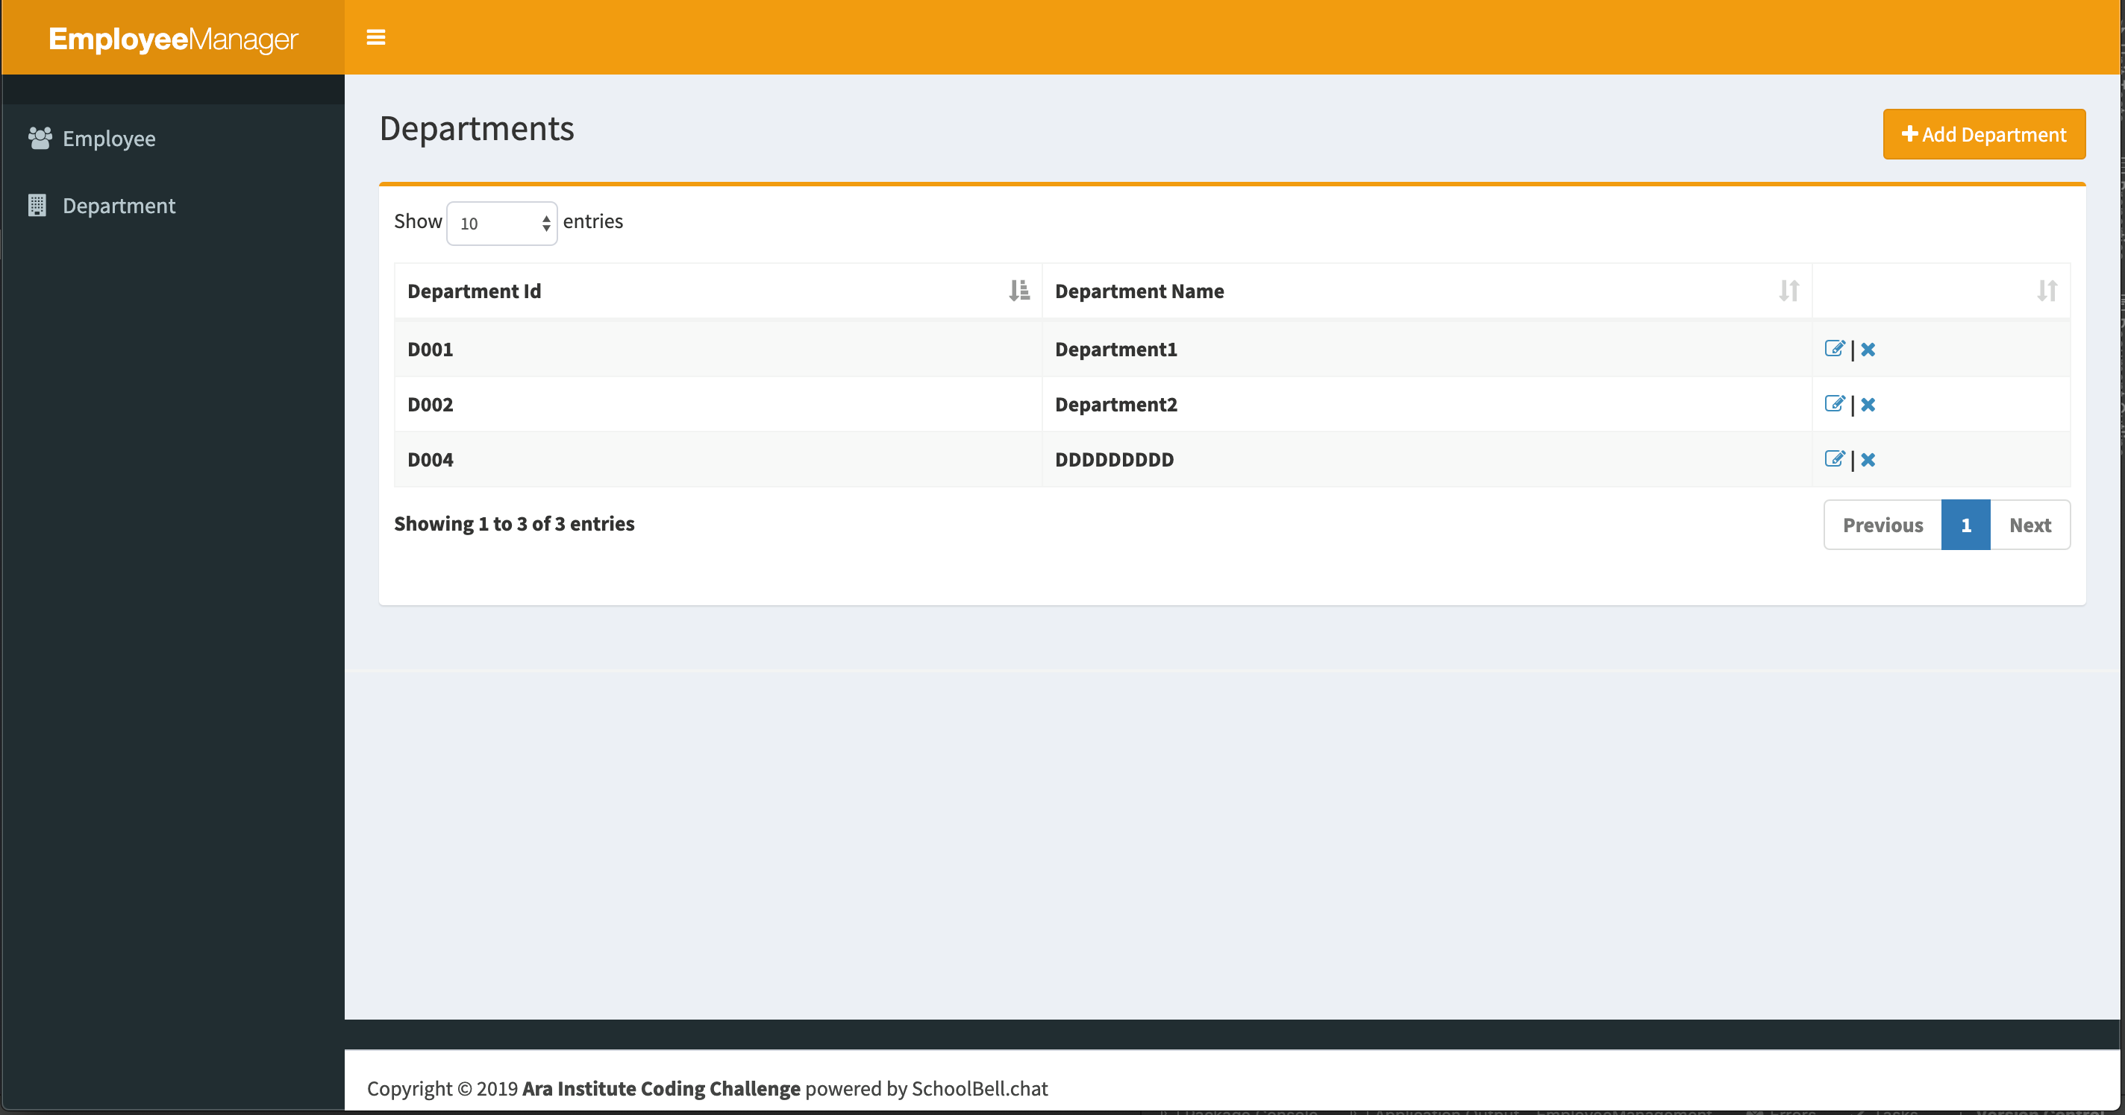
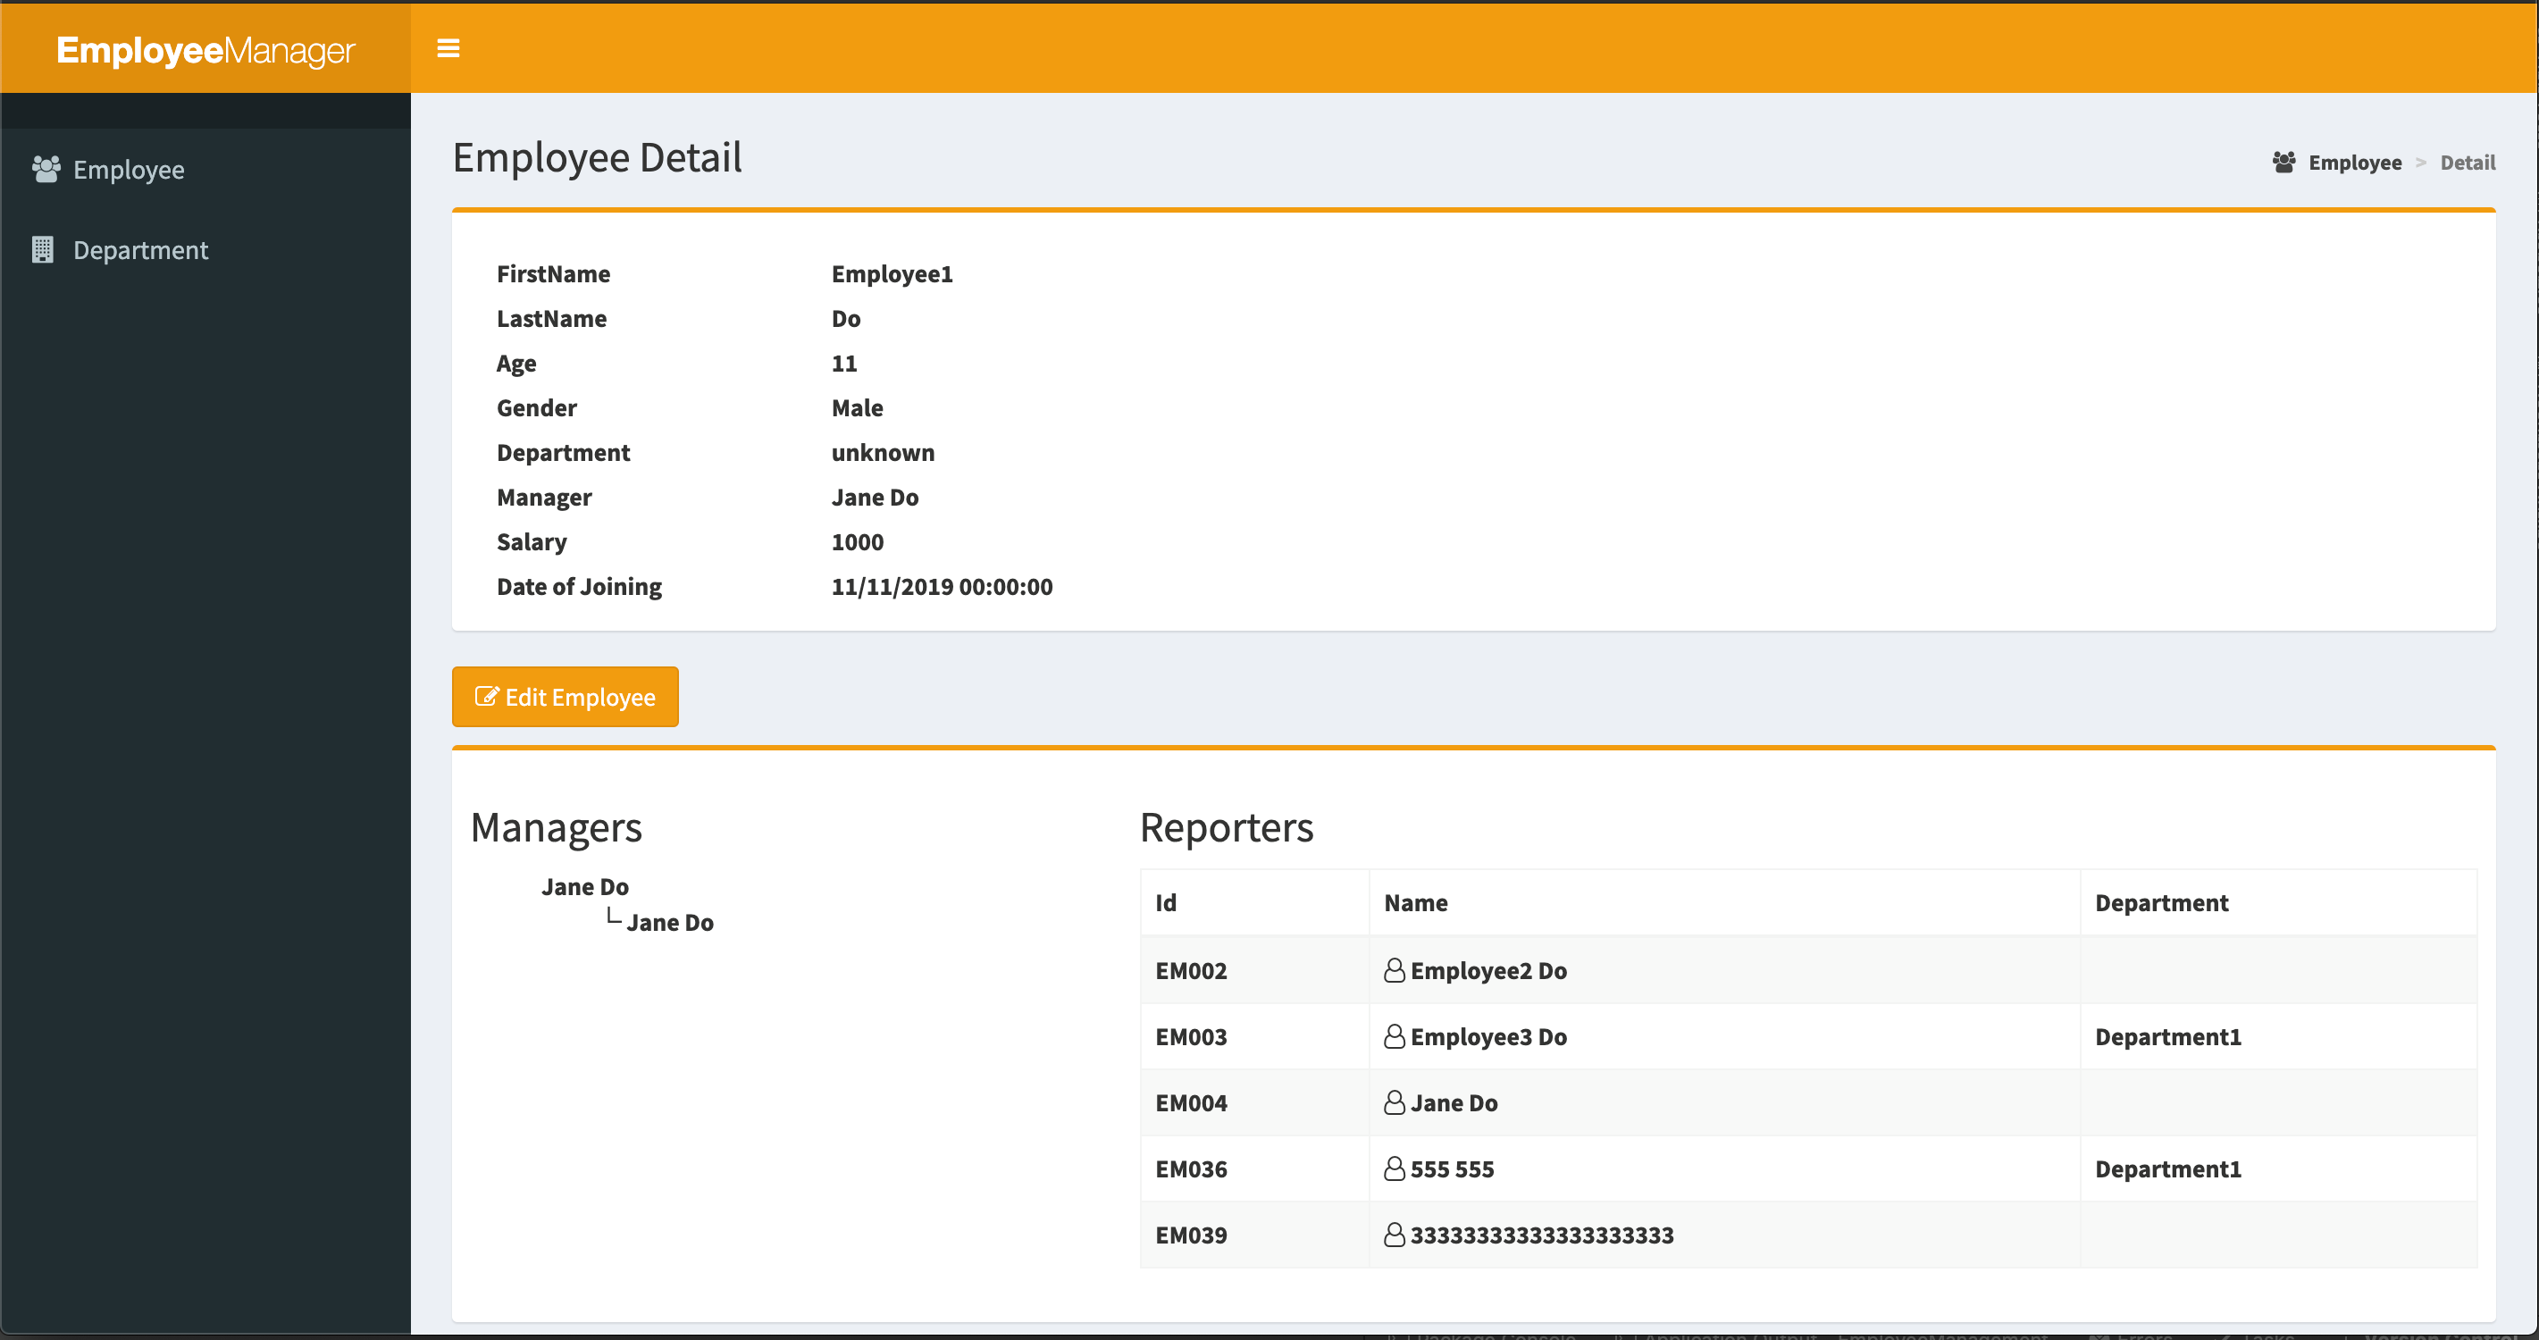
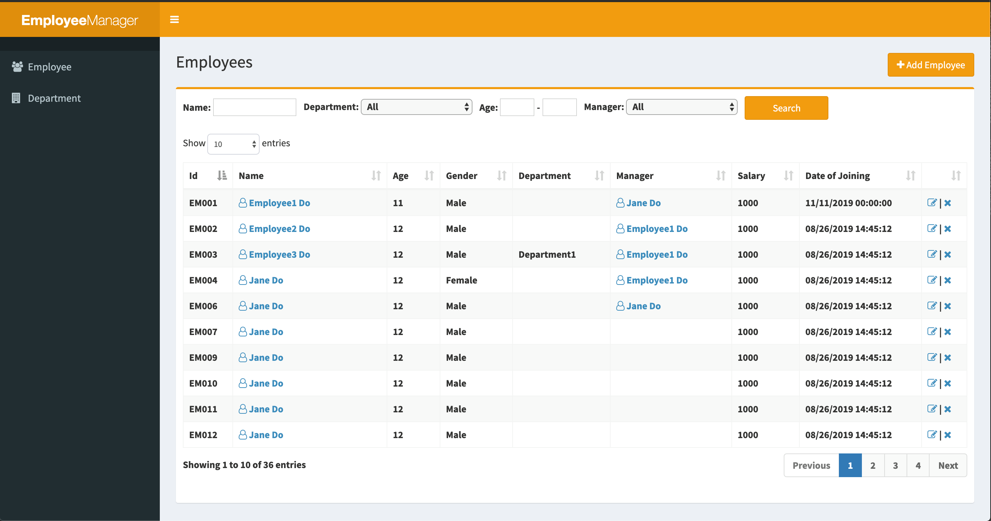
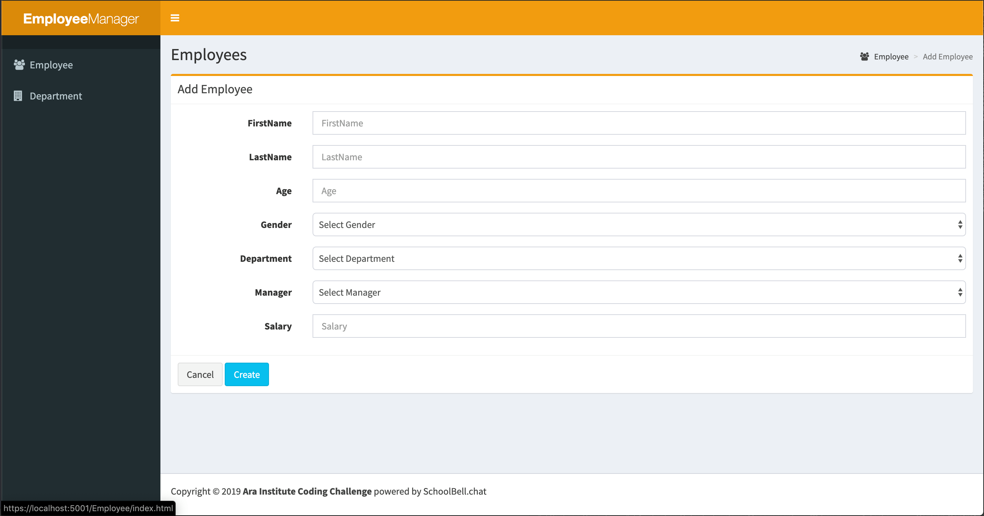
create, read, update & delete (CRUD) functions
Show Individual
Employee Detail
A List of Departments
Allows CRUD Functions
A List of Employees
Allows CRUD Functions
Create Employee

Slide 8
Assumptions
Diagrams are simplified and shows parts of the basic classes, attributes and methods for conceptual illustration only
Every Employee belongs to one department only.
Every Employee is supervised by one manager only

