Slide 1

Predicting the Next Purchase
Natalia Yuka Hiratani – ID Number 500999281

Slide 2
DATASET
Description
180,519 records
53 attributes
27 String
15 Numeric
7 Categorical
2 Boolean
2 Date
Data Cleaning
Missing values
Customer_Lname: 8
Customer_ZipCode: 3
Order_ZipCode: 155,679
6 Duplicated attribute
4 Attribute same data

Slide 3
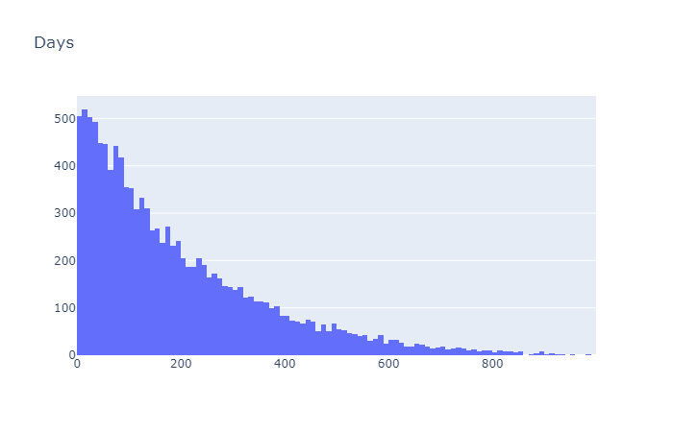
LABEL CLASS
The class label, called “NextPurchaseDay”, is an attribute which is derived by calculating the difference between the last two purchases (in days).

Slide 4
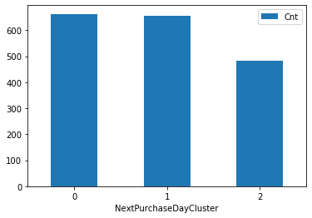
LABEL CLASS
The class labels were divided in to 3 classes, using the quantile method.

Slide 5
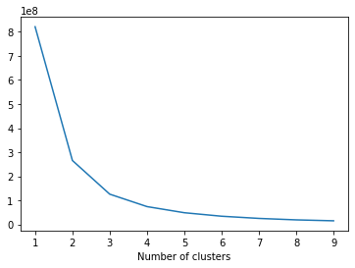
FEATURE SELECTION
RFM: Recency, Frequency and Monetary
K-means cluster
RFM Score | Recency | Frequency | Monetary
0 | 742.23 | 4.07 | 682.62
1 | 416.09 | 5.21 | 890.33
2 | 127.06 | 2.34 | 442.33
3 | 298.39 | 11.19 | 2,086.93
4 | 211.99 | 14.26 | 2,557.27
5 | 267.20 | 22.27 | 4,067.41
6 | 159.65 | 24.44 | 4,455.45

Slide 6
FEATURE SELECTION
Features are divided in 2 parts: numerical and categorical data
Backward Elimination Process
Numerical | Random Forest | Linear Regression | Logistic Regression
Training Score | 1 | 0.1893 | 0.5174
Test score | 0.5299 | 0.1603 | 0.49903
Diff | 0.4701 | 0.029 | 0.01837
Categorical | Random Forest | Linear Regression | Logistic Regression
Training Score | 0.79318 | 0.0223 | 0.43502
Test score | 0.33826 | -0.02963 | 0.41589
Diff | 0.45492 | 0.05193 | 0.01913

Slide 7
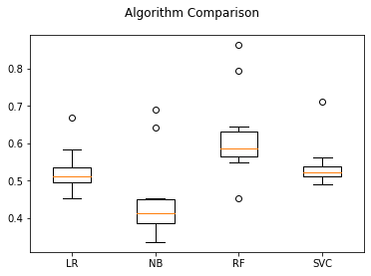
COMPARE MODELS
10 fold cross-validation

Slide 8
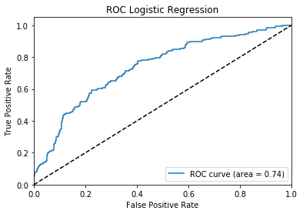
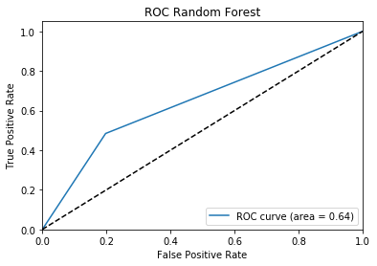
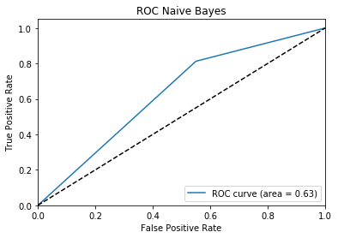
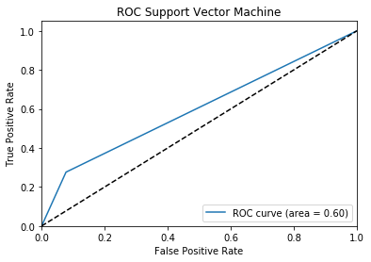
ROC for multiclass
Class 0 VS Class 1 and 2

Slide 9
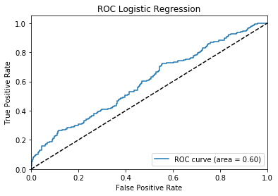
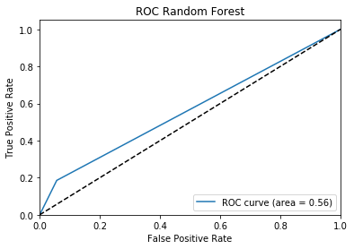
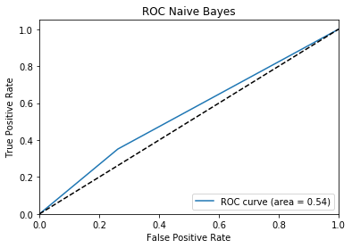
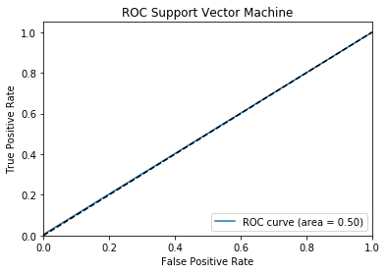
ROC for multiclass
Class 1 VS Class 0 and 2

Slide 10
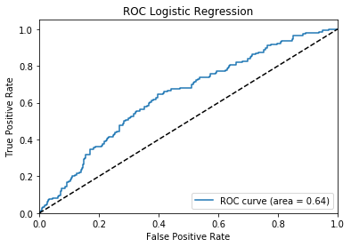
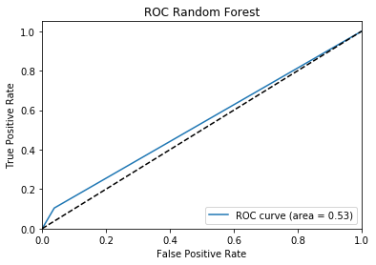
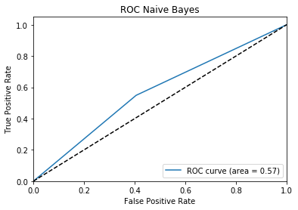
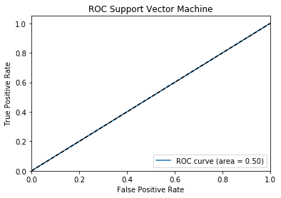
ROC for multiclass
Class 2 VS Class 0 and 1

Slide 11
CONCLUSION
For the Accuracy, Random Forest is the best
For ROC, Logistic Regression is the best
Model | Accuracy
Logistic Regression | 0.526193
Naïve Bayes | 0.450099
Random Forest | 0.620406
Support Vector Machine | 0.539202

Slide 12
RECOMMENDATION
New marketing strategies need to be implemented such as: promotions, discounts, or coupons.
Reassess new attributes to increase the Accuracy and the Class 2

