Slide 1
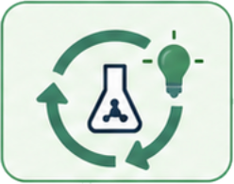













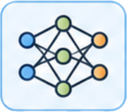
(a)
Centralized bio-agent
(b)
Collaborative training
(c)
BioCoLoop
Research / design loop
Design revision
Research / design loop
Aggregate development evidence
Lab 1
Lab 2
Lab K
Aggregate development evidence
Design
revision
Local
update
Lab 1
Lab 2
Lab K
Accessible data
Local
update
model parameters
model parameters
Accessible dataset
Model
(design revised between rounds)
Model
(design fixed in advance)
Model
(design revised between rounds)
Notes:
Slide 2: annotated variant. Adds the per-round wording contrast between (b) and (c), repairs the overlapping "Aggregate development evidence" label of the source raster, and states in plain words what stays local and what the laboratories return.

