Slide 1















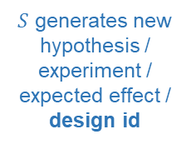

BioCoLoop: Collaborative Evidence-Guided Research Framework
OUTER RESEARCH LOOP
Fixed research language model 𝑆
Aggregated development evidence
①
Propose
𝑆 generates new hypothesis / experiment / expected effect / design_id
②
Instantiate
③
Train + evaluate
④
Retain / revise
executable design
Candidate
design
Development
evidence
Selected
(highest dev score)
INNER COLLABORATIVE TRAINING
Shared coordinator (aggregation/selection service)
OUTPUTS
broadcast model parameters | aggregate local updates
Task-specific
fitted models
model parameters
local updates
Laboratory 1
Laboratory 2
Laboratory K
...
Reusable
computational
solutions
private
data
local
train + dev
model
update
private
data
local
train + dev
model
update
private
data
local
train + dev
model
update
Designs
BIOLOGICAL VALIDATION SETTINGS
Programs
Drug–target interaction
Proteomic efficacy
Cell perturbations
Input: compound+protein seq
Output: interaction probability
Input: proteome profile + drug
Output: drug efficacy
Input: expression response profile
Output: perturbation identity
Policies
Notes:
Repaired layout: unified fonts, fixed text frames, explicit margins and wrapping, and removed shape-autofit behavior.

