Slide 1
Lecture 6: Single-classification multivariate ANOVA (k-group MANOVA)
Rationale and underlying principles
Univariate ANOVA
Multivariate ANOVA (MANOVA): principles and procedures
MANOVA test statistics
MANOVA assumptions
Planned and unplanned comparisons

Slide 2
When to use ANOVA
Tests for effect of “discrete” independent variables.
Each independent variable is called a factor, and each factor may have two or more levels or treatments (e.g. crop yields with nitrogen (N) or nitrogen and phosphorous (N + P) added).
ANOVA tests whether all group means are the same.
Use when number of levels (groups) is greater than two.
Frequency
μ_{C}
μ_{N}
μ_{N+P}
Yield
Control
Experimental (N)
Experimental (N+P)

Slide 3
Why not use multiple 2-sample tests?
For k comparisons, the probability of accepting a true H₀ for all k is (1 - α)^{k}.
For 4 means, (1 - α)^{k} = (0.95)⁶ = .735.
So α (for all comparisons) = 0.265.
So, when comparing the means of four samples from the same population, we would expect to detect significant differences among at least one pair 27% of the time.
μ_{C}: μ_{N+P}
μ_{c}:μ_{N}
μ_{N}:μ_{N+P}
Frequency
μ_{C}
μ_{N}
μ_{N+P}
Yield
Control
Experimental (N)
Experimental (N+P)

Slide 4
What ANOVA does/doesn’t do
μ_{N+P}
Frequency
Tells us whether all group means are equal (at a specified α level)...
...but if we reject H₀, the ANOVA does not tell us which pairs of means are different from one another.
μ_{C}
μ_{N}
Frequency
Control
Experimental (N)
μ_{C}
μ_{N}
μ_{N+P}
Experimental (N+ P)
Yield

Slide 5

Model I ANOVA: effects of temperature on trout growth
3 treatments determined (set) by investigator.
Dependent variable is growth rate (λ), factor (X) is temperature.
Since X is controlled, we can estimate the effect of a unit increase in X (temperature) on λ (the effect size)...
… and can predict λ at other temperatures.
0.20
0.16
0.12
Growth rate λ (cm/day)
0.08
0.04
0.00
16
20
24
28
Water temperature (°C)

Slide 6
Model II ANOVA: geographical variation in body size of black bears
3 locations (groups) sampled from set of possible locations.
Dependent variable is body size, factor (X) is location.
Even if locations differ, we have no idea what factors are controlling this variability...
…so we cannot predict body size at other locations.
280
240
200
Body size (kg)
160
120
Riding
Kluane
Algonquin
Mountain

Slide 7
Model differences
In Model I, the putative causal factor(s) can be manipulated by the experimenter, whereas in Model II they cannot.
In Model I, we can estimate the magnitude of treatment effects and make predictions, whereas in Model II we can do neither.
In one-way (single classification) ANOVA, calculations are identical for both models…
…but this is NOT so for multiple classification ANOVA!

Slide 8
How is it done? And why call it ANOVA?
In ANOVA, the total variance in the dependent variable is partitioned into two components:
  among-groups: variance of means of different groups (treatments)
  within-groups (error): variance of individual observations within groups around the mean of the group

Slide 9

The general ANOVA model
ε₄₂
μ₂
α₂
Y
μ
The general model is:
ANOVA algorithms fit the above model (by least squares) to estimate the α_{i}’s.
H₀: all α_{i}’s = 0
μ =μ₁ = μ₂ = μ₃
Y
μ
Group 1
α₁ =α₂ =α₃ = 0
Group 2
Group 3
Group

Slide 10
Partitioning the total sums of squares
μ₂
Y
μ
μ₃
μ₁
Total SS
Model (Groups) SS
Error SS
Group 1
Group 2
Group 3

Slide 11
The ANOVA table
Source of
Variation
Sum of
Squares
Degrees of
freedom (df)
Mean
Square
F
k
n
i
(
−
)
Total
∑
∑
Y
Y
2
n - 1
SS/df
ij
i
=
1
j
=
1
k
MS_{groups}
(
−
Y
)
Groups
∑
n
Y
2
k - 1
SS/df
i
i
i
MS_{error}
=
1
k
n
i
(
)
Error
∑
∑
Y
−
2
n - k
SS/df
Yi
i
j
i
=
1
j
=
1

Slide 12
Use of single-classification MANOVA
Data set consists of k groups (“treatments”), with n_{i} observations per group, and p variables per observation.
Question: do the groups differ with respect to their multivariate means?
In single-classification ANOVA, we assume that a single factor is variable among groups, i.e., that all other factors which may possible affect the variables in question are randomized among groups.

Slide 13
Examples
Good(ish)
Bad(ish)
4 different concentrations of some suspected contaminant; 10 young fish randomly assigned to each treatment; at age 2 months, a number of measurements taken on each surviving fish.
10 young fish reared in 4 different “treatments”, each treatment consisting of water samples taken at different stages of treatment in a water treatment plant.

Slide 14
Multivariate variance: a geometric interpretation
Larger
variance
Smaller
variance
Univariate variance is a measure of the “volume” occupied by sample points in one dimension.
Multivariate variance involving m variables is the volume occupied by sample points in an m -dimensional space.
X
X
X₁
Occupied
volume
X₂

Slide 15
Multivariate variance: effects of correlations among variables
No correlation
X₁
Correlations between pairs of variables reduce the volume occupied by sample points…
…and hence, reduce the multivariate variance.
Positive
correlation
X₂
Negative
correlation
X₁
Occupied
volume
X₂

Slide 16
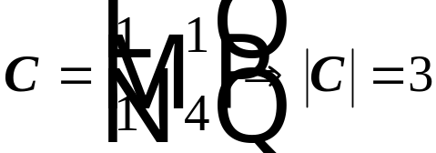
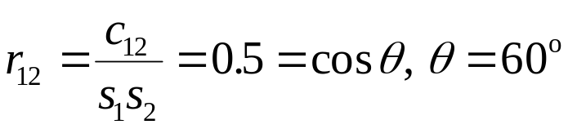




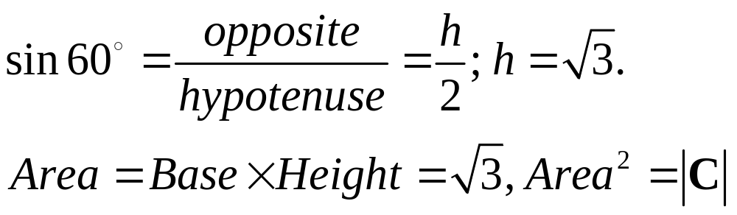
C and the generalized multivariate variance
The determinant of the sample covariance matrix C is a generalized multivariate variance…
… because area² of a parallelogram with sides given by the individual standard deviations and angle determined by the correlation between variables equals the determinant of C.

Slide 17
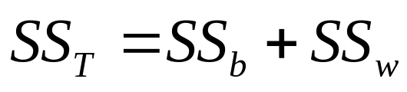

ANOVA vs MANOVA: procedure
In ANOVA, the total sums of squares is partitioned into a within-groups (SS_{w}) and between-group SS_{b} sums of squares:
In MANOVA, the total sums of squares and cross-products (SSCP) matrix is partitioned into a within groups SSCP (W) and a between-groups SSCP (B)

Slide 18
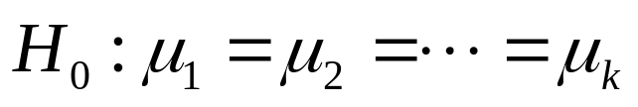
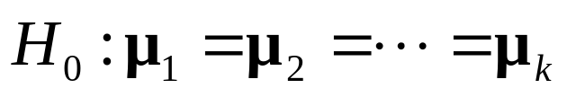
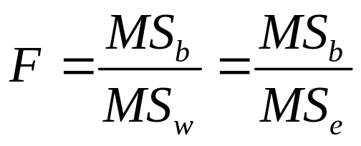
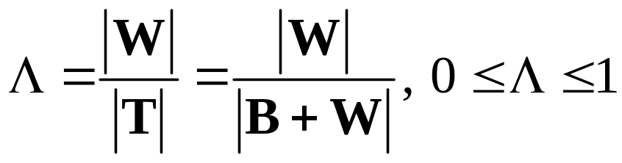
ANOVA vs MANOVA: hypothesis testing
In ANOVA, the null hypothesis is:
This is tested by means of the F statistic:
In MANOVA, the null hypothesis is
This is tested by (among other things) Wilk’s lambda:

Slide 19
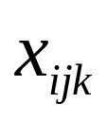
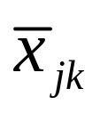

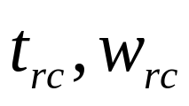
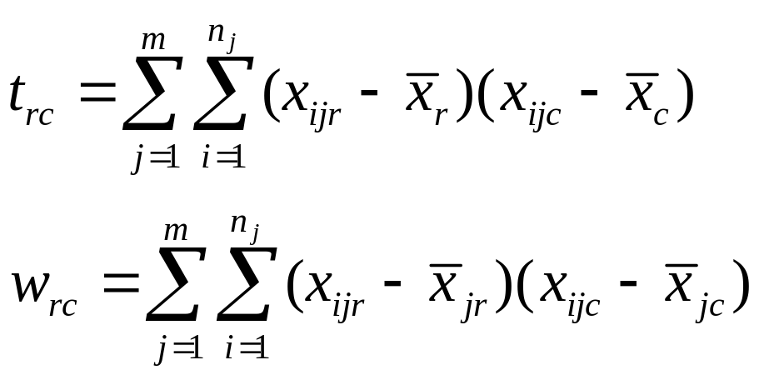

SSCP matrices: within, between, and total
Value of variable X_{k} for
ith observation in group j
Mean of variable X_{k} for
group j
The total (T) SSCP matrix (based on p variables X₁, X₂,…, X_{p} ) in a sample of objects belonging to m groups G₁, G₂,…, G_{m} with sizes n₁, n₂,…, n_{m} can be partitioned into within-groups (W) and between-groups (B) SSCP matrices:
Overall mean of variable X_{k}
Element in row r and
column c of total (T, t) and
within (W, w) SSCP

Slide 20
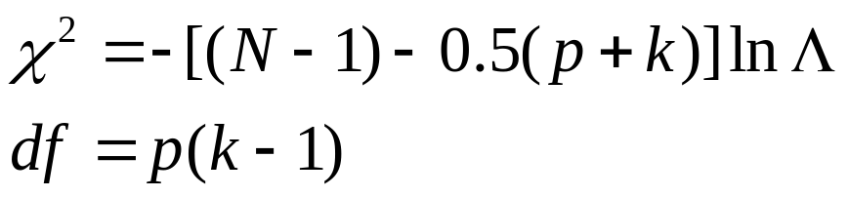
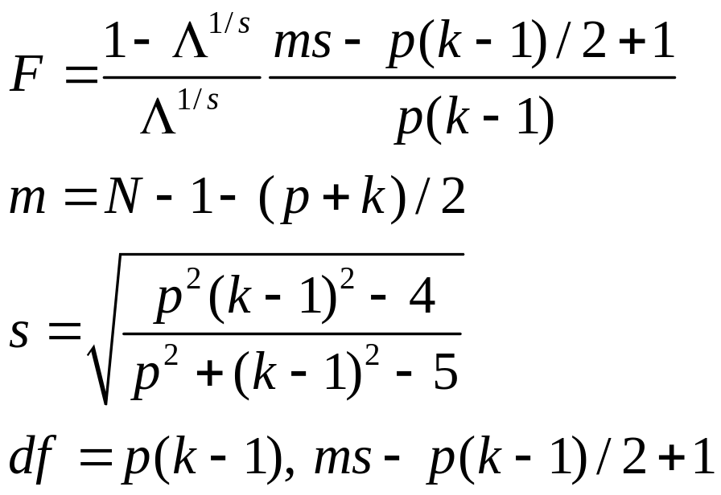
The distribution of Λ
Unlike F, Λ has a very complicated distribution…
…but, given certain assumptions it can be approximated b as Bartlett’s χ² (for moderate to large samples) or Rao’s F (for small samples)

Slide 21
Assumptions
All observations are independent (residuals are uncorrelated)
Within each sample (group), variables (residuals) are multivariate normally distributed
Each sample (group) has the same covariance matrix (compound symmetry)

Slide 22
Effect of violation of assumptions
Assumption | Effect on α | Effect on power
Independence of observations | Very large, actual α much larger than nominal α | Large, power much reduced
Normality | Small to negligible | Reduced power for platykurtotic distributions, skewness has little effect
Equality of covariance matrices | Small to negligible if group Ns similar, if Ns very unequal, actual α larger than nominal α | Power reduced, reduction greater for unequal Ns.

Slide 23
Checking assumptions in MANOVA
Independence
(intraclass correlation,
ACF)
Use group
means as unit
of analysis
No
Yes
N_{i} > 20
MVN
graph test
Assess
MV normality
Check group
sizes
Check
Univariate
normality
N_{i} < 20

Slide 24
Checking assumptions in MANOVA (cont’d)
MV normal?
Check homogeneity
of
covariance
matrices
END
Yes
Yes
Yes
Most variables
normal?
No
Groups
reasonably
large
(> 15)?
Yes
Group sizes
more or
less equal
(R < 1.5)?
No
Yes
Transform
offending
variables
No
Transform
variables, or
adjust α

Slide 25
Then what?
Question | Procedure
What variables are responsible for detected differences among groups? | Check univariate F tests as a guide; use another multivariate procedure (e.g. discriminant function analysis)
Do certain groups (determined beforehand) differ from one another? | Planned multiple comparisons
Which pairs of groups differ from one another (groups not specified beforehand)? | Unplanned multiple comparisons

Slide 26
What are multiple comparisons?
Pair-wise comparisons of different treatments
These comparisons may involve group means, medians, variances, etc.
for means, done after ANOVA
In all cases, H₀ is that the groups in question do not differ.
μ_{C}: μ_{N+P}
μ_{c}:μ_{N}
μ_{N}:μ_{N+P}
Frequency
μ_{C}
μ_{N}
μ_{N+P}
Yield
Control
Experimental (N)
Experimental (N+P)

Slide 27
Types of comparisons
Y
planned (a priori): independent of ANOVA results; theory predicts which treatments should be different.
unplanned (a posteriori): depend on ANOVA results; unclear which treatments should be different.
Test of significance are very different between the two!
Planned
X₁
X₂
X₃
X₄
X₅
unplanned
Y
X₁
X₂
X₃
X₄
X₅

Slide 28
Planned comparisons (a priori contrasts): catecholamine levels in stressed fish
Comparisons of interest are determined by experimenter beforehand based on theory and do not depend on ANOVA results.
Prediction from theory: catecholamine levels increase above basal levels only after threshold PA_{O2} = 30 torr is reached.
So, compare only treatments above and below 30 torr (N_{T} = 12).
0.7
0.6
0.5
0.4
[Catecholamine]
0.3
0.2
0.1
0.0
10
20
30
40
50
PA
O
(torr)
2
Predicted threshold

Slide 29
Unplanned comparisons (a posteriori contrasts): catecholamine levels in stressed fish
Comparisons are determined by ANOVA results.
Prediction from theory: catecholamine levels increase with increasing PA_{O2} .
So, comparisons between any pairs of treatments may be warranted (N_{T} = 21).
0.7
0.6
0.5
0.4
[Catecholamine]
0.3
0.2
0.1
0.0
10
20
30
40
50
PA
O
(torr)
2
Predicted relationship

Slide 30
The problem: controlling experiment-wise α error
For k comparisons, the probability of accepting H₀ (no difference) is (1 - α)^{k}.
For 4 treatments, (1 - α)^{k} = (0.95)⁶ = .735, so experiment-wise α (α_{e}) = 0.265.
Thus we would expect to reject H₀ for at least one paired comparison about 27% of the time, even if all four treatments are identical.
1.0
0.8
0.6
Experiment-wise α (α_{e})
0.4
0.2
0.0
0
2
4
6
8
10
Number of treatments
Nominal α = .05

Slide 31
Unplanned comparisons: Hotelling T² and univariate F tests
Follow rejection of null in original MANOVA by all pairwise multivariate tests using Hotelling T² to determine which groups are different
…but test at modified α to maintain overall nominal type I error rate (e.g. Bonferroni correction)
Then use univariate t-tests to determine which variables are contributing to the detected pairwise differences…
…opinion is divided as to whether these should be done at a modified α.

Slide 32
How many different variables for a MANOVA?
In general, try to use a small number of variables because:
In MANOVA, power generally declines with increasing number of variables.
If a number of variables are included that do not differ among groups, this will obscure differences on a few variables
Measurement error is multiplicative among variables: the larger the number of variables, the larger the measurement noise
Interpretation is easier with a smaller number of variables

Slide 33
How many different variables for a MANOVA : recommendation
Choose variables carefully, attempting to keep them to a minimum
Try to reduce the number of variables by using multivariate procedures (e.g. PCA) to generate composite, uncorrelated variables which can then be used as input.
Use multivariate procedures (such as discriminant function analysis) to “optimize” set of variables.

