Slide 1
Design Patterns
Notes:
the best practices used by experienced object-oriented software developers solutions to general problems
that software developers faced during software development

Slide 2
Design Patterns
What is a design pattern?
What is the advantage of knowing/using design patterns?
Notes:
the best practices used by experienced object-oriented software developers solutions to general problems
that software developers faced during software development
trial and error by numerous software developers over quite a substantial period of time

Slide 3
Gang of Four (GoF) patterns
Creational Patterns (abstracting the object-instantiation process)
Factory Method Abstract Factory Singleton
Builder Prototype
Structural Patterns (how objects/classes can be combined to form larger structures)
Adapter Bridge Composite
Decorator Facade Flyweight
Proxy
Behavioral Patterns (communication between objects)
Command Interpreter Iterator
Mediator Observer State
Strategy Chain of Responsibility Visitor
Template Method
Notes:
In 1994, four authors Erich Gamma, Richard Helm, Ralph Johnson and John Vlissides
published a book titled Design Patterns -
Elements of Reusable Object-Oriented Software which initiated the concept of Design Pattern in Software development.

Slide 4
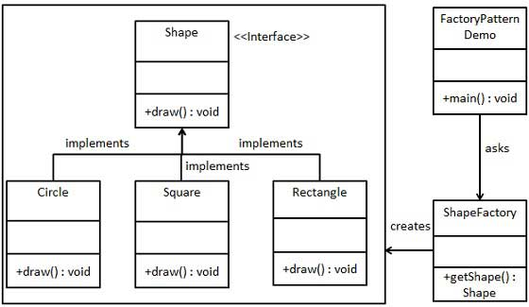
Factory Method
Define an interface for creating an object, but let subclasses decide which class to instantiate. Factory Method lets a class defer instantiation to subclasses.
Real World example: Calender, ResourceBundle etc.

Slide 5
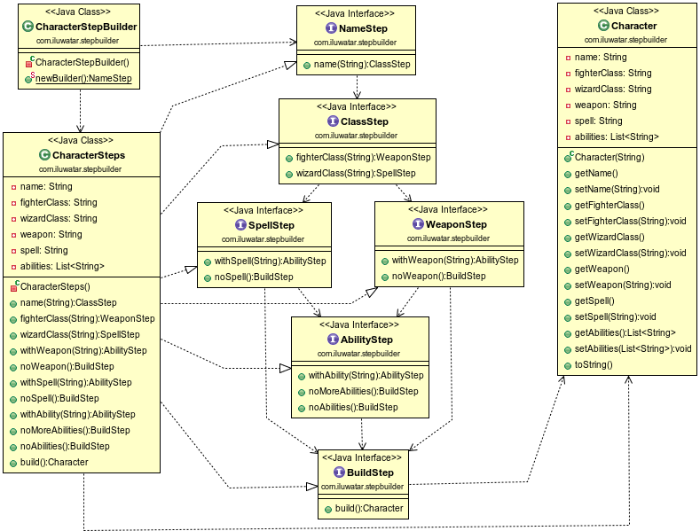
Step Builder
fully guides the user through the creation of the object with no chances of confusion
only see the next step methods available, NO build method until is the right time to build the object.
Real World example: email usage in e-tüzel&gbs

Slide 6
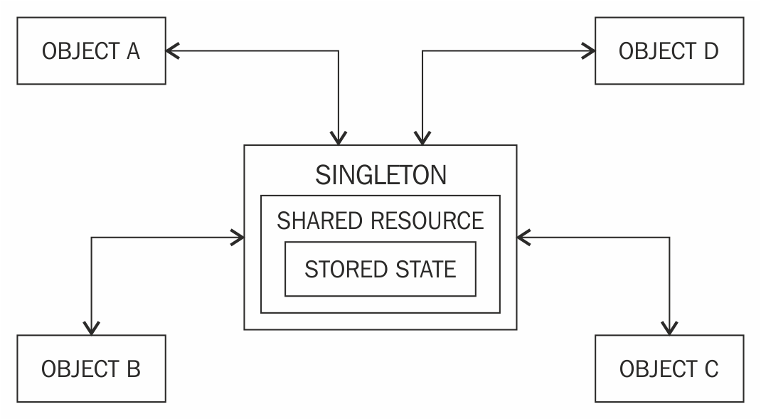
Singleton Pattern
Ensure a class only has one instance, and provide a global point of access to it.
have to restrict the instantiation of a class
Real World example: printing feature for multiple desktop application

Slide 7
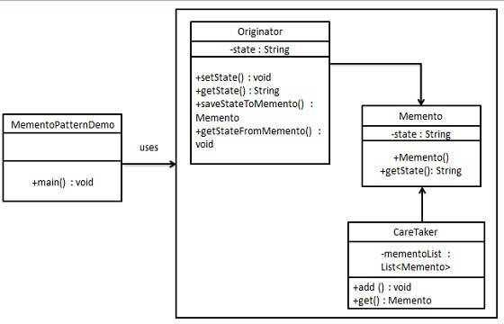
Memento
Without violating encapsulation, capture and externalize an object's internal state so that the object can be restored to this state later.
Real World example: tv volume mute/unmute

Slide 8
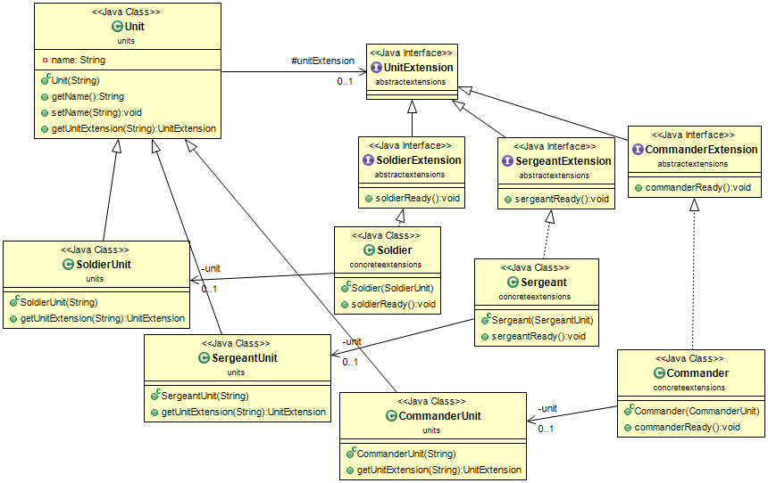
Extension-object
an object’s interface needs to be extended in the future.
Additional interfaces are defined by extension objects.

Slide 9
Throttling
a given client is not able to access service resources more than the assigned limit.
when a service access needs to be restricted to not have high impacts on the performance of the service.
when multiple clients are consuming the same service resources and restriction has to be made according to the usage per client.
Real World example: e-devlet soyagaci

Slide 10
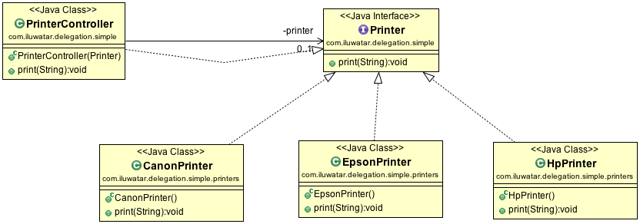
Delegation
a technique where an object expresses certain behavior to the outside but in reality delegates responsibility for implementing that behaviour to an associated object.
Reduce the coupling of methods to their class
Components that behave identically, but realize that this situation can change in the future.
Notes:
Outside is same but behavior different may change in future

Slide 11
Chain
Avoid coupling the sender of a request to its receiver by giving more than one object a chance to handle the request. Chain the receiving objects and pass the request along the chain until an object handles it.
you want to issue a request to one of several objects without specifying the receiver explicitly
Notes:
Commander, officer and soldier chain decide where to send request

Slide 12
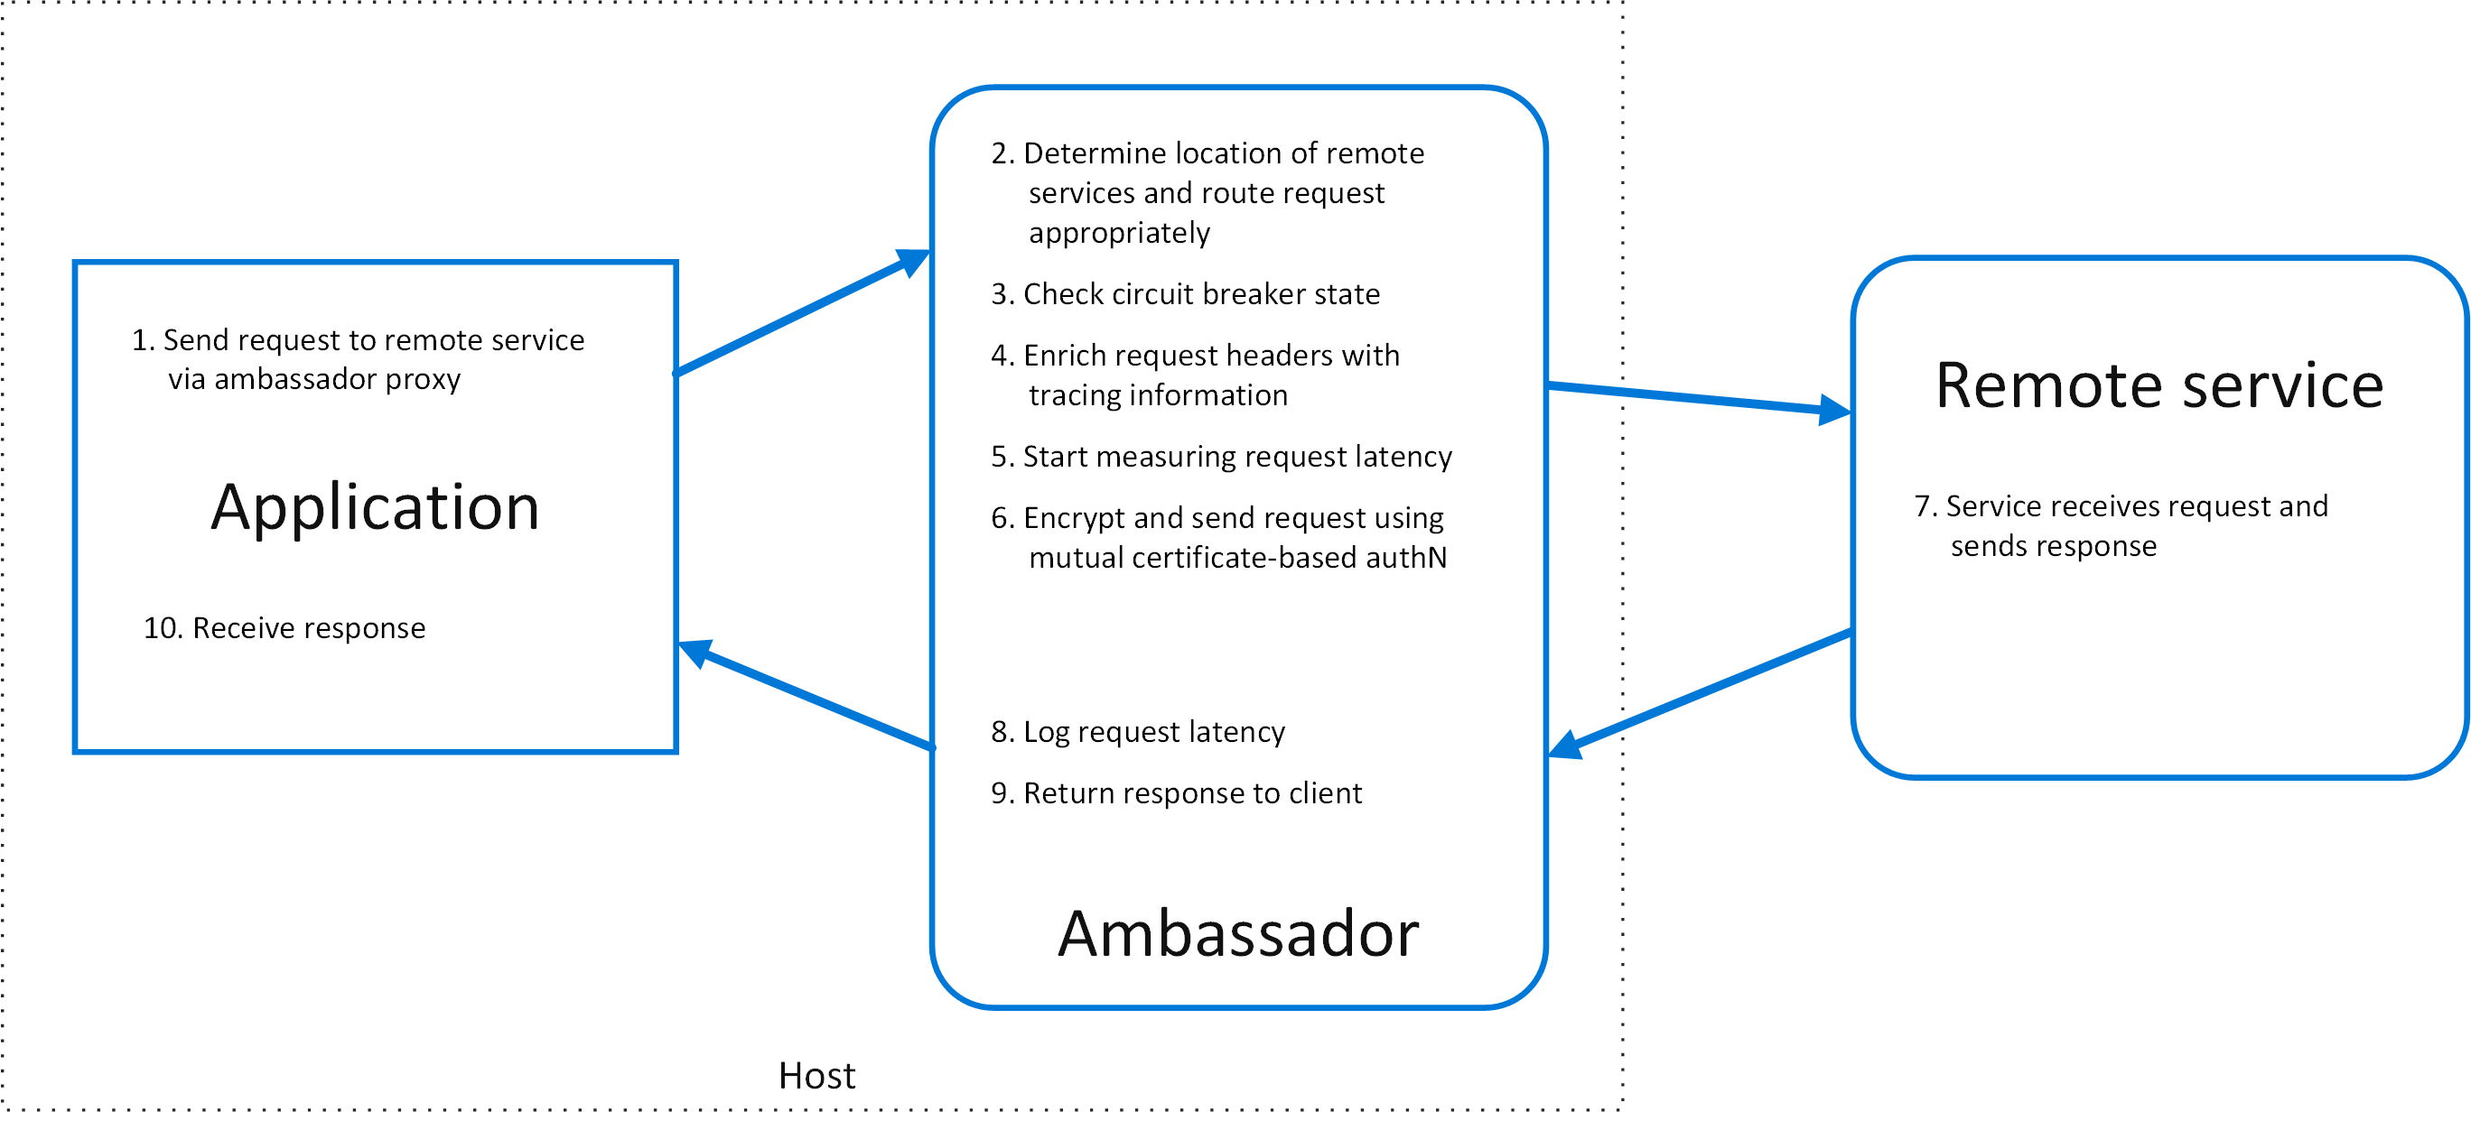
Ambassador
a helper service instance on a client and offload common functionality away from a shared resource.
Notes:
s monitoring, logging, routing, security (such as TLS), and resiliency patterns in a language agnostic way. Circuit breaker

Slide 13
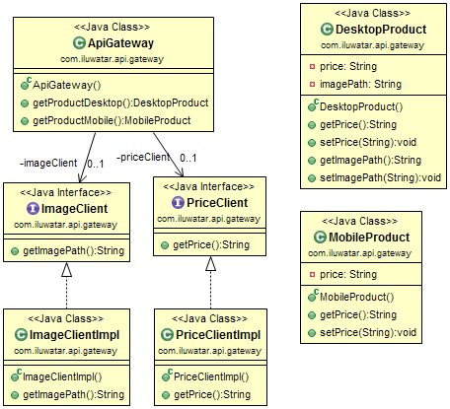
API Gateway
Aggregate calls to microservices in a single location: the API Gateway. The user makes a single call to the API Gateway, and the API Gateway then calls each relevant microservice.

Slide 14
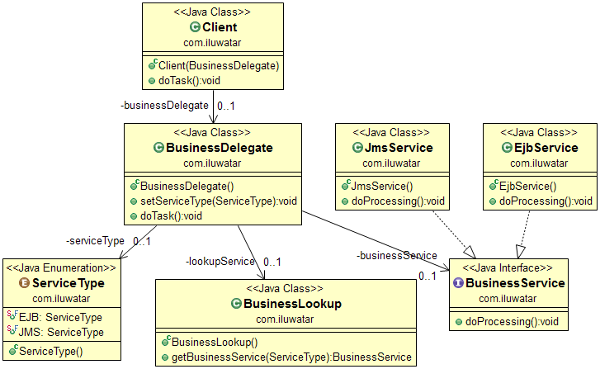
Business Delegate
adds an abstraction layer between presentation and business tiers.
loose coupling between the tiers and encapsulate knowledge about how to locate, connect to, and interact with the business objects that make up the application.
orchestrate calls to multiple business services
Notes:
6th layer of 7 layer. Jsm java message service ejb webservice

Slide 15
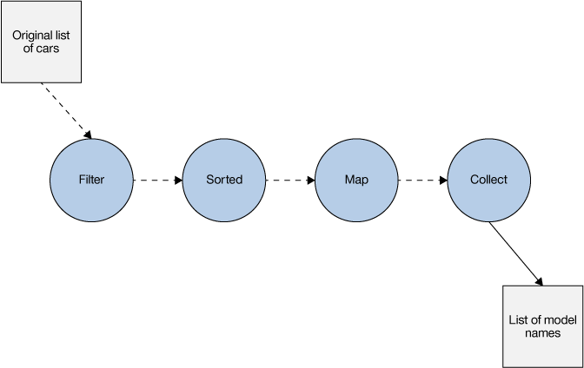
Collection Pipeline
organize some computation as a sequence of operations which compose by taking a collection as output of one operation and feeding it into the next. (Common operations are filter, map, and reduce.)
When you use a lot of statements in your code
When you use a lot of loops in your code

Slide 16
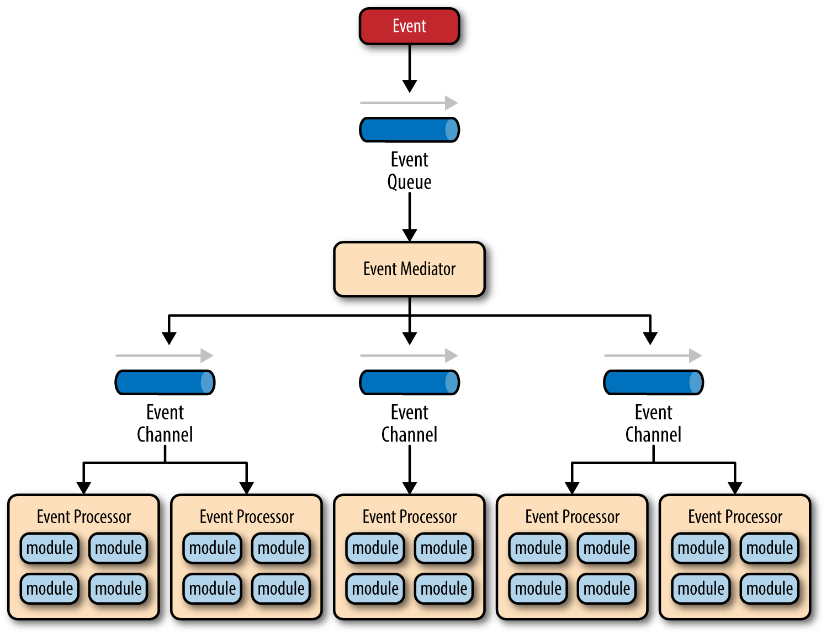
Event Driven Architecture
send and notify state changes of your objects to other applications using an Event-driven Architecture.
Loosely coupled system
A more responsive system
Easier to extend
Real World example: AWS Lambda
Notes:
AWS Lambda, lets you execute code in response to events such as changes to Amazon S3 buckets, updates to an Amazon DynamoDB table, or custom events generated by your applications or devices.

Slide 17
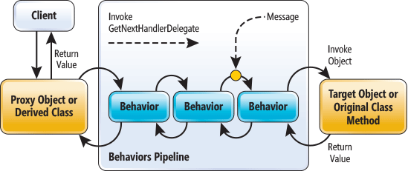
Event Asynchronous
makes available the advantages of multithreaded applications while hiding many of the complex issues inherent in multithreaded design
Perform time-consuming tasks, such as downloads and database operations, "in the background," without interrupting your application.
Execute multiple operations simultaneously, receiving notifications when each completes.

Slide 18
References
https://github.com/iluwatar/java-design-patterns
https://www.tutorialspoint.com/design_pattern/
https://docs.microsoft.com/bs-cyrl-ba/azure/architecture/patterns/ambassador?view=azurermps-4.4.1
https://martinfowler.com/articles/collection-pipeline/

