Slide 1
Db2 Warehouse Development for Data Warehousing

Slide 2

Introduction to Data Warehousing
Data warehousing is a critical component of modern business intelligence, enabling organizations to store and analyze vast amounts of data from multiple sources. Db2 Warehouse Development is a powerful tool for building and managing data warehouses, providing a comprehensive suite of features and capabilities to support every aspect of the data warehousing process.

Slide 3
Db2 Warehouse Overview
Db2 Warehouse is a cloud-based data warehousing solution that provides high-performance analytics and machine learning capabilities.
It is designed to handle large volumes of structured and unstructured data from various sources, and can be deployed on-premises or in the cloud.

Slide 4
Db2 Warehouse Architecture
Data Tier
The data tier is responsible for storing and managing the data.
Compute Tier
The compute tier is responsible for processing the data.
Management Tier
The management tier is responsible for managing the data warehouse.

Slide 5
Security and Compliance
Data Security
Db2 Warehouse provides a range of security features to ensure the confidentiality, integrity, and availability of your data.
Compliance
Db2 Warehouse is designed to comply with a range of industry regulations and standards, including GDPR, HIPAA, and PCI DSS.

Slide 6
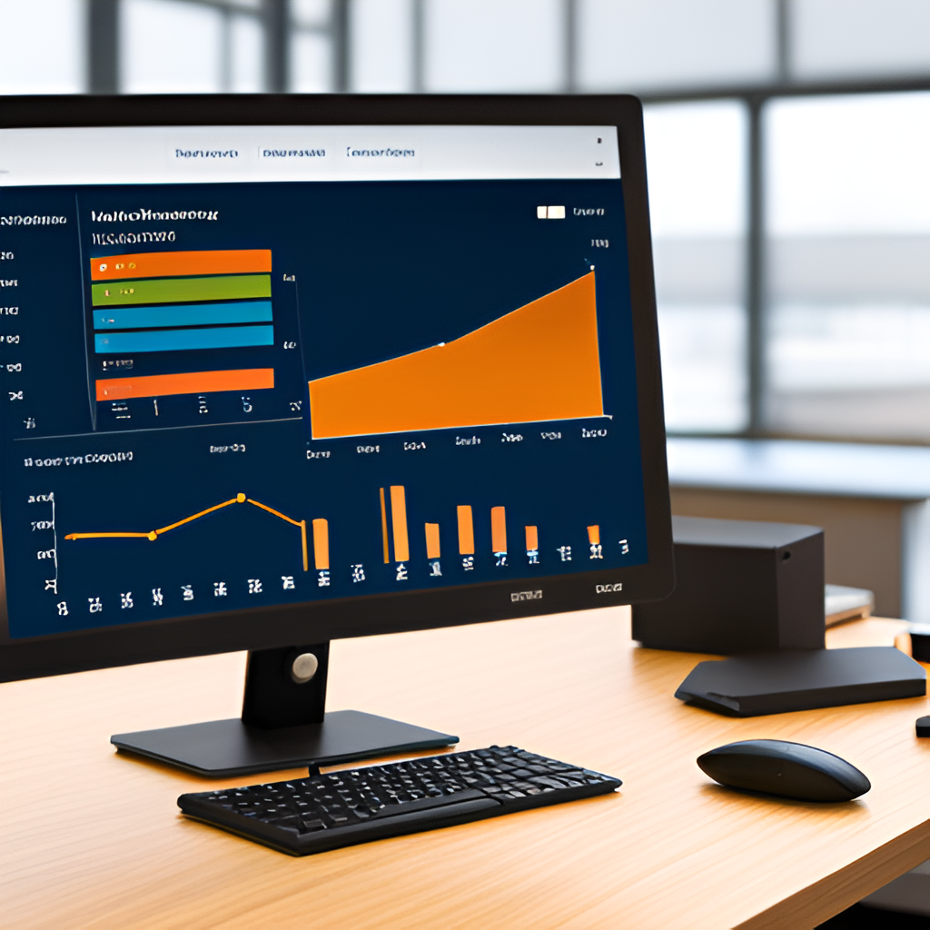
Monitoring and Management
Proactive Monitoring
Db2 Warehouse provides proactive monitoring capabilities to help ensure that the system is running optimally.
Alerts can be configured to notify administrators of issues before they become critical.

Slide 7
Use Cases and Applications
Business Intelligence and Analytics
Db2 Warehouse is an ideal solution for business intelligence and analytics.
Data Science and Machine Learning
Db2 Warehouse can be used to support data science and machine learning workflows.

Slide 8
Best Practices and Future Trends
Best Practices
Design data warehouse schema with business goals in mind
Ensure data quality and consistency through data profiling and cleansing processes
Implement proper security measures to protect sensitive data

Slide 9
Data Ingestion and Integration
Data Ingestion
Db2 Warehouse provides a variety of options for data ingestion, including batch, real-time, and streaming data.
Data Integration
Db2 Warehouse offers a range of tools for data integration, including ETL (extract, transform, load) processes, data quality checks, and data transformations.

Slide 10
Data Management and Governance
Data Quality and Security
Data quality is critical for effective decision making. Db2 Warehouse provides features such as data profiling, cleansing, and validation to ensure data accuracy.
Data Cataloging
Db2 Warehouse includes a data catalog that allows users to easily discover and understand available data assets.

Slide 11

Analytics and Machine Learning
Db2 Warehouse offers advanced analytics and machine learning capabilities to help businesses make data-driven decisions.

Slide 12
Future Trends
Increased use of cloud-based data warehousing solutions for scalability and flexibility
Greater integration with big data technologies for improved analytics and insights
Emergence of AI and machine learning for automated data management and analysis

