Slide 1
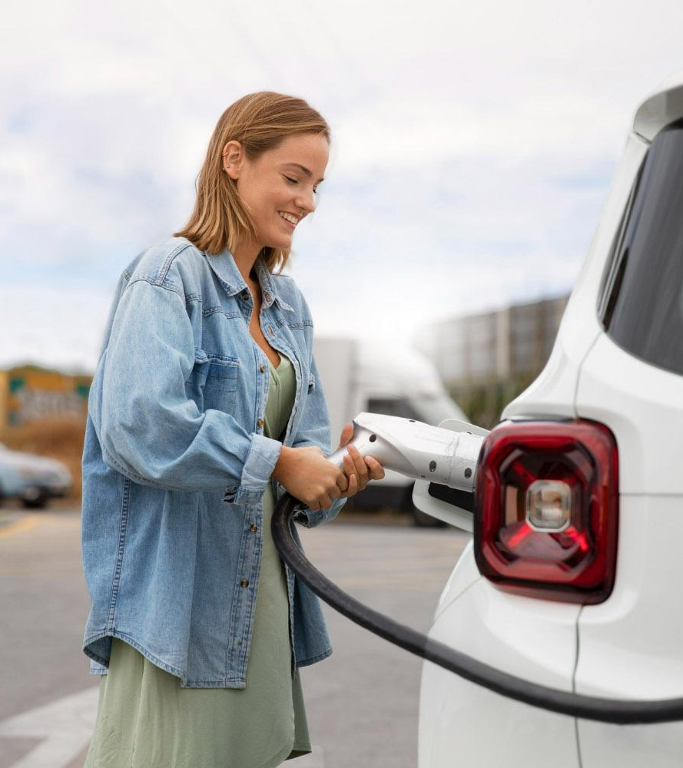
Plug & Power: Revolutionizing the Road
Here is where your presentation begins

Slide 2
INTRODUCTION
Welcome to "Plug & Power: Revolutionizing the Road - A Complete Guide to Electric Vehicle Charging Stations." In this electrifying journey, we will explore how Electric Vehicle Charging Stations, often referred to as "Plug & Power" stations, are reshaping the landscape of transportation. As the world shifts towards sustainable and eco-friendly solutions, electric vehicles have emerged as a driving force of change. At the heart of this transformation lies the infrastructure that fuels these vehicles – the charging stations. It is a user friendly application by having many option to make user experience at high level so It will raise the EV usage.

Slide 3
NOVELTY AND UNIQENESS
01
03
02
04
Energy Cost Estimation
Charging Station Reservation
This could help users make more informed decisions about where to charge based on cost-effectiveness
a reservation system that enables users to reserve a charging spot in advance, ensuring they have a spot available when they arrive at the station.
Charging Queue Management
Augmented Reality Navigation
For busy charging stations, introduce a virtual queue system that lets users join a queue remotely and receivenotifications when it's their turn to charge.
Implement AR navigation that overlays directions and real-time information about charging stations onto the user's smartphone camera view.

Slide 4
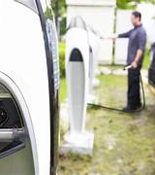
SOCIAL IMPACT

Slide 5
ACCELERATION OF EV ADOPTION
ENVIROMENTAL IMPACT
Increased adoption of electric vehicles could contribute to a cleaner and healthier environment, reducing the overall carbon footprint of transportation.
By addressing range anxiety and providing easy access to charging infrastructure, your project could accelerate the adoption of electric vehicles, leading to a reduction in greenhouse gas emissions and air pollution.
ENERGY TRANSITION
JOB CREATION
The project aligns with the global shift towards renewable energy and energy independence, as electric vehicles can be charged using clean energy sources like solar and wind power.
As the electric vehicle ecosystem expands, the project could indirectly contribute to job creation in areas such as manufacturing, maintenance, and support services for electric vehicles and charging stations.

Slide 6
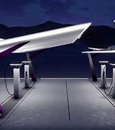
TECHNOLOGIES ARCHITECTURE

Slide 7






TECHNOLOGY

Slide 8
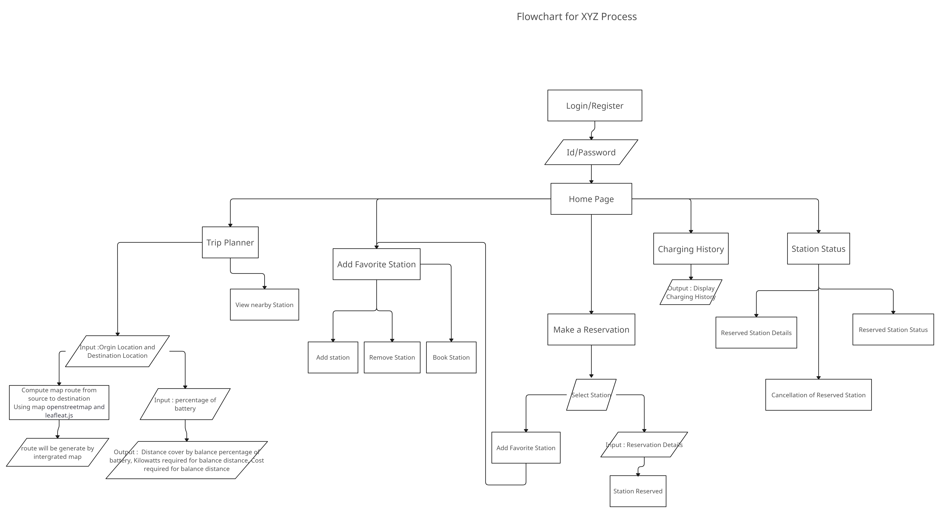

Slide 9

HOME PAGE

Slide 10
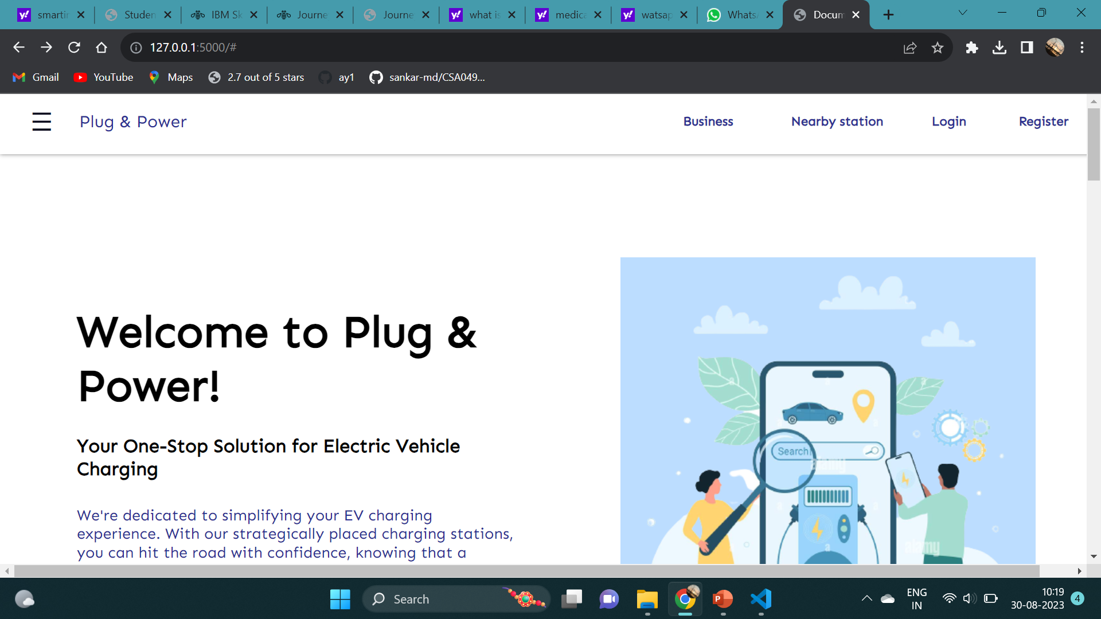

Slide 11

LOGIN PAGE

Slide 12


Slide 13
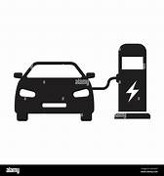
CONCLUSION

Slide 14
In conclusion, "Plug & Power: Revolutionizing the Road" presents a comprehensive and insightful guide to the world of Electric Vehicle (EV) charging stations. The rapid advancement of EV technology and the growing need for sustainable transportation solutions have brought charging infrastructure to the forefront of our modern landscape. This guide has delved deep into the various aspects of EV charging stations, from their importance in reducing carbon emissions and dependence on fossil fuels to the technical nuances of charging standards, station types, and smart technologies.

Slide 15
THANK YOU

