Slide 1
Digital Portfolio
STUDENT NAME:S.YUKESH
REGISTER NO AND NMID:263A1B93ACD482DB67D401343FBD4F8F
DEPARTMENT: BSC(computer science)
COLLEGE:APOLLO ARTS AND SCIENCE COLLEGE

Slide 2
project title
MY DIGITAL PORTFOLIO

Slide 3
AGENDA
Problem Statement
Project Overview
End Users
Tools and Technologies
Portfolio design and Layout
Features and Functionality
Results and Screenshots
Conclusion
Github Link
3/21/2024 Annual Review

Slide 4
PROBLEM STATEMENT
Content:
1. Existing system is time-consuming.
2. Users face difficulties due to lack of automation.
3. Errors occur frequently because of manual work.
4.A better solution is required to improve efficiency

Slide 5
PROJECT OVERVIEW
Content:
1. This project focuses on developing a web-based system.
2. The goal is to automate manual tasks and improve efficiency.
3. The system provides user-friendly features such as login, data management, and reporting.
4. It reduces errors and saves time for users.Overall, the project enhances productivity and ease of use.

Slide 6
WHO ARE THE END USERS?
1. Final users who directly use the product/service.
2. Not developers or testers – but the actual customers/consumers.
3. They interact with the system to achieve their goals.
4. Their feedback is important for improvements.

Slide 7

TOOLS AND TECHNIQUES
Tools:
1. Programming Languages (ex: Java, Python, C#).
2. IDEs (ex: Eclipse, IntelliJ, VS Code).
3. Database (ex: MySQL, Oracle, MongoDB).
4. Version Control (ex: Git, GitHub).
5. Testing Tools (ex: Selenium, JUnit).

Slide 8
Techniques:
1. Requirement Gathering & Analysis.
2. Design Techniques (Flowcharts, UML Diagrams).
3. Development Models (Agile / Waterfall / DevOps).
4. Testing Techniques (Unit Testing, Integration Testing).
5. Deployment & Maintenance Techniques.

Slide 9
POTFOLIO DESIGN AND LAYOUT
Clean & Simple Design – Keep it minimal and professional
Consistent Layout – Use the same fonts, colors, and spacing
Organized Sections – About Me, Skills, Projects, Achievements, Contact
Visual Elements – Use icons, infographics, and images for clarity
Professional Look – Make it neat, attractive, and easy to read
9

Slide 10
FEATURES AND FUNCTIONALITY
User-Friendly Design – Easy navigation and clean interface
Core Features – Highlight main features of the project/product
Functionality – Explain how each feature works step by step
Interactive Elements – Buttons, forms, or tools for user interaction
Efficiency – Fast performance and reliable operations
Scalability – Can be upgraded or expanded in the future

Slide 11

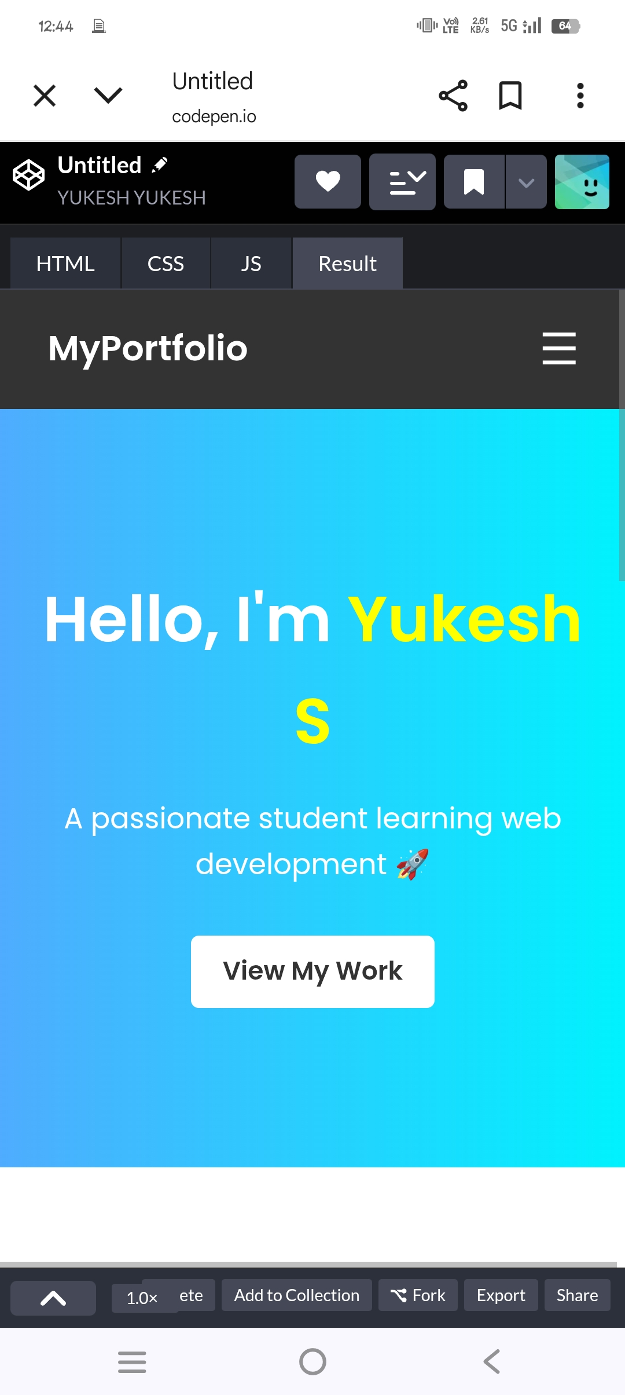
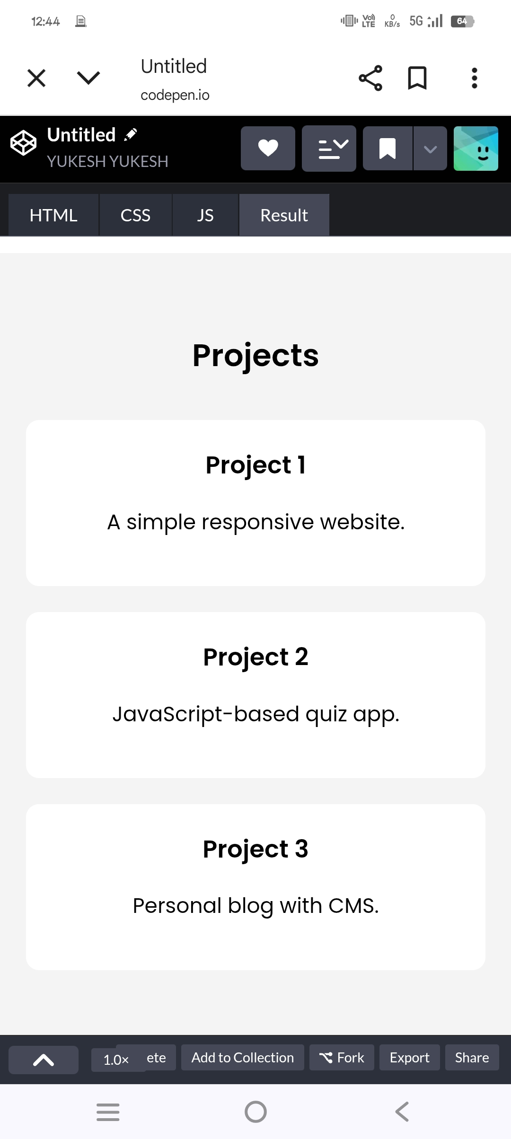
RESULTS AND SCREENSHOTS
3/21/2024 Annual Review
11

Slide 12
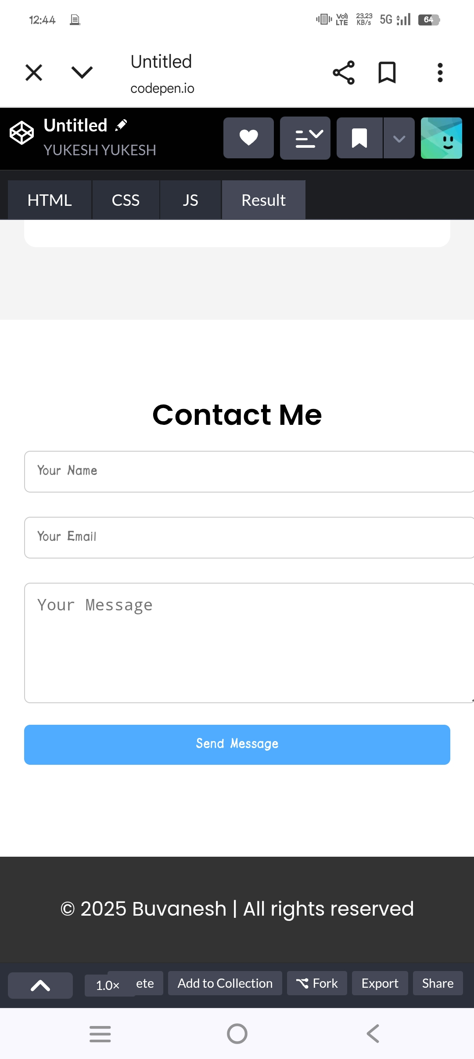
RESULT AND SCREENSHOT

Slide 13
CONCLUSION
Summarize the key points discussed
Highlight the main findings or outcomes
Emphasize the importance of the project/work
Suggest future scope or improvements
End with a strong closing statement
13

