Slide 1
AI-Based EV Charging Demand Prediction
Capstone project demonstration
Random Forest regression + classification
Simulated data for learning; not live station forecasts

Slide 2
Problem and Objectives
Estimate charging-session demand from time/session features
Classify expected demand as Low, Medium, or High
Evaluate models and display trends in a dashboard

Slide 3
Dataset and Features
3,200 simulated observations across 2024
Time: hour, weekday, month, weekend
Session: duration, energy delivered
Targets: session count and demand level

Slide 4
Methodology
Clean and sort records by timestamp
Create time-based features
Use first 80% for training and final 20% for testing
Train Random Forest regressor and classifier

Slide 5
Evaluation Results
Regression MAE: 2.347
Regression RMSE: 3.039; R²: 0.508
Classification accuracy: 0.561
Weighted F1: 0.539
Metrics are illustrative because data is simulated

Slide 6
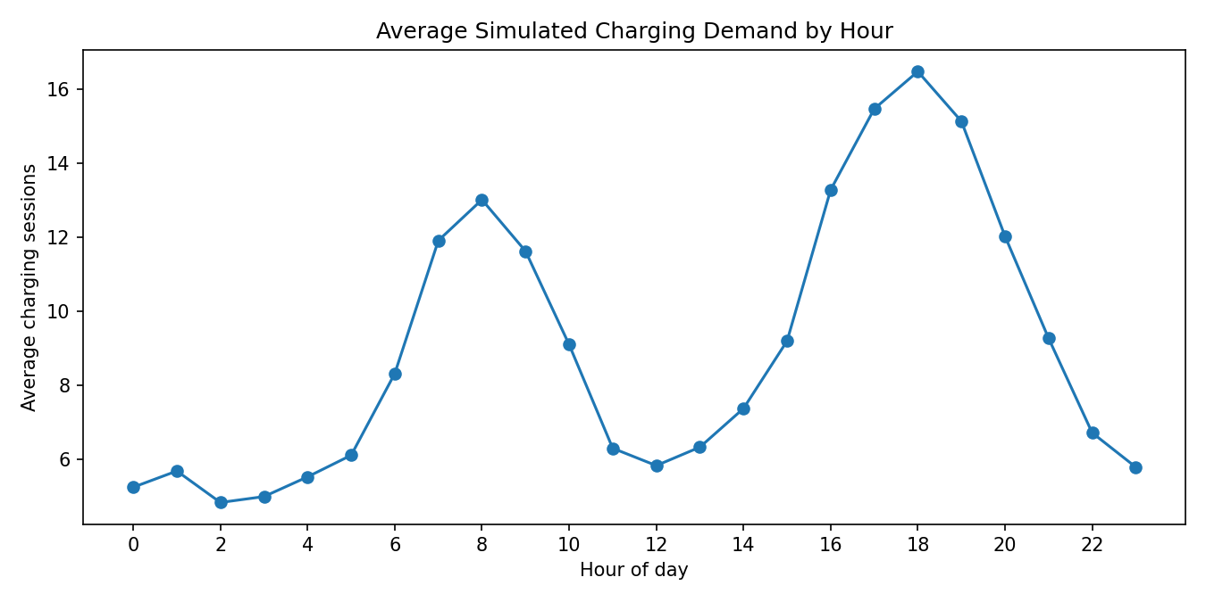
Hourly Demand Pattern

Slide 7
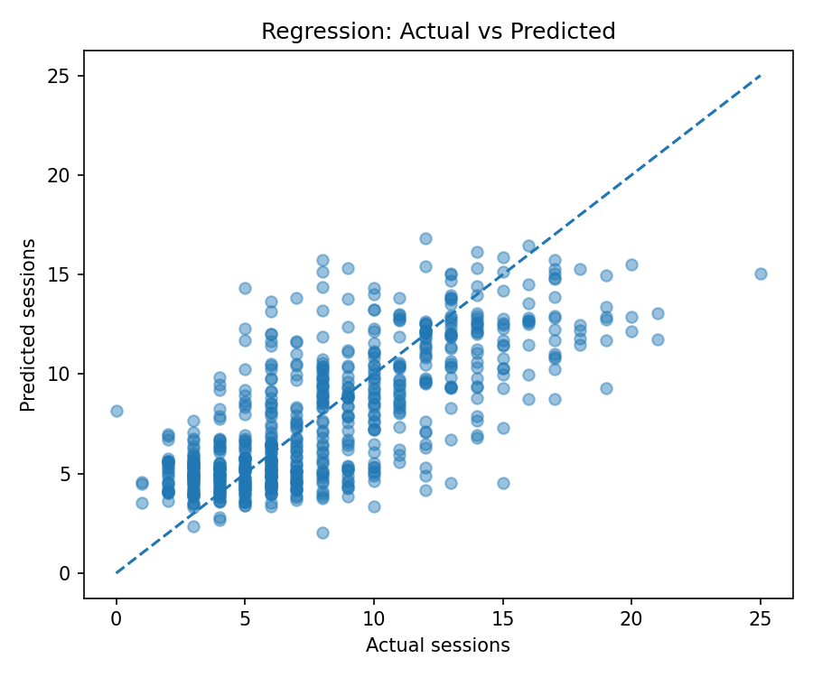
Regression Results

Slide 8
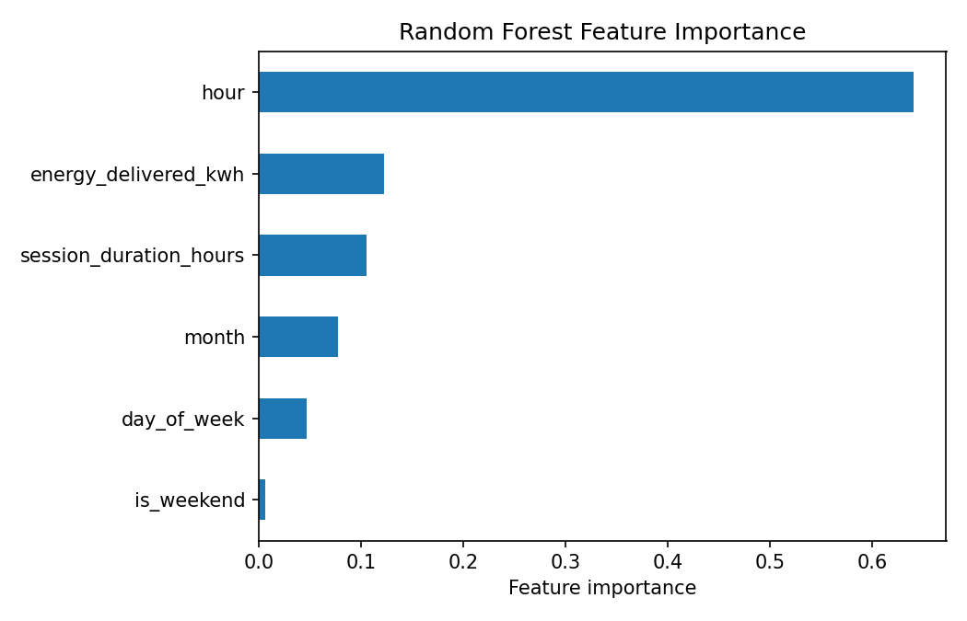
Feature Importance

Slide 9
Dashboard and Sample Prediction
Streamlit dashboard shows demand trends and label distribution
Users select time and session characteristics
Model outputs estimated sessions and demand category
Output is not real-time charger availability

Slide 10
Limitations and Future Work
Replace synthetic data with documented real charging records
Add location, weather, holidays, pricing, and charger status where available
Validate across later dates and multiple stations
Monitor model drift and communicate uncertainty

