Slide 1
eNose Disclosure
Aditya, Li, Frank, Tianyu

Slide 2
Key components of the invention
The invention is a spectroscopy device amenable to miniaturization.
It has the following components:
A light source that can either be broad-spectrum or can comprise multiple light sources, each at a specific wavelength.
Sensors (such as photodiodes) that can measure the intensity of light at a specific wavelength.
A small cavity/chamber to hold the substance under test.
The invention can perform different types of spectroscopy, including absorption and reflectance spectroscopy. The light source(s) and sensor(s) can be oriented differently based on the desired type of spectroscopy.
This invention, a spectroscopy device, outputs an optical spectrum at a discrete set of wavelengths (e.g. 24 different wavelengths).
It is not a full spectrum, which requires expensive benchtop equipment to obtain
The output spectrum contains aggregate information about all the different molecules in the substance under test.
Signal processing, machine learning, and/or other algorithms can be used to recover and estimate the composition of the substance based on the measured optical spectrum at the discrete set of wavelengths.

Slide 3
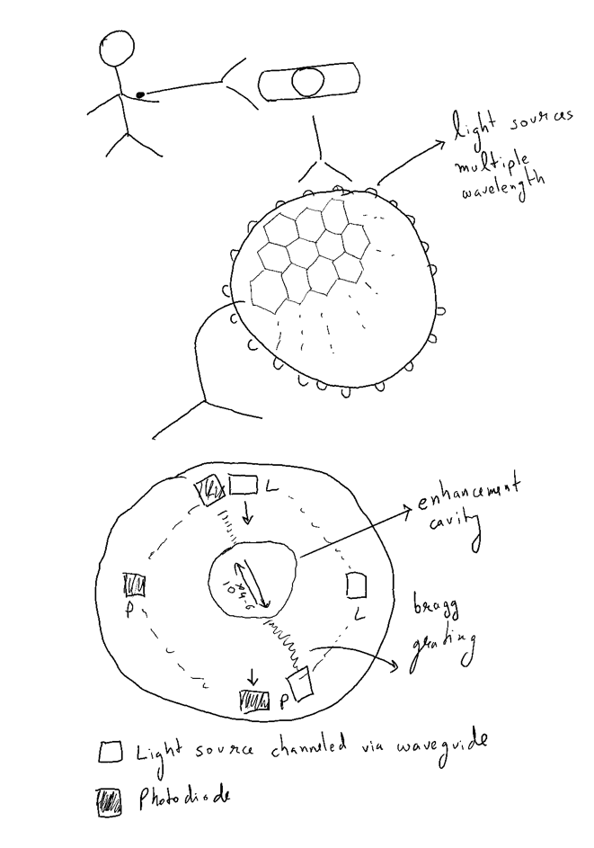
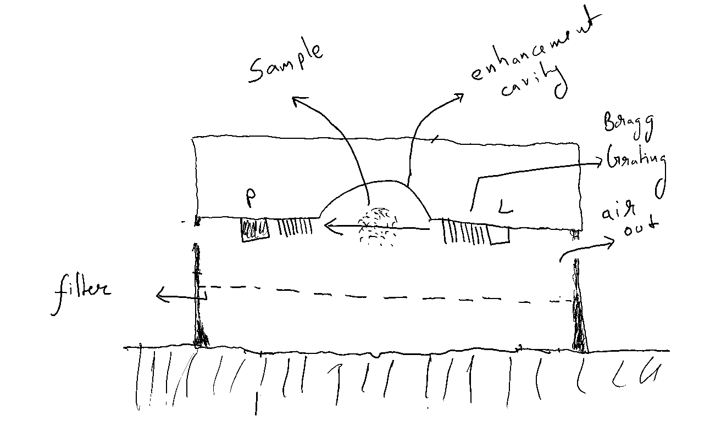
Sketches

Slide 4
Li's Input
The on-chip photonic sensing device is based on the enhanced interactions between guided optical modes and the chemical analytes within a high-finesses nano cavity formed by photonic crystals.
It features
1) high sensitivity to low concentrations of analytes on top of a strong backgroud noise floor
2) high level of identification for distinguishing different chemical species compared to conventional mass spectroscopy methods
Key on-chip components/technologies include
1) Semiconductor light sources with certain tunability
2) Silicon waveguides
3) Electro-optic modulators (EOMs), especially if a two-photon Raman scheme is adopted
4) Photonic crystals, which can either be a 1D array or a 2D hexagon pattern
5) Photodetectors in the VIS, NIR, and MIR ranges

Slide 5
One main point for which to add a bit more detail is how the noted components work together to enable the device to function as a miniaturized version. I.E.,
What prior specific challenges in miniaturizing spectroscopy devices?
Prior attempts at the solution had low specificity
The spectral SNR is low
As the sample is off chip, additional high quality optics are required, which complicates the solution
While still having them perform at multiple wavelengths, were overcome in this version?
Multiple spectral responses at multiple wavelengths, can help tune the algorithm to tune the detection
What special characteristics of the noted combination of components are the biggest factor in getting the miniaturized version to work, where previous attempts at miniaturization might have failed?
By having the sample in a cavity and increasing the number of interactions of the excitation source with the sample, the spectral SNR at each wavelength will be higher
By miniaturizing it on the chip, multiple spectral responses can be generated in different cavities, to reinforce the sensing
The need of high quality off chip optics can be eliminated

