Slide 1
Search Based Software Engineering for Testing Autonomous Cars Test generator : Wiggling Road
Yuki Okumura

Slide 2
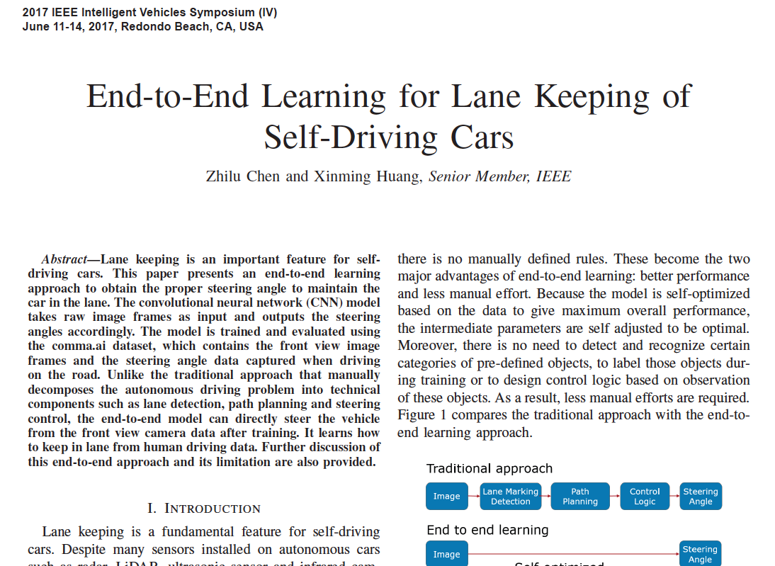

Motivation
Our AI was designed based on “ lane keeping of self-driving cars”
https://ieeexplore.ieee.org/abstract/document/7995975
Lane keeping functions play an active role in particularly highways
Assume that Test generator creates highway road for testing AI’s lane keeping functionality

Slide 3
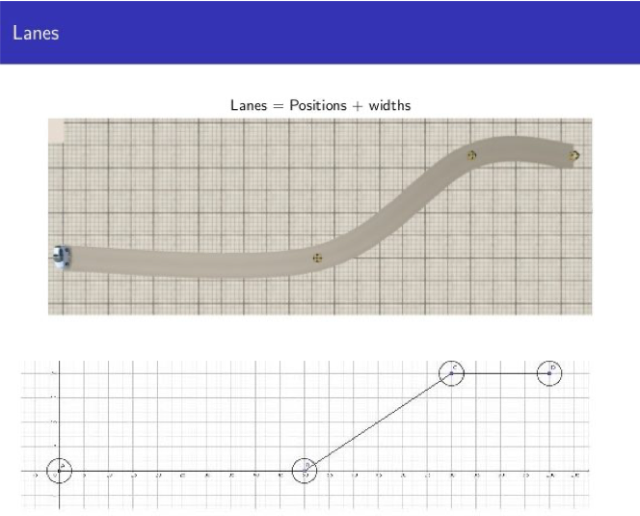
Test generating Conditions
Creates 16 positions
Road Widths are 3,5 m which is the same width with real highway road
Start and Goal are fixed positions
2nd position is also a fixed position to generate at least one straight road
Other positions are generated randomly
Reason of Random : I set a goal to order courses by course’s difficulty
Single lane road and no static and dynamic objects to avoid too complex situations
→but a number of lanes should be increased as real highway usually has multiple
lanes and static and dynamic objects also should be considered in further step
Drivebuild Lane generation method
Lanes = Positions + Widths

Slide 4
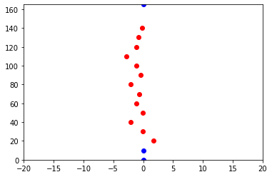
Course Generation Algorithm
Pseudo Code
Course Sample
1. x = 0, y = 0, w = 3.5
2. x += 10, y = 0, w = 3.5
3 ~ 15.
x += 10
y += random.uniform(-2,2)
w = 3.5
16. x = 165, y = 0, w = 3.5
16.
3 ~ 15.
2.
1.
Long : Wide = 4 : 1
: fixed position
: randomly generated position

Slide 5
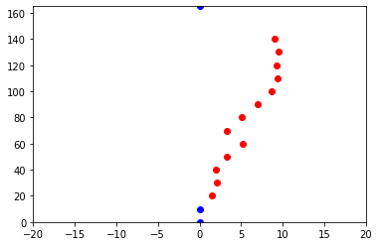
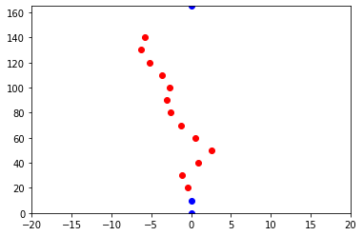
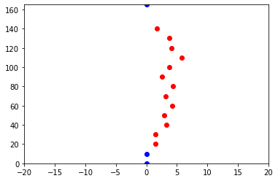
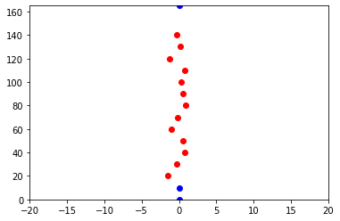
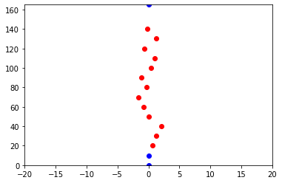
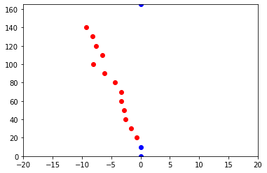
Generated Course Samples

Slide 6
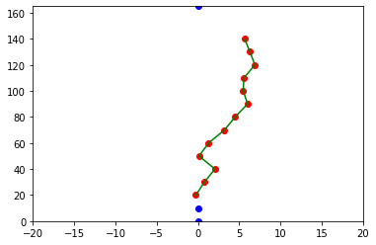
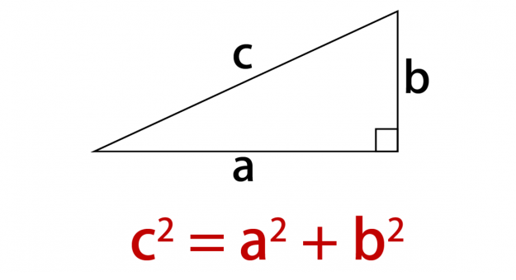
Suggestion 1 for Evaluation Direct Distance of two positions
※ I suggest three evaluation methods since there are no clear evaluation methods exist for test course
Conditions
Total: 15 distances
Calculate
Sum of distances, Mean of distances
Calculation method

Slide 7
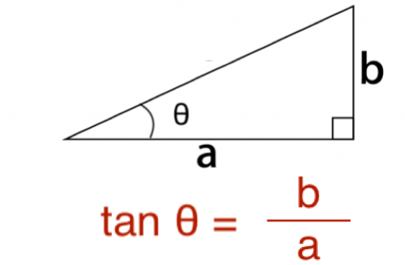
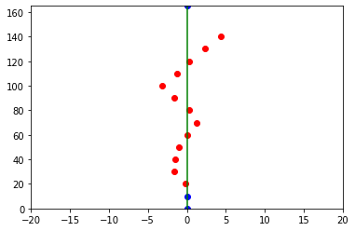
Suggestion 2 for Evaluation Angle of a position from start point
Calculation method
Conditions
Total : 13 angle values
→ except 2nd and goal position
because the angle is always 0°
Calculate
Sum of angles, Mean of angles
Sum of absolute angles, Mean of absolute angles
Left is negative, Center is ０°, Right is positive
Why absolute value?
Angles change both positive and negative because the center has set as 0°
Use Arc tanθ
θ
0°
-90°
90°

Slide 8
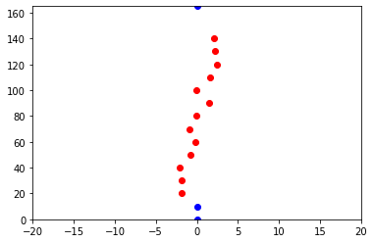
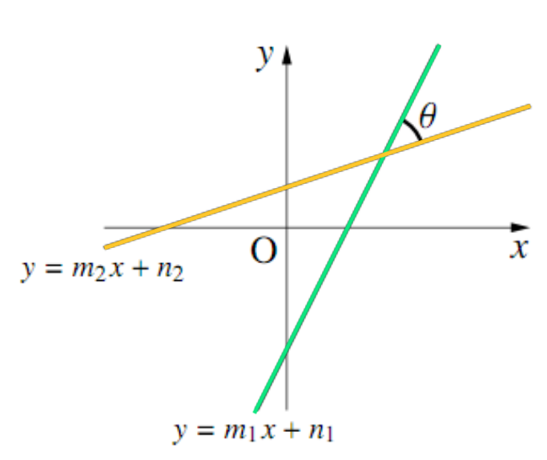
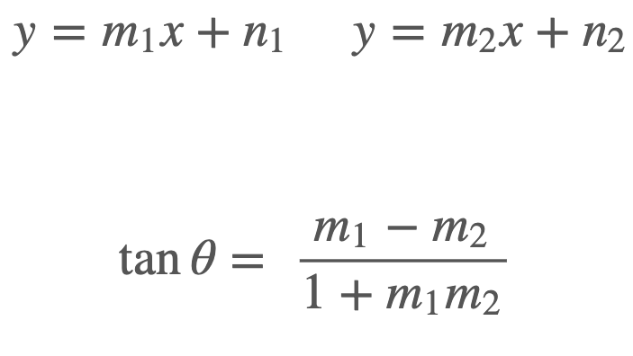
Suggestion 3 for Evaluation Angle of a position from previous 2 positions
Conditions
Total : 14 angles because calculation is available from the 3rd position
Calculate
Sum of angles, Mean of angles
Sum of absolute angles, Mean of absolute angles
Left is negative, Center is ０°, Right is positive
Calculation method
θ
θ
Use Arc tanθ

Slide 9
Evaluation Result
 | Direct Distance |  | Angle of a position from Start position |  |  |  | Angle of a position from previous 2 positions
 | Sum | Mean | Sum | Mean | Absolute Sum | Absolute Mean | Sum | Mean | Absolute Sum | Absolute Mean
 | 167.666 | 11.177 | 52.424 | 4.032 | 52.424 | 4.032 | -19.830 | -1.416 | 52.424 | 3.494
 | 166.756 | 11.117 | -14.800 | -1.138 | 24.081 | 1.852 | 13.197 | 0.942 | 24.081 | 1.605
 | 166.317 | 11.087 | 35.788 | 2.752 | 35.788 | 2.752 | -4.045 | -0.288 | 35.788 | 2.385
 | 165.785 | 11.052 | -3.655 | -0.281 | 10.148 | 0.780 | 0.699 | 0.049 | 10.148 | 0.676
 | 166.0169 | 11.067 | 5.089 | 0.391 | 11.982 | 0.921 | 0.364 | 0.026 | 11.982 | 0.798
 | 167.463 | 11.164 | -43.921 | -3.378 | 43.921 | 3.378 | 20.353 | 1.453 | 43.921 | 2.928

Slide 10
Problem and further work
Need to develop a method which orders generated test courses by difficultly levels that are determined by information from both courses and AI tested result
AI Developer can check the maturity level of AI and AI’s weak operations would be exposed
Evaluation should consider not only information from positions but also AI’s driving data such as vehicle’s velocity, steering angle, test succeed or fail etc. because it is hard to determine difficulty level only with information from courses
Require more data and require ordering method
Easy
Difficult

