Slide 1
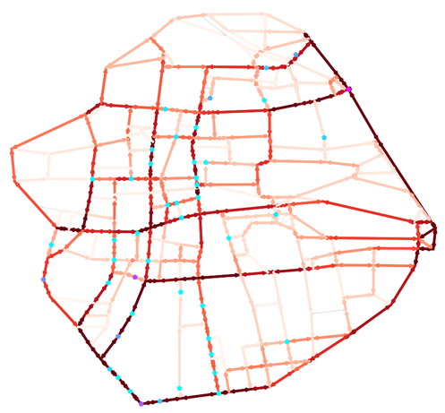
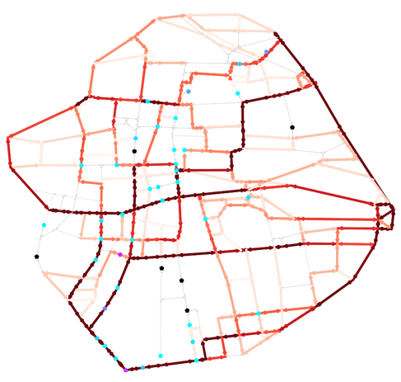
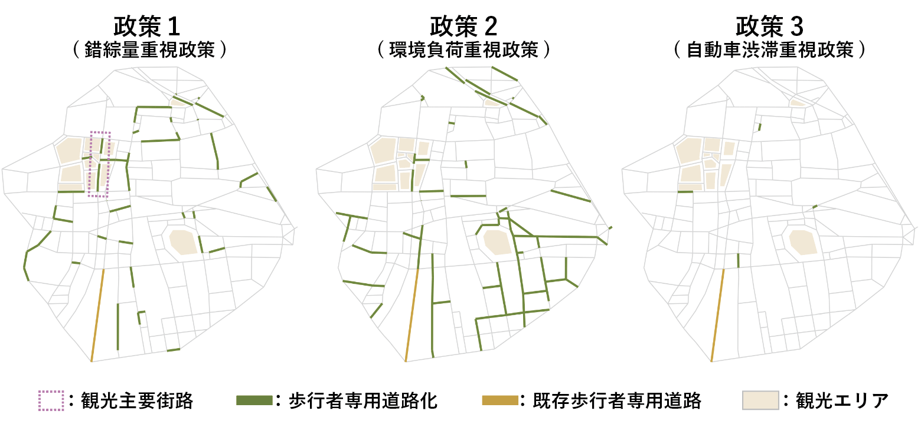


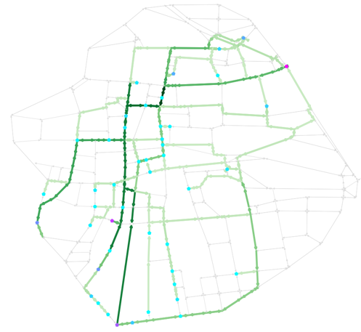
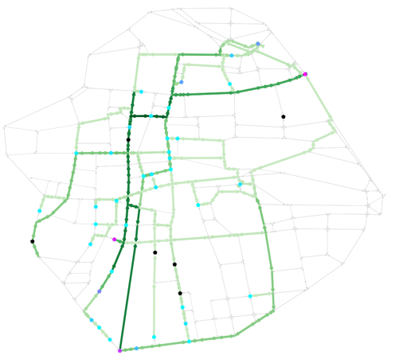

Car traffic
volume
Parking use
volume
Existing pedestrian streets
Pedestrianized streets
Main tourist street
Main area
：鉄道駅
：観光地
Train station
Landmarks
Pedestrian
volume
Before
After (optimized)

