Slide 1
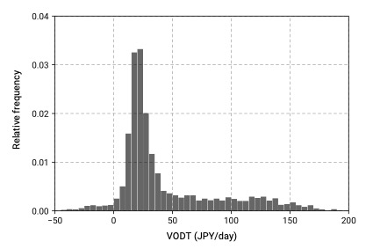
Median
25.6JPY/day
Mean
44.5JPY/day

