Slide 1
PRODUCT OVERVIEW
Habit Tracker
A calm way for busy working parents to build small daily routines.
Notes:
Welcome — introduce the product in one line before moving to the problem.

Slide 2
THE PROBLEM
Most habit apps aren't built for people this busy.
Little time to spare for setup, tracking, or tweaking.
A missed day reads like a red X — a small failure, not a fine one.
They want a few small wins, not another to-do list to manage.
Notes:
Set up the tension: existing habit apps don't fit this audience's real life.

Slide 3
OUR APPROACH
Three principles guide every screen.
01
02
03
Small steps
Gentle nudges
No guilt
Three to five habits at a time — nothing overwhelming.
Reminders that show up quietly, at a time that works.
Missed days stay neutral. Progress is never a grade.
Notes:
Introduce the three design pillars that guide every screen.

Slide 4
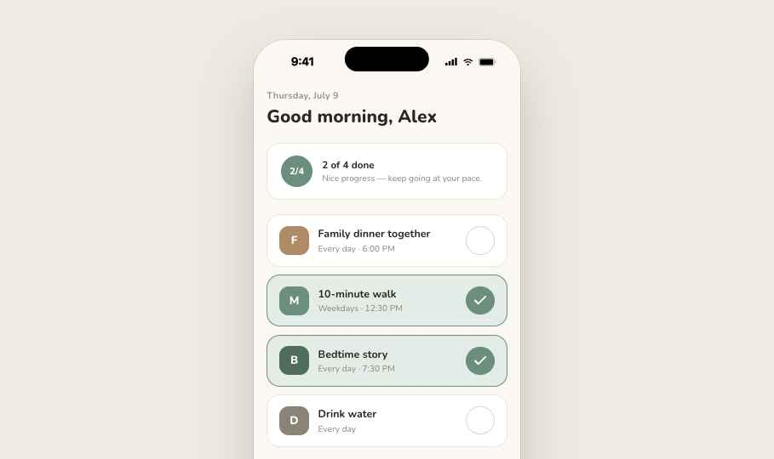
TODAY VIEW
Three to five habits, one tap to check off.
A short summary shows how the day is going — without turning it into a scoreboard.
Notes:
Walk through the daily screen — the core loop of the app.

Slide 5
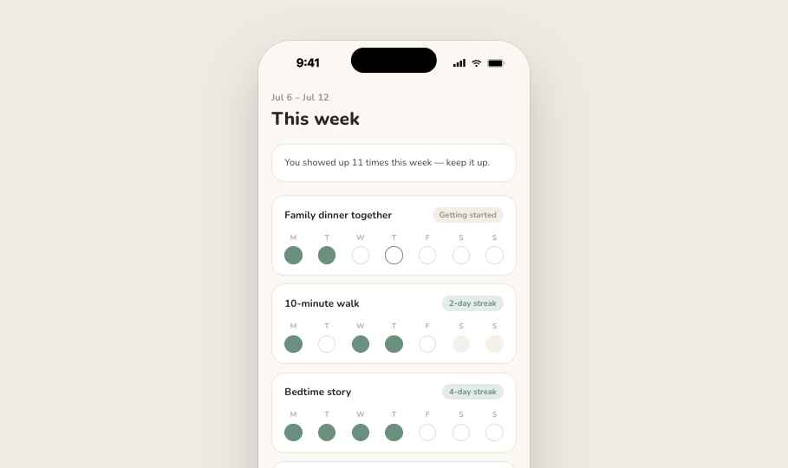
WEEKLY PROGRESS
A simple trail, not a report card.
Filled dots mark a day done. Open dots just mean a day passed — never shown in red.
Notes:
Show the streak trail and explain the neutral treatment of missed days.

Slide 6
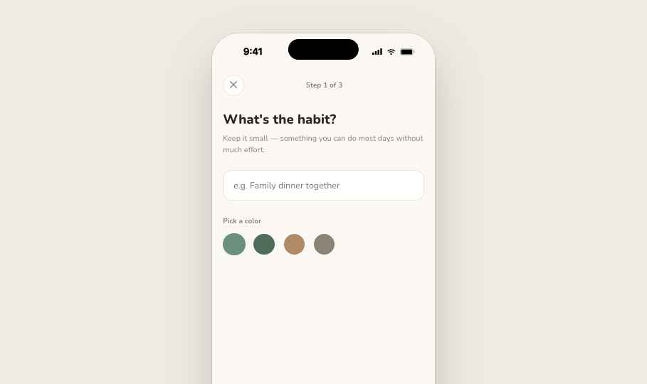
CREATING A HABIT
Name it, set a rhythm, pick a reminder.
Three short steps — under a minute from idea to habit.
Notes:
Show how quick setup is — name, schedule, reminder, done.

Slide 7
OUR PROMISE
Consistency that fits into a busy life — without the guilt.
Notes:
A breathing-room slide before closing — no bullets, just the promise.

Slide 8
WHAT'S NEXT
Where the product goes from here.
Shared habits
Smarter reminders
Beyond the phone
Let partners see and cheer on each other's routines.
Learn the moments a reminder is actually welcome.
A web view for planning the week ahead.
Notes:
Close with roadmap direction; open the floor for questions.

