Slide 1
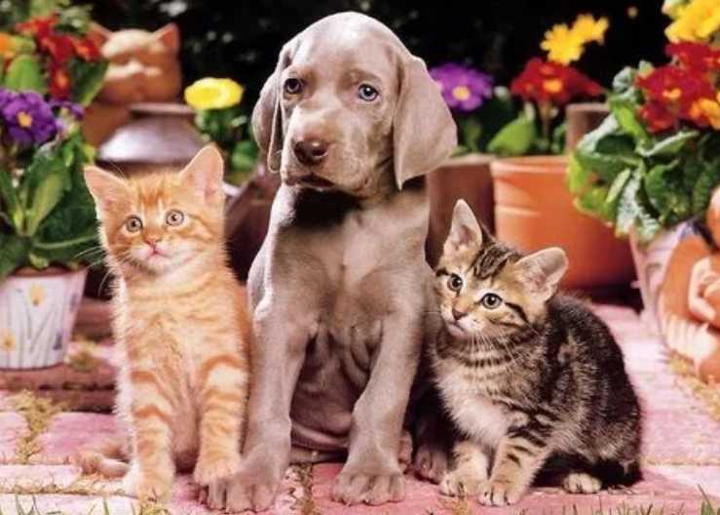
query feature
query box
Query-based R-CNN Head
QGN
Backbone
fature map
Random
RoI Align

Slide 2
Method
query feature
query box
Query-based R-CNN Head
OTA Matcher
QGN
Backbone
fature map
Random Unknown
ROI Attention
RoI Align

Slide 3
ROI Attention Module
flatten
q
Attention
max pool
reshape
upsample
avg pool
k , v
flatten

Slide 4
Hungarian Matcher vs OTA Matcher
Q₀
Q₁
Q₂
Q₃
Q₄
GT₀
-0.9 | -0.1 | -0.2 | -0.7 | -0.4
-0.1 | -0.9 | -0.8 | -0.3 | -0.3
-0.2 | -0.1 | -0.7 | -0.2 | -0.1
-0.3 | -0.2 | -0.3 | -0.4 | -0.3
-0.1 | -0.3 | -0.1 | -0.2 | -0.2
GT₁
Q₀
Q₁
Q₂
Q₃
Q₄
BG
GT₀
-0.9 | -0.1 | -0.2 | -0.7 | -0.4
-0.1 | -0.9 | -0.8 | -0.3 | -0.3
-0.2 | -0.1 | -0.7 | -0.2 | -0.1
k₀ = 2
BG
GT₁
k₁ = 1
BG
BG
Cost Matrix
Cost Matrix
Hungarian Matcher
OTA Matcher

Slide 5
Random Unknown Pseudo Label Selection
Discard top b background queries
Pick k queries as unknown randomly
mathed queries
unmathed queries

Slide 10
roi-attn：预期做特征增强
self-attn
mean
flatten
reshape
repeat
7*7*256
7*7
7*7
7*7*256
49*1
49*1
+
7*7*256

Slide 11
roi-attn：预期做特征增强
3*3*256
q
maxpool
3*3*256
self-attn
avgpool
7*7*256
3*3*256
v

Slide 12
roi-attn：预期做特征增强
3*3*256
q
maxpool
upsample
3*3*256
self-attn
avgpool
7*7*256
7*7*256
3*3*256
v

