Slide 1
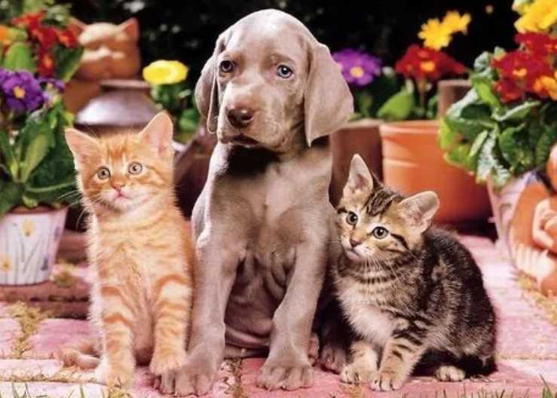
query feature
query box
Query-based R-CNN Head
QGN
Backbone
fature map
Random
RoI Align

Slide 2
query feature
query box
Query-based R-CNN Head
QGN
Backbone
Random
RoI Align
fature map

Slide 10
roi-attn：预期做特征增强
self-attn
mean
flatten
reshape
repeat
7*7*256
7*7
7*7
7*7*256
49*1
49*1
+
7*7*256

Slide 11
roi-attn：预期做特征增强
3*3*256
q
maxpool
3*3*256
self-attn
avgpool
7*7*256
3*3*256
v

Slide 12
roi-attn：预期做特征增强
3*3*256
q
maxpool
upsample
3*3*256
self-attn
avgpool
7*7*256
7*7*256
3*3*256
v

