Slide 1

Motor Imprecision in Clinical High Risk for Psychosis: Insights from Predictive Analytics
Ziyan (Yuki) Han
PhD Candidate in Psychology, Northwestern University

Slide 2


About me
BA in Cognitive Science
at Occidental College
MS student in Statistics at Northwestern University
2017. ~ 2020.
2021. ~ Present.
PhD candidate in Psychology (Brain, Behavior, Cognition) at Northwestern University

Slide 3
Table of Contents
Project Introduction
Research Processes
Key Insights
Obstacles & Challenges
Recommendations and Next Steps

Slide 4
Table of Contents
Project Introduction
Research Processes
Key Insights
Obstacles & Challenges
Recommendations and Next Steps

Slide 5



Why do we conduct this research?
Symptoms of psychosis occur early in adulthood, can severely influence life quality in many domains
The signs of motor deficits occur as early signs of psychosis development, but are currently less studied compared to positive symptoms like hallucination
Current diagnosis for high risk in psychosis is not as accessible

Slide 6
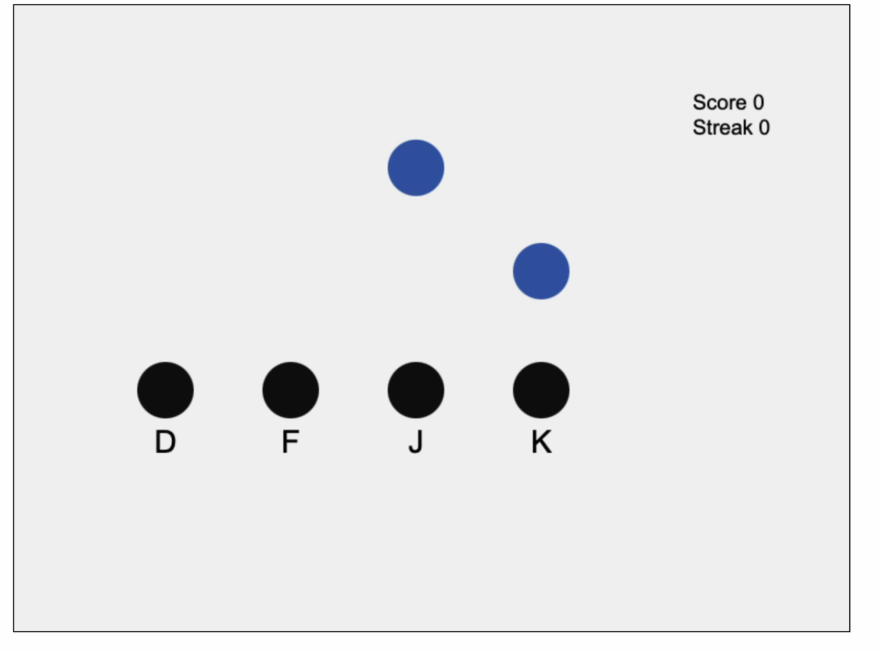
Accessible Motor Task: Serial Interception Sequence Learning task
Online Accessibility
Efficiency
Test re-test reliability
Predictivity

Slide 7
Table of Contents
Project Introduction
Research Processes
Key Insights
Obstacles & Challenges
Recommendations and Next Steps

Slide 8
Research Process: Procedures
Recruitment
Data Collection
Data Analysis
Data Visualization

Slide 9
Research Process: Procedures
Recruitment
I collaborated with the clinical lab to recruit from the pool of participants diagnosed with high risk for psychosis
Healthy participants are recruited from the university to ensure ethical handling and inclusivity
Data Collection
Data Analysis
Data Visualization

Slide 10
Research Process: Procedures
Recruitment
All participants completed clinical assessment to:
rule out formal psychosis
assess for other psychiatric disorders with psychotic features
Motor assessment was conducted using the SISL task
I completed data preprocessing with Python and R studio
Data Collection
Data Analysis
Data Visualization

Slide 11
Research Process: Procedures
Recruitment
Chi-square
Make sure no age/sex differences between groups
A/B testing
Demonstrate motor precision difference between groups while holding other variables constant
Linear Mixed Effect model
Accounts for auto-correlation
Captures hierarchical data
Improve generalizability
Data Collection
Data Analysis
Data Visualization

Slide 12
Research Process: Procedures
Recruitment
Chi-square
Make sure no age/sex differences between groups
A/B testing
Demonstrate motor precision difference between groups while holding other variables constant
Linear Mixed Effect model
Accounts for auto-correlation
Captures hierarchical data
Improve generalizability
Data Collection
Data Analysis
Data Visualization

Slide 13
Research Process: Procedures
Recruitment
Chi-square
Make sure no age/sex differences between groups
A/B testing
Demonstrate motor precision difference between groups while holding other variables constant
Linear Mixed Effect model
Accounts for auto-correlation
Captures hierarchical data
Improve generalizability
Data Collection
Data Analysis
Data Visualization

Slide 14
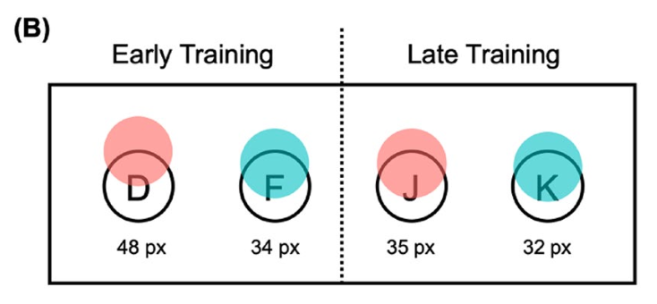
Research Process: Procedures
Recruitment
Clinical high risk for psychosis
Healthy controls
Data Collection
Data Analysis
Data Visualization
Notes:
Innovation and easy communication

Slide 15
Research Process: Procedures
Recruitment
Chi-square
Make sure no age/sex differences between groups
A/B testing
Demonstrate motor precision difference between groups while holding other variables constant
Linear Mixed Effect model
Accounts for auto-correlation
Captures hierarchical data
Improve generalizability
Data Collection
Data Analysis
Data Visualization

Slide 16
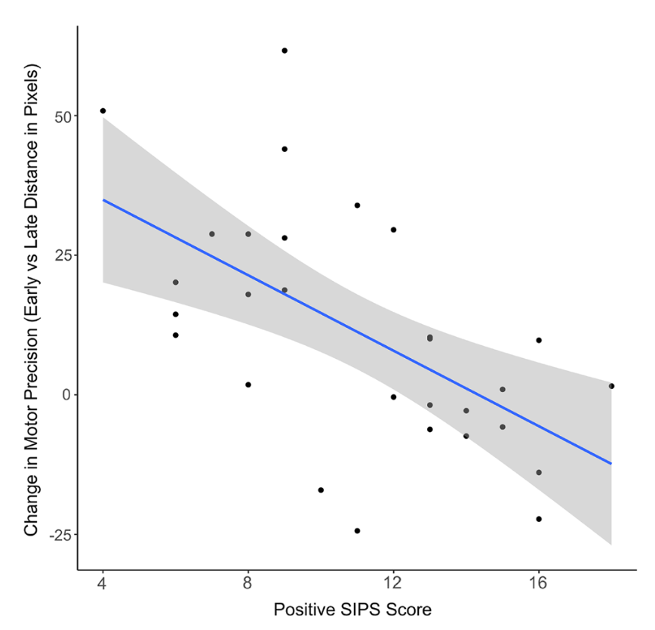
Research Process: Procedures
Recruitment
Less motor improvement is predictive of high psychotic symptomatic measures
Data Collection
Data Analysis
Data Visualization

Slide 17
Table of Contents
Project Introduction
Research Processes
Key Insights
Obstacles & Challenges
Recommendations and Next Steps

Slide 18


Insight and Values: Motor deficits in CHR population vs. healthy controls
For potential patients:
A 15-minute online motor assessment can serve as a powerful predictive tool for psychosis risk, improving diagnostic efficiency and accessibility.
For industry:
Findings suggest a shift in medication development towards early intervention, potentially transforming psychosis treatment.

Slide 19


Insight and Values: Motor improvements are predictive of symptom severity
For potential patients:
Motor assessments enable early detection of psychotic symptoms, empowering patients with timely interventions that improve their quality of life and reduce long-term health risks
For healthcare providers:
Changes in motor precision offer a reliable way to monitor symptom progression, supporting more informed decisions on treatment adjustments and resource allocation

Slide 20
Table of Contents
Project Introduction
Research Processes
Key Insights
Obstacles & Challenges
Recommendations and Next Steps

Slide 21

Obstacles & Challenges
3. Outcome
This shift not only mitigated recruitment issues but also highlighted the potential for scalable, remote assessments in clinical research.
2. Solution
I pivoted to developing an online motor assessment platform using JavaScript, ensuring continued data collection while increasing accessibility for a broader participant base.
1. Challenge
In-person recruitment was paused during COVID, causing significant delays in participant enrollment.

Slide 22



Obstacles & Challenges
1. Challenge
The self-adjusting speed algorithm behaved erratically during missed trials, speeding up unexpectedly and increased task difficulty
2. Solution
I diagnosed the error through forensic data analysis using Python, identifying the bug which came from incorrect labeling of missed trials
3. Outcome
I retested the integrity of collected data, reassuring the validity of study findings and improving future implementations.

Slide 23
Table of Contents
Project Introduction
Research Processes
Key Insights
Obstacles & Challenges
Recommendations and Next Steps

Slide 24
Recommendations and Next Steps
Cross-checking task reliability with other motor tasks
Integrate findings into clinical practice
Broaden the study to include non-clinical populations
Investigate other aspects of psychotic features
Extending accessible assessments to other mental illnesses

Slide 25
Table of Contents
Project Introduction
Research Processes
Key Insights
Obstacles & Challenges
Recommendations and Next Steps

Slide 26
Thank you!
Questions?

