Slide 1
Deep Q Network
Denver Quant Society
Yuki Kitayama

Slide 2
Contents
Introduction
Example
Concept
Implementation

Slide 3
Introduction
Deep Q Network (DQN)
One of many reinforcement learning algorithms using deep learning (“Deep reinforcement learning”)
Proposed in 2013 by DeepMind (AI company in UK under Google) in paper “Playing Atari with Deep Reinforcement Learning”.
Neural network is used to process state data and to output action-value (Q value)
Why I introduce this?
Agent learns from scratch without human intervention and achieves results better than human.
Many reinforcement learning papers use DQN as benchmark.

Slide 4
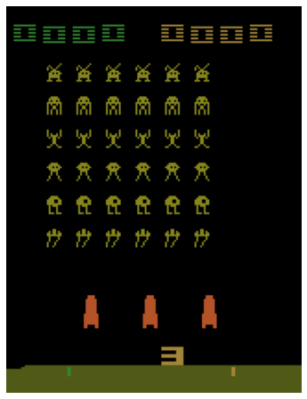
Example
Space Invaders
A game to kill as many enemies as possible to get a high score.
State: Game screen
Action: Fire, move right, move left, move right and fire, move left and fire, do nothing
Reward: Score you can get when you kill an enemy
Approach
Use convolutional neural network to process game screen, and outputs what’s the best in a certain state every time step.
YouTube
https://www.youtube.com/watch?v=W2CAghUiofY

Slide 5
Concept - Big picture
For loop
Get action
Get next state from the action
Collect data
Train model
Current state = next state
Epsilon greedy algorithm
Experience replay
Q-learning

Slide 6
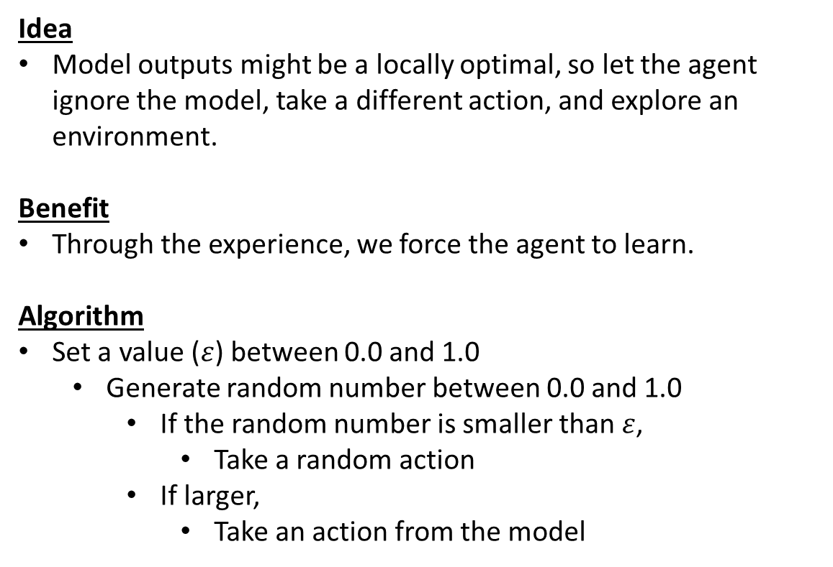
Concept - Epsilon greedy algorithm
Idea
Model outputs might be a locally optimal, so let the agent ignore the model, take a different action, and explore an environment.
Benefit
Through the experience, we force the agent to learn.
Algorithm
Set a value ($ε$) between 0.0 and 1.0
Generate random number between 0.0 and 1.0
If the random number is smaller than $ε$,
Take a random action
If larger,
Take an action from the model
Epsilon = 0.1
Model
decides action
90%
Random
Action
10%

Slide 7
Concept - Experience replay
Idea
It’s a buffer (called replay memory) of experienced data which we collect through iteration.
Becomes a dataset to train our model.
Benefit
Efficient because it stores a large amount of data, but sample mini-batch to train model.
Reduce data correlation through sequentially collecting experience but randomly sampling it
Algorithm
In each time step, collect a tuple of state, action, reward, and next state
Add them to a list of replay memory.
Generate random indices and batch size to sample data
Train neural network.
Replay memory (size = 1M)
$${[State}_{t=1}, {Action}_{t=1}, {Reward}_{t=1}, {Next state}_{t=1}]$$
$${[State}_{t=2}, {Action}_{t=2}, {Reward}_{t=2}, {Next state}_{t=2}]$$
…
Mini-batch (size = 32)
$${[State}_{t=24}, {Action}_{t=24}, {Reward}_{t=24}, {Next state}_{t=24}]$$
$${[State}_{t=73}, {Action}_{t=73}, {Reward}_{t=73}, {Next state}_{t=73}]$$
…
Train neural network

Slide 8
Concept - Q-learning
Model
Use neural network to predict action-values, Q(s, a), (“Q value”)
Shape of Input and output depends on an environment.
Q-learning
Target
Reward + discount factor * max(Q(next state, action))
Estimate
Q(current state, action)
Update
Loss function is mean of (Target - Estimate)^2
E [r + gamma * max(Q(s’,a’)) – Q(s,a; theta)]
Differentiate the loss function w.r.t. theta
Gradient descent and update weights in neural network.
Theta = theta – alpha * gradient of theta.
State
Action | Q value
Fire | 5.5
Right | 4.3
Left | 8.6
Right & fire | 2.1
Left & fire | 2.5
Nothing | 4.6
Action
Neural network
Move left

Slide 9
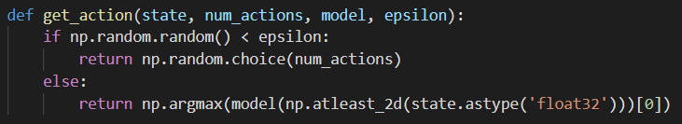
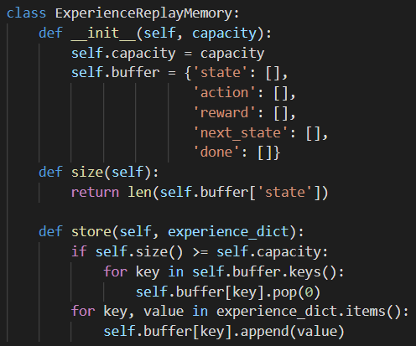
Implementation - Code
OpenAI Gym CartPole
State: Cart position, cart velocity, pole angle, pole velocity
Action: Move cart right, move cart left
Reward: Every time step, you gain 1.
Environment ends when cart moves away from center or when pole loses standing state.
Video of real setting: https://www.youtube.com/watch?v=XiigTGKZfks&feature=youtu.be
Code:
Python: https://github.com/yukikitayama/reinforcement-learning/blob/master/dqs/dqn_cartpole_train.py
Notebook: https://github.com/yukikitayama/reinforcement-learning/blob/master/dqs/dqn_cartpole.ipynb
Epsilon greedy algorithm
Experience replay

Slide 10
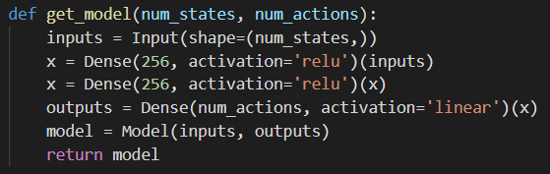
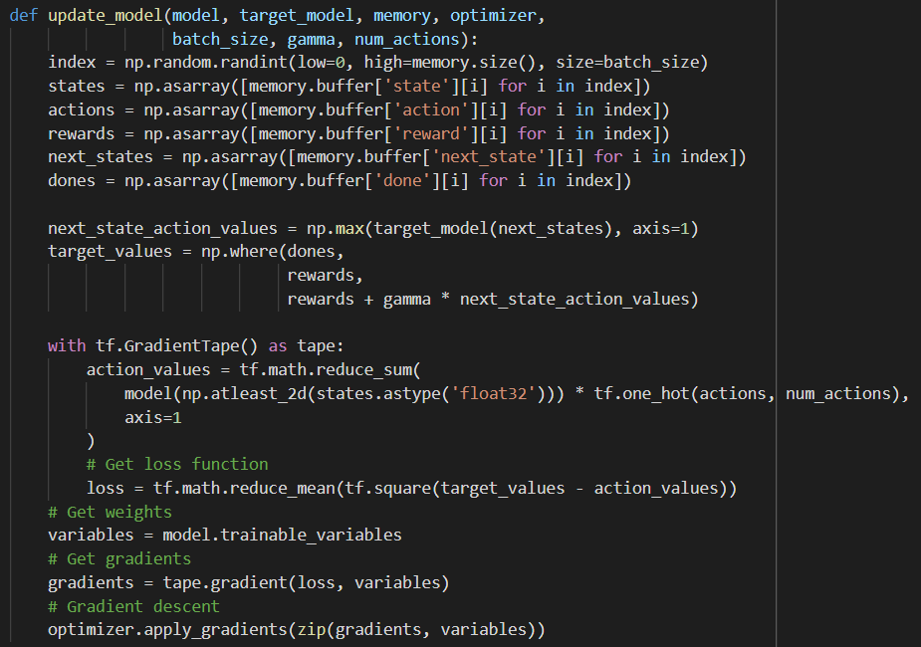
Implementation - Code
Q-learning

Slide 11
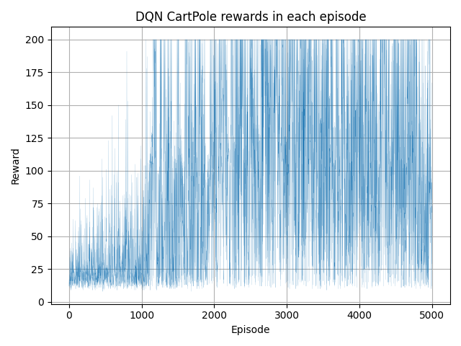
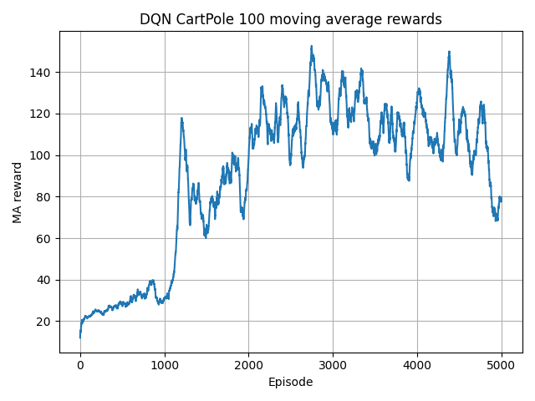
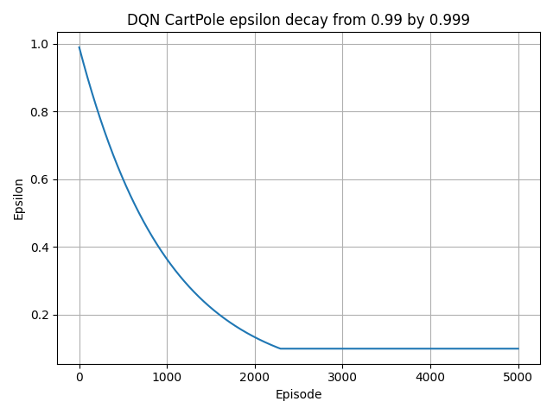
Implementation - Result
Result

