Slide 1
Investigating NHS Covid-19 web archives

Slide 2
Analytical questions
How do the Covid-19 pages change over time?
What can URL use show about changing language surrounding Covid-19?
How does length change over time?

Slide 3
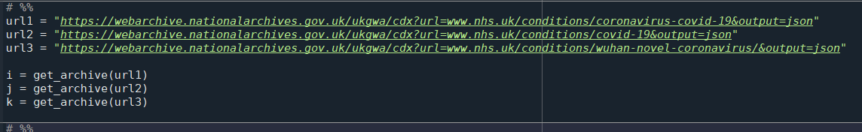
Method
Downloaded archives of 3 NHS conditions urls:
  “coronavirus-covid-19”
  “covid-19”
  “wuhan-novel-coronavirus”
Join queries, create dataframes
Aggregated by timestamp month and mime counts
plot

Slide 4
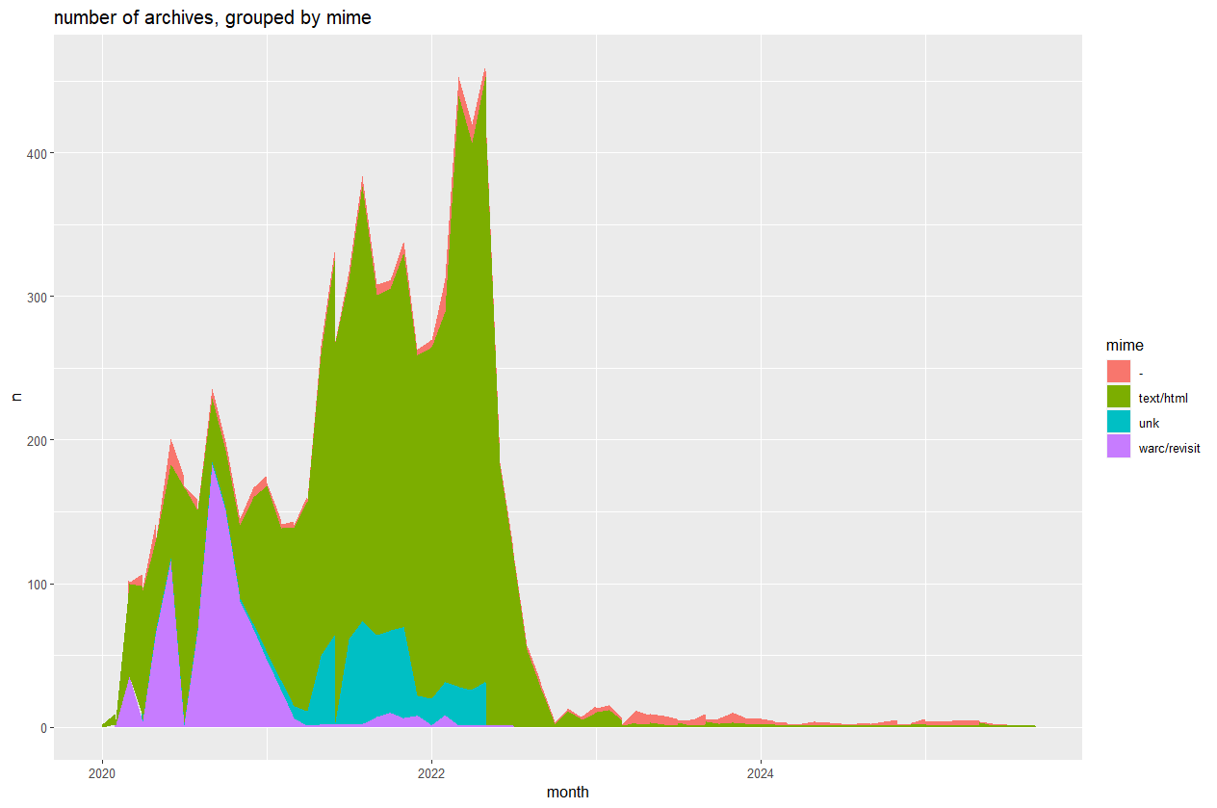
1. How do pages change over time?
text/html mime highest in May 2022 at 422
Changes fall off considerably after that

Slide 5
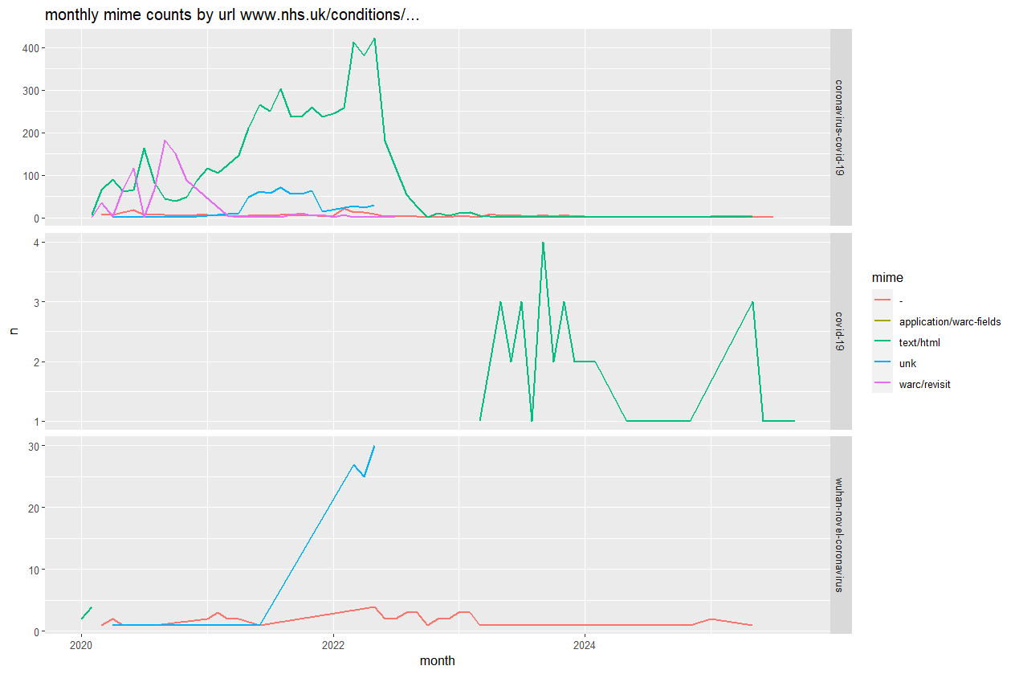
What can URL use show about changing language towards covid-19?
mimes split by the 3 different urls in each box.
Bottom (wuhan-novel) has activity at start, but html updates stop on 7th Feb 2020
“Covid-19” was coined by WHO on 11 Feb 2020
“Coronavirus-covid-19” is used until mid-2022
Shift to covid-19 page in 2023

Slide 6
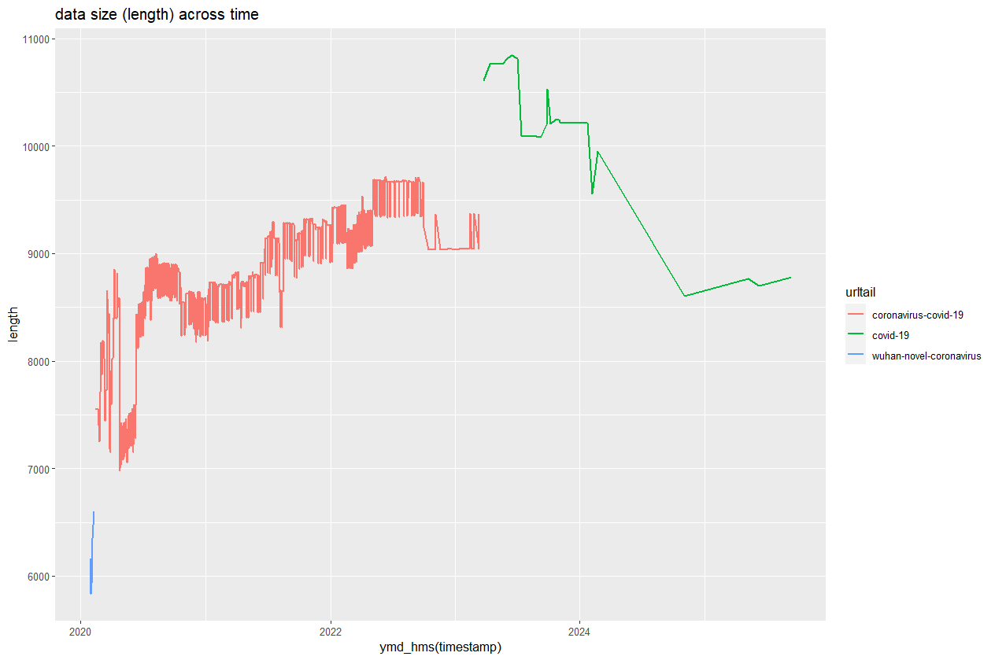
3. How does length change over time?
Filtered for “text/html” mime and status 200
length generally consistent around 6000-10,000
Can also see movements to different URLs in this chart, but interestingly there is little overlap

Slide 7
Further steps & resources
Further analysis of text content (webscraping):
  Symptoms known at the time
  Advice given at the time
  Adapting to changing nomenclature
Qualitative comparisons to the archived webpages
WHO- COVID-19
National Archives – UK Government web archives (1) (2) (3)
Github repo

