Slide 1
Research of data from a large retailer for the period September 1–7, 2023
Reason for the research:
In the first 4 days of September, there was an increase in the number of transactions.
Hypothesis to be tested:
The growth driver is one or more specific outlets. If so, it will also be necessary to check whether the "driver" has "devoured" other outlets.

Slide 2
Number of transactions (absolute values)

Slide 3
Number of transactions (normalized)

Slide 4
Reason for the research:
We notice that we have problems with distributing the load on the servers. It is necessary to study the dynamics of the load and find solutions to the problem.
Hypothesis to be tested:
The increase in load is associated with an increase in the number of transactions, and the uniformity of the load can be "cured" if you "rebind" retail outlets to other servers.

Slide 5
Server load growth rate before/after load balancing
Server load before/after load balancing

Slide 6
Reason for the research:
It is necessary to calculate at which points what percentage of transactions are performed using self-service checkouts. It is also necessary to study the dynamics of the share of transactions at self-service checkouts and correlate this information with the dynamics of the distribution of transactions at retail outlets.
Hypothesis to be tested:
A strong increase in the number of transactions from self-service checkouts increases the average duration of the transaction.

Slide 7
Number of transactions at checkouts with a cashier/self-service

Slide 8
Share of self-service transactions
Service time at self-service checkouts

Slide 9
Reason for the research:
It is necessary to investigate September 1 and determine the reasons for the increased average duration of operations.

Slide 10
Average server transaction duration on September 1

Slide 11
Average server transaction time on September 1

Slide 12
Server load on September 1

Slide 13
Load on September 1 at retail outlets

Slide 14
Average duration of transactions by payment systems on September 1

Slide 15
Prevalence of payment systems on September 1

Slide 16
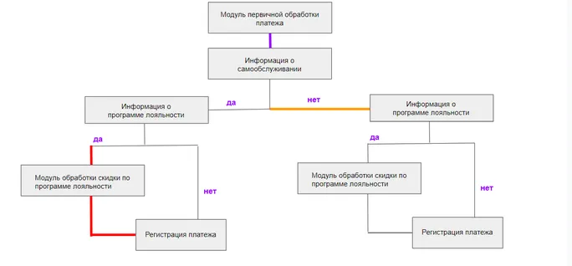
Reason for the research:
The developers sent the following diagram and reported that there were technical problems in the links marked with colors.
It is necessary to provide information on how seriously these technical problems affected the average payment duration and to deduce by what percentage the duration of the transaction has increased compared to the average statistical value.
Lilac – server 1 between 00:00 and 9:00 on day 05.09
Red – Server 1 All Day 06.09
Orange – Server 2 in the period 12.00-13.00 on the day 07.09

Slide 17
Dynamics of the average duration of payment transactions on 1 server from September 5 to September 7

Slide 19
Reason for the research:
Throughout the day on 07.09, there was a marketing campaign, according to which any bearer of a card with a loyalty program for a purchase over 15,000 rubles receives an additional gift.
Estimate how many percent the average check has risen during this period.
Check if the total number of transactions has increased during this period?
The gift is drawn in the format of a lottery:
Five randomly selected lucky ones receive a gift worth 50,000 rubles
Ten more receive a gift worth 10,000 rubles
All others who fall under the terms of the promotion receive a gift worth 750 rubles

Slide 20
Динамика количества покупок и среднего чека с 5 по 7 сентября

Slide 21
Reason for the research:
Segment loyalty discounts: break down all discounts into bins (intervals) and estimate how much money customers save in total within each bin.

Slide 22
Amount saved by customers by bin

