Slide 1
Is it sufficient with only the general detector mag. shield ?
YES
No magnetic shield for the PMU
NO
Is it sufficient with the magnetic circuit of the PMU magnet?
YES
No magnetic shield for the PMU
NO
Design the PMU magnetic shield
Position : PMU side? Detector side?
Shape : Plate? Cylinder?
Material : A4K? Cryoperm?

Slide 2
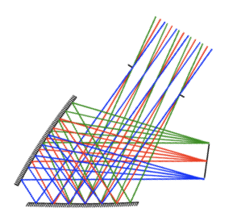
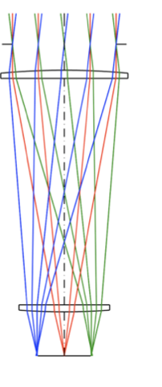
200mm
400mm
PMU
(Magnet)
PMU
(Magnet)
Detector
Detector

Slide 3
Radial magnetization
+ Iron yoke
Axial magnetization

