Slide 1
Is it sufficient with only the general detector mag. shield ?
YES
No magnetic shield for the PMU
NO
Is it sufficient with the magnetic circuit?
YES
No magnetic shield for the PMU
NO
Mag. shield at PMU side? or at detector side?
Design the mag. shield configuration at PMU side
- Shape?
- Material?
Design the mag. shield configuration at detector side
- Shape?
- Material?

Slide 2
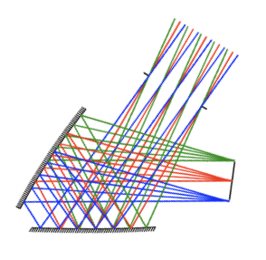
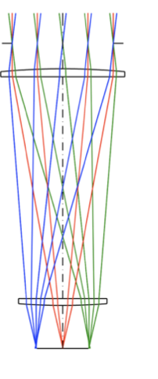
200mm
400mm
PMU
(Magnet)
PMU
(Magnet)
Detector
Detector

