Slide 1
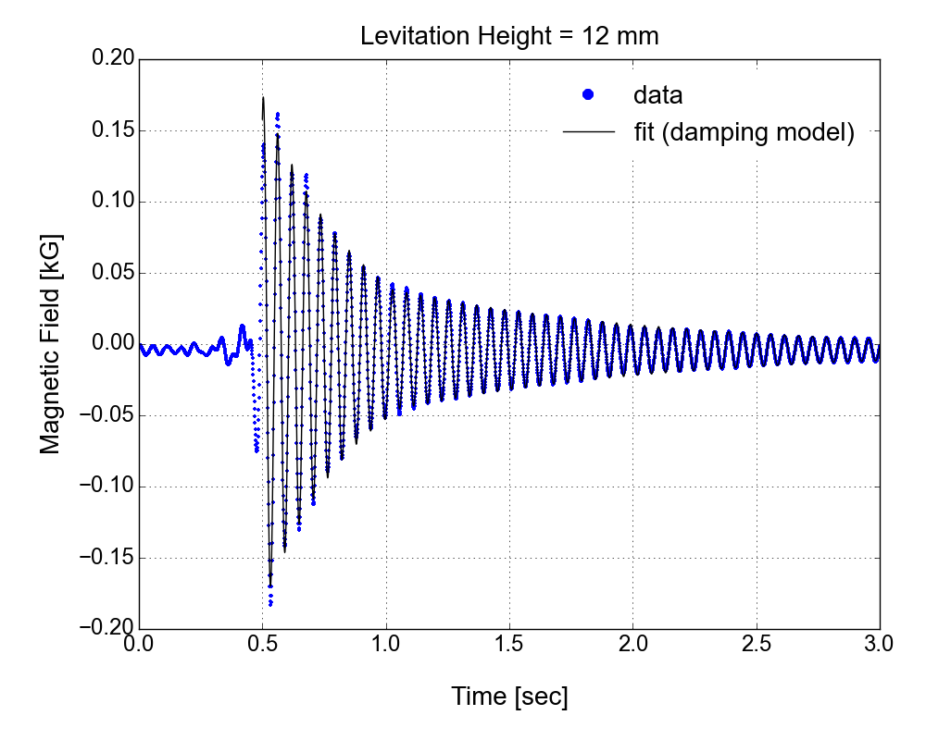
Levitation Height = 12 mm
External Force
Magnetic Field [kG]
Time [sec]

Slide 2
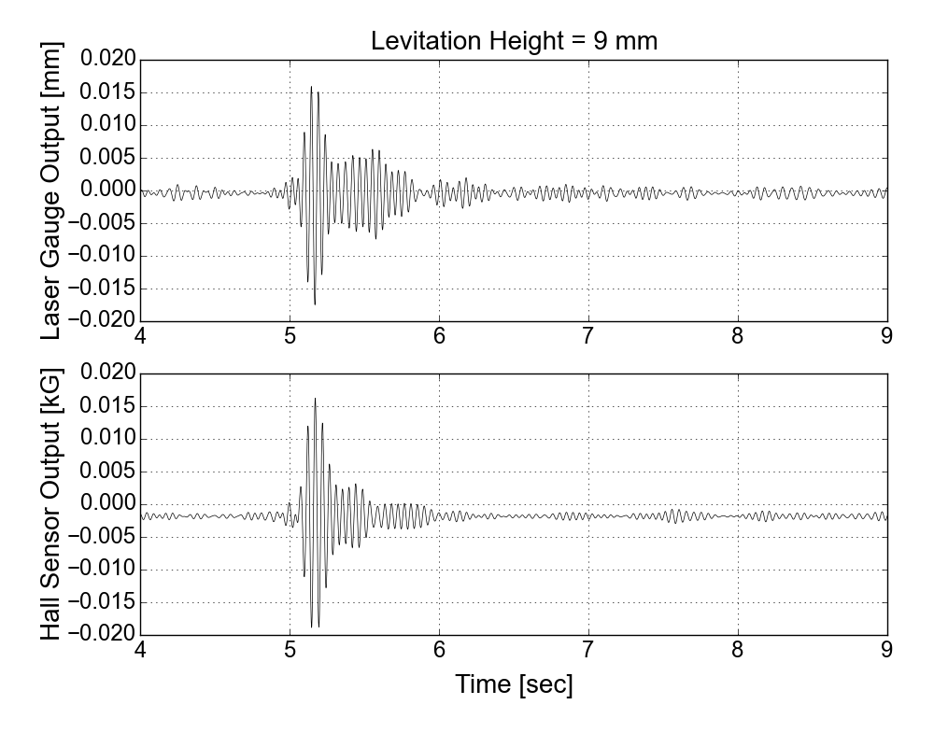
Levitation Height = 9 mm
Bandpass Filter
15 Hz < f < 25Hz
External Force
Bandpass Filter
15 Hz < f < 25Hz
Time [sec]

