Slide 1

STATE OF THE FOREST
Annual Ecological Review — Fiscal Year 2025

Slide 2
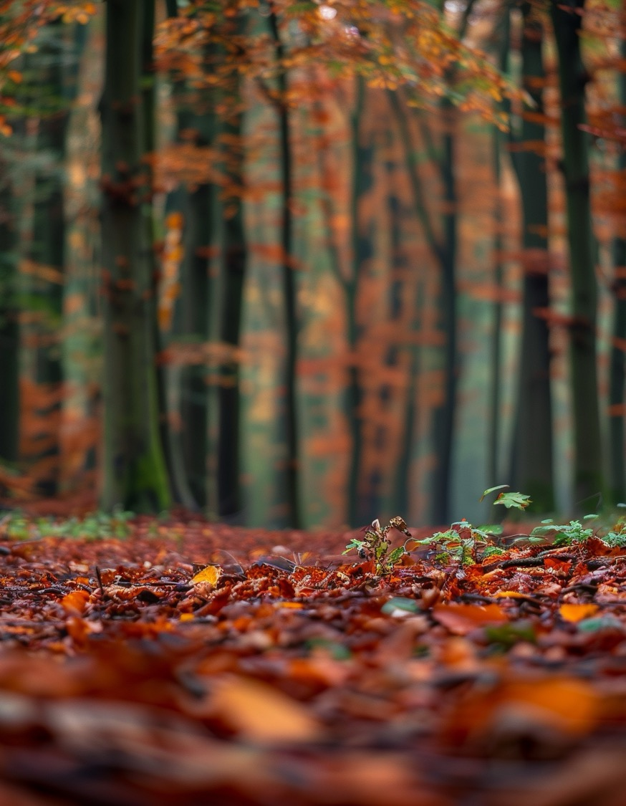

CONTENTS
01 Executive Summary
02 Canopy & Growth Metrics
03 Biodiversity Index
04 Managed vs. Old-Growth
05 Voices from the Field
06 Outlook & Next Steps

Slide 3
EXECUTIVE SUMMARY
A measured look at twelve months of observation across 42,000 hectares of mixed temperate woodland.
KEY FINDINGS
Canopy cover expanded by 3.4%, the strongest gain in seven years.
Avian species richness held steady; ground-nesting populations recovered modestly.
Drought stress in the southern parcels warrants a revised irrigation plan for FY26.
Visitor footfall rose 18%; trail erosion remains within tolerance thresholds.

Slide 4


PART I
Measuring the Canopy
Quantitative indicators of forest health, captured through remote sensing and in-field transects.

Slide 5
CANOPY & GROWTH
Figure 1. Canopy cover index by quarter, 2019–2025. Source: aerial LIDAR composites.
A QUIET RECOVERY
After three consecutive years of contraction, the canopy index climbed back above the seven-year mean in Q2 and has since held.
+3.4%
Year-over-year canopy gain
Driver: replanting in the 2022 burn scar is now visible from altitude.

Slide 6
BIODIVERSITY SNAPSHOT
Observed species counts across six taxonomic groups, compared against the baseline established in 2018.
Taxon | 2018 Baseline | 2024 | 2025 | Δ vs. Baseline
Vascular plants | 312 | 296 | 304 | −2.6%
Birds | 89 | 91 | 93 | +4.5%
Mammals | 24 | 22 | 23 | −4.2%
Amphibians | 11 | 9 | 10 | −9.1%
Lichens & bryophytes | 147 | 158 | 164 | +11.6%
Fungi (macro) | 206 | 211 | 219 | +6.3%

Slide 7
MANAGED vs. OLD-GROWTH
MANAGED PARCELS
28,400 ha
Replanted between 1978 and 2006; species mix dominated by Douglas fir and western hemlock.
Mean stem age: 34 years
Understory diversity: moderate
Harvest rotation: 60 years
OLD-GROWTH RESERVE
13,600 ha
Untouched since pre-industrial baseline; mixed broadleaf-conifer with significant deadwood volume.
Mean stem age: 180+ years
Understory diversity: high
Harvest rotation: none (reserve)

Slide 8
M. RAVENWOOD
Field lead, Eastern District · 21 years on site
“
“Every transect tells the same story in a different dialect. You walk for an hour, and the forest has already told you what it needs.”

Slide 9


NEXT STEPS
FY26 PRIORITIES
Commission a revised irrigation plan for southern parcels by Q1.
Expand the amphibian survey to the western wetland fringe.
Publish the open dataset under CC-BY-4.0 in March.
Invite peer review from the Regional Forestry Council.
Thank you.
Created with Claude for PowerPoint · Imagery generated with Midjourney

