Slide 1

Turtle Graphics
Lesson 2

Slide 2
Homework
There are 3 homeworks to complete during the six lessons of this unit. Your teacher will let you know when a homework has been set for a lesson
They can be completed in a booklet or online using Moodle. Your teacher will let you know her/his preferred method.
Make sure you have written your homework clearly in your planner.
The homework is to be completed for the next lesson

Slide 3
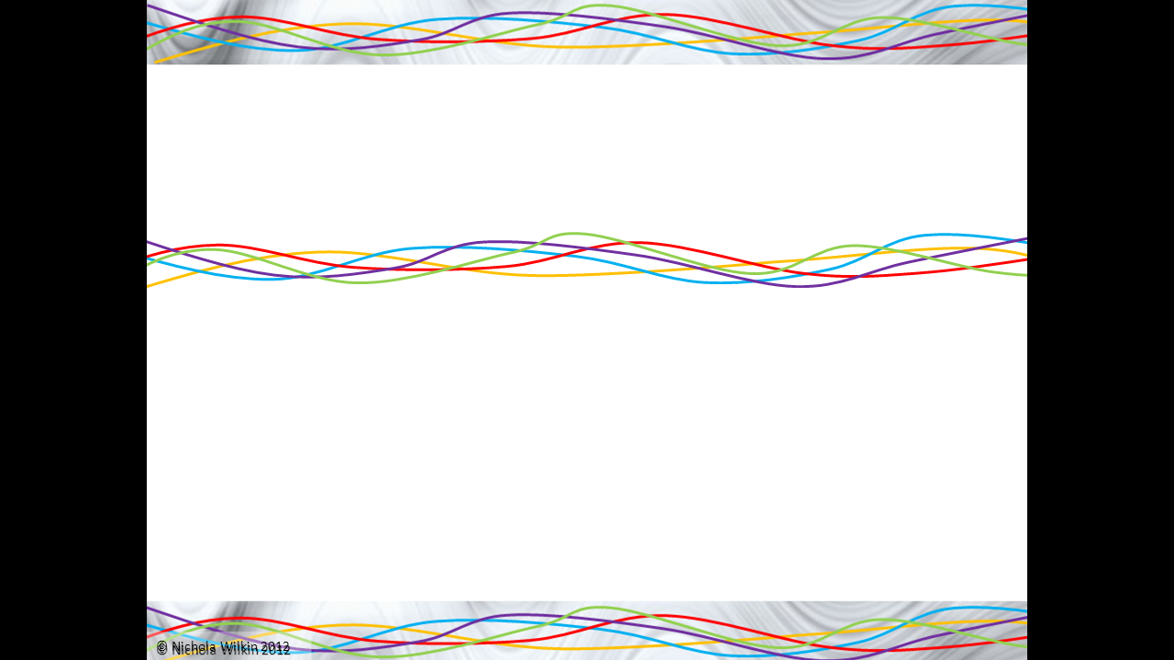
Objective of the lesson
Use Scratch to draw repeating patterns.
All of you will:
Use Python to create graphics on screen
Most of you will:
Use Python to create a shape on screen using loops
Some of you will:
Use Python to create a range of shapes on screen

Slide 4


Starter
Open Idle3 (Python 3)
Click File>New File to open the Python editor
Type the following into the editor
Give your turtle a name. Mine is called timmy
‘import turtle’ allows us to your ‘turtle’ type words
Turtle.Turtle() is the function used run the turtle but we have now given it the name timmy (we have defined it)

Slide 5

We now want to make the turtle move
We do this by typing
timmy.forward(100)
Where timmy is the name of the turtle, forward is the command for the turtle and (100) is an argument which tells the turtle how far to go (in pixels)

Slide 6
We now want to make the turtle turn
We do this by typing
timmy.left(90)
Where timmy is the name of the turtle, left is the command for the turtle to turn left and (90) is an argument which tells the turtle how far to turn (in degrees)

Slide 7
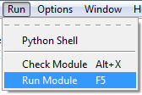
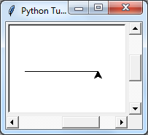
We now want to test our program
We click Run>Run Module or press F5
It should now run and draw a
line forward and then turn
through 90 degrees

Slide 8
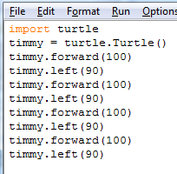
We now want to make it do this four times so that it draws a shape
Copy and paste the code four times
What shape do you think it will draw? Why?
Press F5 to run
Your program

Slide 9
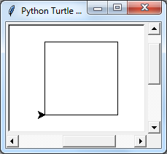
Did you get it correct
The program draws a square
Can you explain why?

Slide 10
However the program is not very efficient
Can you think how it could be made shorter?

Slide 11
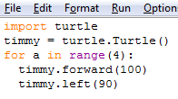
We will write one line of code and tell it to repeat this 4 times
Let’s look at this code
A repeat loop is written as
for a in range(4):

Slide 12
Let’s look at this code
A repeat loop is written as
for a in range(4):
The ‘for a in range’ is the repeat loop
(4) Is an argument which states how many times the loop should run
: is required at the end of a repeat or loop

Slide 13
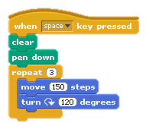
The next two lines of code are indented
You always indent lines after a :
This is because they run inside the loop
In Scratch a loop is a ‘repeat block’
The two blue blocks are indented
because they run inside the repeat loop

Slide 14
Press F5 to run your code
It should make a square again
But use fewer lines of code

Slide 15
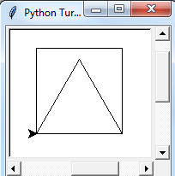
Can you now get it to
Draw a triangle after it draws
a square
A triangle has 3 sides
The turtle will have to turn
120 degrees
You can work this out using the
Equation
Turn = 360/number of sides

Slide 16
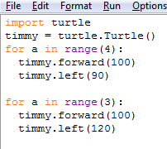
Did you get the code correct?

Slide 17
Can you draw some other shapes?
A pentagon (5 sides)
A hexagon (6 sides)
A decagon (10 sides)
A dodecagon (12 sides)
An approximate circle (360 sides)
Remember
Turn = 360/number of sides
You have a calculator on your mobile phone
As you make shapes with more sides, the length of the sides needs to become shorter

Slide 18
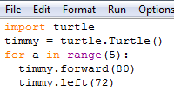
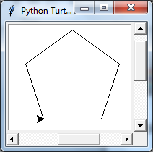
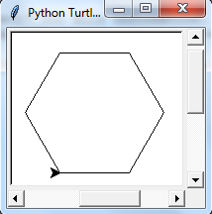
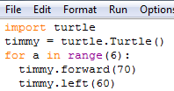
Solutions

Slide 19
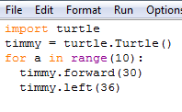
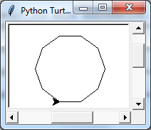
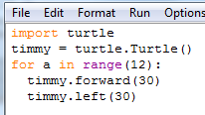
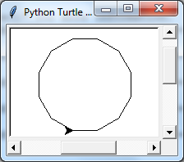
Solutions

Slide 20
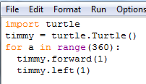
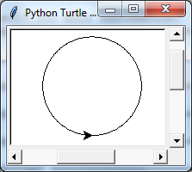
Solutions

Slide 21
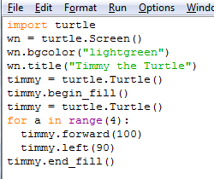
Extra things to try
Make a new coloured window with a title
- wn stands for window
- bgcolour stands for
background color
(American spelling)
Try different colours

Slide 22
Extra things to try
Make a new coloured window with a title
- wn stands for window
- bgcolour stands for
background color
(American spelling)
Try different colours

Slide 23
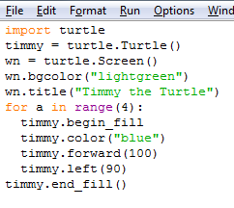
Extra things to try
Change the pen colour
(American spelling)
Colours are a data type
called text or strings.
You tell the program
this by putting the colour
in speech marks
e.g. “blue”

Slide 24
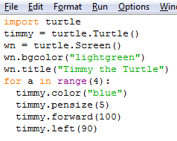
Extra things to try
Change the pen thickness
pensize(5)
The number 5 in the
argument is the
pen thickness in pixels

